Slide 1

Crime IN UNION PARK FOR 2017
Darwin Stahlback / Marcus Haldane - STAT360

Slide 2
What were covering:
How we picked our dataset.
Where we pulled our data from.
What results we found.

Slide 3
Crime in St. Paul Dataset:
How we picked our dataset.
How safe is the area around the St. Thomas Campus?
Where we pulled our data from.
Source 1: St Paul Government / Police Dataset
Source 2: Weather Underground
(Historical Data for the St Paul ZIPCODE)
Source 3: Daylight Data
3541 reports (N (cases) = 3541 / 12 Dimensions)

Slide 4
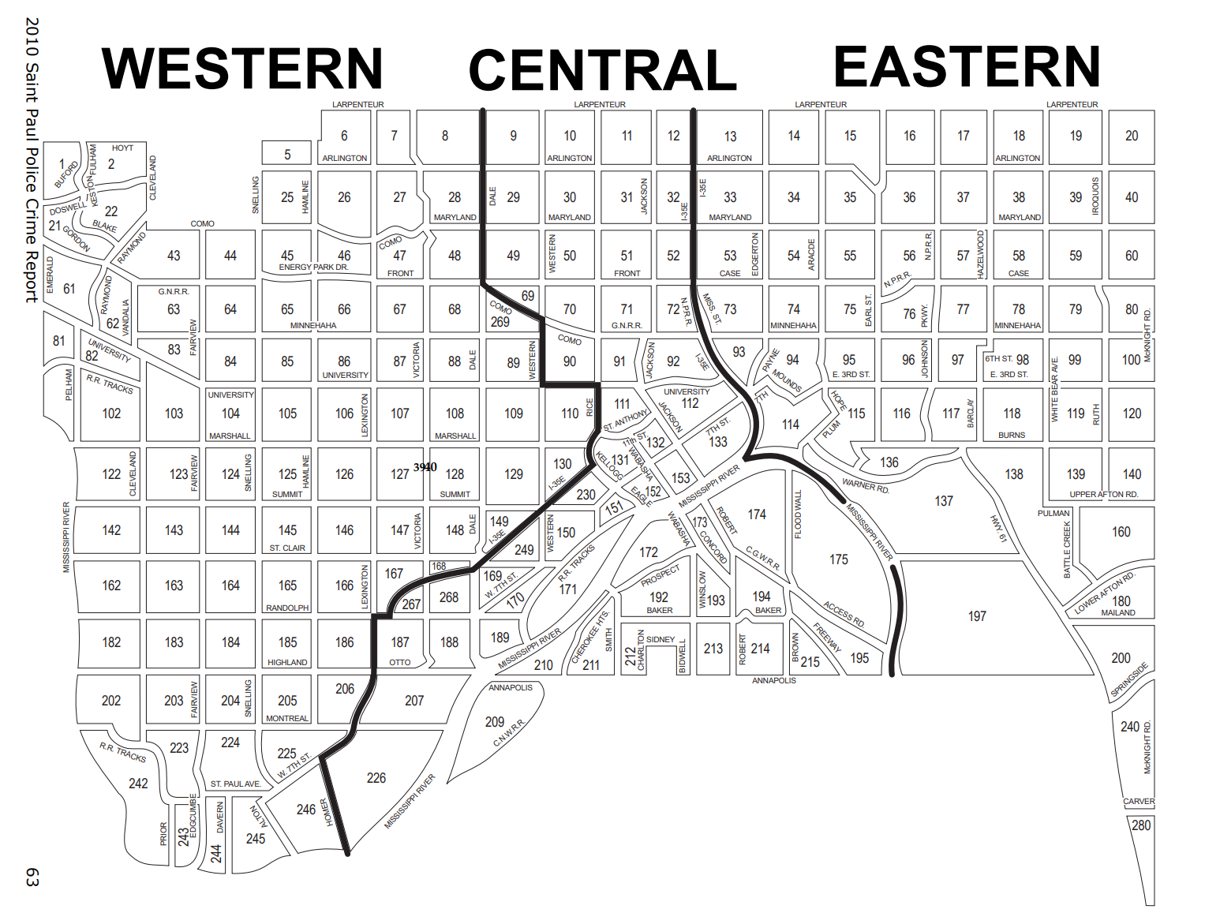
Crime in St. Paul Coverage

Slide 5




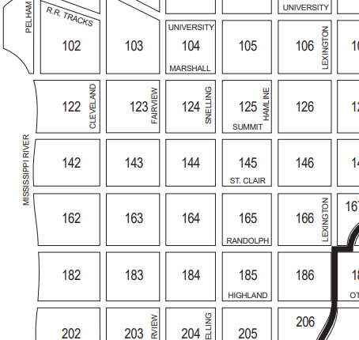

Crime in St. Paul Dataset:
Data Cleansing and parameter selection

Slide 6
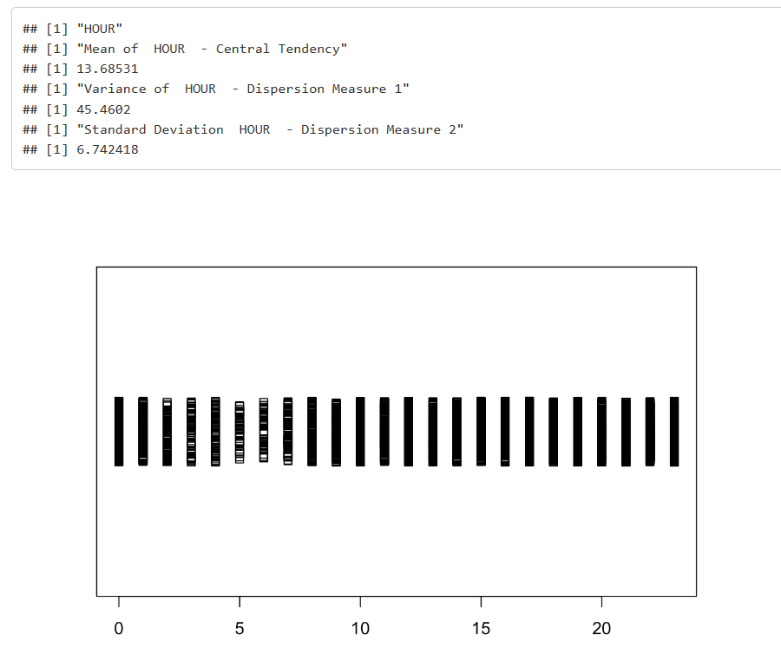
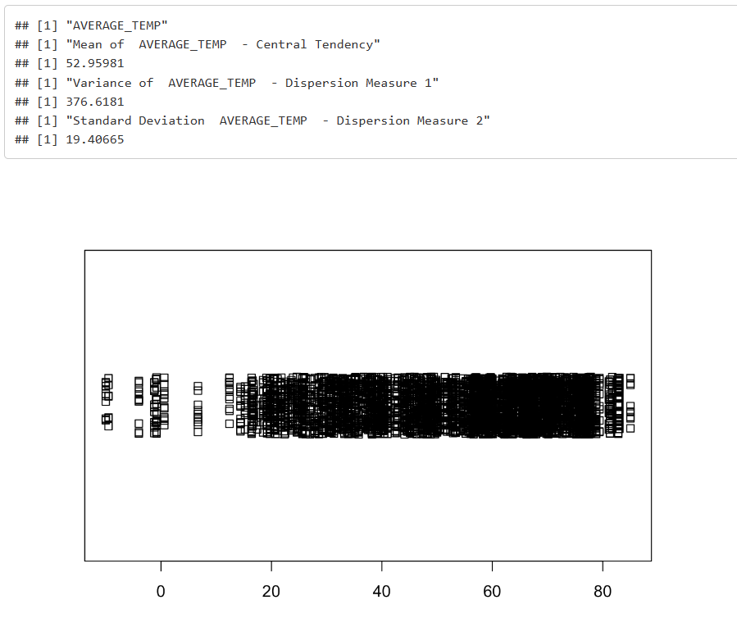
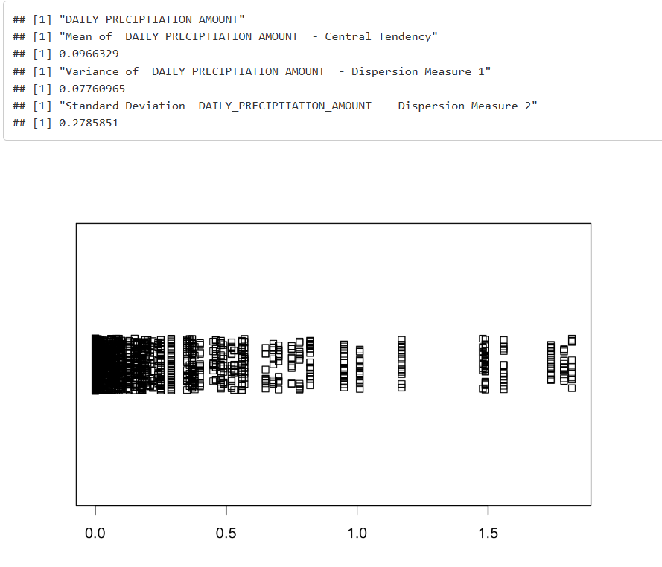
EDA Results
Early mornings and bad weather (Silver Linings)

Slide 7
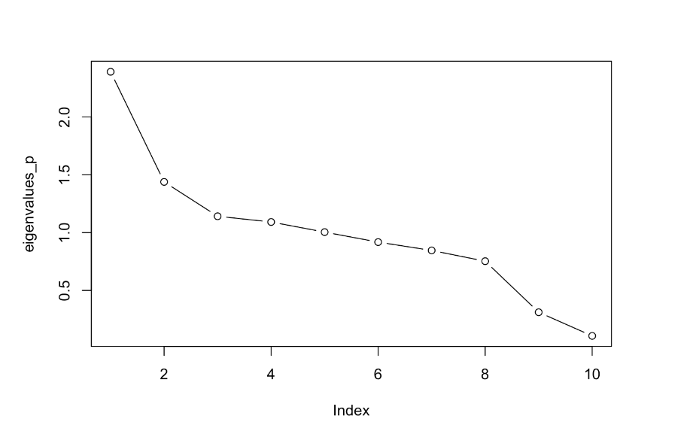
EDA Results
What to keep as factors
Variance of .71
Five (5) Factors kept

Slide 8
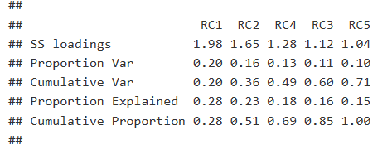
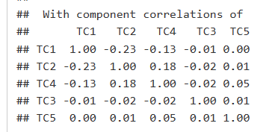
EFA Results (PCA)
Variance of .71
No component > 0.3 threshold
Not necessary to perform oblique rotation

Slide 9
EDA Results (PCA)
Variance of .71
No component > 0.3 threshold
Not necessary to perform oblique rotation

Slide 10
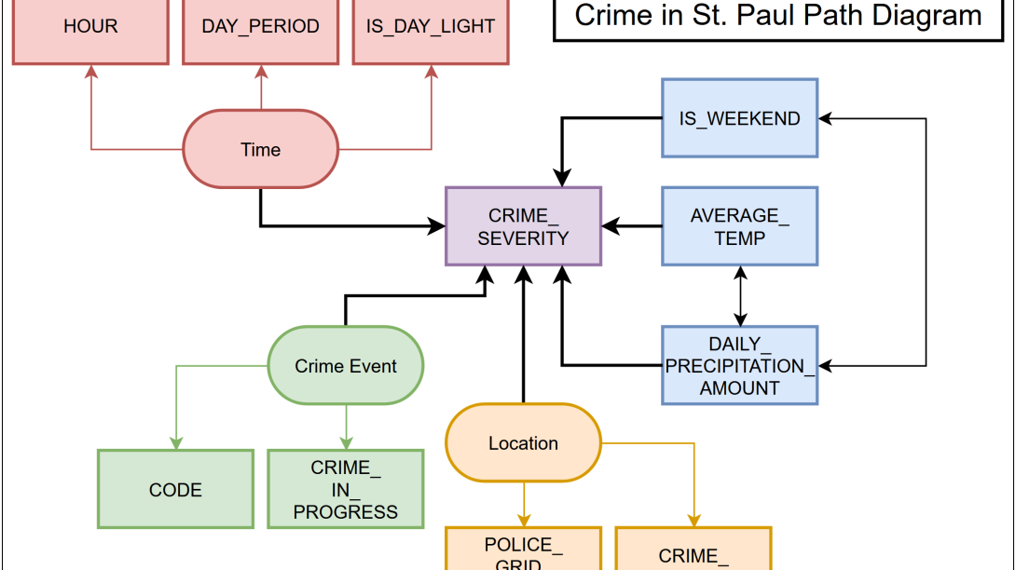
SEM Results
Chi-squared value of 534.575
37 degrees of freedom
p-value of 0.000
Each factor pvalue < .05 (0.000)
Each retained Dim. Pvalue > 0.05
All factors are all statistically significant

Slide 11
Conclusion
NFI.NNFI,IFI,CFI are all above 0.95 threshold an adequate fit to the data.
RMSEA is below 0.08 threshold
Thus indicate an adequate fit for the data.
MFI and GFI (0.981)are also above the 0.95 threshold
98.1% of the variance and covariance are explained by the model

Slide 12

Questions:

