Slide 1
US Rental Price Analysis
Marcus McBride
Roopa Karajgar
Alvin Kim

Slide 2
Our project began with a simple observation: “Why are rent prices so high these days?” To delve into this, we utilized the following sources: Kaggle – average rental pricing info for roughly 17,000 American cities Zillow – used as a backup reference to Kaggle for specific data points US Census Bureau - population statistics, rental vacancy & homeownership data Google Maps API – map building and location referencing Other various sources cited accordingly throughout this presentation

Slide 3
Development tools utilized in this project: Python Jupyter Pandas/Numpy Matplotlib Google Maps API Plotly.JS Data cleaning was relatively straight-forward with only a few minor formatting issues to correct within certain data sets (converting values to floats, reorganizing table data for optimal use, etc). With rental data for over 17k individual cities available, the .loc and .iloc features within Pandas were used to isolate data for individual cities in the various data graphs in this project (heavily).

Slide 4
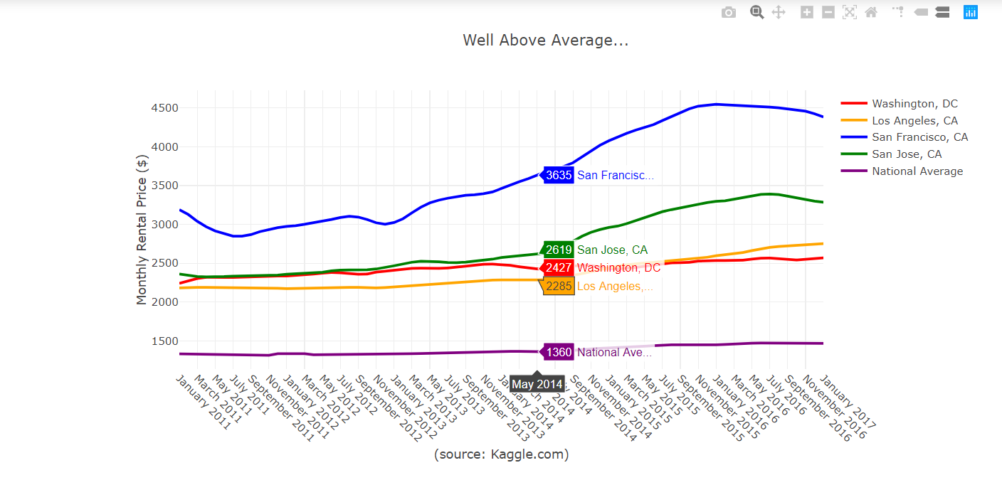
About Plotly.JS Plotly.JS is an open-source graphing library developed for Javascript that is also compatible with Python and Jupyter. It allows developers to build roughly 20 different chart types, including 3D charts and statistical graphs. It’s ideally suited for building interactive data displays for websites; however, they will appear static when used outside of a web browser, such as this presentation.

Slide 5
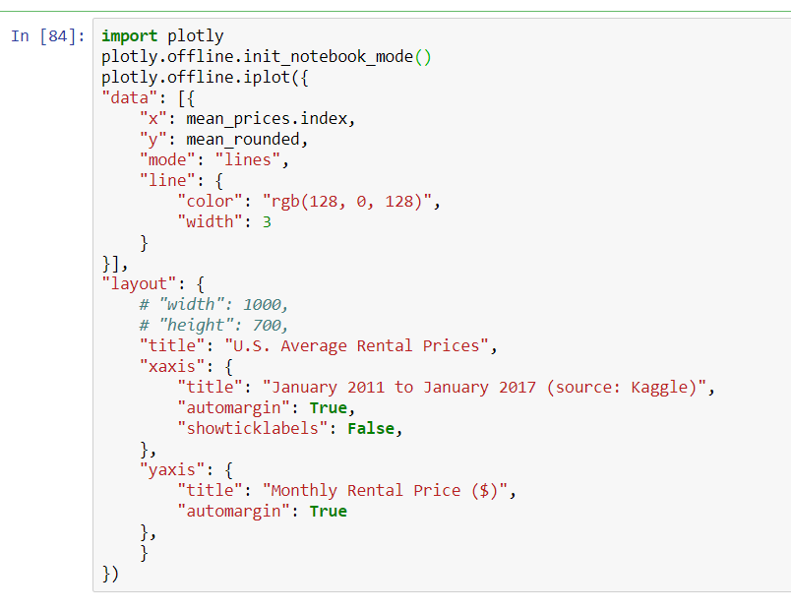
Sample Plotly.JS Code The visuals generated via Plotly require an import of the Plotly code library (via pip install) as well as an “offline” mode designation when not using the library for online development or display. For Python/Pandas, the charts and graphs are coded as a dictionary with a nested “data” list and a “layout” dictionary. Customization options are plentiful.

Slide 6
For this project we looked at the available data from our sources between 2011 and 2017. We also asked ourselves a number of questions along the way: Are rental prices higher just in bigger cities or is it a nationwide trend? Which cities have taken off, are catching up, or have fallen behind? What factors could be causing the changes that we’ve seen? (and a lot of other questions… which we’ll come back to in a minute)

Slide 7
Data Quirks: The Kaggle data that was used gave us rental prices for cities in the United States which were ranked by “city” population, not “metro” population. Accordingly, certain cities in our study ranked higher or lower than they would have had they been ranked by their total metro population. For larger cities with a wider range of rental pricing, the corresponding averages come out noticeably lower than one might think they would be. As an example… When looking at the Zillow data specific to Manhattan rental pricing, it would easy rank among the most expensive areas to rent in currently but because it’s grouped in with the other boroughs of New York City the average for the city comes out considerably lower. Similar trends were noted in cities like Los Angeles, Chicago, Boston and Washington D.C.

Slide 8
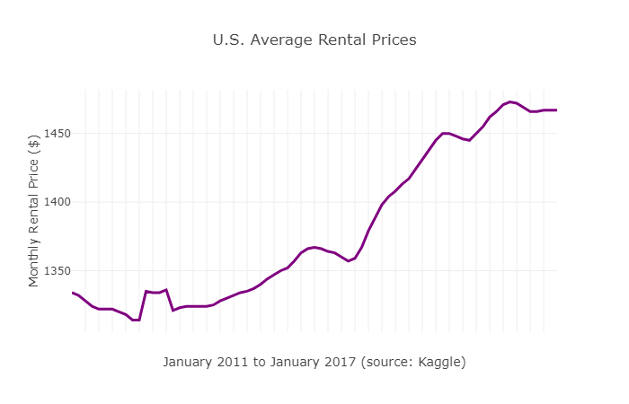
Average annual rent increase: 1.7% The average American paid $1467 in rent per month as of January 2017.
Our base question is pretty broad, so let’s start with the national average.

Slide 9
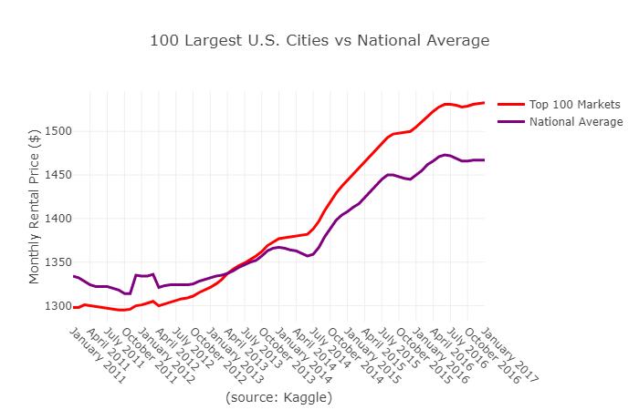
How do the 100 largest cities in the US stack up against the average nationwide?
Average annual rent increase: 3% ($1533 per month)

Slide 10
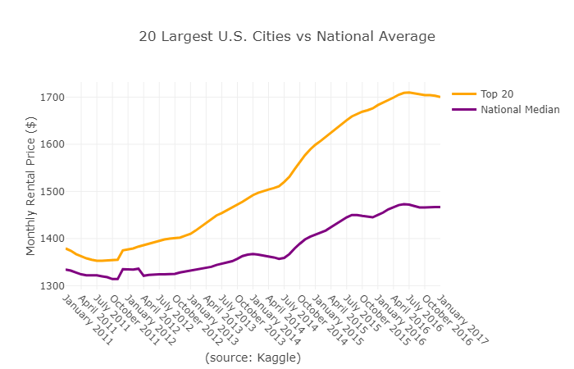
Average annual rent increase: 3.9% ($1700 per month)
How do the 20 most populous cities in the US stack up against the average nationwide?

Slide 11
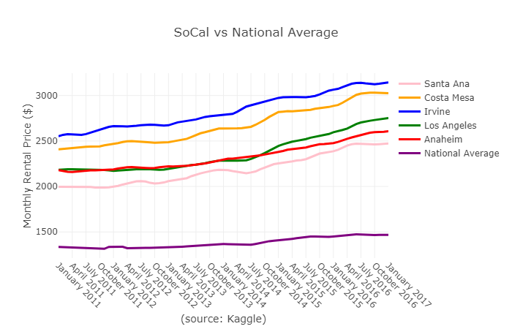
And what about Orange County?
Average annual rent increase: 4.3% (versus the 1.7% national average).
Newport Beach topped the list of OC cities to rent in at $5174 per month, with Laguna Beach ($5120) and Villa Park ($4853) close behind.
Laguna Woods was the least expensive & closest to the national average at $2081 per month.

Slide 12
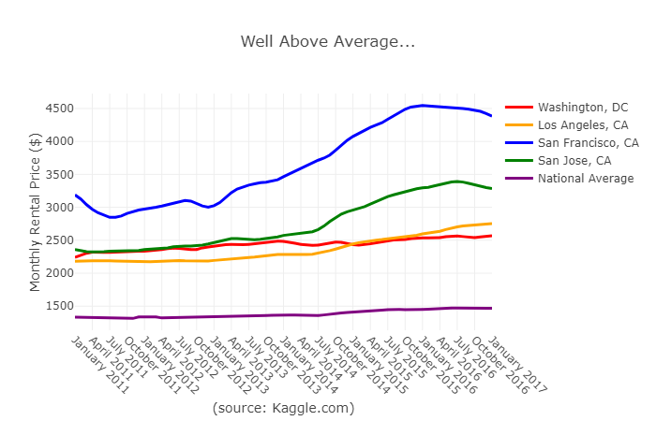
In some of the biggest of the big cities, it’s expensive.
Of the 20 most populous cities, San Francisco was the only one to break the $4,000 per month mark. San Jose was the only other city averaging over $3,000 per month in this group.

Slide 13
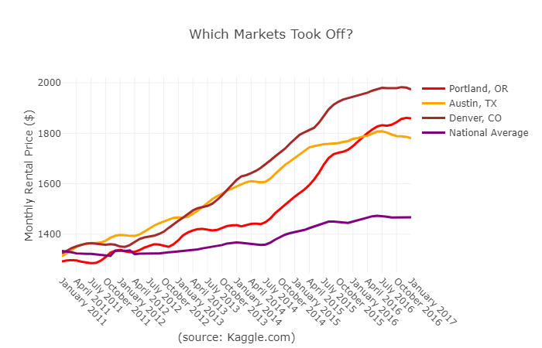
Which cities have accelerated past the national average?
Denver job growth peaked at 4.3% during this time period, roughly double the national average of 2%. (sources: US Census Data, Forbes)

Slide 14
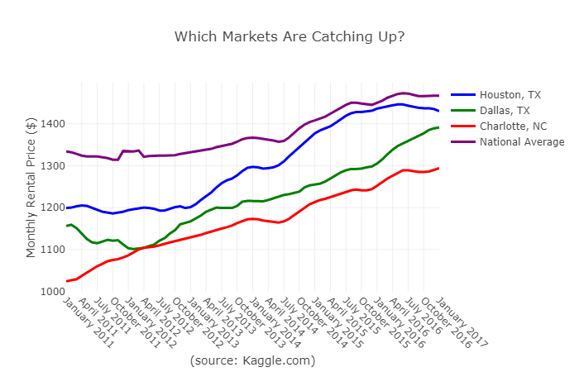
Which cities are catching up?
For the period surveyed, Houston (the 4th largest city in the country) had one of the highest rental vacancy rates in the country (7.1%) for a city of its size. (source: www.chron.com)

Slide 15
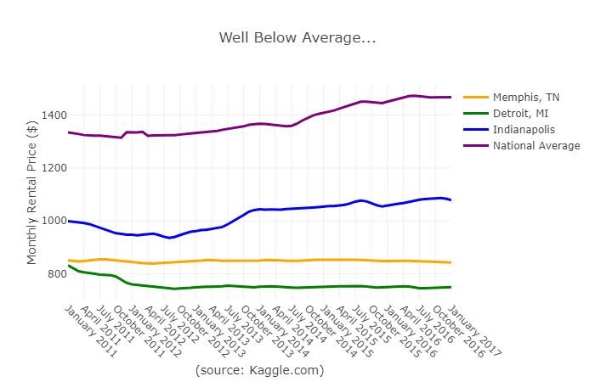
Which cities *aren’t* catching up?
Of the 20 largest cities in the U.S., Detroit and Memphis are the only ones to have gone down (albeit only slightly for Memphis). Despite being the 17th largest city, Detroit is the least expensive to live in of the top 100 ($750 per month).

Slide 16
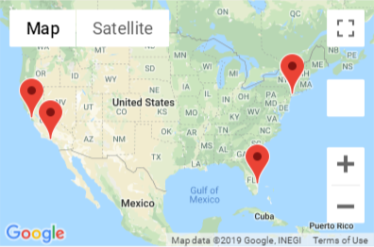
The priciest, mapped.
Atherton, CA. Malibu, CA. Rye, NY. Scarsdale, NY. Jupiter Island, FL. If you’re currently renting in any one of these, you’re paying for it.
There were 13 cities total that topped $10k per month; 8 are in California.

Slide 17
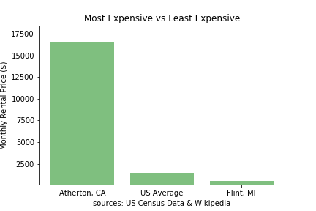
The two extremes.
Atherton, CA (pop. 7,156 and home to many Silicon Valley CEOs) is the most expensive ZIP code in the United States (1029% over the national average). At $549 a month, Flint, MI is currently the least expensive American city to rent in (62% less than the national average).

Slide 18
So…. why exactly have prices gone up?
Our initial observation triggered a lot of questions… which in turn triggered a lot of other questions. The full answers are probably beyond the time and scope of our first group project but we did find a few insights.

Slide 19
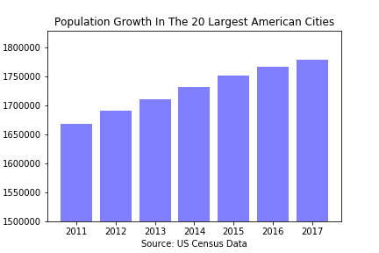
Big cities are getting bigger.
The 20 largest U.S. cities combined add about 1.5 million new residents every year over the period surveyed.

Slide 20
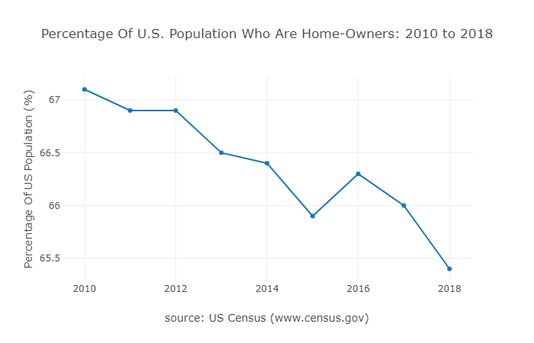
We’re buying less and (possibly) renting more.
Not by much but home-ownership in the U.S. has slowly declined over the period we had data for.

Slide 21
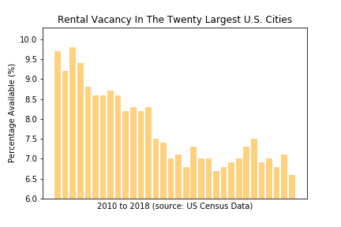
There are fewer rentals on the market.
In 2010, there was nearly a 10% rental vacancy rate among the twenty largest American cities.
It’s since dropped to a current rate of 6.6%.

Slide 22
Closing observations:
Big cities are getting bigger and more expensive but not exclusively so. (Houston, Dallas, etc). What were once “smaller” cities aren’t so small anymore, and their rental pricing reflects that.
A lot of that growth is out west. (11 of the 20 largest cities) We’re renting more with fewer choices in our biggest cities.
The data used here is something of a rabbit hole. In answering one question related to city size, rental data, and other economic factors, we often found ourselves asking even more questions as a result.

Slide 23
Questions & Comments

