Slide 1


Slide 2




Slide 3
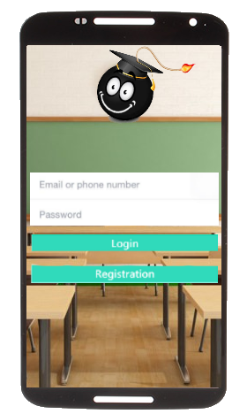

Slide 4
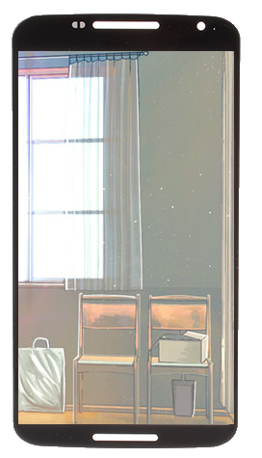

Insert app name
Name
Email
username
password
Confirm password
---Select occupation ---
---Select occupation ---
---Select occupation ---
Educator
Student
Sign up

Slide 6


Slide 7



Slide 9



Slide 10


Slide 12
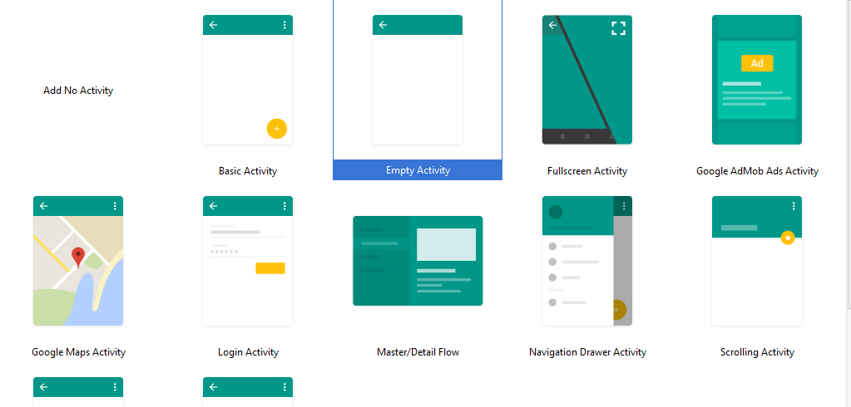

Slide 13












Slide 14




Slide 15



