Slide 1


Slide 2




Slide 3
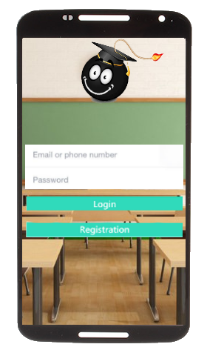

Slide 4
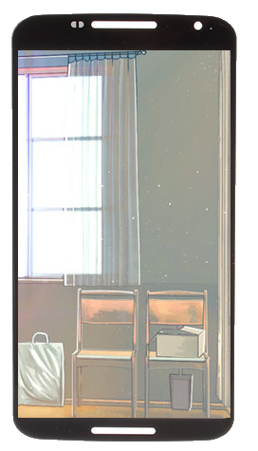

Insert app name
Name
Email
username
password
Confirm password
---Select occupation ---
---Select occupation ---
---Select occupation ---
Educator
Student
Sign up

Slide 6


Slide 7






FONT
CHAWPbyTyler Finck
http://www.1001fonts.com/chalk-fonts.html
Click here to go to resources
Home
Feature
Contact
How do I answer this question, should I pass?
Features
Forget password
@copyright bomb squad

Slide 8
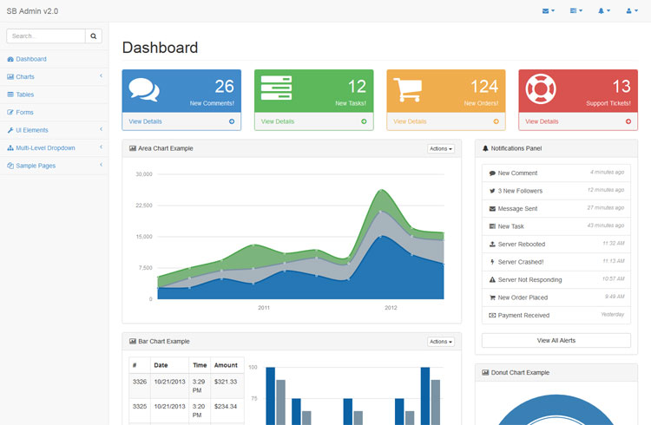
I recommend this style: http://blackrockdigital.github.io/startbootstrap-sb-admin-2/pages/index.html
But this colour scheme: http://blackrockdigital.github.io/startbootstrap-sb-admin/

Slide 10



Slide 11


Slide 12


Slide 13
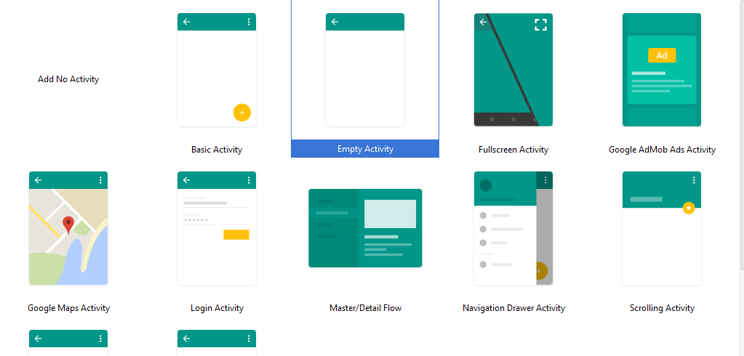

Slide 14












Slide 15




Slide 16



Slide 17



