Slide 1
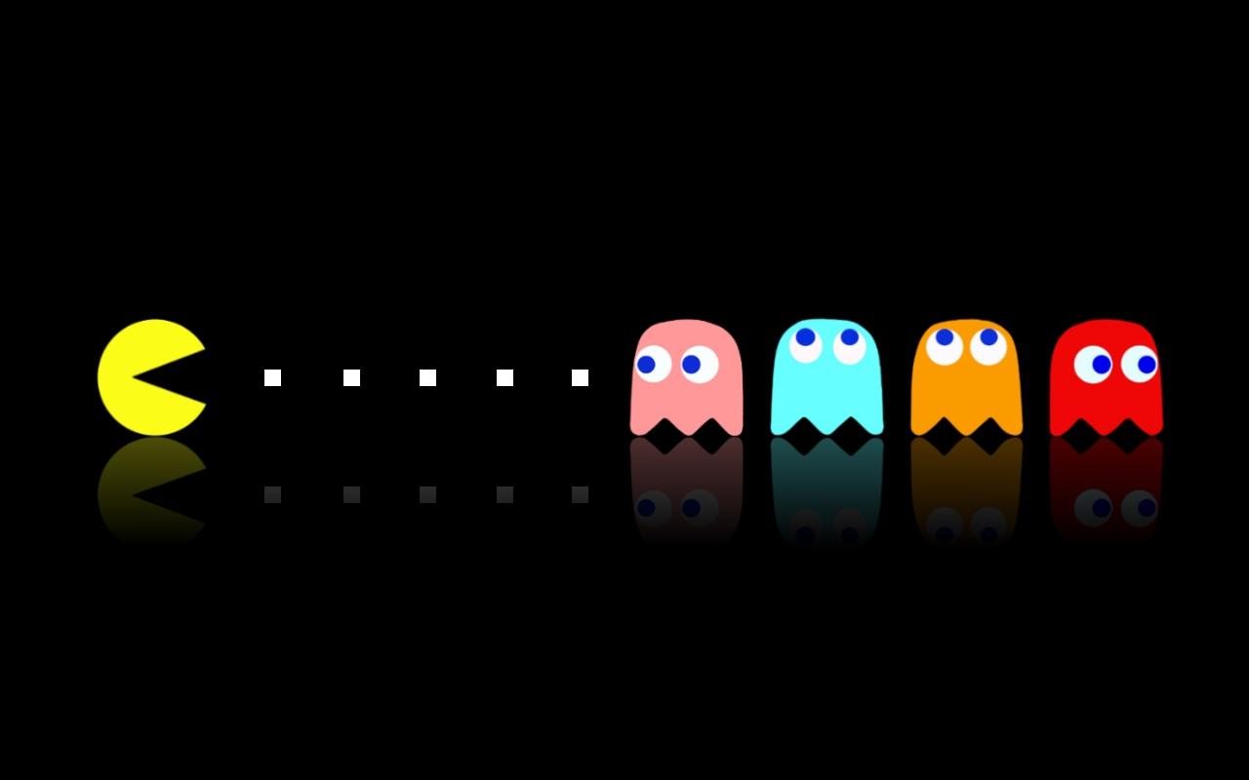
PECKMAN
Vincent Hwang, Marcus Pearce, Justin Hu

Slide 2
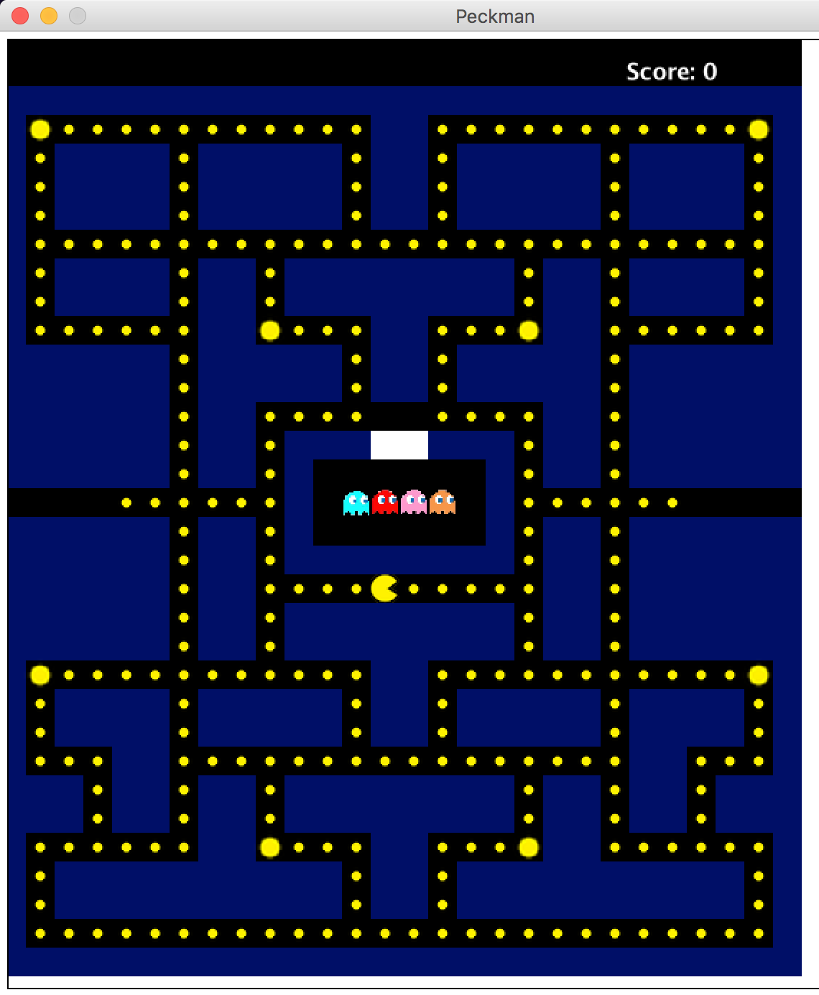
GAME OVERVIEW
Objective:
To eat all the dots in the maze while avoiding the ghosts
User:
Use arrow keys to control Pacman

Slide 3
GAME OVERVIEW
Pacman tries to eat all the dots (and ghosts once Pacman eats a big dot)
The more dots/ghosts eaten, the more points gained (displayed on right hand corner)
Ghosts are respawned once eaten

Slide 4
GREENFOOT (Software Development)
Greenfoot is an interactive Java Development that makes 2D graphical applications easier to make
Greenfoot creates ‘actors’ which lives in ‘worlds’ to build games, run simulations, etc

Slide 5

CLASS HIERARCHY (World)
World is a 2D grid of cells that Actors live in
Pacworld extends World
Reads a given text file to create world
Creates map and GUI for user to see and play the game

Slide 6
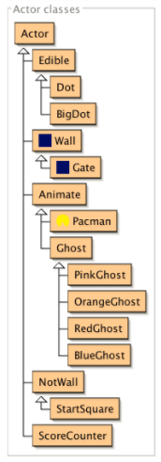
CLASS HIERARCHY (Actor)
Actors are objects in the world whose methods are activated with ‘Act’ method
All the animated characters (i.e., Pacman, the four ghosts, dots, etc) are created through inheritance of the Actor class

Slide 7
DATA STRUCTURE
Queue
Implemented to in the Pacman class to keep track of the ghosts that Pacman has eaten
As ghosts die they need to respawn in the order they died in
Therefore, a queue (first-in first-out) is perfect

Slide 8

GHOST ALGORITHMS
Each of the four ghosts are a separate class that extends the Ghost class, which includes the overarching methods for all four ghosts.
The Ghost class contains the ghosts’ objective of eating Pacman. When the big dot is eaten, the ghosts enter ‘hype mode’, where they turn into ‘dead ghosts’ and scatter away to avoid getting eaten by Pacman.

Slide 9
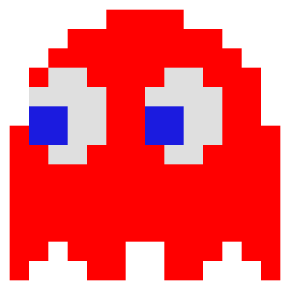

GHOST ALGORITHMS (cont.)
Red Ghost
Trails a direct path behind Pacman
Pink Ghost
Desired location is few units in front of Pacman’s current path

Slide 10


GHOST ALGORITHMS (cont.)
Blue Ghost
Determines where to go by doubling the vector between the positions of Pacman and the red ghost
Orange Ghost
Will have random movements if within certain distance of Pacman
Otherwise it follows Pacman like the red ghost

Slide 11

OTHER IMPORTANT CLASSES
Pacman
Extends the class Animate (contains the overarching movement methods for all the ‘actors’ including ghosts)
Movement is controlled by user input using the up, down, left and right arrows
Objective is to eat all the dots (and ghosts if ‘hype mode’ is on)

Slide 12
OTHER IMPORTANT CLASSES (cont.)
ScoreCounter
Increments the score in upper corner
Updates as dots and ‘hype mode’ ghosts are eaten
StartSquare
Extends the class NotWall (empty space)
Location where ghosts respawn
Separate by a gate (the class Gate)

Slide 13
OTHER IMPORTANT CLASSES (cont.)
Edible
Abstract class for the classes Dot (the dots needed to be eaten to win) and BigDot (the dots that activate ‘hype mode’)
Wall
Establishes boundaries for animated objects

Slide 14
GRAPHICAL USER INTERFACE
The GUI in this project is the equivalent to a screen in a gaming console
The map and characters are created, then the actors move and interact visually as per user input.
Notes:
Marcus

Slide 15
TESTING
JUnit testing not compatible with Greenfoot
Used boolean testing to test methods and conditions
GUI was tested through running the simulations
Notes:
Marcus

Slide 16
SPECIFICATION CHANGES
Used separate test class instead of JUnit for testing
Greenfoot not compatible
Ghosts waiting to respawn made game too easy
Now ghosts respawn immediately
Notes:
Marcus

Slide 17
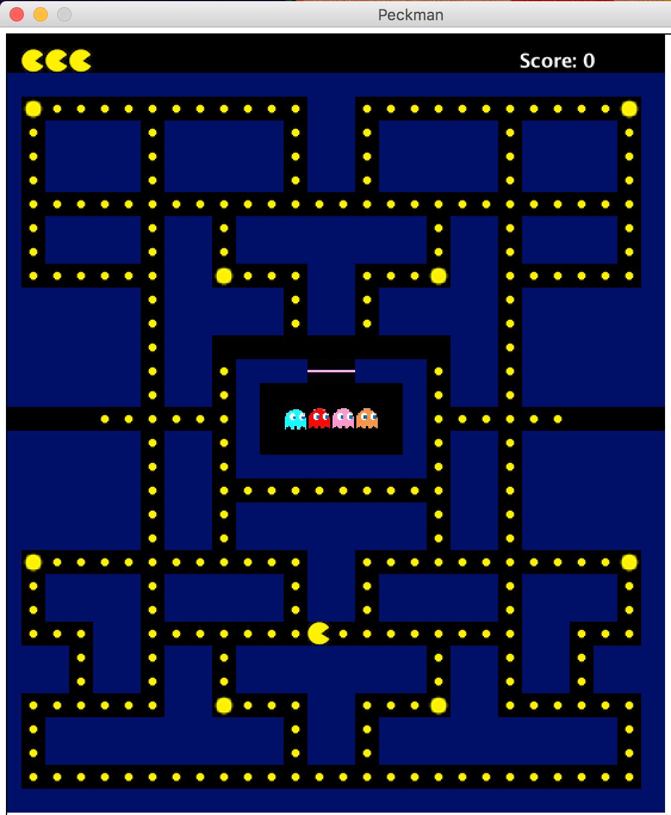
DEMONSTRATION
Notes:
Marcus

Slide 18
THANK YOU FOR LISTENING!!
Notes:
Marcus

