Slide 1
Evolutionary Algorithms
Enumeration vs Natural Selection

Slide 2
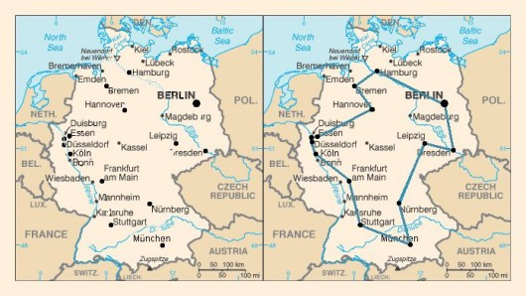
Traveling Salesman
What is it?
Computers can’t “glance” at a map

Slide 3
Enumerating the Alternatives
How many alternate routes are there?
All Possible Paths
Sort by Shortest Distance Traveled
Five cities
Five x Four x Three x Two x One = 120
Six Cities == Six Times More
Fifty Cities == 10^63
History of the Universe == 10^18

Slide 4
Natural Selection
https://www.youtube.com/watch?v=0SCjhI86grU @4:49

Slide 5
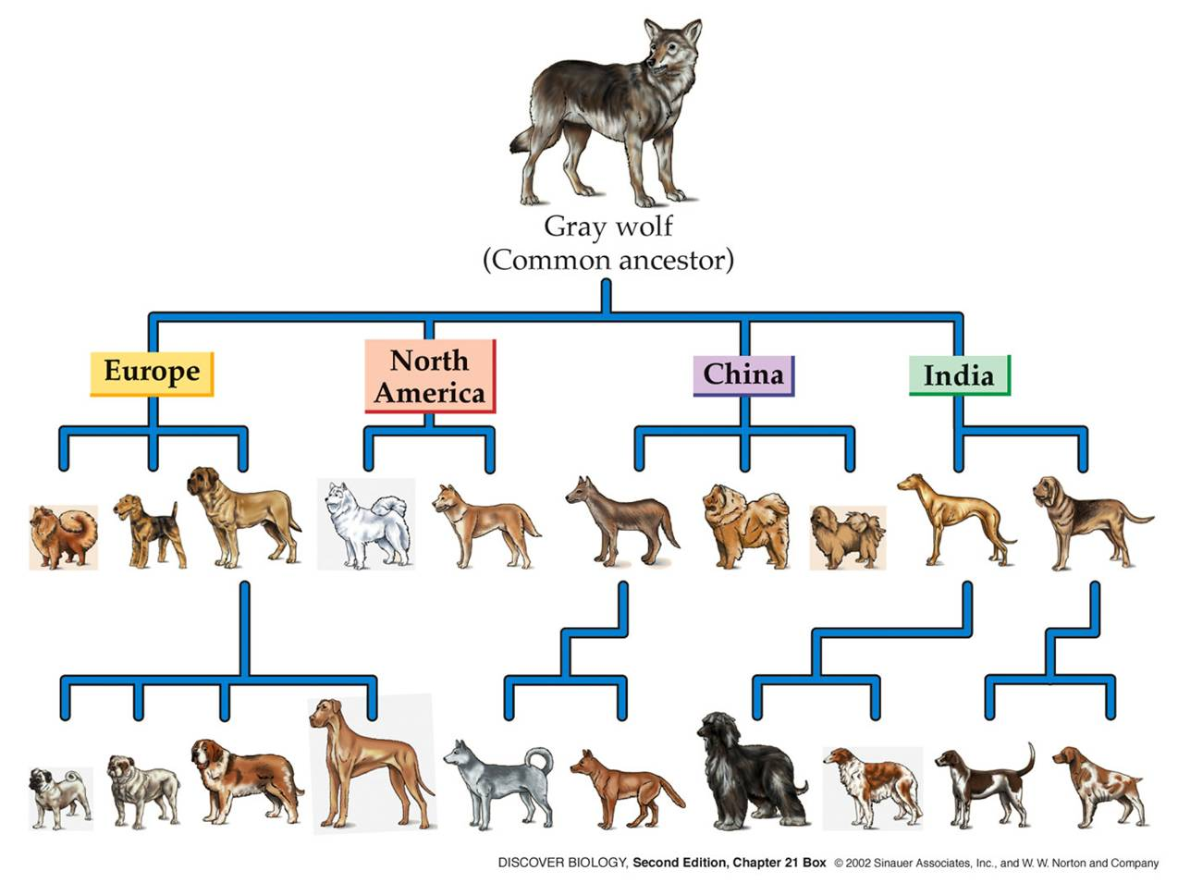

Slide 6
Neural Networks
Similar to how the neurons in your brain work
Commonly used to solve really big/difficult CPS problems
Image Classification, Natural Language Processing

Slide 7
Evolutionary Computation in Action
Population of a few
Duplicate with random variation
Take those that are the shortest
Let them reproduce
Rid of the others
Natural Selection

Slide 8
Evolutionary Neural Networks
Population of NN
Duplicate the Parents
Random Variation on Weights and Thresholds
Keep those NN that are best at accomplishing task x
Satisfied and/or give up

Slide 9
From Parent to Offspring
David Fogel’s Father big influence
David tried making an intelligent machine
Too many individual cases to handle

Slide 10
Evolving Neural Networks: Tic Tac Toe?
“Evolving Artificial Intelligence”
NN could play games
Tic-Tac-Toe
Randomly connected Artificial Neurons
In turn plays the perfect game?

