Slide 1
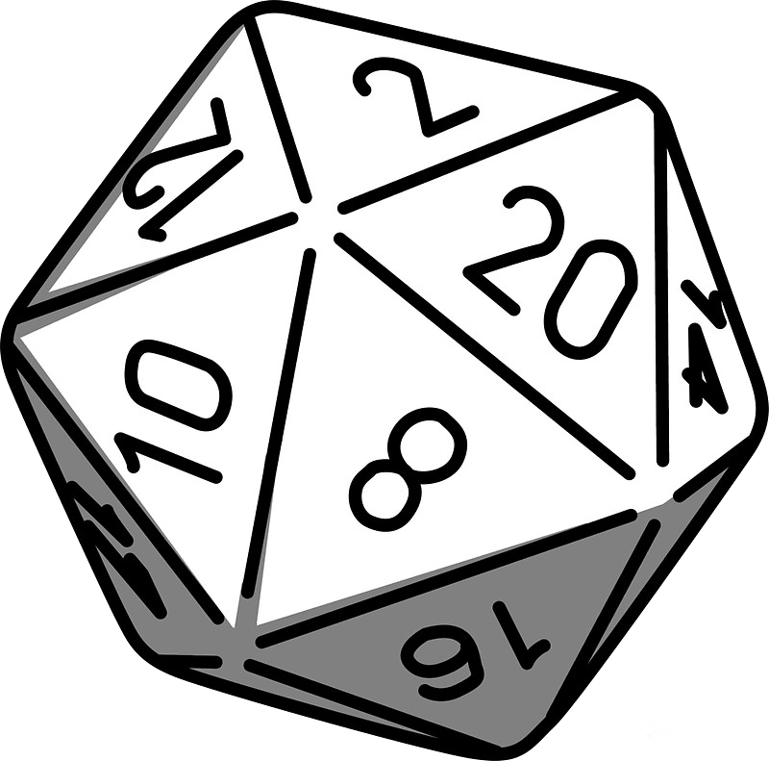
Dungeon and Dragons character sheet app

Slide 2



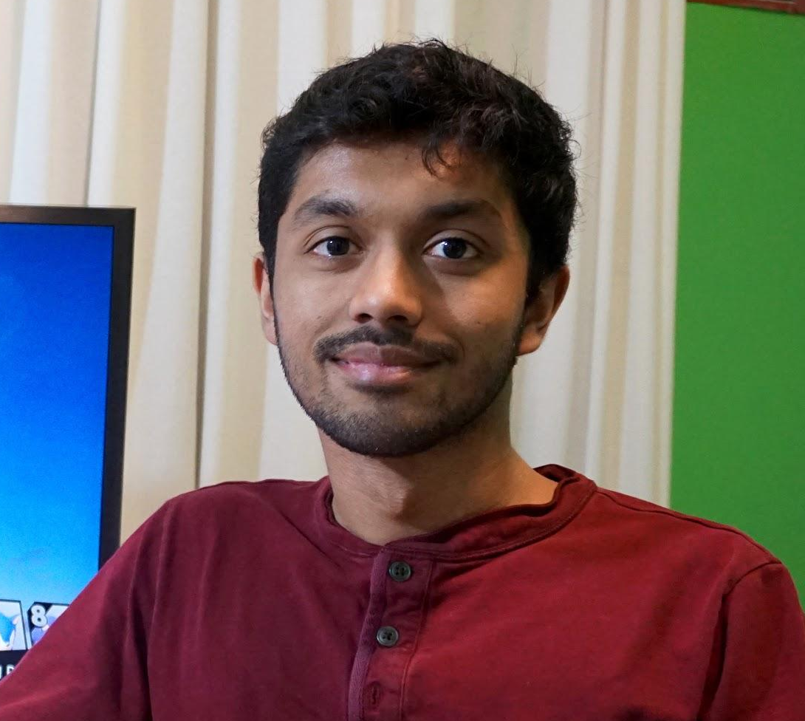
Team Members
Marcus Wong
Austin Cho
Documentation
Testing
Kevin McCarvill
Mehraj Meah
Documentation
Testing
UI Designer
Sequence Diagram
Concept designer
Initial UML draft
Initial UI draft
Lead Programmer

Slide 3

App Introduction
Our project was to develop an app to act as a digital alternative to a normal paper Dungeons and Dragons characters sheet
App Logo

Slide 4
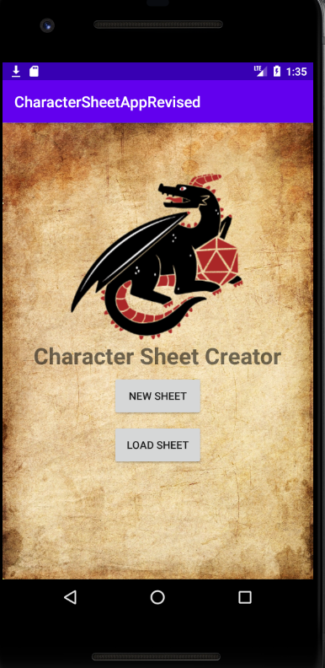
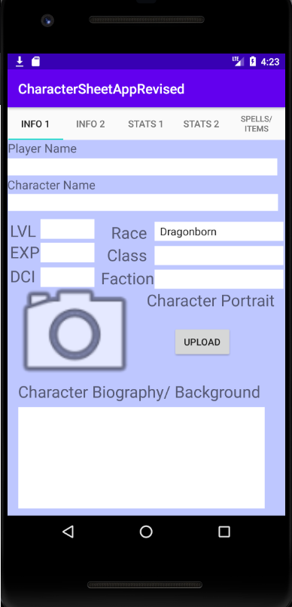

Slide 5
Background
Dungeons and Dragons is one of the oldest tabletop games in the 20th century that was played with nothing more than some slips of paper and dice.
Character sheets are normally single page documents.
The player themselves needs to keep track of and update their sheet.
The person leading the game also needs this information from time to time.

Slide 6
Why develop this app?
Traditional means of using paper is troublesome, easy to lose and annoying to update.
In the digital age, it’s common to play games over the internet as opposed to a table, making paper sheets not as useful.
Currently there are various versions of D&D apps that share a trend of very poor, unworking, and limited in nature, UI designs, that turn new and veteran players away from using a digital alternative to record their characters.

Slide 7
App Overview/ Features
* - new to this app, not found in apps of similar nature
Ability to create, save, load and update character sheets from phone.
Tabbed UI to help lessen cluttering of UI during character sheet creation, easier to focus, not simply recreating one giant page on a phone screen which is primary flaw with apps of similar types. *
Ability to “Build” full one page sheet (image, or file of some other sort) and output it from phone to easily send and be read by others. *
Help hints in interface for those that are new *
Database of items/ spells for quick selection in app as opposed to all having to be written out by the user *

Slide 8
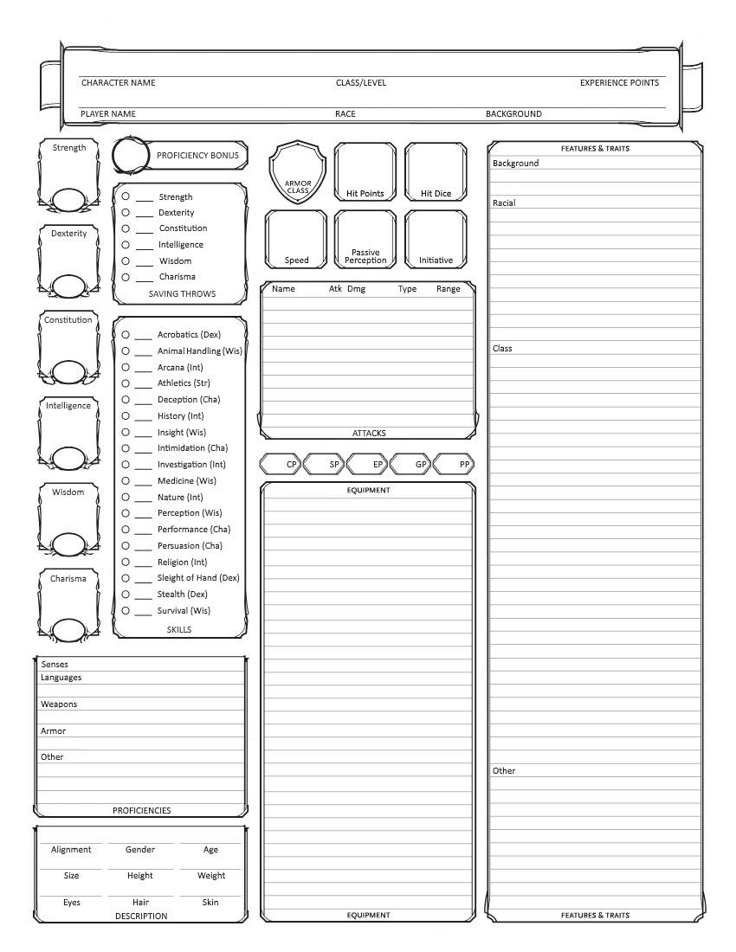
Mistake of similar apps is trying to squeeze this all on to a single phone screen…

Slide 9

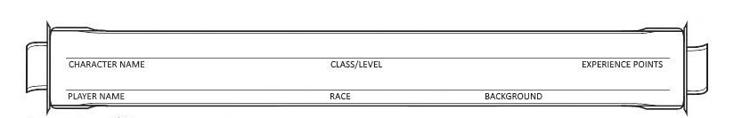
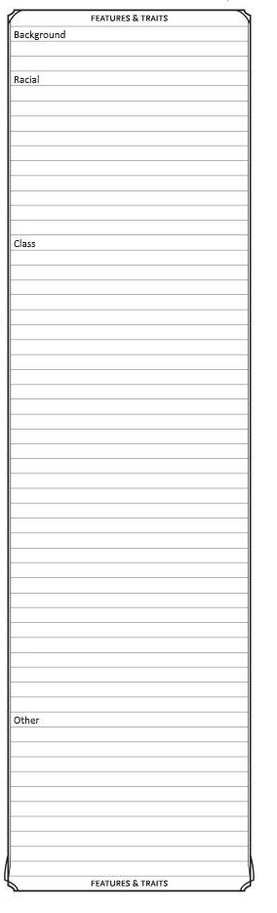
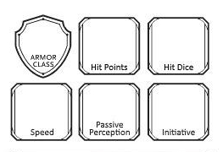
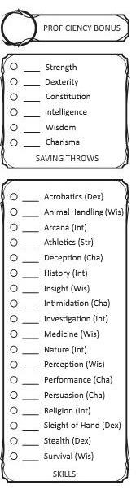
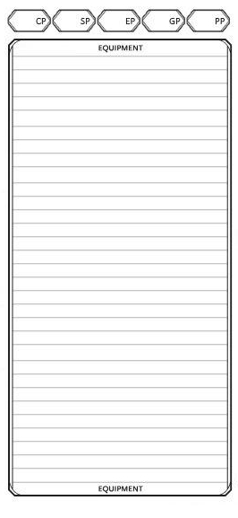
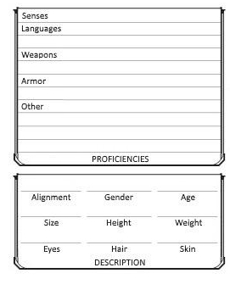
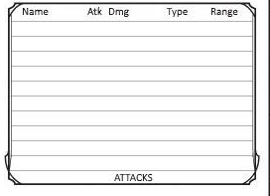
…Instead we will utilize in app tabs to for easier, less cluttered end user experience

Slide 10
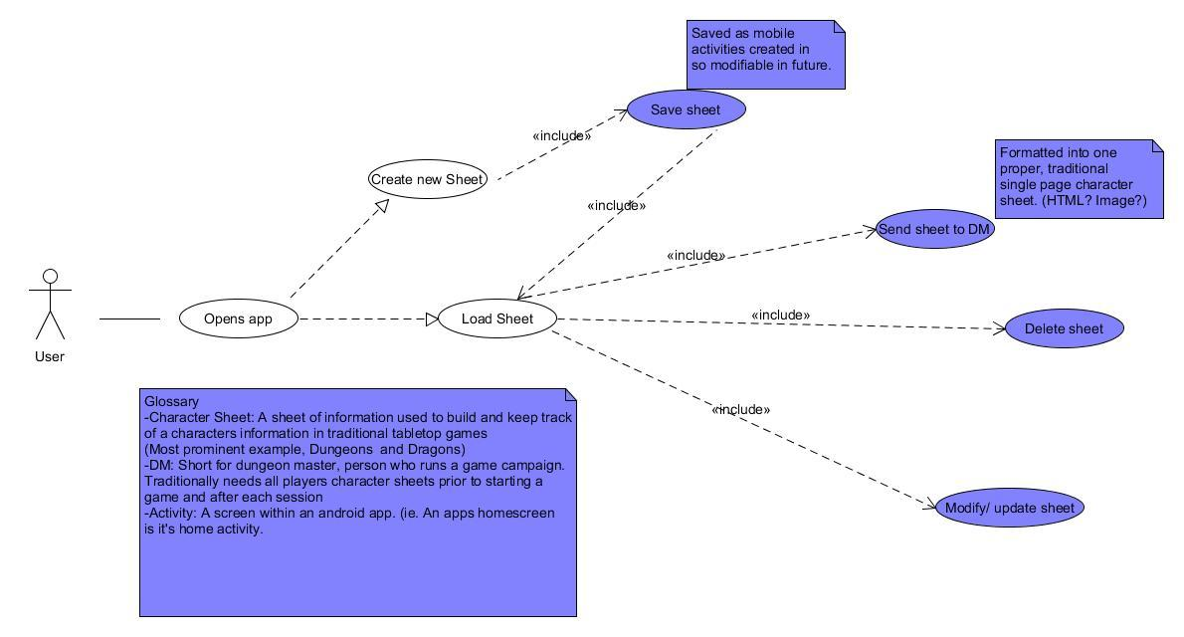
Initial UML

Slide 11
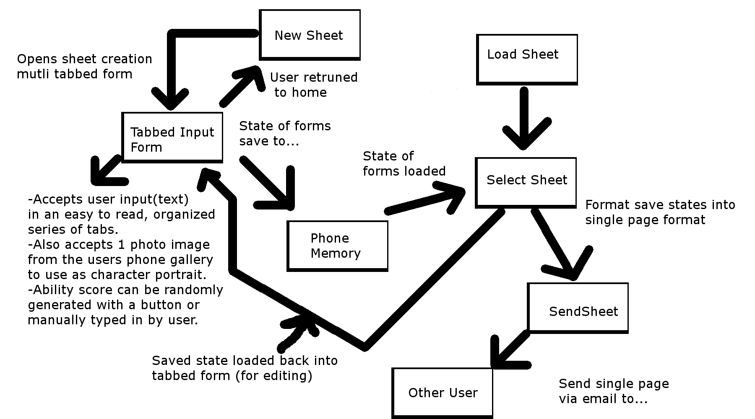

Slide 12
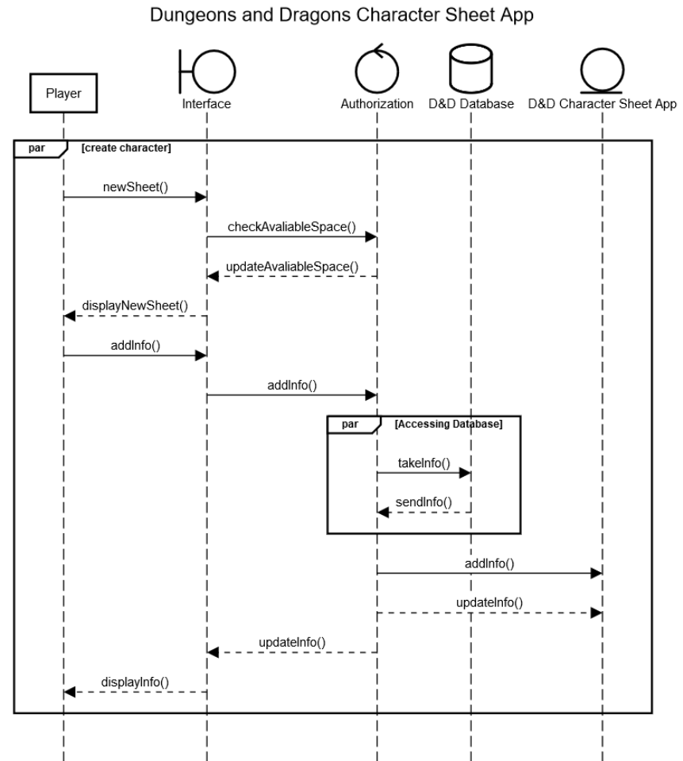
Sequence Diagram

Slide 13
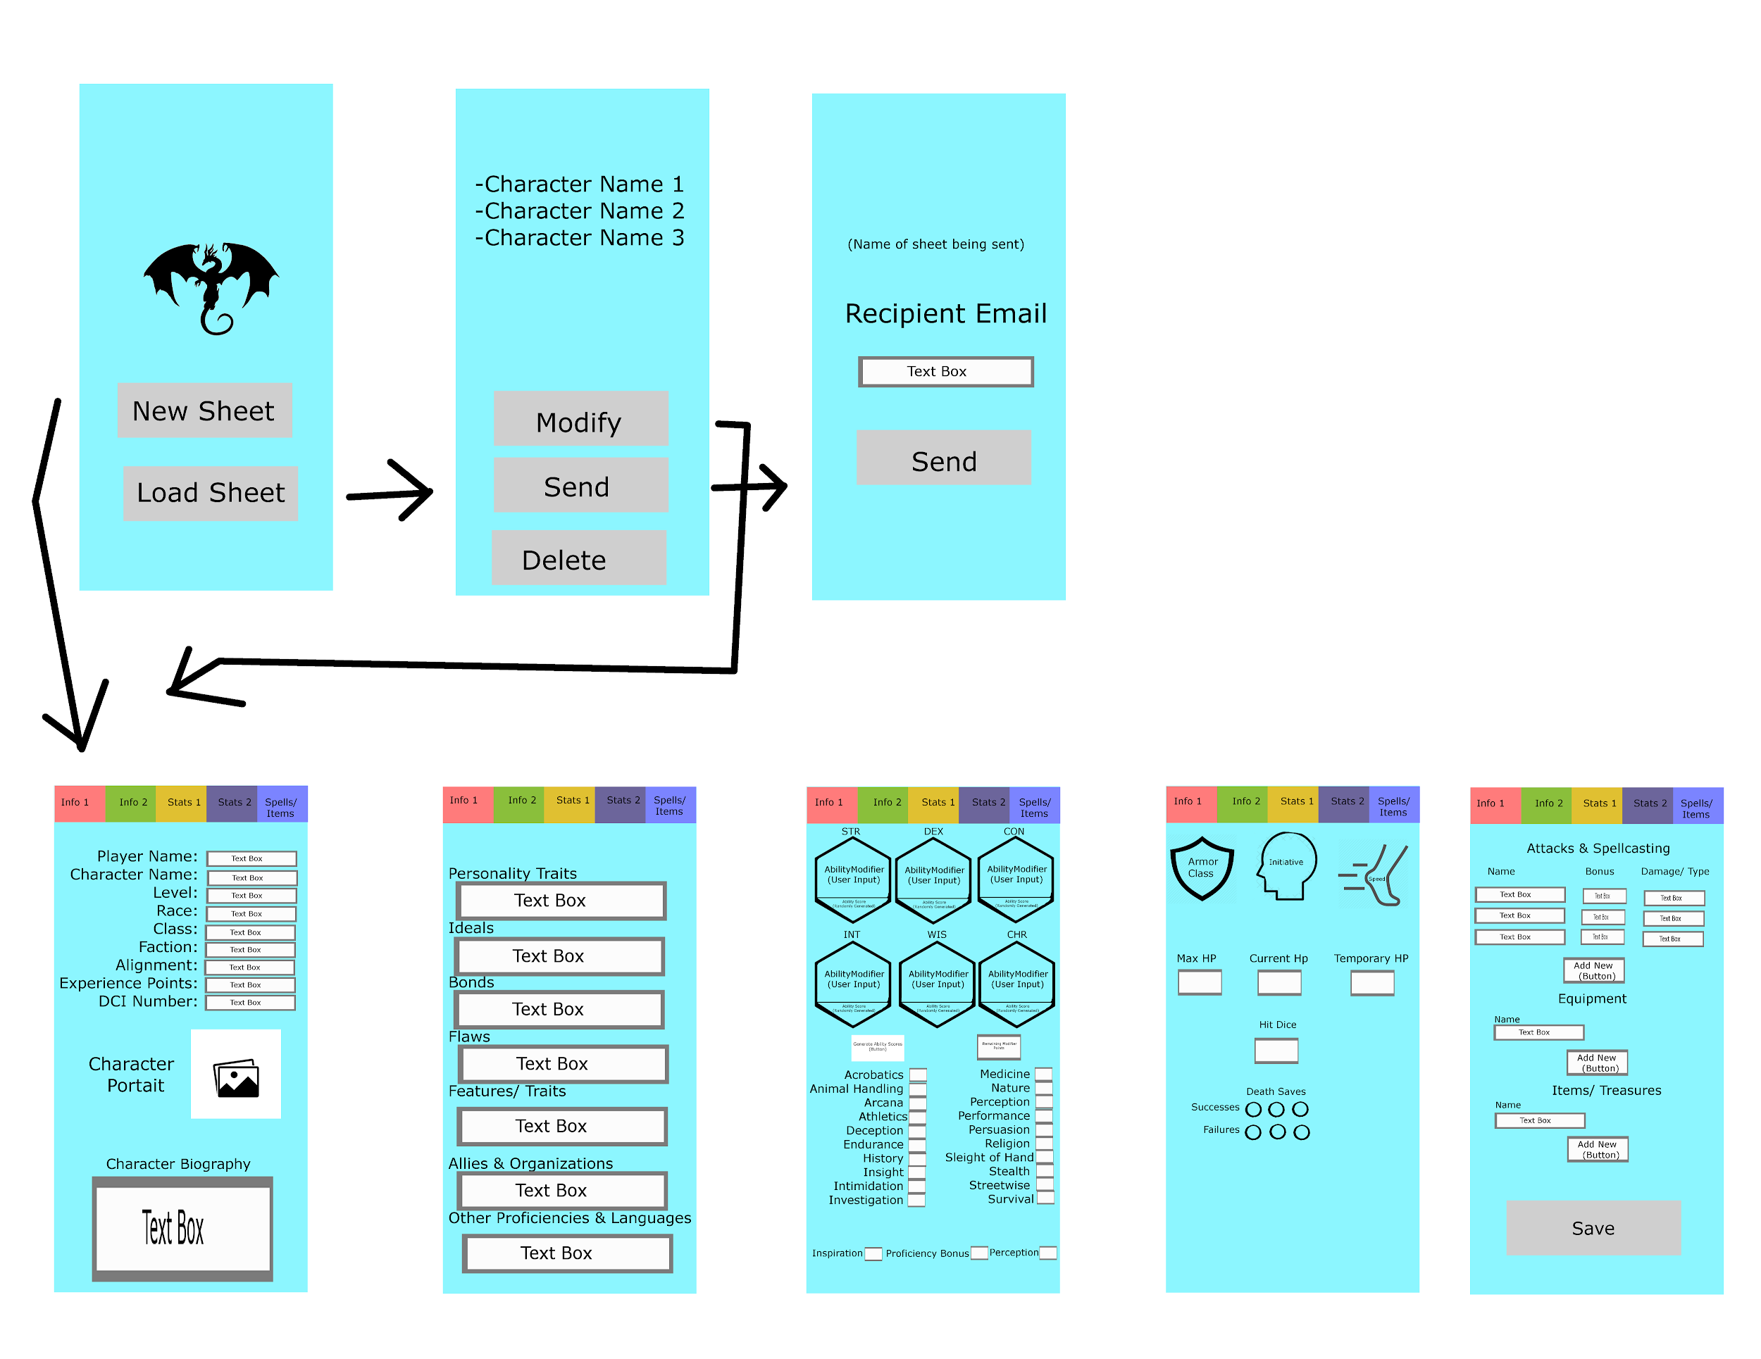
Initial UI design

Slide 14
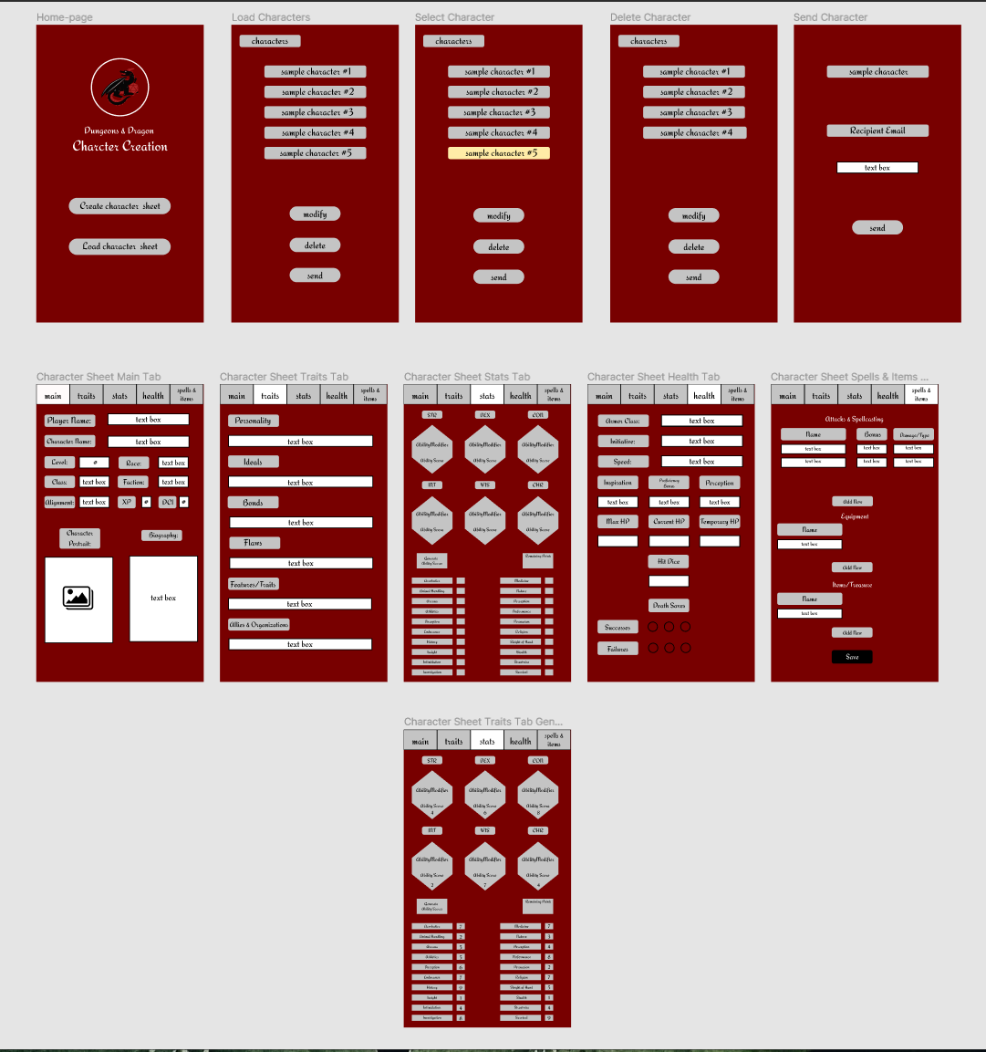
UI Design Expanded

Slide 15
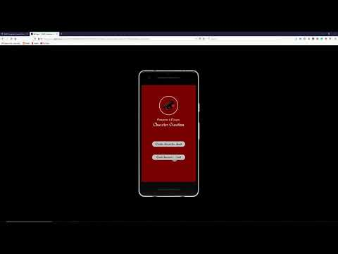
UI Prototype

Slide 16
Technical Specifications
Android Studio
Designed for the Google Pixel 2
No Server - intention was to use phone memory and send everything to the app itself
Save states from tabbed input form in phone memory after input. Can later be loaded to be edited or reput into a new, single page form for game sessions
Figma
https://www.umlet.com/ - UML creation
sequencediagram.org - Sequence Diagram Creation
Notes:
-From the start we intended to implement our designs in android studio
-We based our design around Pixel 2 -We decided against using a server to store sheets for simplicity instead opting to use save states in phone memory
-We used figma and UML to help with our diagram creation as well as photoshop

Slide 17
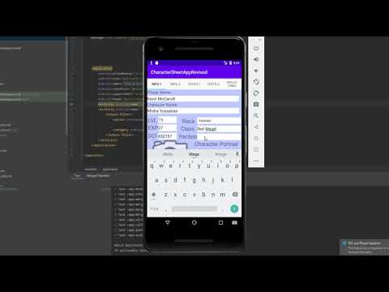
App Demo (Android Prototype)

Slide 18
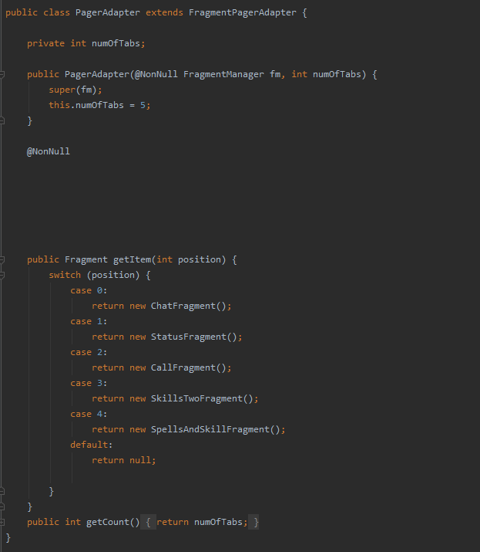
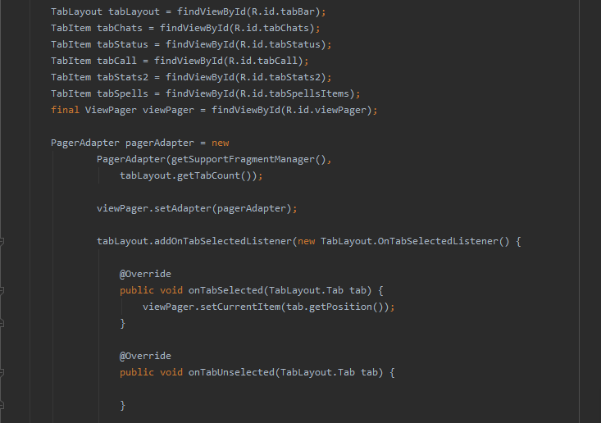
Code Snippet: Tabs/ fragments

Slide 19
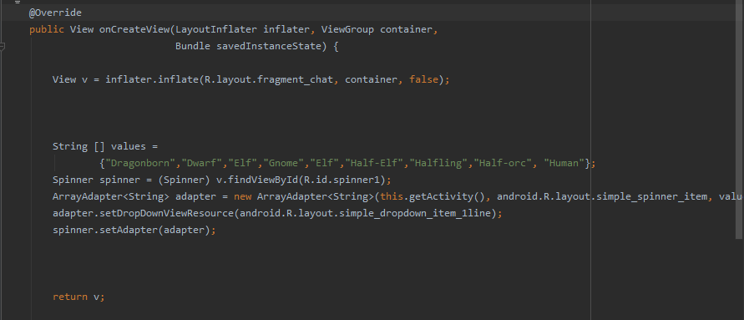
Code Snippet: Spinner

Slide 20
Testing
Parts of the app we’ve first tested was the UI design to see how easy it was in terms of functionality for both experienced and inexperienced players in the genre of D&D.
We chose to test the app ourselves since amongst us, two of our teammates have never played Dungeons and Dragons before. By relying on ourselves for the data we need to understand the flaws of our app; praying to receive any feedback from outside sources were not an issue.

Slide 21
What we learned
A lot of things can negatively affect an app development like a worldwide pandemic or a team member withholding all their work because they think they can sell it after the class is over.
A basic overview of Android studio and it’s capabilities with first time hands on experience working with it and doing any form of app development.
Software Engineering takes a lot of planning, most importantly to make sure everyone working on the project is on the same page and working towards the same goal, not dragging the project in different directions.
Android studio is a very fickle and specific, causing a lot of headaches to even make a small amount of progress.

Slide 22
Github Link
https://github.com/marcustylerwong/Dungeons-Dragons-App

Slide 23
Reference
https://stackoverflow.com/questions/683825/in-uml-class-diagrams-what-are-boundary-classes-control-classes-and-entity-cl
https://developer.android.com/docs
https://www.youtube.com/watch?v=h2TVVMKkn7Y
https://www.youtube.com/watch?v=on_OrrX7Nw4

