Slide 1
Skin Cancer Prediction and Classification
Group members:
Demarcus Wirsing (dwirsin1@umbc.edu)
Drishti Arora (darora1@umbc.edu)
Nigist Woldeeyesus (nwoldee1@umbc.edu)
Sai Kumar Kanuru (saikumk1@umbc.edu)
Yunpeng Li (yli4@umbc.edu)

Slide 2
Why skin cancer?
Skin cancer is one of the most frequent types of cancer and manifests mainly in areas of the skin most exposed to the sun. Since skin cancer occurs on the surface of the skin, its lesions can be evaluated by visual inspection. Dermoscopy is a non invasive method which permits visualizing more profound levels of the skin as its surface reflection is removed. Prior research has found that this technique permits improved visualization of the lesion structures, enhancing the accuracy of dermatologists.
The aim this project is to study the problem of classification of dermoscopic images of skin cancer, including lesions by using various of machine learning and deep learning techniques.
The hypothesis of this project is that combining skin lesion image data with more tabular descriptions or patient data may improve skin lesion classifications and skin cancer diagnosis.

Slide 3
Project Data: PAD-UFES-20 Dataset
PAD-UFES-20 dataset: a skin lesion dataset composed of patient data and clinical images collected from smartphones. The metadata.csv contains more attributes in tabular format.
Source: https://data.mendeley.com/datasets/zr7vgbcyr2/1
2298 skin lesion images
Nearly 3 gigabytes in total size
Tabular data is stored in the metadata.csv file that contains 26 columns

Slide 4
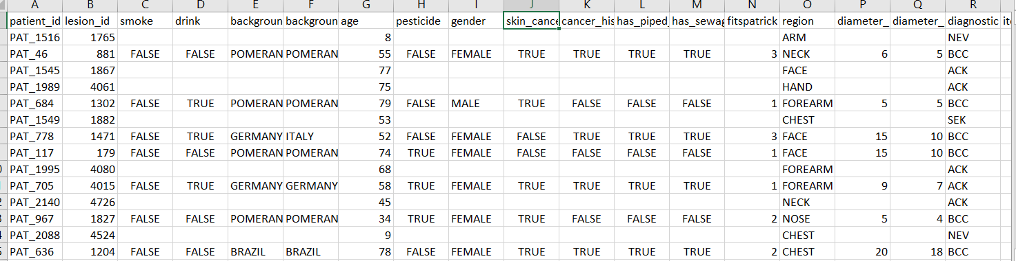
Tabular Data

Slide 5
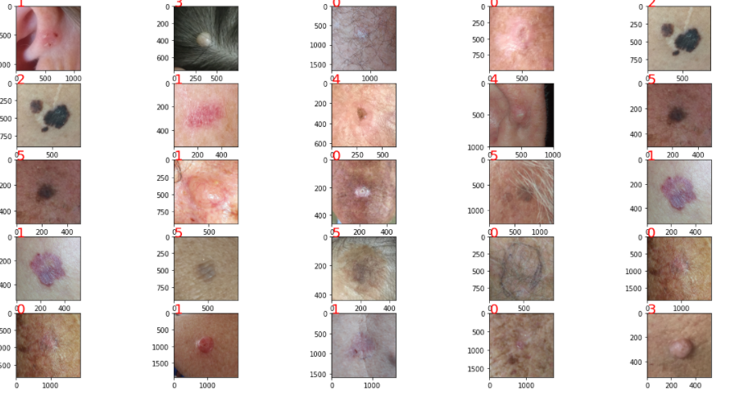
Image Data

Slide 6
Data Description
The dataset consists of 2,298 samples of six different types of skin lesions. Each sample consists of a clinical image and up to 22 clinical features including the patient's age, skin lesion location, fitspatrick skin type, and skin lesion diameter.
The skin lesions are:
Basal Cell Carcinoma (BCC)
Squamous Cell Carcinoma (SCC)
Actinic Keratosis (ACK)
Seborrheic Keratosis (SEK)
Melanoma (MEL)
Nevus (NEV).
In total, approximately 58% of the samples in this dataset are biopsy-proven. This information is described in the metadata.

Slide 7
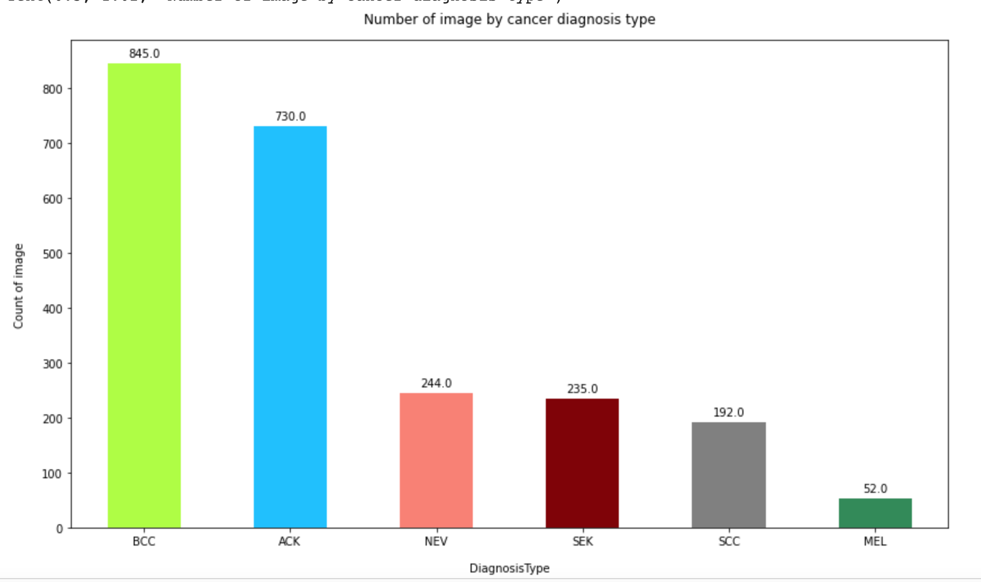
Data Exploration

Slide 8
Feature Engineering
Metadata and image data downloaded separately from mendeley.com and merged to one dataframe in google colab.
Transformed the text data to numerical values using label encoder
34% of missing values from in 13 columns has been handled by imputing random category “Unknown”.
Using Dython library identified the association between the categorical variables for the metaData
Strongly correlated fields are elevation with bleed, Biopsy with Diagnostic, fitspatrick skin type with father,mother background and gender, image diameter 1 with diameter 2.

Slide 9
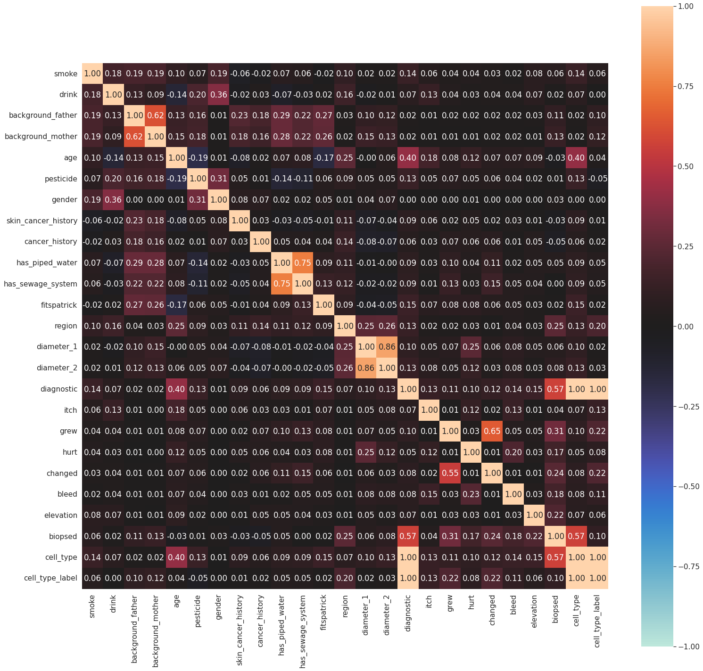
Correlation Matrix Heatmap

Slide 10
Similar Projects or Approaches
Some similar skin cancer projects have used HAM10000 dataset from Harvard Dataverse, which is available at Kaggle.com.
However, those projects mainly or purely focus on image classifications, and there are not sufficient information for describing attributes of skin lesions or other patient conditions in the dataset. So lacking the descriptions of other characteristics of skin lesions besides images may make diagnostic less accurate in real practice.

Slide 11
Some Papers of Related Works
“Melanoma Skin Lesions Classification using Deep Convolutional Neural Network with Transfer Learning”
Utilizes HAM10000 Dataset
Focuses on image processing and CNN
Only classifies skin lesions into 2 categories (benign vs malignant)
“Deep Learning Based Integrated Classification and Image Retrieval System for Early Skin Cancer Detection”
Utilizes a skin cancer image database
Uses pre-trained CNN model to extract features of cancer images
Applies image segmentation and feature fusion to form image features
Uses machine learning models such as LR and SVC on the fused features to do classification.

Slide 12
Some Papers of Related Works (Cont.)
“Comparison of the accuracy of human readers versus machine-learning algorithms for pigmented skin lesion classification: an open, web-based, international, diagnostic study”
Findings: “State-of-the-art machine-learning classifiers outperformed human experts in the diagnosis of pigmented skin lesions”
“Skin Lesion Classification using Deep Learning and Image Processing”
Utilizes HAM10000 Dataset
Focuses on image processing and deep learning models
Integrates a CNN model with another pre-trained CNN model to achieve better accuracy for classification

Slide 13
Our Project Purpose and Scope
Since our dataset contains not only image data but also other information about skin samples and patients in a tabular format, we plan to compare and utilize both tabular data and image data in our models or analysis to see if we can improve skin lesion classifications so as to improve skin cancer diagnosis.
We are going to practice various machines learning, deep learning, and image processing techniques in this project.

Slide 14
Our Approaches
We plan to construct various machine learning models or predictive analysis on the tabular data to evaluate the results of skin lesion classifications.
We plan to use image processing techniques and construct various deep learning models on skin image data to evaluate the results of skin lesion classifications.
We plan to construct a model that combines both image and tabular data and uses deep learning approach to do skin lesion classifications.
We are going to evaluate the accuracy and performance of various models in the end and find the best model for skin lesion classifications.
We will also construct a data web application using streamlit to over take our google collab notebooks, for a more uniform/seamless experience when presenting out project and findings.

Slide 15
References:
Islam, M. K., Ali, M. S., Ali, M. M., Haque, M. F., Das, A. A., Hossain, M. M., Duranta, D. S., & Rahman, M. A. (2021). Melanoma Skin Lesions Classification using Deep Convolutional Neural Network with Transfer Learning. 2021 1st International Conference on Artificial Intelligence and Data Analytics (CAIDA), Artificial Intelligence and Data Analytics (CAIDA), 2021 1st International Conference On, 48–53. https://doi-org.proxy-bc.researchport.umd.edu/10.1109/CAIDA51941.2021.9425117
Jibhakate, A., Parnerkar, P., Mondal, S., Bharambe, V., & Mantri, S. (2020). Skin Lesion Classification using Deep Learning and Image Processing. 2020 3rd International Conference on Intelligent Sustainable Systems (ICISS), Intelligent Sustainable Systems (ICISS), 2020 3rd International Conference On, 333–340. https://doi-org.proxy-bc.researchport.umd.edu/10.1109/ICISS49785.2020.9316092
Layode, O., Alam, T., & Rahman, M. M. (2019). Deep Learning Based Integrated Classification and Image Retrieval System for Early Skin Cancer Detection. 2019 IEEE Applied Imagery Pattern Recognition Workshop (AIPR), Applied Imagery Pattern Recognition Workshop (AIPR), 2019 IEEE, 1–7. https://doi-org.proxy-bc.researchport.umd.edu/10.1109/AIPR47015.2019.9174586
Tschandl, P., Codella, N., Akay, B. N., Argenziano, G., Braun, R. P., Cabo, H., Gutman, D., Halpern, A., Helba, B., Hofmann-Wellenhof, R., Lallas, A., Lapins, J., Longo, C., Malvehy, J., Marchetti, M. A., Marghoob, A., Menzies, S., Oakley, A., Paoli, J., … Kittler, H. (2019). Comparison of the accuracy of human readers versus machine-learning algorithms for pigmented skin lesion classification: an open, web-based, international, diagnostic study. Lancet Oncology, 7, 938.

Slide 16
Accomplished Tasks and Roles
Project topic proposal (Nigist, Sai, and Yunpeng)
Searching various datasets and initial data exploration. (Sai)
Tabular data exploration and feature engineering (Nigist & Drishti)
Image data initial preprocessing (Yunpeng)
Project planning and researching on a potential web application as the end product (Demarcus & Yunpeng)
Research on related works and papers (Demarcus, Dirishti, Nigist, Sai, and Yunpeng)
Team coordination and meeting setup (Nigist & Sai)
Development environment setup (Nigist & Yunpeng)
Slides (Demarcus, Dirishti, Nigist, Sai, and Yunpeng)

Slide 17
Github Repository
https://github.com/yunpengliDataScience/Skin_Cancer_ML_DL

Slide 18
Planning for the Next Step
We will continue more EDA and feature engineering tasks on tabular data.
We will continue more image processing tasks for later DL.
We will build several ML models using tabular data for prediction.
We will build an initial CNN model for classifying skin lesion images.
We will use and evaluate several pretrained DL models.
We will plan to build an application prototype for visualization.

