Slide 1
Skin Cancer Classification: With Machine Learning & Deep Learning
Group members:
Demarcus Wirsing (dwirsin1@umbc.edu)
Drishti Arora (darora1@umbc.edu)
Nigist Woldeeyesus (nwoldee1@umbc.edu)
Sai Kumar Kanuru (saikumk1@umbc.edu)
Yunpeng Li (yli4@umbc.edu)

Slide 2
Dataset
Source: https://data.mendeley.com/datasets/zr7vgbcyr2/1
PPAD-UFES-20 dataset: a skin lesion dataset composed of patient data and clinical images collected from smartphones. The metadata.csv contains more attributes in tabular format.
Tabular data is stored in the metadata.csv file that contains 26 columns
A patient may have one or more skin lesions and a skin lesion may have one or more images. In total, there are 1373 patients, 1641 skin lesions, and 2298 images present in the dataset.
The dataset contains 58.3% image with true biopsy

Slide 3
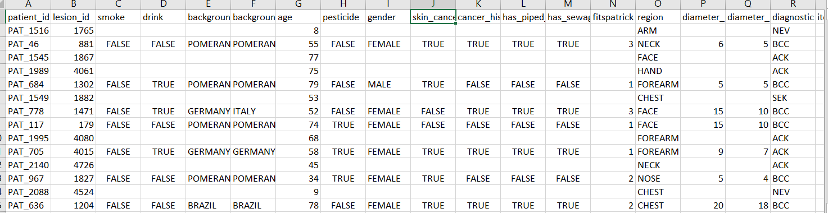
Tabular Data

Slide 4
Data Description
The skin lesions are:
Basal Cell Carcinoma (BCC)
Squamous Cell Carcinoma (SCC)
Actinic Keratosis (ACK)
Seborrheic Keratosis (SEK)
Melanoma (MEL)
Nevus (NEV).

Slide 5
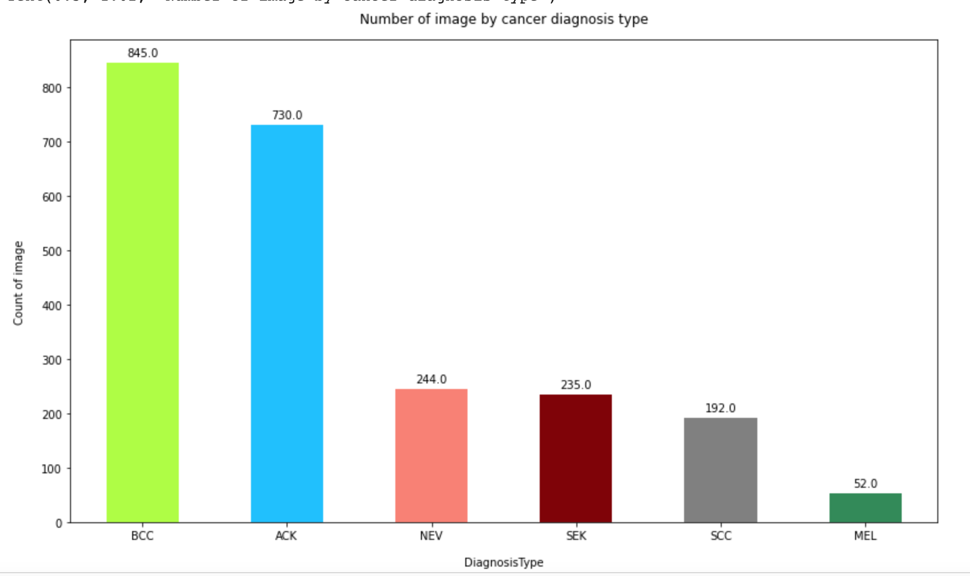
Data Exploration

Slide 6
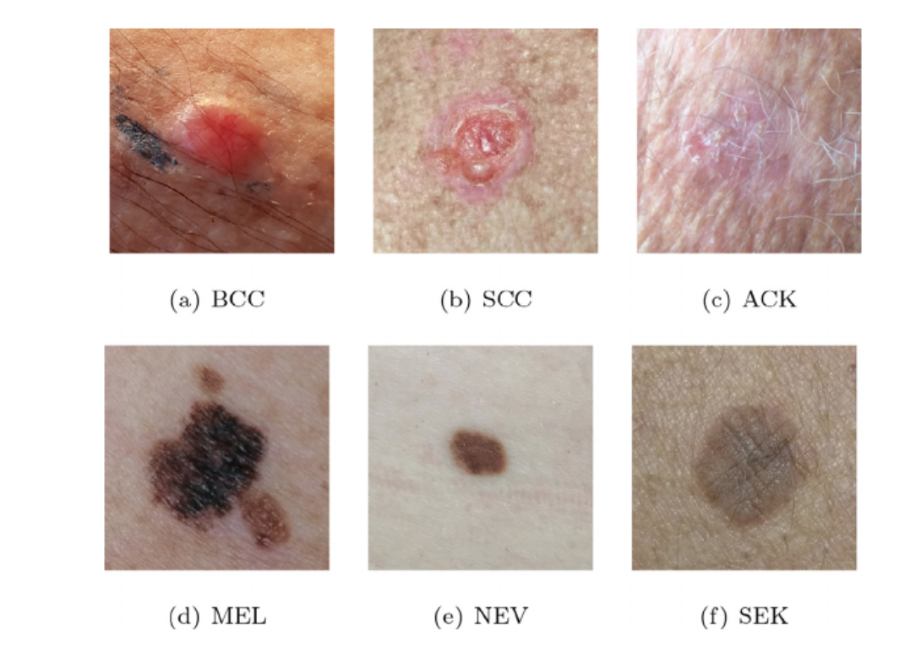
Dataset continue…..
A sample of each type of skin lesion present in PAD-UFES-20 dataset

Slide 7
Project Goals
Construct various machine learning models or predictive analysis on the tabular data to evaluate the results of skin lesion classifications.
Use image processing techniques and construct and utilize various deep learning models on skin image data to evaluate the results of skin lesion classifications.
Construct a model that combines both image and tabular data and uses deep learning approach to do skin lesion classifications.
Evaluate the accuracy and performance of various models in the end and find the best model for skin lesion classifications.
Prove or disprove the hypothesis that combining image data and tabular data can improve model accuracy.
Construct Inference prediction from the image

Slide 8
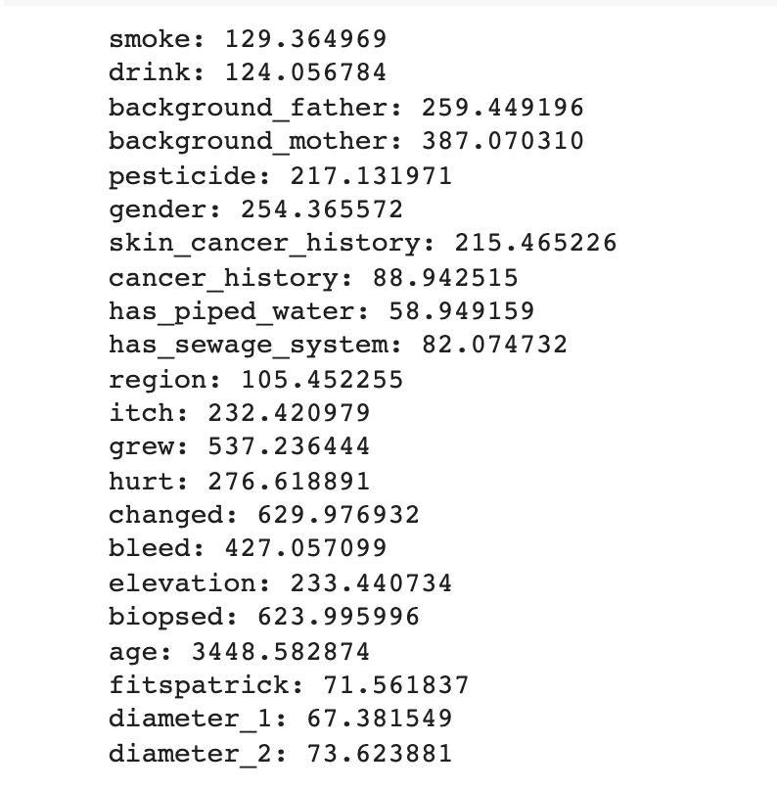
Experimented Feature Engineering on Tabular Data
Chi square test and correlation:
From Sklearn we used SelectKbest module to select features according to the k highest (ANOVA F-value between label/feature for classification tasks.)scores.

Slide 9
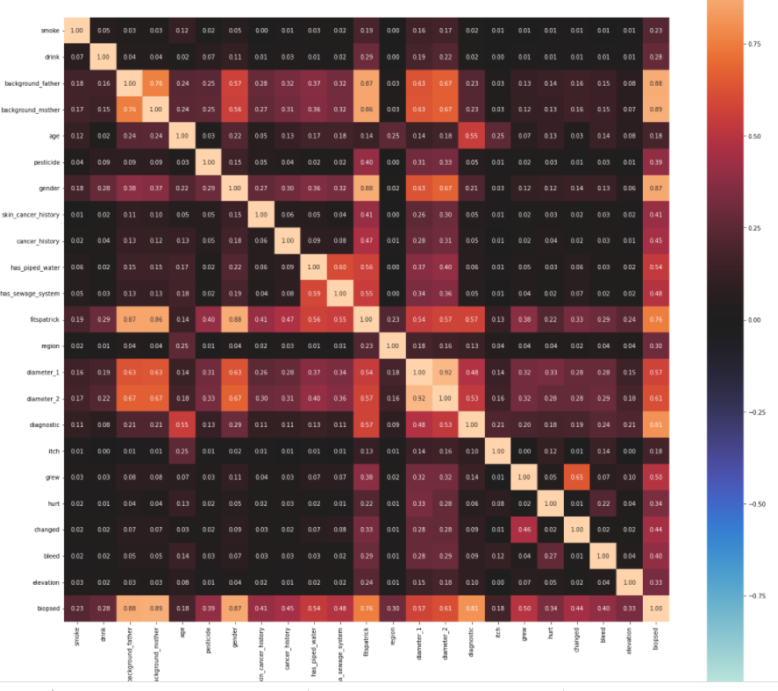
Correlation matrix

Slide 10
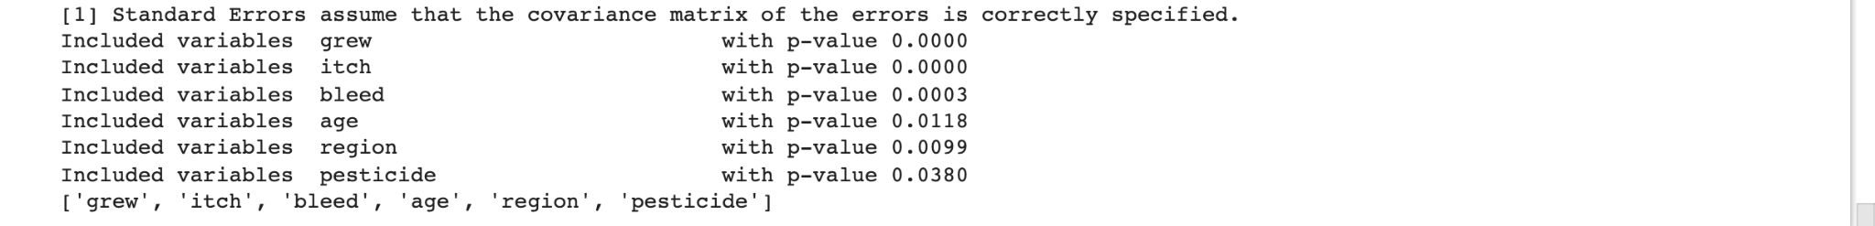
Stepwise Regression Test
Applied Stepwise regression:
To identify the best predictor variables for the dataset that feeds to the ML models. Out of 20 variables 6 variables with p-value <0.05 identified as high predictors for skin cancer diagnostics variable.

Slide 11
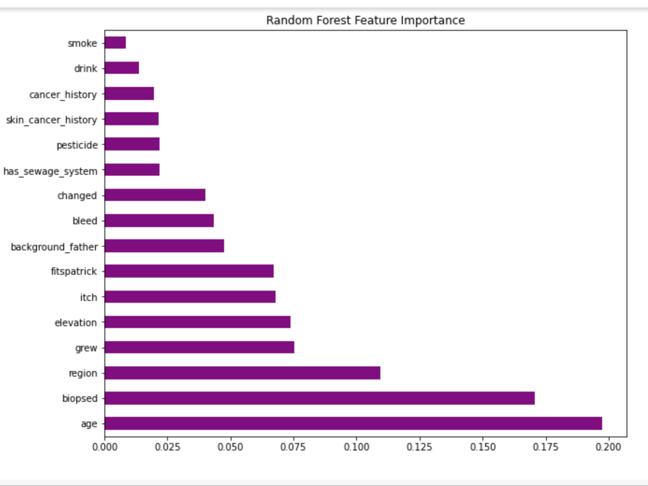
Feature Importance

Slide 12
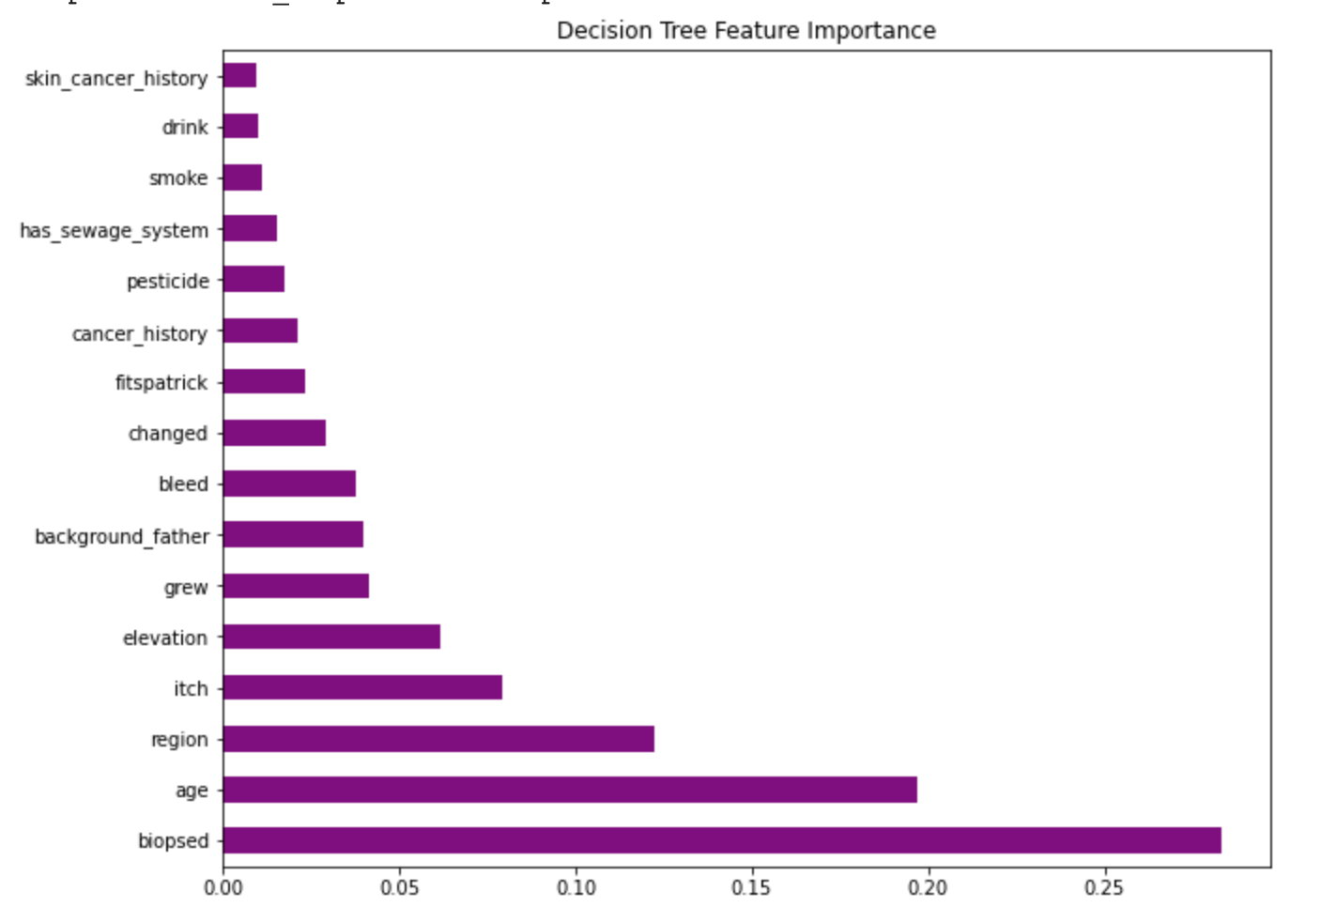
Feature Importance……..

Slide 13
Best predictor variables
After running multiple statistical test to identify the best predictors variable the following variables were used to train the machine learning model:
Age
Biopsed
grew
Region
pesticide
skin_cancer_history,
cancer_history,
background_father,
drink,
smoke
itch
bleed
Changed
Has_sewage_system
elevation

Slide 14
Experimenting Machine Learning Models
Trained scaled tabular data using the following ML models.
SGDClassifier: 64%
OVO: test score 55%
Randomforest:83%
Decision tree:77.9%
MultinomialNB=72%
Multinomial Logistic regression=73%
Feature importance: On Decision Tree and Random forest model

Slide 15
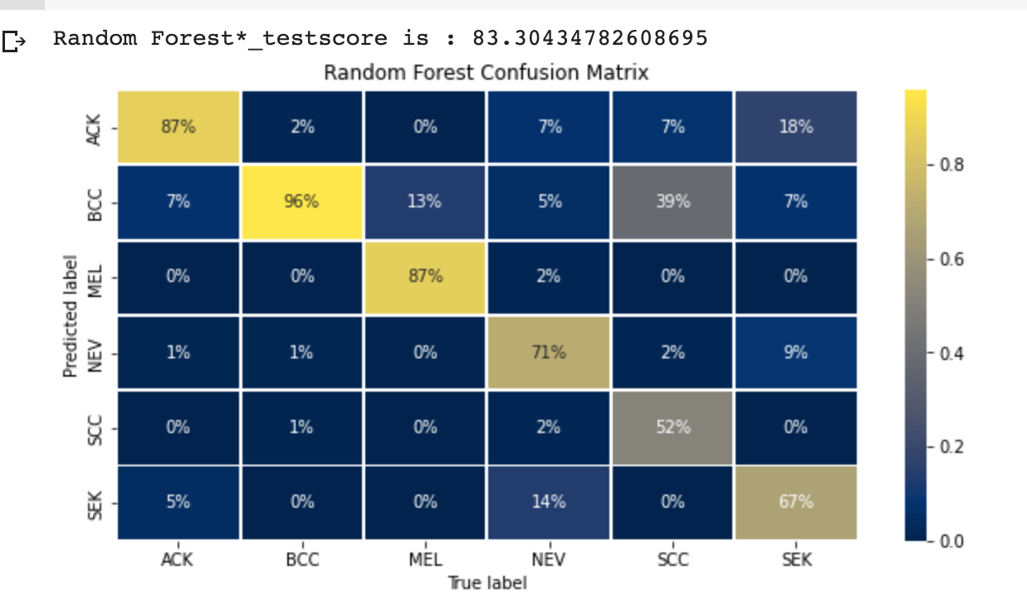
Random Forest Classification

Slide 16
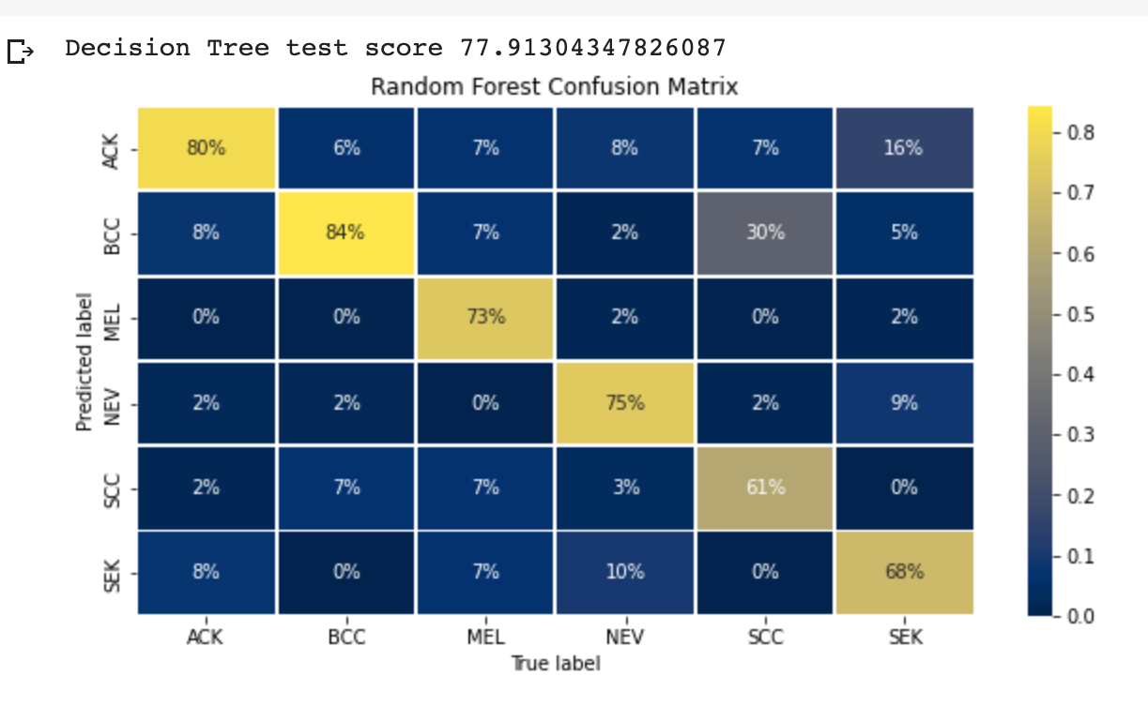
Decision Tree Classification

Slide 17
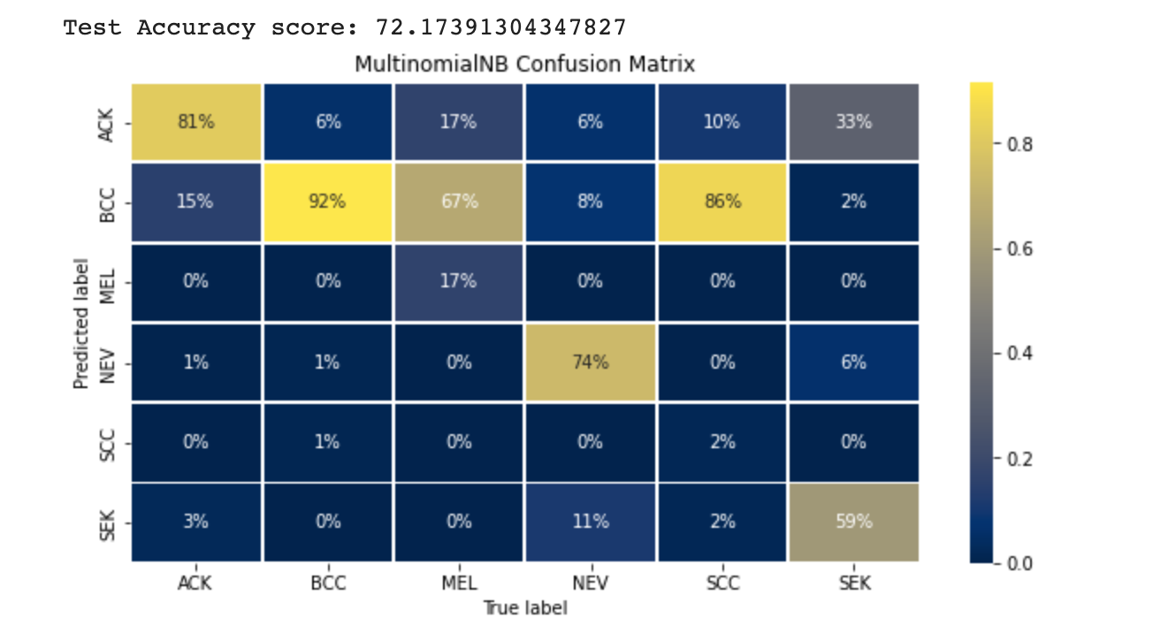
MultinomialNB

Slide 18
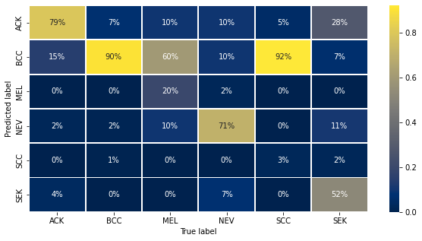
Multinomial Logistic Regression
Accuracy=73%

Slide 19
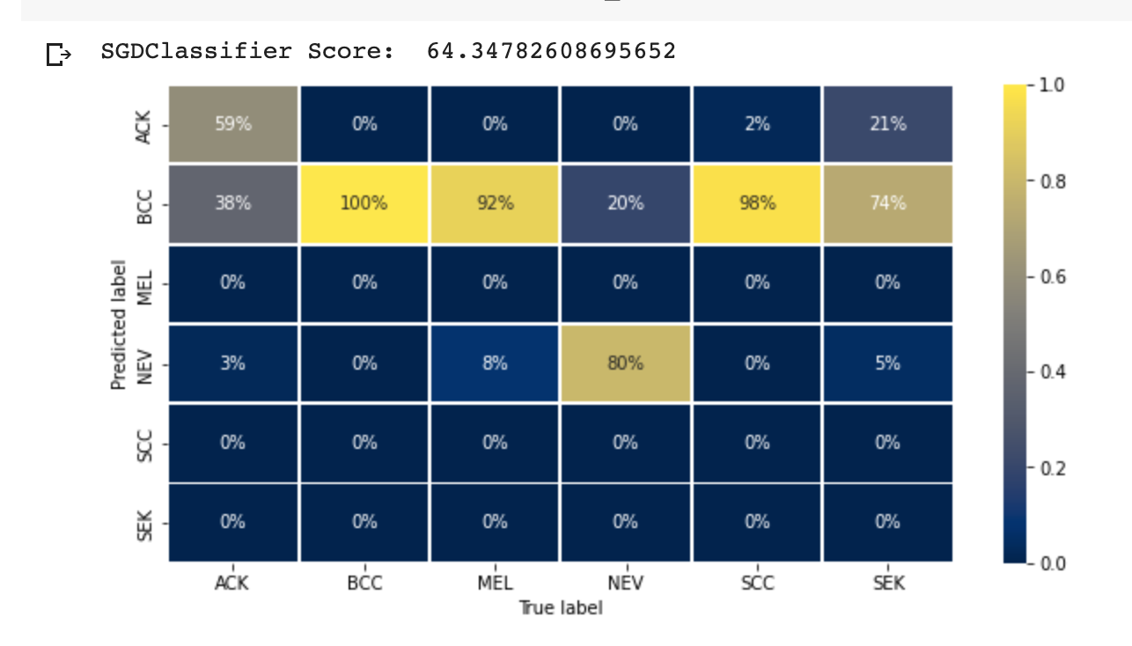
SGDClassifier

Slide 20
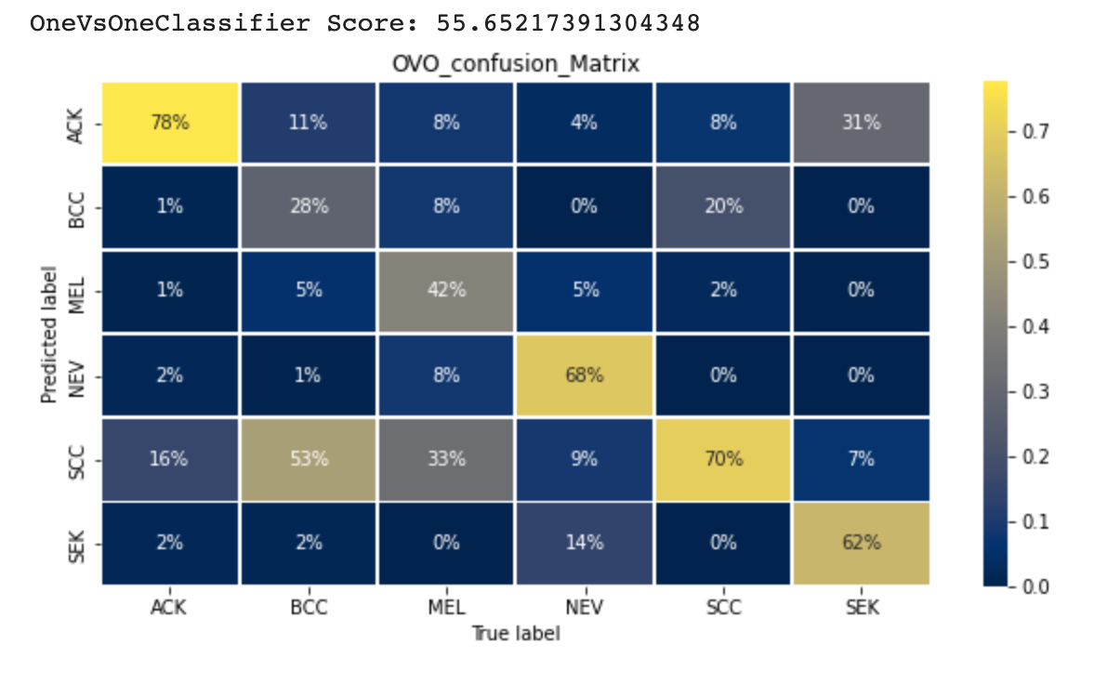
OneVsOneClassifier

Slide 21
Experimented Various Pre-built Transfer Learning Model Architectures for Training Skin Lesion Image Data
Purpose: To explore which model has better classification accuracy on skin image data.
DenseNet (DenseNet121, DenseNet161, DenseNet201)
GoogleNet
ResNet (ResNet18, ResNet50)
MobileNet V2

Slide 22
DenseNet
Connects each layer to every other layer in a feed-forward fashion.
Substantially deeper, more accurate, and efficient to train if they contain shorter connections between layers close to the input and those close to the output.
Alleviate the vanishing-gradient problem, strengthen feature propagation, encourage feature reuse, and substantially reduce the number of parameters
4 Model structures – densenet121, densenet161, densenet169, densenet201.

Slide 23
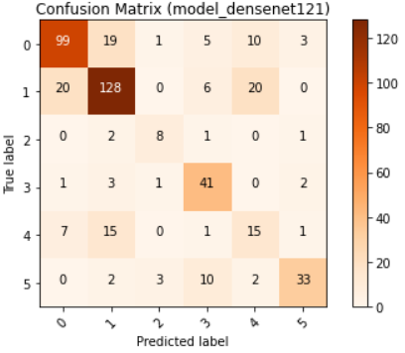
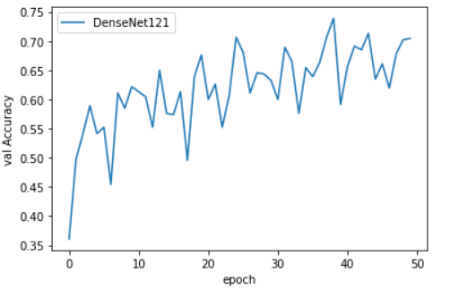
DenseNet121

Slide 24
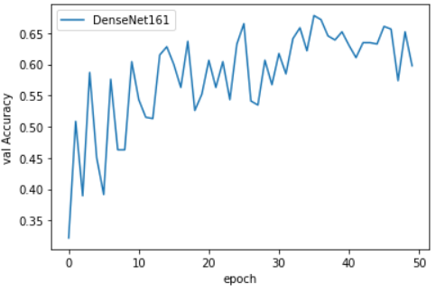
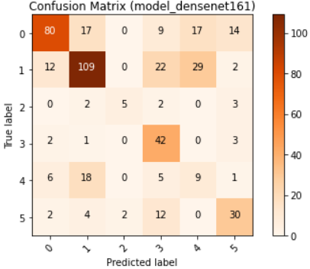
DenseNet161

Slide 25
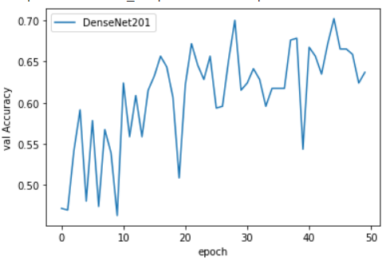
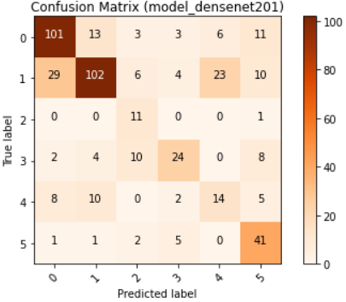
DenseNet201

Slide 26
GoogleNet
Based on a deep convolutional neural network architecture codenamed "Inception"
Convolutions use rectified linear activation.
Designed with computational efficiency and practicality in mind, so that inference can be run on individual devices including even those with limited computational resources, especially with low-memory footprint

Slide 27
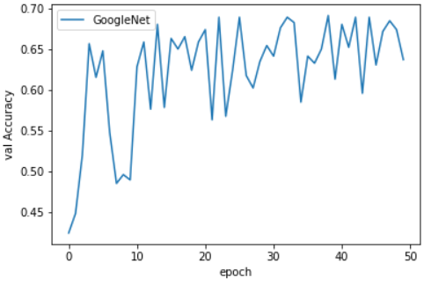
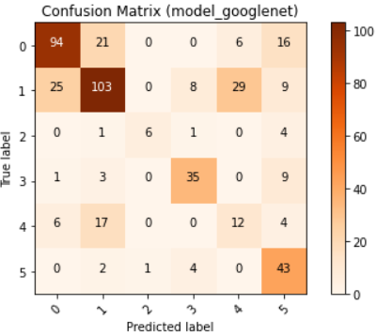
GoogleNet

Slide 28
ResNet
Deep residual networks pre-trained on ImageNet
Easier to optimize and can gain accuracy from considerably increased depth.
5 Model structures – restnet18, restnet34, restnet50, restnet101, restnet152.

Slide 29
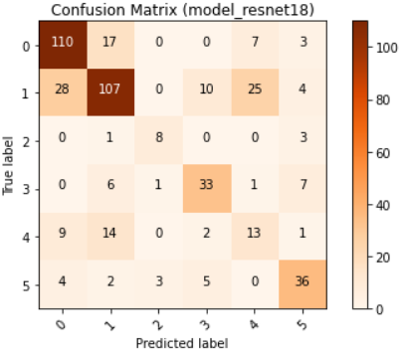
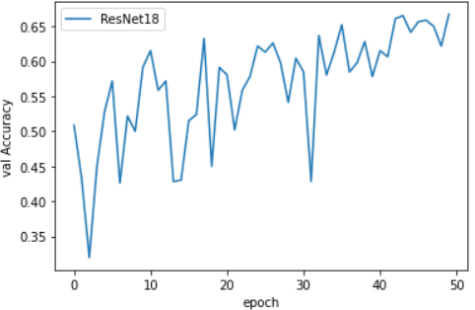
ResNet18

Slide 30
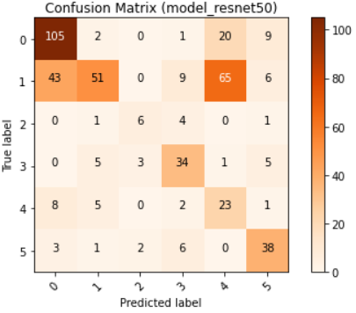
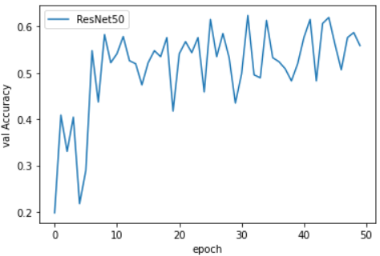
ResNet50

Slide 31
MobileNet V2
Efficient networks optimized for speed and memory, with residual blocks
Based on an inverted residual structure where the shortcut connections are between the thin bottleneck layers opposite to traditional residual models.
Uses lightweight depthwise convolutions to filter features in the intermediate expansion layer.

Slide 32
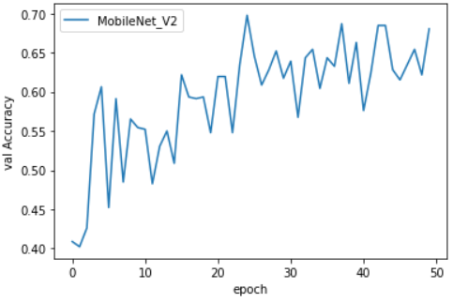
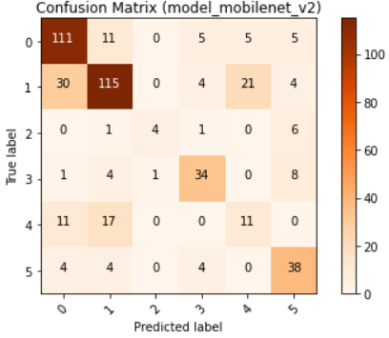
MobileNet V2

Slide 33
Hybrid Model for Deep Learning
Encoded patient clinic and cancer attribute categorical data in the metadata.csv file by using one-hot-encoding approach.
Generate a new csv file containing the encoded tabular data.
Keep the img_id column and image_path column in the csv file so that the model knows where to load the image.
Defined a class named SkinImageTabularDataset, which knows how to access both tabular and image data.
Drafted a class named ImageTabularHybridModel, which extends Pytorch nn.Module and can combine both image data and tabular data for deep learning. User can specify “image-only”, “tabular-only”, or “combined” parameters.

Slide 34
ImageTabularHybridModel
Image
Hijacked Pre-built CNN Model
Fully Connected Layers
Image tensor output
Six Classes
Fully Connected Layers
Tabular tensor output
Tabular
Fully Connected Layers
Fully Connected Layers
Concatenated
The “Hijacked” Pre-built CNN Models: Resnet, MobileNet, GoogleNet, DenseNet…

Slide 35
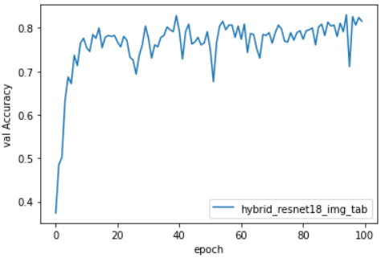
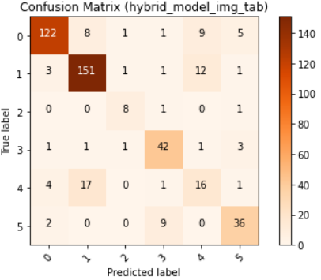
Training Results of Hybrid Model which utilizes ResNet18
The hybrid model reaches accuracy near 0.8152 > 0.70 of purely Resnet18 model.

Slide 36
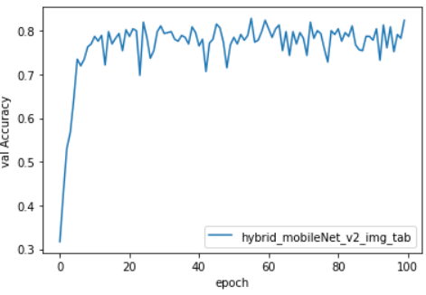
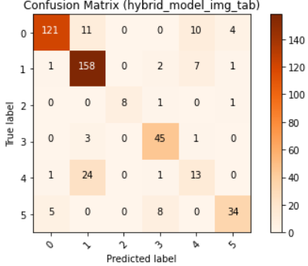
Training Results of Hybrid Model which utilizes MobileNet_V2
The hybrid model reaches accuracy near 0.8239 > 0.7087 of purely MobileNet V2 model.

Slide 37
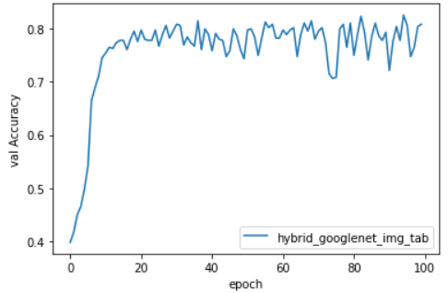

Training Results of Hybrid Model which utilizes GoogleNet
The hybrid model reaches accuracy near 0.8087 > 0.7021 of purely GoogleNet model.

Slide 38
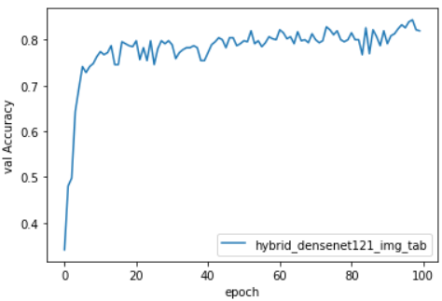
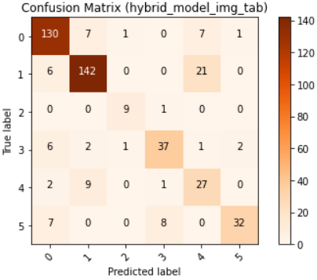
Training Results of Hybrid Model which utilizes DenseNet121
The hybrid model reaches accuracy near 0.8196 > 0.7087 of purely DenseNet121 model.

Slide 39
Hybrid Models: Tabular Data with Original Columns vs Tabular Data with Reduced Columns
We have also chosen the most important tabular columns (features) that we have studied in the machine learning phase to reduce the number of tabular data columns.
We have experimented and compared the training results of Image-Tabular hybrid model using full tabular columns and reduced tabular columns.

Slide 40
Results of Training Hybrid Models (Full Columns vs Reduced Columns)
Image Model Used in the Hybrid Model | Accuracy (Full Column) | Accuracy (Reduced Column)
Resnet18 | 0.815 | 0.8283
MobileNet V2 | 0.8239 | 0.7913
GoogleNet | 0.8087 | 0.7978
DenseNet121 | 0.8198 | 0.8
Resnet18 seems to have slightly improvement when tabular data is made up of reduced columns. Others seem to have no or less improvement. It may make sense because deep learning can figure out what features are important and ignore what are less important after sufficient big number of epochs of training. Or all the original columns may all have some contributions to the classification.

Slide 41
Image-Tabular combined model does perform better than pure image model or pure tabular model in deep learning after 100 epochs of trainings. It is 1 + 1 > 2 !
Image Model Used in the Hybrid Model | Accuracy (Image Only) | Accuracy (Tabular Only) | Accuracy (Image Tabular Combined)
Resnet 18 | 0.70 | 0.8043 | 0.8152
MobileNet V2 | 0.7087 | 0.8217 | 0.8239
GoogleNet | 0.7021 | 0.7717 | 0.8087
DenseNet 121 | 0.7087 | 0.8043 | 0.8196

Slide 42
Experimenting Tabular Column Inferencing by Training Image data in Deep Learning
Main purpose: there are some missing values in some tabular data columns, so using deep learning model trained by image data to predict missing values in those columns.
Main strategy: treat a particular tabular column as a class label, and then train images in deep learning model to predict the value of that column.

Slide 43
Experimenting Tabular Column Inferencing by Training Image data in Deep Learning
Experimented deep learning using ResNet18 to train skin cancer image data to predict column values.
Preliminary results after initial experimentation:
Tabular Column Name | Accuracy
Grew | 0.43<0.5
Region | 0.43<0.5
Elevation | 0.67~0.7

Slide 44
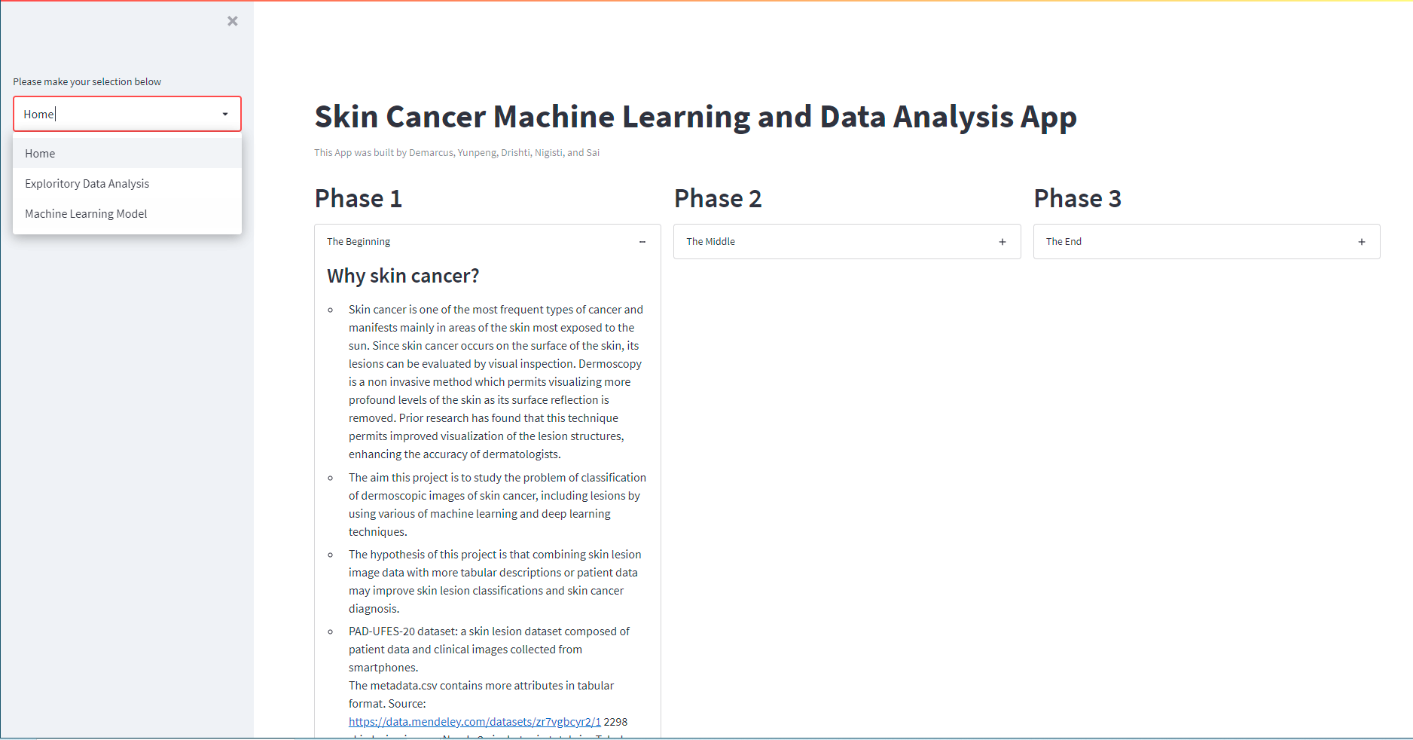
Data Application Progress

Slide 45
Github Repository
https://github.com/yunpengliDataScience/Skin_Cancer_ML_DL

Slide 46
References:
Islam, M. K., Ali, M. S., Ali, M. M., Haque, M. F., Das, A. A., Hossain, M. M., Duranta, D. S., & Rahman, M. A. (2021). Melanoma Skin Lesions Classification using Deep Convolutional Neural Network with Transfer Learning. 2021 1st International Conference on Artificial Intelligence and Data Analytics (CAIDA), Artificial Intelligence and Data Analytics (CAIDA), 2021 1st International Conference On, 48–53. https://doi-org.proxy-bc.researchport.umd.edu/10.1109/CAIDA51941.2021.9425117
Layode, O., Alam, T., & Rahman, M. M. (2019). Deep Learning Based Integrated Classification and Image Retrieval System for Early Skin Cancer Detection. 2019 IEEE Applied Imagery Pattern Recognition Workshop (AIPR), Applied Imagery Pattern Recognition Workshop (AIPR), 2019 IEEE, 1–7. https://doi-org.proxy-bc.researchport.umd.edu/10.1109/AIPR47015.2019.9174586
Tschandl, P., Codella, N., Akay, B. N., Argenziano, G., Braun, R. P., Cabo, H., Gutman, D., Halpern, A., Helba, B., Hofmann-Wellenhof, R., Lallas, A., Lapins, J., Longo, C., Malvehy, J., Marchetti, M. A., Marghoob, A., Menzies, S., Oakley, A., Paoli, J., … Kittler, H. (2019). Comparison of the accuracy of human readers versus machine-learning algorithms for pigmented skin lesion classification: an open, web-based, international, diagnostic study. Lancet Oncology, 7, 938.
Brownlee, J. (2020, August 19). 4 types of classification tasks in machine learning. Machine Learning Mastery. Retrieved November 3, 2021, from https://machinelearningmastery.com/types-of-classification-in-machine-learning/.
Makwana, K. (2021, June 2). Frequent category imputation (missing data imputation technique). Medium. Retrieved November 3, 2021, from https://medium.com/geekculture/frequent-category-imputation-missing-data-imputation-technique-4d7e2b33daf7.
Ivan Vasilev, Daniel Slater, Gianmario Spacagna, Peter Roelants, & Valentino Zocca. (2019). Python Deep Learning : Exploring Deep Learning Techniques and Neural Network Architectures with PyTorch, Keras, and TensorFlow, 2nd Edition: Vol. Second edition. Packt Publishing.
Amer Abdulkader, 10509213 Canada Inc., & Sarmad Tanveer. (2019). PyTorch for Deep Learning and Computer Vision. Packt Publishing.
Torchvision.models. torchvision.models - Torchvision 0.11.0 documentation. (n.d.). Retrieved November 7, 2021, from https://pytorch.org/vision/stable/models.html.

Slide 47
References:
Huang, G., Liu, Z., Maaten, L.V.D., Densely Connected Convolutional Networks, (2016), https://arxiv.org/abs/1608.06993
Szegedy, C., Liu, W., Jia, Y., Sermanet, P., Reed, S., Anguelov, D., Erhan, D., Vanhoucke, V., Rabinovich, A., Going deeper with convolutions, (2014), https://arxiv.org/abs/1409.4842#
He, K., Zhang, X., Ren, S., Sun, J., Deep Residual Learning for Image Recognition, (2015), https://arxiv.org/abs/1512.03385
Sandler, M., Howard A., Zhu, M., Zhmoginov, A., Chen, L.C., MobileNetV2: Inverted Residuals and Linear Bottlenecks, The IEEE Conference on Computer Vision and Pattern Recognition (CVPR), 2018, pp. 4510-4520 https://arxiv.org/abs/1801.04381

