Slide 1
Skin Cancer Classification: With Machine Learning & Deep Learning
Group members:
Demarcus Wirsing (dwirsin1@umbc.edu)
Drishti Arora (darora1@umbc.edu)
Nigist Woldeeyesus (nwoldee1@umbc.edu)
Sai Kumar Kanuru (saikumk1@umbc.edu)
Yunpeng Li (yli4@umbc.edu)

Slide 2
Phase III Progress
Verified number of layers in fully connected network for tabular data is actually 3 not 10.
Experimenting and comparing deep learning model trained by Ordinal-Encoded tabular data and One-Hot-Encoded tabular data.
Training image-tabular combined model by tabular data with “biopsed” and without “biopsed” column.
Experimenting more tabular column inferencing using image deep learning.

Slide 3
Machine Learning
With Biopsed vs without biopsed:
With Biopsed
Model | Accuracy
Multinomial Logistic Regression | 74%
Multinomial Naive Bayes | 69%
SGD Classifier | 52%
Random Forest Classifier | 83.6%
Decision Tree Classifier | 79%

Slide 4
Without Biopsed
Model | Accuracy
Multinomial Logistic Regression | 70%
Multinomial Naive Bayes | 67%
SGD Classifier | 67%
Random Forest Classifier | 80%
Decision Tree Classifier | 73%
All the models perform better with Biopsed column except for SGD Classifier.

Slide 5
Ordinal Encoding vs One hot Encoding
With Ordinal Encoding:
Model | Accuracy
Multinomial Logistic Regression | 74%
Multinomial Naive Bayes | 69%
SGD Classifier | 52%
Random Forest Classifier | 83.6%
Decision Tree Classifier | 79%

Slide 6
With One hot Encoding:
Accuracy score increased for all the models except for Random Forest Classifier.
Model | Accuracy
Multinomial Logistic Regression | 78%
Multinomial Naive Bayes | 73%
SGD Classifier | 65%
Random Forest Classifier | 83%
Decision Tree Classifier | 79%

Slide 7
Ordinal Encoding vs One-hot Encoding

Slide 8
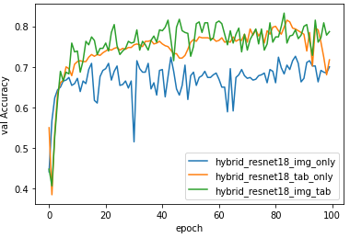
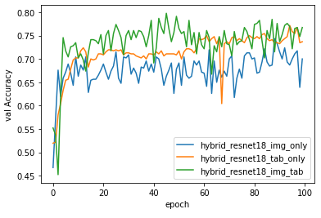
Experimenting on training model with ordinal encoded tabular data
One-hot Encoding
Ordinal Encoding

Slide 9
Ordinal vs One-hot Encoding (Trained by Resnet18, without “biopsed” column)
Encoding | Accuracy (Image-only) after 100 epochs | Accuracy (Tab-only) after 100 epochs | Accuracy (Combined) after 100 epochs | Best Accuracy of Combined Model
Ordinal | 0.7 | 0.7370 | 0.7674 | 0.7978 at epoch #45
One-hot | 0.7 | 0.7174 | 0.7870 | 0.8326 at epoch #83
Model with ordinal encoded tabular data achieves slightly less validation accuracy score than the model with one-hot encoded tabular data.
Training model with ordinal encoded tabular data takes less time.

Slide 10
With “Biopsed” vs Without “Biopsed”

Slide 11
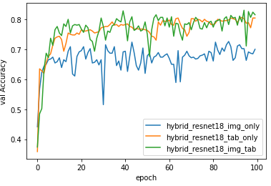
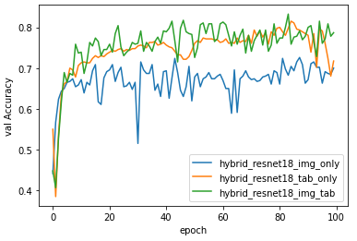
Resnet18 with vs without “biopsed” (one-hot encoding)
With
Without

Slide 12
Resnet18 with vs without “biopsed” (one-hot encoding)
“Biopsed” Column Included? | Accuracy (Image-only) after 100 epochs | Accuracy (Tab-only) after 100 epochs | Accuracy (Combined) after 100 epochs | Best Accuracy of Combined Model
Yes (with) | 0.7 | 0.8043 | 0.8152 | 0.8304 at epoch #94
No (without) | 0.7 | 0.7174 | 0.7870 | 0.8326 at epoch #83
Without “biopsed” column, validation score decreases slightly after 100 epochs of training, but the best score remains almost the same.

Slide 13
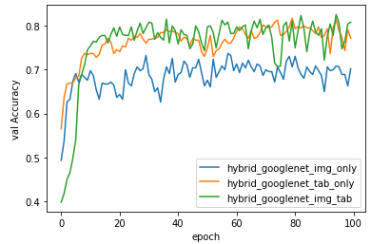
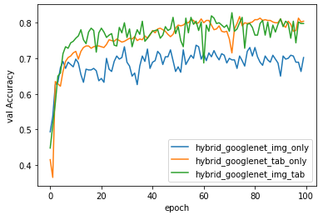
GoogleNet with vs without “biopsed” (one-hot encoding)
With
Without

Slide 14
GoogleNet with vs without “biopsed” (one-hot encoding)
“Biopsed” Column Included? | Accuracy (Image-only) after 100 epochs | Accuracy (Tab-only) after 100 epochs | Accuracy (Combined) after 100 epochs | Best Accuracy of Combined Model
Yes (with) | 0.7022 | 0.7717 | 0.8087 | 0.8261 at epoch #94
No (without) | 0.7022 | 0.8043 | 0.7978 | 0.8283 at epoch #71
Without “biopsed” column, validation score decreases slightly after 100 epochs of training, but the best score remains almost the same.

Slide 15
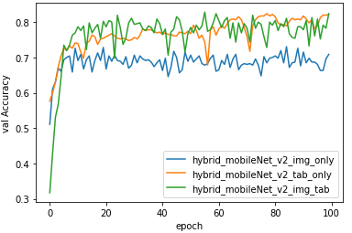
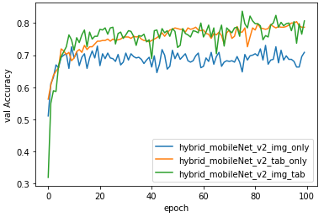
MoblieNet_V2 with vs without “biopsed” (one-hot encoding)
With
Without

Slide 16
MobileNet_V2 with vs without “biopsed” (one-hot encoding)
“Biopsed” Column Included? | Accuracy (Image-only) after 100 epochs | Accuracy (Tab-only) after 100 epochs | Accuracy (Combined) after 100 epochs | Best Accuracy of Combined Model
Yes (with) | 0.7087 | 0.8217 | 0.8239 | 0.8282 at epoch #55
No (without) | 0.7087 | 0.7870 | 0.8065 | 0.8370 at epoch #75
Without “biopsed” column, validation score decreases slightly after 100 epochs of training, but the best score remains almost the same or slightly higher.

Slide 17
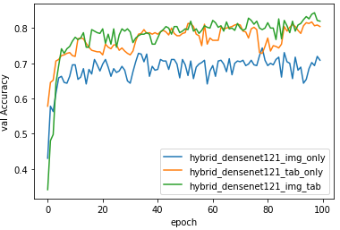
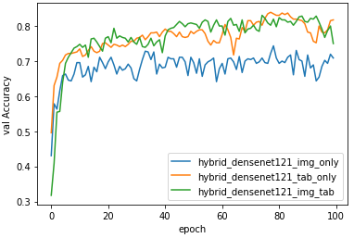
DenseNet121 with vs without “biopsed” (one-hot encoding)
With
Without

Slide 18
DenseNet121 with vs without “biopsed” (one-hot encoding)
“Biopsed” Column Included? | Accuracy (Image-only) after 100 epochs | Accuracy (Tab-only) after 100 epochs | Accuracy (Combined) after 100 epochs | Best Accuracy of Combined Model
Yes (with) | 0.7087 | 0.8043 | 0.8196 | 0.8435 at epoch #97
No (without) | 0.7087 | 0.8174 | 0.75 | 0.8304 at epoch #74
Without “biopsed” column, validation score decreases quite a few after 100 epochs of training, but the best score remains almost the same or slightly lower.

Slide 19
More Column Inferencing

Slide 20
Experimenting Tabular Column Inferencing by Training Image data in Deep Learning
Main purpose: there are some missing values in some tabular data columns, so using deep learning model trained by image data to predict missing values in those columns.
Main strategy: treat a particular tabular column as a class label, and then train images in deep learning model to predict the value of that column.

Slide 21
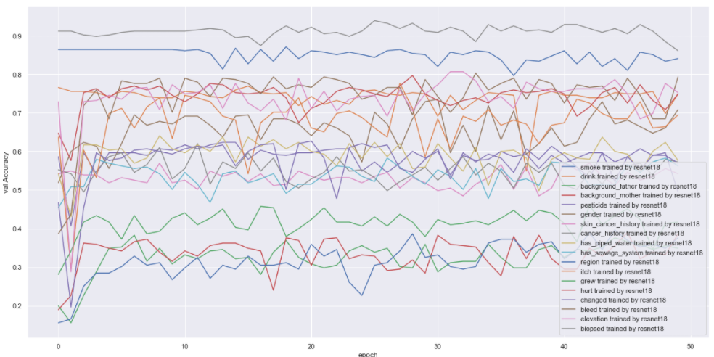
Experimenting Tabular Column Inferencing by Training Image data on Resnet18 Model

Slide 22
Experimenting Tabular Column Inferencing by Training Image data on Resnet18 Model
Column | Inferencing Validation Accuracy
smoke | 0.8406779661016949
drink | 0.7491525423728813
background_father | 0.34915254237288135
background_mother | 0.3864406779661017
pesticide | 0.49491525423728816
gender | 0.7084745762711865
skin_cancer_history | 0.5423728813559322
cancer_history | 0.5728813559322034
has_piped_water | 0.576271186440678

Slide 23
Experimenting Tabular Column Inferencing by Training Image data on Resnet18 Model
Column | Inferencing Validation Accuracy
has_sewage_system | 0.5627118644067797
region | 0.376271186440678
itch | 0.6949152542372882
grew | 0.41694915254237286
hurt | 0.7491525423728813
changed | 0.5694915254237288
bleed | 0.7932203389830509
elevation | 0.752542372881356
biopsed | 0.8610169491525423

Slide 24
TODO Tasks
Upsampling (takes more time to train)
Finalize the best epch number and encoding method and decide whether or not to include “biopsed” column to get the best models.
Refactoring and finalize notebooks.
Begin writing the report paper and building project homepage in Github.
Build Data Application (Streamlit)
Handle inconsistency found in the data (Unknown value and column name- Brasil)

Slide 25
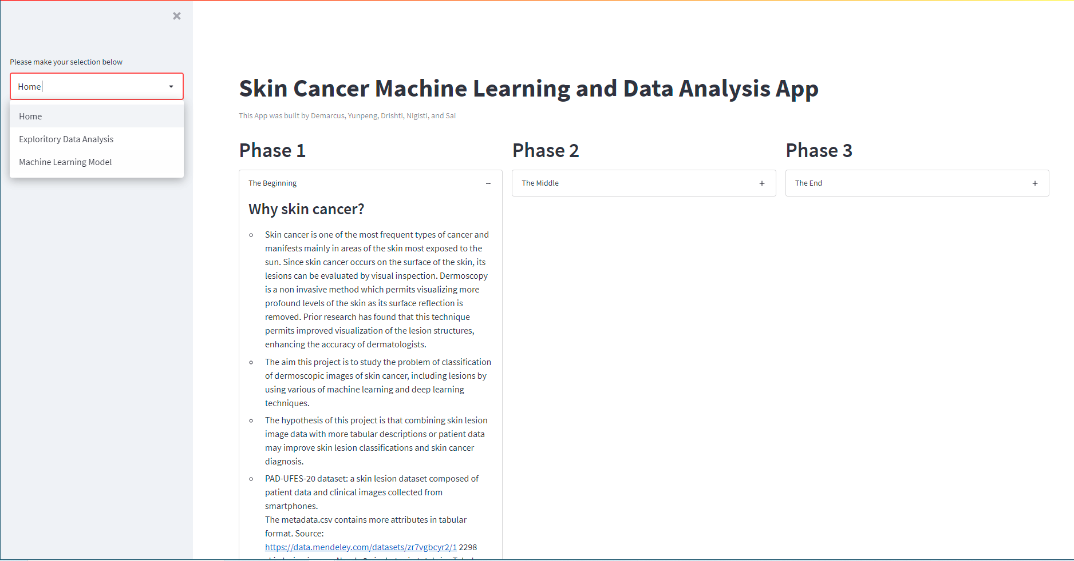
Data Application Progress

Slide 27
Updates up to 11/22/2021

Slide 28
Column Inferencing updates:
Removed rows containing both missing and “UNK” values

Slide 29
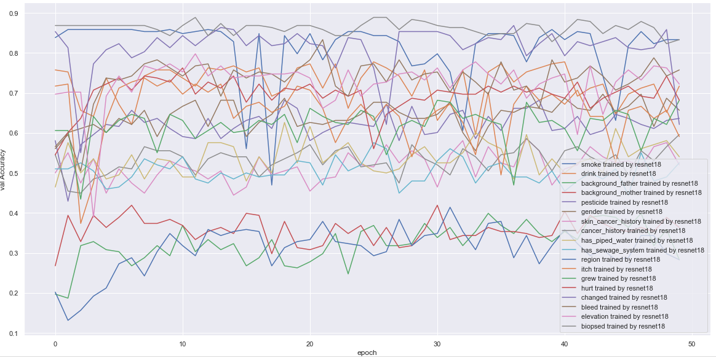
Experimenting Tabular Column Inferencing by Training Image data on Resnet18 Model

Slide 30
Experimenting Tabular Column Inferencing by Training Image data on Resnet18 Model
Column | Inferencing Validation Accuracy
smoke | 0.8333333333333334
drink | 0.7171717171717171
background_father | 0.2828282828282828
background_mother | 0.36363636363636365
pesticide | 0.6363636363636364
gender | 0.6565656565656566
skin_cancer_history | 0.5202020202020202
cancer_history | 0.5959595959595959
has_piped_water | 0.5404040404040404

Slide 31
Experimenting Tabular Column Inferencing by Training Image data on Resnet18 Model
Column | Inferencing Validation Accuracy
has_sewage_system | 0.5252525252525253
region | 0.2828282828282828
itch | 0.5909090909090909
grew | 0.6818181818181818
hurt | 0.6818181818181818
changed | 0.6212121212121212
bleed | 0.7575757575757576
elevation | 0.7222222222222222
biopsed | 0.8333333333333334

Slide 32
Best accuracy score of models after upsampling and treating “UNK” values as missing values
Models | Image Only | Tabular Only | Img-Tab Combined
ResNet18 | 0.7369565217391304 | 0.808695652173913 | 0.841304347826087
GoogleNet | 0.7304347826086957 | 0.8130434782608695 | 0.8239130434782609
DenseNet121 | 0.7282608695652174 | 0.8043478260869565 | 0.8456521739130435
MobileNet_V2 | 0.7304347826086957 | 0.8065217391304348 | 0.8282608695652174

Slide 34
Progress Updates upto 11/28/2021
Refactored code in Jupyter Notebooks.
Restructured and reorganized folders in Github.
Added more code for loading saved best models to do predictions.
Start drafting final paper.

Slide 36
Github Repository
https://github.com/yunpengliDataScience/Skin_Cancer_ML_DL

