Slide 1
STATIC HTTP-SERVER
Marculescu Tudor, ADVANCED COMPUTING IN EMBEDDED SYS
OPERATING SYSTEMS PROJECT

Slide 2
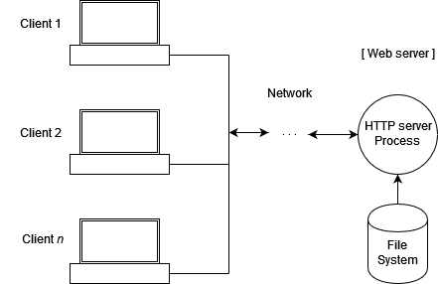
What is this project about?
A C application that runs on Linux
Serves a webpage to the user
Accessible via any port
Uses Sockets and Linux Api functions

Slide 3

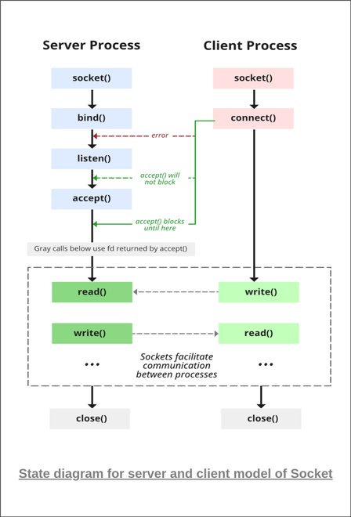

What is a socket?
A way of receiving data between processes on the same machine or diff machines
Can use TCP or UDP
Defined in socket.h header in UNIX-like systems

Slide 4
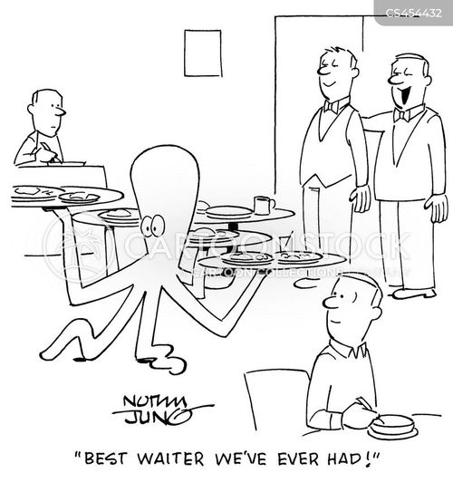
How does the server work?
A socket is opened
Socket is bound to a port like: 8080 or 80
Listens for incoming connections
Accept the clients and serve them what they want, as long as it is on the menu, of course

Slide 5
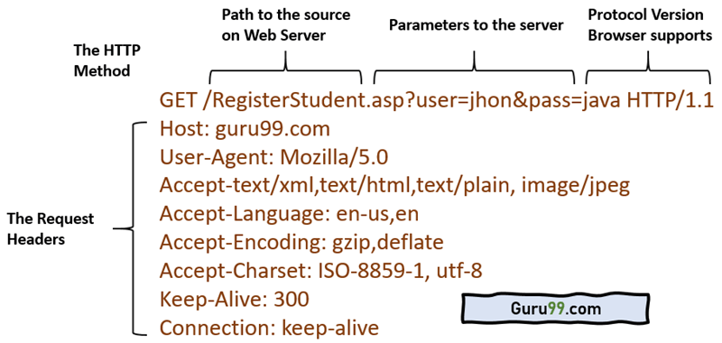
How does it serve exactly?
GET is used by the client to request a certain file
If it is empty, then it reply with index.html
Use send() to transmit the data via the socket
Free the memory – dynamic allocation

Slide 6

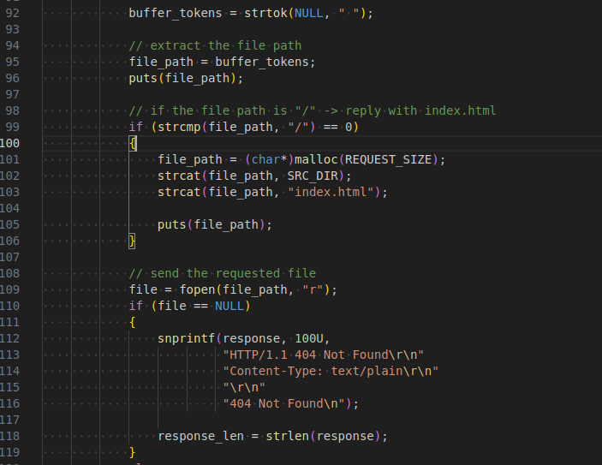
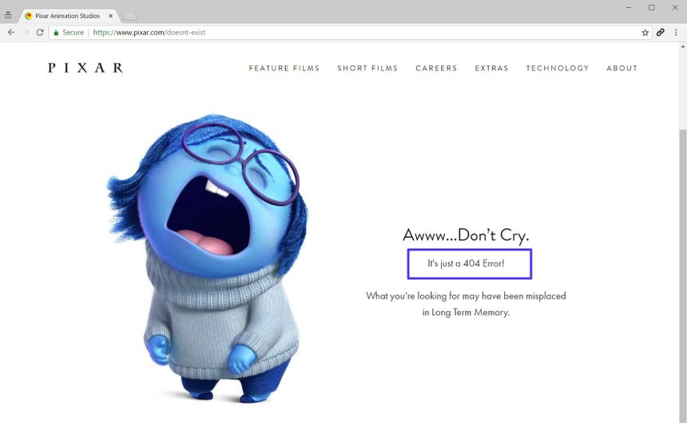
So what is "on the menu" ?
Each HTML GET must req a file from "src/"
Otherwise, it will be rejected with 404

Slide 7

DEMO run of the HTTP-Webserver
Present the build system
Present the source and headers
Present the main function
Build the proj & run it
Open firefox and show the index.html file

Slide 8
Points to improve
Add more HTTP methods (POST, DELETE etc.)
Add HTTPS functionality
Include more MIME types

Slide 9
Thank you

