Slide 1
STATIC HTTP-SERVER
Marculescu Tudor, ADVANCED COMPUTING IN EMBEDDED SYS
OPERATING SYSTEMS PROJECT

Slide 2
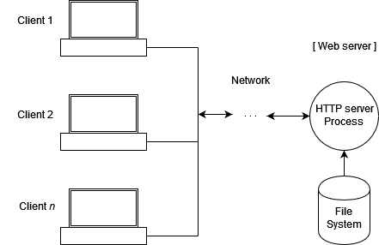
What is this project about?
A C application that runs on Linux
Serves a webpage to the user
Accessible via port 8080
Uses sockets and Linux Api functions

Slide 3
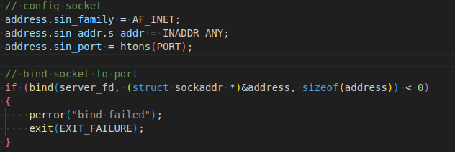
How does it work?
A socket is opened
Socket is bound to a port 8080
Listens for incoming connections

Slide 4
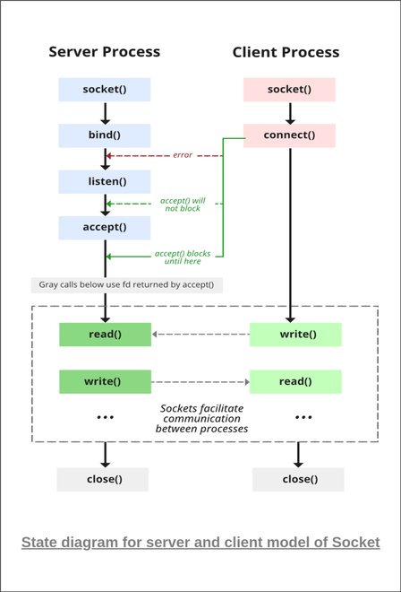
Loop continuously
Continiously loop to accept clients up to maximum 10
Create a new thread for each client
Thread start at handle_client()

Slide 5
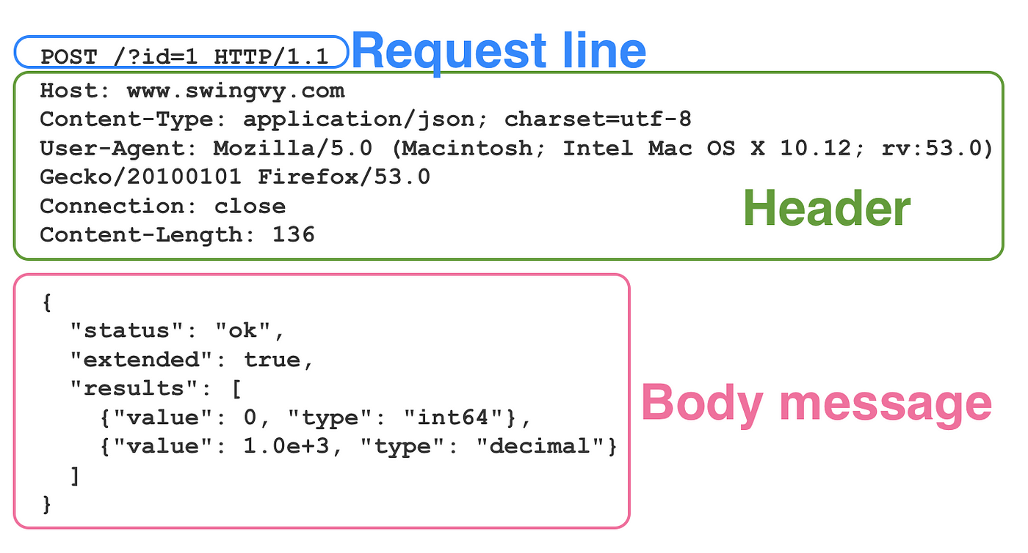
HTTP Method GET
GET is used to request data from a specified resource
If it is empty, then it reply with index.html
Use send() to transmit the data via the socket
Free the memory

Slide 6

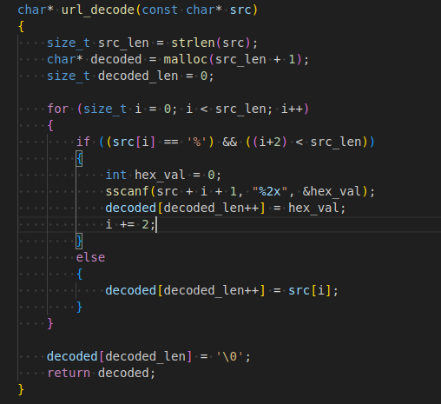
Request must match file structure
Each HTML GET must req a file from src
Otherwise, it will be rejected with 404
Data type is encoded via MIME

Slide 7
Points to improve
Add more HTTP methods (POST, DELETE etc.)
Add HTTPS functionality
Include more MIME types

Slide 8
Thank you

