Slide 1
ResoLogix
North LP3D - Beda M59
10 June 2026

Slide 2
RESOURCE EVALUATION RESULTS
PROB | Area | h | Phi | Sw | Boi/Bgi | Pri RE | Sec RE | In-Place | Pri Yield | Sec Yield | Total BOE
P90 | 325.37 | 18.93 | 0.17 | 0.43 | 1.35 | 0.28 | 0.20 | 4160413.91 | 1243794.77 | 43866905.60 | 1.25
P50 | 435.80 | 26.54 | 0.18 | 0.45 | 1.35 | 0.30 | 0.28 | 6543401.11 | 1962967.11 | 78053828.46 | 1.98
MEAN | 448.04 | 27.36 | 0.18 | 0.45 | 1.35 | 0.30 | 0.29 | 6986988.17 | 2094703.06 | 86130462.81 | 2.11
P10 | 586.12 | 36.93 | 0.19 | 0.47 | 1.35 | 0.32 | 0.40 | 10379432.31 | 3112388.97 | 139093368.64 | 3.13

Slide 3
GEOLOGICAL RISK
RISK FACTOR | PROB
Source | 1.00
Timing / Migration | 1.00
Reservoir Quality | 0.80
Closures | 0.70
Containment / Seal | 0.80
Chance of Success (Pg) | 44.8%

Slide 4
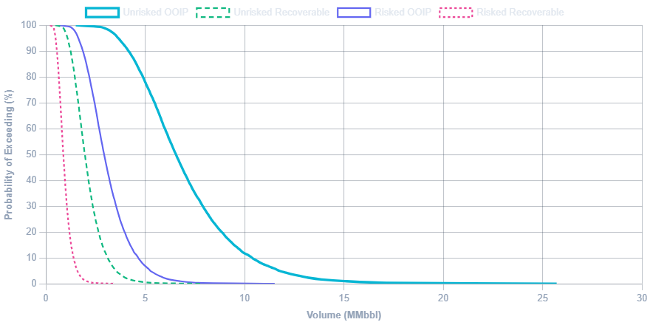
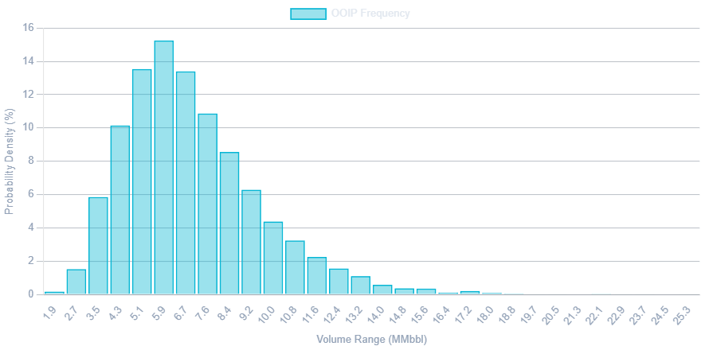
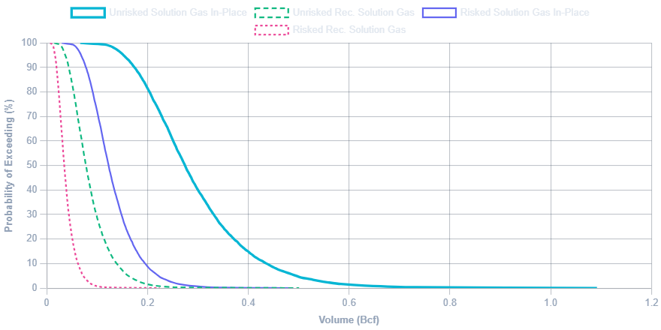
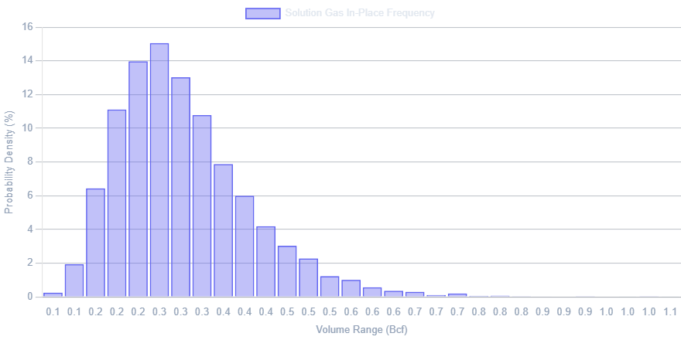
PROBABILITY DISTRIBUTIONS

