Slide 1
ResoLogix
North LP3D - Beda M59
10 June 2026

Slide 2
RESOURCE EVALUATION RESULTS
PROB | Area | h | Phi | Sw | Boi/Bgi | Pri RE | Sec RE | In-Place | Pri Yield | Sec Yield | Total BOE
P90 | 321.24 | 18.91 | 0.17 | 0.43 | 1.35 | 0.28 | 0.20 | 4154969.75 | 1243939.88 | 44467895.29 | 1.25
P50 | 438.69 | 26.42 | 0.18 | 0.45 | 1.35 | 0.30 | 0.28 | 6581607.60 | 1970398.94 | 77682771.87 | 1.98
MEAN | 449.51 | 27.35 | 0.18 | 0.45 | 1.35 | 0.30 | 0.29 | 7001320.80 | 2096648.84 | 85812317.75 | 2.11
P10 | 588.77 | 37.01 | 0.19 | 0.47 | 1.35 | 0.32 | 0.40 | 10406110.94 | 3120126.16 | 137432286.07 | 3.14

Slide 3
GEOLOGICAL RISK
RISK FACTOR | PROB
Source | 1.00
Timing / Migration | 1.00
Reservoir Quality | 0.80
Closures | 0.70
Containment / Seal | 0.80
Chance of Success (Pg) | 44.8%

Slide 4
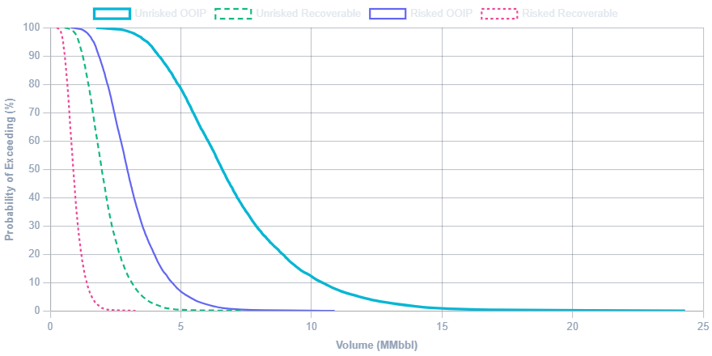
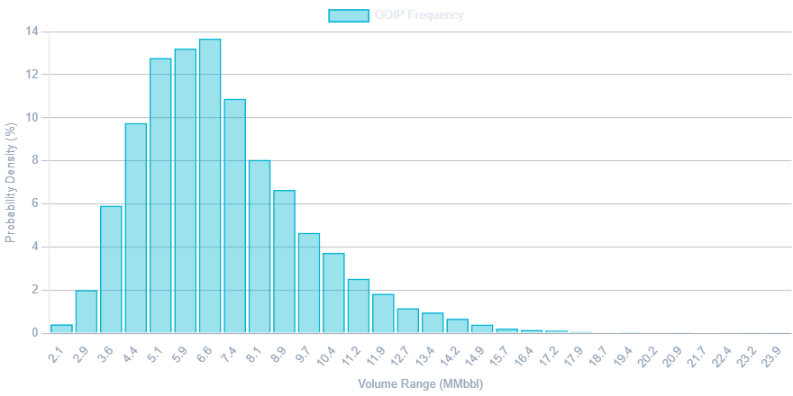
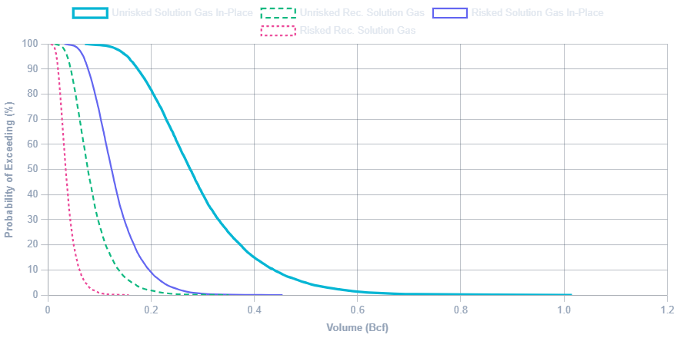
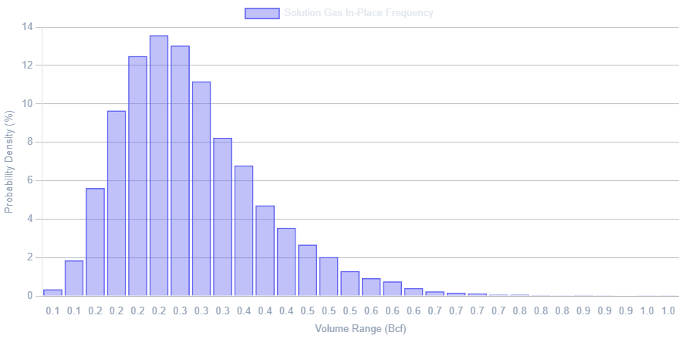
PROBABILITY DISTRIBUTIONS

