Slide 1
ResoLogix
North LP3D - Beda M59
10 June 2026

Slide 2
RESOURCE EVALUATION RESULTS
PROB | Area | h | Phi | Sw | Boi/Bgi | Pri RE | Sec RE | In-Place | Pri Yield | Sec Yield | Total BOE
P90 | 325.77 | 18.96 | 0.17 | 0.43 | 1.35 | 0.28 | 0.20 | 4198953.02 | 1250739.04 | 44354104.33 | 1.26
P50 | 436.60 | 26.56 | 0.18 | 0.45 | 1.35 | 0.30 | 0.28 | 6608117.05 | 1979708.71 | 78118061.02 | 1.99
MEAN | 450.04 | 27.40 | 0.18 | 0.45 | 1.35 | 0.30 | 0.29 | 7022277.16 | 2105455.60 | 86403317.47 | 2.12
P10 | 590.90 | 36.93 | 0.19 | 0.47 | 1.35 | 0.32 | 0.40 | 10400898.72 | 3125320.19 | 138361266.52 | 3.14

Slide 3
GEOLOGICAL RISK
RISK FACTOR | PROB
Source | 1.00
Timing / Migration | 1.00
Reservoir Quality | 0.80
Closures | 0.70
Containment / Seal | 0.80
Chance of Success (Pg) | 44.8%

Slide 4
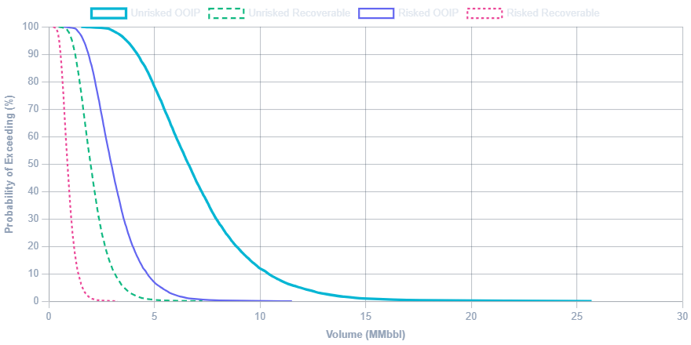
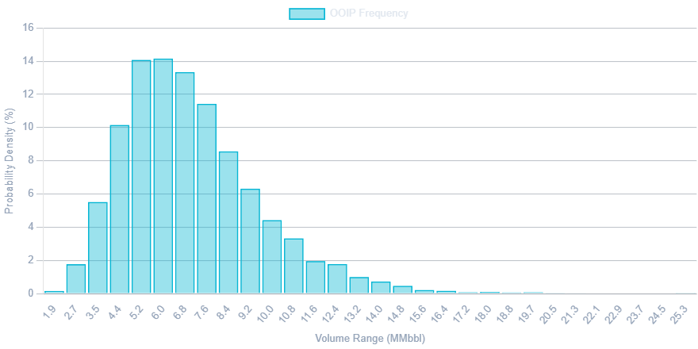
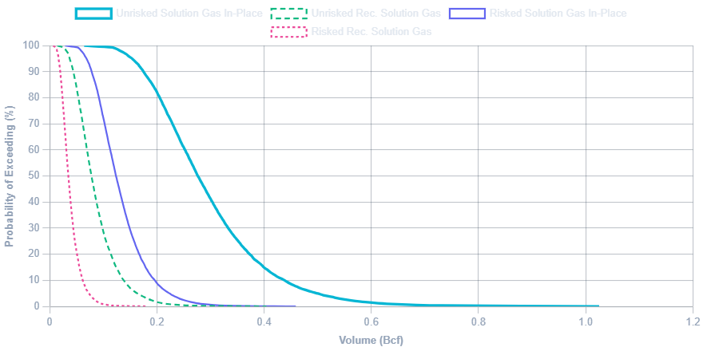
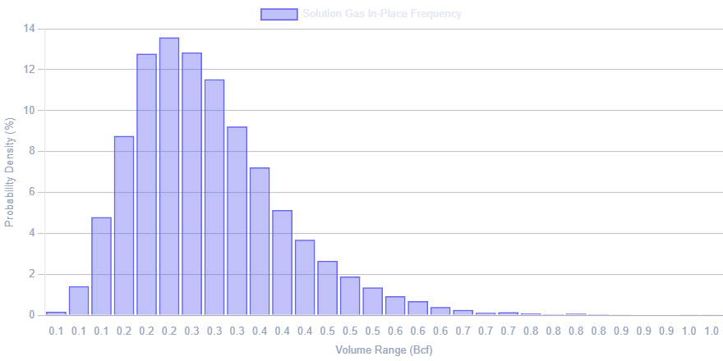
PROBABILITY DISTRIBUTIONS

