Slide 1

QM/MM reaction modelling in enzymes
Marc W. van der Kamp
@marcvanderkamp
vanderkampgroup.wordpress.com
MSc Biophys workshop, Bristol, 9 Nov 2017

Slide 2
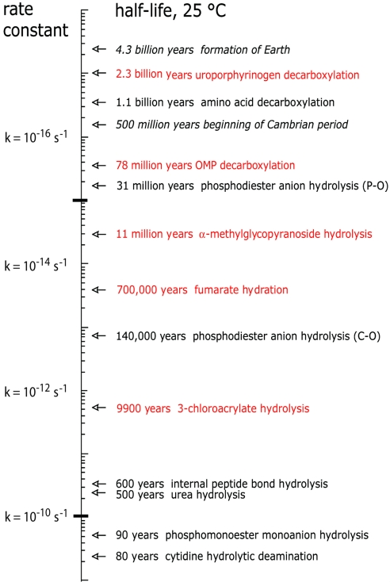
Enzymes are highly efficient and specific catalysts
Rate acceleration of 10¹⁰ is typical, e.g. protease hydrolysis of peptide bonds
k_{cat}/k_{uncat} can reach 10¹⁶ e.g. uroporphyrinogen III decarboxylase
Lewis & Wolfenden PNAS 105, 17328 (2008)

Slide 3

Enzymes lower the activation energy for reaction

Slide 4
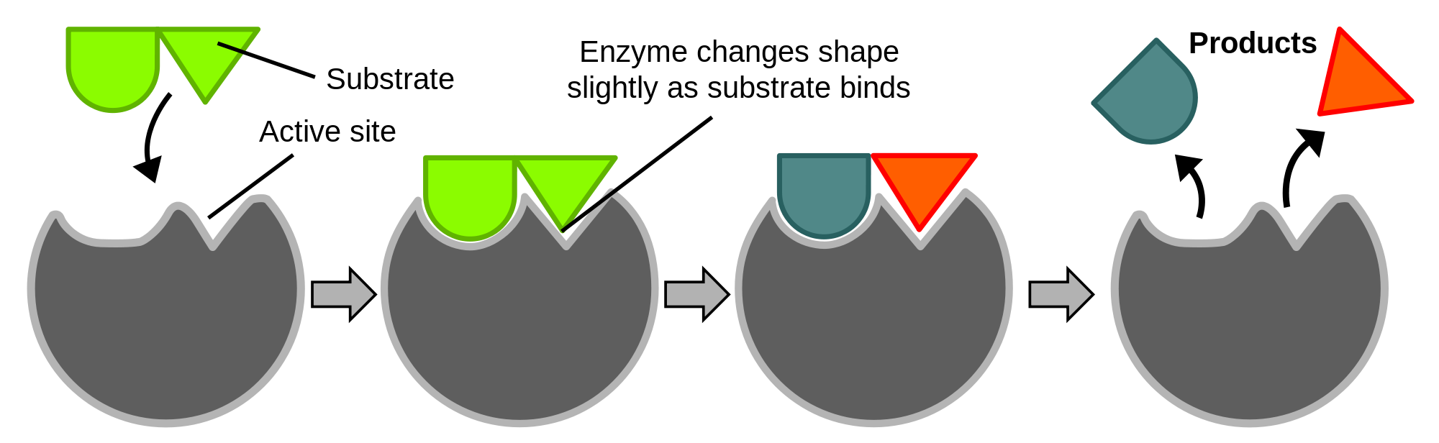
Enzyme catalytic cycles
Michaelis complex is formed (induced fit)
Chemical conversion
Difficult to dissect experimentally: use computer simulation
To simulate chemical change, we need to go beyond molecular mechanics
Notes:
So, first a picture (shamelessly copied from wikipedia) to illustrate a simple enzyme catalytic cycle.
Apart from catalyzing a chemical reaction, an enzyme (or indeed most catalysts) needs to bind its reactants and release its products. Going through this catalytic cycle often requires conformational change – sometimes large, sometimes small. To really understand what makes enzymes such good catalysts requires detailed understanding of all the processes, but this is often difficult to do using just experiments.

Slide 5
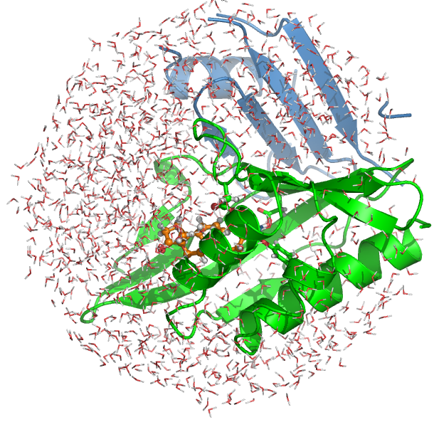
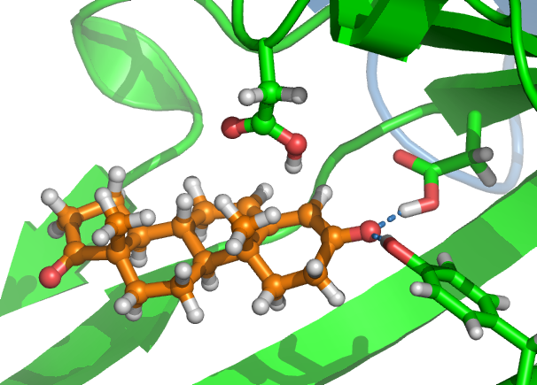
QM/MM enzyme reaction modelling
Use quantum mechanics (QM) only for region where bonding changes, and molecular mechanics (MM) for the surroundings
MM
QM
2013 Nobel prize in Chemistry (Karplus, Levitt, Warshel)
QM/MM for enzymes: Van der Kamp, Mulholland (2013) Biochem 52: 2708
Notes:
In this case, we first modelled the chemical reaction, and did so using the QM/MM approach, which essentially means that a small part of the system (where bond making/breaking takes place) is modelled QM, and the rest is modelled with the much less computationally expensive MM type modelling I discussed before.
To force the reaction to happen, we change a proton transfer ‘reaction coordinate’ which is designed to push the proton from one to the other.

Slide 6
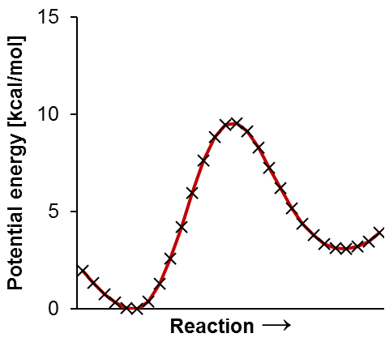
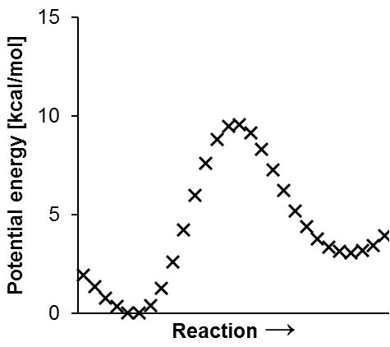
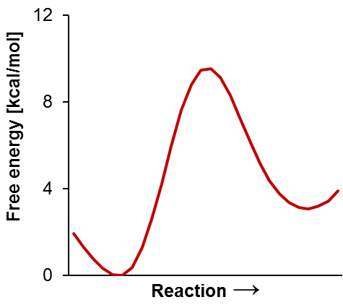
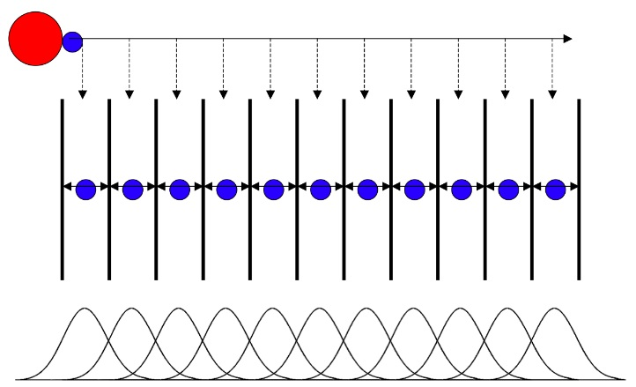
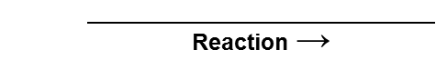
QM/MM reaction modelling
To overcome activation energy, need to ‘force’ a reaction happening: apply ‘bias’ along a ‘reaction coordinate’
Potential Energy Surface
QM/MM minimization
Free Energy Surface
QM/MM MD + statistics
Use enhanced sampling
e.g. ‘umbrella sampling’
‘adiabatic mapping’
Notes:
In this case, we first modelled the chemical reaction, and did so using the QM/MM approach, which essentially means that a small part of the system (where bond making/breaking takes place) is modelled QM, and the rest is modelled with the much less computationally expensive MM type modelling I discussed before.
To force the reaction to happen, we change a proton transfer ‘reaction coordinate’ which is designed to push the proton from one to the other.

Slide 7
Analysing enzyme-catalysed reactions
With QM/MM reaction modelling we can:
Determine mechanism of reaction
Identify intermediates, catalytic residues, transition states
Analyse contributions to catalysis, e.g. hydrogen bonds, electrostatic effects
Conformational effects and dynamics
Atomic level description of reaction (‘movie’)
Relate enzyme structure to activity

Slide 8
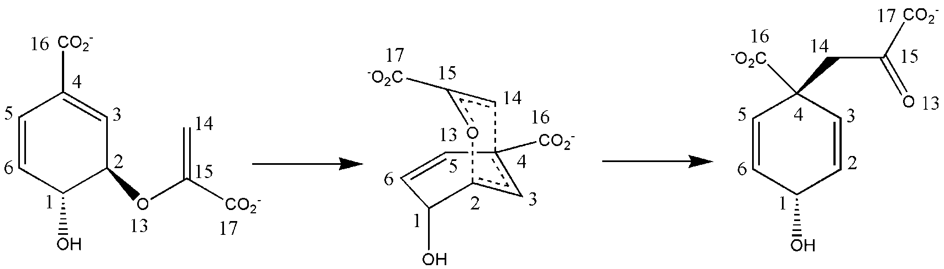
Chorismate mutase (CM)
Shikimate pathway (aromatic amino acid synthesis)
Claisen rearrangement reaction
Same mechanism in enzyme, solution and catalytic antibody: no covalent catalysis
Debates: Why is the reaction so much faster in the enzyme?
chorismate
Transition state (TS)
prephanate

Slide 9
CM: multiple potential energy pathways
Enzymes ‘wiggle’: multiple enzyme-substrate conformations exist
Best to consider multiple conformations for calculating potential energy surfaces (by ‘adiabatic mapping’)
Each person will:
Pick a different enzyme-’TS’ structure
Perform adiabatic mapping to calculate an energy profile for the reaction, incl. activation energy or barrier to reaction (substrate-TS energy difference)
Calculate stabilization by the enzyme (compare vs. vacuum)
Compare to other enzyme-TS structures

Slide 10
CM Reaction modelling
Files needed: https://github.com/marcvanderkamp/qmmm_practical_short/
To force the reaction, we will use a ‘reaction coordinate’: difference in distances of the bond formed and the bond broken
chorismate
reaction coordinate R:
d(C2-O13) − d(C4-C14)
prephanate
First, we go from TS (R=−0.3) to the reactant chorismate (R=−1.8)
Then, we go from TS to the product (R=1.8)

Slide 11
Chorismate mutase (CM)
Instructions: https://github.com/marcvanderkamp/qmmm_practical_short/
Scroll down and click the link indicated
Go directly to Part 1, procedure
Download of zip file (qmmm.zip) to: MyFiles (O:)
Once you have a starting structure (crd & pdb) downloaded, go to exercise 1 before visualising the structure in VMD
In case the short-cut to MSYS doesn’t work, start it through Run…
C:/msys/1.0/msys.bat (and click ‘OK’)

Slide 12
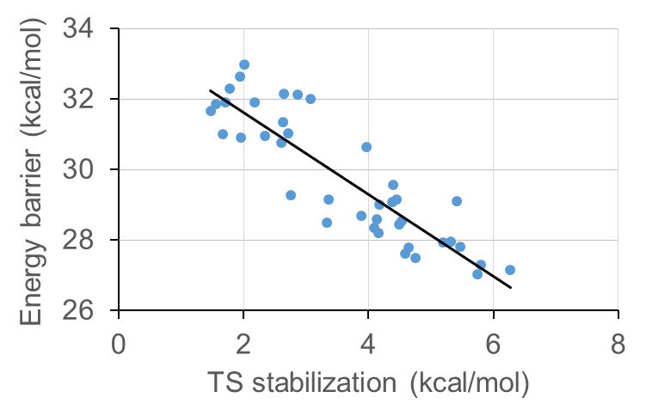
Transition state stabilisation – AM1
R² ≈ 0.8
“Correlation of barrier height with TS stabilization shows that the efficiency of reaction in the enzyme is determined by the degree of TS stabilization in the enzyme”¹
¹F. Claeyssens, K.E. Ranaghan, F.R. Manby, J.N. Harvey & A.J. Mulholland, Chem. Commun. 5068-5070 (2005)

