Slide 1
IBM Data Science Capstone
Predicting the severity of car crash
By Marc Vloeberghs on 06 September 2020

Slide 2
Objective of this Capstone
We will have to proof that we have been able to assimilate the different courses composing this IBM Certificate.
Our mission consist to develop a ML model which will allow us to predict the severity of car accident and this based on data of earlier accidents.
The data we will be using is sample of the data available for the Seattle area.

Slide 3
Elements of our reporting
The methodology we will be applying to approach this mission.
Determining the groups who would benefit of such model.
Description of the data available.
The various steps needed to make our data usable for our ML models.
The results of our modeling.
Our comments.
Our conclusions.

Slide 4
Means of reporting required
Workout in Notebook with Python.
A report in text form whenever possible with visualization tools.
A worked-out presentation.

Slide 5
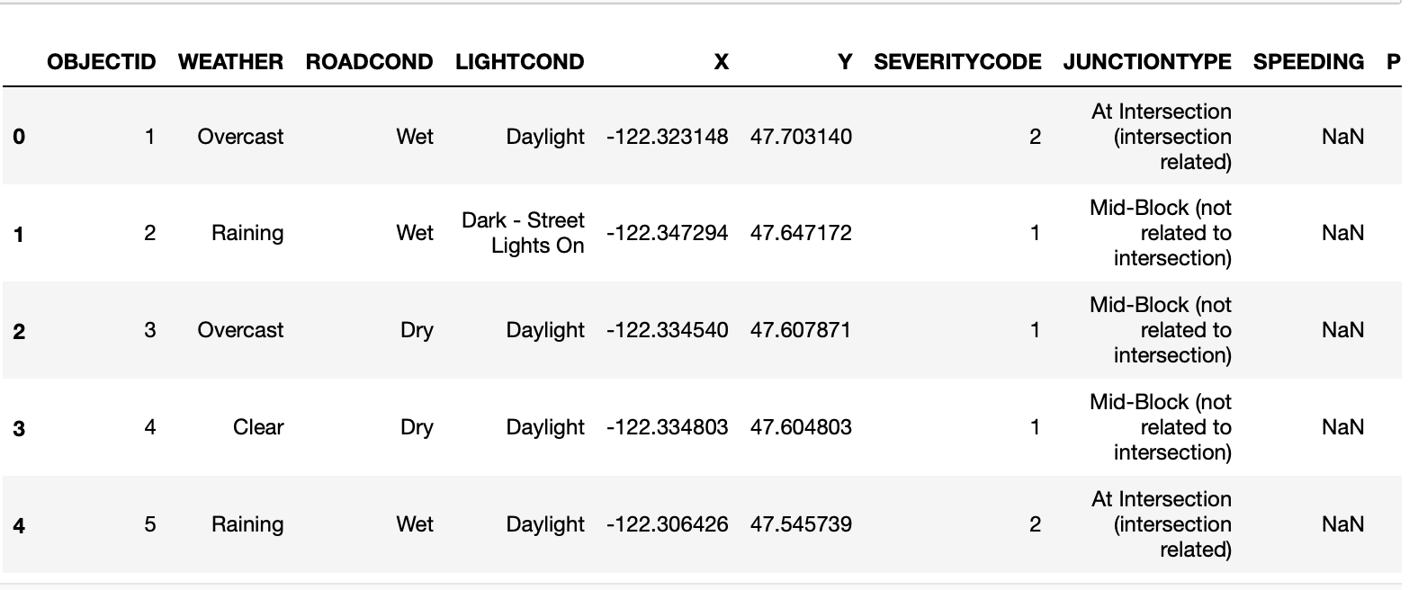
A look at our DataFrame data—collisions.csv
Here the features with we will be working.
As you noticed there are missing data fields
Which we will have to clean up.

Slide 6
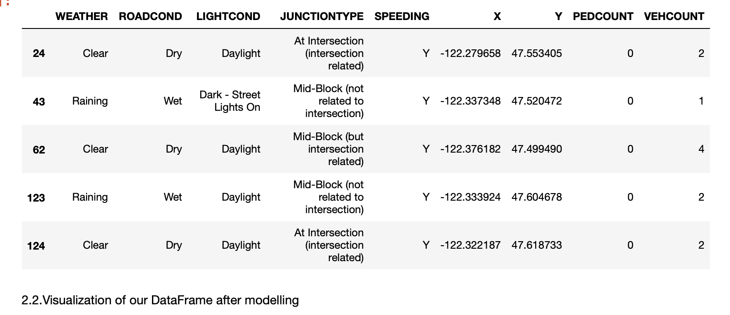
DataFrame after modelling
The missing fields are all removed
The next step will be the standardization.
For the missing data we will be using the policy of the ‘means.

Slide 7
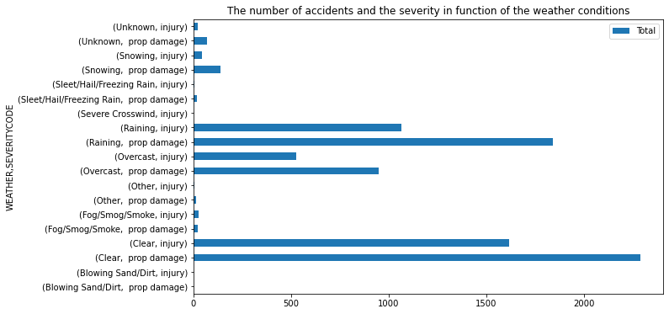
Graphical Visualization of the main Features- weather.
WEATHER
Three elements are predominant here, clear weather, rain and over casted sky.

Slide 8
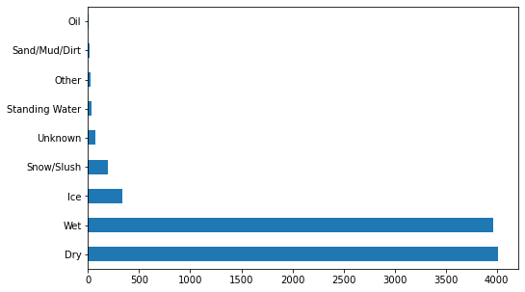
Graphical Visualization of the main Features-Road Conditions
Two elements are predominant being wet and dry road conditions.

Slide 9
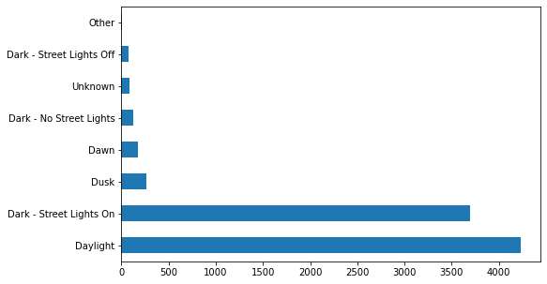
Graphical Visualization of the main Features-Light Conditions.
Two elements are predominant Daylight and Dark- Street lights

Slide 10
Graphical Visualization of the severity of the accidents based on the weather conditions
Injuries occurred in 1/3 of the cases this by rain and over casted sky and 40% for by clear weather.

Slide 11
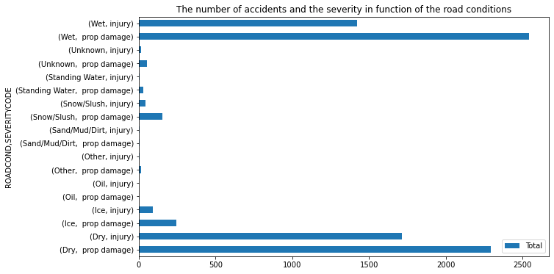
Graphical Visualization of the severity of the accidents based on the road conditions.
For wet road conditions 1/3 of the accidents are injuries for dry road conditions this part is 40%.

Slide 12
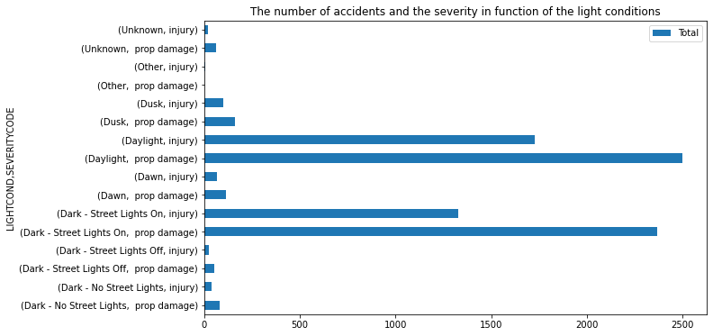
Graphical Visualization of the severity of the accidents based on the light conditions
The injuries occurred 1/3 of the cases with dark light conditions and for 40% by daylight conditions.

Slide 13
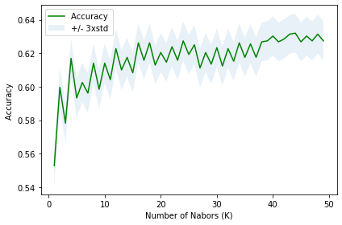
Determination of the k-value for K-Neighbors.
The best performance will be a k-value of 44 for 50 k-iterations after which the curb seems to flatten out, maw no significant precision will be obtained by increasing the number of k-iterations.

Slide 14
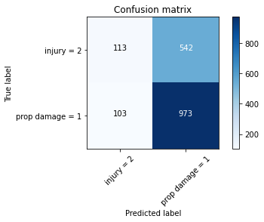
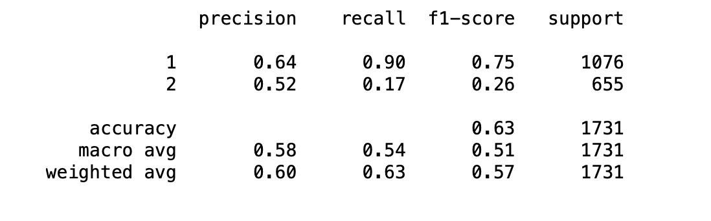
Evaluation of our K-Neighbor model.

Slide 15
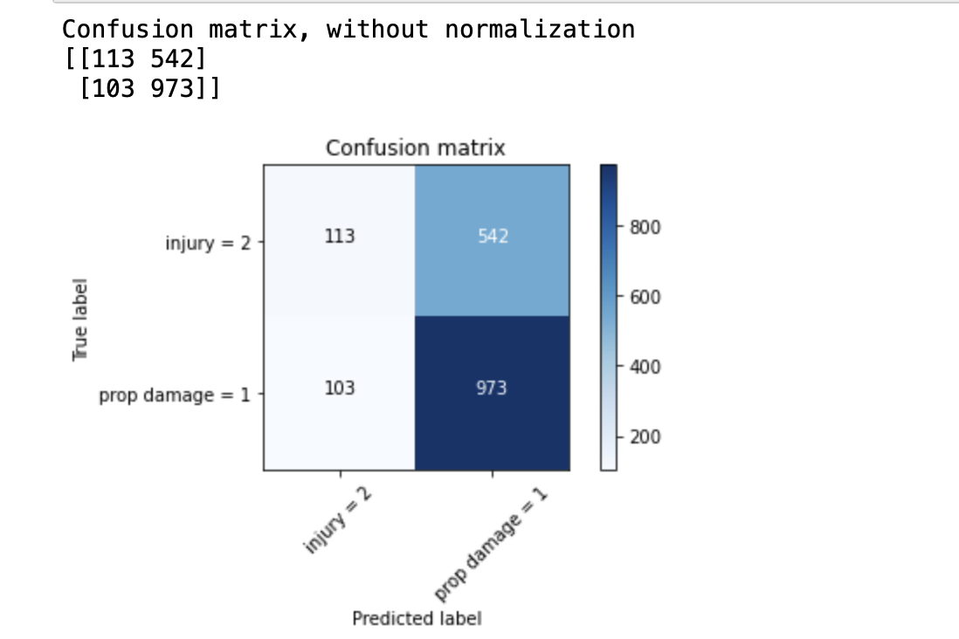

Evaluation of our Decision Tree model.

Slide 16
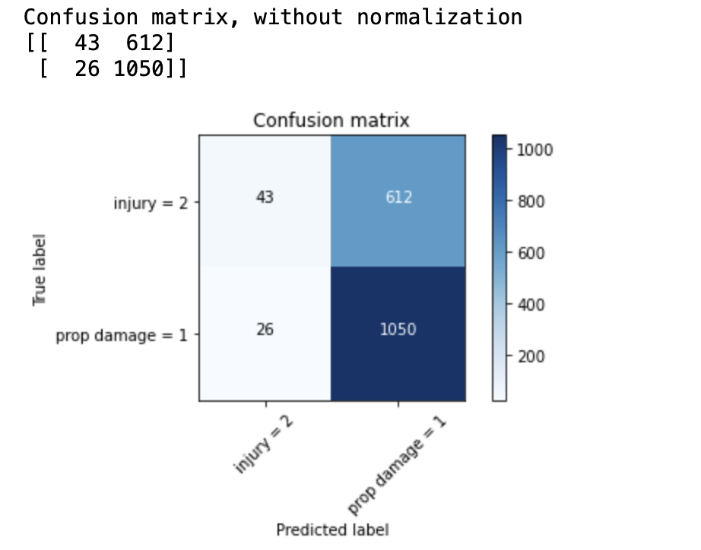
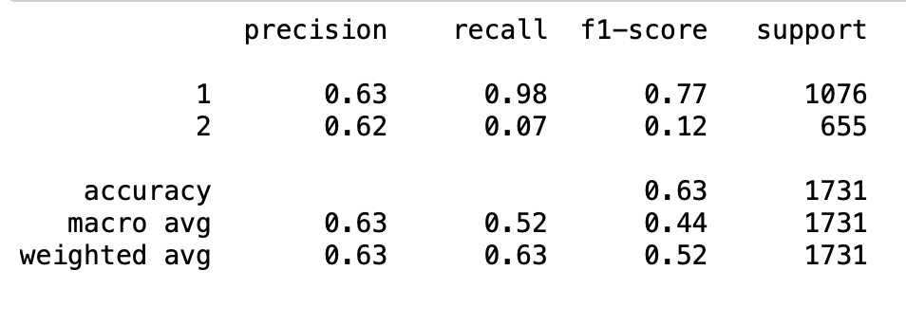
Evaluation of our Logistic Regression model with solver='liblinear’.

Slide 17
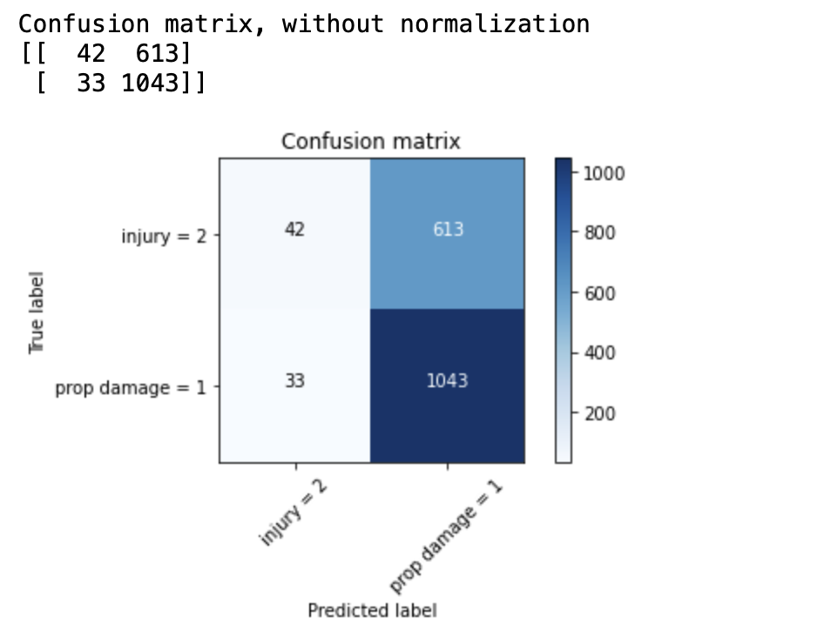
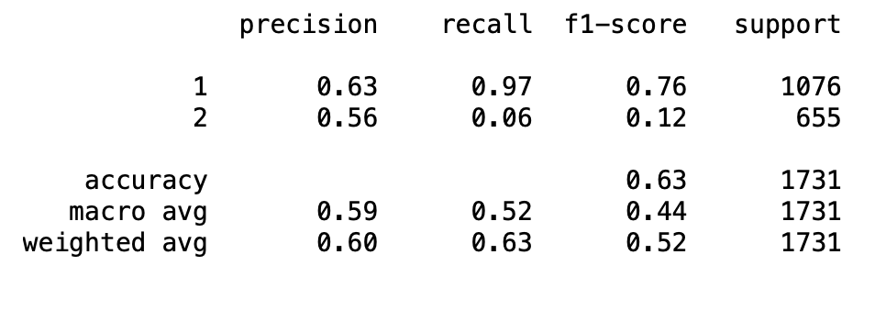
Evaluation of our Support Vector Machine model with kernel = ‘rbf’.

Slide 18
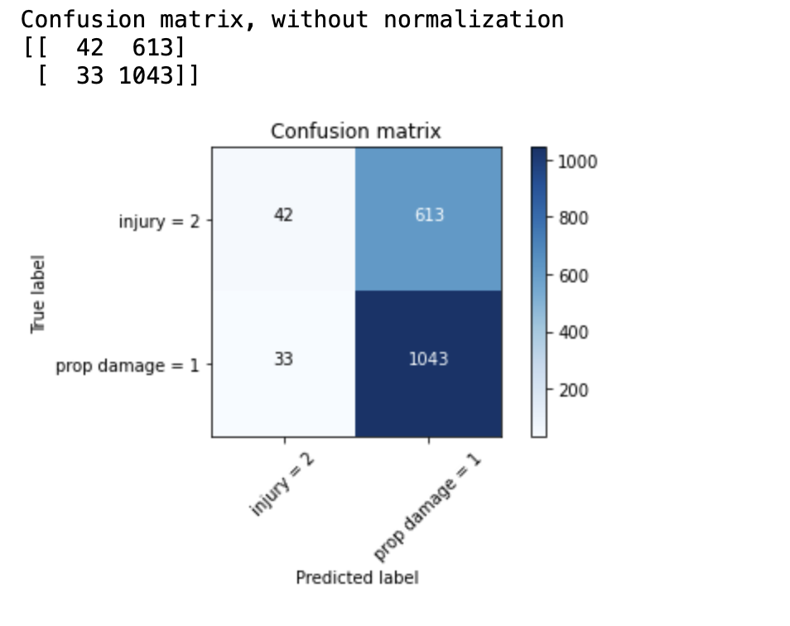
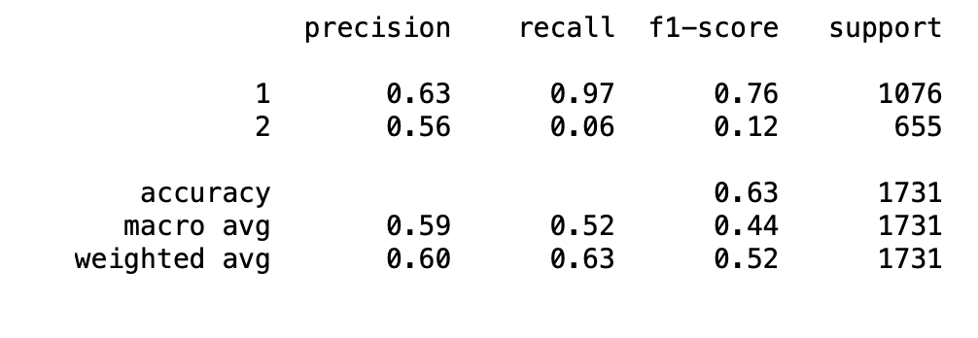
Evaluation of our Support Vector Machine model with kernel = ‘linear’.

Slide 19
Comments
Deploring results concerning our models with predictability scores hoover 50% wouldn’t be better to spent more tome on it and to toss a coin in the future.
We observed that by modelling our data frame we lost 96% of our data which can have a significant impact on our models.
Whatever the causes reporting should de done with more rigor or a better followed up to avoid data going missing.
We will have to go back to our ML models once new data, or the missing data is populated.

Slide 20
Conclusion
We will have to go back to our ML models once we have more or better data!
If this doesn’t resolve the outcome of our ML models, the question will be is
the way we report these accidents adequate for our study?
Are we reporting what we should and in the correct form?

