Slide 1



Methodological Feedback
Counting South Sudan's cropland
Group [1]
Tutor: [Francisco]
Notes:
Goal of the session: confirm the research objective, the method and the story. We end with four questions for feedback.

Slide 2
The problem: a trigger that needs a cropland map
Flood map
Cropland map
Flooded cropland
AA trigger
×
NASA MODIS masks
ASAP, WorldCover, …
hectares per county
flood “inundating cropland”
the weak link
35×
0 ha
“…might not capture agricultural land”
less flooded cropland than the FAO/WFP estimate
flooded cropland ever detected in Bor South
ZOA about the course cropland data
South Sudan 2022: flood masks × ASAP ≈ 3,700 ha; CFSAM reports 130,000 ha damaged
every season checked, in an area ZOA names as flood-prone
Stakeholder Q&A 2, slide 33
Notes:
ZOA's example trigger is a flood 'inundating cropland' (Q&A 2, slides 31 and 40). The number behind it comes from laying a flood map over a cropland map (Pacetti et al. 2017; WFP ADAM does the same). If the cropland map misses the fields, the trigger stays silent. Numbers: flood masks x ASAP, Jun-Nov 2022, national (~3,700 ha) vs CFSAM 2022 (130,000 ha of cultivated land damaged). CFSAM is itself modelled, so 35x shows the size of the gap, not the true loss. Bor South: 0 ha in every season.

Slide 3
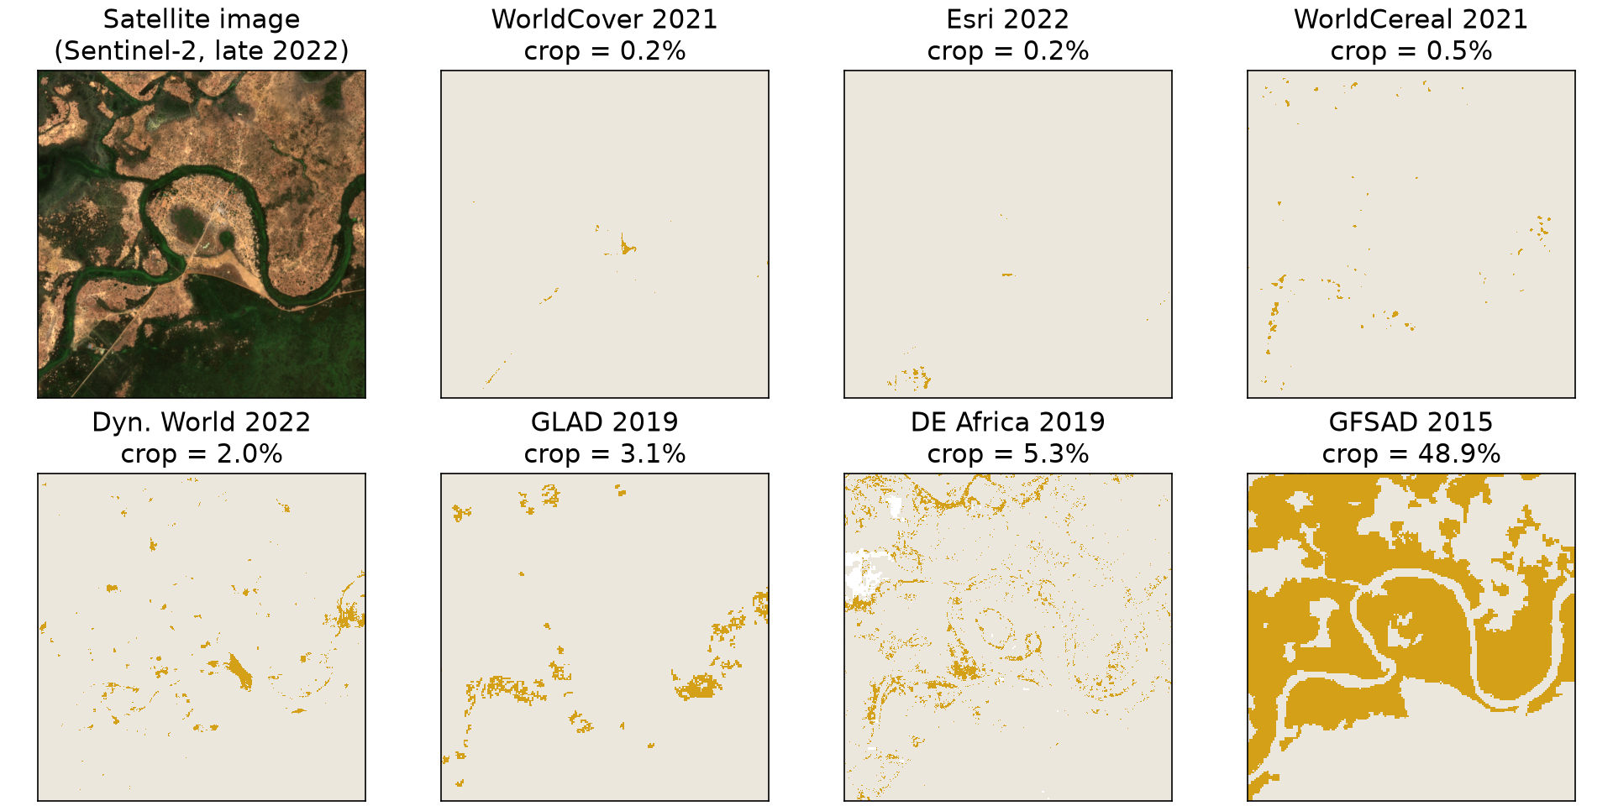
The story: seven maps, seven answers
0.2%
to
48.9%
crop in the same window
By eye, only GFSAD covers the cleared land, and it is the oldest map (2015).
Not measured yet: that is what our labelled points are for.
Same 6 × 6 km window near Turalei (Twic county), outside our study counties so the labelling stays blind. Gold = map says crop.
Notes:
Seven maps, seven answers for one place: from 0.2% (WorldCover 2021, Esri 2022) to 48.9% (GFSAD 2015). Looking at the Sentinel-2 image, GFSAD is the only map that covers the cleared land along the river, but that is our eye, not a measurement; GFSAD also paints whole blocks at 30 m and may include grass and fallow. The window is deliberately outside Aweil and Bor South so labellers never see the maps in the study area. Script: processing_data/cropland/demo_map_panels.py.

Slide 4
The story: the maps barely agree, and they are old
1 ha
where the four newest maps (2021–22) all agree on crop, out of 3 million ha. Best overlap of any two maps: ≤ 25%.
5×
more crop in the FAO/WFP CFSAM 2022 report than in the typical map. CFSAM is modelled from household statistics, not mapped.
2015–22
map years. GFSAD, DE Africa and GLAD are 2019 or older; ASAP merges older maps. The newest three find the least crop.
Crop share from 10 m pixels over the counties' area. CFSAM = 2022 main-harvest cereal area, a modelled estimate (context, not a reference). Agreement between maps is not accuracy.
Notes:
Data: data/cropland/agreement/ (county_crop_share.csv, pairwise_agreement.csv, strata_n_maps.csv) and county_cropland_areas.csv. Four newest maps = WorldCereal 2021, WorldCover 2021, Esri 2022, Dynamic World Jun-Nov 2022. Best pairwise crop overlap (Jaccard) 25% (WorldCereal vs WorldCover, one county); kappa at most 0.39. If one map saying crop is enough, Aweil has ~47,000 ha; if any of seven counts, ~140,000 ha. Map years: GLAD '2019' covers 2016-19; ASAP uses GlobCover in most of Africa (Kerner et al. 2024). The newest three (Dynamic World, WorldCover, Esri) all give 0.4% or less.

Slide 5
Prior work: how Kerner et al. (2024) audited 11 maps
1
Random sample
Mali: 2.2% of the points are crop
Random points per country. In Mali, where crop is rare, stratified by greenness (NDVI) to get enough crop points: 447 points, only 10 were labelled as crop by reviewers.
Map | Accuracy | F1
Esri | 0.97 | 0.00
DE Africa | 0.96 | 0.46
WorldCover | 0.95 | 0.43
GLAD | 0.96 | 0.33
ASAP | 0.95 | 0.21
GFSAD | 0.91 | 0.15
Mean of 11 maps | 0.92 | 0.21
2
Label by eye, blind to all maps
Monthly 3 m PlanetScope images, Sentinel-2 and Google Earth across the season. Crop = sowing, growth or harvest visible in the greenness time series. ≥ 2 labellers per point.
3
Score every map on the same points
Accuracy, precision, recall and F1 with standard errors. 11 maps, 8 countries, no South Sudan.
Accuracy misleads when crop is rare: Esri scores 0.97 and finds no crop at all. Aweil is like Mali, so we report precision, recall and F1.
Kerner et al. (2024), How accurate are existing land cover maps for agriculture in Sub-Saharan Africa? Scientific Data 11:486, Tables 1 and 4. Precision = user's accuracy, recall = producer's.
Notes:
Kerner et al. 2024 is the audit we extend. Sample design: uniform random points in 7 countries; Mali stratified by four mean-annual-NDVI bands with equal points each, because cropland is so rare there. Response design: trained people looked at monthly PlanetScope composites (3 m) plus Sentinel-2 and Google Earth Pro in Collect Earth Online, month by month over the growing season; 'active cropland' = sowing, growing or harvesting seen within 12 months. Labellers never saw the maps. They discarded points where labellers disagreed. Metrics from the area-weighted error matrix (Stehman & Foody 2019; Olofsson et al. 2014). Findings: all maps agree on crop in < 0.5% of pixels; mean F1 < 0.7 in 7 of 8 countries; Mali lowest (mean F1 0.21). Esri's Mali row: accuracy 0.97 with precision, recall and F1 all 0, because it called every point non-crop.

Slide 6
Research objective: what we want to confirm today
Proposed RO
Scope
Measure how much cropland ZOA's areas had in 2022, and how accurately public maps, and a readable map of our own, capture it.
Where
5 Aweil counties (Lol river) + Bor South: ZOA's areas
When
2022 season: flooding, and CFSAM figures to compare
1
Estimate of how much cropland?
hectares ± 95% CI from ≈ 450 labelled points, independent of any map
Map
whole country, but checked only in ZOA's areas
2
How wrong are the public maps?
7 maps scored on held-out points: precision, recall, F1, area
Out
the flood forecast (documented in prediction/)
3
Can readable rules do better here?
our 2022 map, scored on the same points
4
Does the choice matter for AA?
Gap
Kerner et al. skipped South Sudan; we found no accuracy check here
2022 flood × each map: would a trigger have fired?
Notes:
RO as in deliverables/CROPLAND_PLAN.html (28 Sep 2026): 'how much cropland does South Sudan have in 2022, and how wrong are the public maps that ZOA's trigger would use?' The area estimate is the main result and does not depend on any map. The national map is a second result, checked only in ZOA's areas. Week 4 overlays the observed 2022 flood extent, not a forecast. Areas: Q&A 2, slide 3.

Slide 7
Our method: one labelled sample, two uses
1
2
3
4
5
Agreement map
Draw ≈ 450 points
Label blind, twice
Split first
Two results
7 maps on one 10 m grid: how many say crop
strata 0 / 1–2 / 3+ maps say crop; most where none do
Sentinel-2 months + NDVI curve, Google Earth, Esri Wayback
150 to build the map, 300 locked away for testing
cropland area ± CI, and a scorecard for every map
Result A: how much cropland
Result B: which map to trust
Stratified estimate on all points (Olofsson et al. 2014). Valid whatever the maps say. Aweil ≈ 330 points → about ± 2.5 percentage points: enough to tell 1% from 5%.
7 public maps + ours on the same 300 test points: precision, recall, F1 and area, with error bars. No map is judged on points it has seen.
Changed from Kerner: we keep points where labellers disagree (report Cohen's kappa), and label from Sentinel-2 and Google Earth because the free Planet imagery (NICFI) ended in 2025.
Notes:
Why the sample comes first: rules need thresholds, thresholds need labelled points, and a map must be judged on points it never saw. Strata come from the agreement map; most points go to the 'no map says crop' land because the uncertainty of the area comes almost entirely from that big stratum. Aweil ~330 points, Bor South ~120 (wider interval). Per point: crop / not crop / unsure, cues seen, imagery and date, confidence 1-3. Pilot of 60 points near Turalei first. About 1.5 min per point: 450 x 2 = ~22 hours, ~4.5 hours each. Estimator: p = sum W_h p_h, SE from Olofsson et al. 2014 and Stehman 2014 (strata are agreement levels, not one map's classes).

Slide 8
Our method: our own map, tested on held-out points
What the labeller sees → what the computer measures
Three versions, one test
Cue | Feature (from Sentinel-2 / -1)
Bare soil before sowing | low NDVI, bare-soil index Apr–May
Green-up with the rains | NDVI rise Jul–Aug; radar if cloudy
Harvest, grass stays green | NDVI drop Sep–Oct vs 500 m around
Regular plots with edges | texture / edge density at 10 m
Homesteads nearby | distance to buildings
Not crop: trees, water, burns | dry-season NDVI, water, burn scars
1
Hand rules
baseline: if-then thresholds we set by looking at the 150 points
2
Small decision tree
main candidate: 3–4 levels, still prints as readable rules
3
Black box
benchmark only: random forest or Google's satellite embeddings
Why rules: anyone (ZOA, a reviewer) can read why a pixel is crop; it reruns for any year; radar sees through the July–September clouds. If ours loses, the area estimate still stands.
Fit on the 150 calibration points → freeze the rules in a dated file → score on the 300 test points, next to the 7 public maps.
Notes:
From CROPLAND_PLAN.html (Algorithm section). Feature sources: Sentinel-2 surface reflectance with Cloud Score+; Sentinel-1 VH radar for the cloudy months; Google Open Buildings for homesteads; JRC Global Surface Water for permanent water; MODIS MCD64A1 for burn scars. In this savanna, crops and wild grass green up together, which is why the maps disagree; timing and context separate them: bare before sowing, harvested while the grass stays green, regular edges, near homesteads. Cloud Score+ masking and monthly medians; key features sit in the clearer months (Apr-May, Sep-Oct). We keep whichever of versions 1 and 2 is simpler at similar accuracy. The map runs for the whole country in Earth Engine but is only checked in ZOA's areas. What we can claim: 'better or worse than map X in ZOA's areas in 2022, on our test points', with error bars; not 'a better cropland map' in general.

Slide 9
Your feedback: four questions
1
Is this useful to ZOA?
2
How strong is the method?
It does not prescribe an AA action. It gives ZOA a checked cropland number and which map to trust, to process and share with communities. Is that a strong enough contribution?
What would you add? Do you already see a flaw or a gap in the sample, the labels or the test?
3
Is labelling by hand worth it?
4
Is 2022 a useful year?
≈ 450 points × 2 labellers ≈ 22 hours (≈ 4.5 h each). Good use of our time, or is there a shortcut?
Many maps stop at 2019 (GLAD, DE Africa). Is a 2022 check useful to ZOA, or would a more recent year matter more?
Notes:
Q1: the output is understanding (area with error bars, which maps miss fields), not a trigger rule. Q3: labels are the ground truth everything is scored against; LLMs are never used to label. Q4: 2022 had flooding and CFSAM figures; the pipeline can rerun for 2024 with a small new check sample (~100 points).

