Slide 1



Sprint 2 Review
Presentation
Group [1]
Tutor: [Francisco]

Slide 2
Objectives of Current Sprint
Explore different impact areas to find insightful directions
Narrow the individual searches and share with the group
Compare different ROs and choose one to pursue deeper
Understand and improve the INFLOW-AI model for flood prediction

Slide 3
Sprint Summary (from sprint 2 onward)
Our main goal was to find a RO worth pursuing, balancing feasibility, novelty and stakeholder-alignment
We explored several areas of impact and after deepening into them we managed to define a unique RO
Data was very limited -> we had to drop many areas and ROs that seemed logical / interesting
Be more consistent with internal deadlines, initiative taking.

Slide 4
Methodological Angle (Poster/Report):
Problem definition & research objective
Anticipatory action for floods needs to know how much farmland is under water: ZOA's example trigger is a flood “inundating cropland”.
In South Sudan that number comes from overlaying public flood maps on public cropland maps.
Nobody has checked how accurate those maps are where ZOA works: along the Lol river (Aweil) and in Bor South.
Research objective
Evaluate how accurately public satellite data measure cropland, and cropland flooding, in ZOA's areas, and which conditions go with flooding of farmland.
Five Aweil counties + Bor South
Reference season 2022, flood record 2017–2025
≈450 blind, double-labelled 30 m points
Notes:
Trigger wording: Stakeholder Q&A 2, slides 31 and 40 ("a flood inundating cropland"). Areas: slide 3. RO as in the team's final plan of 27 Sep 2026; forecasting is out of scope.

Slide 5
Methodological Angle (Poster/Report):
The method we build on
Flood map
Cropland map
Flooded cropland
Crop & calorie loss
×
satellite (MODIS)
land use
hectares
+ agricultural statistics
Our RO tests these two inputs where ZOA works
The authors' own warning
“Remote sensing data by itself lacks the level of accuracy necessary in a comprehensive food security assessment.”
Changing one input by ±20% changed the estimated losses by 12%.
Same overlay, used today
WFP ADAM reports flooded cropland per county (flood map × NASA GFSAD30) with no accuracy statement.
Kerner et al. (2024) checked 11 cropland maps in 8 African countries, not South Sudan.
Pacetti, Caporali & Rulli (2017), Advances in Water Resources 110:494–504 (Bangladesh 2007, Pakistan 2010). Kerner et al. (2024), Scientific Data, doi:10.1038/s41597-024-03306-z.
Notes:
Pacetti et al. 2017 overlay a MODIS flood map (UNOSAT) on land-use maps, then convert lost crops into calories and water footprint. Quote from the discussion (p. 501). Sensitivity: water-depth threshold ±20% -> 12% change in energy-content losses (abstract). ADAM: report of 2 May 2024, no accuracy statement. Kerner et al. 2024: maps agree unanimously on <0.5% of pixels; no single map optimal.

Slide 6
Methodological Angle (Poster/Report):
Why the problem is neglected
1
No ground truth
2
Clouds in the flood season
Accuracy studies skip South Sudan (Kerner et al. 2024: 8 countries, none of them South Sudan). We found no accuracy figure for flooded cropland there.
Optical flood maps are blind in July–September, exactly when fields flood. Radar sees through clouds but is not used in the standard overlay.
3
Small, shifting fields
4
Numbers without error bars
Smallholder plots are small, move between years and lie fallow, so 10–30 m global maps easily miss them.
Tools publish hectares without uncertainty; CFSAM's harvested area is computed from population and household statistics, not measured.
Notes:
Sources: Kerner et al. 2024 Table 4 (countries). Optical blindness Jul-Sep: team's mask analysis and Downs 2023 (MODIS misses most flooding in South Sudan). CFSAM 2022 method: harvested area computed from population, household size, farming share and area per household (CFSAM 2022 summary, p. 2).

Slide 7
Methodological Angle (Poster/Report):
What unreliable data costs
35×
0 ha
70 / 77
less flooded cropland in the standard overlay than CFSAM reports
flooded cropland ever detected in Bor South
counties where the ASAP cropland map is below CFSAM's harvested area
South Sudan, Jun–Nov 2022: flood masks × ASAP ≈ 3,700 ha vs 130,000 ha damaged
flood masks × ASAP, every season checked, in an area ZOA names as flood-prone (Q&A 2, slide 3)
national: ≈407,000 ha mapped vs 1.03–1.18 million ha harvested
What that means for anticipatory action
A trigger on “flood inundates cropland” would rarely fire, even in seasons when harvests are lost.
Aid follows the data, not the damage; and figures without uncertainty look more precise than they are.
Notes:
Numbers from external_deep_research/superior_ro_search_report.md: check 2 (masks x ASAP, 2022 ~3,700 ha nationally; 0-470 ha per ZOA county-season; 0 ha in Bor South every year) and check 1 (ASAP vs CFSAM, 70 of 77 matched counties). CFSAM 2022 summary p. 1: 130,000 ha of cultivated land damaged. CFSAM is itself a modelled estimate, so the gap shows the size of the uncertainty, not the true loss.

Slide 8
Methodological Angle (Poster/Report): Progress and Results
1
2
3
4
5
Collect
Align
Check
Compare
Stratify
11 public datasets: 7 cropland maps, flood, terrain, buildings
one Sentinel-2-aligned 10 / 30 m grid for Aweil and Bor South
codes verified on the pixels; manifest with sources and checksums
map-to-map agreement per county
strata for the blind sample (maps saying crop × distance to homes)
Done this sprint: steps 1–4 for both areas, scripted and re-runnable.
Next: Sentinel-1 radar flood layer for 2022, fix the strata, draw the sample, 100-point labelling pilot.
Notes:
Code: processing_data/cropland/ (download_*.py, derived_cropland_layers.py, cropland_agreement.py, check_cropland_rasters.py). Documentation: data/cropland/README.md, MANIFEST.csv, CHECKS.md.

Slide 9
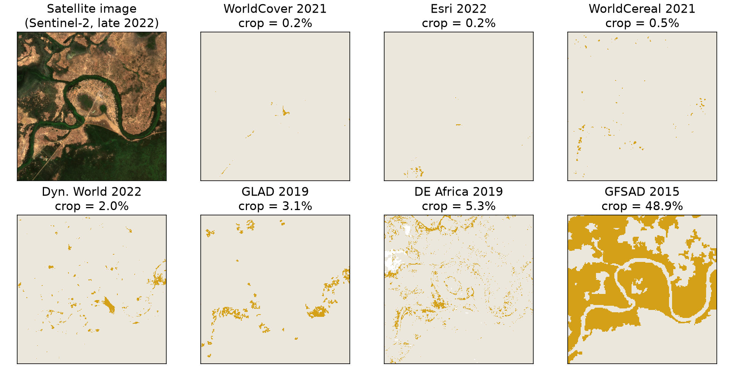
Methodological Angle (Poster/Report):
First results: seven maps, seven answers
0.2%
to
48.9%
of the same window called crop, depending on which map you ask
Same 6 × 6 km near Turalei (Twic county), outside our study counties so the labelling stays blind. Gold = map says crop.
Notes:
Seven maps, seven answers for one place: from 0.2% (WorldCover, Esri) to 48.9% (GFSAD) of the window. Deliberately outside Aweil and Bor South: labellers must not see the maps in the study area. Figure: data/cropland/demo/, script processing_data/cropland/demo_map_panels.py.

Slide 10
Methodological Angle (Poster/Report):
First results: cropland per map in Aweil
1 ha
where all four main maps (2021–22) agree on crop, in 3 million ha
≤ 25%
best overlap of the crop areas of any two maps
5×
CFSAM's modelled harvested area vs the typical map
Crop share from 10 m pixels, counties' own area. CFSAM = 2022 main-harvest cereal area, a modelled estimate (context, not a reference). Agreement is between maps, not accuracy.
Notes:
Data: data/cropland/agreement/ (county_crop_share.csv, pairwise_agreement.csv, strata_n_maps.csv). Four main maps = WorldCereal 2021, WorldCover 2021, Esri 2022, Dynamic World Jun-Nov 2022. Best pairwise crop overlap (Jaccard) 25% (WorldCereal vs WorldCover, one county); kappa at most 0.39. Typical map ~1% vs CFSAM 5.4%. Consequence for the design: 'all maps agree' cannot be a stratum; the sample must also cover the 'no map says crop' land, where most real cropland may be.

Slide 11
Methodological Angle (Poster/Report):
Mistakes and what you have learned
Data quality matters more tan what we thought
Do not assume relationships that might seem logical. Always prove claims with data (datasets OR research evidence)
Notes:
All five were caught by the checks in processing_data/cropland/check_cropland_rasters.py and are documented in data/cropland/README.md. The Esri trap alone would have mapped flooded vegetation as crop.

Slide 12
Stakeholder Angle (Meetings):
Progress and Results
Harvest failure is the priority impact
“The dataset might not capture agricultural land”
slide 6
slide 33
and ≈80% of rural communities live mainly from agriculture (slide 33)
ZOA already suspects the undercount our numbers show
Triggers like a flood “inundating cropland”
Show the reliability, not a perfect forecast
slides 31, 40
slides 9–11, 32
only usable if the cropland and flood data are reliable
a rigorous small sub-problem beats a superficial full one (slides 5, 29)
Stakeholder Q&A 2 (ZOA / Zero Hunger Lab, 21 Sep 2026). Our RO covers ZOA's two areas: the Lol river in Aweil and Bor South (slide 3).
Notes:
Progress with the stakeholders: the Q&A 2 answers fixed the areas, the scale (community) and what ZOA wants from data (reliability and risks). The cropland audit answers the undercount concern directly. Quotes as cited in the team's RO search report; check wording against the slides before presenting.

Slide 13
Stakeholder Angle (Meetings):
Mistakes and what you have learned
Not align our objective with the stakeholder needs
Understanding the problem counts more than assuming things and give a naïve forecast

Slide 14
Societal-Legal-Ethical Angle (Essay):
Progress: the problem as an SLE question
The problem
SLE question (draft, for the team)
ZOA's example trigger: a flood “inundating cropland” (Q&A 2, slides 31, 40).
That number comes from a public flood map laid over a public cropland map.
Nobody has checked those maps along the Lol river (Aweil) or in Bor South.
Whose farmland counts? How the choice of a satellite map decides which flood-hit farmers anticipatory action can see.
Why it matters
Lenses from the lectures
“Technical choices = SLE choices” (L1 p. 5)
“Whose way of ‘seeing’ counts?” (Jasanoff, L1 p. 7)
“Which communities? Who? Where?” (Sen, L2 p. 11)
≈80% of rural communities live mainly from farming, mostly smallholders (slide 33).
Harvest failure is ZOA's priority flood impact (slide 6).
ZOA itself warns: “the dataset might not capture agricultural land” (slide 33).
Stakeholder Q&A 2 (ZOA / Zero Hunger Lab, 21 Sep 2026). L1 = SLE lecture 1 (Petročnik), L2 / L3 = SLE lectures 2 and 3 (van Maanen).
Notes:
Same problem as the methodological slides, but asked as an SLE question: the choice of map is not neutral, it decides who is visible. The question is a draft for the team; the essay text must be the team's own. Check lecture page numbers against the lecture PDFs before citing them.

Slide 15
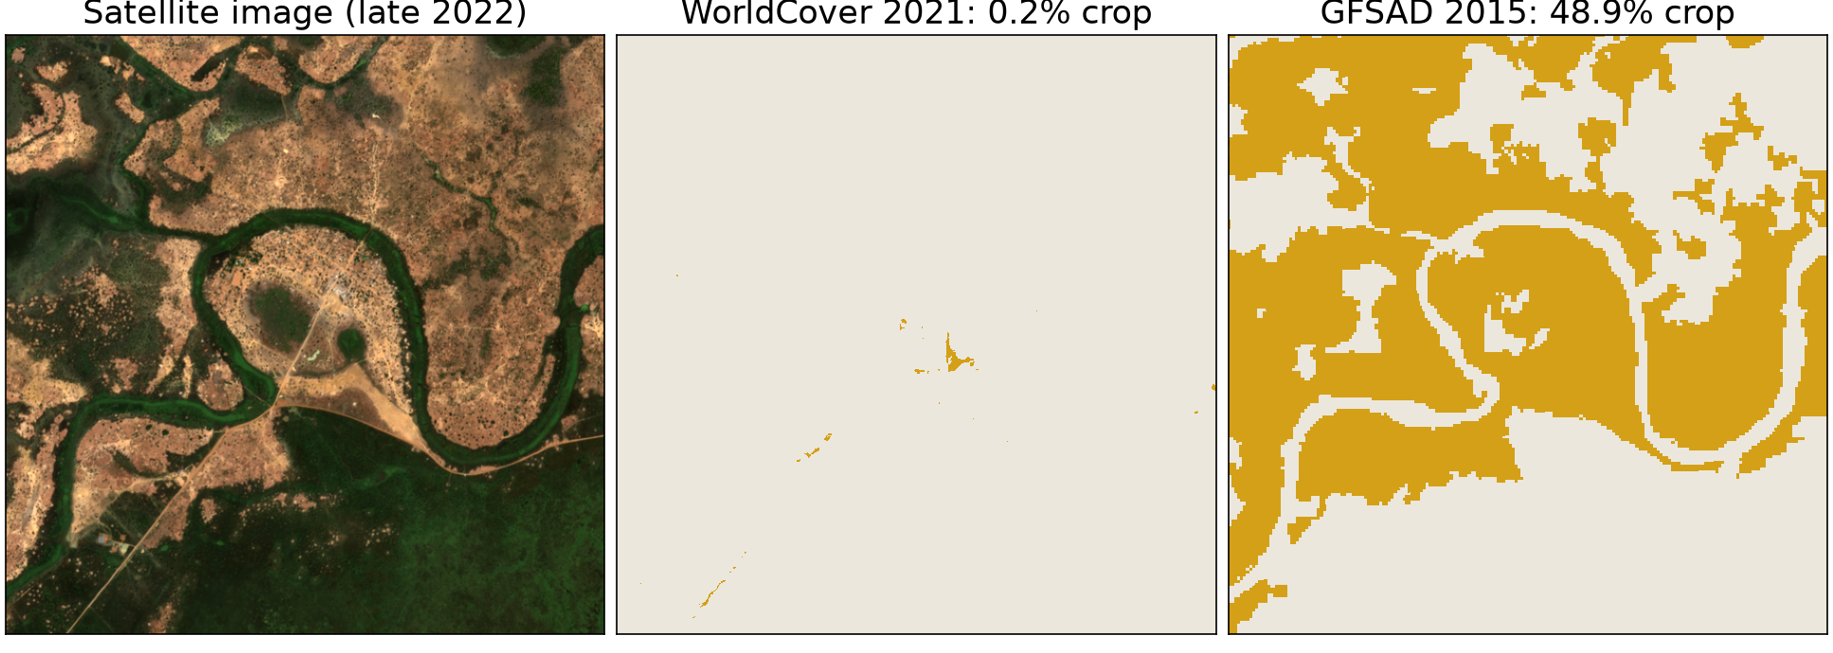
Societal-Legal-Ethical Angle (Essay):
Result: the map decides who is seen
Same fields, near Turalei (outside our study area): one map sees almost no farms, the other sees half the land.
Aweil counties: 1 ha of cropland if all four main maps must agree, ≈47,000 ha if one is enough, ≈140,000 ha if any of seven counts.
Gold = map says crop. Reading: data is socially constructed, not simply “seen” (L1 p. 7); unrepresentative data create blind spots (L1 p. 10). Agreement between maps is not accuracy.
Notes:
The crop-mask result from the method part, told as an SLE point: which farmer 'exists' depends on the map picked, and that pick is usually made silently by the tool. Window: 6 x 6 km near Turalei (Twic), kept outside Aweil and Bor South so the labelling stays blind. Aweil numbers from data/cropland/agreement/strata_n_maps.csv (four main maps = WorldCereal 2021, WorldCover 2021, Esri 2022, Dynamic World Jun-Nov 2022; seven = plus GLAD 2019, DE Africa 2019, GFSAD 2015).

Slide 16
Societal-Legal-Ethical Angle (Essay):
Prior paper and why it is neglected
The paper we build on
Why the problem is neglected
Pacetti, Caporali & Rulli (2017): flood map × land-use map → lost crops and calories (Bangladesh 2007, Pakistan 2010).
Their own warning: “Remote sensing data by itself lacks the level of accuracy necessary in a comprehensive food security assessment.”
WFP ADAM uses the same overlay for South Sudan, with no accuracy statement.
No ground truth: accuracy studies skip South Sudan (Kerner et al. 2024: 8 countries, not this one).
Clouds hide the fields in July–September, exactly when they flood.
Smallholder plots are small, move and lie fallow: global maps miss them.
Hectares are published without error bars, so the gap stays invisible.
Leads for the essay: Who writes what, and for what reason? (L3 p. 18). Do exact-looking hectares serve reporting to donors more than decisions in the field? (logic of audit, L2 p. 4)
Pacetti et al. (2017), Advances in Water Resources 110:494–504, quote p. 501. Kerner et al. (2024), Scientific Data, doi:10.1038/s41597-024-03306-z.
Notes:
Neglect has technical reasons (clouds, small fields, no ground truth) and possibly institutional ones: the lectures ask who produces knowledge and for whom. The audit point is a question to explore, not a finding. ADAM: report of 2 May 2024, no accuracy statement.

Slide 17
Societal-Legal-Ethical Angle (Essay):
What unreliable data costs people
1
Farmers left out
2
Triggers that stay silent
A field missing from the map has no flooding and no household to target. Bor South: 0 ha flooded cropland ever detected, yet its roads close 77–92% of weeks in Sep–Dec.
2022: the standard overlay finds ≈3,700 ha of flooded cropland in South Sudan; CFSAM reports 130,000 ha damaged. The trigger sees ≈3%.
Targeting (Chavez-Gonzalez et al., L3 p. 16); blind spots (L1 p. 10)
Timing and activity: acting too late or not at all (L3 p. 16)
3
False certainty
4
Hectares are not hunger
Hectares without error bars look exact. ZOA asked for the risks of the data so they can choose between misses and false alarms (Q&A 2, slides 2, 9–11).
Flooded cropland is one factor. The same flood hits IDPs, hosts and pastoralists differently (Q&A 2, slide 38).
Data is not self-explanatory (Letz & Maxwell, L3 p. 17)
Do not use one factor; entitlements (Sen, L2 pp. 8–10)
Notes:
Who bears the error: a missed field falls on the smallholder, a false alarm on the budget. Numbers: flood masks x ASAP (2022, national, ~3,700 ha) vs CFSAM 2022 summary p. 1 (130,000 ha of cultivated land damaged); CFSAM is itself modelled, so ~3% shows the size of the gap, not the true loss. Bor South roads: Logistics Cluster maps 2022-2026, eda/ROADS_FLOOD_EDA.md.

Slide 18
Societal-Legal-Ethical Angle (Essay):
Mistakes and what we have learned
Mistake | What we learned
We started from what a model can predict (a flood forecast) | ZOA decides about crops and people; tools can change the problem (L3 p. 11). We check the data first.
We took one cropland map as the truth | Seven maps give seven answers: a map is a way of seeing (L1 p. 7)
Lesson: report every number with its uncertainty and its blind spots, and write down our assumptions (Chavez-Gonzalez et al., L3 p. 16).
Notes:
Team: check that these four match your own experience before presenting. They come from the RO history: the forecast was dropped from the RO (27 Sep plan), CFSAM turned out to be modelled, the cropland maps disagree, and the road data showed closures in Bor South the flood masks miss.

Slide 19
Group Peer Feedback
As a group, use the corresponding feedback from Feedback Fruits (in Canvas) to select one positive outcome, and one action or task to improve. An improvement can also touch on any aspect of the course that you want to approach more efficiently.
Positive
Improvement
Add one group positive feedback here
Add one, or a summary of different approaches that you will implement to i.e., meetings/teacher feedback/stakeholder discussions…

