Slide 1
William Stallings
Komunikasi Data dan Komputer
Edisi 7
Bab 22
Distributed Applications

Slide 2
Electronic Mail
Paling banyak digunakan di aplikasi pada beberapa jaringan
Simple Mail Transfer Protocol (SMTP)
  TCP/IP
  Pengiriman pesan text yang sederhana
Multi-purpose Internet Mail Extension (MIME)
  Pengiriman dari tipe-tipe data yang lain
  Suara, gambar/photo, video

Slide 3
SMTP
RFC 821
Tidak sesuai untuk format pesan/data
  Covered in RFC 822 (see later)
SMTP menggunakan info tertulis di envelope of mail
  Message header
Isinya tidak terlihat
  Message body
Kecuali:
  Standard karakter message diset ke 7 bit ASCII
  Menambah log info untuk memulai dari message
    menampilkan path taken

Slide 4
Dasar Pengoperasian
Mail diciptakan oleh user agen program (mail client)
  Pesan terdiri dari:
    Header containing recipient’s address and other info
    Body containing user data
Pesan diantrikan dan dikirimkan sebagai input ke SMTP sender program
  Typically a server process (daemon on UNIX)

Slide 5
Mail Message Contents
Masing-masing pesan yang diantrikan memiliki:
  Text pesan
    RFC 822 header with message envelope and list of recipients
    Message body, composed by user
  Daftar tujuan pesan
    Derived by user agent from header
    Mungkin ditulis di header
    May require expansion of mailing lists
    May need replacement of mnemonic names with mailbox names
jika BCCs diketahui, user agen perlu untuk menyiapkan format pesan yang benar

Slide 6
SMTP Sender
Mengambil pesan dari antrian
Dikirimkan ke tujuan host sendiri
  Via SMTP transaction
  Over one or more TCP connections to port 25
Host memiliki bermacam-macam senders aktif
Host should be able to create receivers on demand
Ketika pengiriman selesai, sender menghapus tujuan dari daftar pesan
Ketika semua tujuan telah diproses, pesan dihapus

Slide 7
Optimization
Jika tujuan pesan untuk multiple users ditentukan host, pesan dikirim hanya sekali
  Pengiriman ke users ditangani pada host tujuan
Jika berbagai pesan siap diberikan host, sebuah koneksi TCP dapat digunakan
  Saves overhead of setting up and dropping connection

Slide 8
Possible Errors
Host unreachable
Host out of operation
Koneksi TCP gagal selama proses transfer
Sender can re-queue mail
  Menyerah setelah beberapa saat
Faulty destination address
  Kesalahan pengguna
  Target/yang dituju merubah alamat
  Redirect if possible
  Inform user if not

Slide 9
SMTP Protocol - Reliability
Digunakan untuk mengirimkan pesan dari sender to receiver melalui koneksi TCP
Berusaha untuk memberikan layanan yang dapat dipercaya
Tidak menjamin untuk mendapatkan kembali pesan yang hilang
No end to end acknowledgement to originator
Tidak menjamin adanya indikasi kesalahan dalam proses pengiriman
Umumnya dapat dipercaya

Slide 10
SMTP Receiver
Menerima pesan yang datang
Places in user mailbox or copies to outgoing queue for forwarding
Receiver harus:
  Verify local mail destinations
  Deal with errors
    Transmission
    Lack of disk space
Pengirim bertanggung jawab pada pesan sampai receiver memberitahukan proses transfer selesai
  Mengetahui surat yang sudah tiba di host, bukan pemakai

Slide 11
SMTP Forwarding
Sering digunakan untuk transfer secara direct dari pengirim host ke receiver host
May go through intermediate machine via forwarding capability
  Pengirim dapat menspesifikasi route
  Target user may have moved

Slide 12
Conversation
SMTP membatasi pembicaraan antara pengirim dan receiver
Fungsi utama adalah untuk mengirimkan atau transfer pesan
Berhenti menangani mail diluar lingkup SMTP
  Mungkin berbeda antar sistem

Slide 13
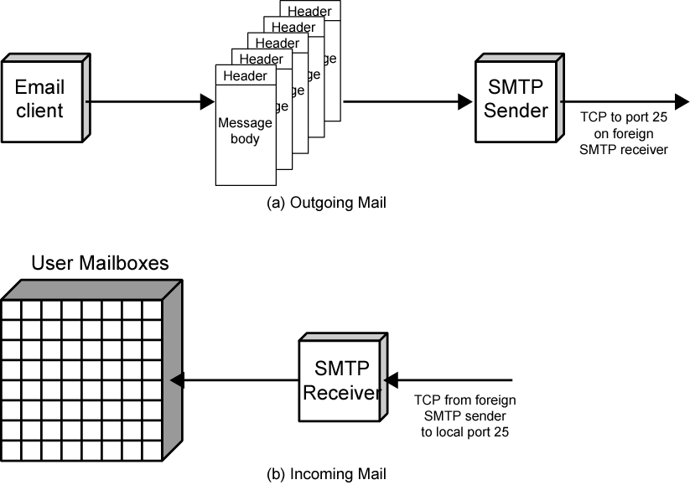
SMTP Mail Flow

Slide 14
SMTP System Overview
Perintah and respon antara sender dan receiver
Permulaan dengan sender
  melakukan koneksi TCP
Sender mengirimkan perintah untuk receiver
HELO<SP><domain><CRLF>
Masing-masing perintah mengaktifkan satu balasan
250 requested mail action ok; completed

Slide 15
SMTP Replies
Digit terdepan menandai kategori
  Positive completion reply (2xx)
  Positive intermediate reply (3xx)
  Transient negative completion reply (4xx)
  Permanent negative completion reply (5xx)

Slide 16
Operation Phases
Setup koneksi
Sentral command-response pairs
Pembatasan koneksi

Slide 17
Connection Setup
Pengrim membuka jalur koneksi TCP dengan receiver
Sekali dikoneksikan, receiver mengidentifikasi dirinya sendiri
  220 <domain> service ready
Sender mengidentifikasi dirinya sendiri
  HELO
Receiver menerima identidikasi dari sender’s
  250 OK
Jika servis mail tidak tersedia, langkah 2 diatas menjadi:
  421 service tidak tersedia

Slide 18
Mail Transfer
Sender boleh mengirim satu pesan atau lebih ke receiver
Perintah MAIL mengidentifikasi originator
  Memberi alur kebalikan digunakan untuk error reporting
  Receiver returns 250 OK or appropriate fail/error message
Satu atau lebih perintah RCPT diidentifikasi penerima dari pesan
  Memisahkan pesan untuk masing-masing penerima
DATA command mentransfer text pesan
  Akhir dari pesan ditandai oleh line yang hanya berisi period (.)

Slide 19
Closing Connection
Dua langkah
Sender mengirim QUIT dan menunggu jawaban
Kemudian memerintahkan TCP menutup koneksi
Receiver memerintahkan TCP menutup koneksi setelah mengirimkan balasan ke QUIT

Slide 20
Format for Text Messages
RFC 882
Message ditampilkan mempunyai amplop dan isi
Amplop berisi informasi yang diperlukan untuk transmisi dan pengiriman message
Message is sequence of lines of text
  Uses general memo framework
  Header biasanya kata kunci yang diikuti oleh tanda titik dua yang diikuti oleh argumentasi

Slide 21
Example Message
Date:Tue, 16 Jan 1996 10:37:17 (EST)
From: “William Stallings” <ws@host.com>
Subject:The syntax of RFC 822
To: Smith@otherhost.com
Cc: Jones@Yet-another_host.com
This is the main text, delimited from the header by a blank line.

Slide 22
Multipurpose Internet Mail Extension (MIME)
Extension to RFC822
SMTP tidak dapat transmit executables
  Uuencode and other schemes are available
    Not standardized
Tidak dapat mengirimkan text termasuk karakter internasional (e.g. â, å, ä, è, é, ê, ë)
  butuh 8 bit ASCII
Servers bisa menolak mail jika melebihi ukuran standar/asli
Terjemah dari ASCII dan EBCDIC tidak standar
SMTP gateways ke X.400 tidak dapat menangani sama sekali data teks di X.400 messages
Beberapa implemantasi SMTP tidak memenuhi standart
  CRLF, truncate or wrap long lines, removal of white space, etc.

Slide 23
Overview of MIME
Lima bentuk header pesan baru
  MIME version
  Content type
  Content transfer encoding
  Content Id
  Content Description
Jumlah format dibatasi
Transfer encoding dibatasi

Slide 24
Content Types
Text body
Multipart
  Mixed, Parallel, Alternative, Digest
Message
  RFC 822, Partial, External-body
Image
  jpeg, gif
Video
  mpeg
Audio
  Basic
Application
  Postscript
  octet stream

Slide 25
MIME Transfer Encodings
Reliable delivery across wide largest range of environments
Isi transfer encoding field
  Six values
  Three (7bit, 8bit, binary) no encoding done
    Provide info about nature of data
Quoted-printable
  Data largely printable ASCII characters
  Non-printing characters represented by hex code
Base64
  Maps arbitrary binary input onto printable output
X-token
  Named nonstandard encoding

Slide 26
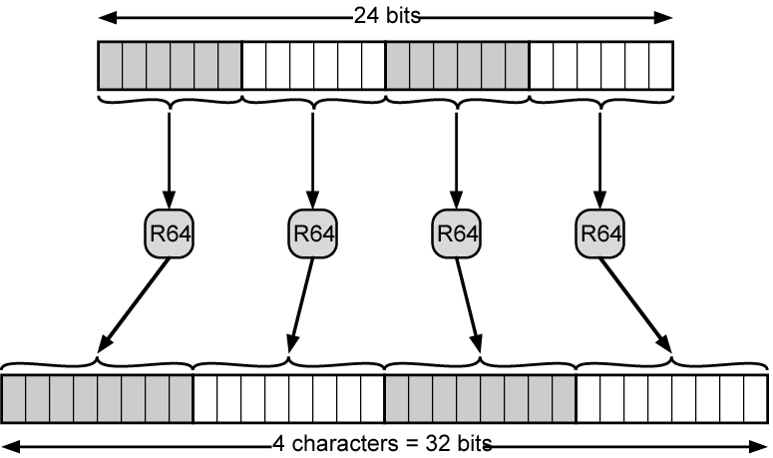
Radix-64 Encoding

Slide 27
Hypertext Transfer Protocol
HTTP
Underlying protocol of the World Wide Web
Bukan protocol untuk pengiriman hypertext
  For transmitting information with efficiency necessary for hypertext jumps
Dapat mentransfer plain text, hypertext, audio, images, dan Informasi Akses Internet

Slide 28
HTTP Overview
Transaction oriented client/server protocol
Biasanya antara Web browser (clinet) dan Web server
Menggunakan koneksi TCP
Stateless
  Each transaction treated independently
  Each new TCP connection for each transaction
  Terminate connection when transaction complete

Slide 29
Key Terms
Cache
Client
Connection
Entity
Gateway
Message
Origin server
Proxy
Resource
Server
Tunnel
User agent

Slide 30
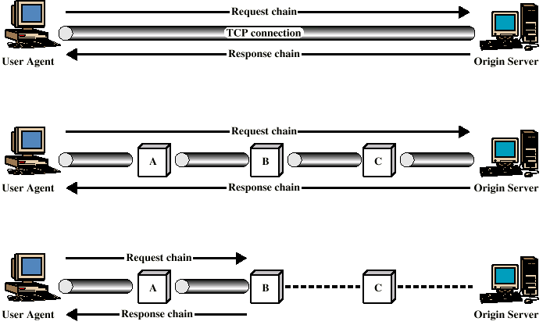
Examples of HTTP Operation

Slide 31
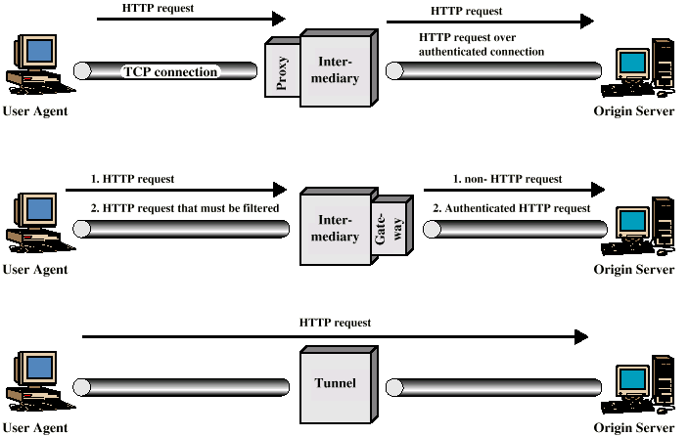
Intermediate HTTP Systems

Slide 32
HTTP Messages
Requests
  Client to server
Responses
  Server to client
Request line
Response line
General header
Request header
Response header
Entity header
Entity body

Slide 33
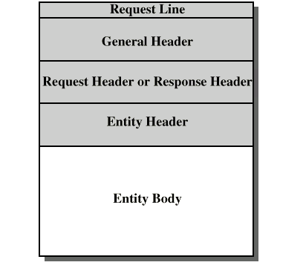
HTTP Message Structure

Slide 34
General Header Fields
Cache control
Connection
Data
Forwarded
Keep alive
MIME version
Pragma
Upgrade

Slide 35
Request Methods
Request-Line = Method <SP> Request_URL <SP> HTTP-Version <CRLF>
Methods:
  Options
  Get
  Head
  Post
  Put
  Patch
  Copy
  Move
  Delete
  Link
  Unlink
  Trace
  Wrapped
  Extension-method

Slide 36
Request Header Field
Accept
Accept charset
Accept encoding
Accept language
Authorization
From
Host
If modified since
Proxy authentication
Range
Referrer
Unless
User agent

Slide 37
Response Messages
Status line followed by one or more general, response and entity headers, followed by optional entity body
Status-Line = HTTP-Version <SP> Status-Code <SP> Reason-Phrase <CRLF>

Slide 38
Status Codes
Informational
Successful
Redirection
Kesalahan client
Kesalahan server

Slide 39
Response Header Fields
Location
Proxy authentication
Public
Retry after
Server
WWW-Authenticate

Slide 40
Entity Header Fields
Allow
Content encoding
Content language
Content length
Content MD5
Content range
Content type
Content version
Derived from
Expires
Last modified
Link
Title
Transfer encoding
URL header
Extension header

Slide 41
Entity Body
Arbitrary sequence of octets
HTTP mengirimkan bermacam-macam tipe data seperti:
  text
  binary data
  audio
  images
  video
Interpretation of data determined by header fields
  Content encoding, content type, transfer encoding

Slide 42
Network Management - SNMP
Simple Network Management Protocol
Networks menjadi sangat dibutuhkan
Lebih komplek membuat kegagalan lebih mungkin
Require automatic network management tools
Standards required to allow multi-vendor networks
Covering:
  Services
  Protocols
  Management information base (MIB)

Slide 43
Network Management Systems
Collection of tools for network management
Single operator interface
Kuat, mudah dalam pengesetan perintah
Performing most or all management tasks
Minimal amount of separate equipment
  i.e. use existing equipment
View entire network as unified architecture
Active elements provide regular feedback

Slide 44
Key Elements
Management station or manager
Agent
Management information base
Network management protocol

Slide 45
Management Station
System yang berdiri sendiri atau merupakan bagian dari shared system
Interface for human network manager
Set of management applications
  Data analysis
  Fault recovery
Interface to monitor and control network
Translate manager’s requirements into monitoring and control of remote elements
Data base of network management information extracted from managed entities

Slide 46
Management Agent
Hosts, bridges, hubs, routers dilengkapi dengan agent software
Allow them to be managed from management station
Respond to requests for information
Respond to requests for action
Asynchronously supply unsolicited information

Slide 47
Management Information Base
MIB
Representation of network resources as objects
Each object a variable representing one aspect of managed object
MIB is collection of access points at agent for management of station
Objects standardized across class of system
  Bridge, router etc.

Slide 48
Network Management Protocol
Menghubungkan antar management station dan agent
TCP/IP menggunakan SNMP
OSI menggunakan Common Management Information Protocol (CMIP)
SNMPv2 (enhanced SNMP) untuk OSI and TCP/IP

Slide 49
Protocol Capabilities
Get
Set
Notify

Slide 50
Management Layout
Mungkin di pusatkan di simple network
Mungkin didistribusikan di jaringan besar yang kompleks
  Multiple management servers
  Each manages pool of agents
  Management may be delegated to intermediate manager

Slide 51
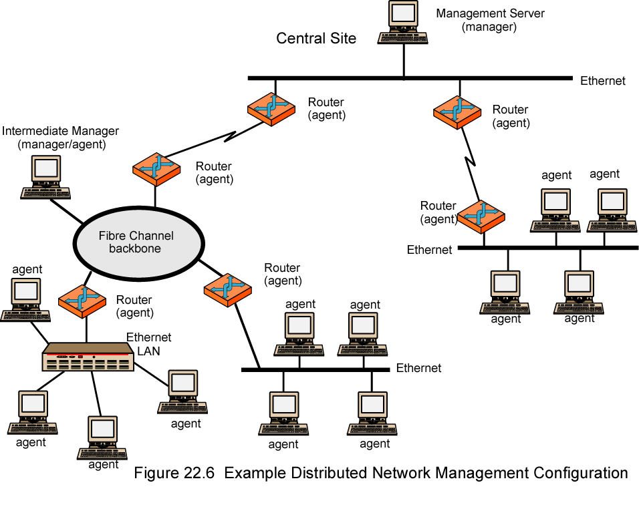
Example of Distributed Network Management Configuration

Slide 52
Network Management Protocol Architecture
Application-level protocol
Part of TCP/IP protocol suite
Runs over UDP
Dari management station, tiga tipe SNMP messages issued
  GetRequest, GetNextRequest, and SetRequest
  Port 161
Agent replies with GetResponse
Agent may issue trap message in response to event that affects MIB and underlying managed
  Port 162

Slide 53
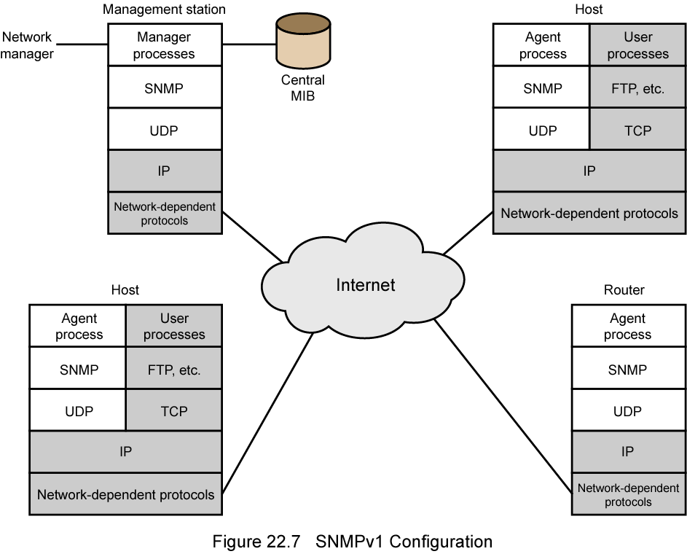
SNMPv1 Configuration

Slide 54
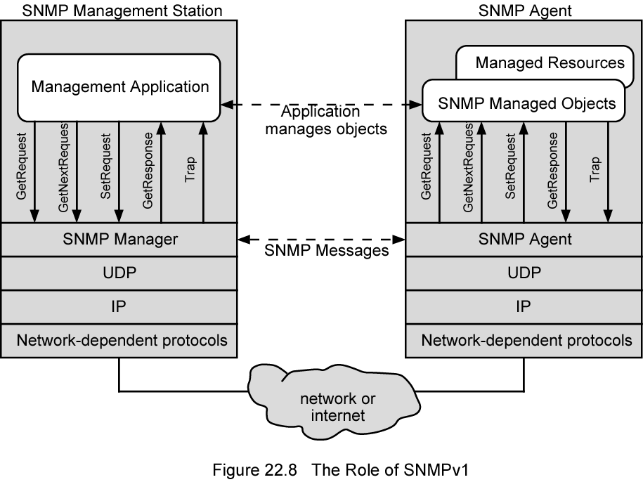
Role of SNMP v1

Slide 55
SNMP v1
Spesifikasi SNMP dikeluarkan agustus 1988
Stand alone management stations and bridges, routers workstations etc supplied with agents
Defines limited, easily implemented MIB of scalar variables and two dimensional tables
Protocol yang diefektifkan
Kemampuan yang terbatas
Ketiadaan keamanan
SNMP v2 1993, ditinjau kembali 1996
  RFC 1901-1908

Slide 56
SNMP v2 (1)
Framework on which network management applications can be built
  e.g fault management, performance monitoring, accounting
Protocol digunakan untuk menukar management information
Each player maintains local MIB
  Structure defined in standard
Sedikitnya satu sistem yang bertanggung jawab untuk management
  Houses management applications

Slide 57
SNPM v2 (2)
Support central atau distributed management
Didalam sistem ditribusi, beberapa elements beroperasi seperti manager dan agent
Pertukaran menggunakan SNMP v2 protocol
  Simple request/response protocol
  Typically uses UDP
    Ongoing reliable connection not required
    Reduces management overhead

Slide 58
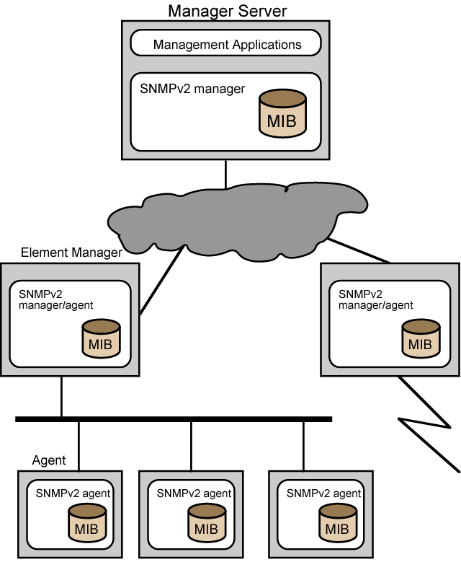
SNMP v2
Managed
Configuration

Slide 59
Structure of
Management Information
SMI
Defines general framework with which MIB defined and constructed
Mengidentifikasi tipe data
How resources are represented and named
Encourages simplicity and extensibility
Scalars and two dimensional arrays of scalars (tables) only

Slide 60
Protocol Operation
Pertukaran pesan
Outer message header deals with security
Tujuh jenis dari PDU

Slide 61
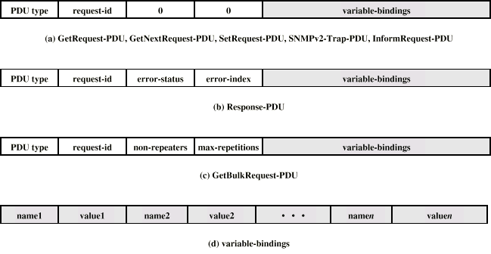
SNMP v2 PDU Formats

Slide 62
SNMP v3
Addresses security issues of SNMP v1/2
RFC 2570-2575
Proposed standard January 1998
Menggambarkan keseluruhan kemampuan keamanan dan arsitektur
Untuk digunakan dengan SNMP v2

Slide 63
SNMP v3 Services
Authentication
  Part of User-Based Security (UBS)
  Assures that message:
    Datang dari identified source
    belum diubah
    belum delayed atau replayed
Privacy
  Encrypted messages using DES
Access control
  Dapat mengatur agen untuk menyediakan sejumlah tingkatan akses ke MIB
  Access to information
  Membatsi operations

Slide 64
Required Reading
Stallings chapter 22
WWW Consortium
Loads of web sites on SNMP

