Slide 1
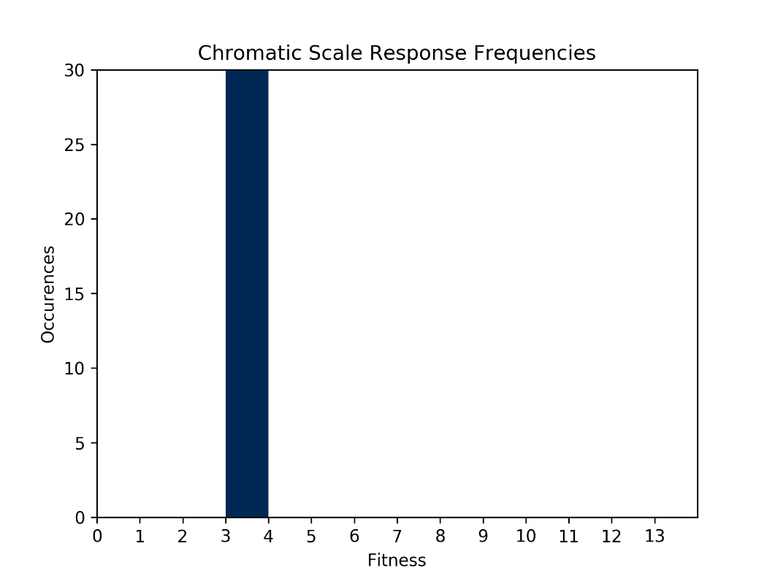
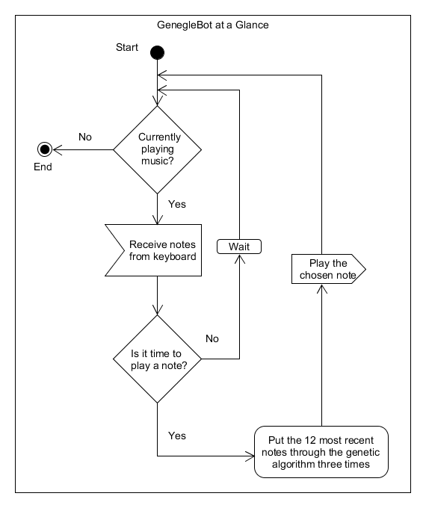
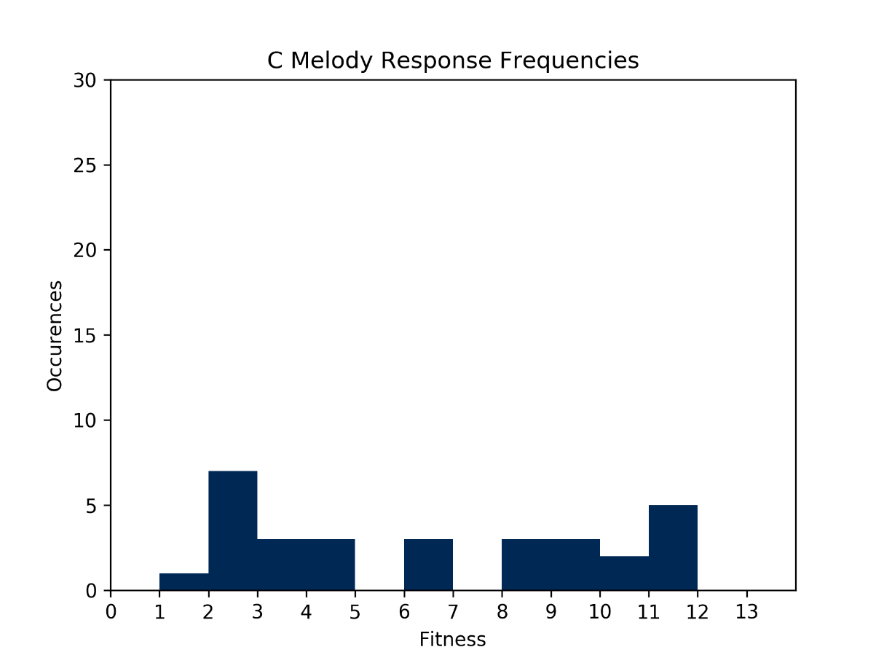
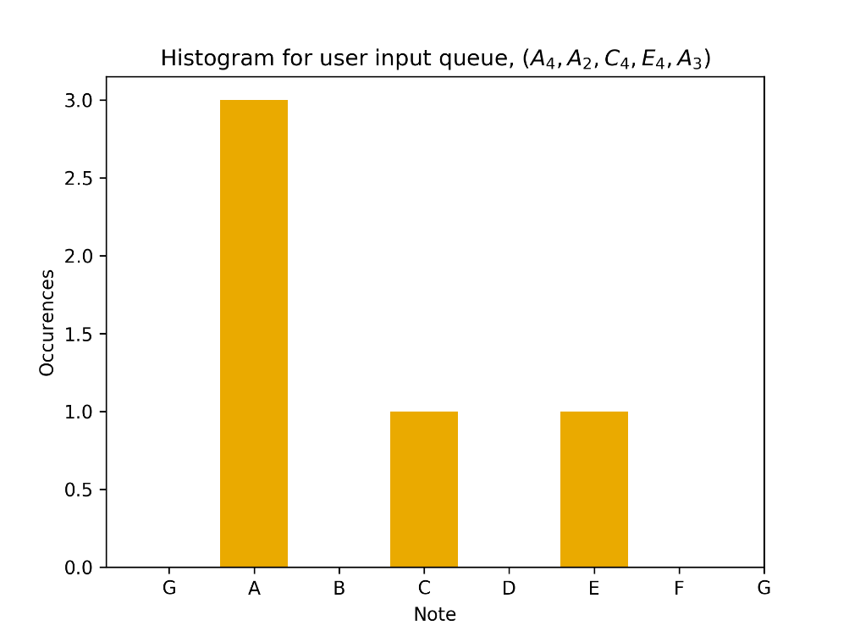
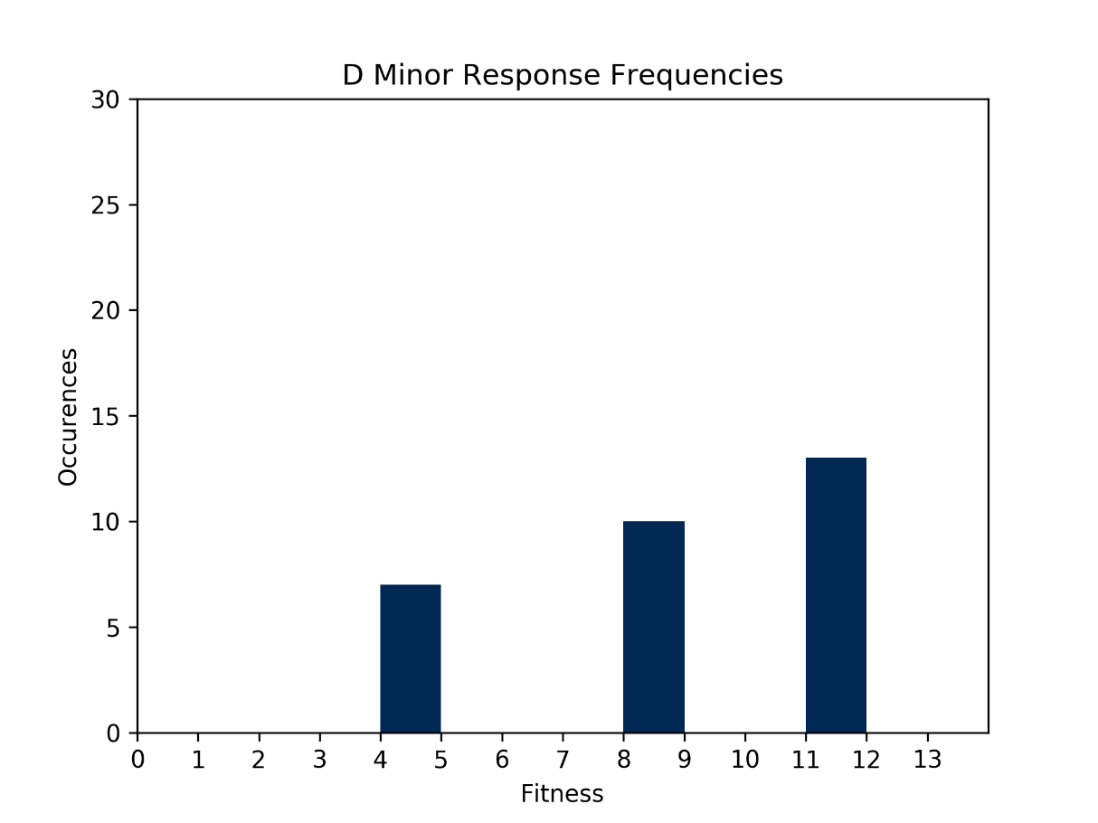

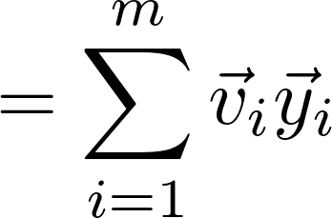
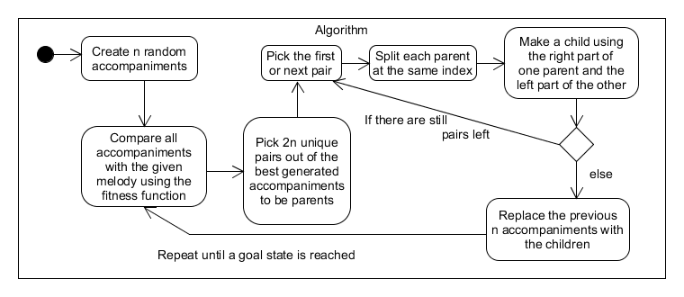

Generating Concurrent Musical Accompaniment using
Artificial Intelligence
Gregory Hughes, Mardigon Toler
West Virginia University Institute of Technology
Leonard C. Nelson College of Engineering
..
Introduction
Driving Question: Can an algorithm be used to create real-time musical accompaniment?
Artificial Intelligence may provide possible solutions.
Goal: Create an AI agent that responds to real-time musical input with real-time musical output
This agent, GenegleBot, plays accompaniment in real time while also following the most recently established pattern when no input is present.
We approach this problem with a genetic algorithm:
an AI Technique for searching for solutions to problems inspired by evolutionary processes
Methods continued…
An example of the relationship between the queue and its associated histogram is shown below. Note that the advantage of using a queue is that this allows only the most recent part of a performance to be considered by the genetic algorithm.
Methods
Input & output are captured and transmitted as MIDI control messages to/from a keyboard
We represent user input with a queue data structure of finite size
A histogram, $\vec{y},$ is computed from the queue
The Genetic Algorithm is comprised of individuals: possible histograms that will be ranked based on their similarity to $\vec{y}$.
Ranking is based on a fitness function: $Fit\left(\vec{v}\right)$
The algorithm relies on a control message for determining the tempo of the performance:
A hardware/software clock source is polled for: 0xF8, 0xFA, and, 0xFC messages to determine tempo events, and messages are masked with 0xF0 and masked with 0x90 to determine when notes are input. Note data is extracted from the next byte of the control message.
At each generation of the genetic algorithm, the “best” individual (a histogram) is selected, which will be sampled for output notes.
Discussion
Results
Exploring the performance of this approach to the problem revealed that the algorithm’s effectiveness relies on the monotony of the user input. Using a population size of 144 individuals with 3 generations of the genetic algorithm each time an individual is chosen for sampling notes, the fitness of each chosen individual occurred with frequencies shown in the above histograms. For a chromatic scale as input, no individual ever exceeded a fitness of 3. When input consisted of a slightly monotonic melody in C, there was more variance in the distribution of individuals’ fitness. Finally, an input of an extremely monotonous D minor arpeggio resulted in many more highly fit individuals being produced.
References
Chien-Hung Liu and Chuan-Kang Ting, “Polyphonic accompaniment using genetic algorithm with music theory,” 2012 IEEE Congress on Evolutionary Computation, Brisbane, QLD, 2012, pp. 1-7.
A. McIntyre, “Bach in a box: the evolution of four part Baroque harmony using the genetic algorithm,” Proceedings of the First IEEE Conference on Evolutionary Computation. IEEE World Congress on Computational Intelligence, Orlando, FL, 1994, pp. 852-857 vol.2.

