Slide 1
Virus Project
Emmanuel Onwuka, Caleb Dingus, Mardigon Toler

Slide 2
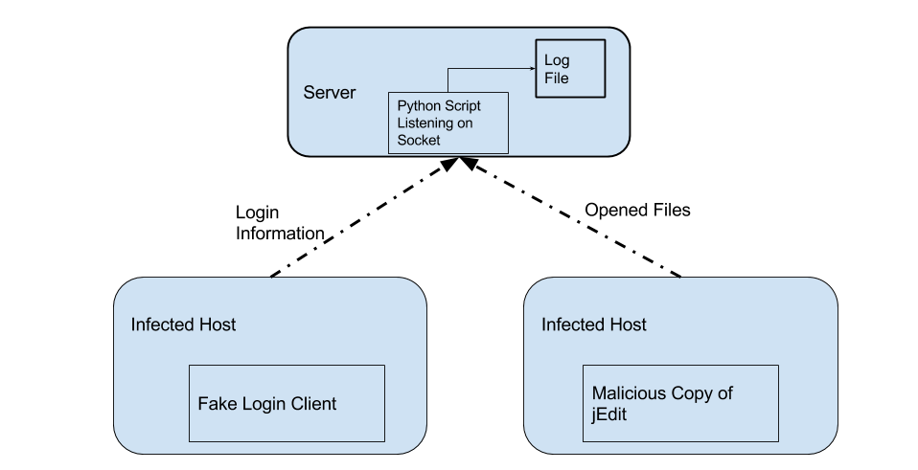

Slide 3
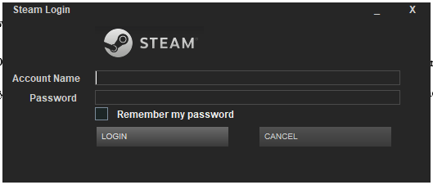
Fake Steam Login
Fools the user into entering their Steam account information into our software
Opens Steam when you press login
Removes itself once the damage is done

Slide 4
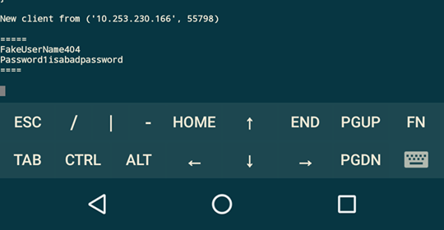
Account Information Sent Directly to the Server

Slide 5
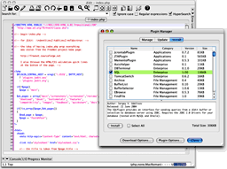
jEdit hack
Changed a java text editor
When a file is opened from the editor, it is sent directly to our server
Works in the background and is undetectable

Slide 6
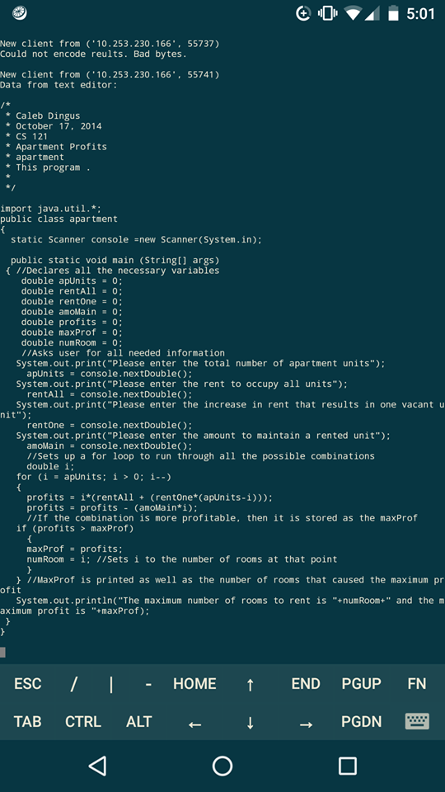
Entire File is Sent to the Server

