Slide 1

“A Buyer’s Journey”
Marialena Dimitriou
Chrysavgi Katsaraki

Slide 2

Contents
The Team
The problem
The road to salvation
The results

Slide 3


The Team
Marialena Dimitriou
Chrysavgi Katsaraki

Slide 4
Contents
The Team
The problem
The road to salvation
The results

Slide 5



“You should know your customer.”
Boost sales
Increase return on ad spent
Improve user experience and satisfaction

Slide 6


I want more data!
RecSys Challenge 2015
Dataset provided by
Data collected during several months in the year of 2014
E-commerce retailer in Europe
Clicks | 33.003.945
Buys | 1.150.753

Slide 7

The datasets
CLICKS
Session ID
Timestamp
Item ID
Category
BUYS
Session ID
Timestamp
Item ID
Price
Quantity

Slide 8
Contents
The Team
The problem
The road to salvation
The results

Slide 9



The road to salvation
…to there
How we went from here
Session | Clicks | Time Spend | Buys
1 | 4 | 0:05:51 | 0
2 | 6 | 0:05:59 | 0
3 | 3 | 0:12:26 | 0
4 | 2 | 0:17:15 | 0
6 | 2 | 0:04:06 | 0
7 | 2 | 0:00:12 | 0
8 | 2 | 0:02:14 | 0
9 | 3 | 0:02:49 | 0
11 | 12 | 0:13:04 | 2
12 | 2 | 0:02:59 | 1
1 2014-04-07T10:51:09.277Z 214536502 0
1 2014-04-07T10:54:09.868Z 214536500 0
1 2014-04-07T10:54:46.998Z 214536506 0
1 2014-04-07T10:57:00.306Z 214577561 0
2 2014-04-07T13:56:37.614Z 214662742 0
2 2014-04-07T13:57:19.373Z 214662742 0
2 2014-04-07T13:58:37.446Z 214825110 0
2 2014-04-07T13:59:50.710Z 214757390 0
2 2014-04-07T14:00:38.247Z 214757407 0

Slide 10






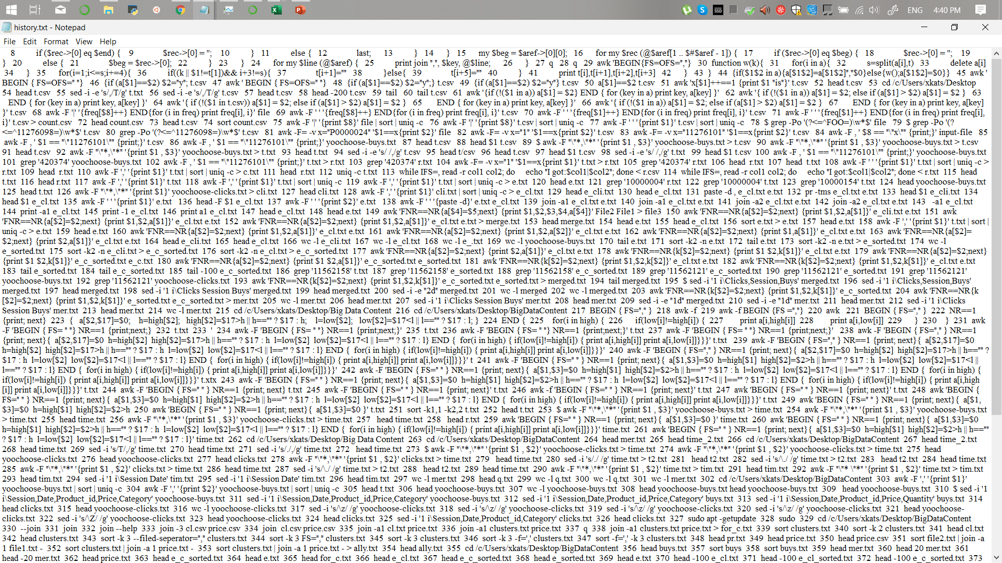
Hours and hours with our friends
Bin
Python
Small example of bash code

Slide 11
Contents
The Team
The problem
The road to salvation
The results

Slide 12


Part 1: The Prediction

Slide 13
Three prediction models…
Method | Accuracy
Logistic Regression | 94.37%
Random Forest Classifier | 94.23%
Binary Classification with Keras | 94.49%

Slide 14
Part 2: The Clustering of Products

Slide 15



Clustering - Products
Vanilla Stuff
Luxury delights
Price: Very High
Membership: Low
Need: Very Low
Cheap Essentials
Price: Medium
Membership: Busy
Need: High
Price: Low
Membership: Very Busy
Need: Ultra
Pricy Necessities
Price: High
Membership: Busiest
Need: Medium

Slide 16
Part 3: The Clustering of Sessions

Slide 17

Clustering - Sessions
Casual Viewers
Clicks: High
Buys: Very low
Spent: Low
Membership: Busiest
Determined
Bargain Hunters
Clicks: High
Buys: Very high
Spent: High
Membership: Medium
Elite Buyers
Clicks: Low
Buys: Low
Spent: Very High
Membership: Very low
Clicks: High
Buys: Low
Spent: Very Low
Membership: Busy

Slide 18
What if….
If we had more information about the sessions
If we had more information about the products
If our data, in general, were MORE SPECIFIC!!!

Slide 19







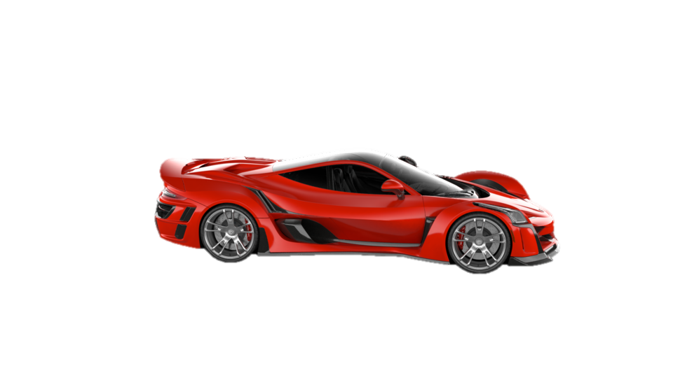
For example…
CEO
Richy Elite

Slide 20
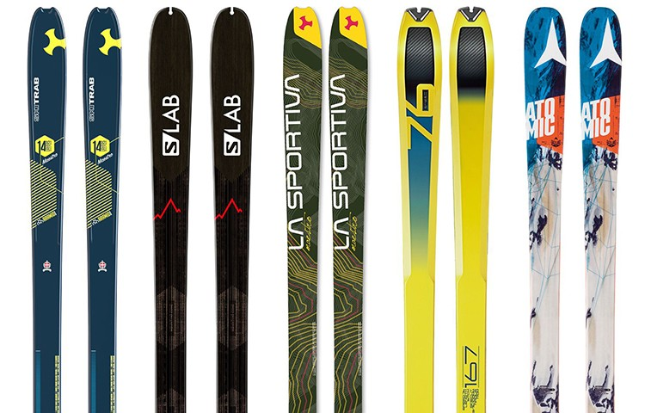

He became …
Jacqueline
Richy
Liliane
Amancio
Edward
… Session 11360961

Slide 21
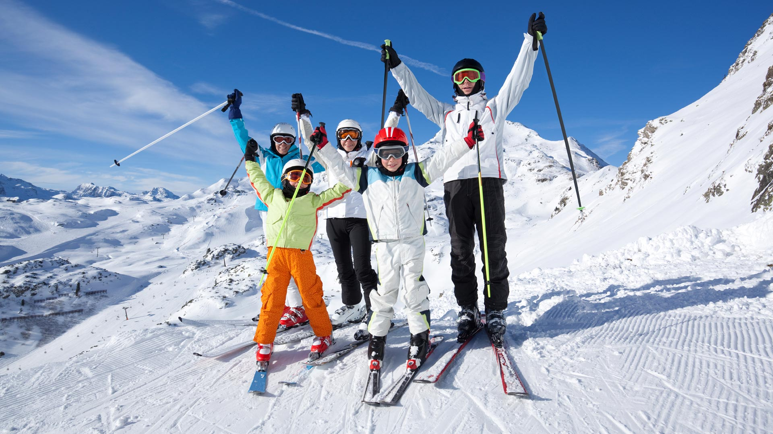
Elite Family in Alpes

Slide 22

The journey has come to an end!
Thank you!

