Slide 1
Client Server Project
Muhammad Asim, Nick Packull-Mccormick, Ali Mardini, Umang Mohini, Aleks Grujicic
CSCN73060

Slide 2
Project Design
Simple Aviation Fuel Consumption logger.
Multiple Clients sending time and fuel information
Server Calculates Fuel efficiency
Average Fuel Efficiency is logged server side.

Slide 3
Testing System
Windows 11
Visual Enterprise 2022
Windows Console
Windows Batch Files

Slide 4
Test Files
4 Test
.txt documents containing dateTime and remaining fuel
Clients pick random file after connecting to server

Slide 5
Clients per Test
Load Testing: 75-300 Clients
Endurance Testing: 100 Clients every 250s
Crash Testing: 200 Clients

Slide 6
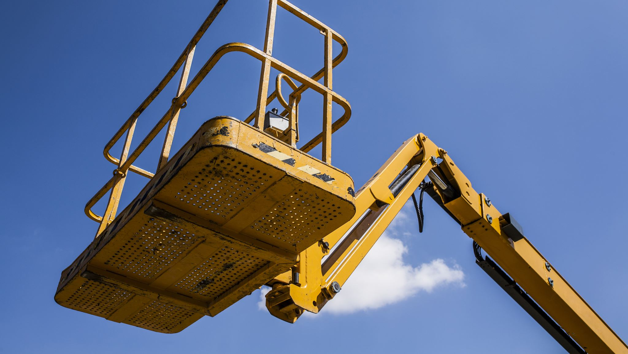
Load Test Demonstration

Slide 7
Performance Testing Results

Slide 8
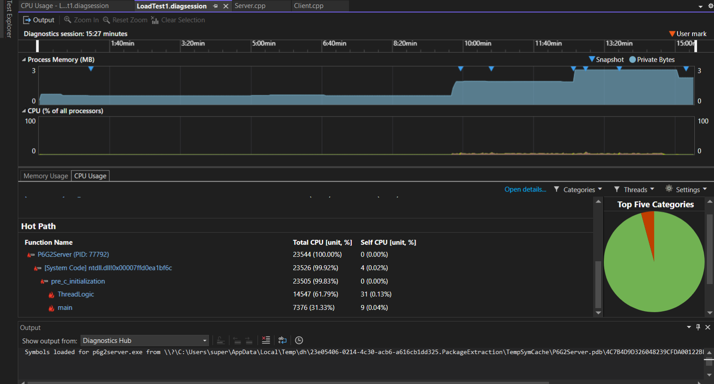
First Load Test

Slide 9
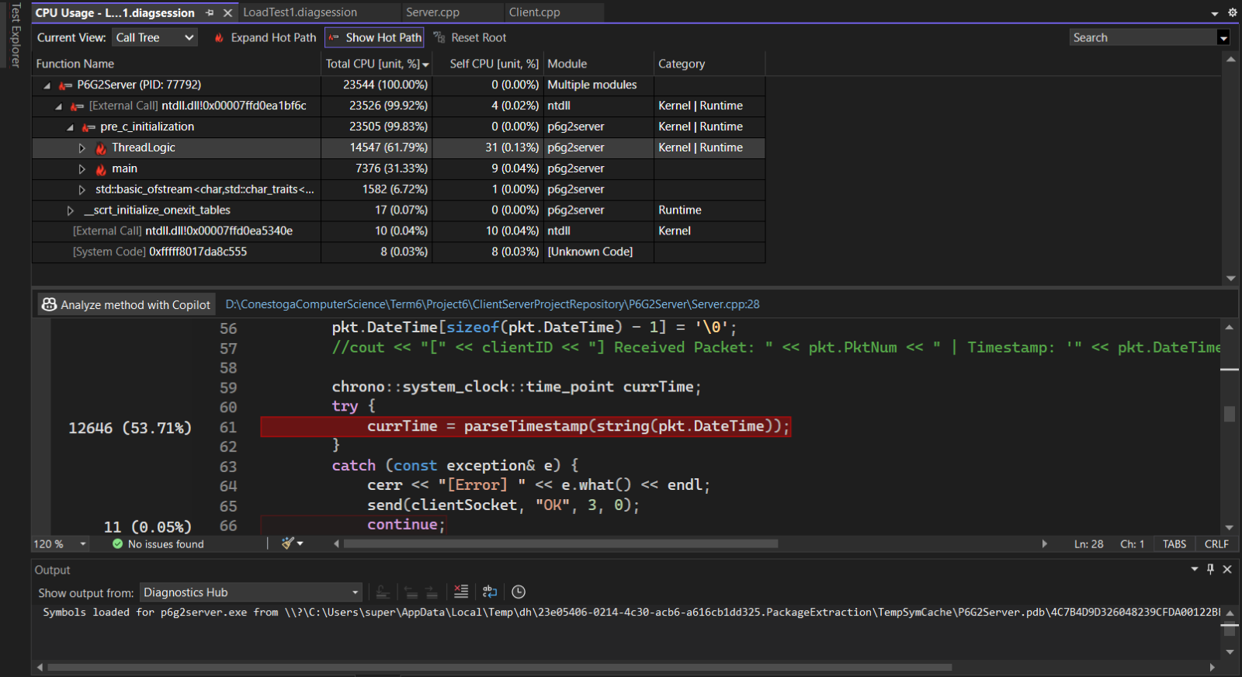
First Load Test Contd

Slide 10
Performance Enhancements I
Server struggled to keep client connections
Server was creating new thread for each client, relying on OS to schedule threads
                Result: Threads hanging and timing out

Slide 11
Performance Enhancements II
Architecture changed to use thread pool
  Limiting number of open threads
  Client checks for active sockets
  Retries communication
          Result: Threads no longer hand and timeout

Slide 12
Performance Testing Results Contd

Slide 13
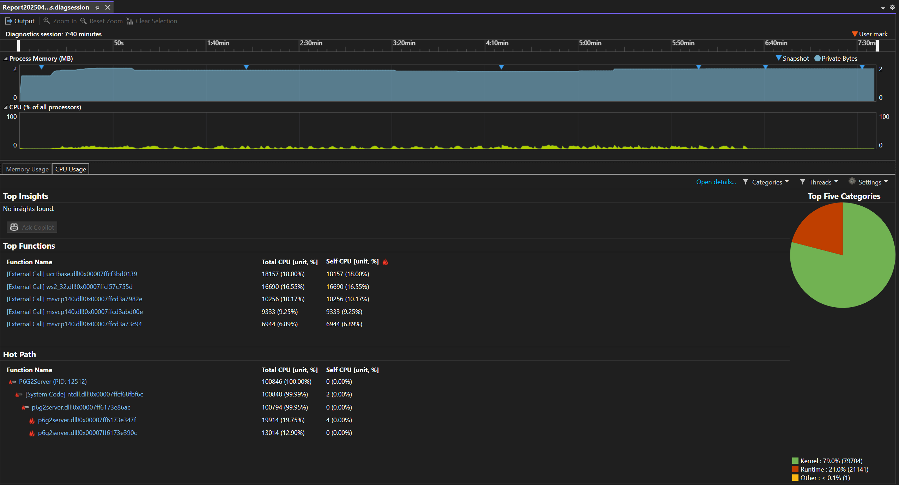
Load Test 2 300 Clients
Server handled 300 clients without crashing
CPU stayed low and stable (~10–15%)
Thread pool managed client load well
Most CPU used by socket & logging functions
Notes:
For Load Test 2, we pushed the server by running 300 clients all at once. This was way more than before. Thanks to the thread pool, the CPU stayed super steady, so no crazy spikes or crashes. and The server handled the pressure well. Most of the CPU work came from basic stuff like sending and receiving data and writing to the log file, which is exactly what we wanted. Overall, this test showed the new setup was solid and ready for heavier loads.

Slide 14
Endurance Testing Results

Slide 15
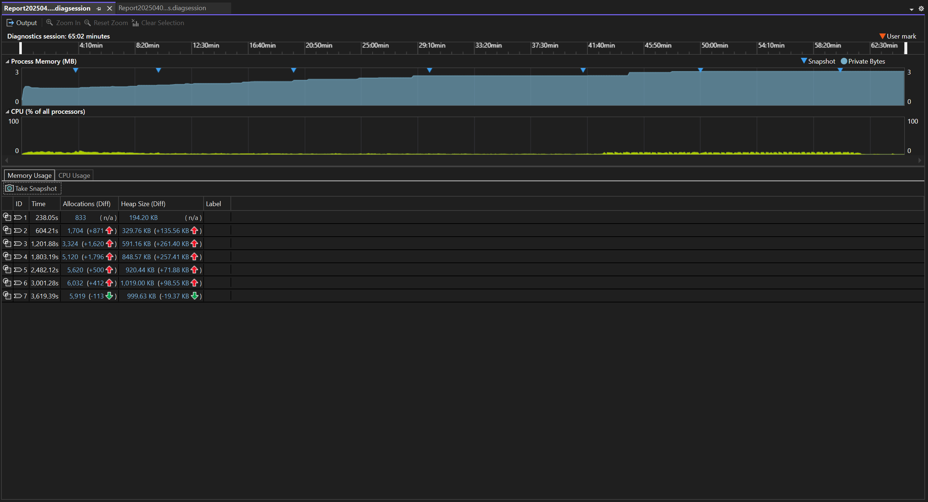
Endurance Testing – Memory Usage (65 Min)
Memory climbed slowly then stabilized (~3MB)
No memory leaks or spikes
Server ran the full hour with no issues
Notes:
For endurance testing, we ran everything for over an hour straight to check long-term performance. The memory usage slowly went up as expected, then stayed stable around 3MB. We didn’t see any leaks or spikes, which means the server was cleaning up properly and not holding onto anything it didn’t need. This shows the server can run for a long time without eating up memory or crashing.

Slide 16
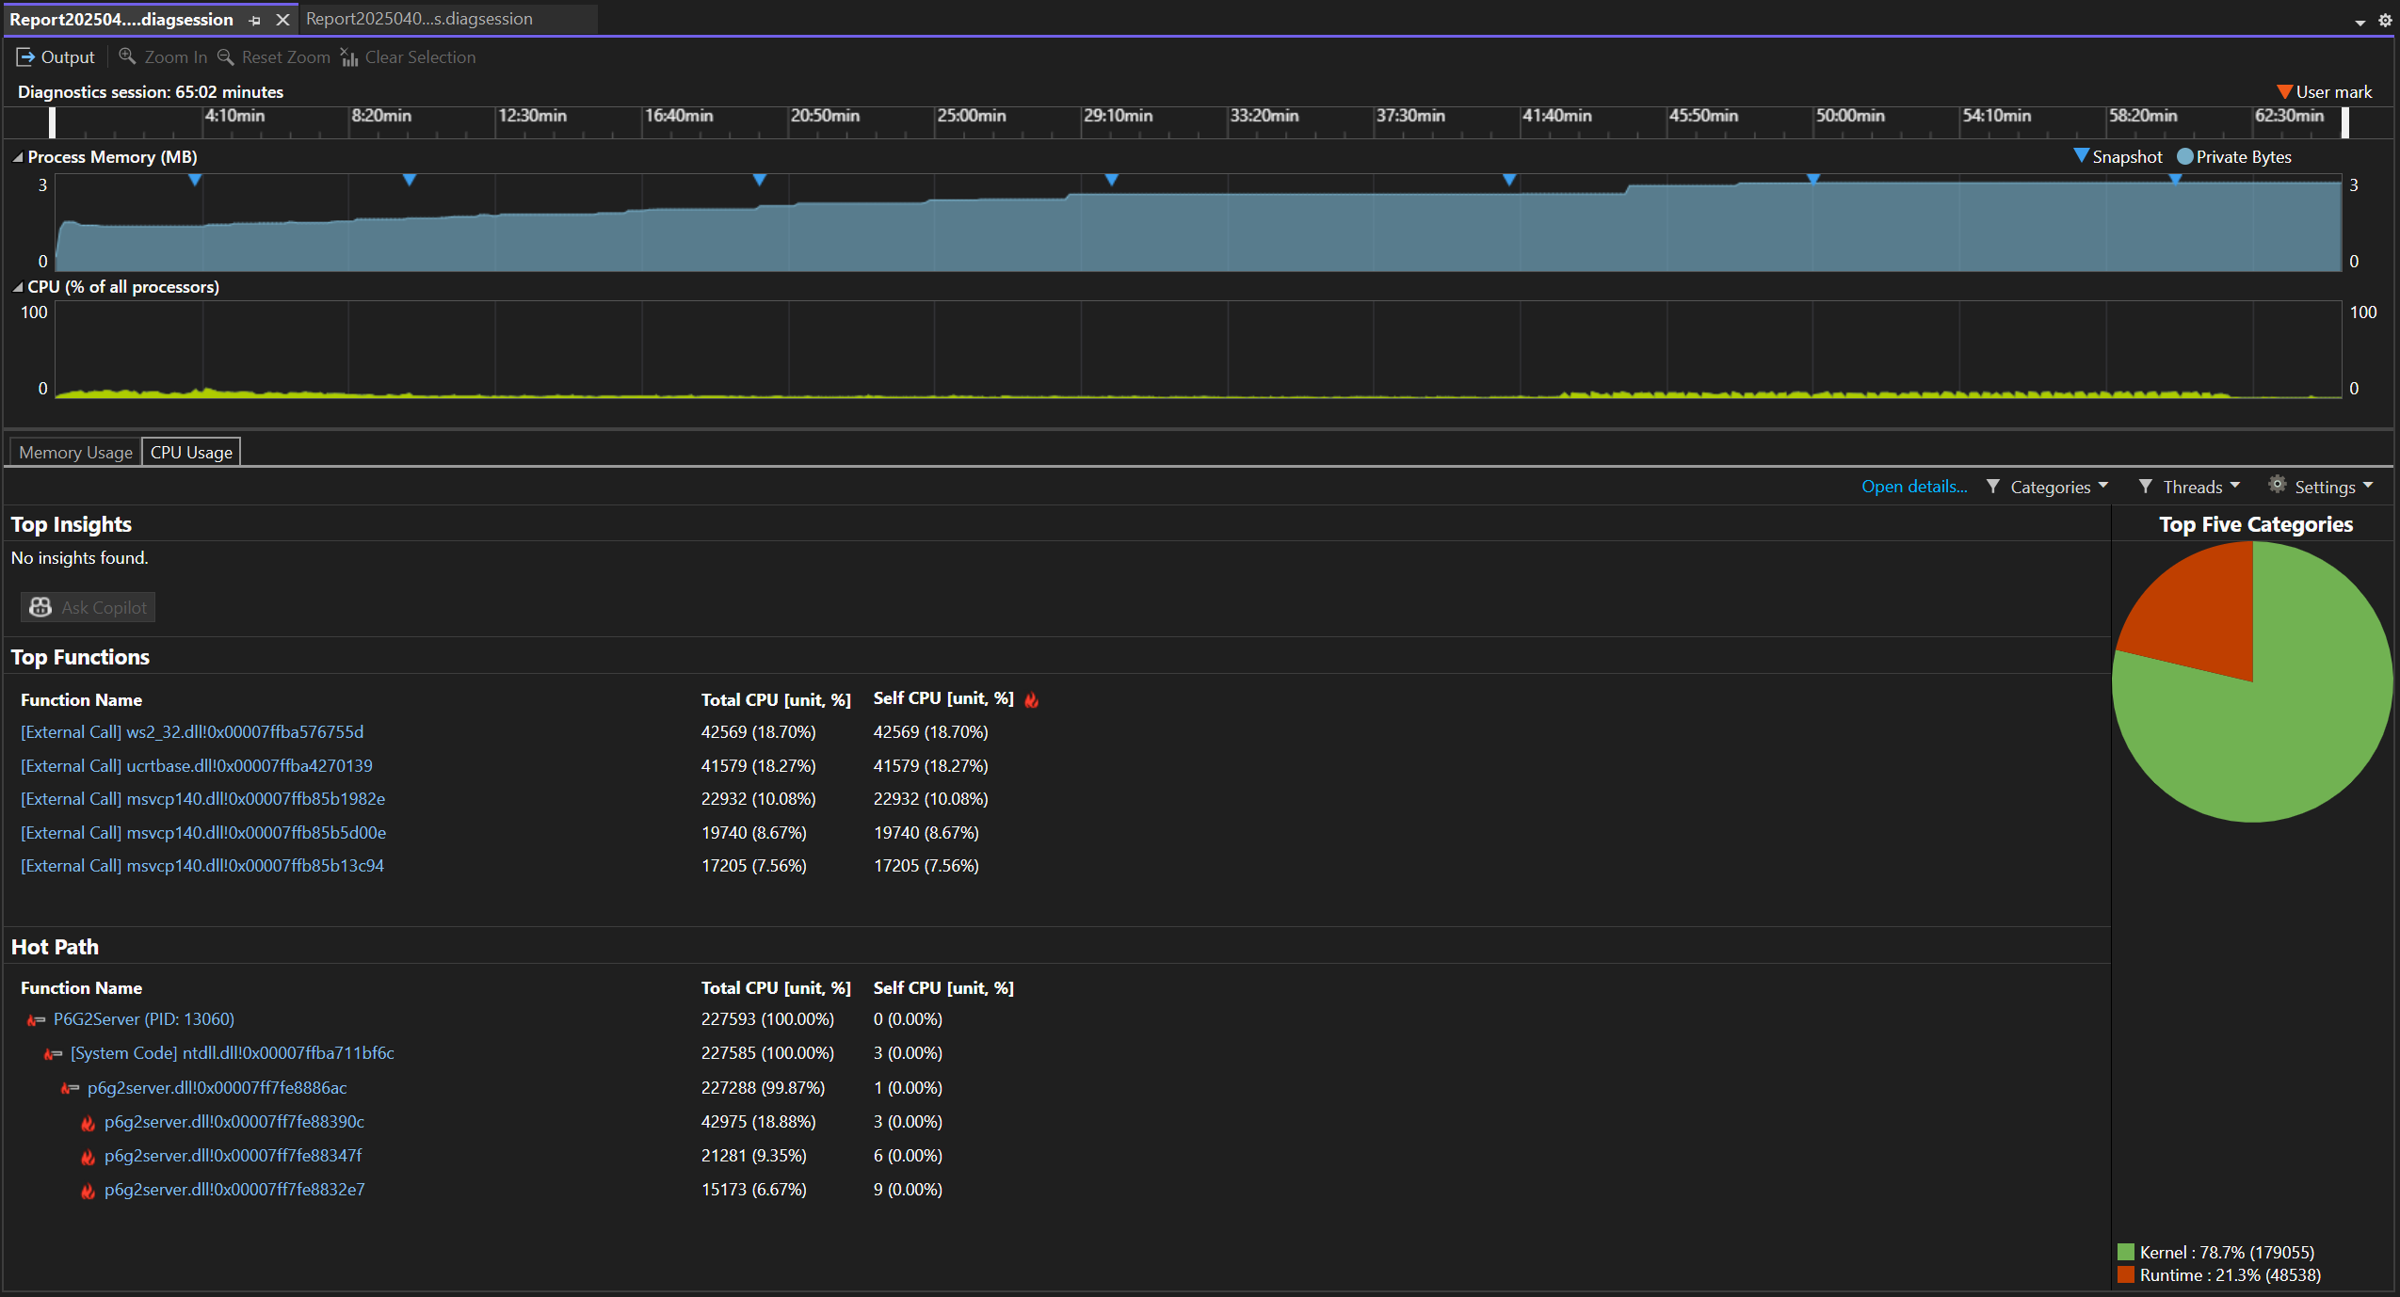
Endurance Testing – CPU Usage (65 Min)
CPU stayed low and consistent (~10–15%)
Thread pool balanced the load
Most work done by networking & logging functions
Notes:
While the test was running, we kept an eye on the CPU too. It stayed really low, usually under 15%, which is great considering the server was constantly talking to all the clients. The thread pool helped spread the work out nicely. and Most of the CPU time went into networking and logging, which is exactly what the server should be doing.

Slide 17
Crash Testing

Slide 18
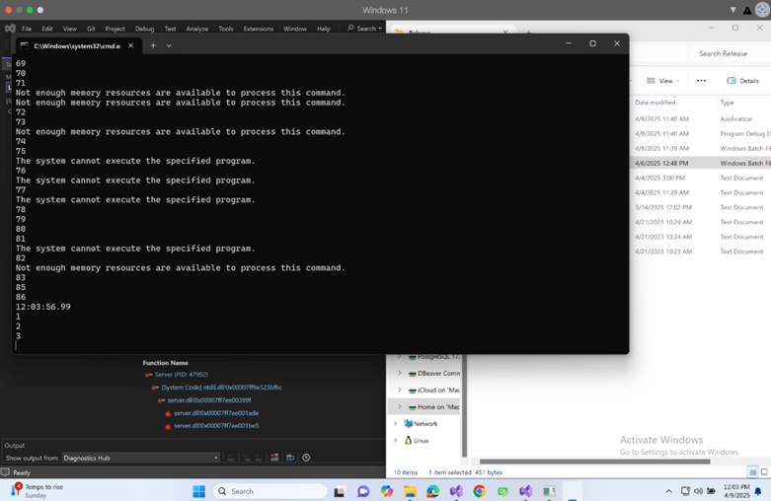
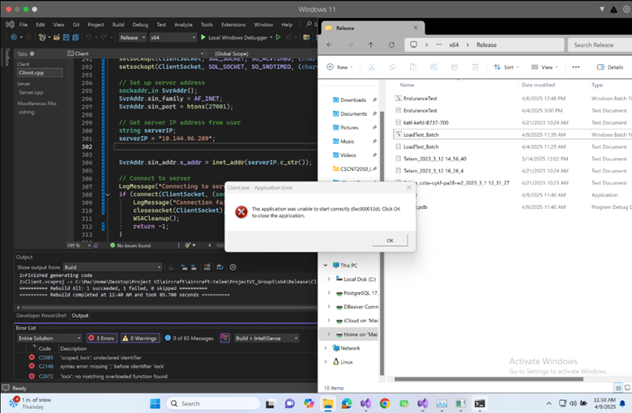
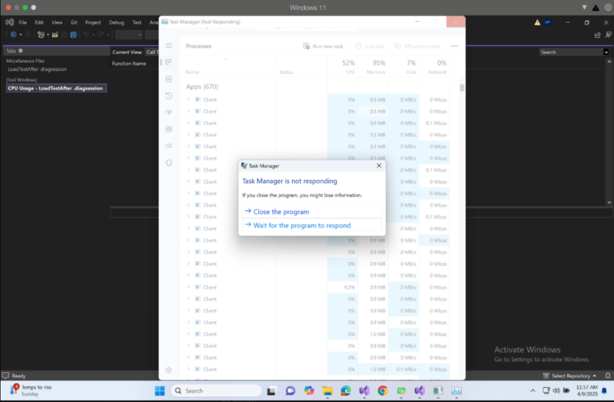
Client Report – Crash Testing
Initially, clients launched and communicated with server successfully
After Reaching ~100+ Clients Threshold - System ran out of memory and failed to spawn clients

Slide 19
How did the Server Handle Client Crashing?
Server remained stable and fully responsive
Gracefully Detected:
  Socket timeouts
  Forceful client disconnects
  Partial or missing packets
Continued to serve healthy clients
Continued without freeze, crash or memory leaks
Logged and safely shut down with results saved

Slide 20
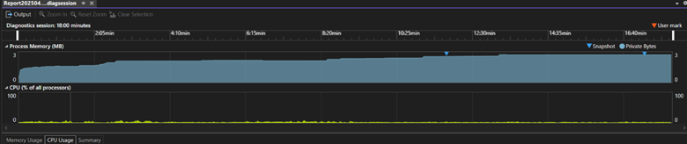
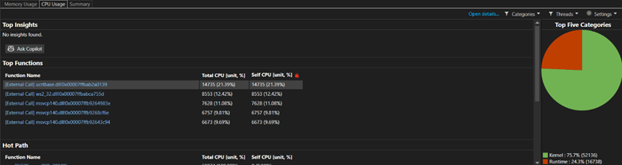
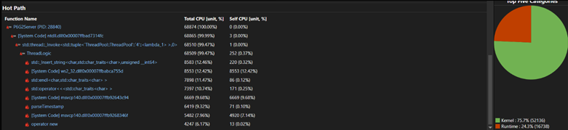
Server Report – Crash Testing
Server ran continuously without crashing
Detected disconnects, Logged proper timeout and/or error codes
CPU Utilization:
Average CPU usage ~21%
  Main Contributors:
    Std::insert_string
    Std::endl
    operator<< inside Thread Logic
Memory Utilization:
Peak Usage: ~3.2 MB
No memory leaks or spikes observed
Stable and consistent throughout entire test session

Slide 21

Conclusions
First Implementation could not deal with heavy load
Second Implementation is stable
  Won't processes more than 8 Clients in parallel
Server capable of handling Crashed Clients

Slide 22

Thank you – Questions?

