Slide 1





B.TECH FINAL YEAR PROJECT · PROJECT REVIEW
Shared Memory Layer for Cross-Team AI Agents
Dev-Agent
QA-Agent
A secure, semantic and versioned organisational memory that lets AI agents of different teams reuse each other's knowledge — without leaking what they must not see.
Shared
Memory
Presented by: Kushagra 23070122122
Guide: Dr. Ranjeet Bidwe
Department of Computer Science & Engineering
September 2026
Security-Agent
Support-Agent
Notes:
Title slide. Replace the name, roll number, guide and institute placeholders before presenting. One-line pitch: agents from different teams share one governed memory instead of keeping isolated silos.

Slide 2
AGENDA
What this review covers
01
Introduction
06
Testing & Performance Validation
02
Motivation
07
Gantt Chart / Project Tracking
03
Status of Current Work
08
Collaboration Evidence & Peer Reviews
04
Research Gaps
09
Conclusion
05
Prototype / Software Development
10
References
Shared Memory Layer for Cross-Team AI Agents
2
Notes:
Highlighted items (prototype and validation) are where most of the review time goes.

Slide 3




01 · INTRODUCTION
One governed memory for every team's AI agents
AI agents now write code, test releases, review security and answer customers. This project builds the infrastructure that lets them remember together: a secure shared memory layer where authorised agents store, find, share and version knowledge created by other teams.
Agent A → Shared Memory → Agent B
Semantic retrieval
Find knowledge by meaning (embeddings + vector search), not keywords.
Secure sharing
RBAC + five visibility levels enforced in the API and inside the vector index.
Versioning & provenance
Every update is an immutable version; who created, changed and read it is traceable.
Point-to-point
10 links for 5 agents, no shared policy
Shared memory
5 links, one place to authorise & audit
Auditability
Append-only audit log of every access — including denials and their reasons.
n agents need n(n−1)/2 pairwise channels, but only n connections to a shared layer.
Shared Memory Layer for Cross-Team AI Agents
3
Notes:
Introduce the idea: instead of agents messaging each other, they read and write one governed memory. The graph on the right shows why this scales: 5 agents need 10 pairwise links but only 5 links to the hub, and the hub is the single place where access control and auditing happen.

Slide 4





02 · MOTIVATION
Isolated agent memory wastes work and splits knowledge
62.5%
Duplicated work
Repeated reasoning
of agent tasks had to be re-derived when each agent could only use its own memory
An agent re-investigates a problem another team's agent already solved.
Expensive LLM reasoning is spent re-deriving facts that already exist.
Measured in this project's benchmark: 40 tasks, 4 teams
…but one big vector store is unsafe
Information silos
Inconsistent decisions
Similarity ≠ authorisation: a Support agent asking about PDF export would retrieve Security's confidential SSRF finding.
Knowledge stays locked inside one team's agent or chat history.
Two agents record contradicting facts (MongoDB vs PostgreSQL) and nobody notices.
Shared Memory Layer for Cross-Team AI Agents
4
Notes:
Four pains of isolated memory. The 62.5% figure is not from literature — it is measured by our own benchmark (25 of 40 tasks needed another team's knowledge). The red box explains why simply pooling everything into one vector database is not acceptable: semantic similarity would leak confidential memories.

Slide 5
03 · STATUS OF CURRENT WORK
Existing work shares context, not secure long-term memory
Approach | Persistent memory | Shared across teams | Semantic retrieval | Per-memory access control | Versioning & provenance | Security audit trail
AutoGen (Wu et al., 2023) | ◐ | ◐ | ◐ | ✗ | ✗ | ✗
MetaGPT (Hong et al., 2023) | ◐ | ◐ | ◐ | ✗ | ✗ | ✗
CAMEL (Li et al., 2023) | ✗ | ◐ | ✗ | ✗ | ✗ | ✗
Generative Agents (Park et al., 2023) | ✓ | ✗ | ✓ | ✗ | ✗ | ✗
MemGPT (Packer et al., 2023) | ✓ | ✗ | ✓ | ✗ | ✗ | ✗
RAG + vector-DB memory (LangChain, LlamaIndex) | ✓ | ◐ | ✓ | ◐ | ✗ | ✗
Mem0 (Chhikara et al., 2025) | ✓ | ◐ | ✓ | ◐ | ◐ | ✗
Zep (Rasmussen et al., 2025) | ✓ | ◐ | ✓ | ✗ | ◐ | ✗
This project — Shared Memory Layer | ✓ | ✓ | ✓ | ✓ | ✓ | ✓
✓ supported ◐ partial / session-scoped / via extensions ✗ not addressed — assessment based on the designs described in the cited papers and documentation.
Shared Memory Layer for Cross-Team AI Agents
5
Notes:
State of the art: multi-agent frameworks (AutoGen, MetaGPT, CAMEL) share context within one run; memory systems (Generative Agents, MemGPT, RAG memories) give one agent long-term semantic memory. Mem0 and Zep are production memory layers for one user or agent (LLM-extracted facts, temporal knowledge graph); they scope memory by user/agent/project but have no per-memory cross-team access rules or security audit trail. None combines cross-team sharing with per-memory access control, versioning and a security audit trail.

Slide 6

03 · STATUS OF CURRENT WORK
Project status: working prototype, all 10 build phases complete
Implementation phases
57 + MCP
3
Phase 1 Repository, backend, PostgreSQL, Qdrant, Docker
REST endpoints + Model Context Protocol server
public benchmarks (LoCoMo, LongMemEval, BEIR)
Phase 2 Authentication, users, teams, agents, RBAC
Phase 3 Memory CRUD, embeddings, vector search
124
11
Phase 4 Permission filtering, sharing, versioning, provenance
automated tests (105 backend, 14 Python SDK, 5 TypeScript)
dashboard screens incl. Connect-an-agent
Phase 5 Audit logs, duplicate & conflict detection
Phase 6 LLM agent runtime & Python SDK
3
1
Phase 7 React dashboard & Agent Playground
client SDKs & tools: Python + CLI, TypeScript, LLM tool specs
command to run 4 services (Docker)
Phase 8 Tests, evaluation benchmark, docs, demo data
Phase 9 Real-world access: MCP, hybrid search, import, SDKs
Remaining: final report and viva; end-to-end answer accuracy with a hosted LLM judge.
Phase 10 Public benchmarks: LoCoMo, LongMemEval, BEIR
Shared Memory Layer for Cross-Team AI Agents
6
Notes:
Our own status. All eight implementation phases from the project plan are done and verified end to end with docker compose up --build on a clean machine. Numbers are from the repository: 57 operations in the OpenAPI spec plus the MCP endpoint, 105 backend + 14 Python SDK + 5 TypeScript SDK tests. Phases 9 and 10 made the prototype usable from real agent tools and measured it on public benchmarks.

Slide 7




04 · RESEARCH GAPS
What is missing — and how this project fills it
RESEARCH GAP
OUR APPROACH
Memory is private to one agent or lives only for one session
Persistent organisational memory shared by independent agents of different teams
Semantic similarity ignores authorisation — vector search can leak
Access rules compiled into the Qdrant filter + authoritative re-check in PostgreSQL
No versioning or provenance of agent knowledge
Immutable version history, provenance and an append-only audit trail
Duplicates and contradictions go unnoticed
Semantic duplicate detection + rule-based conflict flags with human review
No measured comparison of shared vs isolated agent memory
Reproducible benchmark: accuracy, reuse, duplicate work, latency, leakage
Shared Memory Layer for Cross-Team AI Agents
7
Notes:
Five gaps derived from the literature survey. The key technical one is the second: in a normal RAG setup, the vector search ranks everything by similarity and filtering happens afterwards (or not at all). We push the permission rule into the vector index itself, so an unauthorised memory is never even scored.

Slide 8






05 · PROTOTYPE / SOFTWARE DEVELOPMENT
System architecture
FastAPI backend
PostgreSQL
Agent gateway / REST API
metadata · versions · ACL · audit
AI agents
validation · rate limiting · request IDs
MCP · Python / TS SDK · API key
Authentication
Qdrant
JWT · rotating refresh tokens · API keys · Argon2id
vectors + permission payload
Authorisation
Humans
RBAC permissions + per-memory visibility
Embedding model
React dashboard via nginx
bge-small-en-v1.5 (local ONNX)
Memory manager
Hybrid retrieval
Agent runtime
versions · sharing · archive
vector + full-text
memory-augmented LLM
LLM provider
Duplicate & conflict detection
Audit logger (own transaction)
Ollama · OpenAI · Anthropic · none
Shared Memory Layer for Cross-Team AI Agents
8
Notes:
Request path: agents (SDK) and humans (dashboard through nginx) call the FastAPI gateway; every request is authenticated, then authorised with RBAC plus the memory's visibility. PostgreSQL is the system of record; Qdrant stores one vector per memory with the fields needed for permission filtering. Audit writes use their own transaction so denied requests are always recorded.

Slide 9



05 · PROTOTYPE / SOFTWARE DEVELOPMENT
Technology stack and modules
Backend & API
Data & versioning
Hybrid search
Python 3.12 · FastAPI · Pydantic v2 · Uvicorn
PostgreSQL 16 · SQLAlchemy 2 · Alembic migrations
Qdrant 1.13 (HNSW + payload indexes) · PostgreSQL full-text
57 REST operations (OpenAPI) + MCP server for agent tools
18 normalised tables, FKs, CHECKs, indexes; append-only audit trigger
bge-small-en-v1.5, 384-d, local ONNX — no API key
Security
Dashboard
Agents & delivery
JWT + rotating refresh · Argon2id · hashed API keys
React 18 · Vite · TypeScript · TanStack Query · Recharts
MCP · Python SDK + CLI · TypeScript SDK · LLM runtime
4 roles, 16 editable permissions, 5 visibility levels, rate limiting
11 screens incl. Agent Playground, Connect page, conflict review
Docker Compose: 4 services, one command, seeded demo org
Shared Memory Layer for Cross-Team AI Agents
9
Notes:
Every component is replaceable behind an interface: VectorStore (Qdrant today), EmbeddingProvider (fastembed, Ollama, OpenAI) and LLM providers. The embedding model is baked into the Docker image, so semantic search works offline.

Slide 10





05 · PROTOTYPE / SOFTWARE DEVELOPMENT
Core workflows: store, search and control access
Memory creation — POST /api/memories
1
2
3
4
5
6
Validate input
Authenticate & authorise
Embed text (384-d)
Detect duplicates & conflicts
Store in PostgreSQL + Qdrant
Version 1 + audit event
Permission-aware hybrid search — POST /api/memories/search
1
2
3
4
5
Embed query + parse keywords
Vector + full-text search, same ACL filter
Re-check each hit in PostgreSQL
Rank: meaning, keywords, confidence
Top-k results + audit event
Visibility levels (per memory)
Private
Team
Selected teams
Selected agents
Organization
Creating agent only
Owning team (+ explicit grants)
Owning team + allowed teams
Only the allowed agents
Every authenticated agent
Shared Memory Layer for Cross-Team AI Agents
10
Notes:
Creation: the same pipeline for every write — including duplicate and conflict detection before storing. Search: the access rule is part of the Qdrant query filter, then every candidate is re-validated against the database row before it is returned. Visibility is chosen per memory; confidential memories can never be organisation-wide.

Slide 11
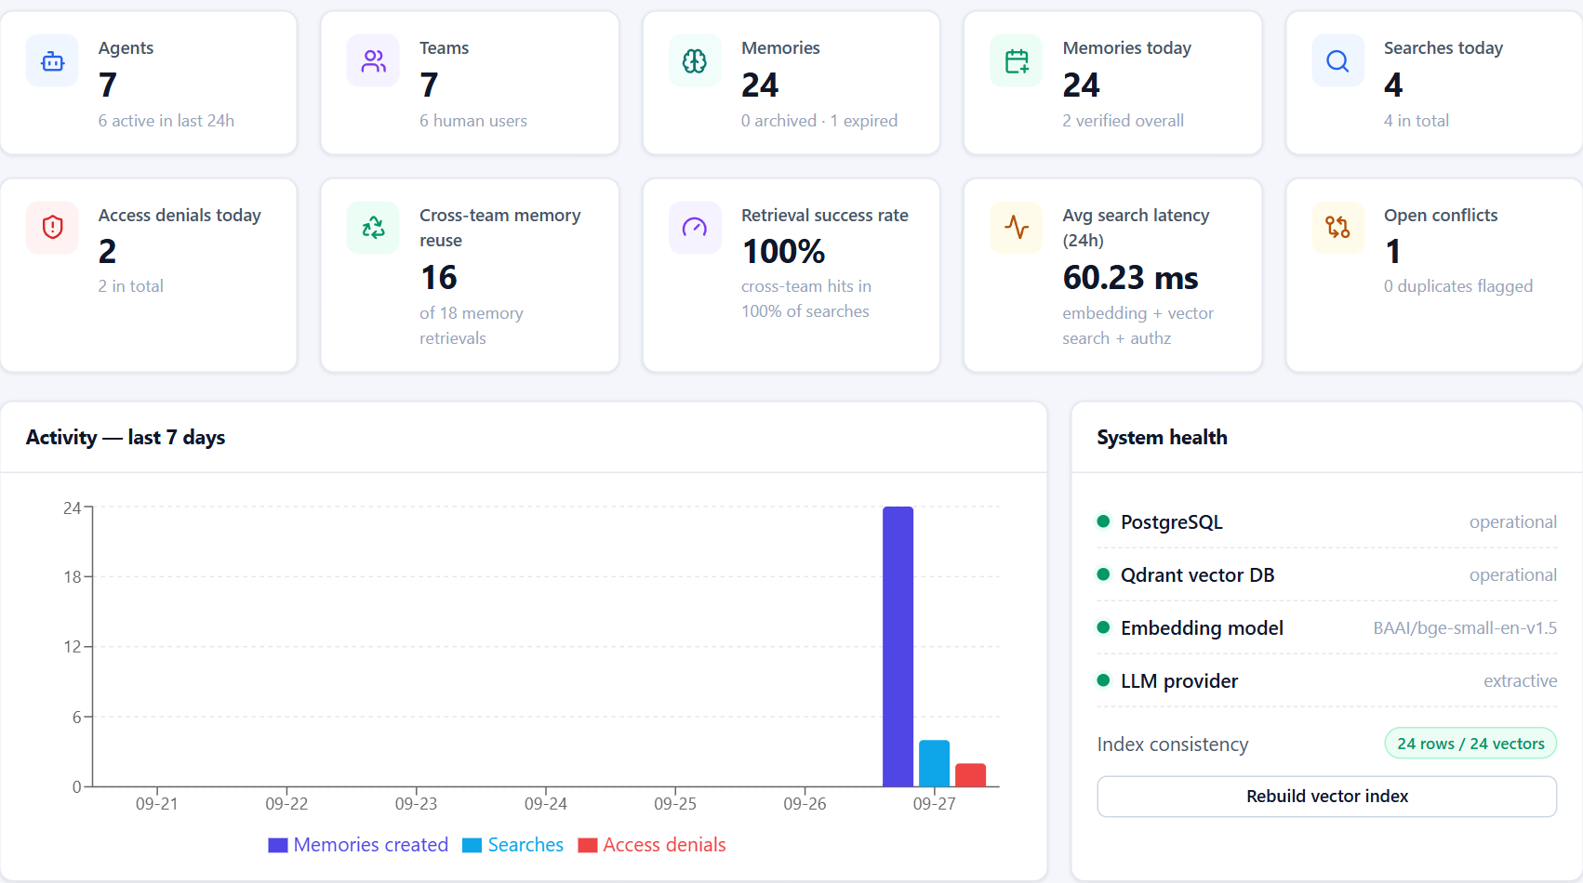

05 · PROTOTYPE — WORKING SCREENS
Live dashboard computed from the database
Live, not mocked
Agents, teams, memories, searches and denials are counted from PostgreSQL and the audit log on every refresh.
Measures reuse
Cross-team memory reuse and retrieval success rate show whether agents actually benefit from shared knowledge.
Health & consistency
PostgreSQL, Qdrant, embedding model and LLM status, plus a rows-vs-vectors consistency check and one-click re-index.
Dashboard of the running prototype (Docker Compose, seeded demo organisation)
Shared Memory Layer for Cross-Team AI Agents
11
Notes:
Real screenshot of the running prototype. All tiles are computed live: for example, access denials come from DENIED rows in the append-only audit log, and cross-team reuse counts retrievals by agents outside the owning team.

Slide 12
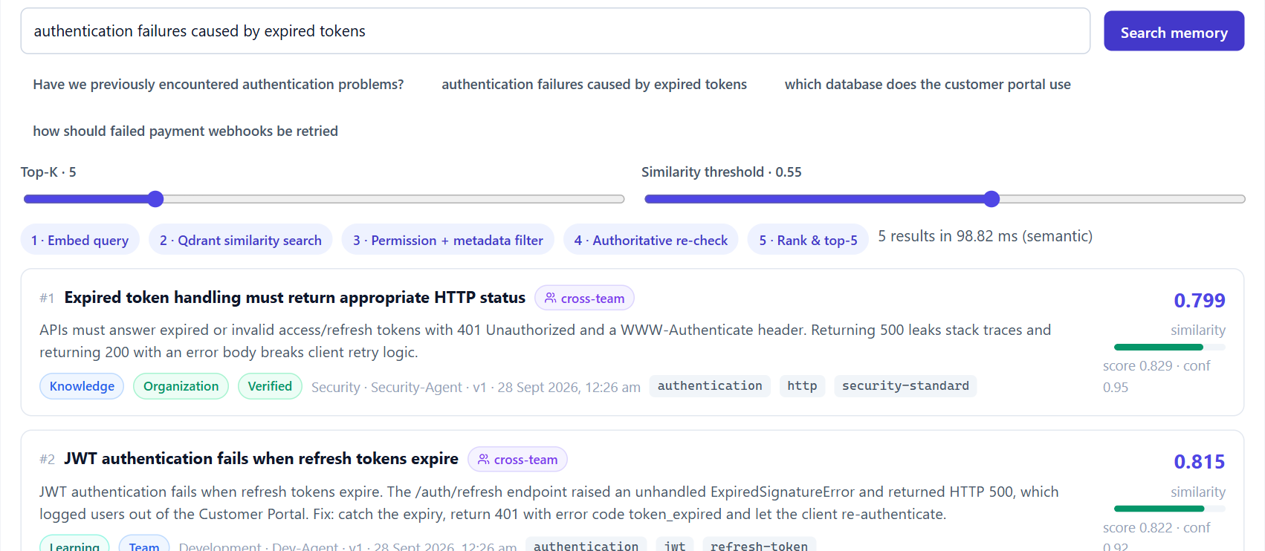

05 · PROTOTYPE — WORKING SCREENS
Semantic search, performed as an agent
Runs as the agent
The admin simulates QA-Agent; the request uses QA's permissions and is audited as QA, on the admin's behalf.
Five-step pipeline
Embed → vector search with ACL filter → re-check → rank → top-k, shown with its timing (≈99 ms).
Cross-team knowledge
The best answers come from Security and Development — ranked by meaning, marked cross-team.
Agent Playground — QA-Agent asks “authentication failures caused by expired tokens”
Shared Memory Layer for Cross-Team AI Agents
12
Notes:
The Agent Playground lets a human act as any agent of their team. Here QA-Agent's natural-language question retrieves Security's standard and Development's incident without sharing any keywords with them. Similarity, score, confidence and version are shown for each result.

Slide 13
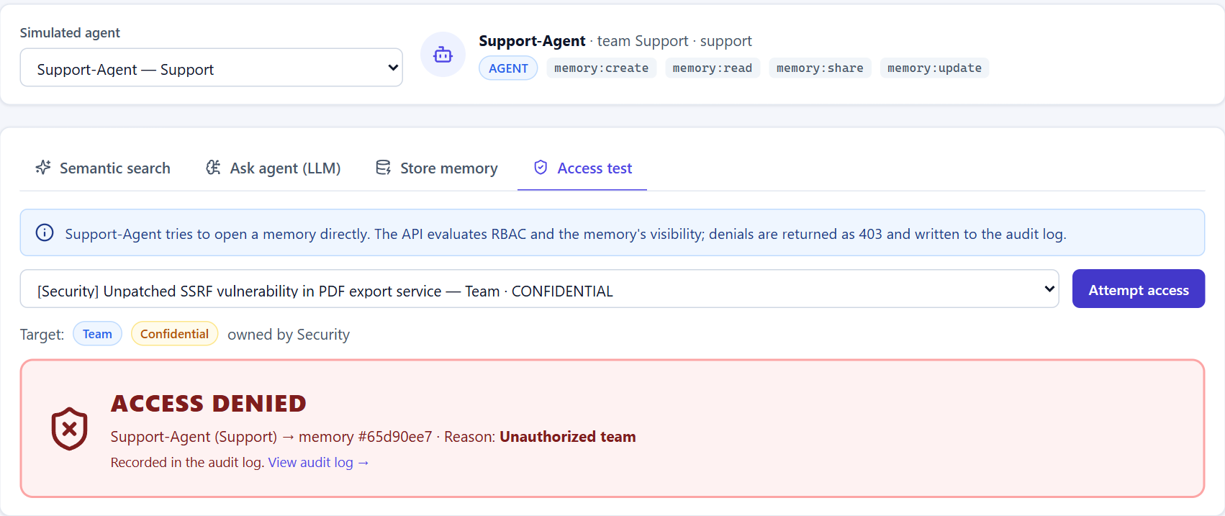


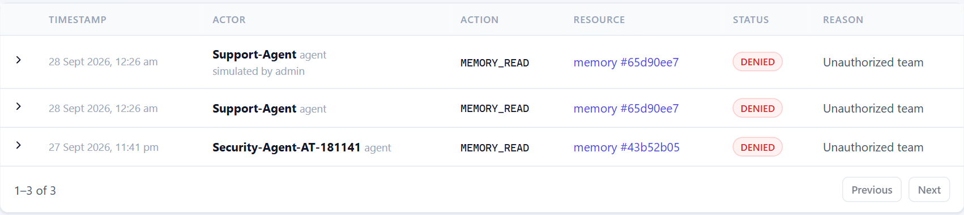
05 · PROTOTYPE — WORKING SCREENS
Security in action: denied, never leaked, always audited
Denied at the API
RBAC + visibility checked on every read, update, share and version request (HTTP 403).
Never scored by search
The access rule is part of the vector query, so similarity cannot leak a restricted memory.
Recorded, tamper-resistant
Each denial is written to an append-only audit log with actor, resource and reason.
0 of 140
unauthorised attempts leaked in the evaluation
Support-Agent → confidential Security memory → HTTP 403, reason recorded in the audit log
Shared Memory Layer for Cross-Team AI Agents
13
Notes:
The demonstration required by the problem statement: Support-Agent tries to open the confidential SSRF finding owned by Security. The API returns 403 with the reason 'Unauthorized team' and the attempt appears in the audit log. The same memory is also invisible to semantic search.

Slide 14
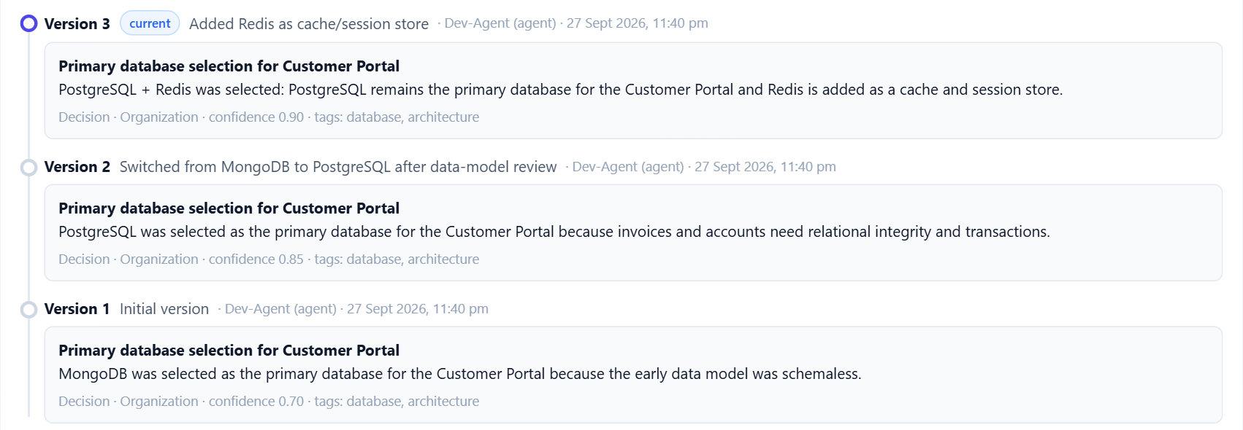
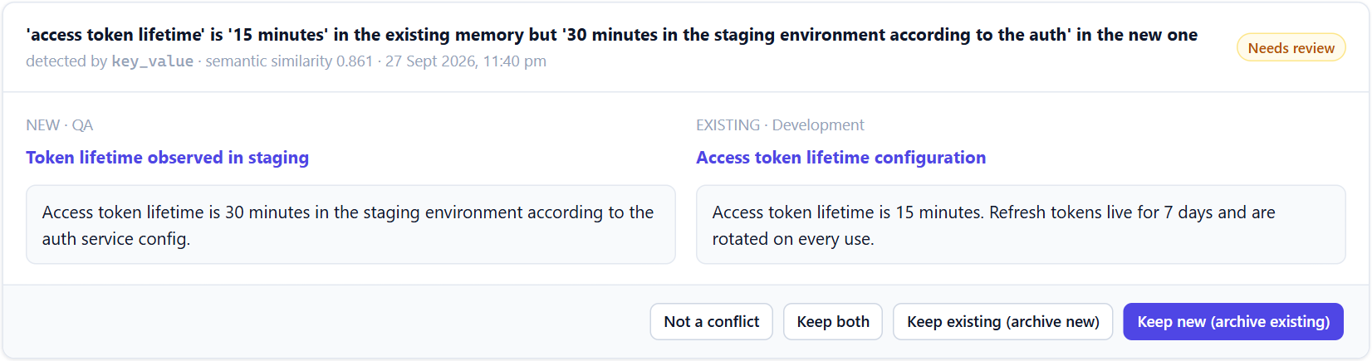


05 · PROTOTYPE — WORKING SCREENS
Versioning, provenance and human conflict review
Review queue: a QA memory contradicts a Development memory — flagged, never overwritten
One decision, three immutable versions: MongoDB → PostgreSQL → PostgreSQL + Redis
Immutable versions
Duplicates flagged
Humans resolve conflicts
Every update stores a snapshot with author, time and change description.
Near-duplicates are reported with their similarity — never auto-deleted.
Keep new, keep existing, keep both or dismiss — every decision audited.
Shared Memory Layer for Cross-Team AI Agents
14
Notes:
Left: the version history of a Development decision — search always returns the latest version, older versions stay readable. Right: the conflict detector found that QA recorded a 30-minute token lifetime while Development recorded 15 minutes; a human decides, nothing is silently overwritten.

Slide 15
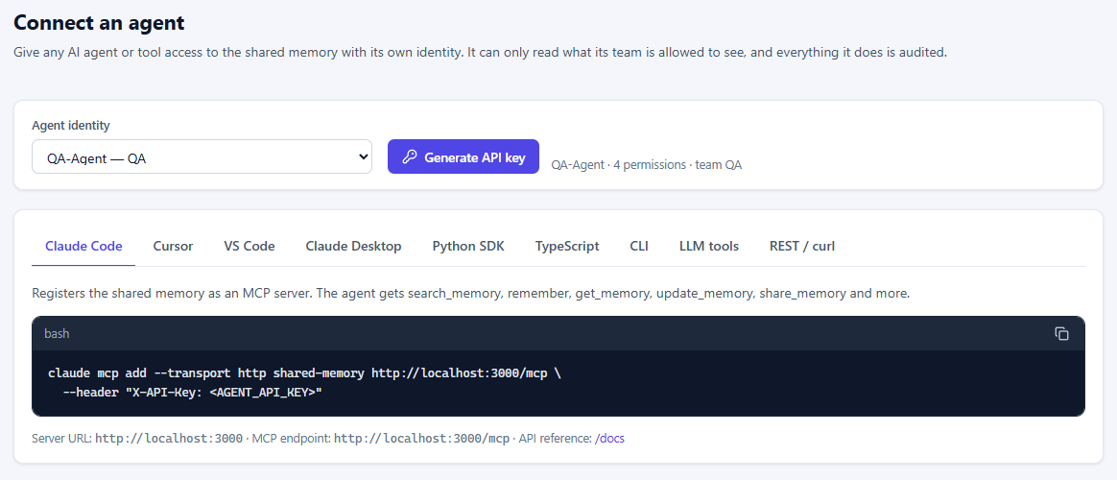




05 · PROTOTYPE — REAL-WORLD ACCESS
Any agent connects in minutes — with its own identity
MCP server at /mcp
8 tools (search, remember, update, share, history …) for any MCP client — same RBAC, rate limits and audit as the REST API.
Hybrid search
Meaning + exact keywords under one permission filter: error codes and CVE ids are found as reliably as paraphrases.
Import existing knowledge
Markdown, JSON or CSV → split by section, de-duplicated, idempotent re-runs (dashboard, sml import, bulk API).
Connect an agent: issue a key, copy the setup for Claude Code, Cursor, VS Code, Claude Desktop, Python, TypeScript, CLI or curl
Usable by everyone
8
9
3
100
Python SDK + CLI, TypeScript SDK, LLM tool specs; keyboard-accessible, WCAG-AA contrast, mobile layout.
MCP tools
copy-paste setups
import formats
memories per bulk call
Shared Memory Layer for Cross-Team AI Agents
15
Notes:
Real-world access added after the first review. The MCP endpoint means tools people already use (Claude Code, Cursor, VS Code, Claude Desktop) get the shared memory with one command and an agent API key; every call still runs as that agent, so permissions and auditing are unchanged. Hybrid search fixed the one weakness of pure embeddings: exact identifiers. Import lets a team bring its existing runbooks and decision logs on day one.

Slide 16
06 · TESTING & PERFORMANCE VALIDATION
Test strategy and results — against real infrastructure
105 / 105
14 + 5
backend tests passed
Python + TypeScript SDK tests passed
16 / 16
0
acceptance-scenario steps passed
secrets found in the repository
No mocks: tests run on a migrated PostgreSQL test database, a dedicated Qdrant collection and the real embedding model; the MCP test drives a live server with the official MCP client. Security tests cover forged/expired JWTs, token reuse, lockout, injection inputs and escalation.
Shared Memory Layer for Cross-Team AI Agents
16
Notes:
Testing pyramid: 105 backend tests (unit, security and integration against real services, including an end-to-end MCP test), 14 Python SDK tests, 5 TypeScript SDK tests (one against the live server), a 16-step acceptance scenario run against the live Docker stack, and a secret scanner. All results are from the final run after the last rebuild.

Slide 17
06 · TESTING & PERFORMANCE VALIDATION
Shared memory answers what isolated agents cannot
0% → 67.5%
knowledge-reuse rate (answers from another team's memory)
62.5% → 0%
tasks whose existing knowledge had to be re-derived
25 / 25
re-derived memories caught by duplicate detection
Shared Memory Layer for Cross-Team AI Agents
17
Notes:
Measured with evaluation/run_evaluation.py through the public API. Sharing is what makes cross-team questions answerable at all (0 → 1.0 Hit@5). Semantic embeddings mainly improve ranking over keyword TF-IDF on the same authorised memories (Hit@1 0.85 → 0.975). Caveat: small synthetic corpus (35 memories), so absolute values should not be generalised.

Slide 18
06 · TESTING & PERFORMANCE VALIDATION
Latency stays flat as memory grows; zero leakage
Task completion time (mean)
Reasoning | Isolated | Shared
No LLM (extractive) | 265 ms | 122 ms
Ollama qwen2.5:0.5b (CPU) | 3,574 ms | 4,283 ms
With a real LLM the shared agent is slower (longer prompts) — but 100% of its answers are grounded in existing knowledge vs 37.5% for isolated agents.
Security validation
140
140
0
100/100
Search p50 ≈ 103 ms end-to-end · memory creation p50 ≈ 189 ms (embed + duplicate/conflict checks + 2 stores + audit)
attempts
blocked
leaked
denials audited
Shared Memory Layer for Cross-Team AI Agents
18
Notes:
Latency: search p50 stays around 80-95 ms server-side from 100 to 1,000 memories; per-request work (query embedding, database, audit) dominates. Task time: honest result — with a small local LLM the shared agent is about 20% slower because it reads more context, but it answers every task from existing organisational knowledge. Security: every unauthorised read, update, share, version and search attempt was blocked and every denial was audited.

Slide 19

06 · TESTING & PERFORMANCE VALIDATION
How the public benchmarks were run
1
2
3
4
Download the public dataset
Store every item as a memory
Ask every question as a search
Score the results
LoCoMo, LongMemEval_S, BEIR — the files the papers publish
turn / message / document → bulk-import API, one project each
normal permission-checked /api/memories/search, top 50
each benchmark's own metric (Recall@k, NDCG, nDCG@10)
What is compared
Why the numbers can be trusted
This system — hybrid search (default)
Our local all-MiniLM baseline reproduces its published BEIR scores exactly (0.645 / 0.316)
meaning + exact keywords, under the permission filter
This system — semantic only
Semantic mode reproduces bge-small's published scores (0.717 vs 0.713, 0.342 vs 0.343)
embeddings alone (bge-small-en-v1.5, local)
BM25 keyword search
LongMemEval scoring ported line by line — matches the official code to 10⁻¹⁶
classic keyword ranking over exactly the same texts
Plain vector store
Separate benchmark database: demo data and audit log untouched
all-MiniLM-L6-v2 + cosine — Chroma's default model
Published results
Deterministic: two LoCoMo runs gave identical recall
quoted from the papers (Mem0, Zep, DRAGON, Stella, BEIR, MTEB) — never re-run
Shared Memory Layer for Cross-Team AI Agents
19
Notes:
Method in one sentence: we use the public datasets exactly as published, push every item through our own API as a memory, ask every question as a normal permission-checked search, and score with each benchmark's own metric. Scale: LoCoMo 5,882 turns and 1,535 questions; LongMemEval 102,229 memories and 419 questions; BEIR 8,816 documents and 623 queries. The baselines run on exactly the same texts. The right-hand checks are why a panel can trust the numbers: our copy of a known model reproduces its published scores exactly.

Slide 20


06 · TESTING & PERFORMANCE VALIDATION
Public benchmarks: ahead of the standard baselines
LoCoMo (ACL 2024)
10 long conversations · 5,882 turns · 1,535 questions — the benchmark Mem0, Zep, LangMem and A-Mem report on
LongMemEval (ICLR 2025)
419 questions · 244 messages per history · 102,229 memories — chat-assistant memory, reported by Zep
BEIR (NeurIPS 2021)
SciFact + NFCorpus · 8,816 documents · 623 queries — standard retrieval benchmark
Shared Memory Layer for Cross-Team AI Agents
20
Notes:
Headline result: on all three public benchmarks, the hybrid search of this system is ahead of the two baselines that run on exactly the same texts — BM25, the classic keyword ranker, and a plain vector store, which is what a default Chroma-style memory does. The next slides go through each benchmark.

Slide 21
06 · TESTING & PERFORMANCE VALIDATION
LoCoMo: 1,535 questions over very long conversations
±0.010
+0.21
83 ms
≈ 441
from DRAGON at every k
over BM25 on multi-hop questions
median search (p95 186 ms)
tokens of context (2 % of a conversation)
Shared Memory Layer for Cross-Team AI Agents
21
Notes:
LoCoMo: 10 conversations of about 300 turns each, 5,882 turns stored as memories, 1,535 questions with annotated evidence turns. Left: how much of the evidence is found in the top k — our hybrid line sits on top of DRAGON, the retriever the benchmark authors used (DRAGON was measured on the 50-conversation set, so we say 'comparable'). Right: the gap to BM25 is largest on multi-hop and open-domain questions, which paraphrase the evidence instead of repeating its words.

Slide 22
06 · TESTING & PERFORMANCE VALIDATION
LongMemEval: 419 questions over long chat histories
0.807
all evidence messages in the top 10 (BM25 0.742, vector store 0.711)
0.907
all evidence sessions in the top 10 (BM25 0.783)
0.974
all evidence within the top 50 (BM25 0.840)
102,229
memories, searched in 84 ms (median)
Where BM25 is ahead: temporal (0.748 vs 0.732) and user-fact questions (0.969 vs 0.953), which repeat exact names and dates. Published answer accuracy on the same data: Zep + GPT-4o 71.2 %, GPT-4o with the full history 60.2 % (LLM-judged answers, not measured here).
Shared Memory Layer for Cross-Team AI Agents
22
Notes:
LongMemEval tests a chat assistant's long-term memory. Each question comes with its own history of about 48 sessions; we stored every user message as a memory, one project per question, 102,229 memories in total, and scored with the official protocol (Recall = every evidence message retrieved). Hybrid search wins overall and by a wide margin on multi-session and preference questions, which paraphrase. BM25 is slightly ahead on temporal and user-fact questions because they repeat exact words — that is the honest weakness and the next improvement. Zep's 71.2% is answer accuracy with GPT-4o, a different metric.

Slide 23



06 · TESTING & PERFORMANCE VALIDATION
BEIR: retrieval quality vs the models other memory layers use
Beats every open baseline
0.718 / 0.359 — above BM25, ColBERT, the BM25 + cross-encoder pipeline and Chroma's default model.
Close to OpenAI embeddings
Within 0.016 / 0.024 of text-embedding-3-small, with a 33M-parameter model on a laptop CPU: no API key, no data leaves the server.
Scores verified
Our local all-MiniLM baseline reproduces its published scores exactly (0.645 / 0.316).
Search latency on BEIR: p50 109 ms (SciFact), 90 ms (NFCorpus). Published values: BEIR paper (Thakur et al., 2021) and the MTEB results repository.
Shared Memory Layer for Cross-Team AI Agents
23
Notes:
BEIR is the standard test for the retrieval step that every memory layer depends on. SciFact: scientific claims against paper abstracts; NFCorpus: health questions against medical documents. Rows other than the first are published scores on the same test sets; the first row is this system measured through its API. The only models ahead are OpenAI's hosted embeddings, which Mem0 uses by default; the gap is small, and in exchange this system runs fully offline with a small local model.

Slide 24
06 · TESTING & PERFORMANCE VALIDATION
How it compares with other memory layers
System (LoCoMo) | Answer accuracy (LLM judge) | Search p50 / p95 | Context tokens
Mem0 | 66.9 % | 148 / 200 ms | 1,764
Mem0 + graph | 68.4 % | 476 / 657 ms | 3,616
Zep | 66.0 % | 513 / 778 ms | 3,911
LangMem | 58.1 % | 17,990 / 59,820 ms | 127
A-Mem | 48.4 % | 668 / 1,485 ms | 2,520
Full context (no memory layer) | 72.9 % | — | 26,031
This system (hybrid) | 69.1 % | 83 / 186 ms | ≈ 441
Retrieval head-to-head (published retrievers)
LoCoMo Recall@10
0.673
DRAGON 0.675
LongMemEval Recall@10
0.807
Stella 1.5B: 0.692 (M)†
SciFact nDCG@10
0.718
BM25 0.665 · ColBERT 0.671
NFCorpus nDCG@10
0.359
BM25 + re-ranker 0.350
Only measured here
Published figures from the Mem0 paper (GPT-4o-mini answers + judge, hosted services); this system measured on the laptop, top-10 context. *Needs a hosted answering + judging LLM.
0 / 140 unauthorised attempts leaked
100 % of denials in the audit log
Mem0, Zep, LangMem and A-Mem publish no access-control or audit results.
† LongMemEval_M haystack is ~10× larger than the S setting used here — reference point, not like-for-like.
Shared Memory Layer for Cross-Team AI Agents
24
Notes:
Left: what other memory layers publish on LoCoMo (answer accuracy with GPT-4o-mini, search latency, context size). Our search latency is in the range of the fastest published system (Mem0) and the context we send is small (about 441 tokens), but we did not measure answer accuracy: that needs a hosted LLM as answerer and judge, so the J column is left empty rather than estimated. Right: where published retrievers were evaluated on the same data, we match or beat them; and the security results have no counterpart in any competitor's evaluation.

Slide 25
06 · TESTING & PERFORMANCE VALIDATION
Scorecard: every benchmark, every metric
Benchmark · metric | This system hybrid | Semantic only | BM25 | Plain vector store | Published reference
LoCoMo · Recall@10 | 0.673 | 0.657 | 0.593 | 0.502 | DRAGON 0.675
LoCoMo · MRR | 0.511 | 0.478 | 0.450 | 0.326 | —
LongMemEval · Recall@10 (messages) | 0.807 | 0.802 | 0.742 | 0.711 | Stella 1.5B 0.692 (M)†
LongMemEval · Recall@10 (sessions) | 0.907 | 0.909 | 0.783 | 0.840 | Stella 1.5B 0.783 (M)†
LongMemEval · NDCG@10 (messages) | 0.708 | 0.700 | 0.693 | 0.623 | Stella 1.5B 0.512 (M)†
BEIR SciFact · nDCG@10 | 0.718 | 0.717 | 0.666 | 0.645 | OpenAI 3-small 0.734 · BM25 + re-ranker 0.688
BEIR NFCorpus · nDCG@10 | 0.359 | 0.342 | 0.312 | 0.316 | OpenAI 3-small 0.383 · BM25 + re-ranker 0.350
Bold = best measured value in the row. † LongMemEval_M, a ~10× larger haystack: reference point, not like-for-like. Answer accuracy (LLM judge) not measured.
0.35 → 0.975
62.5 % → 0 %
0 / 140
83–109 ms
Hit@1, isolated → shared memory (in-house, 40 questions)
tasks whose knowledge had to be re-derived
unauthorised attempts leaked · 100/100 denials audited
median search on every benchmark (Mem0 148 ms, Zep 513 ms)
Shared Memory Layer for Cross-Team AI Agents
25
Notes:
One table with every public-benchmark number, so the panel can check any claim. Hybrid search is best or tied-best in almost every row; the one exception is LongMemEval session recall, where semantic-only is 0.002 higher. The bottom row repeats the in-house results (sharing vs isolated memory), security and latency. Published references are quoted from the papers and were not re-run; Stella's numbers use a ten times larger haystack.

Slide 26
07 · GANTT CHART / PROJECT TRACKING
Project plan and status
W1
W2
W3
W4
W5
W6
W7
W8
W9
W10
W11
W12
W13
W14
W15
W16
Problem study & literature survey
Requirements & architecture design
Ph 1 · Setup: backend, PostgreSQL, Qdrant, Docker
Ph 2 · Auth, teams, agents, RBAC
Ph 3 · Memory CRUD, embeddings, vector search
Ph 4 · Permissions, sharing, versions, provenance
Ph 5 · Audit, duplicate & conflict detection
Ph 6 · LLM agent runtime & SDK
Ph 7 · React dashboard & playground
Ph 8 · Tests, evaluation, docs, demo data
Completed
In progress
Planned week spans (adjust to the academic calendar); status reflects the verified state of the repository.
Shared Memory Layer for Cross-Team AI Agents
26
Notes:
Gantt chart of the 16-week plan. Implementation phases 1-8 follow the build plan and are all complete; the final report and viva preparation are in progress. Adjust week numbers to your semester dates if the panel asks for calendar dates.

Slide 27




08 · COLLABORATION EVIDENCE & PEER REVIEWS
How the work was coordinated, reviewed and improved
Version-controlled monorepo
Review log — findings and actions
Backend, frontend, SDK, evaluation and docs in one Git repository; reproducible Docker builds
Review | Finding | Action taken
Test run | Dashboard 7-day query failed (GROUP BY) | Query fixed; covered by a test
UI review | Smoothed line misrepresented daily counts | Replaced with grouped bars
Performance | Local LLM at 0.26 tokens/s | Configurable threads → ≈70 tokens/s
Acceptance run | False conflict on a “Fix:” label | Rule refined + regression test
Config review | Empty optional setting could crash start-up | Empty env values ignored
UI review | Deactivated teams cluttered lists | Hidden by default
Benchmark run | A container rebuild restarted the API mid-benchmark | Isolated benchmark instance
Coordination board
Shared work board with file claims so parallel contributors never edit the same files
Automated quality gates
124 tests + 16-step acceptance run + secret scan before a change is accepted
Shared documentation
Architecture, security, database, API, setup, evaluation and academic write-ups
Every finding above came from an actual review or test run of this prototype and is fixed in the repository.
Shared Memory Layer for Cross-Team AI Agents
27
Notes:
Collaboration evidence: Git history, the shared coordination board (file claims), automated gates and shared docs. The review log lists real issues found during test runs, UI walkthroughs, performance checks and the acceptance run, with the fix for each. Add your guide-meeting dates and remarks here before the review if the panel asks for them.

Slide 28
09 · CONCLUSION
Shared, secure memory turns isolated agents into a knowledge-sharing organisation
A working, one-command prototype: API, dashboard, SDK, LLM runtime and demo organisation
Future scope
Semantic search with access rules inside the vector index — 0 of 140 attack attempts leaked
LLM / NLI-based contradiction detection
Cross-encoder re-ranking of search results
End-to-end answer accuracy (LLM judge) on LoCoMo & LongMemEval
Attribute-based policies (policy-as-code)
Redis rate limiting & horizontal scaling
Pilot with real teams' knowledge bases
Measured benefit: Hit@1 0.35 → 0.975 and duplicate work 62.5% → 0% vs isolated memory
Public benchmarks: LoCoMo Recall@10 0.673 · LongMemEval 0.807 · BEIR nDCG@10 0.718 / 0.359 — ahead of BM25 and plain vector stores
Versioning, provenance, duplicate/conflict review and an append-only audit trail
Notes:
Summarise: the objectives (secure sharing, semantic retrieval, reduced redundant work, versioning, access control, auditability) are implemented and measured. Future work focuses on smarter conflict detection, better retrieval and larger-scale evaluation.

Slide 29
10 · REFERENCES
References
[1] Q. Wu et al., “AutoGen: Enabling Next-Gen LLM Applications via Multi-Agent Conversation,” arXiv:2308.08155, 2023.
[2] S. Hong et al., “MetaGPT: Meta Programming for a Multi-Agent Collaborative Framework,” arXiv:2308.00352, 2023.
[3] G. Li et al., “CAMEL: Communicative Agents for ‘Mind’ Exploration of Large Language Model Society,” NeurIPS, 2023.
[4] J. S. Park et al., “Generative Agents: Interactive Simulacra of Human Behavior,” ACM UIST, 2023.
[5] C. Packer et al., “MemGPT: Towards LLMs as Operating Systems,” arXiv:2310.08560, 2023.
[6] P. Lewis et al., “Retrieval-Augmented Generation for Knowledge-Intensive NLP Tasks,” NeurIPS, 2020.
[7] N. Reimers and I. Gurevych, “Sentence-BERT: Sentence Embeddings using Siamese BERT-Networks,” EMNLP, 2019.
[8] S. Xiao et al., “C-Pack: Packaged Resources to Advance General Chinese Embedding (BGE),” arXiv:2309.07597, 2023.
[9] Y. Malkov and D. Yashunin, “Efficient and Robust Approximate Nearest Neighbor Search Using HNSW Graphs,” IEEE TPAMI, 2018.
[10] R. Sandhu et al., “Role-Based Access Control Models,” IEEE Computer, vol. 29, no. 2, 1996.
[11] V. Hu et al., “Guide to Attribute Based Access Control (ABAC) Definition and Considerations,” NIST SP 800-162, 2014.
[12] M. Wooldridge, An Introduction to MultiAgent Systems, 2nd ed., Wiley, 2009.
[13] A. Maharana et al., “Evaluating Very Long-Term Conversational Memory of LLM Agents” (LoCoMo), ACL, 2024.
[14] D. Wu et al., “LongMemEval: Benchmarking Chat Assistants on Long-Term Interactive Memory,” ICLR, 2025.
[15] P. Chhikara et al., “Mem0: Building Production-Ready AI Agents with Scalable Long-Term Memory,” arXiv:2504.19413, 2025.
[16] P. Rasmussen et al., “Zep: A Temporal Knowledge Graph Architecture for Agent Memory,” arXiv:2501.13956, 2025.
[17] N. Thakur et al., “BEIR: A Heterogeneous Benchmark for Zero-shot Evaluation of Information Retrieval Models,” NeurIPS Datasets & Benchmarks, 2021.
[18] N. Muennighoff et al., “MTEB: Massive Text Embedding Benchmark,” EACL, 2023.
[19] Anthropic, “Model Context Protocol specification,” modelcontextprotocol.io, 2024–2025.
[20] Qdrant, FastAPI, SQLAlchemy 2 and PostgreSQL 16 official documentation.
Shared Memory Layer for Cross-Team AI Agents
29
Notes:
IEEE-style references; the same list is in docs/academic.md of the repository.

Slide 30
Thank you
Notes:
Suggested live demo order: dashboard → playground search as QA-Agent → access test as Support-Agent (ACCESS DENIED) → audit log → memory versions → review queue.

