Slide 1





B.TECH FINAL YEAR PROJECT · PROJECT REVIEW
Shared Memory Layer for Cross-Team AI Agents
Dev-Agent
QA-Agent
Shared
Memory
A secure, semantic and versioned organisational memory that lets AI agents of different teams reuse each other's knowledge — without leaking what they must not see.
Presented by: Kushagra
Guide: Dr. Ranjeet Bidwe
Department of Computer Science & Engineering
September 2026
Security-Agent
Support-Agent
Notes:
Title slide. Replace the name, roll number, guide and institute placeholders before presenting. One-line pitch: agents from different teams share one governed memory instead of keeping isolated silos.

Slide 2
AGENDA
What this review covers
01
Introduction
06
Testing & Performance Validation
02
Motivation
07
Gantt Chart / Project Tracking
03
Status of Current Work
08
Collaboration Evidence & Peer Reviews
04
Research Gaps
09
Conclusion
05
Prototype / Software Development
10
References
Shared Memory Layer for Cross-Team AI Agents
2
Notes:
Highlighted items (prototype and validation) are where most of the review time goes.

Slide 3




01 · INTRODUCTION
One governed memory for every team's AI agents
AI agents now write code, test releases, review security and answer customers. This project builds the infrastructure that lets them remember together: a secure shared memory layer where authorised agents store, find, share and version knowledge created by other teams.
Agent A → Shared Memory → Agent B
Semantic retrieval
Find knowledge by meaning (embeddings + vector search), not keywords.
Secure sharing
RBAC + five visibility levels enforced in the API and inside the vector index.
Versioning & provenance
Every update is an immutable version; who created, changed and read it is traceable.
Point-to-point
10 links for 5 agents, no shared policy
Shared memory
5 links, one place to authorise & audit
Auditability
Append-only audit log of every access — including denials and their reasons.
n agents need n(n−1)/2 pairwise channels, but only n connections to a shared layer.
Shared Memory Layer for Cross-Team AI Agents
3
Notes:
Introduce the idea: instead of agents messaging each other, they read and write one governed memory. The graph on the right shows why this scales: 5 agents need 10 pairwise links but only 5 links to the hub, and the hub is the single place where access control and auditing happen.

Slide 4





02 · MOTIVATION
Isolated agent memory wastes work and splits knowledge
62.5%
Duplicated work
Repeated reasoning
of agent tasks had to be re-derived when each agent could only use its own memory
An agent re-investigates a problem another team's agent already solved.
Expensive LLM reasoning is spent re-deriving facts that already exist.
Measured in this project's benchmark: 40 tasks, 4 teams
…but one big vector store is unsafe
Information silos
Inconsistent decisions
Similarity ≠ authorisation: a Support agent asking about PDF export would retrieve Security's confidential SSRF finding.
Knowledge stays locked inside one team's agent or chat history.
Two agents record contradicting facts (MongoDB vs PostgreSQL) and nobody notices.
Shared Memory Layer for Cross-Team AI Agents
4
Notes:
Four pains of isolated memory. The 62.5% figure is not from literature — it is measured by our own benchmark (25 of 40 tasks needed another team's knowledge). The red box explains why simply pooling everything into one vector database is not acceptable: semantic similarity would leak confidential memories.

Slide 5
03 · STATUS OF CURRENT WORK
Existing work shares context, not secure long-term memory
Approach | Persistent memory | Shared across teams | Semantic retrieval | Per-memory access control | Versioning & provenance | Security audit trail
AutoGen (Wu et al., 2023) | ◐ | ◐ | ◐ | ✗ | ✗ | ✗
MetaGPT (Hong et al., 2023) | ◐ | ◐ | ◐ | ✗ | ✗ | ✗
CAMEL (Li et al., 2023) | ✗ | ◐ | ✗ | ✗ | ✗ | ✗
Generative Agents (Park et al., 2023) | ✓ | ✗ | ✓ | ✗ | ✗ | ✗
MemGPT (Packer et al., 2023) | ✓ | ✗ | ✓ | ✗ | ✗ | ✗
RAG + vector-DB memory (LangChain, LlamaIndex) | ✓ | ◐ | ✓ | ◐ | ✗ | ✗
This project — Shared Memory Layer | ✓ | ✓ | ✓ | ✓ | ✓ | ✓
✓ supported ◐ partial / session-scoped / via extensions ✗ not addressed — assessment based on the designs described in the cited papers and documentation.
Shared Memory Layer for Cross-Team AI Agents
5
Notes:
State of the art: multi-agent frameworks (AutoGen, MetaGPT, CAMEL) share context within one run; memory systems (Generative Agents, MemGPT, RAG memories) give one agent long-term semantic memory. None combines cross-team sharing with per-memory access control, versioning and a security audit trail.

Slide 6

03 · STATUS OF CURRENT WORK
Project status: working prototype, all 8 build phases complete
Implementation phases
56
18
Phase 1 Repository, backend, PostgreSQL, Qdrant, Docker
documented REST endpoints
normalised database tables
Phase 2 Authentication, users, teams, agents, RBAC
107
10
Phase 3 Memory CRUD, embeddings, vector search
automated tests (99 backend + 8 SDK)
dashboard screens
Phase 4 Permission filtering, sharing, versioning, provenance
Phase 5 Audit logs, duplicate & conflict detection
≈13k
1
Phase 6 LLM agent runtime & Python SDK
lines of code incl. 1.5k of tests
command to run 4 services (Docker)
Phase 7 React dashboard & Agent Playground
Phase 8 Tests, evaluation benchmark, docs, demo data
Shared Memory Layer for Cross-Team AI Agents
6
Notes:
Our own status. All eight implementation phases from the project plan are done and verified end to end with docker compose up --build on a clean machine. Numbers are from the repository: 56 endpoints in the OpenAPI spec, 18 tables in the Alembic migration, 99 backend + 8 SDK tests.

Slide 7




04 · RESEARCH GAPS
What is missing — and how this project fills it
RESEARCH GAP
OUR APPROACH
Memory is private to one agent or lives only for one session
Persistent organisational memory shared by independent agents of different teams
Semantic similarity ignores authorisation — vector search can leak
Access rules compiled into the Qdrant filter + authoritative re-check in PostgreSQL
No versioning or provenance of agent knowledge
Immutable version history, provenance and an append-only audit trail
Duplicates and contradictions go unnoticed
Semantic duplicate detection + rule-based conflict flags with human review
No measured comparison of shared vs isolated agent memory
Reproducible benchmark: accuracy, reuse, duplicate work, latency, leakage
Shared Memory Layer for Cross-Team AI Agents
7
Notes:
Five gaps derived from the literature survey. The key technical one is the second: in a normal RAG setup, the vector search ranks everything by similarity and filtering happens afterwards (or not at all). We push the permission rule into the vector index itself, so an unauthorised memory is never even scored.

Slide 8






05 · PROTOTYPE / SOFTWARE DEVELOPMENT
System architecture
FastAPI backend
PostgreSQL
Agent gateway / REST API
metadata · versions · ACL · audit
AI agents
validation · rate limiting · request IDs
Python SDK · API key / JWT
Authentication
Qdrant
JWT · rotating refresh tokens · API keys · Argon2id
vectors + permission payload
Authorisation
Humans
RBAC permissions + per-memory visibility
Embedding model
React dashboard via nginx
bge-small-en-v1.5 (local ONNX)
Memory manager
Semantic retrieval
Agent runtime
versions · sharing · archive
filtered vector search
memory-augmented LLM
LLM provider
Duplicate & conflict detection
Audit logger (own transaction)
Ollama · OpenAI · Anthropic · none
Shared Memory Layer for Cross-Team AI Agents
8
Notes:
Request path: agents (SDK) and humans (dashboard through nginx) call the FastAPI gateway; every request is authenticated, then authorised with RBAC plus the memory's visibility. PostgreSQL is the system of record; Qdrant stores one vector per memory with the fields needed for permission filtering. Audit writes use their own transaction so denied requests are always recorded.

Slide 9



05 · PROTOTYPE / SOFTWARE DEVELOPMENT
Technology stack and modules
Backend & API
Data & versioning
Semantic search
Python 3.12 · FastAPI · Pydantic v2 · Uvicorn
PostgreSQL 16 · SQLAlchemy 2 · Alembic migrations
Qdrant 1.13 (HNSW + payload indexes) · fastembed ONNX
56 documented REST endpoints with OpenAPI / Swagger
18 normalised tables, FKs, CHECKs, indexes; append-only audit trigger
bge-small-en-v1.5, 384-d — runs locally, no API key
Security
Dashboard
Agents & delivery
JWT + rotating refresh · Argon2id · hashed API keys
React 18 · Vite · TypeScript · TanStack Query · Recharts
Python SDK · LLM runtime (Ollama / OpenAI / Anthropic)
4 roles, 16 editable permissions, 5 visibility levels, rate limiting
10 screens incl. Agent Playground and conflict review
Docker Compose: 4 services, one command, seeded demo org
Shared Memory Layer for Cross-Team AI Agents
9
Notes:
Every component is replaceable behind an interface: VectorStore (Qdrant today), EmbeddingProvider (fastembed, Ollama, OpenAI) and LLM providers. The embedding model is baked into the Docker image, so semantic search works offline.

Slide 10





05 · PROTOTYPE / SOFTWARE DEVELOPMENT
Core workflows: store, search and control access
Memory creation — POST /api/memories
1
2
3
4
5
6
Validate input
Authenticate & authorise
Embed text (384-d)
Detect duplicates & conflicts
Store in PostgreSQL + Qdrant
Version 1 + audit event
Permission-aware semantic search — POST /api/memories/search
1
2
3
4
5
Embed the query
Vector search with ACL + metadata filter
Re-check each hit in PostgreSQL
Rank: similarity, importance, confidence
Top-k results + audit event
Visibility levels (per memory)
Private
Team
Selected teams
Selected agents
Organization
Creating agent only
Owning team (+ explicit grants)
Owning team + allowed teams
Only the allowed agents
Every authenticated agent
Shared Memory Layer for Cross-Team AI Agents
10
Notes:
Creation: the same pipeline for every write — including duplicate and conflict detection before storing. Search: the access rule is part of the Qdrant query filter, then every candidate is re-validated against the database row before it is returned. Visibility is chosen per memory; confidential memories can never be organisation-wide.

Slide 11
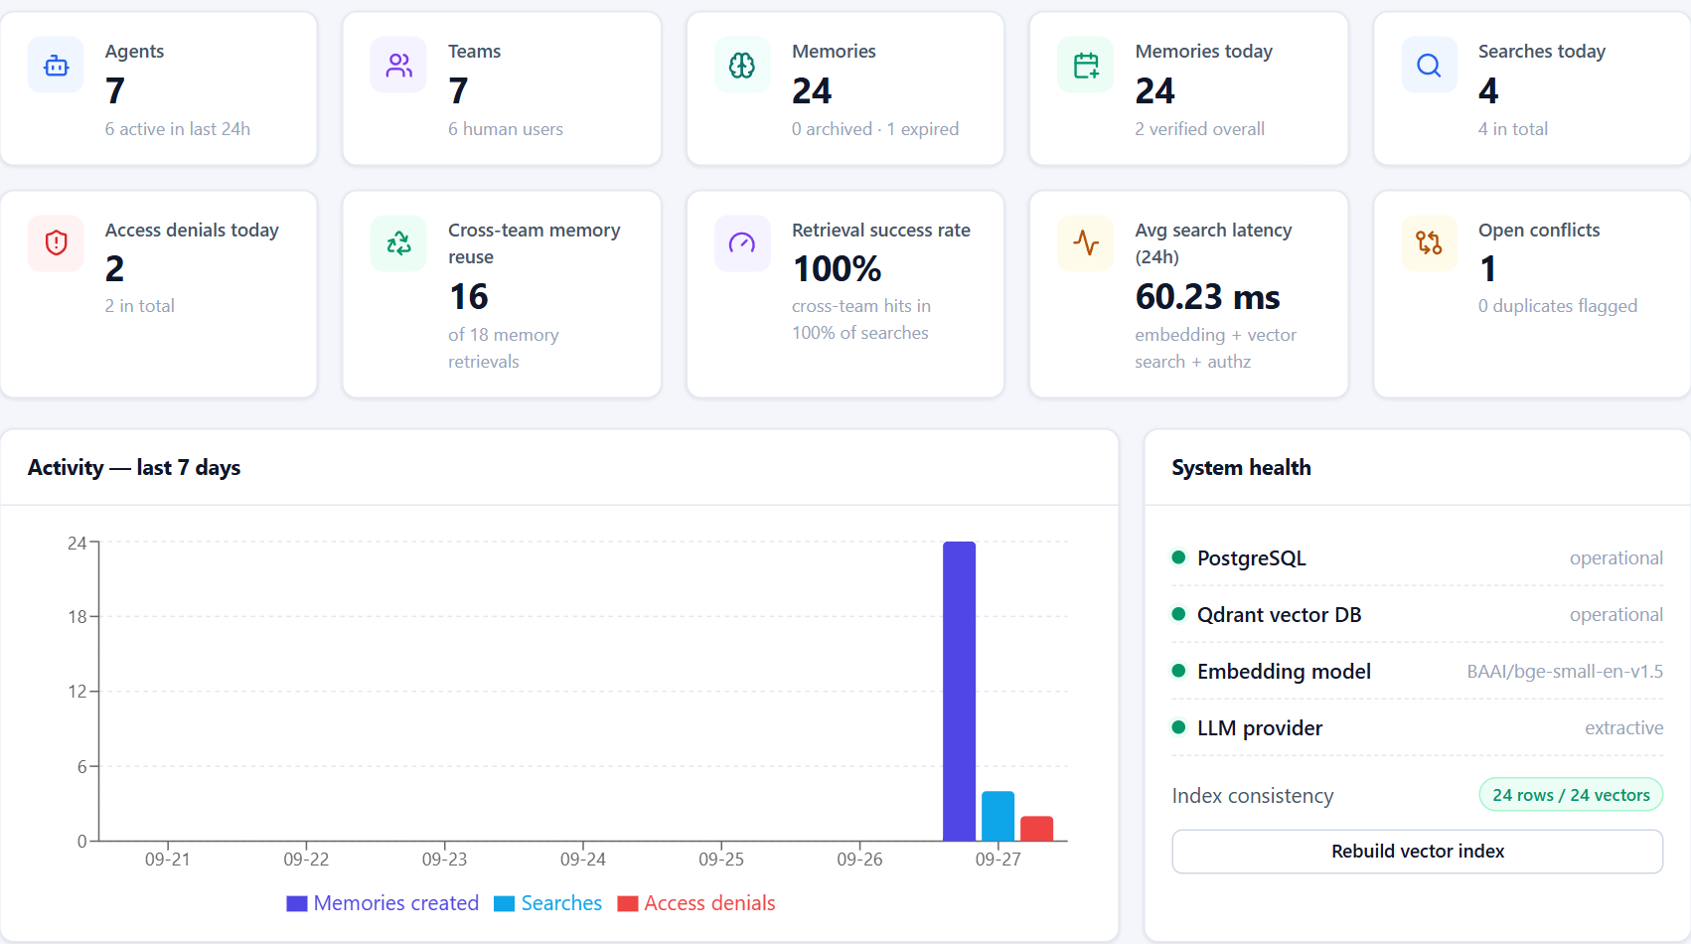

05 · PROTOTYPE — WORKING SCREENS
Live dashboard computed from the database
Live, not mocked
Agents, teams, memories, searches and denials are counted from PostgreSQL and the audit log on every refresh.
Measures reuse
Cross-team memory reuse and retrieval success rate show whether agents actually benefit from shared knowledge.
Health & consistency
PostgreSQL, Qdrant, embedding model and LLM status, plus a rows-vs-vectors consistency check and one-click re-index.
Dashboard of the running prototype (Docker Compose, seeded demo organisation)
Shared Memory Layer for Cross-Team AI Agents
11
Notes:
Real screenshot of the running prototype. All tiles are computed live: for example, access denials come from DENIED rows in the append-only audit log, and cross-team reuse counts retrievals by agents outside the owning team.

Slide 12
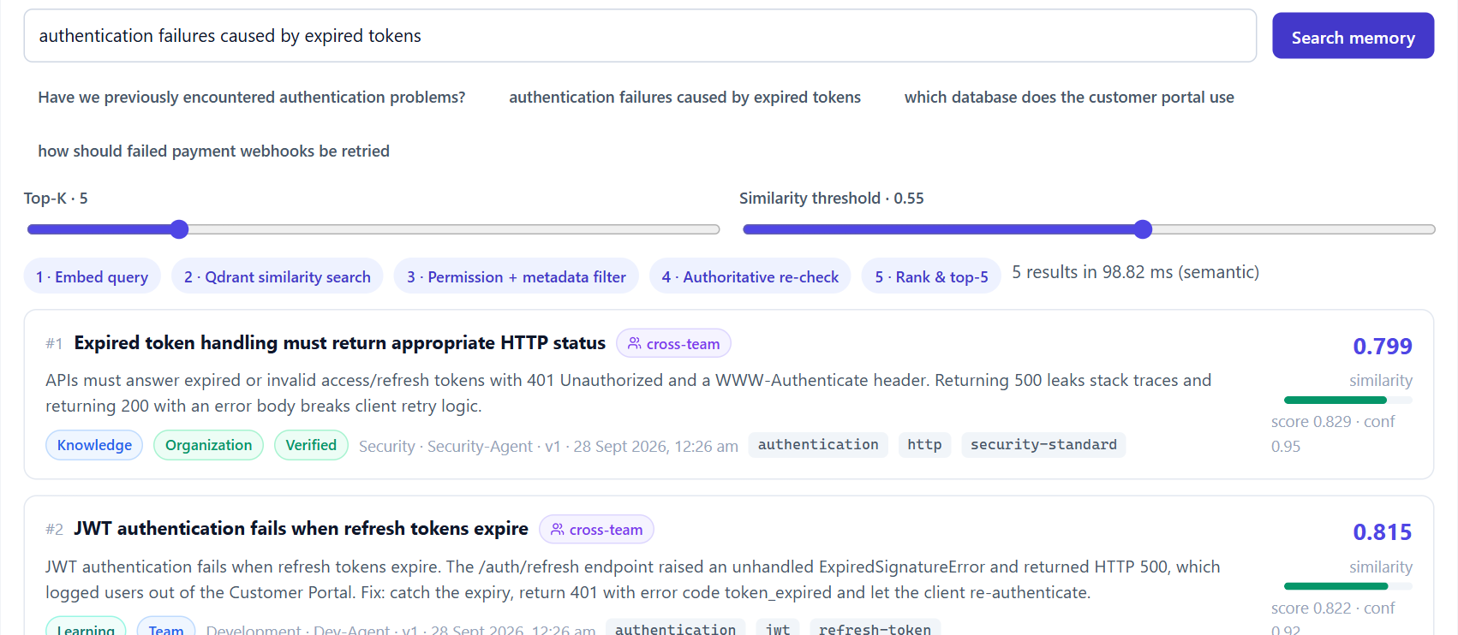

05 · PROTOTYPE — WORKING SCREENS
Semantic search, performed as an agent
Runs as the agent
The admin simulates QA-Agent; the request uses QA's permissions and is audited as QA, on the admin's behalf.
Five-step pipeline
Embed → vector search with ACL filter → re-check → rank → top-k, shown with its timing (≈99 ms).
Cross-team knowledge
The best answers come from Security and Development — ranked by meaning, marked cross-team.
Agent Playground — QA-Agent asks “authentication failures caused by expired tokens”
Shared Memory Layer for Cross-Team AI Agents
12
Notes:
The Agent Playground lets a human act as any agent of their team. Here QA-Agent's natural-language question retrieves Security's standard and Development's incident without sharing any keywords with them. Similarity, score, confidence and version are shown for each result.

Slide 13
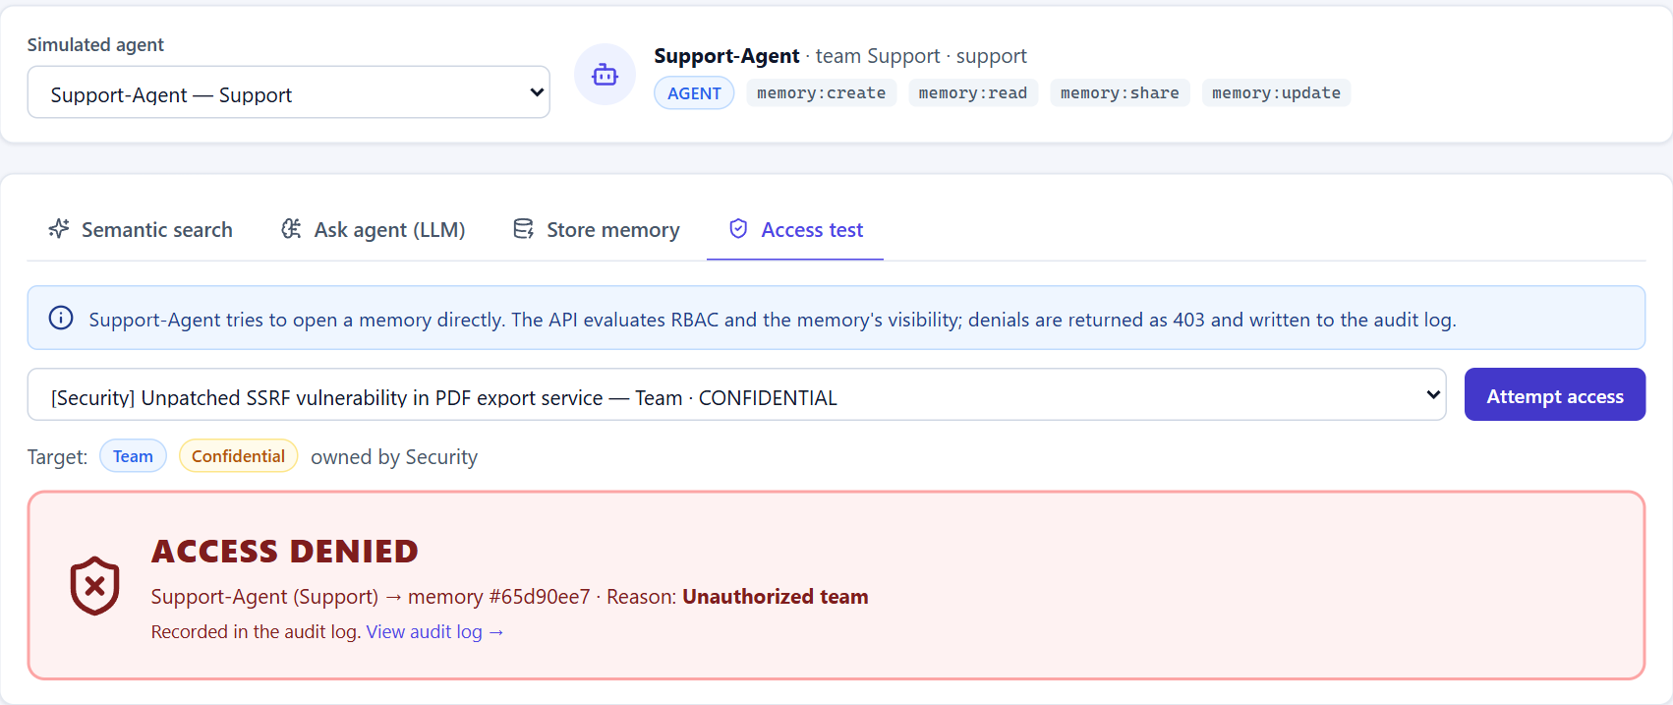


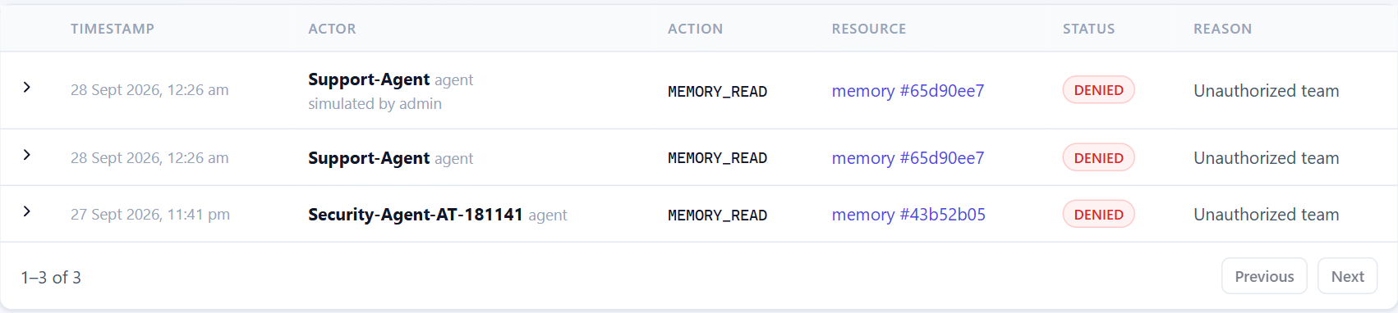
05 · PROTOTYPE — WORKING SCREENS
Security in action: denied, never leaked, always audited
Denied at the API
RBAC + visibility checked on every read, update, share and version request (HTTP 403).
Never scored by search
The access rule is part of the vector query, so similarity cannot leak a restricted memory.
Recorded, tamper-resistant
Each denial is written to an append-only audit log with actor, resource and reason.
0 of 140
unauthorised attempts leaked in the evaluation
Support-Agent → confidential Security memory → HTTP 403, reason recorded in the audit log
Shared Memory Layer for Cross-Team AI Agents
13
Notes:
The demonstration required by the problem statement: Support-Agent tries to open the confidential SSRF finding owned by Security. The API returns 403 with the reason 'Unauthorized team' and the attempt appears in the audit log. The same memory is also invisible to semantic search.

Slide 14
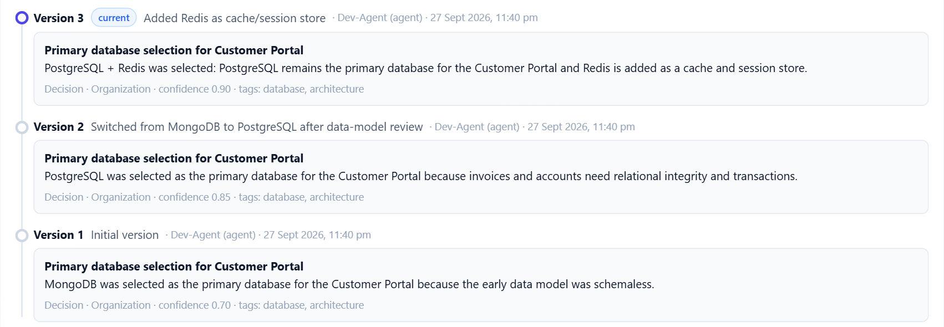
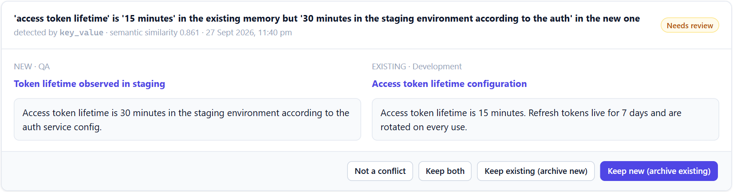


05 · PROTOTYPE — WORKING SCREENS
Versioning, provenance and human conflict review
Review queue: a QA memory contradicts a Development memory — flagged, never overwritten
One decision, three immutable versions: MongoDB → PostgreSQL → PostgreSQL + Redis
Immutable versions
Duplicates flagged
Humans resolve conflicts
Every update stores a snapshot with author, time and change description.
Near-duplicates are reported with their similarity — never auto-deleted.
Keep new, keep existing, keep both or dismiss — every decision audited.
Shared Memory Layer for Cross-Team AI Agents
14
Notes:
Left: the version history of a Development decision — search always returns the latest version, older versions stay readable. Right: the conflict detector found that QA recorded a 30-minute token lifetime while Development recorded 15 minutes; a human decides, nothing is silently overwritten.

Slide 15
06 · TESTING & PERFORMANCE VALIDATION
Test strategy and results — against real infrastructure
99 / 99
8 / 8
backend tests passed
SDK unit tests passed
16 / 16
0
acceptance-scenario steps passed
secrets found in the repository
No mocks: tests run on a migrated PostgreSQL test database, a dedicated Qdrant collection and the real embedding model. Security tests cover forged, alg=none and expired JWTs, refresh-token reuse, lockout, XSS/SQL-injection inputs and escalation attempts.
Shared Memory Layer for Cross-Team AI Agents
15
Notes:
Testing pyramid: 99 backend tests (unit, security and integration against real services), 8 SDK tests, a 16-step acceptance scenario run against the live Docker stack, and a secret scanner. All results are from the final clean run on a freshly created stack.

Slide 16
06 · TESTING & PERFORMANCE VALIDATION
Shared memory answers what isolated agents cannot
0% → 67.5%
knowledge-reuse rate (answers from another team's memory)
62.5% → 0%
tasks whose existing knowledge had to be re-derived
25 / 25
re-derived memories caught by duplicate detection
Shared Memory Layer for Cross-Team AI Agents
16
Notes:
Measured with evaluation/run_evaluation.py through the public API. Sharing is what makes cross-team questions answerable at all (0 → 1.0 Hit@5). Semantic embeddings mainly improve ranking over keyword TF-IDF on the same authorised memories (Hit@1 0.85 → 0.975). Caveat: small synthetic corpus (35 memories), so absolute values should not be generalised.

Slide 17
06 · TESTING & PERFORMANCE VALIDATION
Latency stays flat as memory grows; zero leakage
Task completion time (mean)
Reasoning | Isolated | Shared
No LLM (extractive) | 265 ms | 122 ms
Ollama qwen2.5:0.5b (CPU) | 3,574 ms | 4,283 ms
With a real LLM the shared agent is slower (longer prompts) — but 100% of its answers are grounded in existing knowledge vs 37.5% for isolated agents.
Security validation
140
140
0
100/100
Search p50 ≈ 103 ms end-to-end · memory creation p50 ≈ 189 ms (embed + duplicate/conflict checks + 2 stores + audit)
attempts
blocked
leaked
denials audited
Shared Memory Layer for Cross-Team AI Agents
17
Notes:
Latency: search p50 stays around 80-95 ms server-side from 100 to 1,000 memories; per-request work (query embedding, database, audit) dominates. Task time: honest result — with a small local LLM the shared agent is about 20% slower because it reads more context, but it answers every task from existing organisational knowledge. Security: every unauthorised read, update, share, version and search attempt was blocked and every denial was audited.

Slide 18
07 · GANTT CHART / PROJECT TRACKING
Project plan and status
W1
W2
W3
W4
W5
W6
W7
W8
W9
W10
W11
W12
W13
W14
W15
W16
Problem study & literature survey
Requirements & architecture design
Ph 1 · Setup: backend, PostgreSQL, Qdrant, Docker
Ph 2 · Auth, teams, agents, RBAC
Ph 3 · Memory CRUD, embeddings, vector search
Ph 4 · Permissions, sharing, versions, provenance
Ph 5 · Audit, duplicate & conflict detection
Ph 6 · LLM agent runtime & SDK
Ph 7 · React dashboard & playground
Ph 8 · Tests, evaluation, docs, demo data
Final report & viva preparation
Completed
In progress
Planned week spans (adjust to the academic calendar); status reflects the verified state of the repository.
Shared Memory Layer for Cross-Team AI Agents
18
Notes:
Gantt chart of the 16-week plan. Implementation phases 1-8 follow the build plan and are all complete; the final report and viva preparation are in progress. Adjust week numbers to your semester dates if the panel asks for calendar dates.

Slide 19




08 · COLLABORATION EVIDENCE & PEER REVIEWS
How the work was coordinated, reviewed and improved
Version-controlled monorepo
Review log — findings and actions
Backend, frontend, SDK, evaluation and docs in one Git repository; reproducible Docker builds
Review | Finding | Action taken
Test run | Dashboard 7-day query failed (GROUP BY) | Query fixed; covered by a test
UI review | Smoothed line misrepresented daily counts | Replaced with grouped bars
Performance | Local LLM at 0.26 tokens/s | Configurable threads → ≈70 tokens/s
Acceptance run | False conflict on a “Fix:” label | Rule refined + regression test
Config review | Empty optional setting could crash start-up | Empty env values ignored
UI review | Deactivated teams cluttered lists | Hidden by default
Coordination board
Shared work board with file claims so parallel contributors never edit the same files
Automated quality gates
107 tests + 16-step acceptance run + secret scan before a change is accepted
Shared documentation
Architecture, security, database, API, setup, evaluation and academic write-ups
Every finding above came from an actual review or test run of this prototype and is fixed in the repository.
Shared Memory Layer for Cross-Team AI Agents
19
Notes:
Collaboration evidence: Git history, the shared coordination board (file claims), automated gates and shared docs. The review log lists real issues found during test runs, UI walkthroughs, performance checks and the acceptance run, with the fix for each. Add your guide-meeting dates and remarks here before the review if the panel asks for them.

Slide 20

09 · CONCLUSION
Shared, secure memory turns isolated agents into a knowledge-sharing organisation
A working, one-command prototype: API, dashboard, SDK, LLM runtime and demo organisation
Future scope
LLM / NLI-based contradiction detection
Hybrid keyword + dense retrieval with re-ranking
Attribute-based policies (policy-as-code)
Redis rate limiting & horizontal scaling
Connectors for AutoGen, LangGraph and MCP
Evaluation on a larger real-world corpus
Semantic search with access rules inside the vector index — 0 of 140 attack attempts leaked
Measured benefit: Hit@1 0.35 → 0.975 and duplicate work 62.5% → 0% vs isolated memory
Versioning, provenance, duplicate/conflict review and an append-only audit trail
Notes:
Summarise: the objectives (secure sharing, semantic retrieval, reduced redundant work, versioning, access control, auditability) are implemented and measured. Future work focuses on smarter conflict detection, better retrieval and larger-scale evaluation.

Slide 21
10 · REFERENCES
References
[1] Q. Wu et al., “AutoGen: Enabling Next-Gen LLM Applications via Multi-Agent Conversation,” arXiv:2308.08155, 2023.
[2] S. Hong et al., “MetaGPT: Meta Programming for a Multi-Agent Collaborative Framework,” arXiv:2308.00352, 2023.
[3] G. Li et al., “CAMEL: Communicative Agents for ‘Mind’ Exploration of Large Language Model Society,” NeurIPS, 2023.
[4] J. S. Park et al., “Generative Agents: Interactive Simulacra of Human Behavior,” ACM UIST, 2023.
[5] C. Packer et al., “MemGPT: Towards LLMs as Operating Systems,” arXiv:2310.08560, 2023.
[6] P. Lewis et al., “Retrieval-Augmented Generation for Knowledge-Intensive NLP Tasks,” NeurIPS, 2020.
[7] N. Reimers and I. Gurevych, “Sentence-BERT: Sentence Embeddings using Siamese BERT-Networks,” EMNLP, 2019.
[8] S. Xiao et al., “C-Pack: Packaged Resources to Advance General Chinese Embedding (BGE),” arXiv:2309.07597, 2023.
[9] Y. Malkov and D. Yashunin, “Efficient and Robust Approximate Nearest Neighbor Search Using HNSW Graphs,” IEEE TPAMI, 2018.
[10] R. Sandhu et al., “Role-Based Access Control Models,” IEEE Computer, vol. 29, no. 2, 1996.
[11] V. Hu et al., “Guide to Attribute Based Access Control (ABAC) Definition and Considerations,” NIST SP 800-162, 2014.
[12] M. Wooldridge, An Introduction to MultiAgent Systems, 2nd ed., Wiley, 2009.
[13] Qdrant documentation — filtering and payload indexes, qdrant.tech/documentation.
[14] FastAPI, SQLAlchemy 2 and PostgreSQL 16 official documentation.
Shared Memory Layer for Cross-Team AI Agents
21
Notes:
IEEE-style references; the same list is in docs/academic.md of the repository.

Slide 22
Thank you
Questions & live demo
Run it: docker compose up --build
Dashboard: localhost:3000 API docs: localhost:8000/docs
Notes:
Suggested live demo order: dashboard → playground search as QA-Agent → access test as Support-Agent (ACCESS DENIED) → audit log → memory versions → review queue.

