Slide 1
INTELLIGENT 5G CELLULAR ENVIRONMENT
Mareesh Kumar Issar

Slide 2
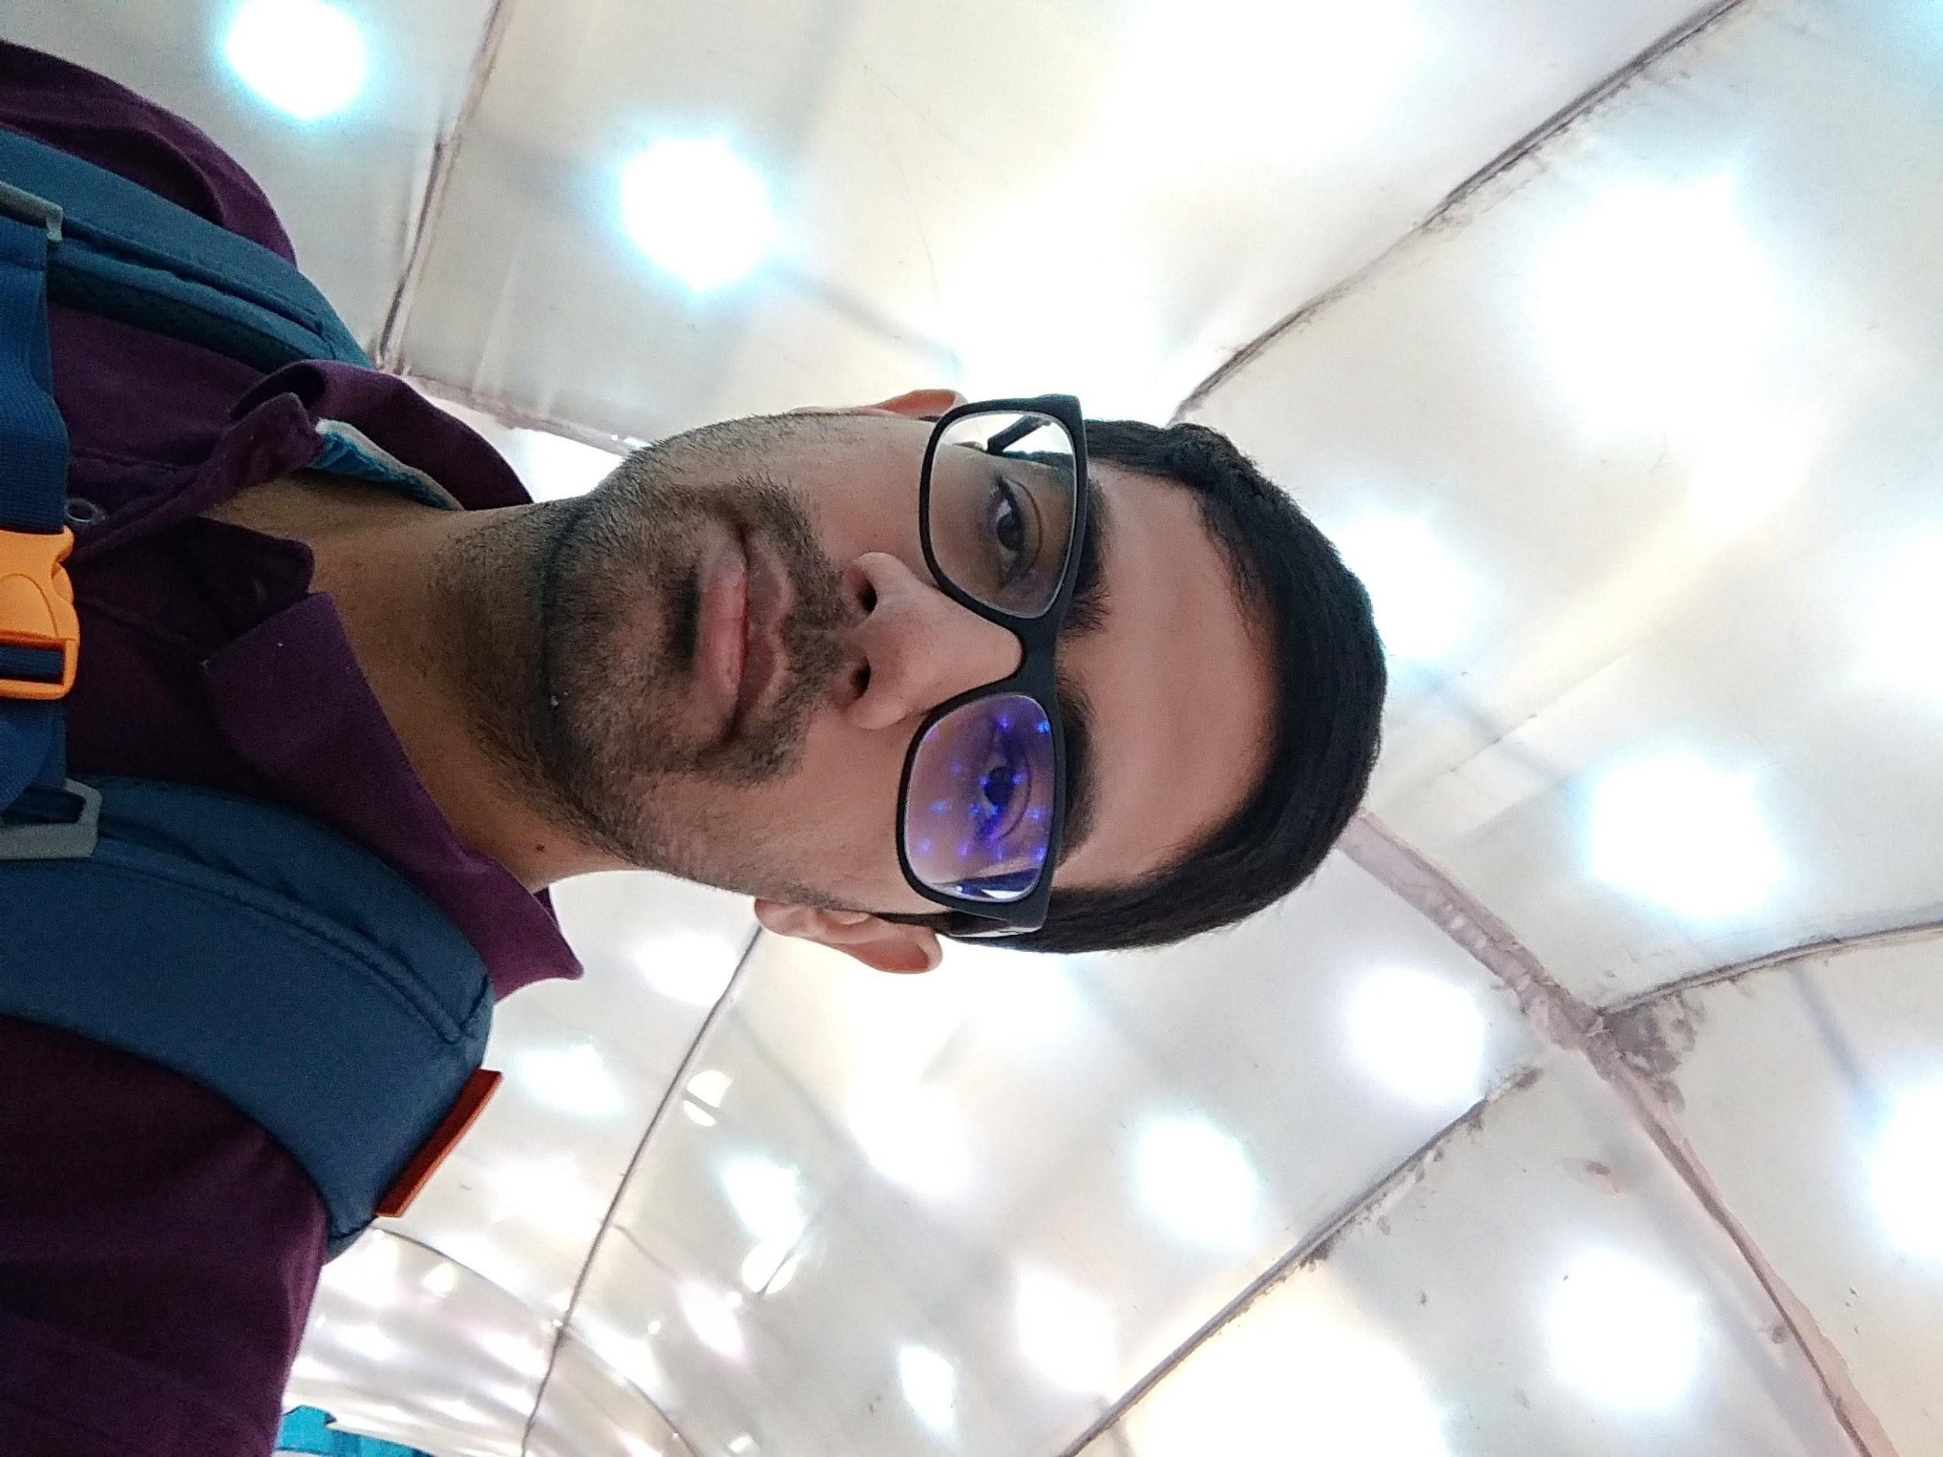
PROJECT PARTICIPANT
Mareesh Kumar Issar
Graduate student, ECE department
Rutgers University

Slide 3

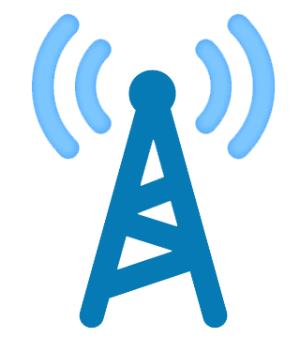


PROJECT OVERVIEW
RADIO ACCESS NETWORK INTELLIGENT CONTROLLER (RIC)
Macro cell
Small cell

Slide 4
BACKGROUND
What current technologies do?
Each cellular base station works as an independent entity during the handover process.
Handover is governed by the signal strength.
What am I trying to achieve?
Better Quality-of-Experience (QoE) for users by optimizing the network throughput.
Distributed
Centralized

Slide 5
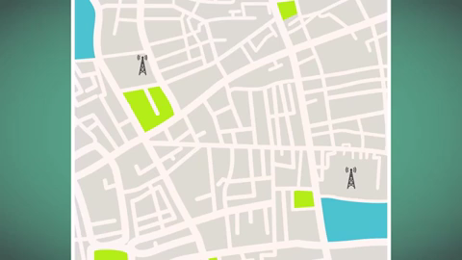
CELLULAR ARCHITECTURE
https://www.youtube.com/watch?v=HtCBsULS2VA

Slide 6
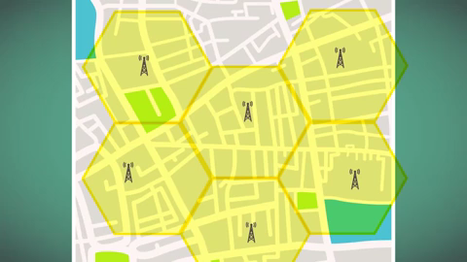
HANDOVER
https://www.youtube.com/watch?v=HtCBsULS2VA

Slide 7
WHY SIMULATION?
Evaluation of cellular systems typically involves the following three different methodologies:-
Analytical modeling
Real-world measurements
Simulation
Network simulators are fundamental tools to assess the effectiveness of novel designs, architectures, and algorithms for networking problems, offering the possibility to monitor the performance of the overall system in a controlled environment, with different scenarios and parameter settings, and without the need for a real deployment.
NS-3 is a discrete-event network simulator for Internet systems, targeted primarily for research and educational use.

Slide 8
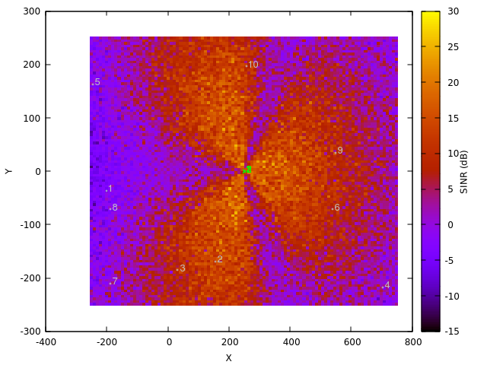
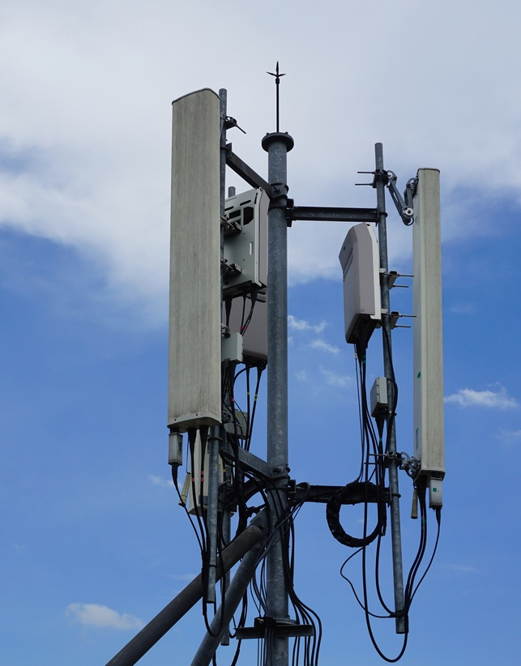

BUILDING BLOCKS USING NS-3

Slide 9
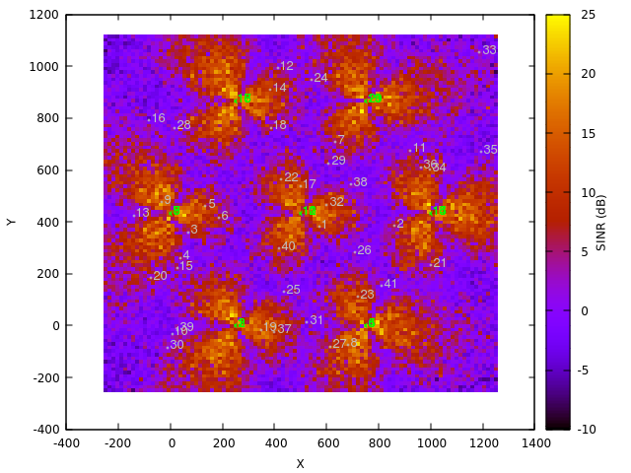
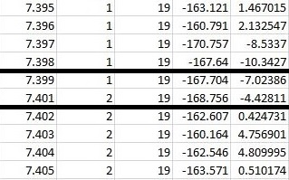
RADIO ENVIRONMENT MAP
2
1

Slide 10
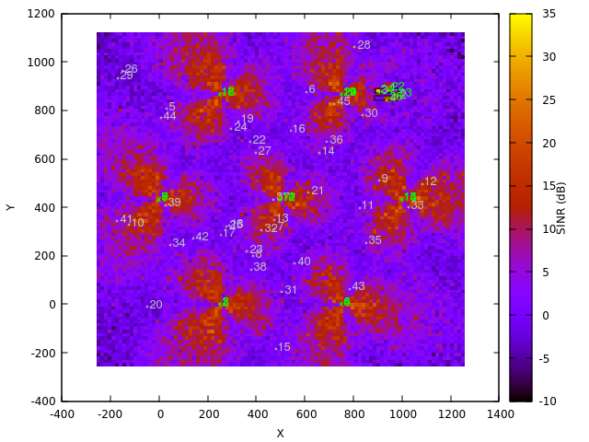

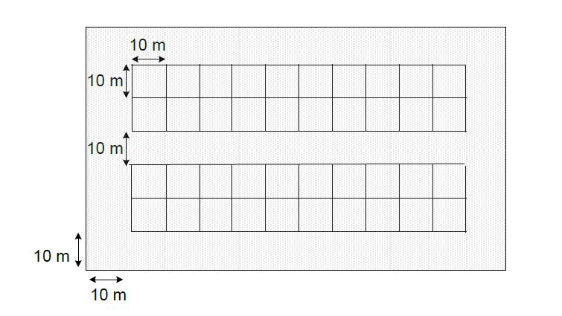
RADIO ENVIRONMENT MAP
room
* as per 3GPP R4-092042

Slide 11
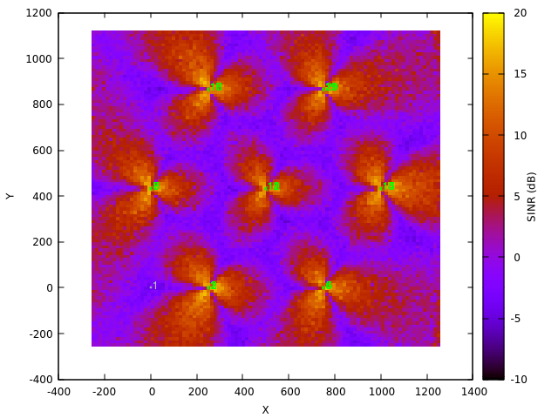





RADIO ENVIRONMENT MAP
20
16
11
7
9
2

Slide 12
REFERENCES
Zugno, Tommaso, et al. "Simulation of Next-generation Cellular Networks with ns-3: Open Challenges and New Directions." Proceedings of the 2019 Workshop on Next-Generation Wireless with ns-3. ACM, 2019.
Dalla Cia, Massimo, et al. "Mobility-aware handover strategies in smart cities." 2017 International Symposium on Wireless Communication Systems (ISWCS). IEEE, 2017.
Karandikar, Abhay, Nadeem Akhtar, and Mahima Mehta. Mobility Management in LTE Heterogeneous Networks. Springer Singapore, 2017.
Asghar, Ahmad, Hasan Farooq, and Ali Imran. "Self-Healing in Emerging Cellular Networks: Review, Challenges, and Research Directions." IEEE Communications Surveys & Tutorials 20.3 (2018): 1682-1709.

Slide 13


THANK YOU
QUESTIONS

