Slide 1
Design and Implementation of Content Routing Protocol
Mareesh Kumar Issar
March 9, 2020

Slide 2







BACKGROUND
Graduate
Content Routing Protocol, Web application for stock price prediction, Minesweeper, Maze runner, Bayesian Hunting, and image colorizer
Undergraduate
Electric Solar Vehicle Championship, Kalam Nanosatellite, Visible light communication and Robotics club.
Notes:
Why I am perfect for this role?
Highlight skills.

Slide 3



MOTIVATION
IoT
Smart connected IoT systems like smart homes, smart cities, and smart factories.
Challenges in accessing these devices.
Content more important than device.
Issues with existing network protocols:
Latency
Network congestion

Slide 4
CHALLENGES
How to mitigate the drawbacks of traditional protocols?
Can we create a content centric network protocol?
What if we can fetch content from nearby devices?
Can we reduce the latency?
Key idea: Design a network protocol by assigning unique id to each content.
Notes:
Anycast- one to nearest
Unicast – one to one
Multicast- one to many
Broadcast – one to all

Slide 5
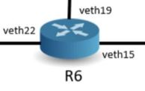
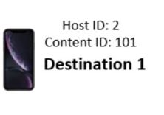


KEY COMPONENTS
Router
Host device
Packets
Client
Server
Control packet
Data packet
Notes:
High level overview of network

Slide 6
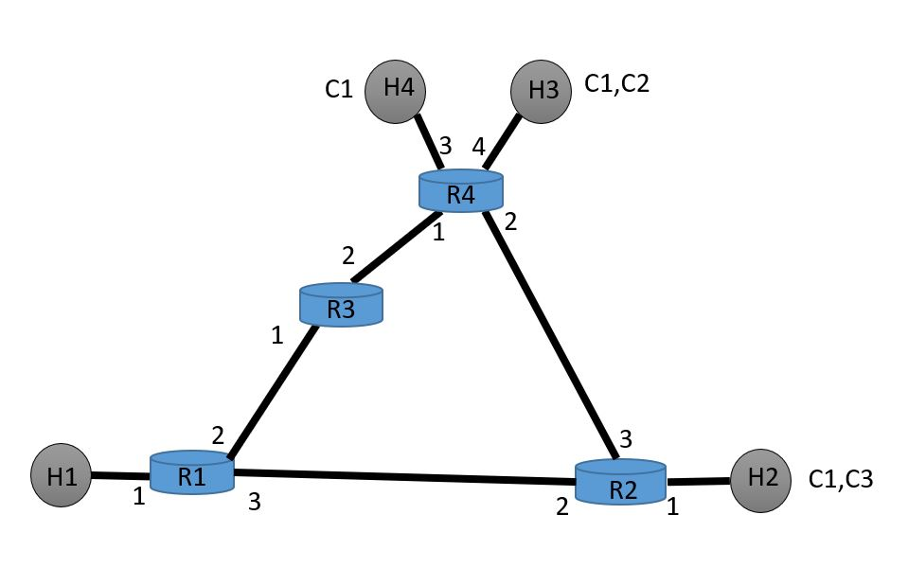
TRADITIONAL MECHANISM (UNICAST)

Slide 7
PROPOSED MECHANISM (ANYCAST)

Slide 8
BOOTSTRAP AND DISCOVERY
Type-0 | Source H1 | Length 0 | NULL
Type-0 | Source-H2 | Length 2 | C1 | C3
Type-0 | Src-H3 | Length 2 | C1 | C2
Type-0 | Src-H4 | Length 1 | C1

Slide 9
ROUTING UPDATE
Type-4 | Src- R1 | Hops-0 | Length-1 | H1
Type-4 | Src-R2 | Hops-0 | Length-3 | H2 | C1 | C3
Type-4 | Src-R4 | Hops-0 | Length-4 | H3 | H4 | C1 | C2

Slide 10
ROUTING UPDATE
STEP 1: In the bootstrap phase.
STEP 2: After one time tick.
STEP 3: After two time ticks.
At Router 1
Host Routing Table: Content Routing Table:
Host ID | Hop Count | Port No.
H1 | 0 | 1
H2 | 1 | 3
H3 | 2 | 3
H4 | 2 | 3
Content ID | Hop Count | Port No.
C1 | 1 | 3
C3 | 1 | 3
C2 | 2 | 3
Notes:
In STEP 3 we assume that packet from port 3 was received at R1 before the packet from port 2 (this is done to break ties since both the packets are coming from two hops away). Also, since the router already had an entry for C1 with 1 hop, the info about C1 from the other ports will be ignored, since it already knows a closer location of C1

Slide 11
ROUTING UPDATE
STEP 1: In the bootstrap phase.
STEP 2: After one time tick.
STEP 3: After two time ticks.
At Router 2
Host Routing Table: Content Routing Table:
Host ID | Hop Count | Port No.
H2 | 0 | 1
H1 | 1 | 2
H3 | 1 | 3
H4 | 1 | 3
Content ID | Hop Count | Port No.
C1 | 0 | 1
C3 | 0 | 1
C2 | 1 | 3

Slide 12
ROUTING UPDATE
STEP 1: In the bootstrap phase.
STEP 2: After one time tick.
STEP 3: After two time ticks.
At Router 3
Host Routing Table: Content Routing Table:
Host ID | Hop Count | Port No.
H1 | 1 | 1
H3 | 1 | 2
H4 | 1 | 2
H2 | 2 | 1
Content ID | Hop Count | Port No.
C1 | 1 | 2
C2 | 1 | 2
C3 | 2 | 1
Notes:
In STEP 3 we assume that packet from port 1 was received at R3 before the packet from port 2 (this is done to break ties since both the packets are coming from two hops away).

Slide 13
ROUTING UPDATE
STEP 1: In the bootstrap phase.
STEP 2: After one time tick.
STEP 3: After two time ticks.
At Router 4
Host Routing Table: Content Routing Table:
Host ID | Hop Count | Port No.
H3 | 0 | 4
H4 | 0 | 3
H2 | 1 | 2
H1 | 2 | 1
Content ID | Hop Count | Port No.
C1 | 0 | 4
C2 | 0 | 4
C3 | 1 | 2
Notes:
In STEP 3 we assume that packet from port 1 was received at R4 before the packet from port 2 (this is done to break ties since both the packets are coming from two hops away).

Slide 14
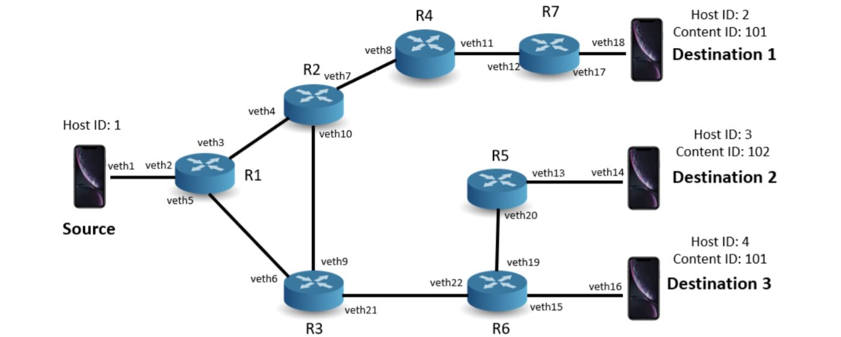
NETWORK TOPOLOGY
Notes:
What is click? Coombining components we verify our implementation.

Slide 15
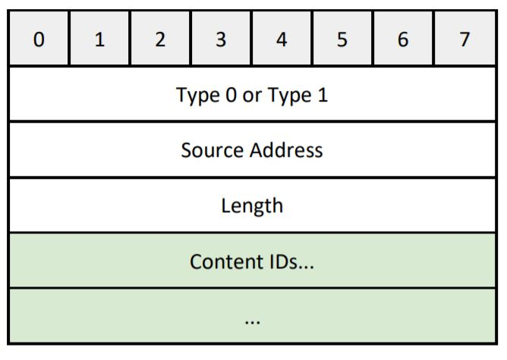
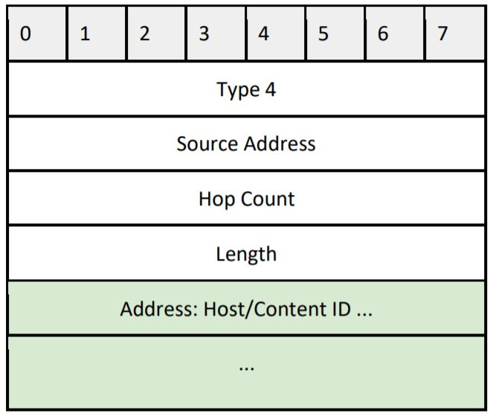
PACKET STRUCTURE
Update packet and Delete packet
Routing Update packet
Notes:
Information is propagation through the network using packets grouping in control control and data packets

Slide 16
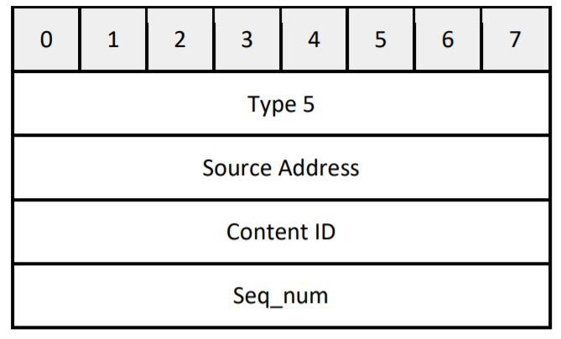
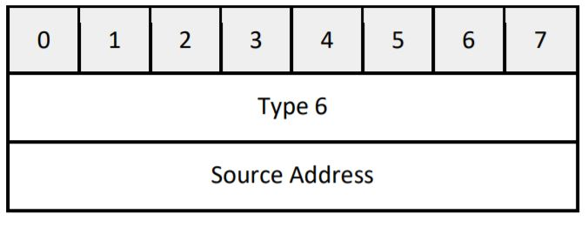
PACKET STRUCTURE
ACK packet
Hello packet

Slide 17
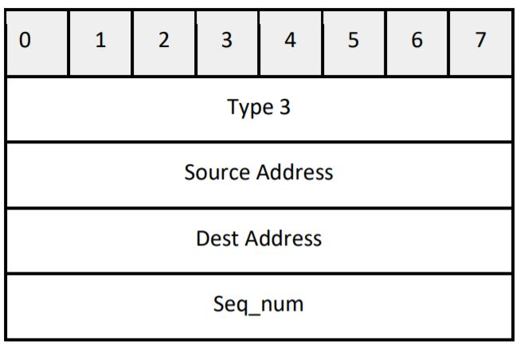
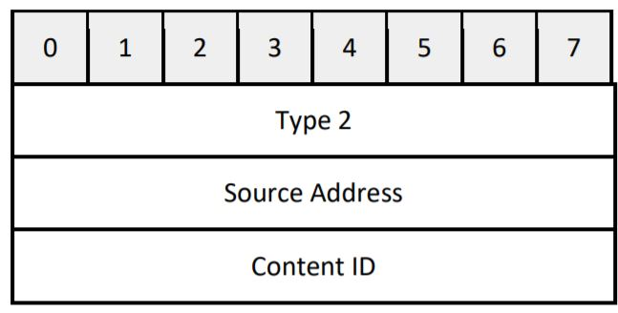
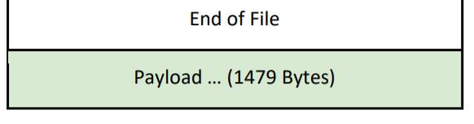
PACKET STRUCTURE
Data Response packet
Data request packet
Notes:
Design [packet keeping out applicationinmind

Slide 18
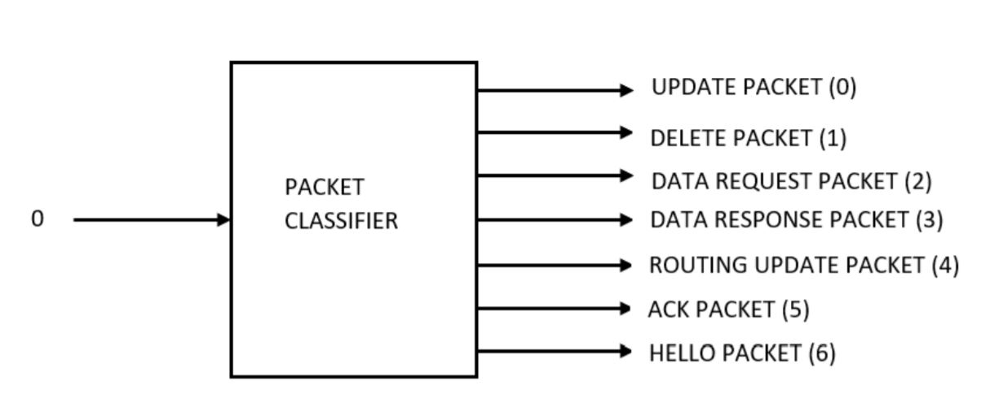
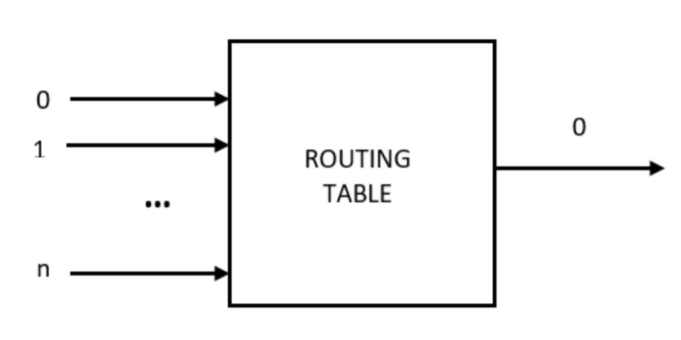
PACKET HANDLING ELEMENTS
3 x
Notes:
Receives packets from router port element and classifies it based on type field.
Builds host and content routing table using update packet, delete packet, and routing update packet as inputs.

Slide 19
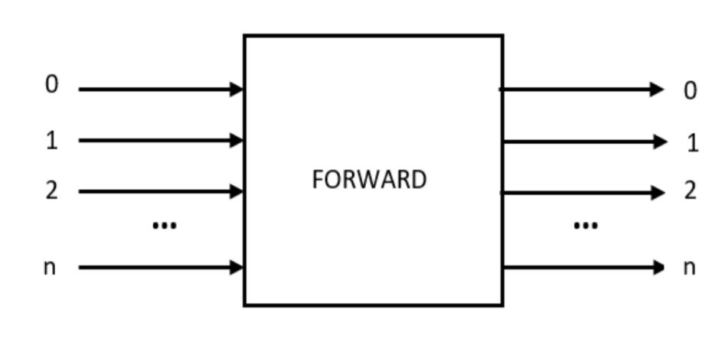
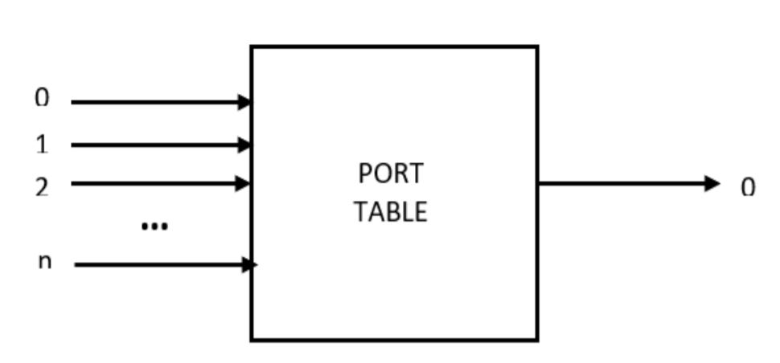
PACKET HANDLING ELEMENTS
3 x
Notes:
Forwards data request/data response and ack packets to their respective destinations.
Responsible for the handling of hello packets.

Slide 20
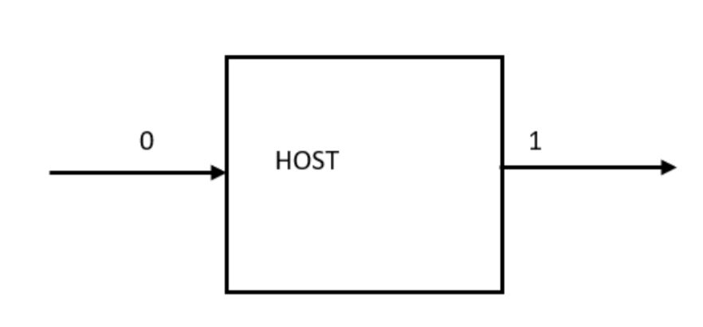
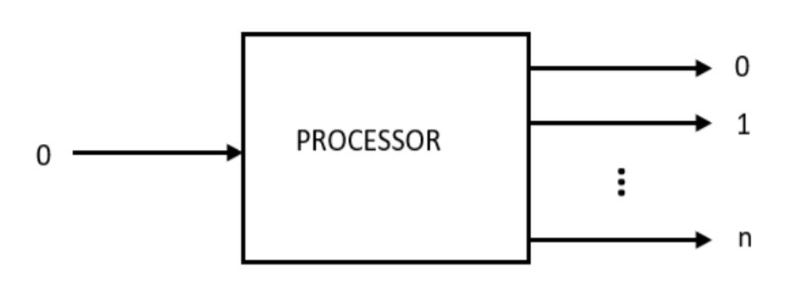
PACKET HANDLING ELEMENTS
Notes:
Broadcasts the packet to all its directly attached ports.
Generates data request, data response and ack packets.

Slide 21
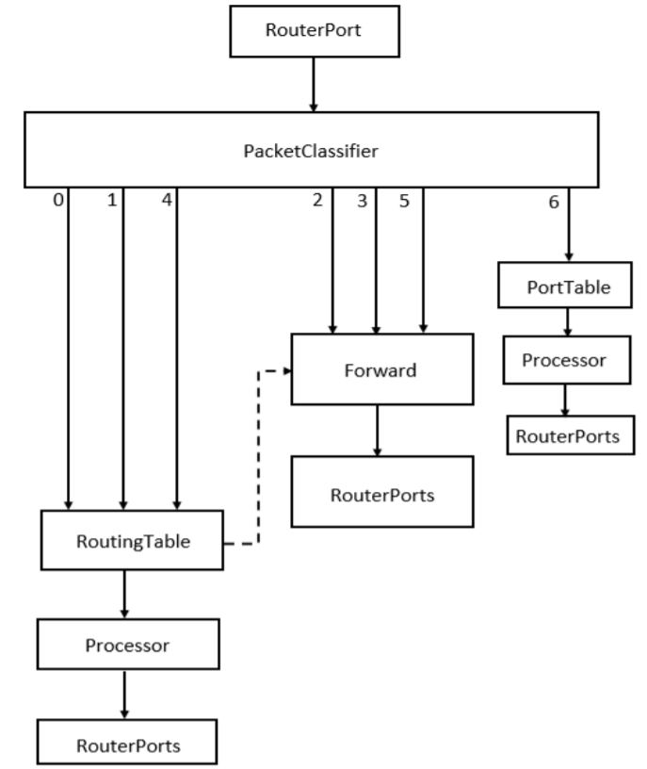
SYSTEM FLOWCHART
Notes:
Router building blocks

Slide 22
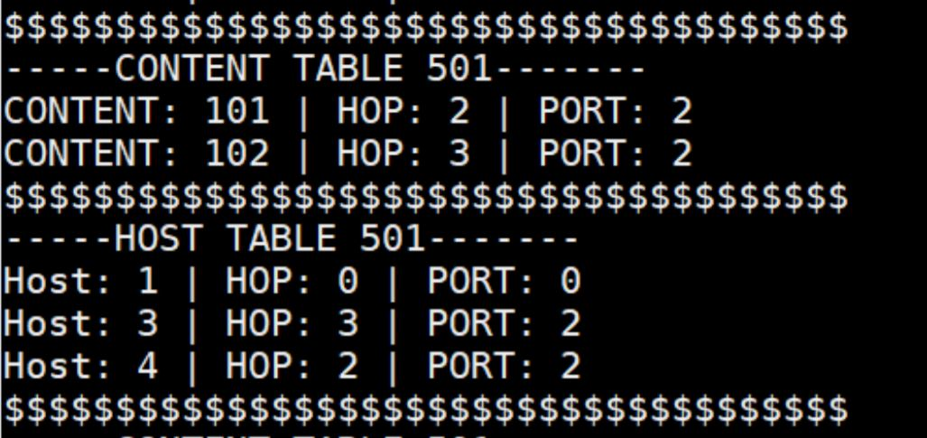
RESULTS
Source (Host ID) | Destination (Host ID) | End-to-end Latency (ms)
1 | 2 | 61
1 | 3 | 64
1 | 4 | 37
Notes:
How implementation is better than baseline? Metric to optimize latency?

Slide 23
CONCLUSION
Traditional network protocols are host centric rather than content centric.
Designed and implemented the syntax, semantics and the algorithm for content based routing protocol.
Used controlled flooding based routing with loop prevention mechanism to disseminate control information.
Implemented the packets and router elements in click.
Reduced end-to-end latency by 39%.

Slide 24
FUTURE WORK
Analyze results for larger and complex topologies.
Implement and analyze the results for mobile host devices.
Expand the current implementation to support multicast.

Slide 25



THANK YOU
QUESTIONS

Slide 26
BACKUP SLIDES
For further information, please visit: https://github.com/mareeshissar/ECE544_Communication_Networks_II

Slide 27
Pseudo code: Routing Update
Router receives a type 3 packet:
num_ids = length
increment sequence number in packet by 1
for (i=1 to length){
if the CID/Host ID exists in the CID/Host routing table {
if ((hops for CID in table) > (hops for CID in pkt)||(hops for host in table) > (hops for host in pkt)){
Replace the entry in respective table with new entry for host or content
}
else {
Pop out that content or host from the packet
num_ids =num_ids - 1 (from the packet) //loop prevention
}
}

Slide 28
Pseudo code: Routing Update
else {
Add CID/Host ID with hop count along with port number to respective table
}
} //end of for loop
if (num_ids == 0){ // No IDs were updated
Drop packet }//loop prevention
else {
Forward the updated packet to all output ports
}

Slide 29
Pseudo code: Packet Forwarding
Date request/response packet received
if (Type == 2 || Type == 3|| Type == 5){ //data request packet type
if (Dst address == Content ID){
Lookup next hop in Content Table and forward packet}
else {
Lookup next hop in Host Table and forward packet}
}

Slide 30
TRADITIONAL MECHANISM (UNICAST)
Notes:
What is click?
Wired ethernet connections.
Coombining components we verify our implementation.

Slide 31
PROPOSED MECHANISM (ANYCAST)
Notes:
What is click?
Click is a new software architecture for building flexible and configurable routers.
Coombining components we verify our implementation.

Slide 32
BOOTSTRAP AND DISCOVERY
Notes:
What is click? Coombining components we verify our implementation.

Slide 33
ROUTING UPDATE
Notes:
Flooding packets, building tables.
Loop prevention mechanism:
Any packet with src address matching to router own address - discard
Loop through IDs check if the hop in the packet is less than the hops stored in tables, forward ONLY the updated entries. If by the end of the loop, there was no updates, then drop the packet.

