Slide 1

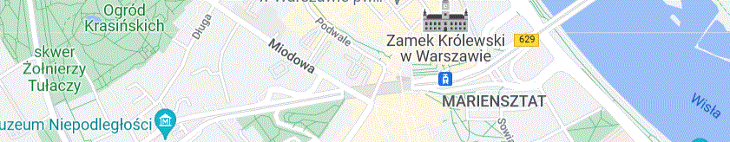

DIRECTIONAL RESIDUAL STABILISATION FOR HIGH-PÉCLET-NUMBER
GPU-ACCELERATED IMPLEMENTATION IN THE VANADIS SYSTEM
Marek Chodorski
Independent Researcher
Warsaw, Poland
marek_ac@wp.pl
Notes:
Good morning. My name is Marek Chodorski, and I am an independent researcher from Warsaw, Poland.
The animation you can see here is a simple illustration of transient pollutant transport calculated with the Vanadis model.
Vanadis is a three-dimensional finite-element system for atmospheric transport and dispersion.
Today I would like to focus on two closely connected aspects of the system.
The first is Directional Residual stabilisation for advection-dominated problems at high Péclet numbers.
The second is the computational implementation, particularly the Element-by-Element formulation and GPU acceleration.
I will show how these numerical and computational components are combined in Vanadis to form a practical three-dimensional transport solver.

Slide 2

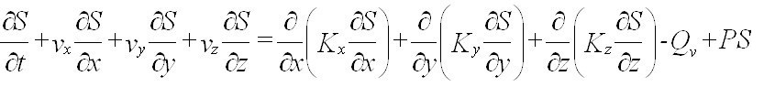
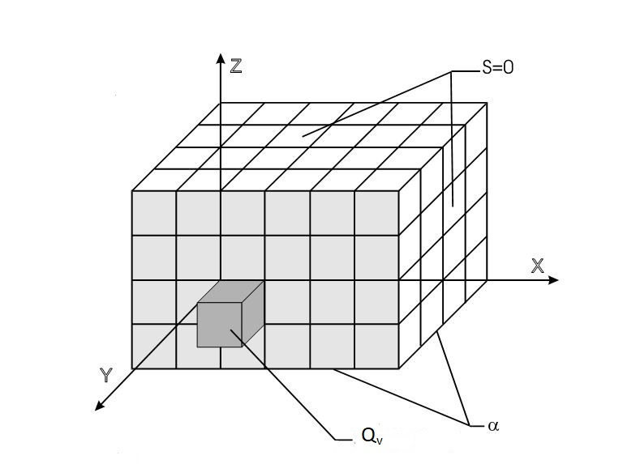
Vanadis — a dynamic 3D atmospheric transport model
• 3D transient advection–diffusion–reaction FEM
• Directional Residual stabilisation for high Pe transport
• HEX8 elements with implicit θ=2/3 integration
• EbE + Jacobi-preconditioned DBCG
• OpenMP CPU / CUDA GPU implementation
2.8 M nodes | ~1.4 GB EbE matrices | 6.6–8.9 s GPU solve/step
Notes:
Before going into the Directional Residual formulation, let me briefly put it in the context of the complete Vanadis system.
Vanadis solves the three-dimensional transient advection–diffusion–reaction equation using the finite-element method.
The spatial discretisation is based on eight-node hexahedral elements.
For strongly advection-dominated transport, Directional Residual stabilisation is used to supplement the standard Galerkin formulation. I will explain this in more detail on the next slide.
Time integration is implicit, with theta equal to two-thirds.
On the computational side, Vanadis uses an Element-by-Element formulation together with a Jacobi-preconditioned D-B-C-G iterative solver.
Element calculations can be parallelised on the CPU using OpenMP, while the solution stage can be accelerated using CUDA on the GPU.
In a separate large-mesh benchmark, the model handled approximately 2.8 million nodes, using about 1.4 gigabytes for the Element-by-Element matrix data.
The GPU linear-solver stage required approximately 6.6 to 8.9 seconds per time step.
The important point is that these numerical and computational components are designed to work together as one integrated system.

Slide 3
Standard Galerkin — unstabilised
Directional Residual (DR) — stabilised
Same mesh and physical parameters. DR suppresses spurious high-Pe oscillations
without modifying the prescribed physical diffusion coefficients.
Notes:
This slide illustrates the numerical problem that motivates the Directional Residual formulation.
On the left, you can see the result obtained with the standard, unstabilised Galerkin formulation for an advection-dominated test case.
The solution develops visible oscillatory structures, with repeated lobes and irregular concentration contours behind the main plume.
On the right, the same type of calculation is performed using Directional Residual stabilisation.
The plume becomes much smoother and remains aligned with the direction of transport.
Importantly, the prescribed physical diffusion is not modified. The physical diffusion term remains in the standard Galerkin form, while the stabilisation is introduced through a directional modification of the test function.
Please note that the two panels use individually scaled concentration ranges; the comparison here concerns primarily the spatial structure of the solution.
This figure is intended to demonstrate the stabilising effect of DR. It is not, by itself, a comparison of accuracy with other stabilisation methods such as SUPG.
On the next slide, I will show how the Directional Residual test function is defined.

Slide 4

DIRECTIONAL RESIDUAL STABILISATION
Vanadis-specific Petrov–Galerkin formulation, closely related to SUPG
Directional modification of the test function along the local flow direction
Representative test: Pestream​≈3.1–156.3
• DR weighting is applied to the transient and advective terms
• Physical diffusion remains in the standard Galerkin form
• τDR​ is determined from the local streamwise Péclet number
• Stabilisation adapts to flow direction, element geometry and directional diffusion
Same mesh and physical parameters. DR suppresses spurious high-Pe oscillations
without modifying the prescribed physical diffusion coefficients.
Notes:
Now let me show how the Directional Residual stabilisation is constructed.
Directional Residual is a Vanadis-specific Petrov–Galerkin formulation, closely related to SUPG.
Instead of using only the standard Galerkin test function, Ni​, the test function is modified in the local direction of transport.
The additional term is proportional to the directional derivative of the shape function along the velocity vector.
The strength of this modification is controlled by the parameter tau D-R.
Tau D-R is determined locally from the streamwise Péclet number.
This Péclet number depends on the velocity magnitude, the streamwise element length, and the diffusion coefficient projected onto the direction of flow.
As a result, the stabilisation adapts to the local flow direction, element geometry, and directional diffusion.
In the representative test shown here, the streamwise Péclet number ranges from approximately 3.1 to 156.3.
In Vanadis, the Directional Residual weighting is applied to both the transient and advective terms.
The physical diffusion term, however, remains in the standard Galerkin form.
So the stabilisation does not rely on increasing the prescribed physical diffusion. Instead, it modifies the test-function weighting according to the local transport conditions.

Slide 5
WHY ELEMENT-BY-ELEMENT?
2.8 MILLION NODES — MEMORY REQUIREMENTS
Dense matrix storage [TB] | Banded matrix storage [GB] | Vanadis EbE storage [GB]
≈ 66 | ≈ 333 | ≈ 1.4
Why this matters for GPU execution
• Multi-million-node problems can fit on a single GPU
• Solver data can remain resident in GPU memory
• Reduced CPU↔GPU data transfers
• Single-GPU execution avoids inter-GPU communication
EbE also reduces the work in the dominant DBCG kernels
Banded matrix: Nnodes × B
HEX8 EbE: 64 × Nelements
→ substantially fewer matrix entries processed in MATVEC / MTTVEC
Parallel nodal accumulation is handled by atomic updates or element coloring
Notes:
Now I would like to move from the numerical formulation to the computational architecture, and explain why Vanadis uses an Element-by-Element approach.
The first reason is memory.
For the 2.8-million-node benchmark, full dense matrix storage would require approximately 66 terabytes.
The banded matrix representation used for this comparison would require approximately 333 gigabytes.
In contrast, the Vanadis Element-by-Element representation requires only about 1.4 gigabytes for the matrix data.
This has an important consequence for GPU computing. Multi-million-node problems can fit on a single GPU, and the solver data can remain resident in GPU memory.
This reduces transfers between the CPU and GPU and, when one GPU is sufficient, avoids inter-GPU communication completely.
Element-by-Element storage also reduces the amount of matrix data processed in the dominant solver kernels.
For an eight-node hexahedral element, Vanadis processes a local eight-by-eight matrix, which means 64 matrix entries per element.
This is substantially less than processing the corresponding wide banded matrix representation.
The local element contributions must then be accumulated at shared nodes. On the GPU, this is handled using atomic updates or element colouring.
So the Element-by-Element formulation provides both a major reduction in memory requirements and a computational structure that maps naturally onto GPU execution.

Slide 6
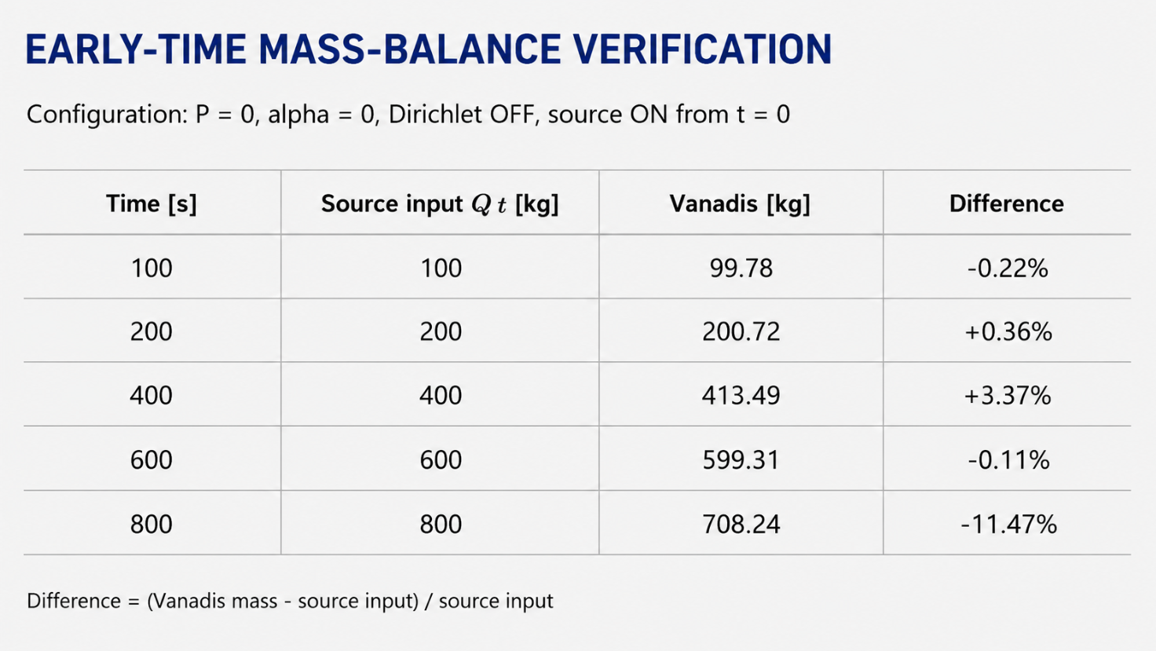
MASS-BALANCE VERIFICATION
DR mass-balance test: Q=1 kg/s, P=0, α=0, no imposed Dirichlet concentration constraints.
Up to 600 s, the integrated mass remains within about 3.3% of the cumulative source input; at later times, boundary outflow becomes significant.
Notes:
After looking at the computational efficiency, I would now like to show a simple global mass-balance verification.
For this test, the source strength is one kilogram per second.
The reaction term is switched off, the deposition parameter alpha is zero, and no Dirichlet concentration constraints are imposed.
Therefore, during the early part of the calculation, before significant pollutant mass leaves the computational domain, the total mass should approximately follow the cumulative source input, Q times t.
The table compares this expected source input with the integrated pollutant mass calculated by Vanadis.
At 100 seconds, the difference is only about 0.2 percent, and at 200 seconds it remains below 0.4 percent.
Up to 600 seconds, the maximum difference remains about 3.4 percent.
By 800 seconds, the total mass remaining inside the domain has decreased to about 708 kilograms, compared with 800 kilograms introduced by the source. At this stage, mass outflow through the open boundaries has become significant.
At this stage, boundary losses have become significant.
So this test does not demonstrate exact mass conservation. It shows that, during the early transport phase, the Directional Residual formulation maintains a reasonably good global mass balance.

Slide 7
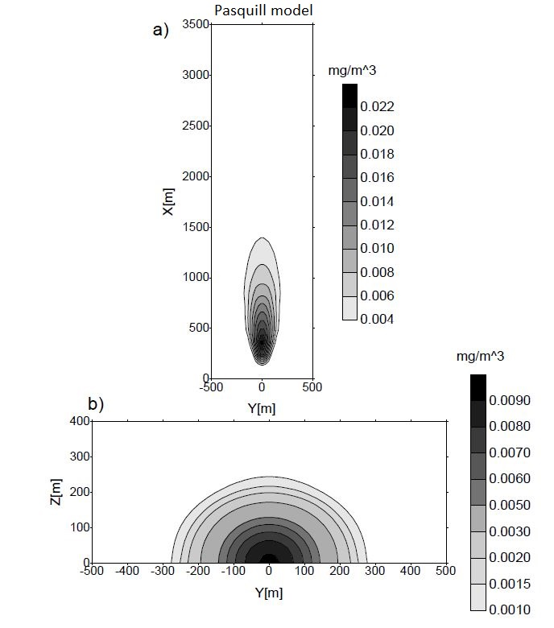
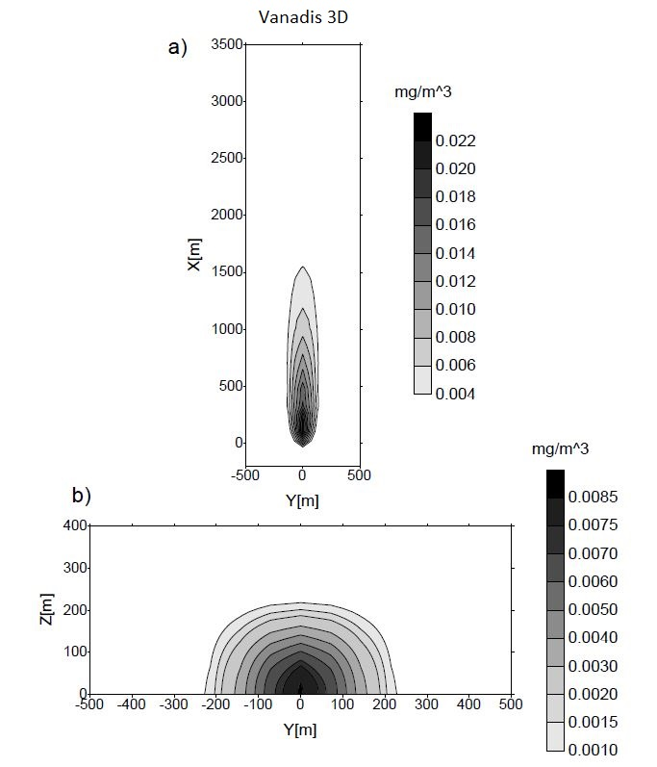
VANADIS 3D vs PASQUILL DISPERSION MODEL
Horizontal ground-level and vertical cross-sections
Similar plume location, lateral and vertical spread, and concentration scale are obtained with both approaches.
Notes:
The previous slide considered global mass balance. Here I show a different type of verification, based on comparison with a classical Pasquill dispersion model.
The Pasquill results are shown on the left, and the corresponding Vanadis results are shown on the right.
The upper plots show horizontal ground-level concentration fields, while the lower plots show vertical cross-sections through the plume.
The purpose of this comparison is not to demonstrate point-by-point agreement, because the two models are based on very different formulations.
Instead, I compare the plume location, overall dimensions, and concentration scale.
At ground level, both models give a maximum concentration of about 0.022 milligrams per cubic metre.
The vertical cross-sections also show a similar concentration range and a comparable plume extent.
The plume shapes are not identical, and this is expected. The Pasquill model uses a parameterised dispersion formulation, while Vanadis directly solves the three-dimensional transient advection–diffusion equation using finite elements.
So I treat this comparison mainly as a physical-scale check, showing that Vanadis produces a plume with a reasonable position, size, and concentration magnitude.

Slide 8


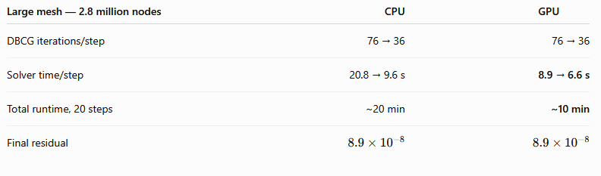
TEMPORAL EVOLUTION AND LARGE-MESH GPU PERFORMANCE
Ground‑level temporal evolution
Vertical‑plane temporal evolution
Small-mesh demonstration
Small-mesh demonstration
2.8 million nodes: GPU solve time decreases from 8.9 to 6.6 s per step,
with the same DBCG iteration history and numerical solution as the CPU calculation.
Notes:
The previous slide showed a static comparison of plume structure. Here I would like to show the transient evolution of the Vanadis solution.
The two animations at the top are from the smaller demonstration mesh.
On the left, you can see the ground-level evolution of the plume, and on the right, the corresponding vertical-plane evolution.
These animations are included mainly to illustrate the transient behaviour of the model.
The performance results in the table below come from a separate large-mesh benchmark with 2.8 million nodes.
In this benchmark, the D-B-C-G iteration count decreases from about 76 to 36 iterations per time step, and this behaviour is the same on the CPU and GPU.
The difference appears in the solution time.
On the CPU, the linear solver requires approximately 20.8 to 9.6 seconds per step.
On the GPU, this is reduced to approximately 8.9 to 6.6 seconds per step.
For 20 time steps, the total runtime is about 20 minutes on the CPU and about 10 minutes on the GPU.
The final residual is essentially identical in both cases, approximately eight point nine times ten to the minus eight.
So the GPU implementation accelerates the solution while preserving the same convergence behaviour and numerical result.

Slide 9
THE STRENGTH OF VANADIS: INTEGRATED NUMERICS AND HPC
Vanadis: scalable HPC — from a low-cost GPU PC to a high-performance workstation
NUMERICS
HPC
Directional Residual (DR)
local flow-directed stabilisation
Implicit θ=2/3 transient scheme
DR-weighted transient matrix
Element-by-Element (EbE)
low-memory local operators
OpenMP CPU
parallel element assembly
CUDA GPU + DBCG
single-GPU solution for multi-million-node meshes
reduced data-transfer overhead
The performance and robustness of Vanadis come from the coupling of these components, not from any single technique alone.
2.8 million nodes: GPU solve time decreases from 8.9 to 6.6 s per step,
with the same DBCG iteration history and numerical solution as the CPU calculation.
Notes:
The previous slides presented the individual numerical and computational components of Vanadis.
This slide summarises what I consider to be the main strength of the system: these components are designed to work together.
On the numerical side, Directional Residual stabilisation is used for strongly advection-dominated transport.
For time integration, Vanadis uses an implicit theta scheme, with theta equal to two thirds. Directional Residual weighting is also included in the transient matrix.
The Element-by-Element formulation keeps the operators local and significantly reduces the memory requirement.
On the computational side, element assembly can be parallelised on the CPU using OpenMP, while the iterative solution stage can be accelerated on the GPU using CUDA and D-B-C-G.
The low-memory Element-by-Element representation is particularly important because it makes single-GPU execution practical for multi-million-node problems and reduces data-transfer overhead.
This architecture also provides useful hardware scalability, from a relatively low-cost GPU PC to a more powerful workstation.
So the main point is that the performance and robustness of Vanadis come from the coupling of these components, rather than from any single technique alone.

Slide 10


Thank you for your attention
Vanadis project page
Homepage: https://marek-ac.meri.pl/
DOI: https://doi.org/10.5281/zenodo.22016556
GitHub: https://github.com/marek-ac/vanadis_solver-directional_residual/
E-mail: marek_ac@wp.pl
Notes:
To conclude, Vanadis combines Directional Residual stabilisation, low-memory Element-by-Element computation, and CPU/GPU parallelisation in a single three-dimensional atmospheric transport solver.
The complete source code is publicly available, together with the archived release and project documentation.
Anyone interested in the numerical formulation, the GPU implementation, or independent testing of the Directional Residual approach is welcome to inspect and experiment with the code.
The project links and QR code are shown here.
So, I think that's all from me.
Ladies and gentlemen, thank you very much for your attention.

