Slide 1

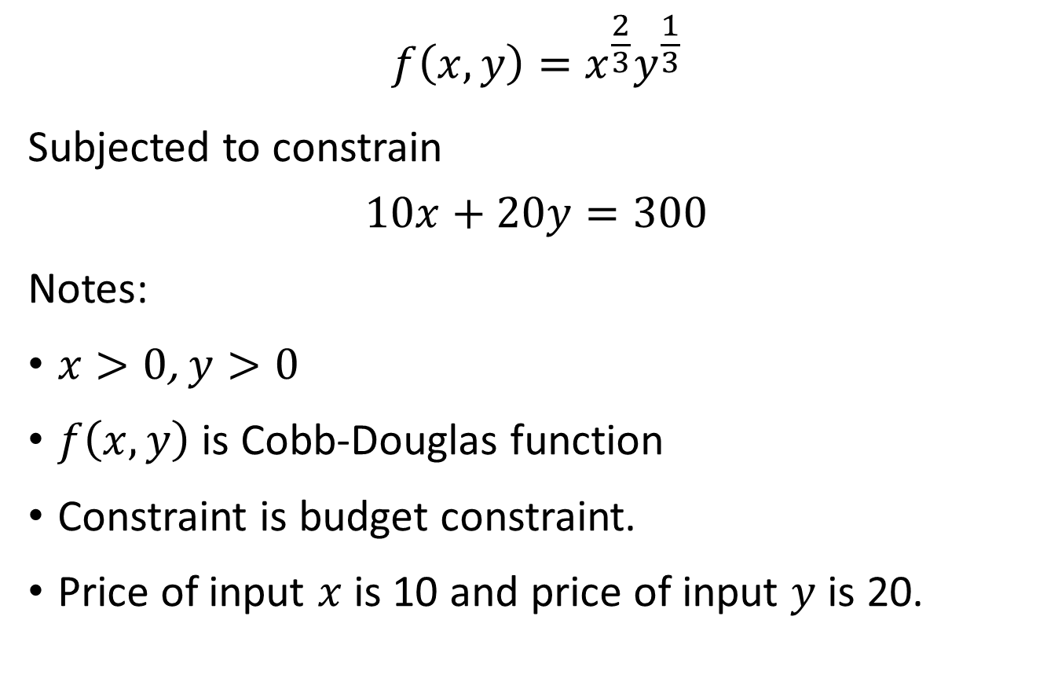
Exercise
$$f\left(x,y\right)=x^{\frac{2}{3}}y^{\frac{1}{3}}$$
Subjected to constrain
$$10x+20y=300$$
Notes:
$x>0$, $y>0$
$f\left(x,y\right)$ is Cobb-Douglas function
Constraint is budget constraint.
Price of input $x$ is 10 and price of input $y$ is 20.
$$f\left(x,y\right)=x^{α}y^{1−α}$$
$$P_{x}x+P_{y}y=k$$
$$\frac{∂f\left(x,y\right)}{∂x}\frac{1}{P_{x}}=λ$$

Slide 2


Exercise
$$f\left(x,y\right)=x^{α}y^{1−α}$$
Subjected to constrain
$$P_{x}x+P_{y}y=k$$
$$\frac{∂f\left(x,y\right)}{∂x}\frac{1}{P_{x}}=λ$$

Slide 3
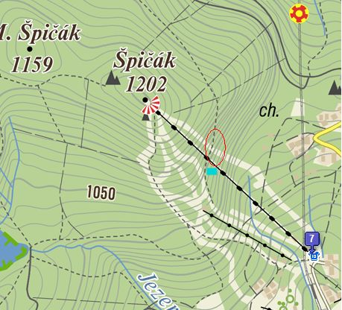
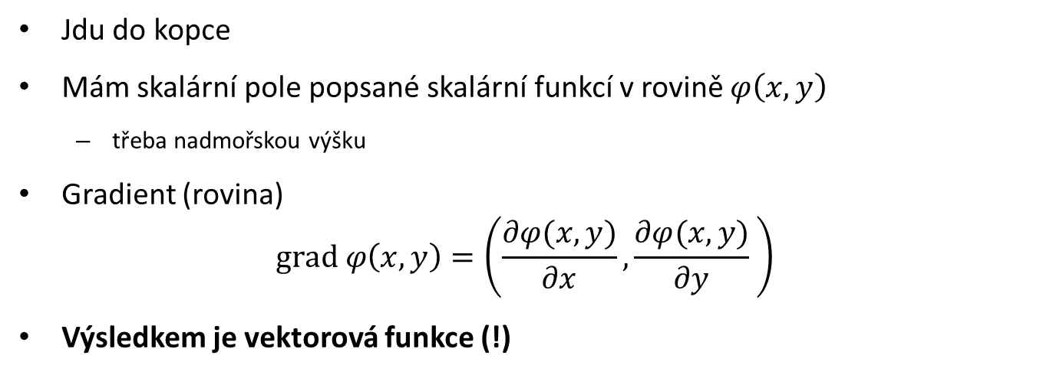
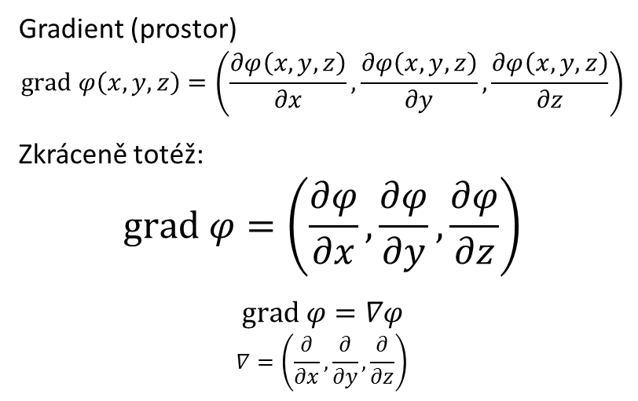
Gradient
Jdu do kopce
Mám skalární pole popsané skalární funkcí v rovině $φ\left(x,y\right)$
třeba nadmořskou výšku
Gradient (rovina)
$$grad φ\left(x,y\right)=\left(\frac{∂φ(x,y)}{∂x},\frac{∂φ(x,y)}{∂y} \right)$$
Výsledkem je vektorová funkce (!)
Gradient (prostor)
$$grad φ\left(x,y,z\right)=\left(\frac{∂φ\left(x,y,z\right)}{∂x},\frac{∂φ\left(x,y,z\right)}{∂y},\frac{∂φ\left(x,y,z\right)}{∂z}\right)$$
Zkráceně totéž:
$$grad φ=\left(\frac{∂φ}{∂x},\frac{∂φ}{∂y},\frac{∂φ}{∂z}\right)$$
$$grad φ=∇φ$$
$$∇=\left(\frac{∂}{∂x},\frac{∂}{∂y},\frac{∂}{∂z}\right)$$

Slide 4
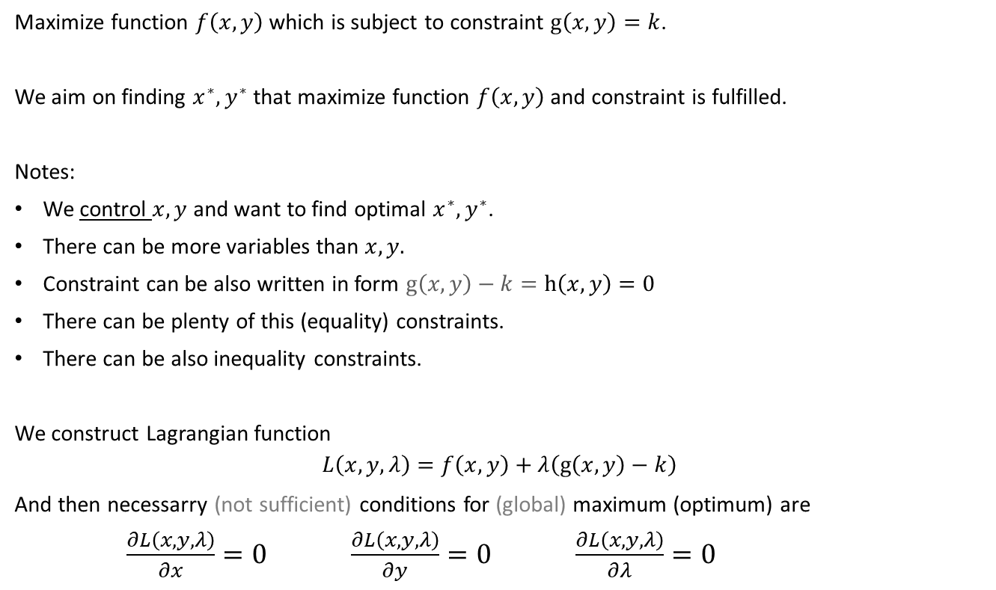
Constrained optimization
Maximize function $f\left(x,y\right)$ which is subject to constraint $g\left(x,y\right)=k$.
We aim on finding $x^{∗},y^{∗}$ that maximize function $f\left(x,y\right)$ and constraint is fulfilled.
Notes:
We control $x,y$ and want to find optimal $x^{∗},y^{∗}$.
There can be more variables than $x,y.$
Constraint can be also written in form $g\left(x,y\right)−k=h\left(x,y\right)=0$
There can be plenty of this (equality) constraints.
There can be also inequality constraints.
We construct Lagrangian function
$$L\left(x,y,λ\right)=f\left(x,y\right)+λ\left(g\left(x,y\right)−k\right)$$
And then necessarry (not sufficient) conditions for (global) maximum (optimum) are
$\frac{∂L\left(x,y,λ\right)}{∂x}=0$ $\frac{∂L\left(x,y,λ\right)}{∂y}=0$ $\frac{∂L\left(x,y,λ\right)}{∂λ}=0$

Slide 5
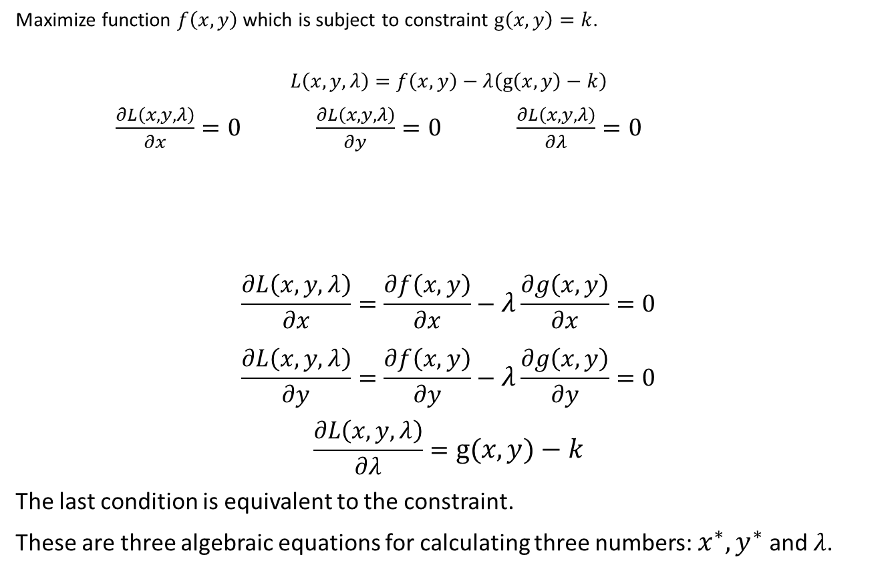
Constrained optimization
Maximize function $f\left(x,y\right)$ which is subject to constraint $g\left(x,y\right)=k$.
$$L\left(x,y,λ\right)=f\left(x,y\right)−λ\left(g\left(x,y\right)−k\right)$$
$\frac{∂L\left(x,y,λ\right)}{∂x}=0$ $\frac{∂L\left(x,y,λ\right)}{∂y}=0$ $\frac{∂L\left(x,y,λ\right)}{∂λ}=0$
$$\frac{∂L\left(x,y,λ\right)}{∂x}=\frac{∂f\left(x,y\right)}{∂x}−λ\frac{∂g\left(x,y\right)}{∂x}=0$$
$$\frac{∂L\left(x,y,λ\right)}{∂y}=\frac{∂f\left(x,y\right)}{∂y}−λ\frac{∂g\left(x,y\right)}{∂y}=0$$
$$\frac{∂L\left(x,y,λ\right)}{∂λ}=g\left(x,y\right)−k$$
The last condition is equivalent to the constraint.
These are three algebraic equations for calculating three numbers: $x^{∗},y^{∗}$ and $λ$.

Slide 6
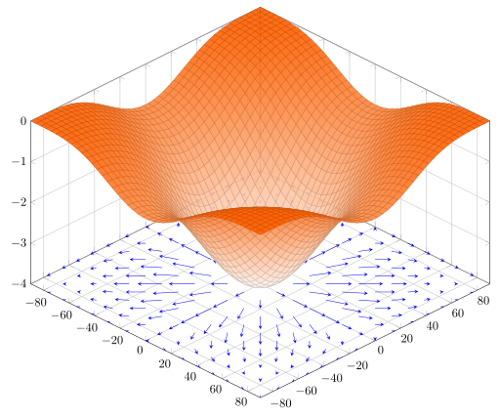
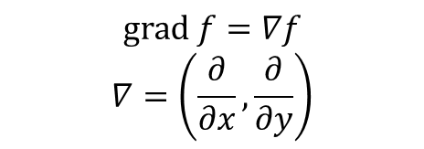
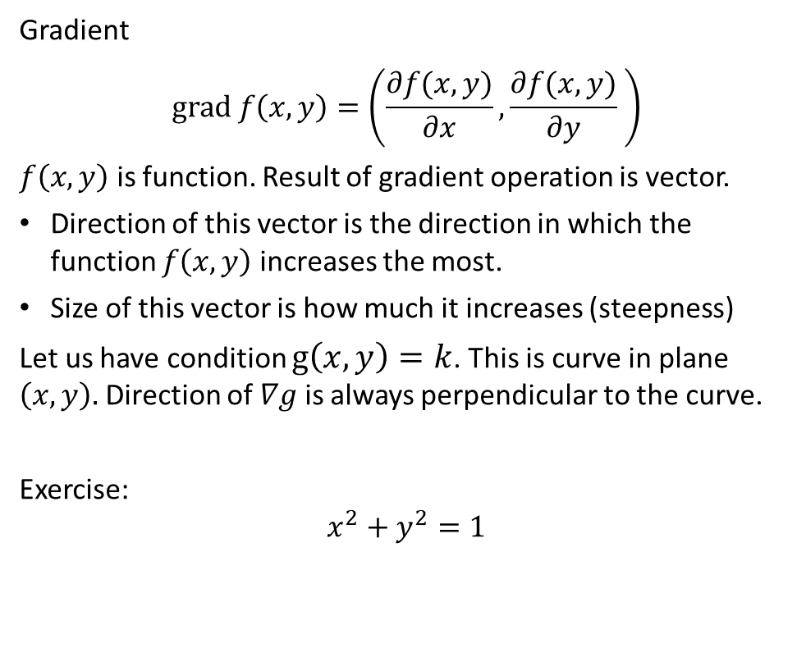
Intuition behind Lagrangian
Gradient
$$grad f\left(x,y\right)=\left(\frac{∂f(x,y)}{∂x},\frac{∂f(x,y)}{∂y} \right)$$
$f\left(x,y\right)$ is function. Result of gradient operation is vector.
Direction of this vector is the direction in which the function $f\left(x,y\right)$ increases the most.
Size of this vector is how much it increases (steepness)
Let us have condition $g\left(x,y\right)=k$. This is curve in plane $\left(x,y\right).$ Direction of $∇g$is always perpendicular to the curve.
Exercise:
$$x^{2}+y^{2}=1$$
$$grad f=∇f$$
$$∇=\left(\frac{∂}{∂x},\frac{∂}{∂y}\right)$$

Slide 7
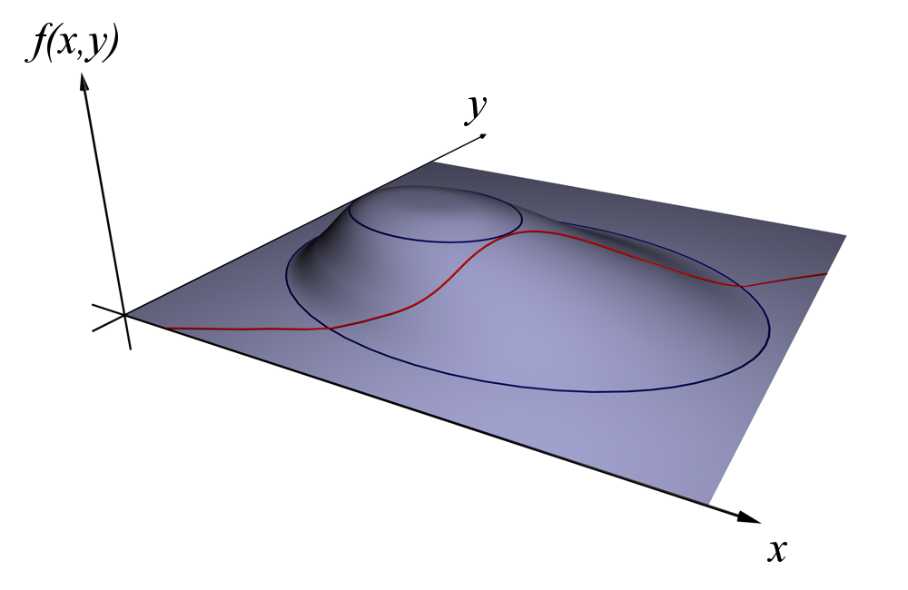
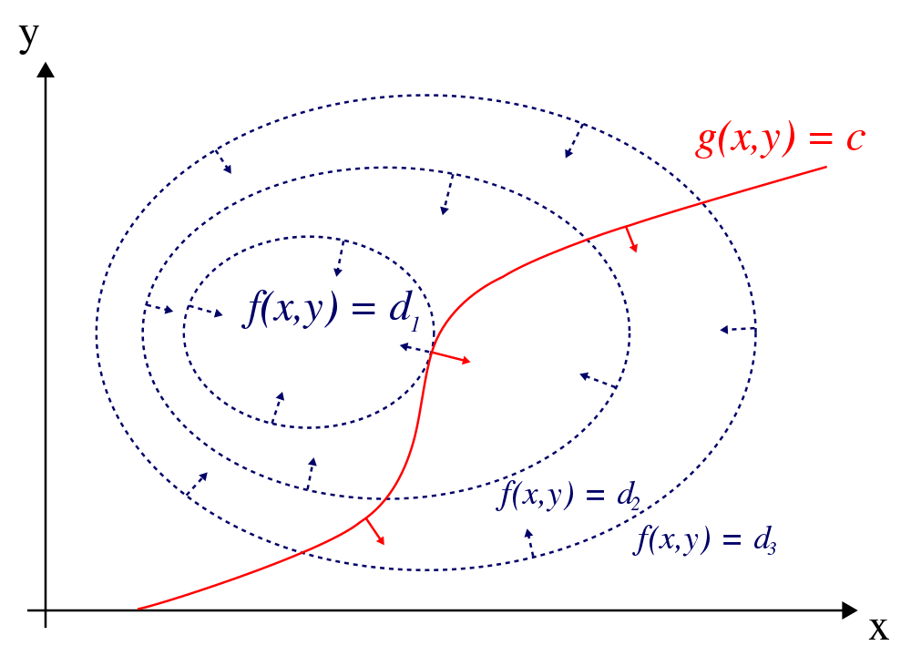
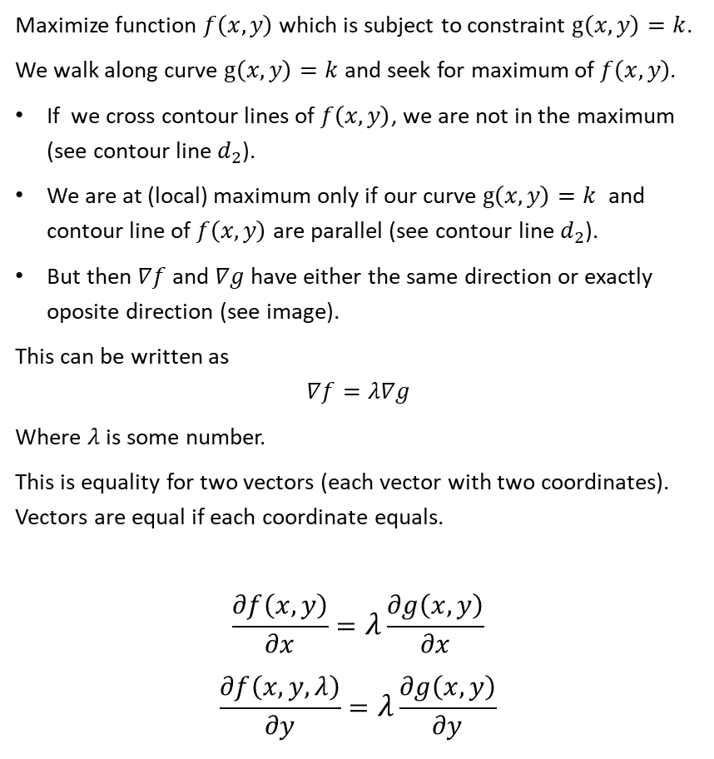
Intuition behind Lagrangian
Maximize function $f\left(x,y\right)$ which is subject to constraint $g\left(x,y\right)=k$.
We walk along curve $g\left(x,y\right)=k$ and seek for maximum of $f\left(x,y\right)$.
If we cross contour lines of $f\left(x,y\right)$, we are not in the maximum (see contour line $d_{2}$).
We are at (local) maximum only if our curve $g\left(x,y\right)=k$ and contour line of $f\left(x,y\right)$ are parallel (see contour line $d_{2}$).
But then $∇f$ and $∇g$ have either the same direction or exactly oposite direction (see image).
This can be written as
$$∇f=λ∇g$$
Where $λ$ is some number.
This is equality for two vectors (each vector with two coordinates). Vectors are equal if each coordinate equals.
$$\frac{∂f\left(x,y\right)}{∂x}=λ\frac{∂g\left(x,y\right)}{∂x}$$
$$\frac{∂f\left(x,y,λ\right)}{∂y}=λ\frac{∂g\left(x,y\right)}{∂y}$$
God bless Wikipedia

Slide 8
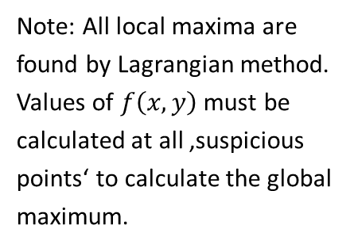
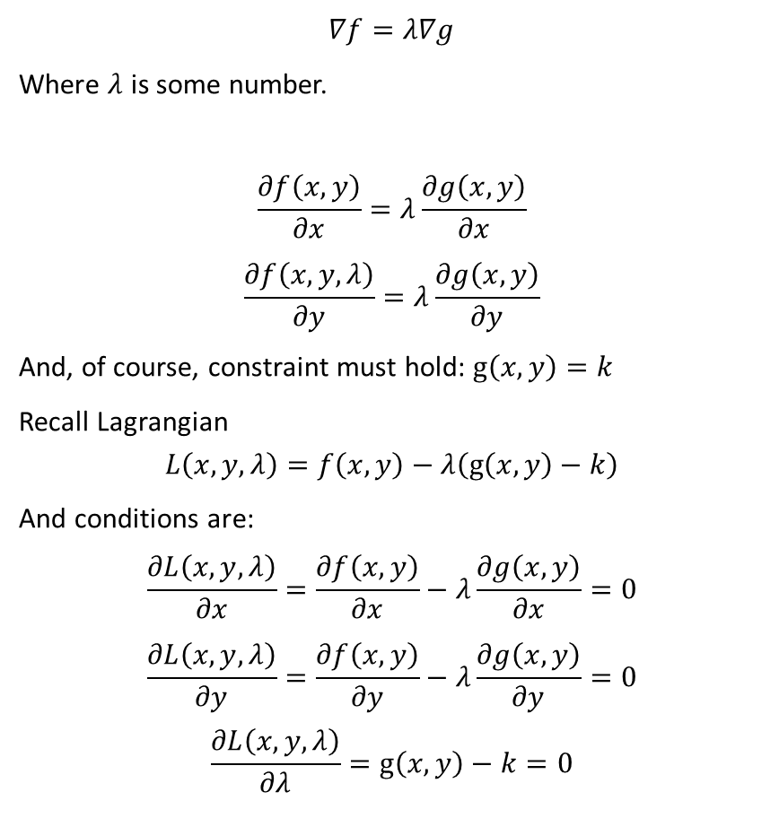
Intuition behind Lagrangian
$$∇f=λ∇g$$
Where $λ$ is some number.
$$\frac{∂f\left(x,y\right)}{∂x}=λ\frac{∂g\left(x,y\right)}{∂x}$$
$$\frac{∂f\left(x,y,λ\right)}{∂y}=λ\frac{∂g\left(x,y\right)}{∂y}$$
And, of course, constraint must hold: $g\left(x,y\right)=k$
Recall Lagrangian
$$L\left(x,y,λ\right)=f\left(x,y\right)−λ\left(g\left(x,y\right)−k\right)$$
And conditions are:
$$\frac{∂L\left(x,y,λ\right)}{∂x}=\frac{∂f\left(x,y\right)}{∂x}−λ\frac{∂g\left(x,y\right)}{∂x}=0$$
$$\frac{∂L\left(x,y,λ\right)}{∂y}=\frac{∂f\left(x,y\right)}{∂y}−λ\frac{∂g\left(x,y\right)}{∂y}=0$$
$$\frac{∂L\left(x,y,λ\right)}{∂λ}=g\left(x,y\right)−k=0$$
These are the same conditions!
Note: All local maxima are found by Lagrangian method. Values of $f\left(x,y\right)$ must be calculated at all ‚suspicious points‘ to calculate the global maximum.

Slide 9
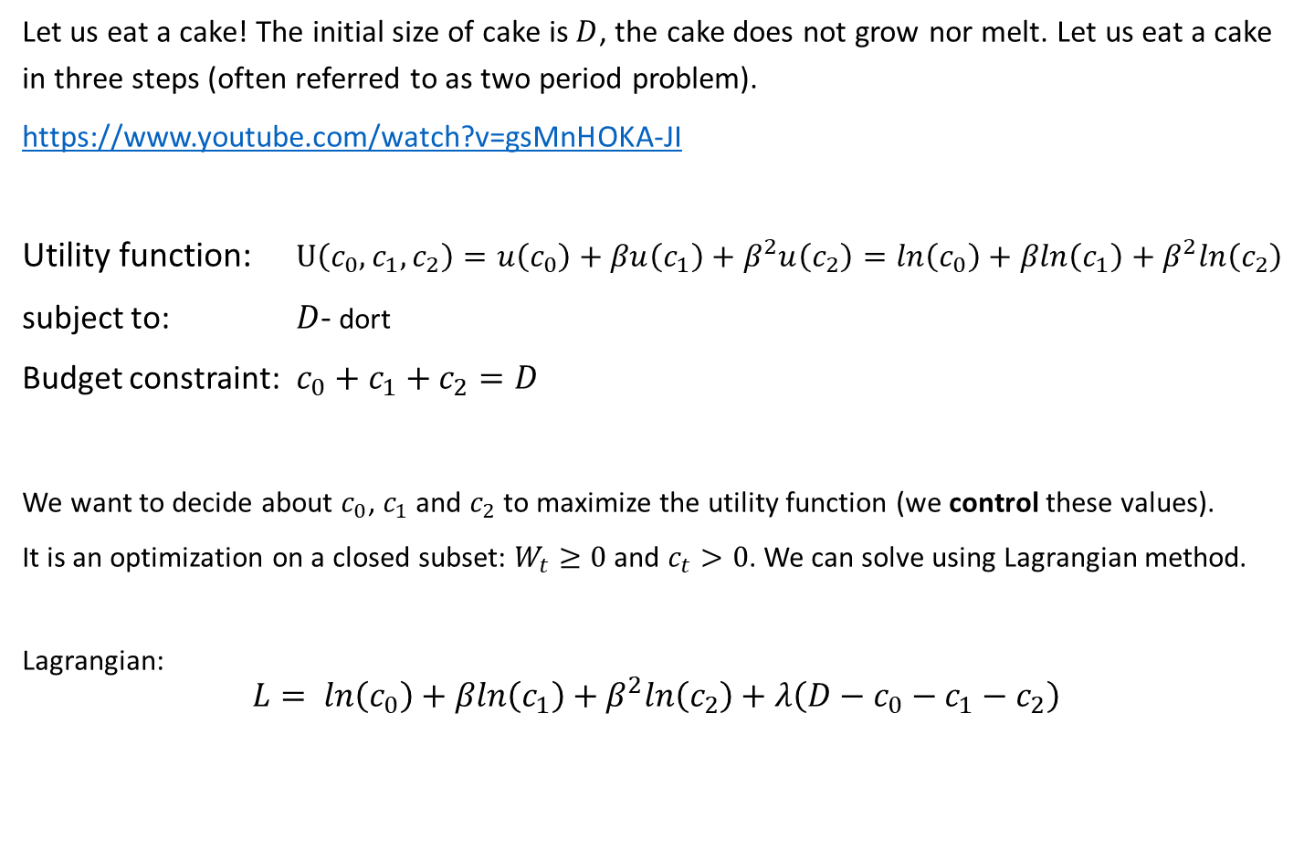

Cake eating – classical (Lagrangian) solution 1
Let us eat a cake! The initial size of cake is $D$, the cake does not grow nor melt. Let us eat a cake in three steps (often referred to as two period problem).
https://www.youtube.com/watch?v=gsMnHOKA-JI
Utility function: $U\left(c_{0},c_{1}, c_{2}\right)=u\left(c_{0}\right)+βu\left(c_{1}\right)+β^{2}u\left(c_{2}\right)=ln\left(c_{0}\right)+βln\left(c_{1}\right)+β^{2}ln\left(c_{2}\right)$
subject to: $D$- dort
Budget constraint: $c_{0}+c_{1}+c_{2}=D$
We want to decide about $c_{0}$, $c_{1}$ and $c_{2}$ to maximize the utility function (we control these values).
It is an optimization on a closed subset: $W_{t}≥0$ and $c_{t}>0$. We can solve using Lagrangian method.
Lagrangian:
$$L= ln\left(c_{0}\right)+βln\left(c_{1}\right)+β^{2}ln\left(c_{2}\right)+λ\left(D−c_{0}−c_{1}−c_{2}\right)$$
$$u\left(c_{t}\right)=ln\left(c_{t}\right)$$
$$t=0, 1, 2$$

Slide 10
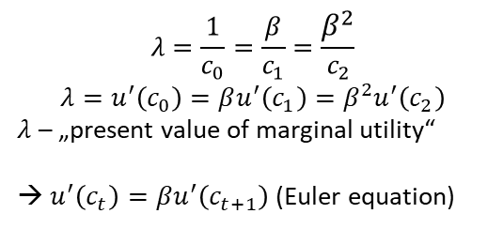

Cake eating – classical (Lagrangian) solution 2
Lagrangian:
$$L= ln\left(c_{0}\right)+βln\left(c_{1}\right)+β^{2}ln\left(c_{2}\right)+λ\left(D−c_{0}−c_{1}−c_{2}\right)$$
$$\frac{∂L}{∂c_{0}}=\frac{1}{c_{0}}−λ=0$$
$$\frac{∂L}{∂c_{1}}=\frac{β}{c_{1}}−λ=0$$
$$\frac{∂L}{∂c_{2}}=\frac{β^{2}}{c_{2}}−λ=0$$
$$\frac{∂L}{∂λ}=D−c_{0}−c_{1}−c_{2}=0$$
These are four equations for four uknown variables $c_{0}$, $c_{1}$, $c_{2}$ and $λ$.
Let us solve them:
$$c_{1}=βc_{0}$$
$$c_{2}=β^{2}c_{0}$$
$$D=c_{0}+βc_{0}+β^{2}c_{0}$$
$$c_{0}=\frac{1}{1+β+β^{2}}D$$
$$c_{1}=\frac{β}{1+β+β^{2}}D$$
$$c_{2}=\frac{β^{2}}{1+β+β^{2}}D$$
$$λ=\frac{1}{c_{0}}=\frac{β}{c_{1}}=\frac{β^{2}}{c_{2}}$$
$$λ=u^{′}\left(c_{0}\right)=βu^{′}\left(c_{1}\right)=β^{2}u^{′}\left(c_{2}\right)$$
$λ$ – „present value of marginal utility“
→ $u^{′}\left(c_{t}\right)=βu^{′}\left(c_{t+1}\right)$(Euler equation)

Slide 11
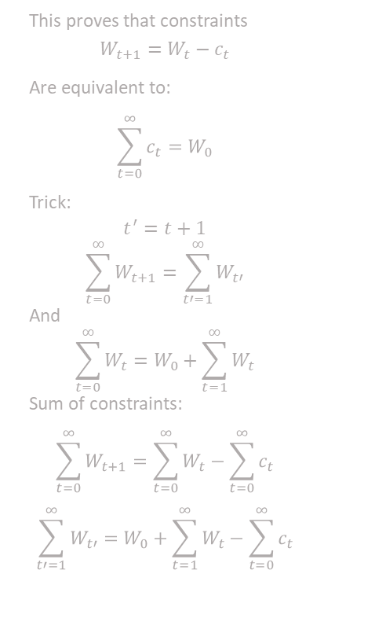
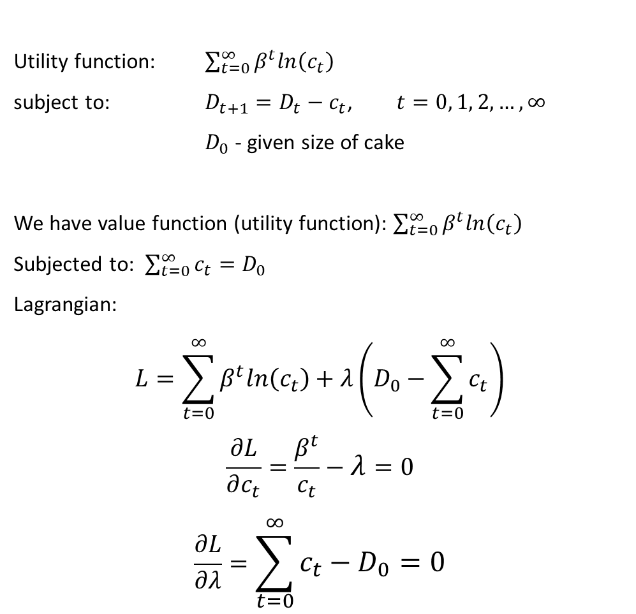
Cake eating, infinite horizon –Lagrangian solution 1
Utility function: $\sum_{t=0}^{∞}{β^{t}ln\left(c_{t}\right)}$
subject to: $D_{t+1}=D_{t}−c_{t}$, $t=0, 1, 2,…, ∞$
$D_{0}$ - given size of cake
We have value function (utility function): $\sum_{t=0}^{∞}{β^{t}ln\left(c_{t}\right)}$
Subjected to: $\sum_{t=0}^{∞}{c_{t}}=D_{0}$
Lagrangian:
$$L=\sum_{t=0}^{∞}{β^{t}ln\left(c_{t}\right)}+λ\left(D_{0}−\sum_{t=0}^{∞}{c_{t}}\right)$$
$$\frac{∂L}{∂c_{t}}=\frac{β^{t}}{c_{t}}−λ=0$$
$$\frac{∂L}{∂λ}=\sum_{t=0}^{∞}{c_{t}}−D_{0}=0$$
This proves that constraints
$$W_{t+1}=W_{t}−c_{t}$$
Are equivalent to:
$$\sum_{t=0}^{∞}{c_{t}}=W_{0}$$
Trick:
$$t^{′}=t+1$$
$$\sum_{t=0}^{∞}{W_{t+1}}=\sum_{t′=1}^{∞}{W_{t′}}$$
And
$$\sum_{t=0}^{∞}{W_{t}}=W_{0}+\sum_{t=1}^{∞}{W_{t}}$$
Sum of constraints:
$$\sum_{t=0}^{∞}{W_{t+1}}=\sum_{t=0}^{∞}{W_{t}}−\sum_{t=0}^{∞}{c_{t}}$$
$$\sum_{t′=1}^{∞}{W_{t′}}=W_{0}+\sum_{t=1}^{∞}{W_{t}}−\sum_{t=0}^{∞}{c_{t}}$$

Slide 12

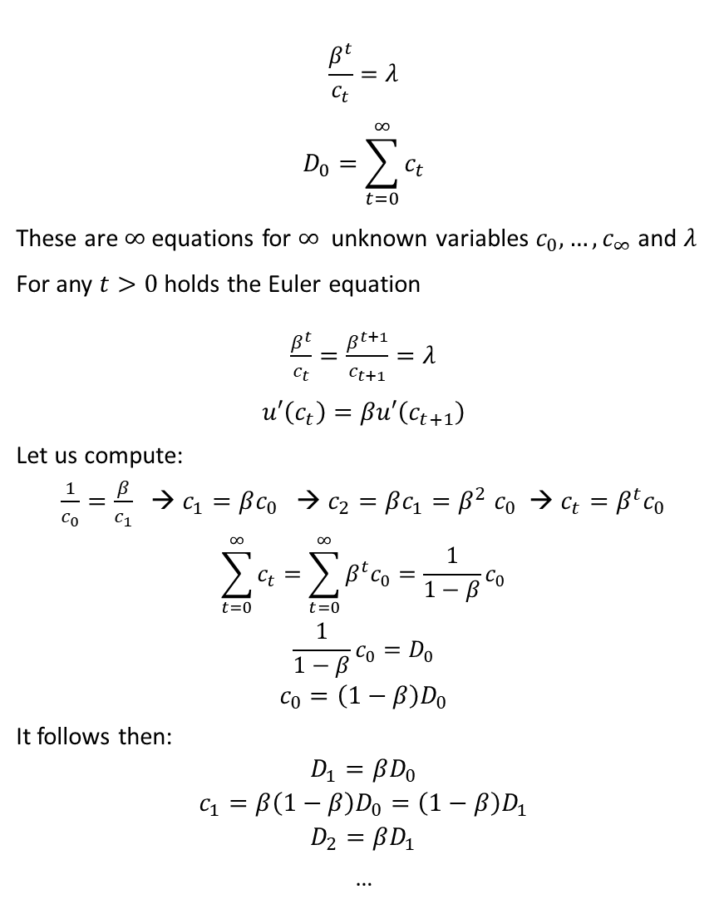
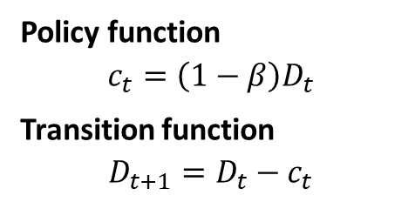
$$\frac{β^{t}}{c_{t}}=λ$$
$$D_{0}=\sum_{t=0}^{∞}{c_{t}}$$
These are $∞$equations for $∞$ unknown variables $c_{0},…,c_{∞}$ and $λ$
For any $t>0$ holds the Euler equation
$\frac{β^{t}}{c_{t}}=\frac{β^{t+1}}{c_{t+1}}=λ$
$$u′\left(c_{t}\right)=βu′\left(c_{t+1}\right)$$
Let us compute:
$\frac{1}{c_{0}}=\frac{β}{c_{1}}$ → $c_{1}=βc_{0}$ → $c_{2}=βc_{1}{=β}^{2}c_{0}$ → $c_{t}=β^{t}c_{0}$
$$\sum_{t=0}^{∞}{c_{t}}=\sum_{t=0}^{∞}{β^{t}c_{0}}=\frac{1}{1−β}c_{0}$$
$$\frac{1}{1−β}c_{0}=D_{0}$$
$$c_{0}=\left(1−β\right)D_{0}$$
It follows then:
$$D_{1}=βD_{0}$$
$$c_{1}=β\left(1−β\right)D_{0}=\left(1−β\right)D_{1}$$
$$D_{2}=βD_{1}$$
…
$λ$ – present value of marginal utility
$$λ=β^{t}u′\left(c_{t}\right)$$
Policy function
$$c_{t}=\left(1−β\right)D_{t}$$
Transition function
$$D_{t+1}=D_{t}−c_{t}$$

