Slide 1
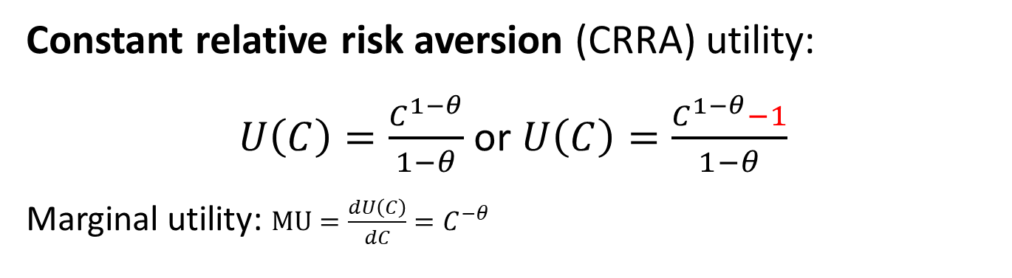

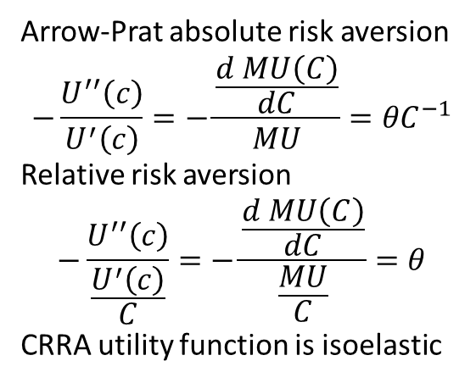
Intermezzo: CRRA vs. Log-utility
Constant relative risk aversion (CRRA) utility:
$U\left(C\right)=\frac{C_{ }^{1−θ}}{1−θ}$ or $U\left(C\right)=\frac{C_{ }^{1−θ}−1}{1−θ}$
Marginal utility: $MU=\frac{dU\left(C\right)}{dC}=C^{−θ}$
Arrow-Prat absolute risk aversion
$$−\frac{U^{′′}\left(c\right)}{U^{′}\left(c\right)}=−\frac{\frac{d MU\left(C\right)}{dC}}{MU}={θC}^{−1}$$
Relative risk aversion
$$−\frac{U^{′′}\left(c\right)}{\frac{U^{′}\left(c\right)}{C}}=−\frac{\frac{d MU\left(C\right)}{dC}}{\frac{MU}{C}}=θ$$
CRRA utility function is isoelastic
Larger $θ$ leads to larger consumption smoothing.

Slide 2
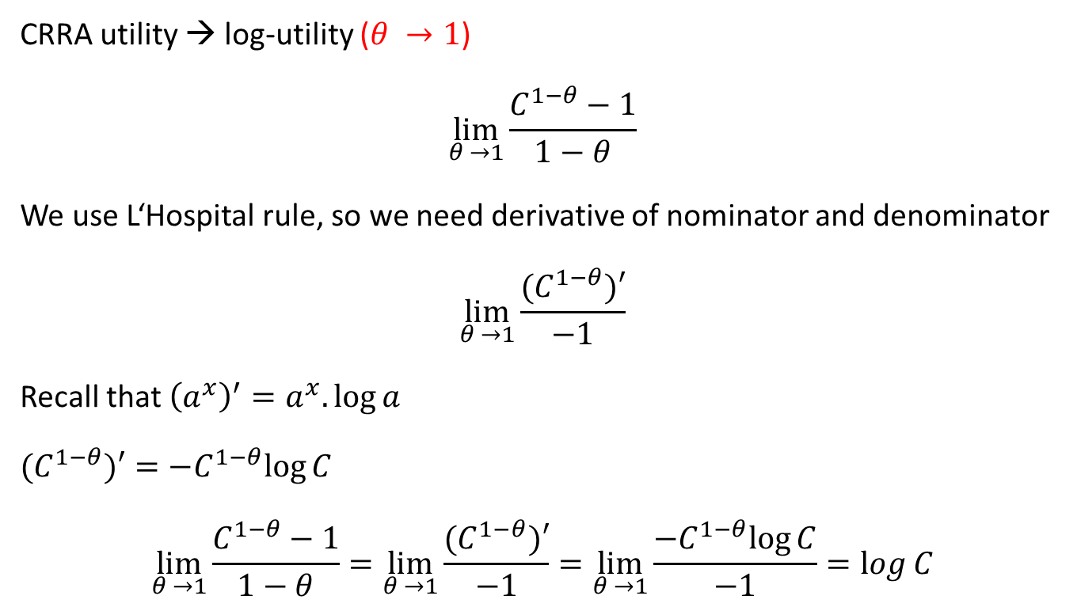
Intermezzo: CRRA vs. Log-utility
CRRA utility → log-utility ($θ →1$)
$$\lim_{θ →1}{\frac{C_{ }^{1−θ}−1}{1−θ}}$$
We use L‘Hospital rule, so we need derivative of nominator and denominator
$$\lim_{θ →1}{\frac{{(C}_{ }^{1−θ})′}{−1}}$$
Recall that ${\left(a^{x}\right)}^{′}=a^{x}.\log{a}$
${(C}_{ }^{1−θ})′=−C_{ }^{1−θ}log⁡C$
$$\lim_{θ →1}{\frac{C_{ }^{1−θ}−1}{1−θ}}=\lim_{θ →1}{\frac{{(C}_{ }^{1−θ})′}{−1}}=\lim_{θ →1}{\frac{−C_{ }^{1−θ}log⁡C}{−1}}=\log{C}$$

