Slide 1
MMM
Difference equations
Lecture
josef.strasky@gmail.com

Slide 2
Outline
Basic definitions
Equilibrium and stability in discrete systems
Phase diagrams
Solution methods: 1st order
Solution methods: 2nd order

Slide 3
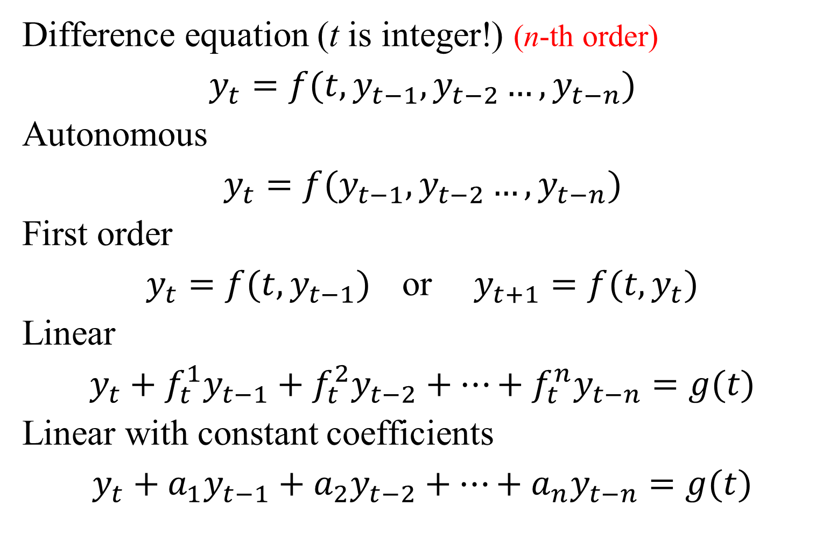
Basic Definitions 1
Difference equation (t is integer!) (n-th order)
$$y_{t}=f(t,y_{t−1},y_{t−2}…,y_{t−n})$$
Autonomous
$$y_{t}=f(y_{t−1},y_{t−2}…,y_{t−n})$$
First order
$y_{t}=f(t,y_{t−1})$ or $y_{t+1}=f(t,y_{t})$
Linear
$$y_{t}+f_{t}^{1}y_{t−1}+f_{t}^{2}y_{t−2}+…+f_{t}^{n}y_{t−n}=g(t)$$
Linear with constant coefficients
$$y_{t}+a_{1}y_{t−1}+a_{2}y_{t−2}+…+a_{n}y_{t−n}=g(t)$$

Slide 4
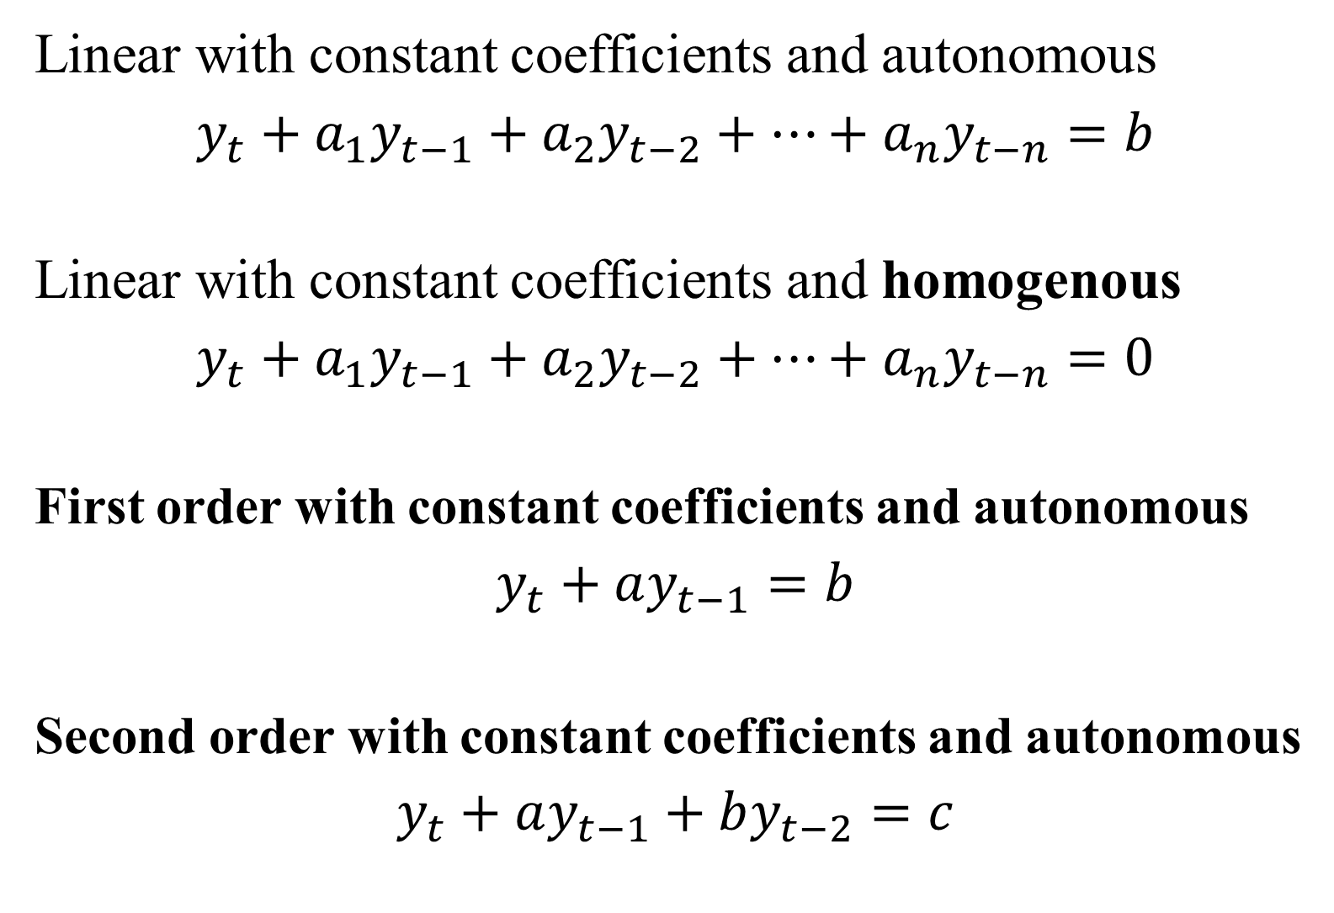
Basic Definitions 2
Linear with constant coefficients and autonomous
$$y_{t}+a_{1}y_{t−1}+a_{2}y_{t−2}+…+a_{n}y_{t−n}=b$$
Linear with constant coefficients and homogenous
$$y_{t}+a_{1}y_{t−1}+a_{2}y_{t−2}+…+a_{n}y_{t−n}=0$$
First order with constant coefficients and autonomous
$$y_{t}+ay_{t−1}=b$$
Second order with constant coefficients and autonomous
$$y_{t}+ay_{t−1}+by_{t−2}=c$$

Slide 5
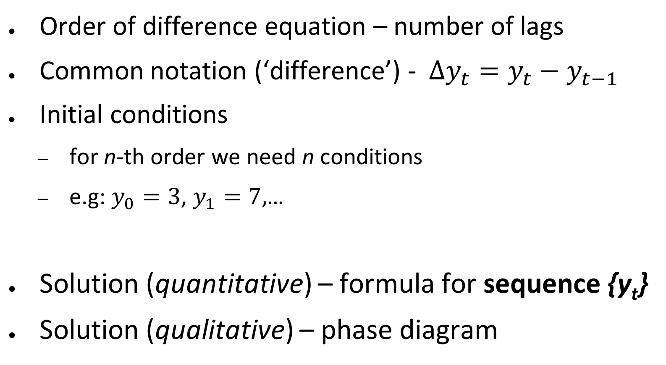
Basic Definitions 3
Order of difference equation – number of lags
Common notation (‘difference’) - $∆y_{t}=y_{t}−y_{t−1}$
Initial conditions
for n-th order we need n conditions
e.g: $y_{0}=3$, $y_{1}=7,$…
Solution (quantitative) – formula for sequence {y_{t}}
Solution (qualitative) – phase diagram

Slide 6
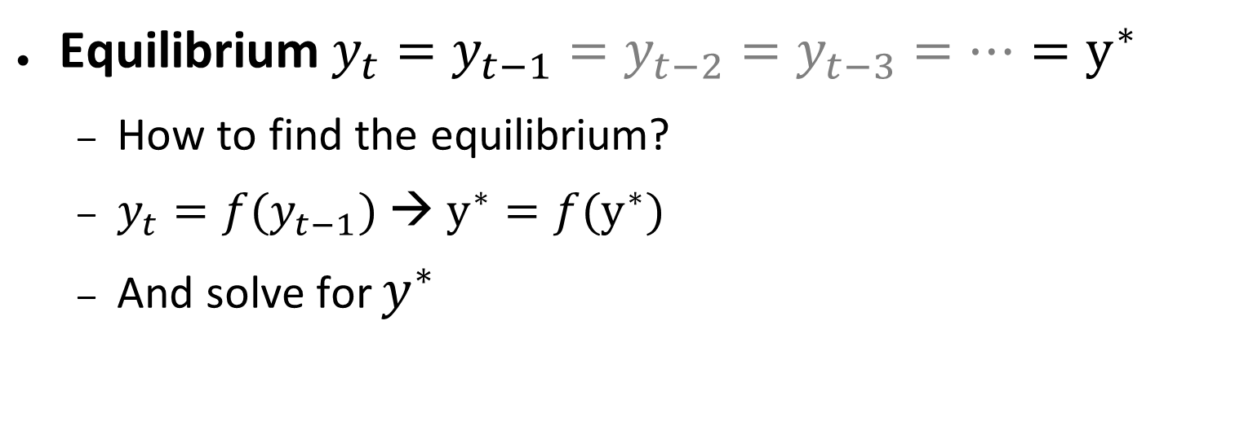
Equilibrium
Equilibrium $y_{t}=y_{t−1}=y_{t−2}=y_{t−3}=…=y^{∗}$
How to find the equilibrium?
$y_{t}=f(y_{t−1})$ → $y^{∗}=f(y^{∗})$
And solve for $y^{∗}$

Slide 7
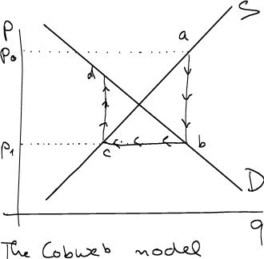
Economic example
Cobweb model
Demand-Supply model in discrete time
q^{d}_{t}=a-bp_{t} a,b>0
q^{s}_{t}=c+dp_{t-1} c,d>0
q^{s}=q^{d}
a-bp_{t}=c+dp_{t-1}.
Find equilibrium p*

Slide 8
Economic example
Cobweb model
Demand-Supply model in discrete time
q^{d}_{t}=4-2p_{t}
q^{s}_{t}=2+p_{t-1}
p₀ =1.5
Draw phase diagram.

Slide 9
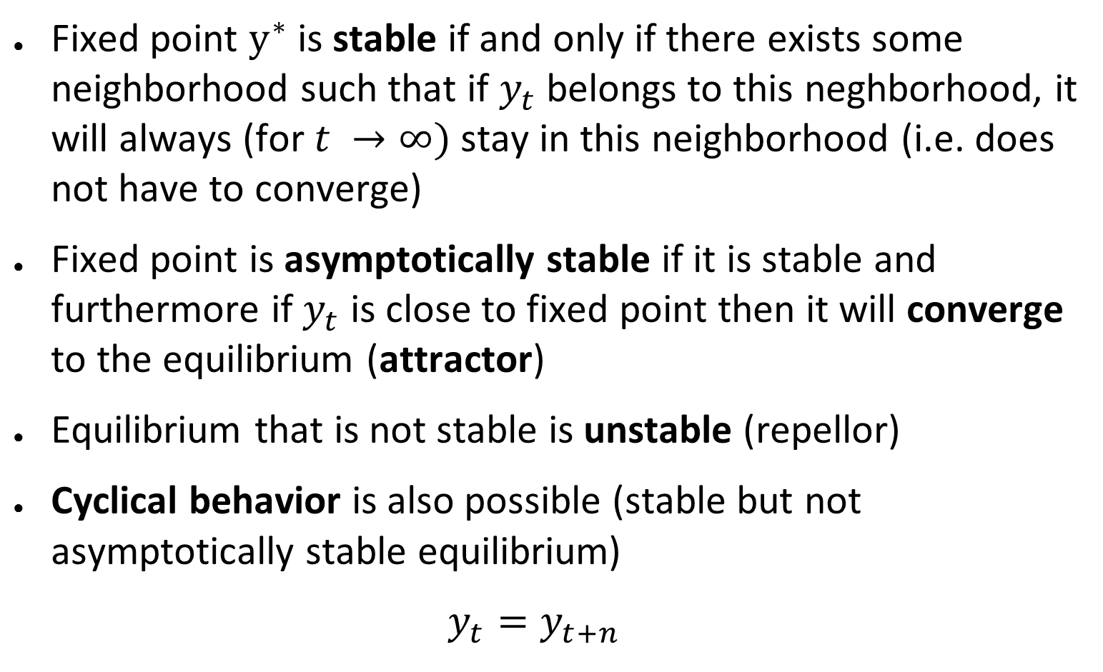
Equilibrium and stability
Fixed point $y^{∗}$ is stable if and only if there exists some neighborhood such that if $y_{t}$belongs to this neghborhood, it will always (for $t →∞)$ stay in this neighborhood (i.e. does not have to converge)
Fixed point is asymptotically stable if it is stable and furthermore if $y_{t}$ is close to fixed point then it will converge to the equilibrium (attractor)
Equilibrium that is not stable is unstable (repellor)
Cyclical behavior is also possible (stable but not asymptotically stable equilibrium)
$$y_{t}=y_{t+n}$$

Slide 10
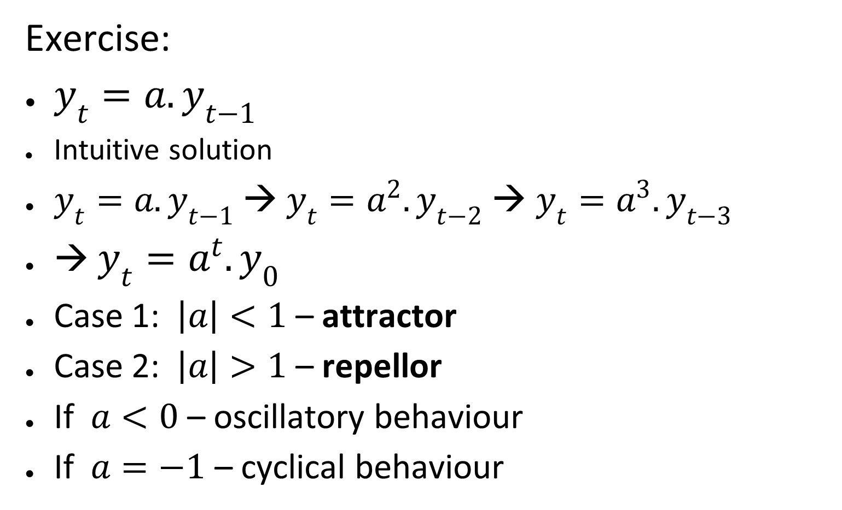
Equilibrium and stability important simple case
Exercise:
$y_{t}=a{.y}_{t−1}$
Intuitive solution
$y_{t}=a{.y}_{t−1}$→ $y_{t}=a^{2}{.y}_{t−2}$→ $y_{t}=a^{3}{.y}_{t−3}$
→ $y_{t}=a^{t}{.y}_{0}$
Case 1: $\left|a\right|<1$ – attractor
Case 2: $\left|a\right|>1$ – repellor
If $a<0$ – oscillatory behaviour
If $a=−1$ – cyclical behaviour

Slide 11
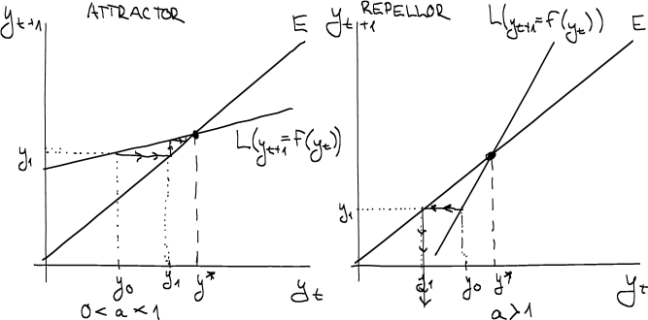
Equilibrium and stability important simple case

Slide 12
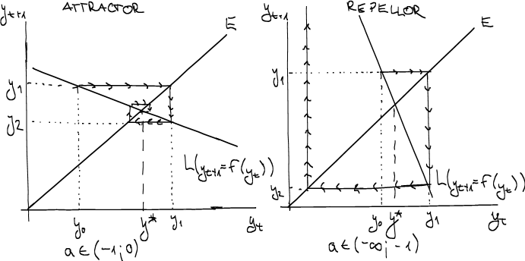
Equilibrium and stability important simple case

Slide 13
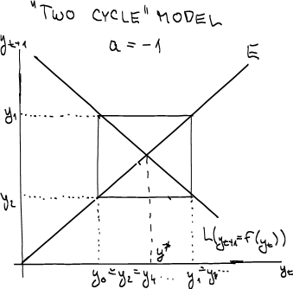
Equilibrium and stability important simple case

Slide 14
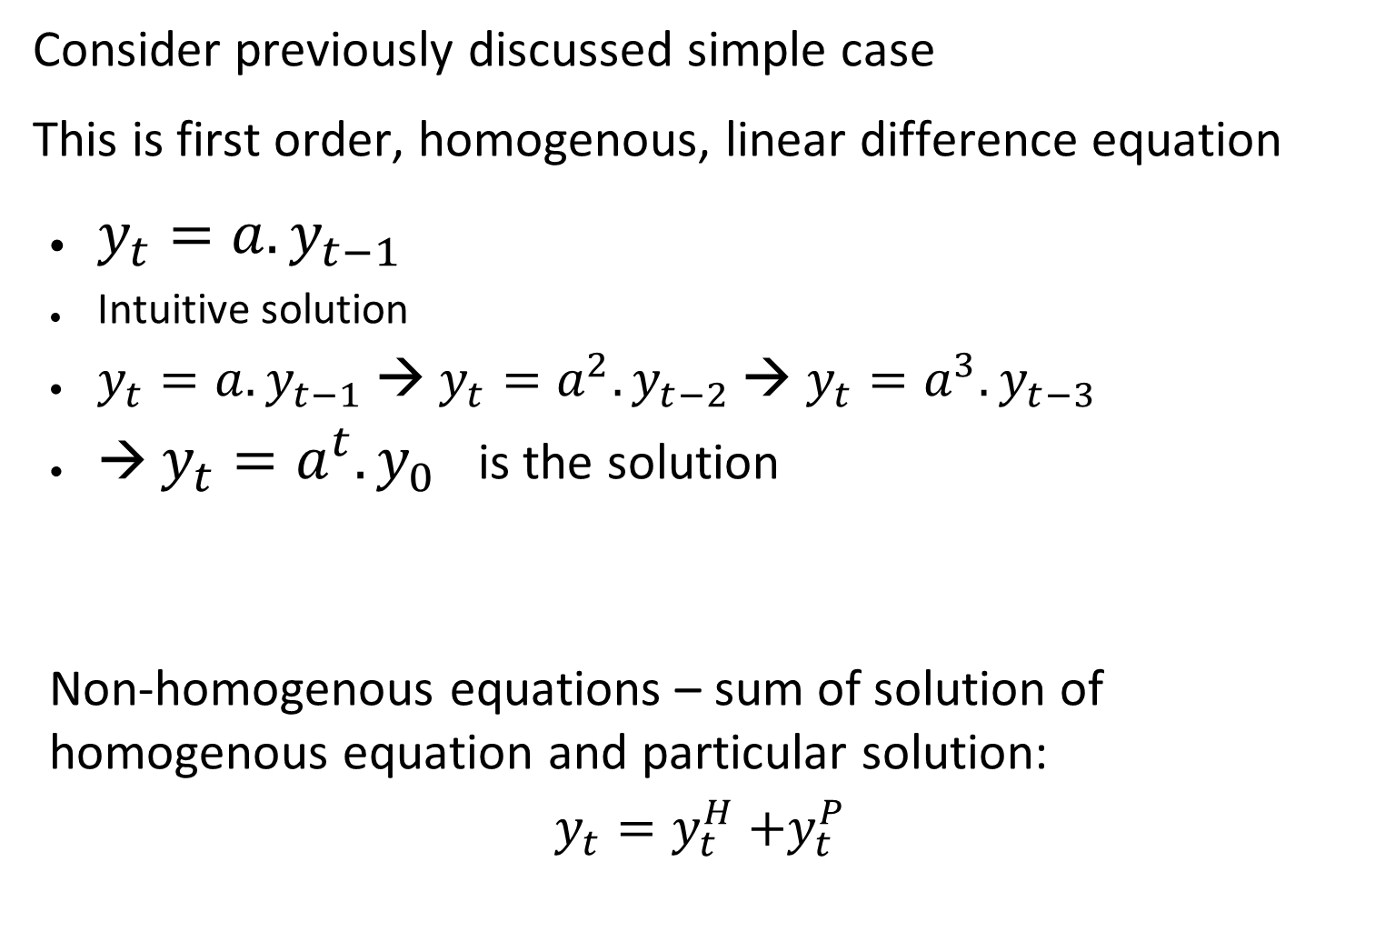
Solution Methods: 1st Order
Consider previously discussed simple case
This is first order, homogenous, linear difference equation
$y_{t}=a{.y}_{t−1}$
Intuitive solution
$y_{t}=a{.y}_{t−1}$→ $y_{t}=a^{2}{.y}_{t−2}$→ $y_{t}=a^{3}{.y}_{t−3}$
→ $y_{t}=a^{t}{.y}_{0}$ is the solution
Non-homogenous equations – sum of solution of homogenous equation and particular solution:
$$y_{t}=y_{t}^{H}{+y}_{t}^{P}$$

Slide 15
Solution Methods: 1st order, non homogenous
Non-homogeneous: Undetermined coefficients method
Suppose an equation y_{t+1}+ay_{t} = r_{k}
Now the form of the particular solution depends on the form of the right side of the equation r_{k}
Right side r_{k} Trial solution
a^{k} Aa^{k}
k^{n} A₀+A₁k+A₂k²+…+A_{n}k^{n}
sin(αk) or cos(αk) Asin(αk)+Bcos(αk)

Slide 16
Solution Methods: 1st order, non-homogenous
Solution algorithm:
Take particular form of the solution according to the right side of the equation
Plug it into the original equation and where was y_{k+1} put the trial solution with (k+1) instead of k.
Examples:
y_{k+1}-3y_{k}=2
y_{k+1}-3y_{k}=k²+k+2

Slide 17
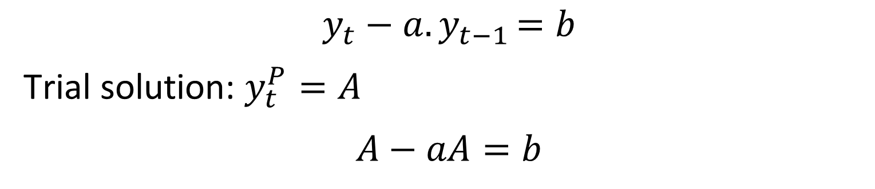
Solution Methods: 1st order, autonomous
$$y_{t}−a{.y}_{t−1}=b$$
Trial solution: $y_{t}^{P}=A$
$$A−aA=b$$
Exercise:
y_{k+1} - 3y_{k}= 2

Slide 18
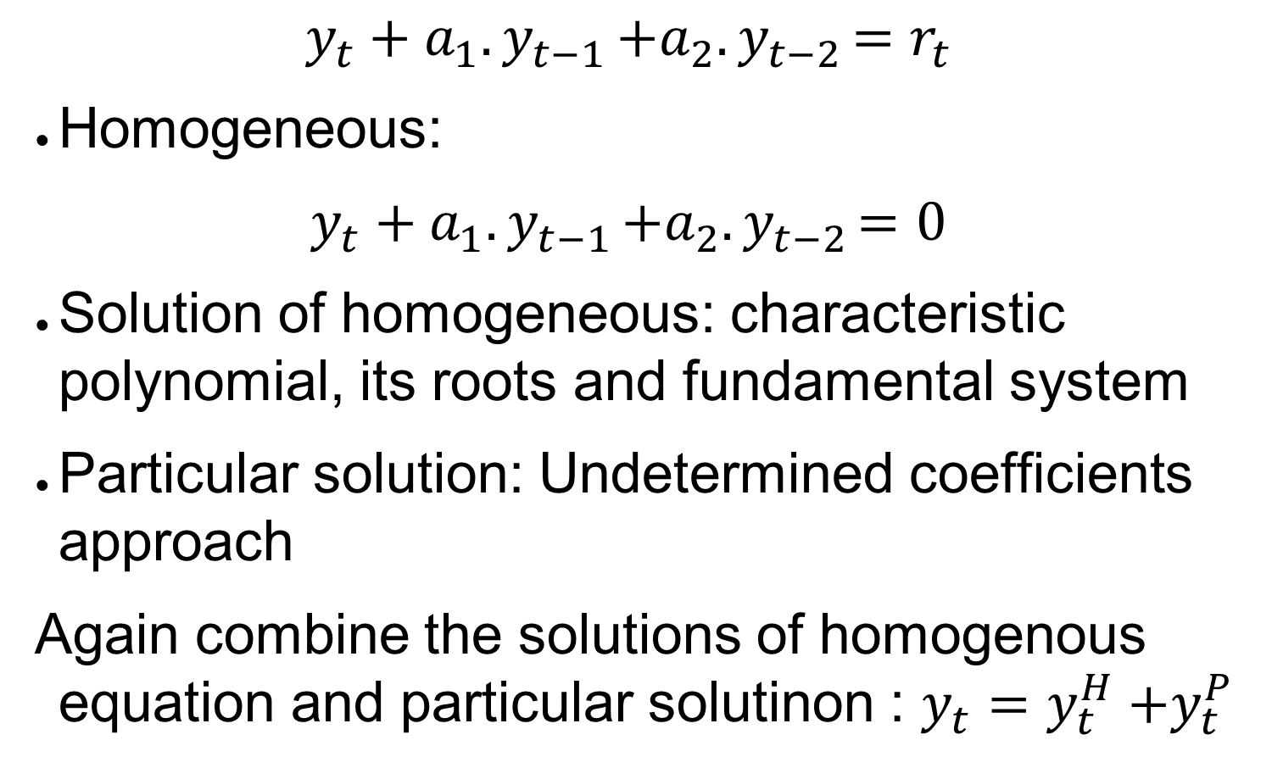
Solution Methods: 2nd Order
$$y_{t}+a_{1}{.y}_{t−1}+a_{2}{.y}_{t−2}=r_{t}$$
Homogeneous:
$$y_{t}+a_{1}{.y}_{t−1}+a_{2}{.y}_{t−2}=0$$
Solution of homogeneous: characteristic polynomial, its roots and fundamental system
Particular solution: Undetermined coefficients approach
Again combine the solutions of homogenous equation and particular solutinon : $y_{t}=y_{t}^{H}{+y}_{t}^{P}$

Slide 19
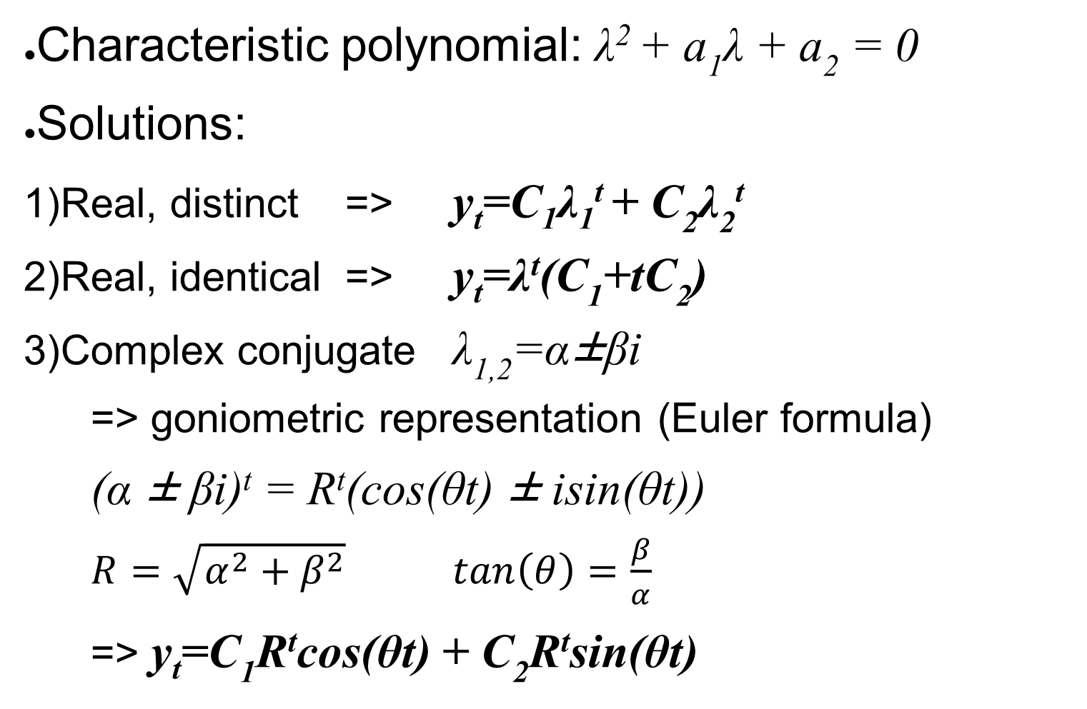
Solution Methods: 2nd Order - homogenous
Characteristic polynomial: λ² + a₁λ + a₂ = 0
Solutions:
Real, distinct => y_{t}=C₁λ₁^{t} + C₂λ₂^{t}
Real, identical => y_{t}=λ^{t}(C₁+tC₂)
Complex conjugate λ_{1,2}=α±βi
=> goniometric representation (Euler formula)
(α ± βi)^{t} = R^{t}(cos(θt) ± isin(θt))
$R=\sqrt{α^{2}+β^{2}}$ $tan\left(θ\right)=\frac{β}{α}$
=> y_{t}=C₁R^{t}cos(θt) + C₂R^{t}sin(θt)

Slide 20
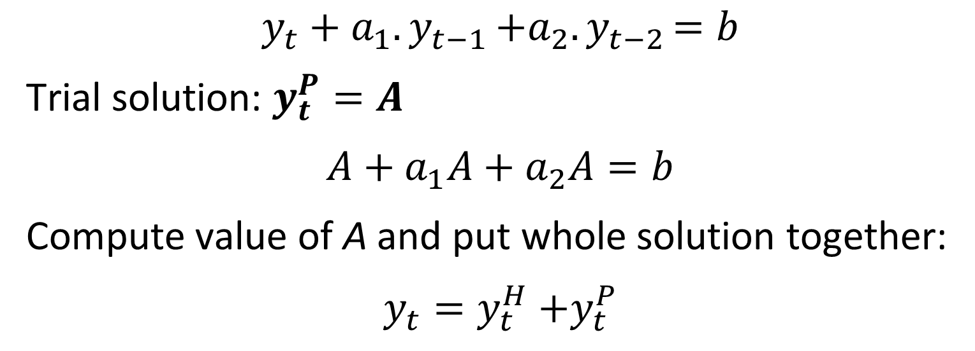
Solution Methods: 2nd order – non-homogenous
Same approach as in the case of 1st order
2nd order, autonomous:
$$y_{t}+a_{1}{.y}_{t−1}+a_{2}{.y}_{t−2}=b$$
Trial solution: $y_{t}^{P}=A$
$$A+a_{1}A+a_{2}A=b$$
Compute value of A and put whole solution together:
$$y_{t}=y_{t}^{H}{+y}_{t}^{P}$$

Slide 21

Final exercises
Find all solutions of following difference equations:
$$\begin{matrix}y_{k+2}−5y_{k+1}+6y_{k}=0 \\ y_{k+2}−8y_{k+1}+16y_{k}=−9 \\ y_{k+2}+y_{k+1}+y_{k}=0 \\ y_{k+2}−4y_{k+1}+16y_{k}=26\end{matrix}$$

