Slide 1
Heterogeneous agents models
Josef Stráský
2021

Slide 2
Hetergeneous agents models
Efficient market hypothesis does not hold
Obtaining full information is costly (or impossible)
→ Different rationalizable expectations
Heteregeneous beliefs/expectations → heterogeneous agents
Different optimization rules
Simple rational model leads to complicated (chaotic) dynamics

Slide 3
Cobweb model with heterogeneous agents
Brock and Hommes, Econometrica 65 (1997), 1059-1095
A demand-supply model with supply delayed by one-period (i.e. cobweb model)
Two possible behaviours of suppliers (two different rationalizable strategies for suppliers)
Agents select a strategy according to its performance
→ adaptive rational equilibrium
Simple model leads to a non-linear system of two difference equations of the first order
Complicated chaotic behaviour

Slide 4

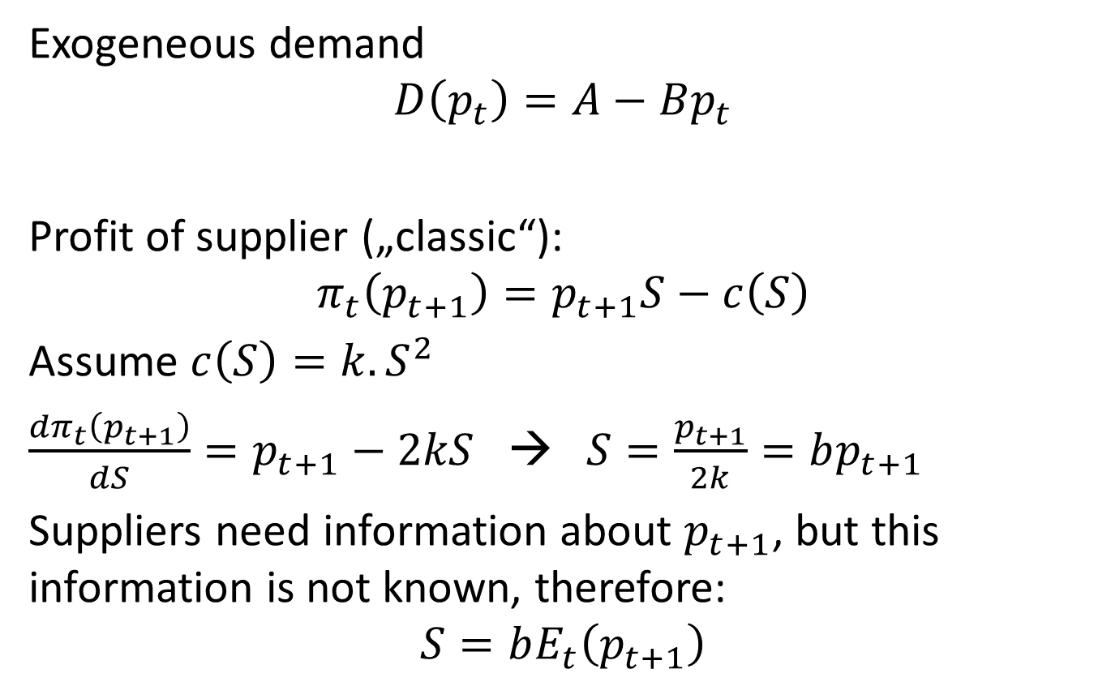
Demand and supply
Exogeneous demand
$$D\left(p_{t}\right)=A−Bp_{t}$$
Profit of supplier („classic“):
$$π_{t}\left(p_{t+1}\right)=p_{t+1}S−c\left(S\right)$$
Assume $c\left(S\right)=k.S^{2}$
$\frac{{dπ}_{t}\left(p_{t+1}\right)}{dS}=p_{t+1}−2kS$ → $S=\frac{p_{t+1}}{2k}=bp_{t+1}$
Suppliers need information about $p_{t+1}$, but this information is not known, therefore:
$$S=bE_{t}\left(p_{t+1}\right)$$
$$b=\frac{1}{2k}$$

Slide 5

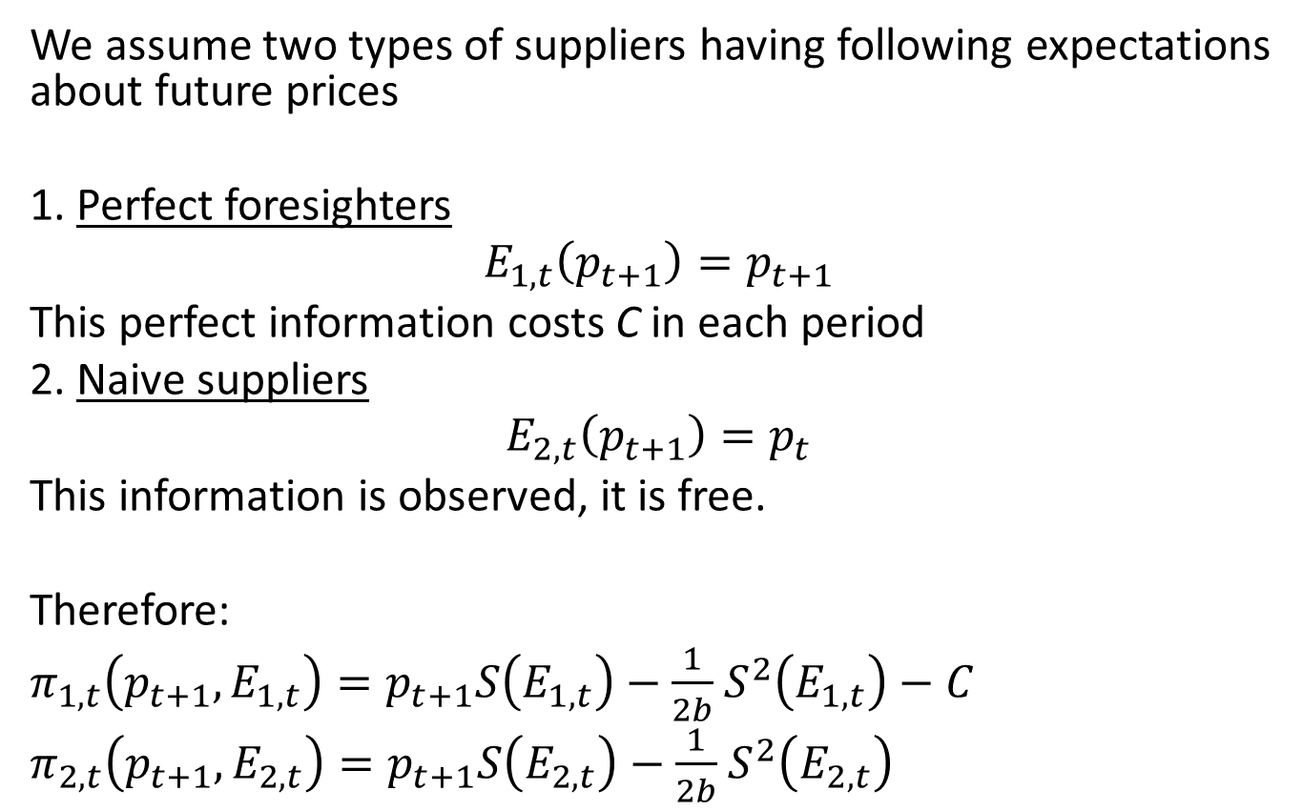
Heterogeneous suppliers
We assume two types of suppliers having following expectations about future prices
1. Perfect foresighters
$$E_{1,t}\left(p_{t+1}\right)=p_{t+1}$$
This perfect information costs C in each period
2. Naive suppliers
$$E_{2,t}\left(p_{t+1}\right)=p_{t}$$
This information is observed, it is free.
Therefore:
$π_{1,t}\left(p_{t+1},E_{1,t}\right)=p_{t+1}S\left(E_{1,t}\right)−\frac{1}{2b}$ $S^{2}\left(E_{1,t}\right)−C$
$π_{2,t}\left(p_{t+1},E_{2,t}\right)=p_{t+1}S\left(E_{2,t}\right)−\frac{1}{2b}$ $S^{2}\left(E_{2,t}\right)$
$$k=\frac{1}{2b}$$

Slide 6
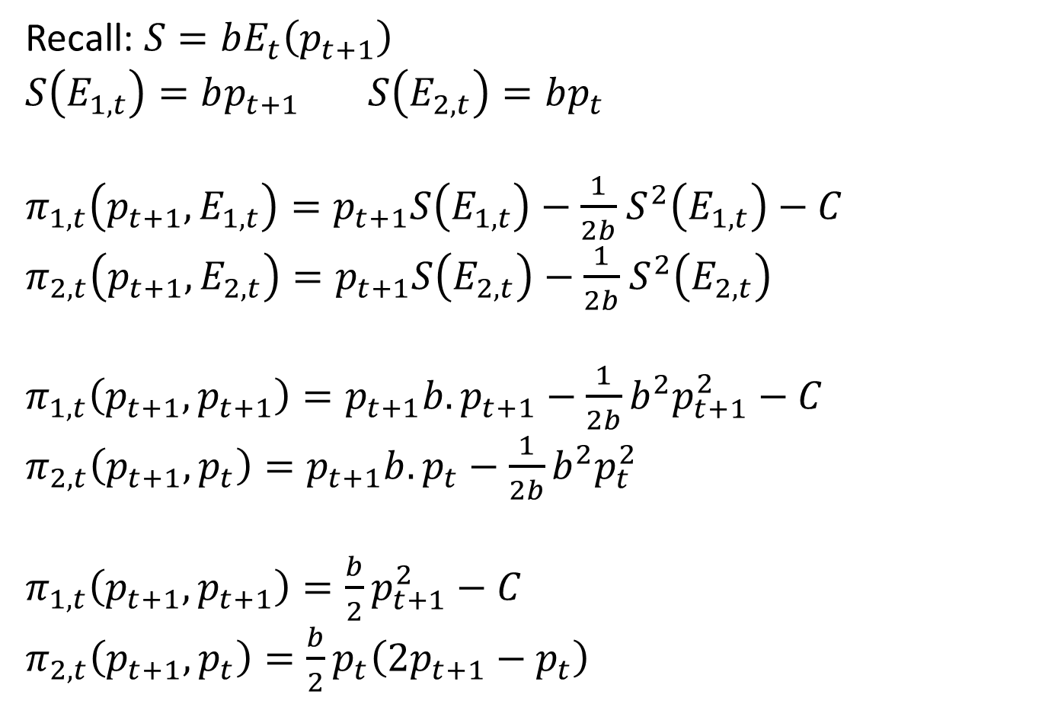
Heterogeneous suppliers
Recall: $S=bE_{t}\left(p_{t+1}\right)$
$S\left(E_{1,t}\right)=bp_{t+1}$ $S\left(E_{2,t}\right)=bp_{t}$
$π_{1,t}\left(p_{t+1},E_{1,t}\right)=p_{t+1}S\left(E_{1,t}\right)−\frac{1}{2b}$ $S^{2}\left(E_{1,t}\right)−C$
$π_{2,t}\left(p_{t+1},E_{2,t}\right)=p_{t+1}S\left(E_{2,t}\right)−\frac{1}{2b}$ $S^{2}\left(E_{2,t}\right)$
$π_{1,t}\left(p_{t+1},p_{t+1}\right)=p_{t+1}{b.p}_{t+1}−\frac{1}{2b}b^{2}p_{t+1}^{2}−C$
$π_{2,t}\left(p_{t+1},p_{t}\right)=p_{t+1}{b.p}_{t}−\frac{1}{2b}b^{2}p_{t}^{2}$
$π_{1,t}\left(p_{t+1},p_{t+1}\right)=\frac{b}{2}p_{t+1}^{2}−C$
$π_{2,t}\left(p_{t+1},p_{t}\right)=\frac{b}{2}p_{t}\left({2p}_{t+1}−p_{t}\right)$

Slide 7
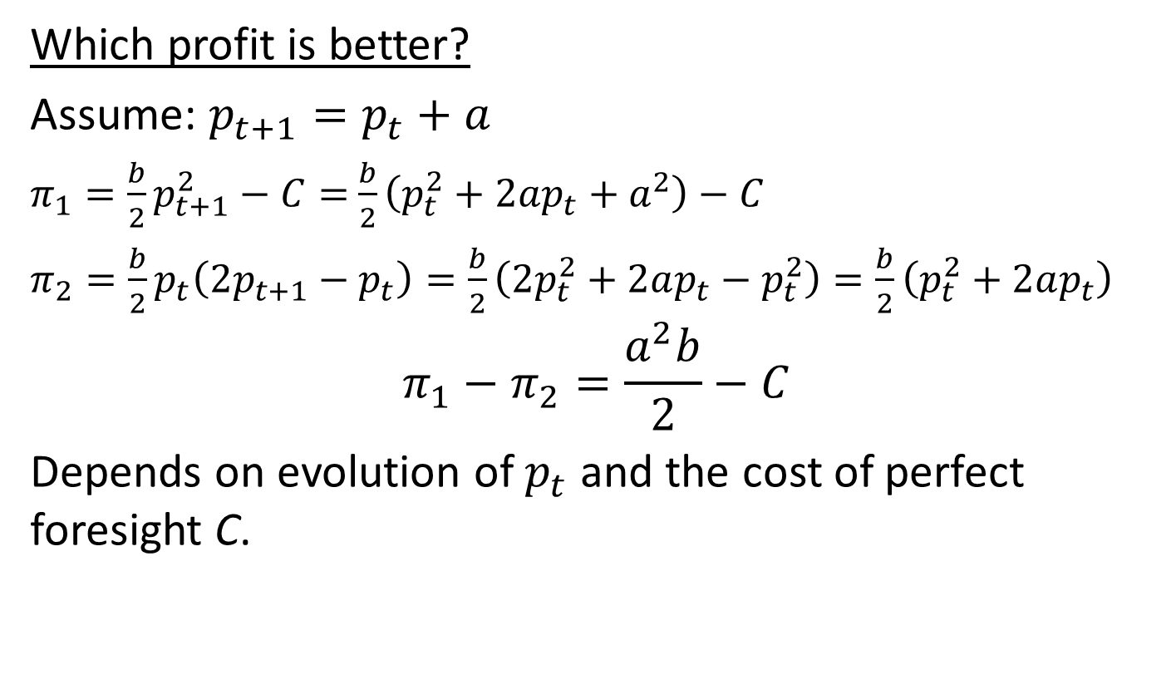
Heterogeneous suppliers
Which profit is better?
Assume: $p_{t+1}=p_{t}+a$
$π_{1}=\frac{b}{2}p_{t+1}^{2}−C=$ $\frac{b}{2}\left(p_{t}^{2}+2ap_{t}+a^{2}\right)−C$
$π_{2}=\frac{b}{2}p_{t}\left({2p}_{t+1}−p_{t}\right)=\frac{b}{2}\left(2p_{t}^{2}+2ap_{t}−p_{t}^{2}\right)=\frac{b}{2}\left(p_{t}^{2}+2ap_{t}\right)$
$$π_{1}−π_{2}=\frac{a^{2}b}{2}−C$$
Depends on evolution of $p_{t}$ and the cost of perfect foresight C.

Slide 8
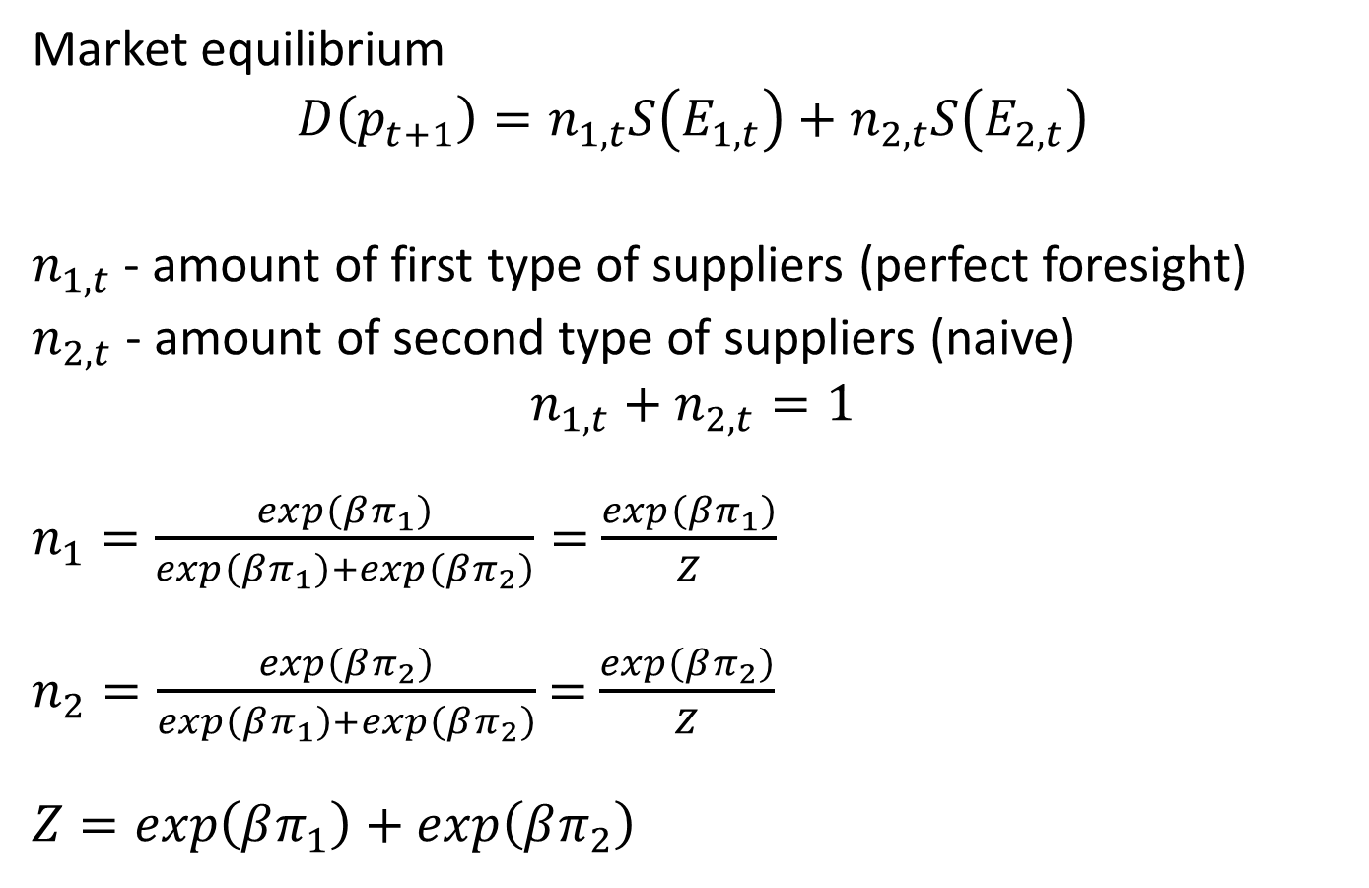
Equilibrium
Market equilibrium
$$D\left(p_{t+1}\right)=n_{1,t}S\left(E_{1,t}\right)+n_{2,t}S\left(E_{2,t}\right)$$
$n_{1,t}$ - amount of first type of suppliers (perfect foresight)
$n_{2,t}$ - amount of second type of suppliers (naive)
$$n_{1,t}+n_{2,t}=1$$
$n_{1}=\frac{exp\left(βπ_{1}\right)}{exp\left(βπ_{1}\right)+exp\left(βπ_{2}\right)}=$ $\frac{exp\left(βπ_{1}\right)}{Z}$
$n_{2}=\frac{exp\left(βπ_{2}\right)}{exp\left(βπ_{1}\right)+exp\left(βπ_{2}\right)}$ $=$ $\frac{exp\left(βπ_{2}\right)}{Z}$
$Z=exp\left(βπ_{1}\right)+exp\left(βπ_{2}\right)$

Slide 9

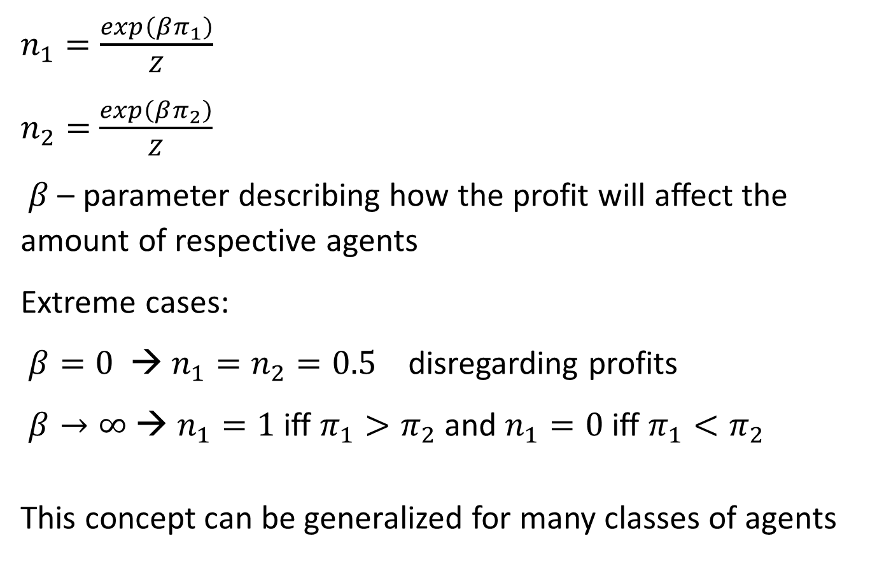
Maxwell-Boltzmann statistics
$n_{1}=\frac{exp\left(βπ_{1}\right)}{Z}$
$n_{2}=$ $\frac{exp\left(βπ_{2}\right)}{Z}$
$β$ – parameter describing how the profit will affect the amount of respective agents
Extreme cases:
$β=0$ → $n_{1}=n_{2}=0.5$ disregarding profits
$β→∞$ → $n_{1}=1$ iff $π_{1}>π_{2}$ and $n_{1}=0$ iff $π_{1}<π_{2}$
This concept can be generalized for many classes of agents
$$Z=exp\left(βπ_{1}\right)+exp\left(βπ_{2}\right)$$

Slide 10
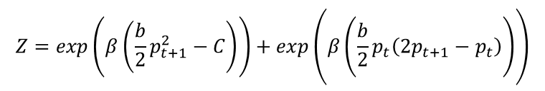

Agents - suppliers
More properly:
$n_{1,t+1}=\frac{exp\left(β\left(\frac{b}{2}p_{t+1}^{2}−C\right)\right)}{Z}$
$n_{2,t+1}=$ $\frac{exp\left(β\left(\frac{b}{2}p_{t}\left({2p}_{t+1}−p_{t}\right)\right)\right)}{Z}$
Let us define:
$$m_{t}=n_{1,t}−n_{2,t}$$
$n_{1,t}=\frac{m_{t}+1}{2}$
$n_{2,t}=\frac{{1−m}_{t}}{2}$
$$Z=exp\left(β\left(\frac{b}{2}p_{t+1}^{2}−C\right)\right)+exp\left(β\left(\frac{b}{2}p_{t}\left({2p}_{t+1}−p_{t}\right)\right)\right)$$

Slide 11
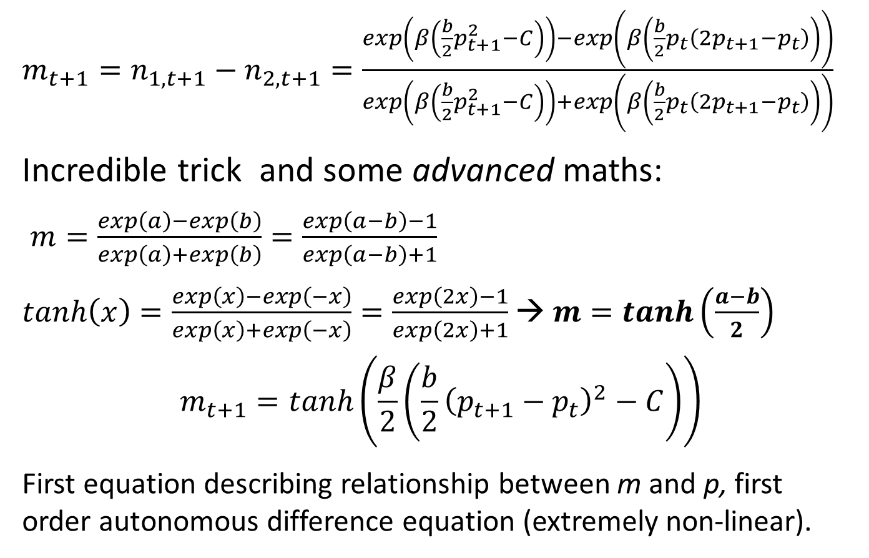
Agents - suppliers
$m_{t+1}=n_{1,t+1}−n_{2,t+1}=\frac{exp\left(β\left(\frac{b}{2}p_{t+1}^{2}−C\right)\right)−exp\left(β\left(\frac{b}{2}p_{t}\left({2p}_{t+1}−p_{t}\right)\right)\right)}{exp\left(β\left(\frac{b}{2}p_{t+1}^{2}−C\right)\right)+exp\left(β\left(\frac{b}{2}p_{t}\left({2p}_{t+1}−p_{t}\right)\right)\right)}$
Incredible trick and some advanced maths:
$m=\frac{exp\left(a\right)−exp\left(b\right)}{exp\left(a\right)+exp\left(b\right)}=\frac{exp\left(a−b\right)−1}{exp\left(a−b\right)+1}$
$tanh\left(x\right)=\frac{exp\left(x\right)−exp\left(−x\right)}{exp\left(x\right)+exp\left(−x\right)}=\frac{exp\left(2x\right)−1}{exp\left(2x\right)+1}$ → $m=tanh\left(\frac{a−b}{2}\right)$
$$m_{t+1}=tanh\left(\frac{β}{2}\left(\frac{b}{2}{\left(p_{t+1}−p_{t}\right)}^{2}−C\right)\right)$$
First equation describing relationship between m and p, first order autonomous difference equation (extremely non-linear).

Slide 12
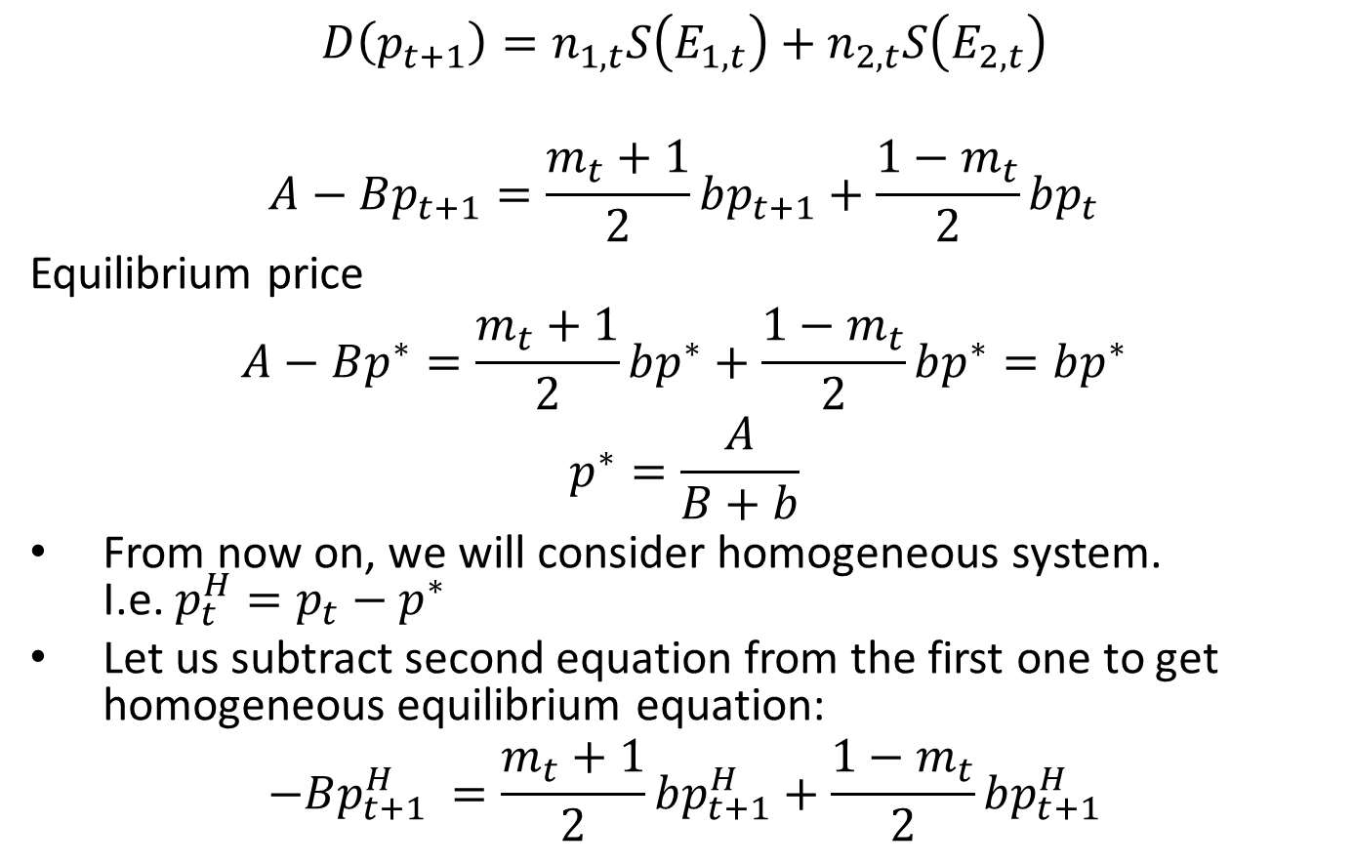
Market Equilibrium and homogeniztation
$$D\left(p_{t+1}\right)=n_{1,t}S\left(E_{1,t}\right)+n_{2,t}S\left(E_{2,t}\right)$$
$$A−Bp_{t+1}=\frac{m_{t}+1}{2}bp_{t+1}+\frac{{1−m}_{t}}{2}bp_{t}$$
Equilibrium price
$$A−Bp^{∗}=\frac{m_{t}+1}{2}bp^{∗}+\frac{{1−m}_{t}}{2}bp^{∗}=bp^{∗}$$
$$p^{∗}=\frac{A}{B+b}$$
From now on, we will consider homogeneous system. I.e. ${p_{t}^{H}=p_{t}−p}^{∗}$
Let us subtract second equation from the first one to get homogeneous equilibrium equation:
$$−B{p_{t+1}^{H}}_{ }=\frac{m_{t}+1}{2}bp_{t+1}^{H}+\frac{{1−m}_{t}}{2}bp_{t+1}^{H}$$

Slide 13
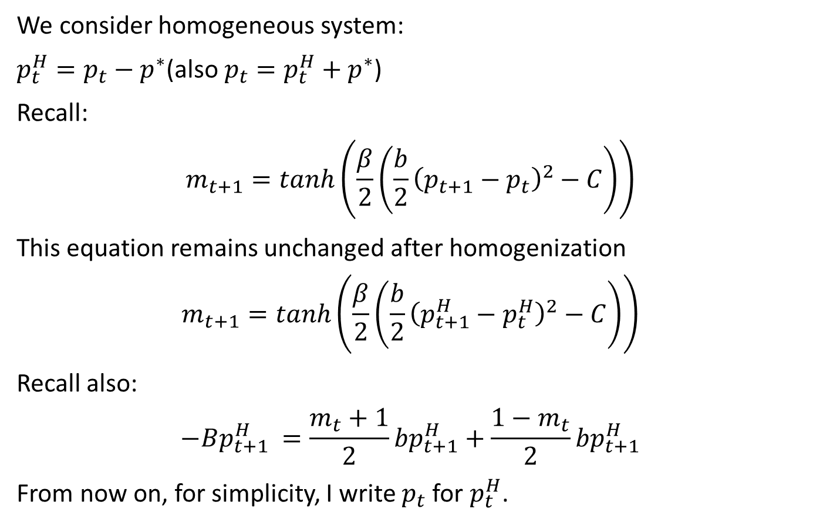
Homogeniztation
We consider homogeneous system:
${p_{t}^{H}=p_{t}−p}^{∗}$(also ${p_{t}=p_{t}^{H}+p}^{∗}$)
Recall:
$$m_{t+1}=tanh\left(\frac{β}{2}\left(\frac{b}{2}{\left(p_{t+1}−p_{t}\right)}^{2}−C\right)\right)$$
This equation remains unchanged after homogenization
$$m_{t+1}=tanh\left(\frac{β}{2}\left(\frac{b}{2}{\left(p_{t+1}^{H}−p_{t}^{H}\right)}^{2}−C\right)\right)$$
Recall also:
$$−B{p_{t+1}^{H}}_{ }=\frac{m_{t}+1}{2}bp_{t+1}^{H}+\frac{{1−m}_{t}}{2}bp_{t+1}^{H}$$
From now on, for simplicity, I write $p_{t}$ for $p_{t}^{H}$.

Slide 14
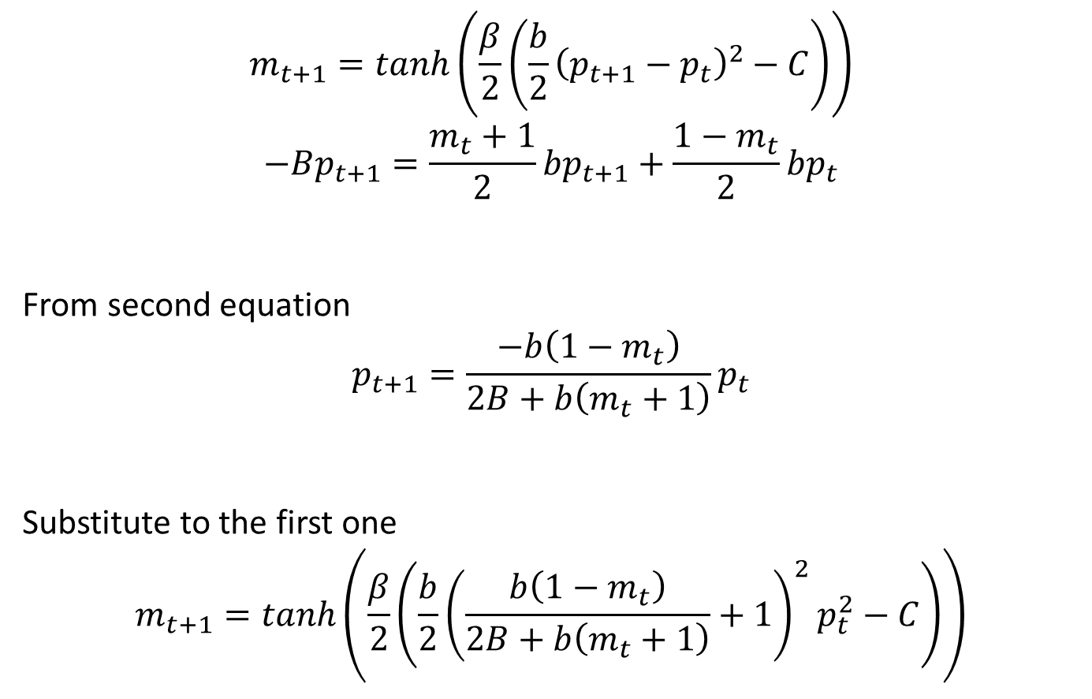
Almost finished
$$m_{t+1}=tanh\left(\frac{β}{2}\left(\frac{b}{2}{\left(p_{t+1}−p_{t}\right)}^{2}−C\right)\right)$$
$$−Bp_{t+1}=\frac{m_{t}+1}{2}bp_{t+1}+\frac{{1−m}_{t}}{2}bp_{t}$$
From second equation
$$p_{t+1}=\frac{−b\left({1−m}_{t}\right)}{2B+b\left(m_{t}+1\right)}p_{t}$$
Substitute to the first one
$$m_{t+1}=tanh\left(\frac{β}{2}\left(\frac{b}{2}{\left(\frac{b\left({1−m}_{t}\right)}{2B+b\left(m_{t}+1\right)}+1\right)}^{2}p_{t}^{2}−C\right)\right)$$

Slide 15

System of two difference equations
$$p_{t+1}=\frac{−b\left({1−m}_{t}\right)}{2B+b\left(m_{t}+1\right)}p_{t}$$
$$m_{t+1}=tanh\left(\frac{β}{2}\left(\frac{b}{2}{\left(\frac{b\left({1−m}_{t}\right)}{2B+b\left(m_{t}+1\right)}+1\right)}^{2}p_{t}^{2}−C\right)\right)$$
Equilibrium
$p^{H∗}=0$
$$m^{∗}=tanh\left(−\frac{βC}{2}\right)$$

Slide 16

Final remarks
Many possible generalizations
Asset pricing model (Brock and Hommes, Journal of Economic Dynamics and Control 22 (1998) 1235-1274)
Heterogeneous agents with memory
$n_{i,t}= \frac{exp\left(βπ_{i,t}\right)}{Z}$ → $\frac{exp\left(βf\left(π_{i,t},π_{i,t−1},π_{i,t−2},π_{i,t−3,}…\right)\right)}{Z}$
More classes of agents (even continuum of different agents)
Rationalization of complicated dynamic behaviour
Efficient market theory is questioned

