Slide 1
Dynamic optimization in continuous time
08. 12. 2022

Slide 2
Content
Dynamic optimization (Hamiltonian method)
Ramsey model

Slide 3
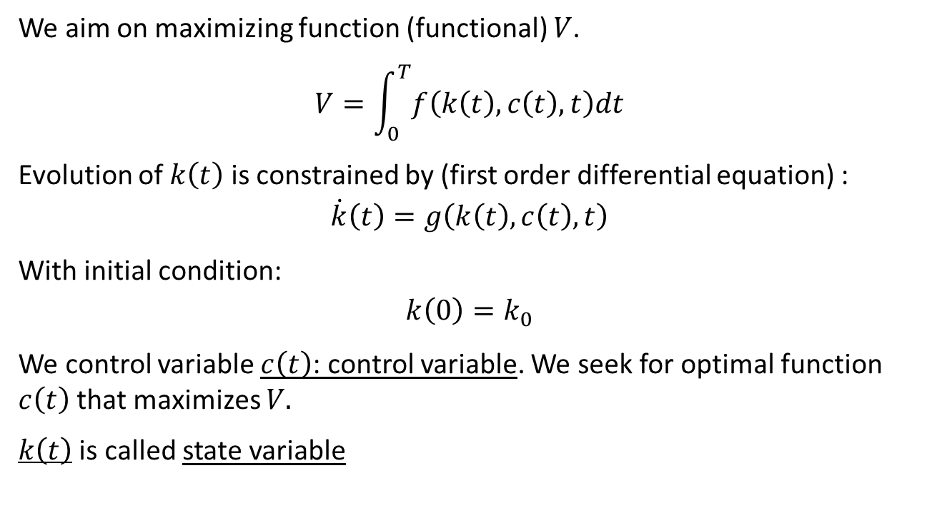
Dynamic optimization
We aim on maximizing function (functional) $V$.
$$V=\int_{0}^{T}{f\left(k\left(t\right),c\left(t\right),t\right)dt}$$
Evolution of $k\left(t\right)$ is constrained by (first order differential equation) :
$$\dot{k}\left(t\right)=g\left(k\left(t\right),c\left(t\right),t\right)$$
With initial condition:
$$k\left(0\right)=k_{0}$$
We control variable $c\left(t\right)$: control variable. We seek for optimal function $c\left(t\right)$ that maximizes $V.$
$k\left(t\right)$ is called state variable

Slide 4
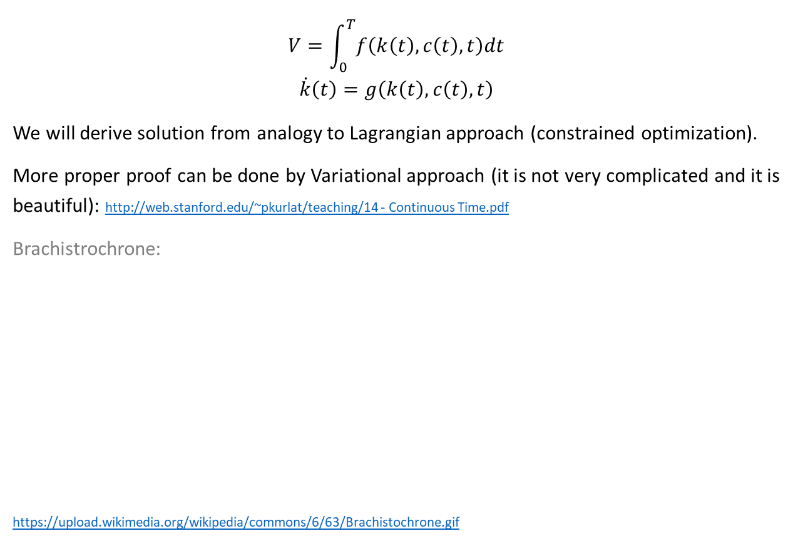
Dynamic optimization
$$V=\int_{0}^{T}{f\left(k\left(t\right),c\left(t\right),t\right)dt}$$
$$\dot{k}\left(t\right)=g\left(k\left(t\right),c\left(t\right),t\right)$$
We will derive solution from analogy to Lagrangian approach (constrained optimization).
More proper proof can be done by Variational approach (it is not very complicated and it is beautiful): http://web.stanford.edu/~pkurlat/teaching/14 - Continuous Time.pdf
Brachistrochrone:
https://upload.wikimedia.org/wikipedia/commons/6/63/Brachistochrone.gif

Slide 5
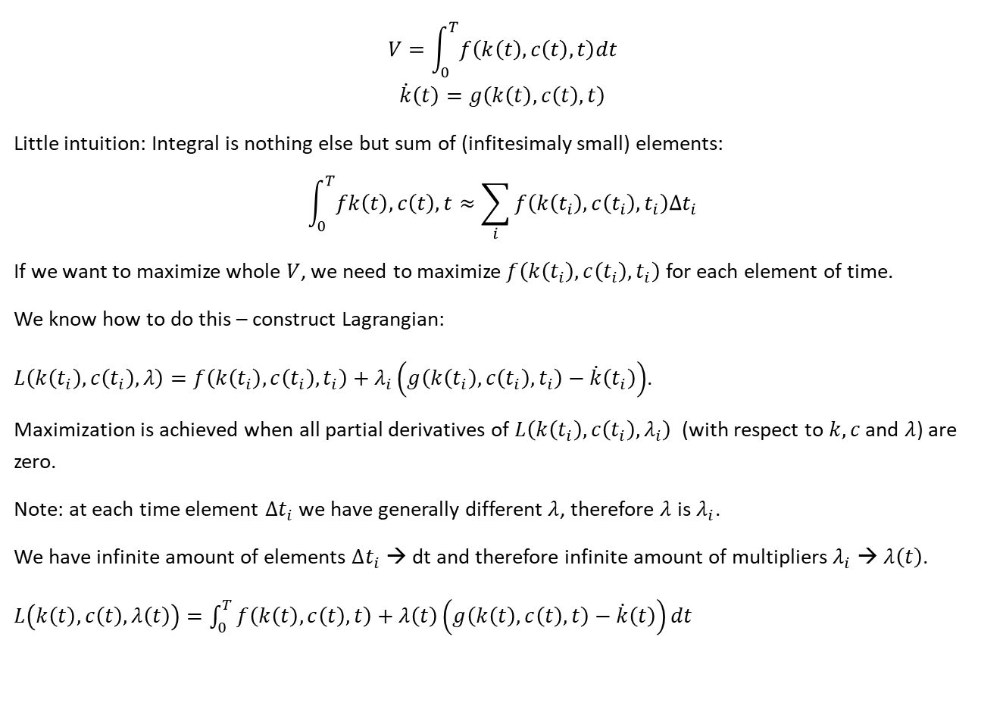
Dynamic optimization (finite horizon)
$$V=\int_{0}^{T}{f\left(k\left(t\right),c\left(t\right),t\right)dt}$$
$$\dot{k}\left(t\right)=g\left(k\left(t\right),c\left(t\right),t\right)$$
Little intuition: Integral is nothing else but sum of (infitesimaly small) elements:
$$\int_{0}^{T}{fk\left(t\right),c\left(t\right),t}≈\sum_{i}{f\left(k\left(t_{i}\right),c\left(t_{i}\right),t_{i}\right)Δt_{i}}$$
If we want to maximize whole $V$, we need to maximize $f\left(k\left(t_{i}\right),c\left(t_{i}\right),t_{i}\right)$ for each element of time.
We know how to do this – construct Lagrangian:
$L\left(k\left(t_{i}\right),c\left(t_{i}\right),λ\right)=f\left(k\left(t_{i}\right),c\left(t_{i}\right),t_{i}\right)+λ_{i}\left(g\left(k\left(t_{i}\right),c\left(t_{i}\right),t_{i}\right)−\dot{k}\left(t_{i}\right)\right)$.
Maximization is achieved when all partial derivatives of $L\left(k\left(t_{i}\right),c\left(t_{i}\right),λ_{i}\right)$ (with respect to $k, c$ and $λ$) are zero.
Note: at each time element ${Δt}_{i}$ we have generally different $λ$, therefore $λ$ is $λ_{i}$.
We have infinite amount of elements $Δt_{i}$ → dt and therefore infinite amount of multipliers $λ_{i}$ → $λ\left(t\right)$.
$L\left(k\left(t\right),c\left(t\right),λ\left(t\right)\right)=\int_{0}^{T}{f\left(k\left(t\right),c\left(t\right),t\right)+λ\left(t\right)\left(g\left(k\left(t\right),c\left(t\right),t\right)−\dot{k}\left(t\right)\right)dt}$
← continuous to discrete
← discrete to continuous

Slide 6
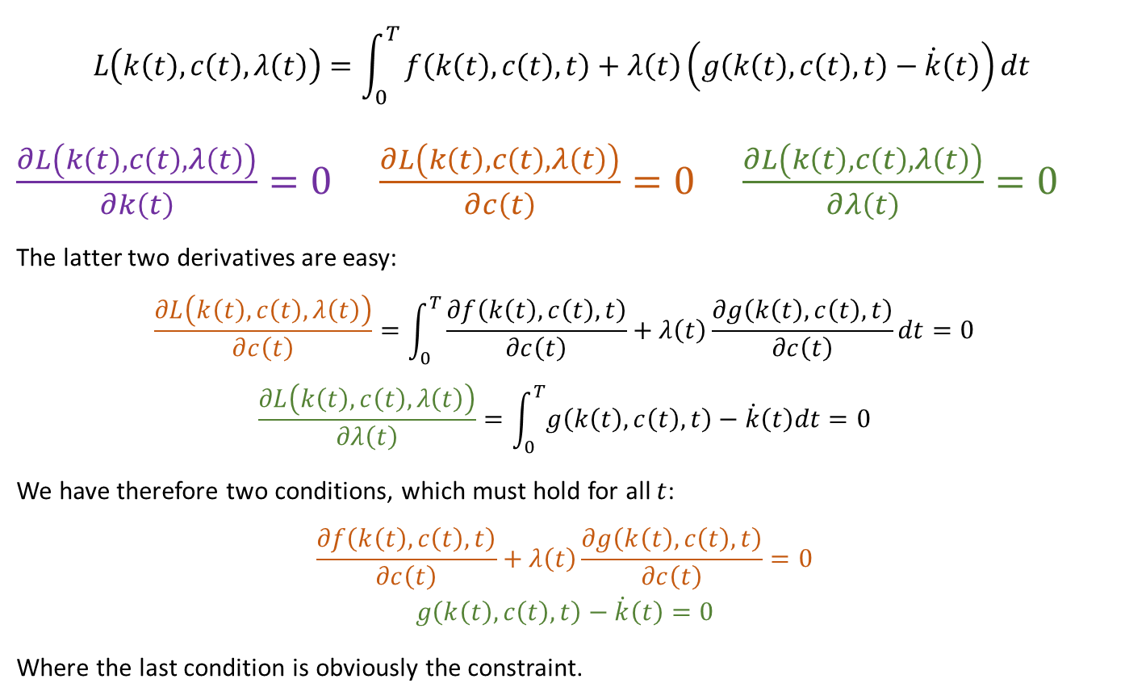
Dynamic optimization (finite horizon)
$$L\left(k\left(t\right),c\left(t\right),λ\left(t\right)\right)=\int_{0}^{T}{f\left(k\left(t\right),c\left(t\right),t\right)+λ\left(t\right)\left(g\left(k\left(t\right),c\left(t\right),t\right)−\dot{k}\left(t\right)\right)dt}$$
$\frac{∂L\left(k\left(t\right),c\left(t\right),λ\left(t\right)\right)}{∂k\left(t\right)}=0$ $\frac{∂L\left(k\left(t\right),c\left(t\right),λ\left(t\right)\right)}{∂c\left(t\right)}=0$ $\frac{∂L\left(k\left(t\right),c\left(t\right),λ\left(t\right)\right)}{∂λ\left(t\right)}=0$
The latter two derivatives are easy:
$$\frac{∂L\left(k\left(t\right),c\left(t\right),λ\left(t\right)\right)}{∂c\left(t\right)}=\int_{0}^{T}{\frac{∂f\left(k\left(t\right),c\left(t\right),t\right)}{∂c\left(t\right)}+λ\left(t\right)\frac{∂g\left(k\left(t\right),c\left(t\right),t\right)}{∂c\left(t\right)}dt}=0$$
$$\frac{∂L\left(k\left(t\right),c\left(t\right),λ\left(t\right)\right)}{∂λ\left(t\right)}=\int_{0}^{T}{g\left(k\left(t\right),c\left(t\right),t\right)−\dot{k}\left(t\right)dt}=0$$
We have therefore two conditions, which must hold for all $t$:
$$\frac{∂f\left(k\left(t\right),c\left(t\right),t\right)}{∂c\left(t\right)}+λ\left(t\right)\frac{∂g\left(k\left(t\right),c\left(t\right),t\right)}{∂c\left(t\right)}=0$$
$$g\left(k\left(t\right),c\left(t\right),t\right)−\dot{k}\left(t\right)=0$$
Where the last condition is obviously the constraint.

Slide 7
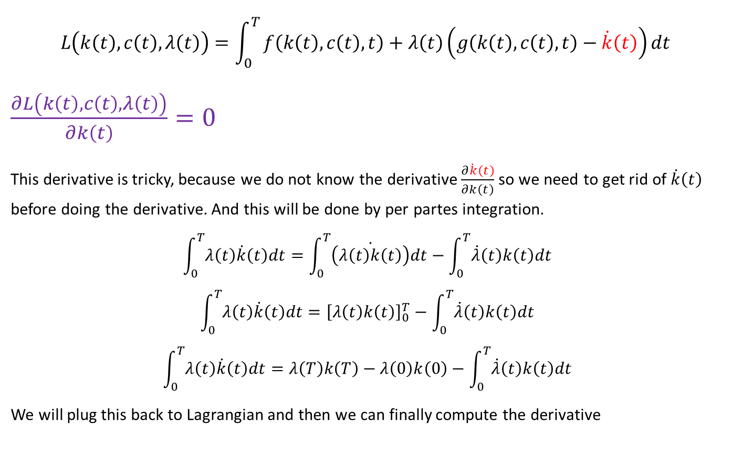
Dynamic optimization (finite horizon)
$$L\left(k\left(t\right),c\left(t\right),λ\left(t\right)\right)=\int_{0}^{T}{f\left(k\left(t\right),c\left(t\right),t\right)+λ\left(t\right)\left(g\left(k\left(t\right),c\left(t\right),t\right)−\dot{k}\left(t\right)\right)dt}$$
$\frac{∂L\left(k\left(t\right),c\left(t\right),λ\left(t\right)\right)}{∂k\left(t\right)}=0$
This derivative is tricky, because we do not know the derivative $\frac{∂\dot{k}\left(t\right)}{∂k\left(t\right)}$ so we need to get rid of $\dot{k}\left(t\right)$ before doing the derivative. And this will be done by per partes integration.
$$\int_{0}^{T}{λ\left(t\right)\dot{k}\left(t\right)dt}=\int_{0}^{T}{\dot{\left(λ\left(t\right)k\left(t\right)\right)}dt}−\int_{0}^{T}{\dot{λ}\left(t\right)k\left(t\right)dt}$$
$$\int_{0}^{T}{λ\left(t\right)\dot{k}\left(t\right)dt}={\left[λ\left(t\right)k\left(t\right)\right]}_{0}^{T}−\int_{0}^{T}{\dot{λ}\left(t\right)k\left(t\right)dt}$$
$$\int_{0}^{T}{λ\left(t\right)\dot{k}\left(t\right)dt}=λ\left(T\right)k\left(T\right)−λ\left(0\right)k\left(0\right)−\int_{0}^{T}{\dot{λ}\left(t\right)k\left(t\right)dt}$$
We will plug this back to Lagrangian and then we can finally compute the derivative

Slide 8
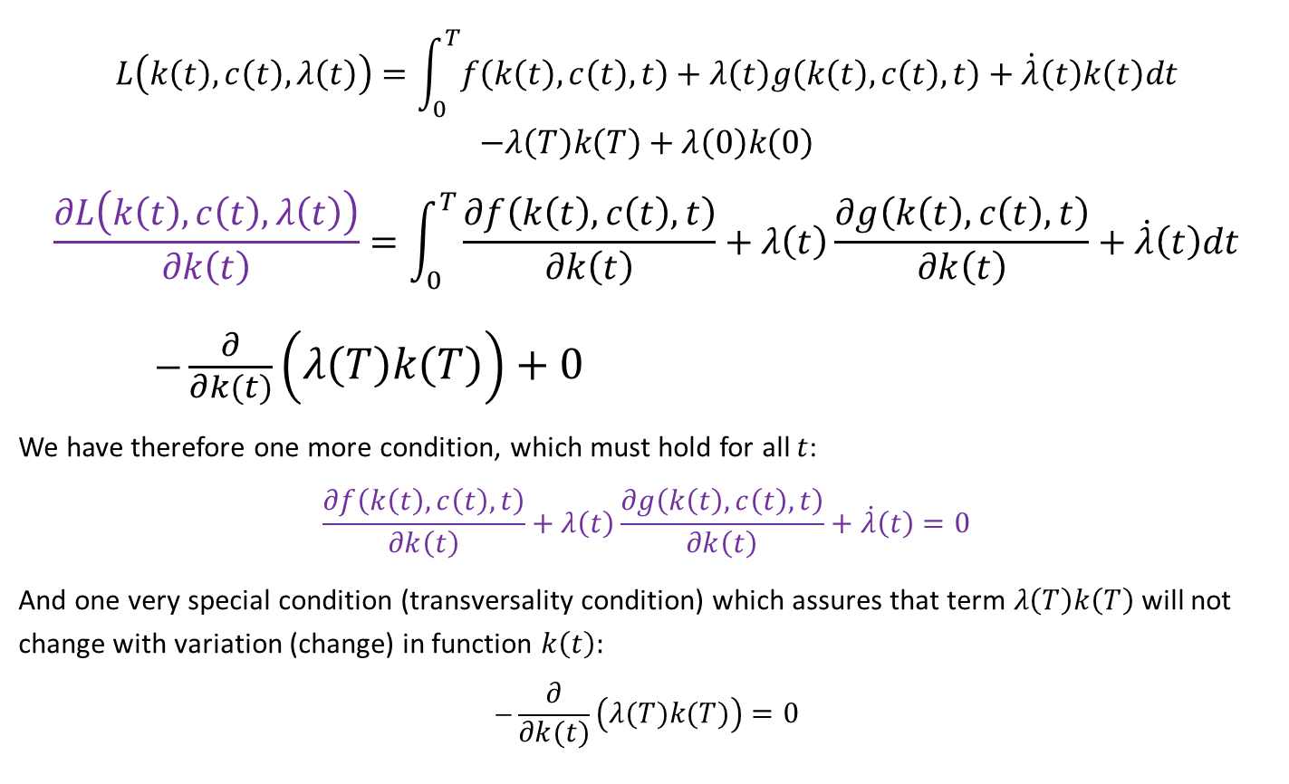
Dynamic optimization (finite horizon)
$$L\left(k\left(t\right),c\left(t\right),λ\left(t\right)\right)=\int_{0}^{T}{f\left(k\left(t\right),c\left(t\right),t\right)+λ\left(t\right)g\left(k\left(t\right),c\left(t\right),t\right)+\dot{λ}\left(t\right)k\left(t\right)dt} \\ −λ\left(T\right)k\left(T\right)+λ\left(0\right)k\left(0\right)$$
$$\frac{∂L\left(k\left(t\right),c\left(t\right),λ\left(t\right)\right)}{∂k\left(t\right)}=\int_{0}^{T}{\frac{∂f\left(k\left(t\right),c\left(t\right),t\right)}{∂k\left(t\right)}+λ\left(t\right)\frac{∂g\left(k\left(t\right),c\left(t\right),t\right)}{∂k\left(t\right)}+\dot{λ}\left(t\right)dt}$$ $−\frac{∂}{∂k\left(t\right)}\left(λ\left(T\right)k\left(T\right)\right)+0$
We have therefore one more condition, which must hold for all $t$:
$$\frac{∂f\left(k\left(t\right),c\left(t\right),t\right)}{∂k\left(t\right)}+λ\left(t\right)\frac{∂g\left(k\left(t\right),c\left(t\right),t\right)}{∂k\left(t\right)}+\dot{λ}\left(t\right)=0$$
And one very special condition (transversality condition) which assures that term $λ\left(T\right)k\left(T\right)$ will not change with variation (change) in function $k\left(t\right):$
$$−\frac{∂}{∂k\left(t\right)}\left(λ\left(T\right)k\left(T\right)\right)=0$$
← cheating, this operation should be variation, not just derivatve w.r.t. function

Slide 9
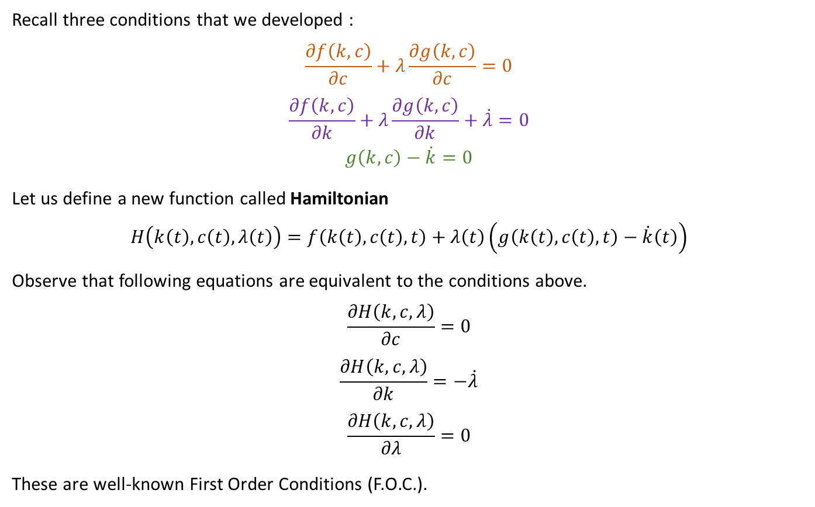
Dynamic optimization (finite horizon)
Recall three conditions that we developed :
$$\frac{∂f\left(k,c\right)}{∂c}+λ\frac{∂g\left(k,c\right)}{∂c}=0$$
$$\frac{∂f\left(k,c\right)}{∂k}+λ\frac{∂g\left(k,c\right)}{∂k}+\dot{λ}=0$$
$$g\left(k,c\right)−\dot{k}=0$$
Let us define a new function called Hamiltonian
$$H\left(k\left(t\right),c\left(t\right),λ\left(t\right)\right)=f\left(k\left(t\right),c\left(t\right),t\right)+λ\left(t\right)\left(g\left(k\left(t\right),c\left(t\right),t\right)−\dot{k}\left(t\right)\right)$$
Observe that following equations are equivalent to the conditions above.
$$\frac{∂H\left(k,c,λ\right)}{∂c}=0$$
$$\frac{∂H\left(k,c,λ\right)}{∂k}=−\dot{λ}$$
$$\frac{∂H\left(k,c,λ\right)}{∂λ}=0$$
These are well-known First Order Conditions (F.O.C.).

Slide 10

Dynamic optimization (finite horizon)
Cookbook
We want to maximize: $V=\int_{0}^{T}{f\left(k\left(t\right),c\left(t\right),t\right)dt}$
State variable $k\left(t\right)$ is subject to constraint: $\dot{k}\left(t\right)=g\left(k\left(t\right),c\left(t\right),t\right)$
Construct Hamiltonian
$$H\left(k\left(t\right),c\left(t\right),λ\left(t\right)\right)=f\left(k\left(t\right),c\left(t\right),t\right)+λ\left(t\right)\left(g\left(k\left(t\right),c\left(t\right),t\right)−\dot{k}\left(t\right)\right)$$
Calculate First Order Conditions (F.O.C.):
$$\frac{∂H\left(k,c,λ\right)}{∂c}=0$$
$$\frac{∂H\left(k,c,λ\right)}{∂k}=−\dot{λ}$$
$$\frac{∂H\left(k,c,λ\right)}{∂λ}=0$$

Slide 11
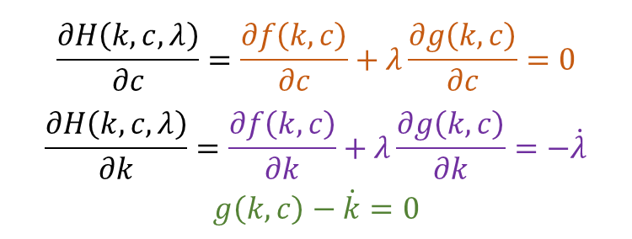
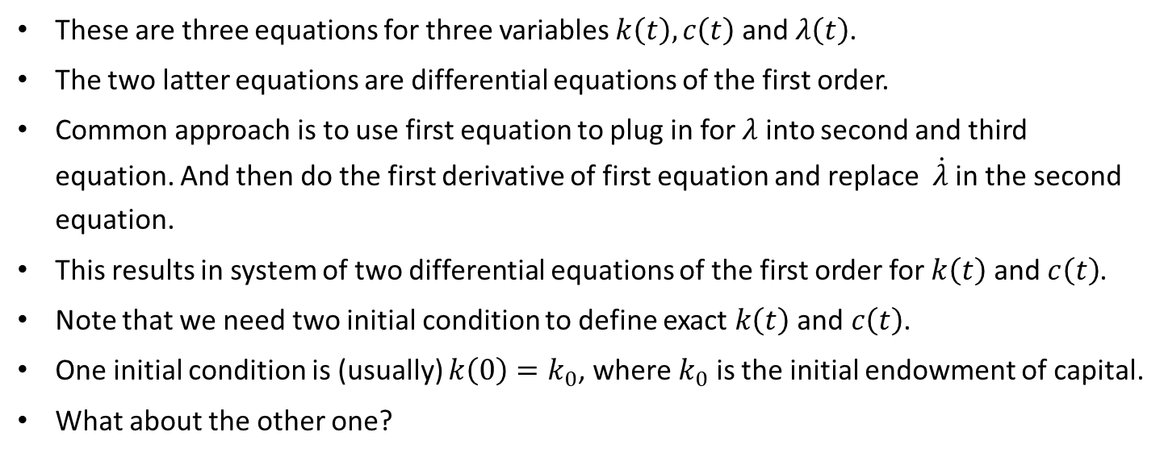
Dynamic optimization (finite horizon)
F.O.C. again:
$$\frac{∂H\left(k,c,λ\right)}{∂c}=\frac{∂f\left(k,c\right)}{∂c}+λ\frac{∂g\left(k,c\right)}{∂c}=0$$
$$\frac{∂H\left(k,c,λ\right)}{∂k}=\frac{∂f\left(k,c\right)}{∂k}+λ\frac{∂g\left(k,c\right)}{∂k}=−\dot{λ}$$
$$g\left(k,c\right)−\dot{k}=0$$
(1)
(2)
(3)
These are three equations for three variables $k\left(t\right),c\left(t\right)$ and $λ\left(t\right)$.
The two latter equations are differential equations of the first order.
Common approach is to use first equation to plug in for $λ$ into second and third equation. And then do the first derivative of first equation and replace $\dot{λ}$ in the second equation.
This results in system of two differential equations of the first order for $k\left(t\right)$ and $c\left(t\right)$.
Note that we need two initial condition to define exact $k\left(t\right)$ and $c\left(t\right)$.
One initial condition is (usually) $k\left(0\right)=k_{0}$, where $k_{0}$ is the initial endowment of capital.
What about the other one?

Slide 12
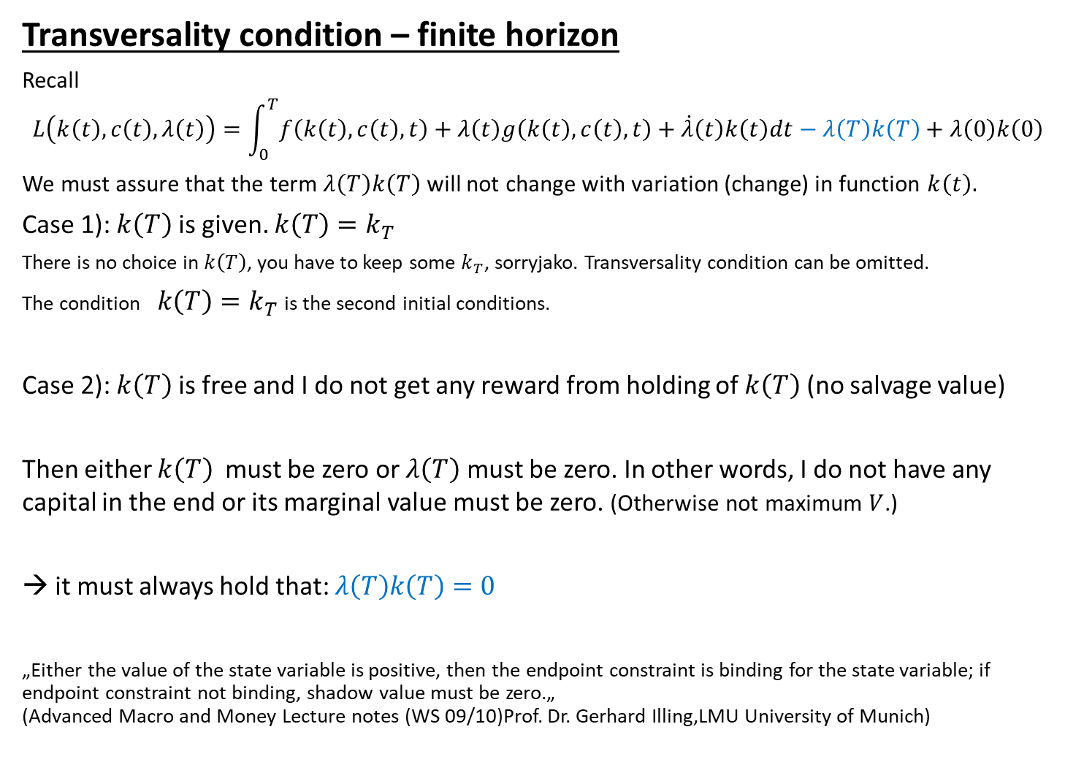
Transversality condition – finite horizon
Recall
$$L\left(k\left(t\right),c\left(t\right),λ\left(t\right)\right)=\int_{0}^{T}{f\left(k\left(t\right),c\left(t\right),t\right)+λ\left(t\right)g\left(k\left(t\right),c\left(t\right),t\right)+\dot{λ}\left(t\right)k\left(t\right)dt}−λ\left(T\right)k\left(T\right)+λ\left(0\right)k\left(0\right)$$
We must assure that the term $λ\left(T\right)k\left(T\right)$ will not change with variation (change) in function $k\left(t\right).$
Case 1): $k\left(T\right)$ is given. $k\left(T\right)=k_{T}$
There is no choice in $k\left(T\right)$, you have to keep some $k_{T}$, sorryjako. Transversality condition can be omitted.
The condition $k\left(T\right)=k_{T}$ is the second initial conditions.
Case 2): $k\left(T\right)$ is free and I do not get any reward from holding of $k\left(T\right)$ (no salvage value)
Then either $k\left(T\right)$ must be zero or $λ\left(T\right)$ must be zero. In other words, I do not have any capital in the end or its marginal value must be zero. (Otherwise not maximum $V$.)
→ it must always hold that: $λ\left(T\right)k\left(T\right)=0$
„Either the value of the state variable is positive, then the endpoint constraint is binding for the state variable; if endpoint constraint not binding, shadow value must be zero.„ (Advanced Macro and Money Lecture notes (WS 09/10)Prof. Dr. Gerhard Illing,LMU University of Munich)

Slide 13

Dynamic optimization - EXERCISE
We aim on maximizing function (functional) $V$.
$$V=\int_{0}^{1}{x\left(t\right)−a.{u\left(t\right)}^{2}dt}$$
Evolution of $x\left(t\right)$ is constrained by (first order differential equation) :
$$\dot{x}\left(t\right)=b.u\left(t\right)$$
$$x\left(0\right)=0$$
$a>0$, $b>0$
Use:
$$H\left(k\left(t\right),c\left(t\right),λ\left(t\right)\right)=f\left(k\left(t\right),c\left(t\right),t\right)+λ\left(t\right)\left(g\left(k\left(t\right),c\left(t\right),t\right)−\dot{k}\left(t\right)\right)$$
$$\frac{∂H\left(k,c,λ\right)}{∂c}=0$$
$$\frac{∂H\left(k,c,λ\right)}{∂k}=−\dot{λ}$$
$$\frac{∂H\left(k,c,λ\right)}{∂λ}=0$$

Slide 14
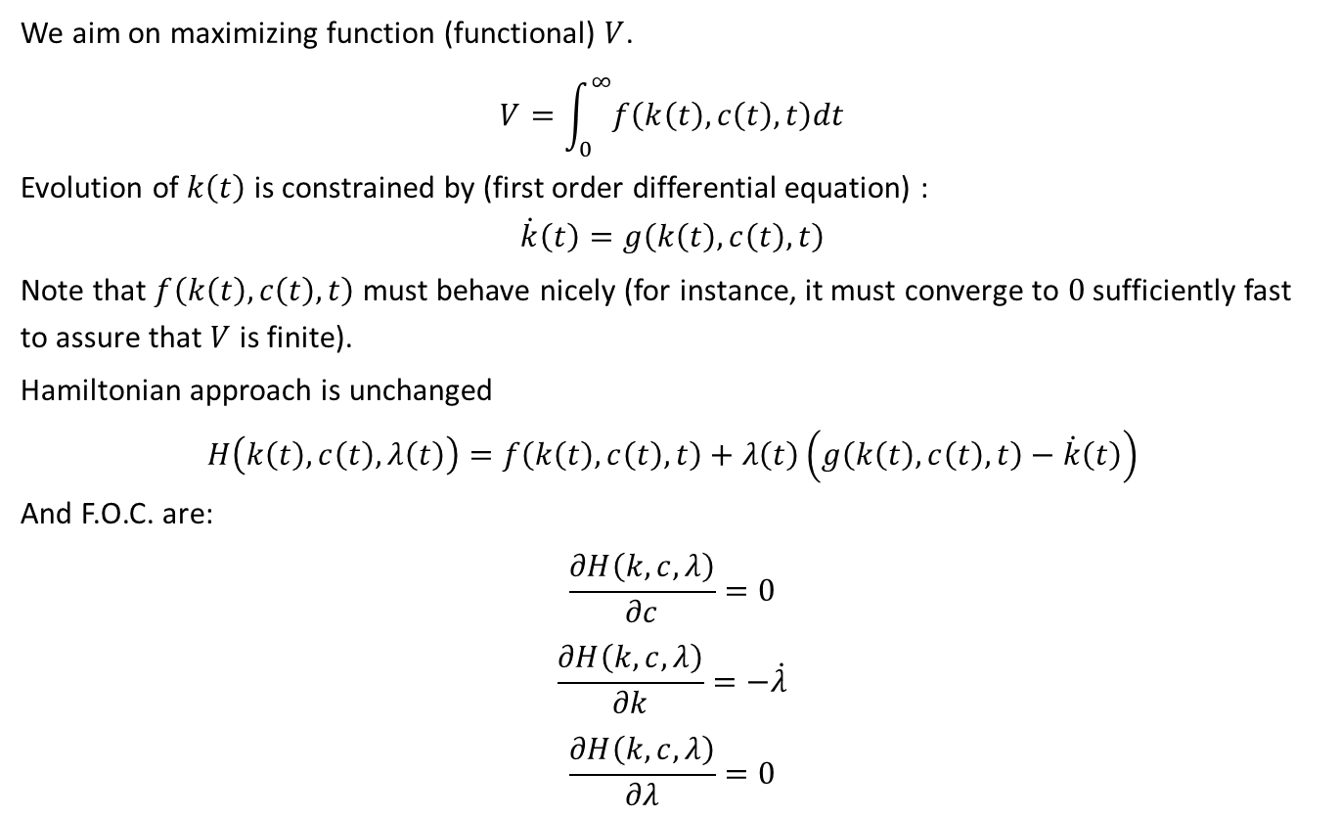
Dynamic optimization (infinite horizon)
We aim on maximizing function (functional) $V$.
$$V=\int_{0}^{∞}{f\left(k\left(t\right),c\left(t\right),t\right)dt}$$
Evolution of $k\left(t\right)$ is constrained by (first order differential equation) :
$$\dot{k}\left(t\right)=g\left(k\left(t\right),c\left(t\right),t\right)$$
Note that $f\left(k\left(t\right),c\left(t\right),t\right)$ must behave nicely (for instance, it must converge to $0$ sufficiently fast to assure that $V$ is finite).
Hamiltonian approach is unchanged
$$H\left(k\left(t\right),c\left(t\right),λ\left(t\right)\right)=f\left(k\left(t\right),c\left(t\right),t\right)+λ\left(t\right)\left(g\left(k\left(t\right),c\left(t\right),t\right)−\dot{k}\left(t\right)\right)$$
And F.O.C. are:
$$\frac{∂H\left(k,c,λ\right)}{∂c}=0$$
$$\frac{∂H\left(k,c,λ\right)}{∂k}=−\dot{λ}$$
$$\frac{∂H\left(k,c,λ\right)}{∂λ}=0$$

Slide 15
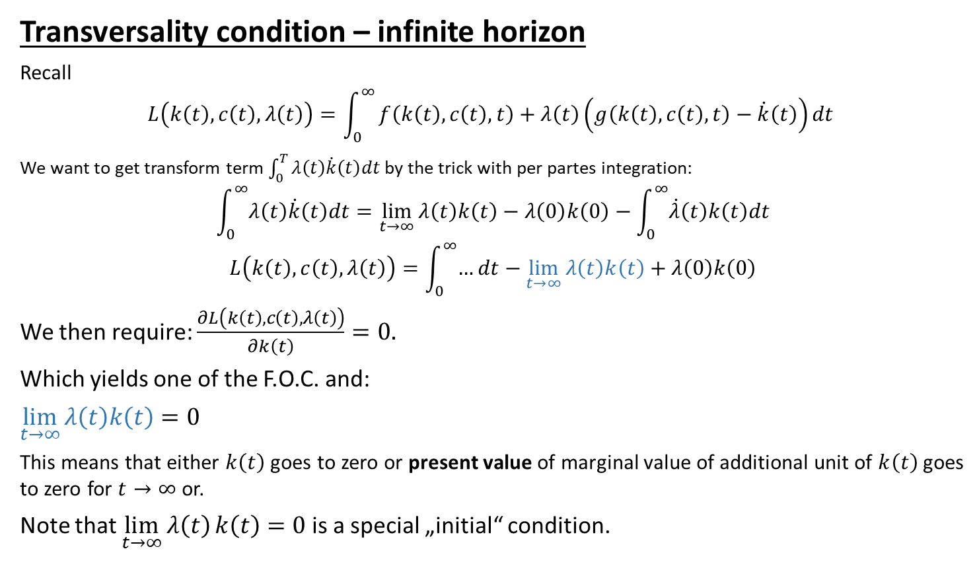
Dynamic optimization (infinite horizon)
Transversality condition – infinite horizon
Recall
$$L\left(k\left(t\right),c\left(t\right),λ\left(t\right)\right)=\int_{0}^{∞}{f\left(k\left(t\right),c\left(t\right),t\right)+λ\left(t\right)\left(g\left(k\left(t\right),c\left(t\right),t\right)−\dot{k}\left(t\right)\right)dt}$$
We want to get transform term $\int_{0}^{T}{λ\left(t\right)\dot{k}\left(t\right)dt}$ by the trick with per partes integration:
$$\int_{0}^{∞}{λ\left(t\right)\dot{k}\left(t\right)dt}=\lim_{t→∞}{λ\left(t\right)k\left(t\right)}−λ\left(0\right)k\left(0\right)−\int_{0}^{∞}{\dot{λ}\left(t\right)k\left(t\right)dt}$$
$$L\left(k\left(t\right),c\left(t\right),λ\left(t\right)\right)=\int_{0}^{∞}{…dt}−\lim_{t→∞}{λ\left(t\right)k\left(t\right)}+λ\left(0\right)k\left(0\right)$$
We then require: $\frac{∂L\left(k\left(t\right),c\left(t\right),λ\left(t\right)\right)}{∂k\left(t\right)}=0.$
Which yields one of the F.O.C. and:
$\lim_{t→∞}{λ\left(t\right)k\left(t\right)}=0$
This means that either $k\left(t\right)$ goes to zero or present value of marginal value of additional unit of $k\left(t\right)$ goes to zero for $t→∞$ or.
Note that $\lim_{t→∞}{λ\left(t\right)}k\left(t\right)=0$ is a special „initial“ condition.

Slide 16
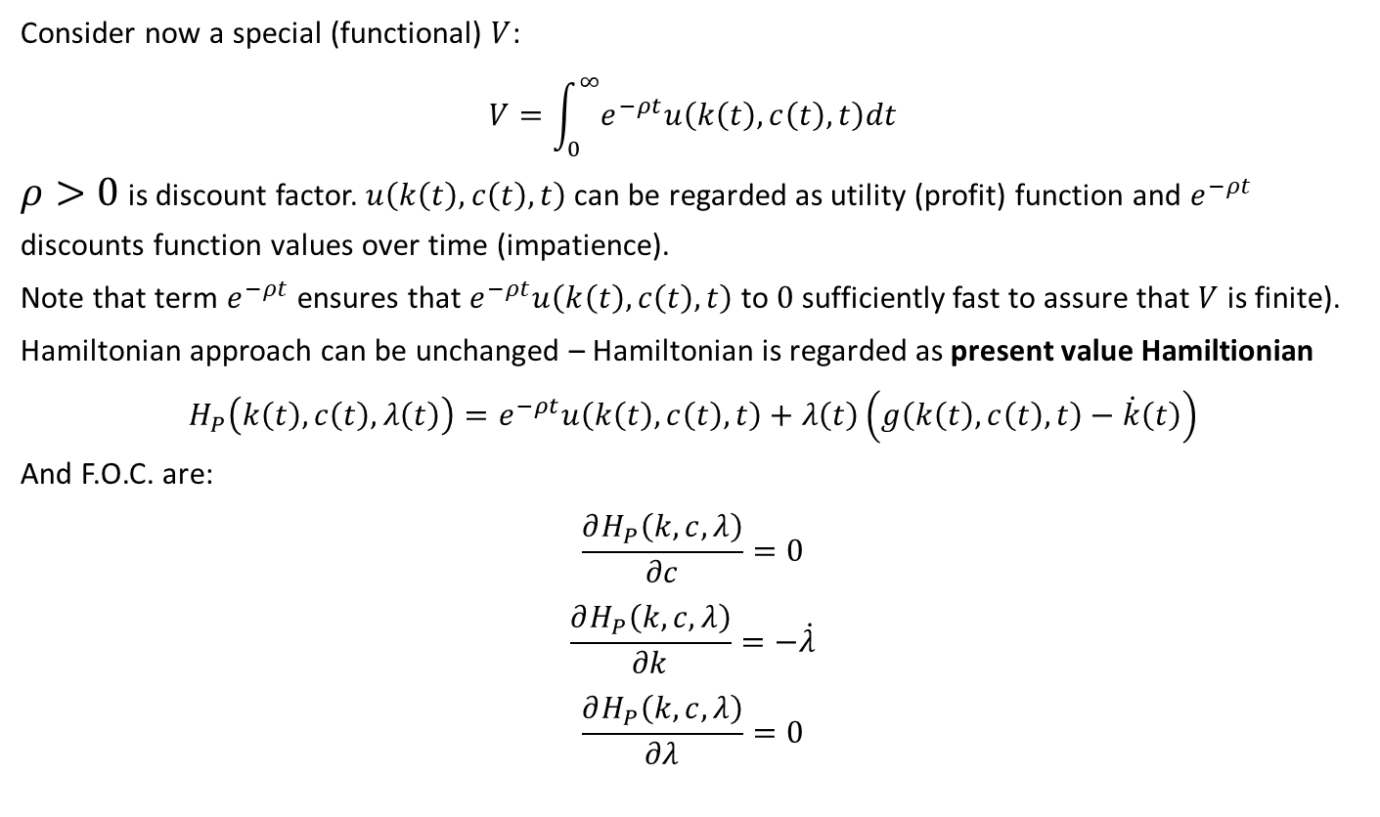
Dynamic optimization with discounting
Consider now a special (functional) $V$:
$$V=\int_{0}^{∞}{e^{−ρt}u\left(k\left(t\right),c\left(t\right),t\right)dt}$$
$ρ>0$ is discount factor. $u\left(k\left(t\right),c\left(t\right),t\right)$ can be regarded as utility (profit) function and $e^{−ρt}$ discounts function values over time (impatience).
Note that term $e^{−ρt}$ ensures that $e^{−ρt}u\left(k\left(t\right),c\left(t\right),t\right)$ to $0$ sufficiently fast to assure that $V$ is finite).
Hamiltonian approach can be unchanged – Hamiltonian is regarded as present value Hamiltionian
$$H_{P}\left(k\left(t\right),c\left(t\right),λ\left(t\right)\right)=e^{−ρt}u\left(k\left(t\right),c\left(t\right),t\right)+λ\left(t\right)\left(g\left(k\left(t\right),c\left(t\right),t\right)−\dot{k}\left(t\right)\right)$$
And F.O.C. are:
$$\frac{∂H_{P}\left(k,c,λ\right)}{∂c}=0$$
$$\frac{∂H_{P}\left(k,c,λ\right)}{∂k}=−\dot{λ}$$
$$\frac{∂H_{P}\left(k,c,λ\right)}{∂λ}=0$$

Slide 17
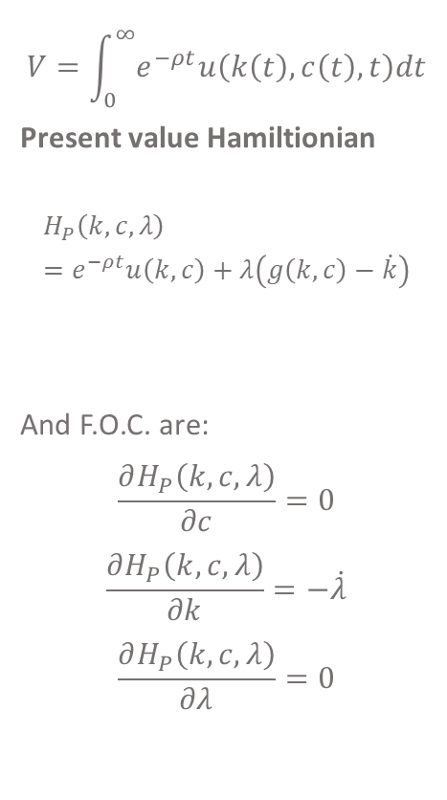
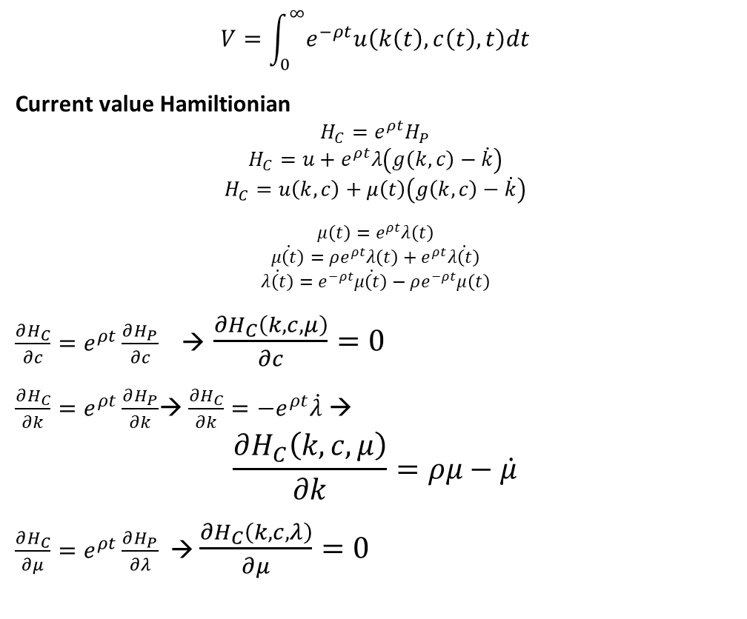

Dynamic optimization with discounting
$$V=\int_{0}^{∞}{e^{−ρt}u\left(k\left(t\right),c\left(t\right),t\right)dt}$$
Current value Hamiltionian
$$H_{C}=e^{ρt}H_{P}$$
$$H_{C}=u+e^{ρt}λ\left(g\left(k,c\right)−\dot{k}\right)$$
$$H_{C}=u\left(k,c\right)+μ\left(t\right)\left(g\left(k,c\right)−\dot{k}\right)$$
$${μ\left(t\right)=e}^{ρt}λ\left(t\right)$$
$$\dot{μ\left(t\right)}=ρe^{ρt}λ\left(t\right)+e^{ρt}\dot{λ\left(t\right)}$$
$$\dot{λ\left(t\right)}=e^{−ρt}\dot{μ\left(t\right)}−ρe^{−ρt}μ\left(t\right)$$
$\frac{∂H_{C}}{∂c}=e^{ρt}\frac{∂H_{P}}{∂c}$ → $\frac{∂H_{C}\left(k,c,μ\right)}{∂c}=0$
$\frac{∂H_{C}}{∂k}=e^{ρt}\frac{∂H_{P}}{∂k}$→ $\frac{∂H_{C}}{∂k}=−e^{ρt}\dot{λ}$ →
$$\frac{∂H_{C}\left(k,c,μ\right)}{∂k}=ρμ−\dot{μ}$$
$\frac{∂H_{C}}{∂μ}=e^{ρt}\frac{∂H_{P}}{∂λ}$ → $\frac{∂H_{C}\left(k,c,λ\right)}{∂μ}=0$
$$V=\int_{0}^{∞}{e^{−ρt}u\left(k\left(t\right),c\left(t\right),t\right)dt}$$
Present value Hamiltionian
$$H_{P}\left(k,c,λ\right)=e^{−ρt}u\left(k, c\right)+λ\left(g\left(k,c\right)−\dot{k}\right)$$
And F.O.C. are:
$$\frac{∂H_{P}\left(k,c,λ\right)}{∂c}=0$$
$$\frac{∂H_{P}\left(k,c,λ\right)}{∂k}=−\dot{λ}$$
$$\frac{∂H_{P}\left(k,c,λ\right)}{∂λ}=0$$
$$\lim_{t→∞}{e^{−ρt}μ\left(t\right)k\left(t\right)}=0$$

Slide 18
Ramsey model

Slide 19
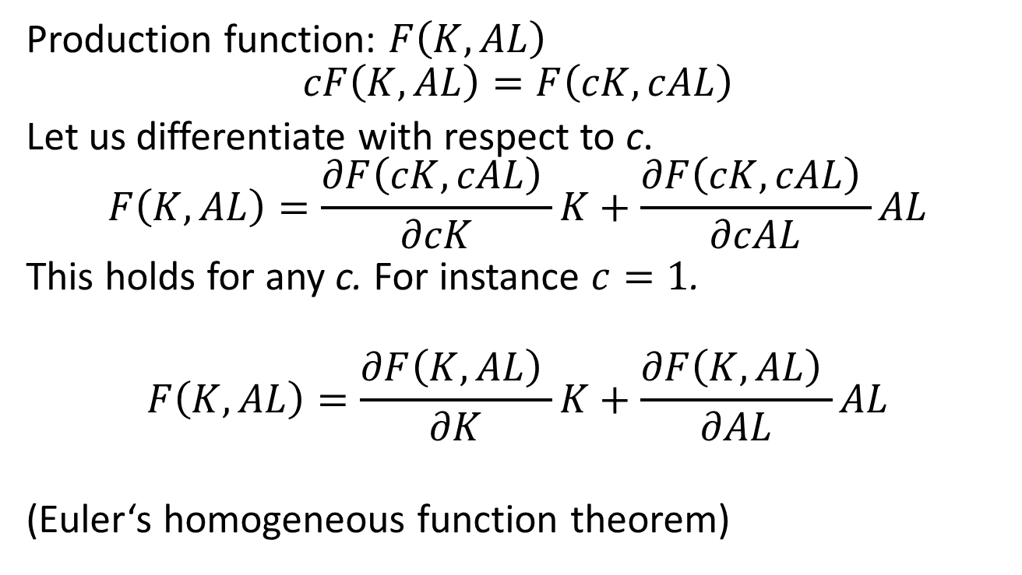
Production function
Production function: $F\left(K,AL\right)$
$$cF\left(K,AL\right)=F\left(cK,cAL\right)$$
Let us differentiate with respect to c.
$$F\left(K,AL\right)=\frac{∂F\left(cK,cAL\right) }{∂cK}K+\frac{∂F\left(cK,cAL\right) }{∂cAL}AL$$
This holds for any c. For instance $c=1$.
$$F\left(K,AL\right)=\frac{∂F\left(K,AL\right) }{∂K}K+\frac{∂F\left(K,AL\right) }{∂AL}AL$$
(Euler‘s homogeneous function theorem)

Slide 20

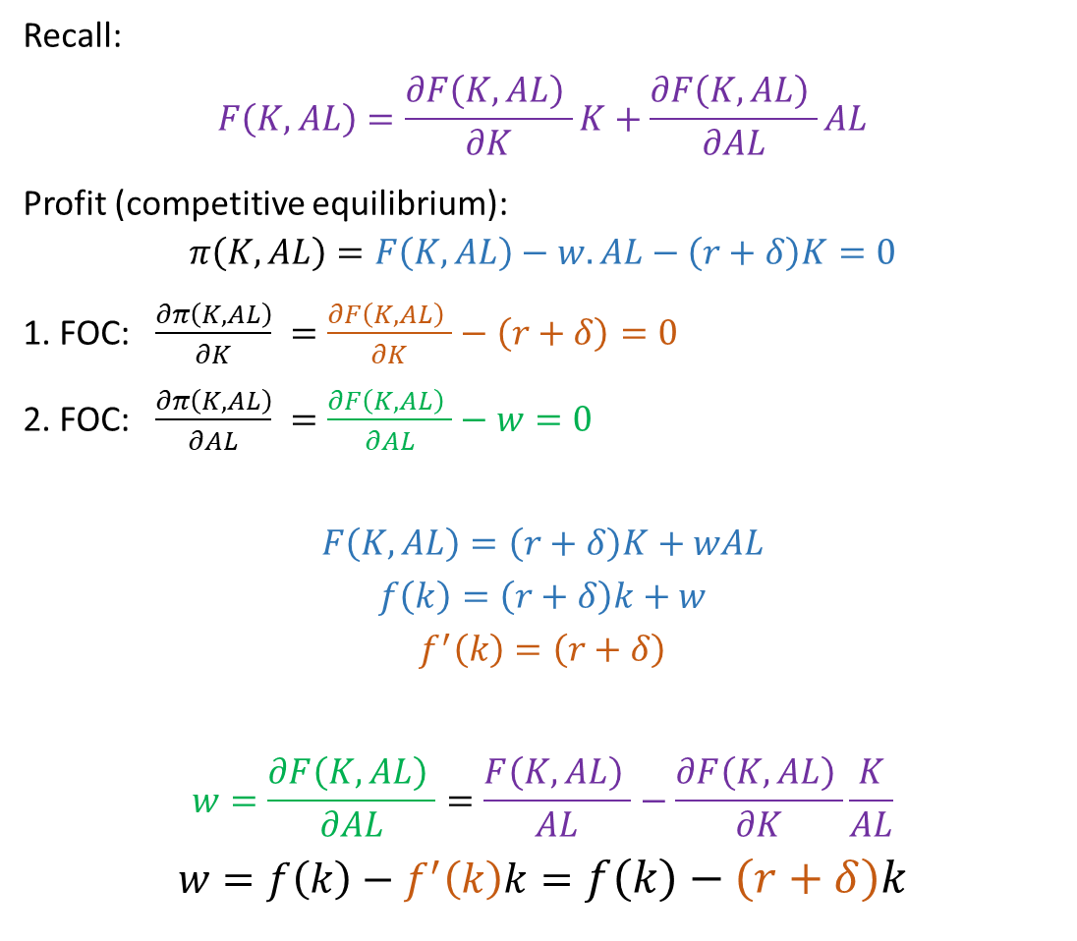
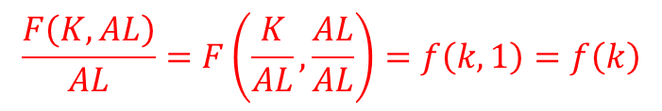
Competitive equilibrium
Recall:
$$F\left(K,AL\right)=\frac{∂F\left(K,AL\right) }{∂K}K+\frac{∂F\left(K,AL\right) }{∂AL}AL$$
Profit (competitive equilibrium):
$$π\left(K,AL\right)=F\left(K,AL\right)−w.AL−\left(r+δ\right)K=0$$
1. FOC: $\frac{∂π\left(K,AL\right)}{∂K} =\frac{∂F\left(K,AL\right) }{∂K}−\left(r+δ\right)=0$
2. FOC: $\frac{∂π\left(K,AL\right)}{∂AL} =\frac{∂F\left(K,AL\right) }{∂AL}−w=0$
$$F\left(K,AL\right)=\left(r+δ\right)K+wAL$$
$$f\left(k\right)=\left(r+δ\right)k+w$$
$$f^{′}\left(k\right)=\left(r+δ\right)$$
$$w=\frac{∂F\left(K,AL\right) }{∂AL}=\frac{F\left(K,AL\right) }{AL}−\frac{∂F\left(K,AL\right) }{∂K}\frac{K}{AL}$$
$$w=f\left(k\right)−f^{′}\left(k\right)k=f\left(k\right)−\left(r+δ\right)k$$
$$\frac{F\left(K,AL\right)}{AL}=F\left(\frac{K}{AL},\frac{AL}{AL}\right)=f\left(k,1\right)=f\left(k\right)$$
$$k=\frac{K}{AL}$$

Slide 21
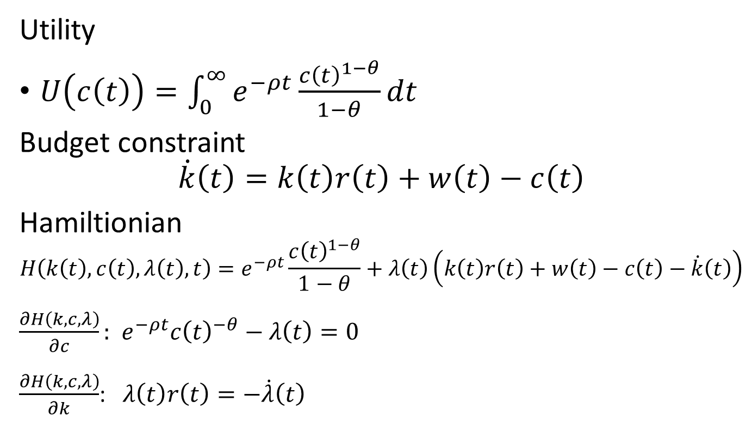
Consumers
Utility
$U\left(c\left(t\right)\right)=\int_{0}^{∞}{e^{−ρt}\frac{{c\left(t\right)}_{ }^{1−θ}}{1−θ}dt}$
Budget constraint
$$\dot{k}\left(t\right)=k\left(t\right)r\left(t\right)+w\left(t\right)−c\left(t\right)$$
Hamiltionian
$$H\left(k\left(t\right),c\left(t\right),λ\left(t\right),t\right)=e^{−ρt}\frac{{c\left(t\right)}_{ }^{1−θ}}{1−θ}+λ\left(t\right)\left(k\left(t\right)r\left(t\right)+w\left(t\right)−c\left(t\right)−\dot{k}\left(t\right)\right)$$
$\frac{∂H\left(k,c,λ\right)}{∂c}:$ $e^{−ρt}{c\left(t\right)}_{ }^{−θ}−λ\left(t\right)=0$
$\frac{∂H\left(k,c,λ\right)}{∂k}$: $λ\left(t\right)r\left(t\right)=−\dot{λ}\left(t\right)$

Slide 22
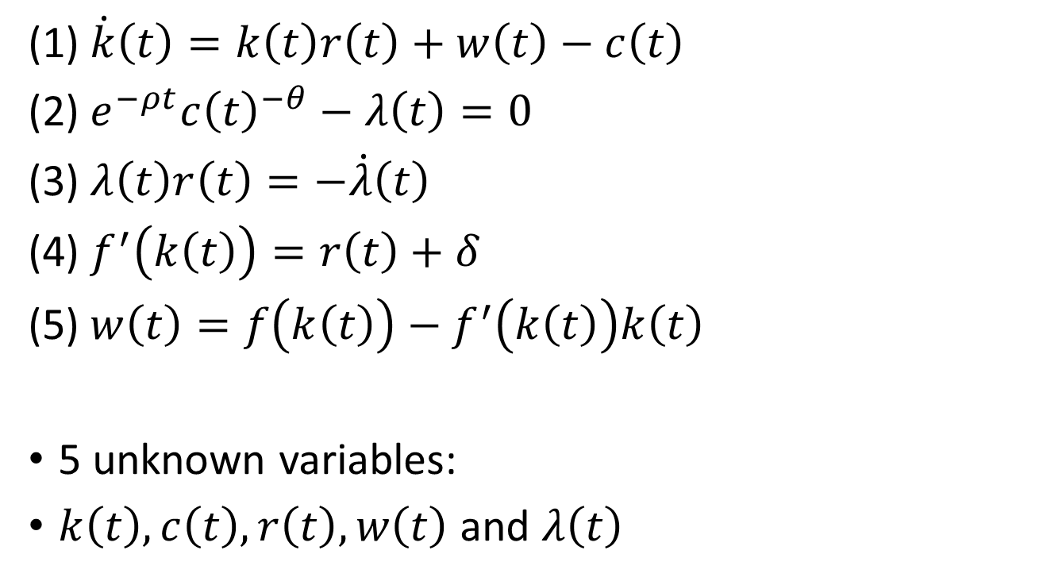
5 equations
(1) $\dot{k}\left(t\right)=k\left(t\right)r\left(t\right)+w\left(t\right)−c\left(t\right)$
(2) $e^{−ρt}{c\left(t\right)}_{ }^{−θ}−λ\left(t\right)=0$
(3) $λ\left(t\right)r\left(t\right)=−\dot{λ}\left(t\right)$
(4) $f^{′}\left(k\left(t\right)\right)=r\left(t\right)+δ$
(5) $w\left(t\right)=f\left(k\left(t\right)\right)−f^{′}\left(k\left(t\right)\right)k\left(t\right)$
5 unknown variables:
$k\left(t\right),c\left(t\right),r\left(t\right),w\left(t\right)$ and $λ\left(t\right)$

Slide 23
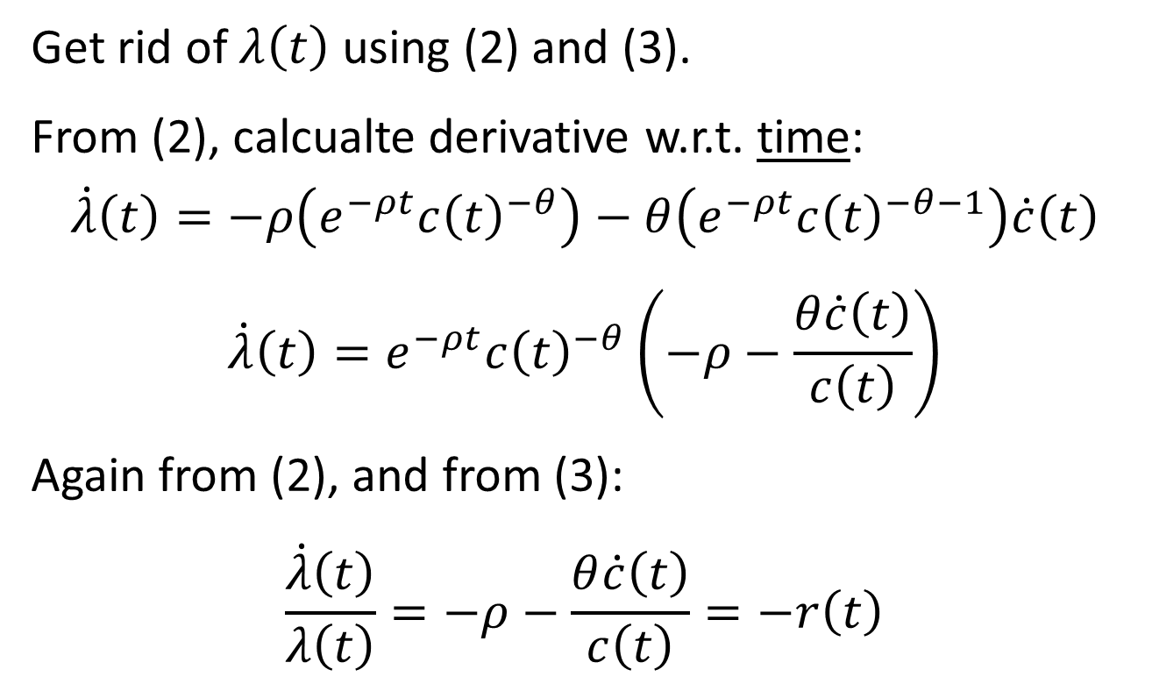
Solution 1
Get rid of $λ\left(t\right)$ using (2) and (3).
From (2), calcualte derivative w.r.t. time:
$$\dot{λ}\left(t\right)=−ρ\left(e^{−ρt}{c\left(t\right)}_{ }^{−θ}\right)−θ\left(e^{−ρt}{c\left(t\right)}_{ }^{−θ−1}\right)\dot{c}\left(t\right)$$
$$\dot{λ}\left(t\right)=e^{−ρt}{c\left(t\right)}_{ }^{−θ}\left(−ρ−\frac{θ\dot{c}\left(t\right)}{c\left(t\right)}\right)$$
Again from (2), and from (3):
$$\frac{\dot{λ}\left(t\right)}{λ\left(t\right)}=−ρ−\frac{θ\dot{c}\left(t\right)}{c\left(t\right)}=−r\left(t\right)$$

Slide 24
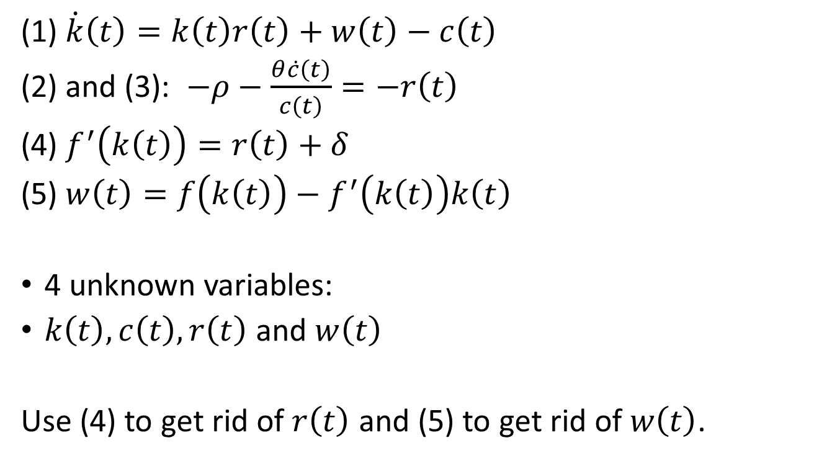
4 equations
(1) $\dot{k}\left(t\right)=k\left(t\right)r\left(t\right)+w\left(t\right)−c\left(t\right)$
(2) and (3): $−ρ−\frac{θ\dot{c}\left(t\right)}{c\left(t\right)}=−r\left(t\right)$
(4) $f^{′}\left(k\left(t\right)\right)=r\left(t\right)+δ$
(5) $w\left(t\right)=f\left(k\left(t\right)\right)−f^{′}\left(k\left(t\right)\right)k\left(t\right)$
4 unknown variables:
$k\left(t\right),c\left(t\right),r\left(t\right)$ and $w\left(t\right)$
Use (4) to get rid of $r\left(t\right)$ and (5) to get rid of $w\left(t\right)$.

Slide 25
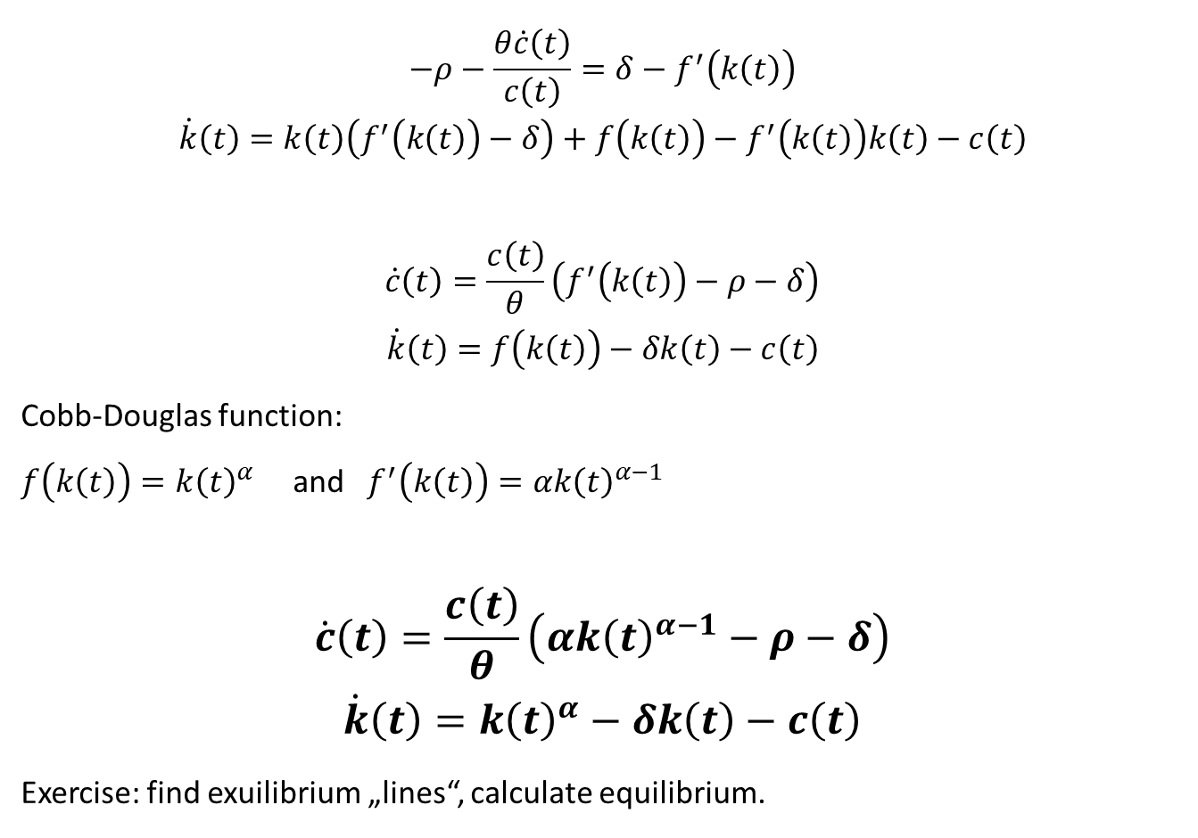
Solution 2
$$−ρ−\frac{θ\dot{c}\left(t\right)}{c\left(t\right)}=δ−f^{′}\left(k\left(t\right)\right)$$
$$\dot{k}\left(t\right)=k\left(t\right)\left(f^{′}\left(k\left(t\right)\right)−δ\right)+f\left(k\left(t\right)\right)−f^{′}\left(k\left(t\right)\right)k\left(t\right)−c\left(t\right)$$
$$\dot{c}\left(t\right)=\frac{c\left(t\right)}{θ}\left(f^{′}\left(k\left(t\right)\right)−ρ−δ\right)$$
$$\dot{k}\left(t\right)=f\left(k\left(t\right)\right)−δk\left(t\right)−c\left(t\right)$$
Cobb-Douglas function:
$f\left(k\left(t\right)\right)=k{\left(t\right)}^{α}$ and $f^{′}\left(k\left(t\right)\right)=αk{\left(t\right)}^{α−1}$
$$\dot{c}\left(t\right)=\frac{c\left(t\right)}{θ}\left(αk{\left(t\right)}^{α−1}−ρ−δ\right)$$
$$\dot{k}\left(t\right)=k{\left(t\right)}^{α}−δk\left(t\right)−c\left(t\right)$$
Exercise: find exuilibrium „lines“, calculate equilibrium.

Slide 26
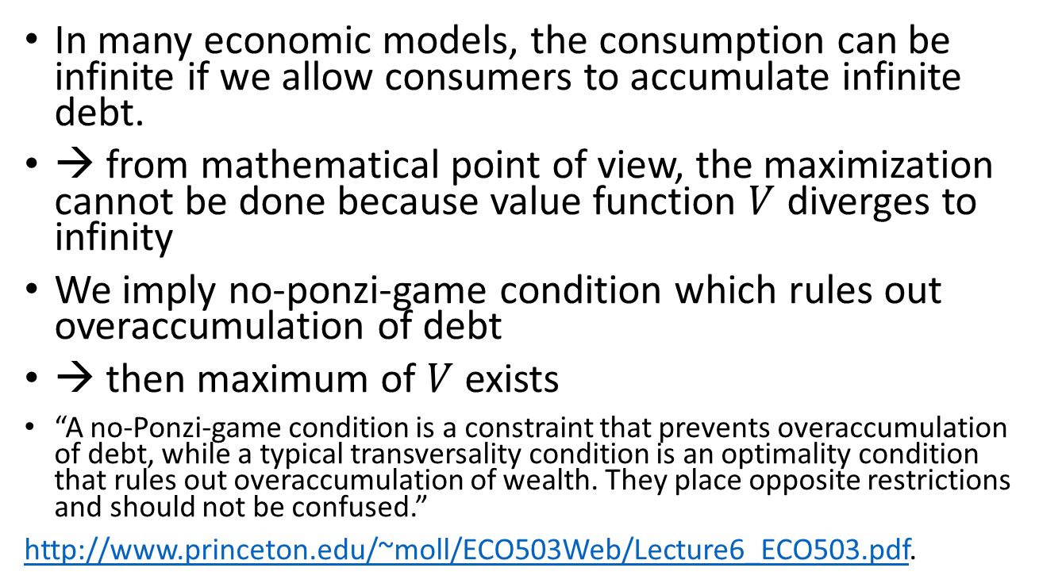
No ponzi game vs. transversality
In many economic models, the consumption can be infinite if we allow consumers to accumulate infinite debt.
→ from mathematical point of view, the maximization cannot be done because value function $V$ diverges to infinity
We imply no-ponzi-game condition which rules out overaccumulation of debt
→ then maximum of $V$ exists
“A no-Ponzi-game condition is a constraint that prevents overaccumulation of debt, while a typical transversality condition is an optimality condition that rules out overaccumulation of wealth. They place opposite restrictions and should not be confused.”
http://www.princeton.edu/~moll/ECO503Web/Lecture6_ECO503.pdf.

Slide 27
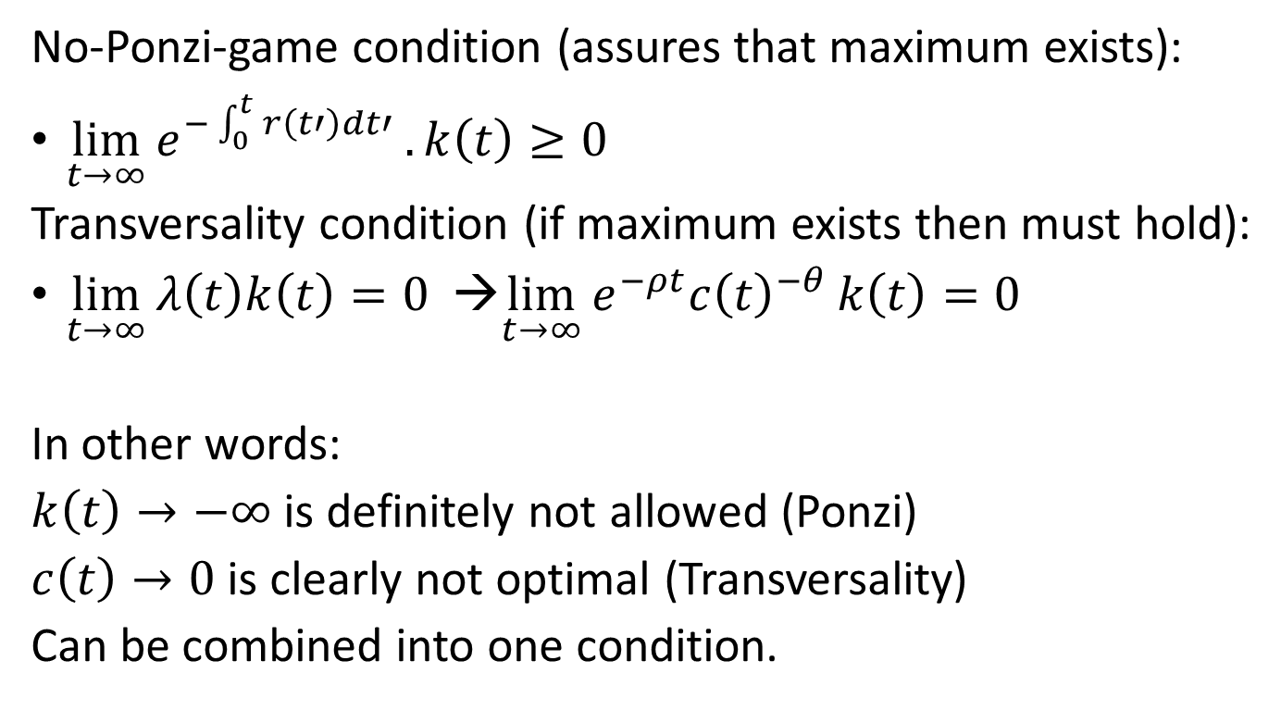
Ponzi & Transversality
No-Ponzi-game condition (assures that maximum exists):
$\lim_{t→∞}{e^{−\int_{0}^{t}{r\left(t′\right)dt′}}}.k\left(t\right)≥0$
Transversality condition (if maximum exists then must hold):
$\lim_{t→∞}{λ\left(t\right)k\left(t\right)}=0$ →$\lim_{t→∞}{e^{−ρt}{c\left(t\right)}_{ }^{−θ}}k\left(t\right)=0$
In other words:
$k\left(t\right)→−∞$ is definitely not allowed (Ponzi)
$c\left(t\right)→0$ is clearly not optimal (Transversality)
Can be combined into one condition.

Slide 28
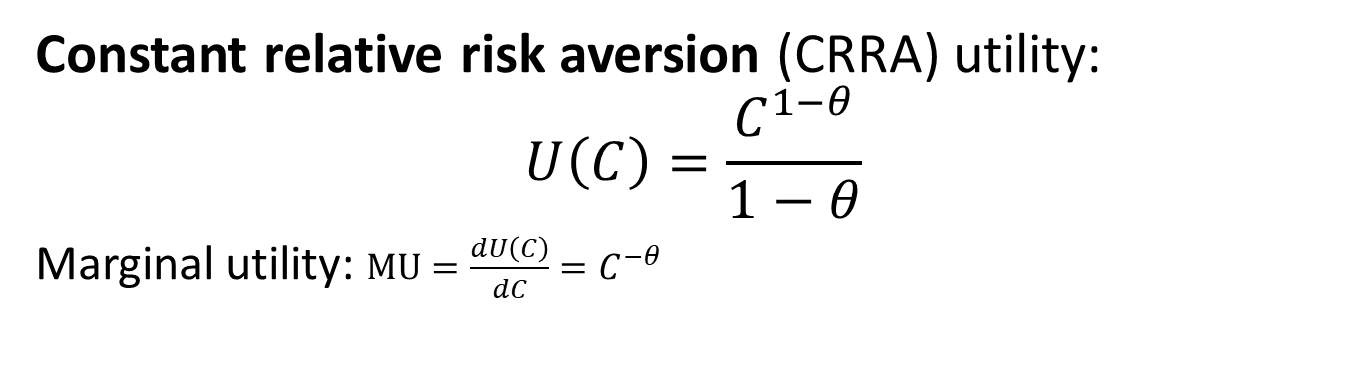
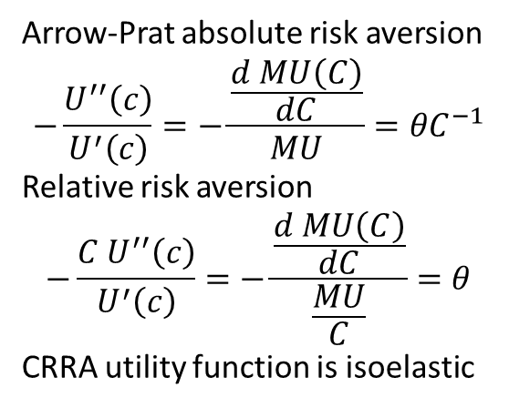
Intermezzo: CRRA vs. Log-utility
Constant relative risk aversion (CRRA) utility:
$$U\left(C\right)=\frac{C_{ }^{1−θ}}{1−θ}$$
Marginal utility: $MU=\frac{dU\left(C\right)}{dC}=C^{−θ}$
Arrow-Prat absolute risk aversion
$$−\frac{U^{′′}\left(c\right)}{U^{′}\left(c\right)}=−\frac{\frac{d MU\left(C\right)}{dC}}{MU}={θC}^{−1}$$
Relative risk aversion
$$−\frac{{C U}^{′′}\left(c\right)}{U^{′}\left(c\right)}=−\frac{\frac{d MU\left(C\right)}{dC}}{\frac{MU}{C}}=θ$$
CRRA utility function is isoelastic

Slide 29
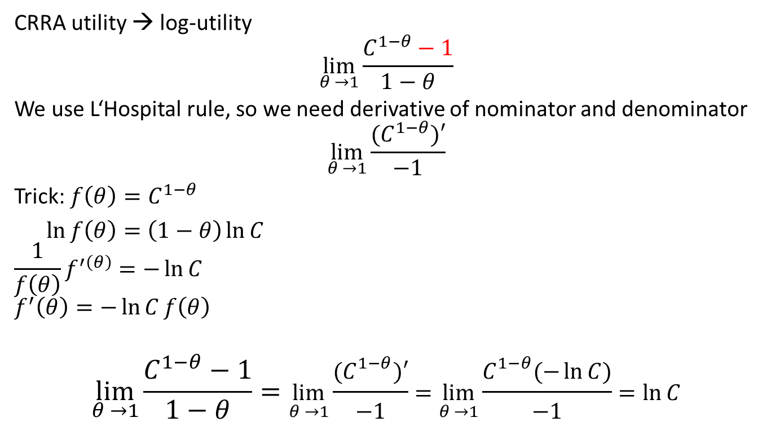
Intermezzo: CRRA vs. Log-utility
CRRA utility → log-utility
$$\lim_{θ →1}{\frac{C_{ }^{1−θ}−1}{1−θ}}$$
We use L‘Hospital rule, so we need derivative of nominator and denominator
$$\lim_{θ →1}{\frac{{(C}_{ }^{1−θ})′}{−1}}$$
Trick: ${f\left(θ\right)=C}_{ }^{1−θ}$
$\ln{f\left(θ\right)}=\left(1−θ\right)\ln{C}$
$$\frac{1}{f\left(θ\right)}f^{′\left(θ\right)}=−\ln{C}$$
$$f^{′}\left(θ\right)=−\ln{C}f\left(θ\right)$$
$$\lim_{θ →1}{\frac{C_{ }^{1−θ}−1}{1−θ}}=\lim_{θ →1}{\frac{{(C}_{ }^{1−θ})′}{−1}}=\lim_{θ →1}{\frac{C_{ }^{1−θ}(−\ln{C)}}{−1}}=\ln{C}$$

