Slide 1
MMM
Linearization – brief notes
Josef.strasky@gmail.com

Slide 2
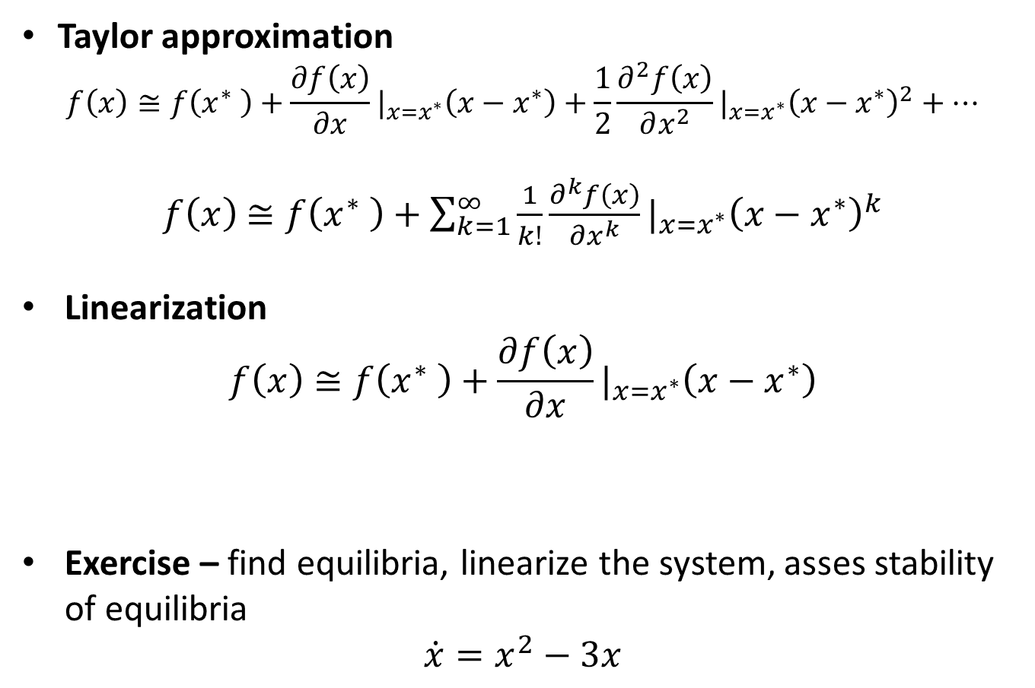
Taylor series
Taylor approximation
$$f\left(x\right)≅f\left(x^{∗} \right)+\frac{∂f\left(x\right)}{∂x}|_{x=x^{∗}}\left(x−x^{∗}\right)+\frac{1}{2}\frac{∂^{2}f\left(x\right)}{∂x^{2}}|_{x=x^{∗}}{\left(x−x^{∗}\right)}^{2}+…$$
$f\left(x\right)$ $≅f\left(x^{∗} \right)+\sum_{k=1}^{∞}{\frac{1}{k!}\frac{∂^{k}f\left(x\right)}{∂x^{k}}|_{x=x^{∗}}{\left(x−x^{∗}\right)}^{k}}$
Linearization
$$f\left(x\right)≅f\left(x^{∗} \right)+\frac{∂f\left(x\right)}{∂x}|_{x=x^{∗}}\left(x−x^{∗}\right)$$
Exercise – find equilibria, linearize the system, asses stability of equilibria
$$\dot{x}=x^{2}−3x$$

Slide 3
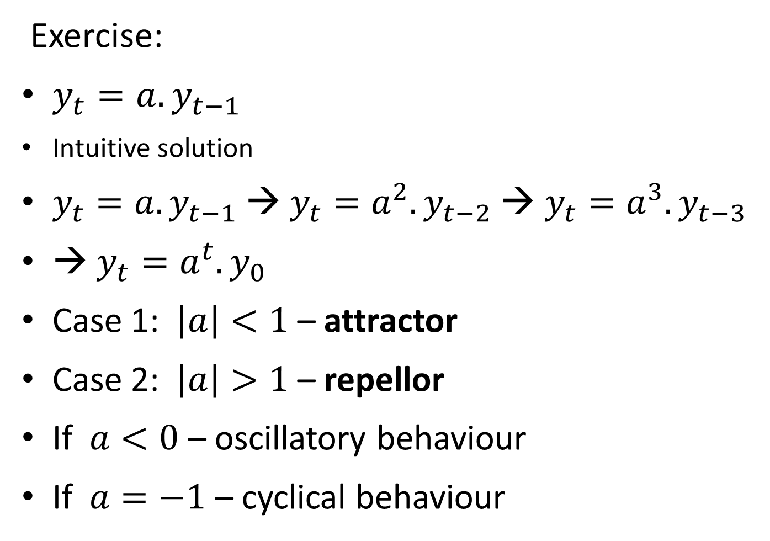
Recall
Exercise:
$y_{t}=a{.y}_{t−1}$
Intuitive solution
$y_{t}=a{.y}_{t−1}$→ $y_{t}=a^{2}{.y}_{t−2}$→ $y_{t}=a^{3}{.y}_{t−3}$
→ $y_{t}=a^{t}{.y}_{0}$
Case 1: $\left|a\right|<1$ – attractor
Case 2: $\left|a\right|>1$ – repellor
If $a<0$ – oscillatory behaviour
If $a=−1$ – cyclical behaviour

Slide 4
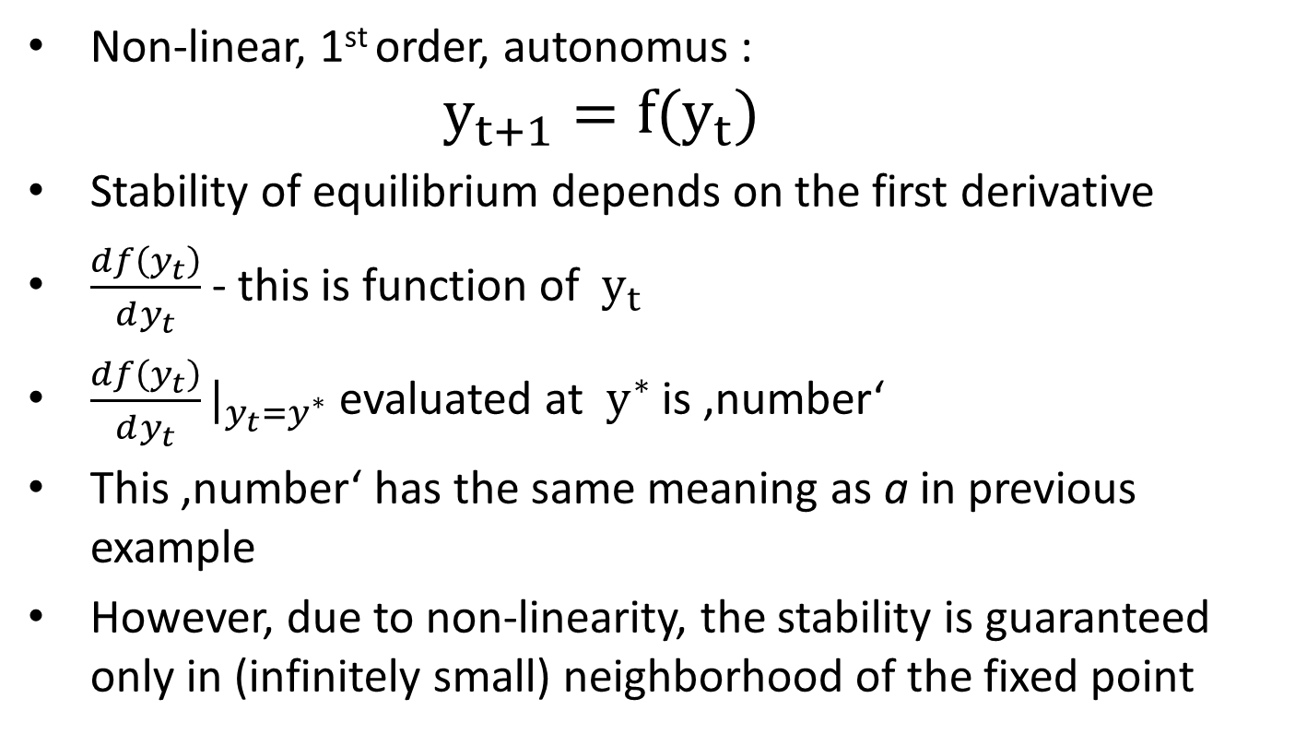
Equilibrium and stability non-linear case
Non-linear, 1st order, autonomus :
$$y_{t+1}=f{(y}_{t})$$
Stability of equilibrium depends on the first derivative
$\frac{df\left(y_{t}\right)}{dy_{t}}$ - this is function of $y_{t}$
$\frac{df\left(y_{t}\right)}{dy_{t}}|_{y_{t}=y^{∗}}$ evaluated at${ y}^{∗}$ is ‚number‘
This ‚number‘ has the same meaning as a in previous example
However, due to non-linearity, the stability is guaranteed only in (infinitely small) neighborhood of the fixed point

Slide 5
Non-linear difference equation
Exercise
Draw the phase diagram for
y_{t+1}= (y_{t})²
y_{t+1}= - (y_{t})²+ 2y_{t}
Decide whether the steady states are attracting or repelling.

Slide 6
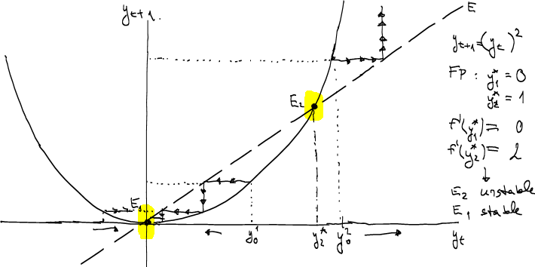
Non-linear case - exercise

Slide 7
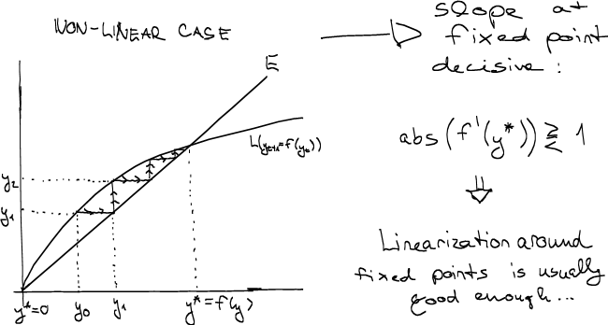
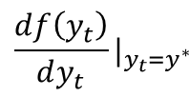
Equilibrium and stability non-linear case
$$\frac{df\left(y_{t}\right)}{dy_{t}}|_{y_{t}=y^{∗}}$$

Slide 8
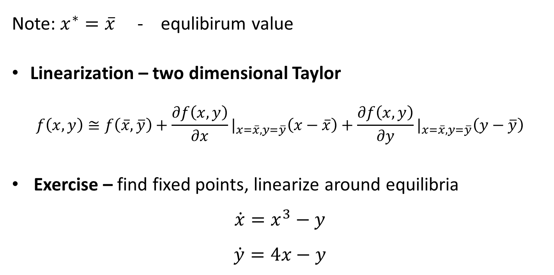
Stability in non-linear system of differential equations
Note: $x^{∗}=\overline{x}$ - equlibirum value
Linearization – two dimensional Taylor
$$f\left(x,y\right)≅f\left(\overline{x},\overline{y}\right)+\frac{∂f\left(x,y\right)}{∂x}|_{x=\overline{x},y=\overline{y}}\left(x−\overline{x}\right)+\frac{∂f\left(x,y\right)}{∂y}|_{x=\overline{x},y=\overline{y}}\left(y−\overline{y}\right)$$
Exercise – find fixed points, linearize around equilibria
$$\dot{x}=x^{3}−y$$
$$\dot{y}=4x−y$$

Slide 9
MMM
Log-linearization – brief notes
Josef.strasky@gmail.com

Slide 10
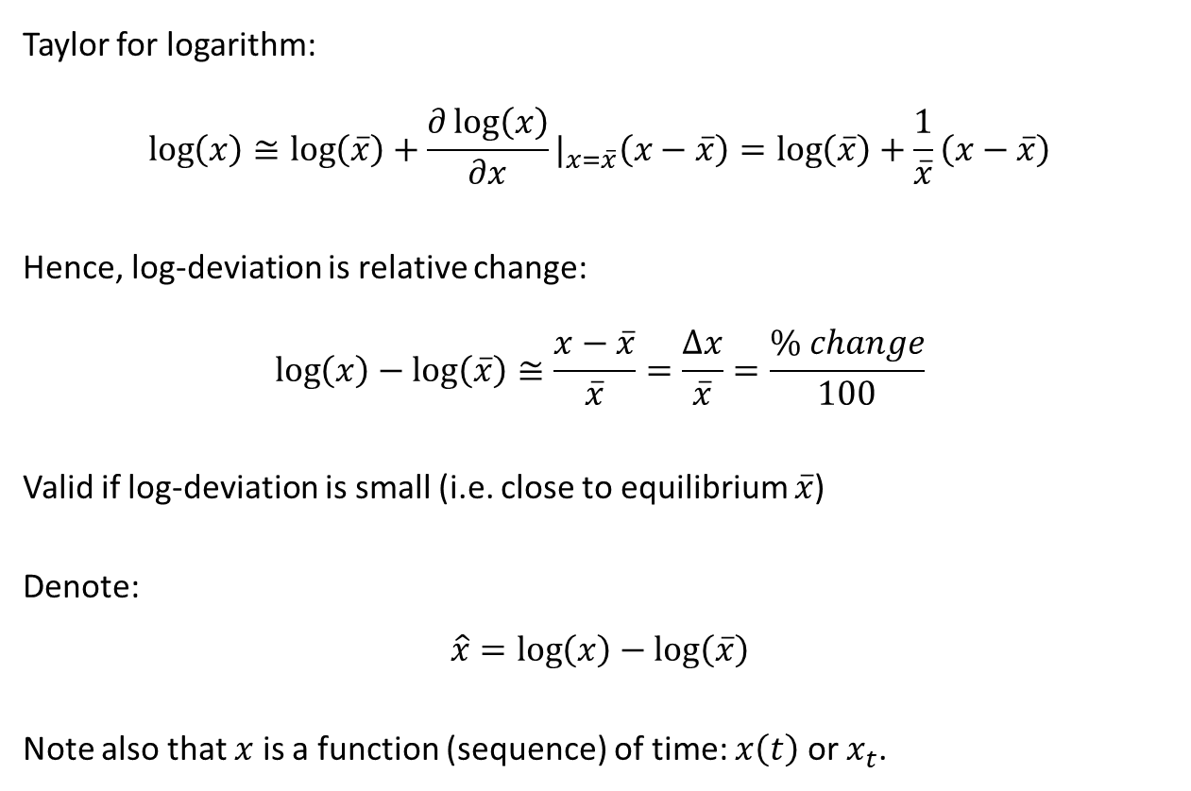
Logarithmic deviation (log-deviation)
Taylor for logarithm:
$$\log\left(x\right)≅\log\left(\overline{x}\right)+\frac{∂\log\left(x\right)}{∂x}|_{x=\overline{x}}\left(x−\overline{x}\right)=\log\left(\overline{x}\right)+\frac{1}{\overline{x}}\left(x−\overline{x}\right)$$
Hence, log-deviation is relative change:
$$\log\left(x\right)−\log\left(\overline{x}\right)≅\frac{x−\overline{x}}{\overline{x}}=\frac{Δx}{\overline{x}}=\frac{\% change}{100}$$
Valid if log-deviation is small (i.e. close to equilibrium $\overline{x}$)
Denote:
$$\hat{x}=\log\left(x\right)−\log\left(\overline{x}\right)$$
Note also that $x$ is a function (sequence) of time: $x\left(t\right)$ or $x_{t}$.

Slide 11
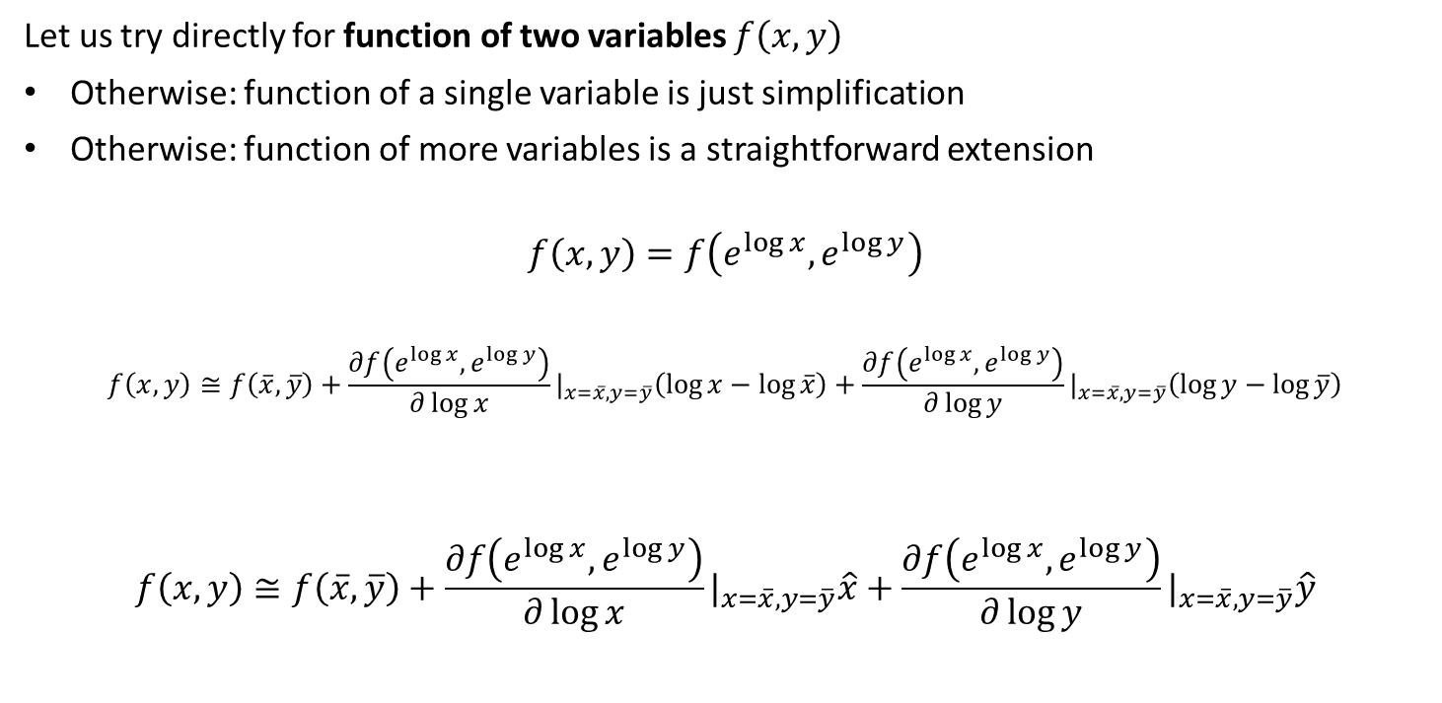
Log-linearization: standard method
Let us try directly for function of two variables $f\left(x,y\right)$
Otherwise: function of a single variable is just simplification
Otherwise: function of more variables is a straightforward extension
$$f\left(x,y\right)=f\left(e^{\log{x}},e^{\log{y}}\right)$$
$$f\left(x,y\right)≅f\left(\overline{x},\overline{y}\right)+\frac{∂f\left(e^{\log{x}},e^{\log{y}}\right)}{∂\log{x}}|_{x=\overline{x},y=\overline{y}}\left(\log{x}−\log{\overline{x}}\right)+\frac{∂f\left(e^{\log{x}},e^{\log{y}}\right)}{∂\log{y}}|_{x=\overline{x},y=\overline{y}}\left(\log{y}−\log{\overline{y}}\right)$$
$$f\left(x,y\right)≅f\left(\overline{x},\overline{y}\right)+\frac{∂f\left(e^{\log{x}},e^{\log{y}}\right)}{∂\log{x}}|_{x=\overline{x},y=\overline{y}}\hat{x}+\frac{∂f\left(e^{\log{x}},e^{\log{y}}\right)}{∂\log{y}}|_{x=\overline{x},y=\overline{y}}\hat{y}$$

Slide 12
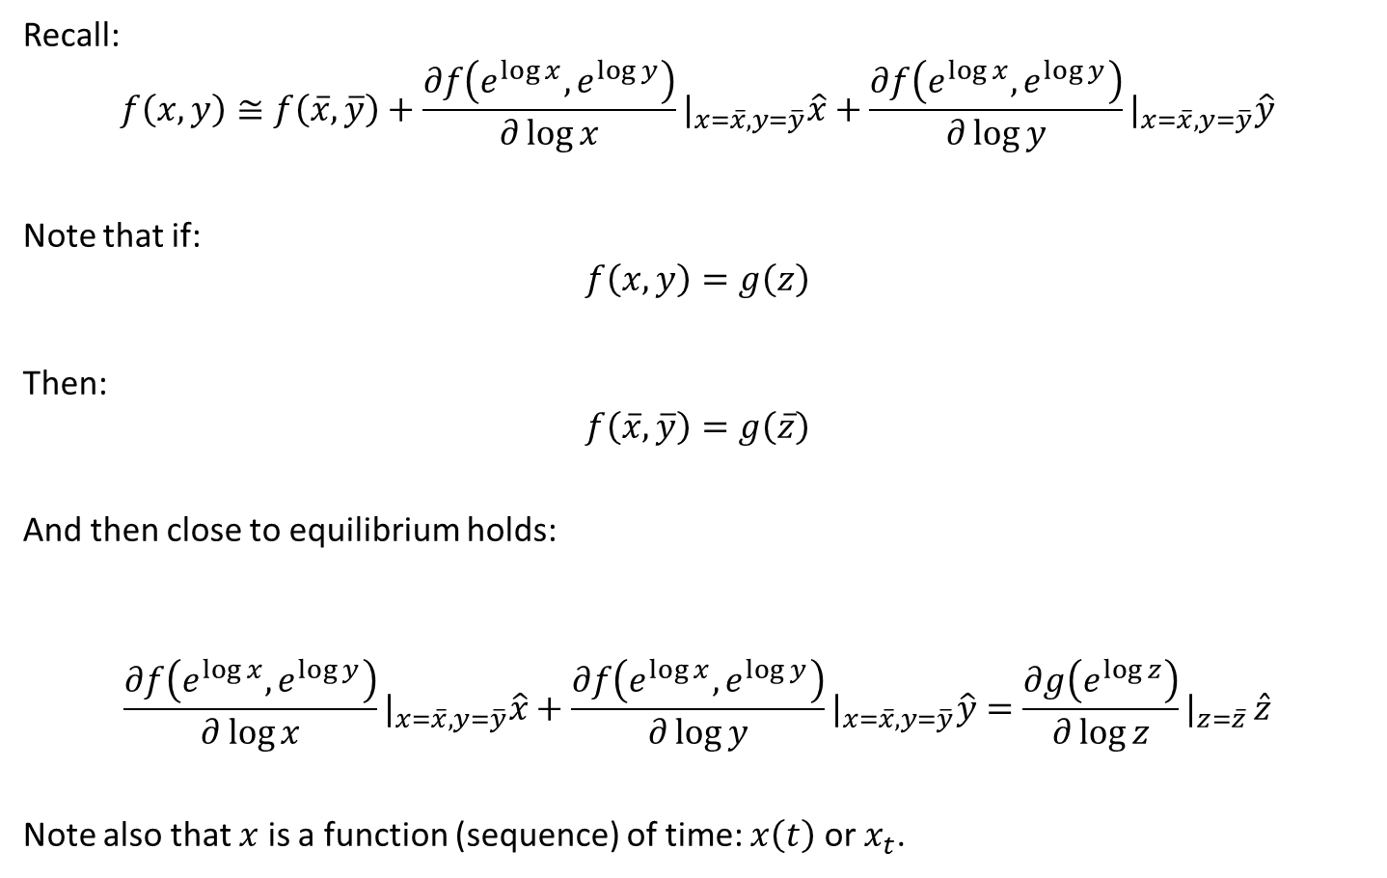
Log-linearization: standard method
Recall:
$$f\left(x,y\right)≅f\left(\overline{x},\overline{y}\right)+\frac{∂f\left(e^{\log{x}},e^{\log{y}}\right)}{∂\log{x}}|_{x=\overline{x},y=\overline{y}}\hat{x}+\frac{∂f\left(e^{\log{x}},e^{\log{y}}\right)}{∂\log{y}}|_{x=\overline{x},y=\overline{y}}\hat{y}$$
Note that if:
$$f\left(x,y\right)=g\left(z\right)$$
Then:
$$f\left(\overline{x},\overline{y}\right)=g\left(\overline{z}\right)$$
And then close to equilibrium holds:
$$\frac{∂f\left(e^{\log{x}},e^{\log{y}}\right)}{∂\log{x}}|_{x=\overline{x},y=\overline{y}}\hat{x}+\frac{∂f\left(e^{\log{x}},e^{\log{y}}\right)}{∂\log{y}}|_{x=\overline{x},y=\overline{y}}\hat{y}=\frac{∂g\left(e^{\log{z}}\right)}{∂\log{z}}|_{z=\overline{z} }\hat{z}$$
Note also that $x$ is a function (sequence) of time: $x\left(t\right)$ or $x_{t}$.

Slide 13

Log-linearization: exercises
Log-linearize following exercise equations:
Equation 1:
$$K_{t}=I_{t}+\left(1−δ\right)K_{t−1}$$
Equation 2:
$$Y_{t}=K_{t}^{α}N_{t}^{1−α}$$

Slide 14
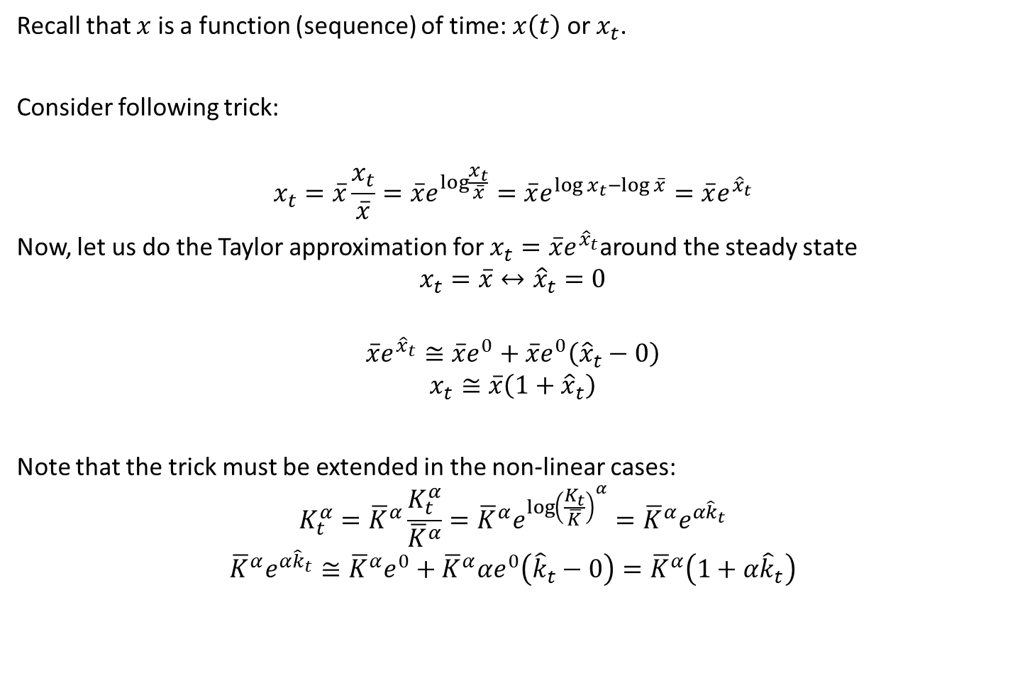
Log-linearization: rewriting trick
Recall that $x$ is a function (sequence) of time: $x\left(t\right)$ or $x_{t}$.
Consider following trick:
$$x_{t}=\overline{x}\frac{x_{t}}{\overline{x}}=\overline{x}e^{\log{\frac{x_{t}}{\overline{x}}}}=\overline{x}e^{\log{x_{t}}−\log{\overline{x}}}=\overline{x}e^{{\hat{x}}_{t}}$$
Now, let us do the Taylor approximation for $x_{t}=\overline{x}e^{{\hat{x}}_{t}}$around the steady state $$x_{t}=\overline{x}↔{\hat{x}}_{t}=0$$
$$\overline{x}e^{{\hat{x}}_{t}}≅\overline{x}e^{0}+\overline{x}e^{0}\left({\hat{x}}_{t}−0\right)$$
$$x_{t}≅\overline{x}\left({1+\hat{x}}_{t}\right)$$
Note that the trick must be extended in the non-linear cases:
$$K_{t}^{α}={\overline{K}}^{α}\frac{K_{t}^{α}}{{\overline{K}}^{α}}={\overline{K}}^{α}e^{{\log\left(\frac{K_{t}}{\overline{K}}\right)}^{α}}={\overline{K}}^{α}e^{α{\hat{k}}_{t}}$$
$${\overline{K}}^{α}e^{α{\hat{k}}_{t}}≅{\overline{K}}^{α}e^{0}+{\overline{K}}^{α}αe^{0}\left({\hat{k}}_{t}−0\right)={\overline{K}}^{α}\left({1+α\hat{k}}_{t}\right)$$

Slide 15

Log-linearization: rewriting trick - calculus
Recall: $x_{t}≅\overline{x}\left({1+\hat{x}}_{t}\right)$
$$x_{t}+y_{t}≅\overline{x}\left({1+\hat{x}}_{t}\right)+\overline{y}\left({1+\hat{y}}_{t}\right)=\overline{x}+\overline{y}+\overline{x}{\hat{x}}_{t}+\overline{y}{\hat{y}}_{t}$$
$$x_{t}y_{t}≅\overline{x}\left({1+\hat{x}}_{t}\right)\overline{y}\left({1+\hat{y}}_{t}\right)=\overline{x}\overline{y}+\overline{x}\overline{y}{\hat{x}}_{t}+\overline{x}\overline{y}{\hat{y}}_{t}$$
Since ${\hat{x}}_{t}$ and ${\hat{y}}_{t}$ are small, the term ${{\hat{x}}_{t}\hat{y}}_{t}$ can be omitted.
$$x_{t}^{α}={\overline{x}}^{α}\left({1+α\hat{x}}_{t}\right)$$
$$x_{t}^{−1}={\overline{x}}^{−1}\left({1−\hat{x}}_{t}\right)$$
Some more calculus:
$$z_{t}= x_{t}+y_{t}→{\hat{z}}_{t}=\frac{\overline{x}}{\overline{z}}{\hat{x}}_{t}+\frac{\overline{y}}{\overline{z}}{\hat{y}}_{t}$$
$$z_{t}= x_{t}y_{t}→{\hat{z}}_{t}={\hat{x}}_{t}+{\hat{y}}_{t}$$
$$z_{t}= \frac{x_{t}}{y_{t}}→{\hat{z}}_{t}={\hat{x}}_{t}−{\hat{y}}_{t}$$

Slide 16
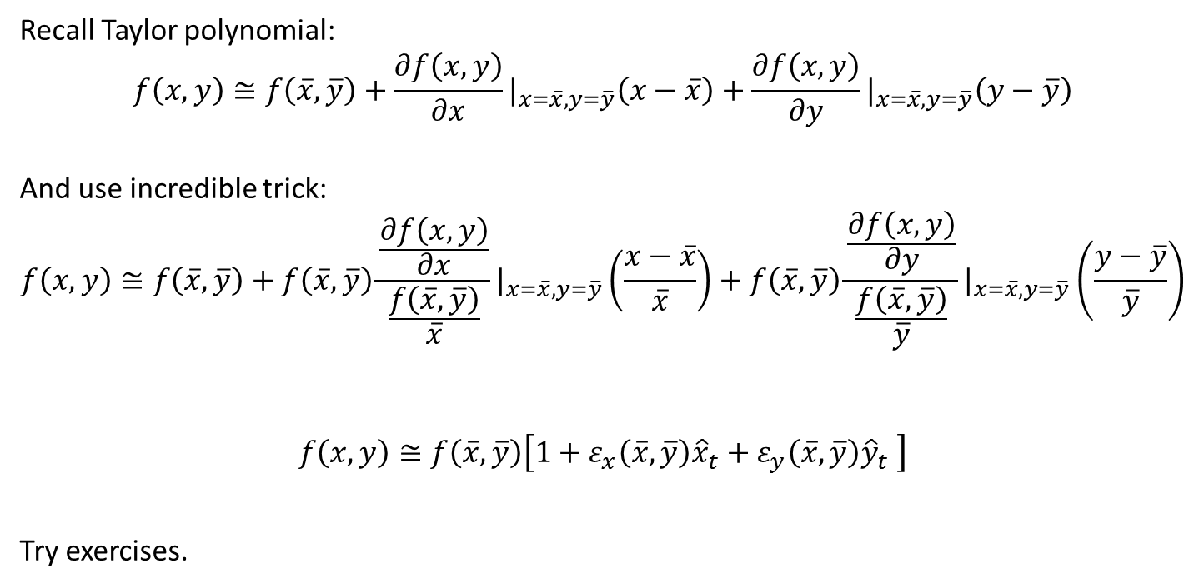
Log-linearization: elasticity formulation
Recall Taylor polynomial:
$$f\left(x,y\right)≅f\left(\overline{x},\overline{y}\right)+\frac{∂f\left(x,y\right)}{∂x}|_{x=\overline{x},y=\overline{y}}\left(x−\overline{x}\right)+\frac{∂f\left(x,y\right)}{∂y}|_{x=\overline{x},y=\overline{y}}\left(y−\overline{y}\right)$$
And use incredible trick:
$$f\left(x,y\right)≅f\left(\overline{x},\overline{y}\right)+f\left(\overline{x},\overline{y}\right)\frac{\frac{∂f\left(x,y\right)}{∂x}}{\frac{f\left(\overline{x},\overline{y}\right)}{\overline{x}}}|_{x=\overline{x},y=\overline{y}}\left(\frac{x−\overline{x}}{\overline{x}}\right)+f\left(\overline{x},\overline{y}\right)\frac{\frac{∂f\left(x,y\right)}{∂y}}{\frac{f\left(\overline{x},\overline{y}\right)}{\overline{y}}}|_{x=\overline{x},y=\overline{y}}\left(\frac{y−\overline{y}}{\overline{y}}\right)$$
$$f\left(x,y\right)≅f\left(\overline{x},\overline{y}\right)\left[1+ε_{x}\left(\overline{x},\overline{y}\right){\hat{x}}_{t}+ε_{y}\left(\overline{x},\overline{y}\right){\hat{y}}_{t} \right]$$
Try exercises.

