Slide 1
Belman equation
Josef Stráský
Jerome Adda, Russel Cooper: Dynamic Economics: Quantitative Methods and Applications
http://www.colorado.edu/Economics/courses/boileau/7020/Cgdynpro.PDF

Slide 2
Content
Intuition behind Lagrangian
Derivation of Belman equation for „Cake eating problem“
Belman equation for infinite horizon Cake-eating problem
Numerical solution by value function iterations
Stochastic version of cake-eating problem (Markov chain)

Slide 3
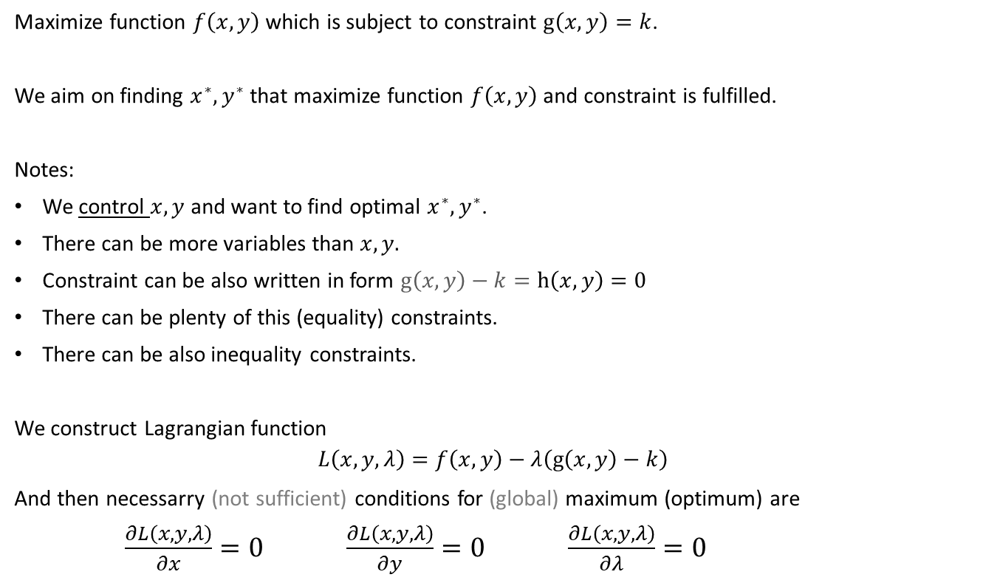
Constrained optimization
Maximize function $f\left(x,y\right)$ which is subject to constraint $g\left(x,y\right)=k$.
We aim on finding $x^{∗},y^{∗}$ that maximize function $f\left(x,y\right)$ and constraint is fulfilled.
Notes:
We control $x,y$ and want to find optimal $x^{∗},y^{∗}$.
There can be more variables than $x,y.$
Constraint can be also written in form $g\left(x,y\right)−k=h\left(x,y\right)=0$
There can be plenty of this (equality) constraints.
There can be also inequality constraints.
We construct Lagrangian function
$$L\left(x,y,λ\right)=f\left(x,y\right)−λ\left(g\left(x,y\right)−k\right)$$
And then necessarry (not sufficient) conditions for (global) maximum (optimum) are
$\frac{∂L\left(x,y,λ\right)}{∂x}=0$ $\frac{∂L\left(x,y,λ\right)}{∂y}=0$ $\frac{∂L\left(x,y,λ\right)}{∂λ}=0$

Slide 4
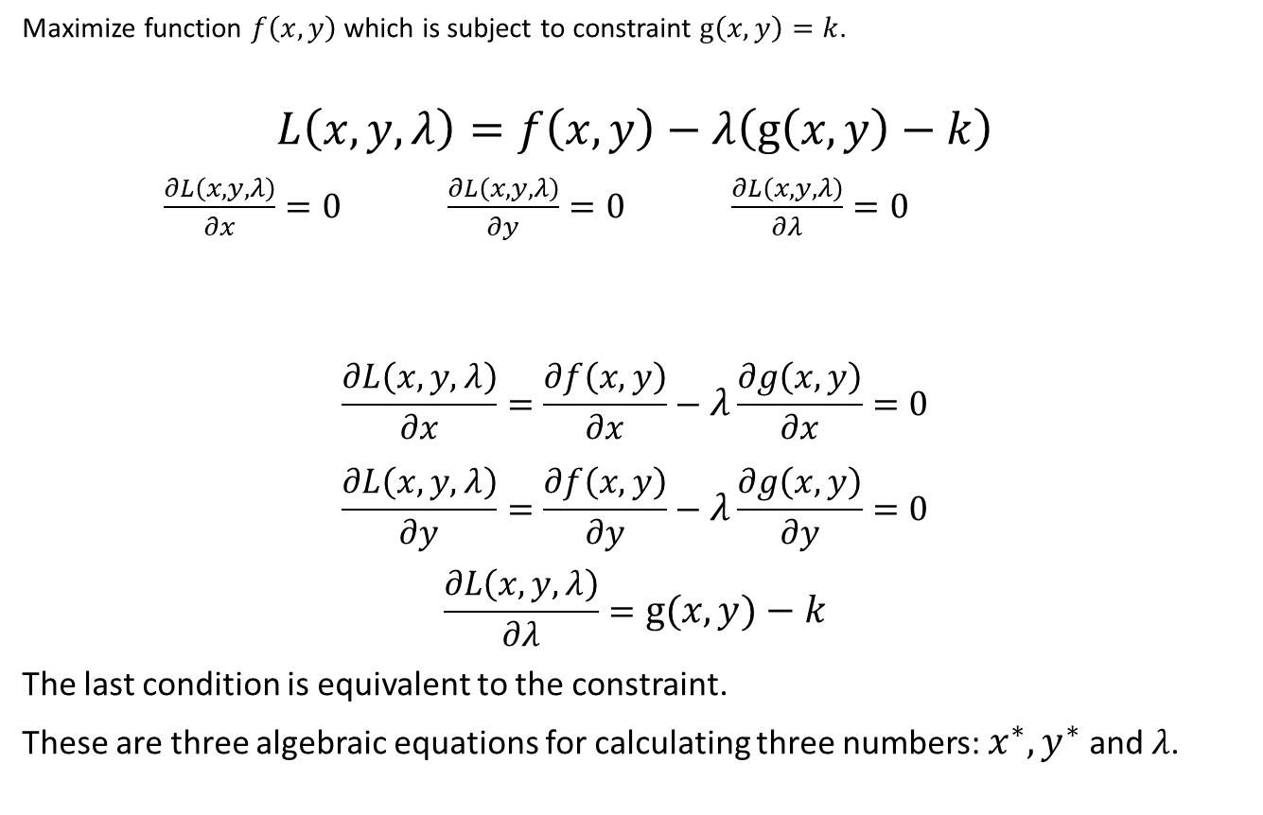
Constrained optimization
Maximize function $f\left(x,y\right)$ which is subject to constraint $g\left(x,y\right)=k$.
$$L\left(x,y,λ\right)=f\left(x,y\right)−λ\left(g\left(x,y\right)−k\right)$$
$\frac{∂L\left(x,y,λ\right)}{∂x}=0$ $\frac{∂L\left(x,y,λ\right)}{∂y}=0$ $\frac{∂L\left(x,y,λ\right)}{∂λ}=0$
$$\frac{∂L\left(x,y,λ\right)}{∂x}=\frac{∂f\left(x,y\right)}{∂x}−λ\frac{∂g\left(x,y\right)}{∂x}=0$$
$$\frac{∂L\left(x,y,λ\right)}{∂y}=\frac{∂f\left(x,y\right)}{∂y}−λ\frac{∂g\left(x,y\right)}{∂y}=0$$
$$\frac{∂L\left(x,y,λ\right)}{∂λ}=g\left(x,y\right)−k$$
The last condition is equivalent to the constraint.
These are three algebraic equations for calculating three numbers: $x^{∗},y^{∗}$ and $λ$.

Slide 5
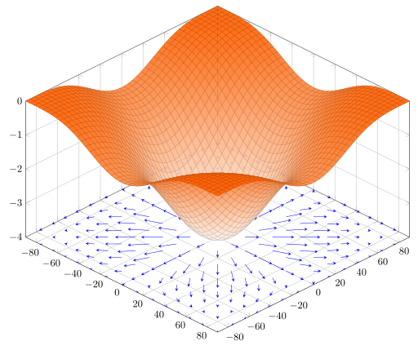
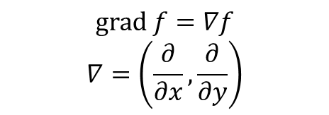
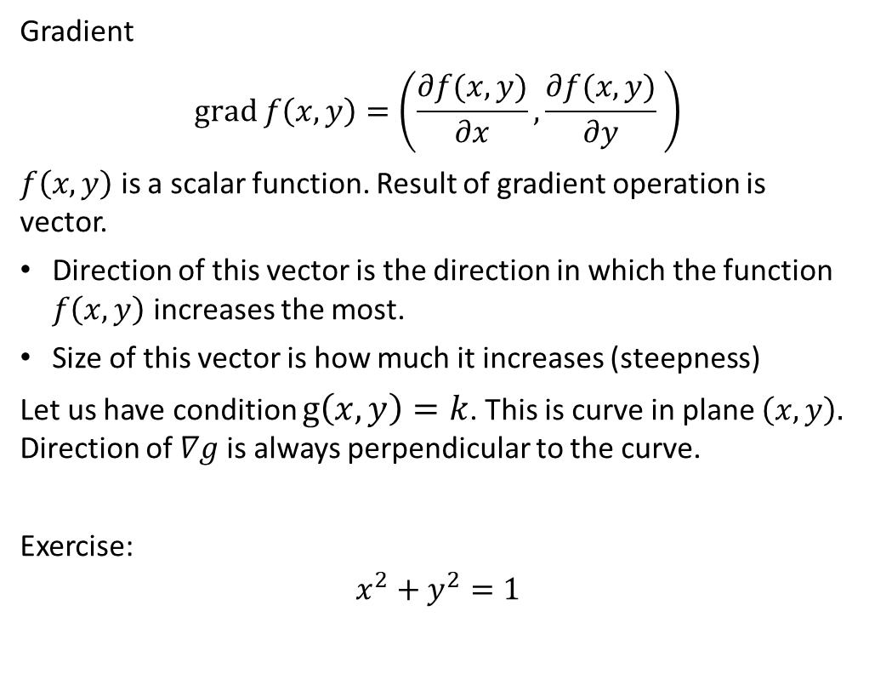
Intuition behind Lagrangian
Gradient
$$grad f\left(x,y\right)=\left(\frac{∂f(x,y)}{∂x},\frac{∂f(x,y)}{∂y} \right)$$
$f\left(x,y\right)$ is a scalar function. Result of gradient operation is vector.
Direction of this vector is the direction in which the function $f\left(x,y\right)$ increases the most.
Size of this vector is how much it increases (steepness)
Let us have condition $g\left(x,y\right)=k$. This is curve in plane $\left(x,y\right).$ Direction of $∇g$is always perpendicular to the curve.
Exercise:
$$x^{2}+y^{2}=1$$
$$grad f=∇f$$
$$∇=\left(\frac{∂}{∂x},\frac{∂}{∂y}\right)$$

Slide 6
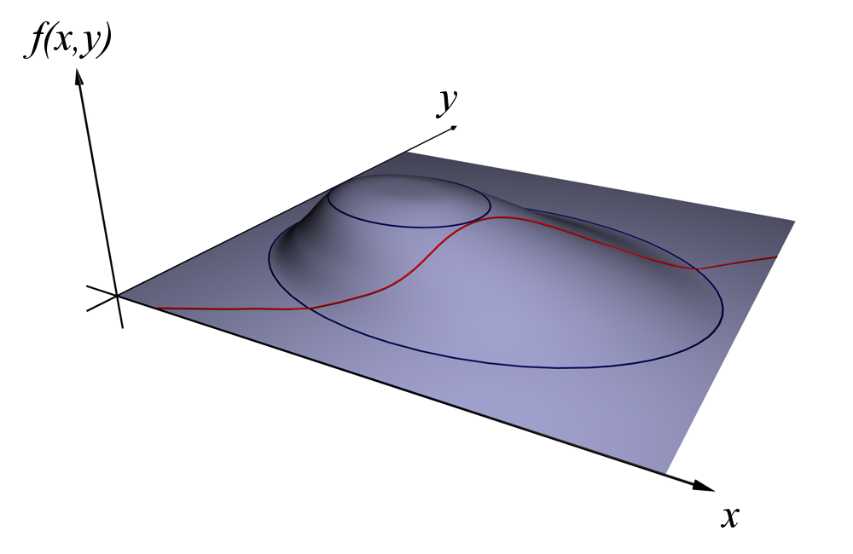
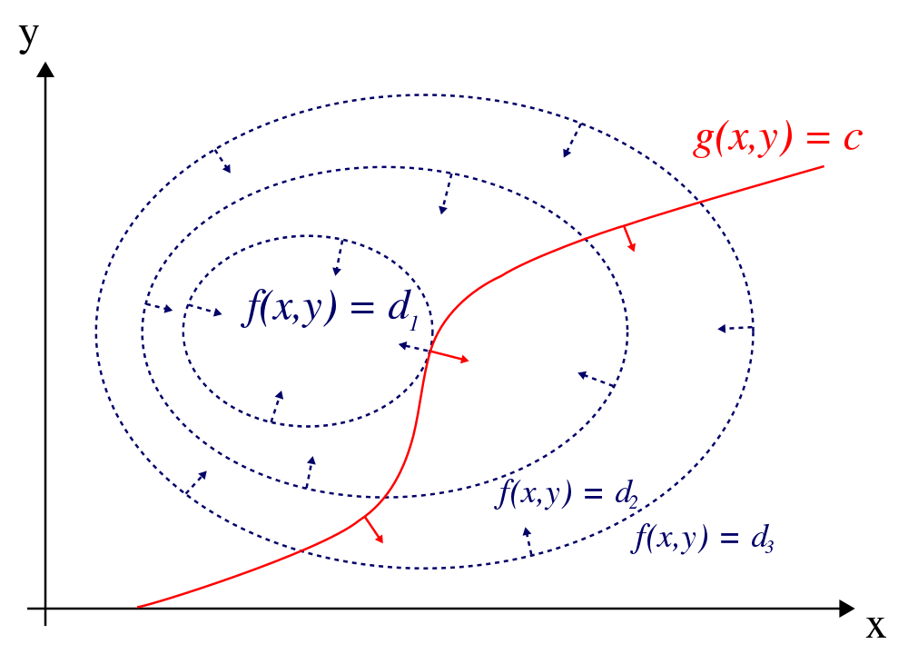
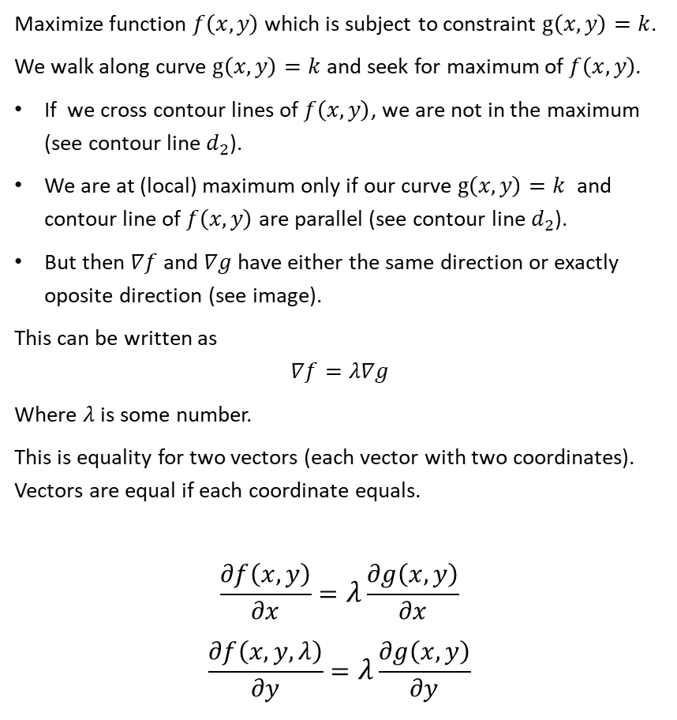
Intuition behind Lagrangian
Maximize function $f\left(x,y\right)$ which is subject to constraint $g\left(x,y\right)=k$.
We walk along curve $g\left(x,y\right)=k$ and seek for maximum of $f\left(x,y\right)$.
If we cross contour lines of $f\left(x,y\right)$, we are not in the maximum (see contour line $d_{2}$).
We are at (local) maximum only if our curve $g\left(x,y\right)=k$ and contour line of $f\left(x,y\right)$ are parallel (see contour line $d_{2}$).
But then $∇f$ and $∇g$ have either the same direction or exactly oposite direction (see image).
This can be written as
$$∇f=λ∇g$$
Where $λ$ is some number.
This is equality for two vectors (each vector with two coordinates). Vectors are equal if each coordinate equals.
$$\frac{∂f\left(x,y\right)}{∂x}=λ\frac{∂g\left(x,y\right)}{∂x}$$
$$\frac{∂f\left(x,y,λ\right)}{∂y}=λ\frac{∂g\left(x,y\right)}{∂y}$$
God bless Wikipedia

Slide 7
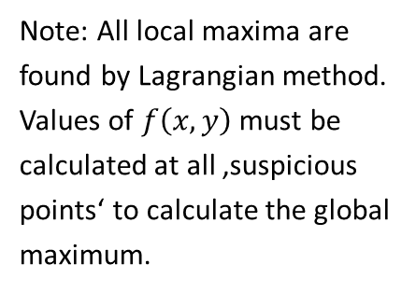
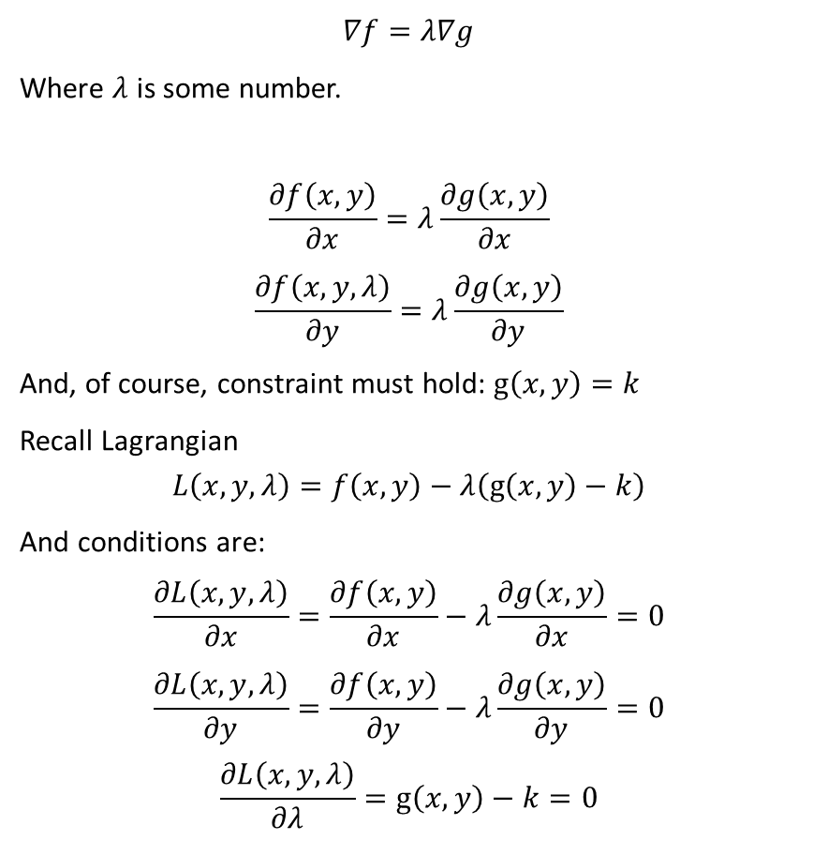
Intuition behind Lagrangian
$$∇f=λ∇g$$
Where $λ$ is some number.
$$\frac{∂f\left(x,y\right)}{∂x}=λ\frac{∂g\left(x,y\right)}{∂x}$$
$$\frac{∂f\left(x,y,λ\right)}{∂y}=λ\frac{∂g\left(x,y\right)}{∂y}$$
And, of course, constraint must hold: $g\left(x,y\right)=k$
Recall Lagrangian
$$L\left(x,y,λ\right)=f\left(x,y\right)−λ\left(g\left(x,y\right)−k\right)$$
And conditions are:
$$\frac{∂L\left(x,y,λ\right)}{∂x}=\frac{∂f\left(x,y\right)}{∂x}−λ\frac{∂g\left(x,y\right)}{∂x}=0$$
$$\frac{∂L\left(x,y,λ\right)}{∂y}=\frac{∂f\left(x,y\right)}{∂y}−λ\frac{∂g\left(x,y\right)}{∂y}=0$$
$$\frac{∂L\left(x,y,λ\right)}{∂λ}=g\left(x,y\right)−k=0$$
These are the same conditions!
Note: All local maxima are found by Lagrangian method. Values of $f\left(x,y\right)$ must be calculated at all ‚suspicious points‘ to calculate the global maximum.

Slide 8

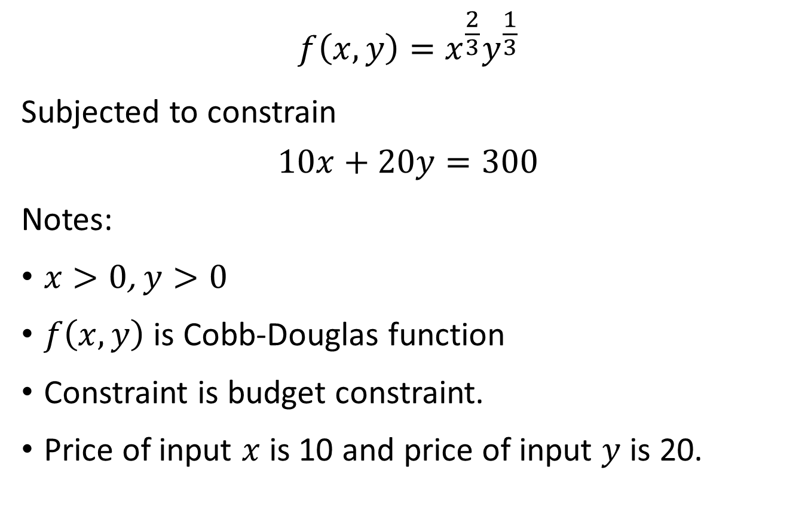
Exercise
$$f\left(x,y\right)=x^{\frac{2}{3}}y^{\frac{1}{3}}$$
Subjected to constrain
$$10x+20y=300$$
Notes:
$x>0$, $y>0$
$f\left(x,y\right)$ is Cobb-Douglas function
Constraint is budget constraint.
Price of input $x$ is 10 and price of input $y$ is 20.
$$f\left(x,y\right)=x^{α}y^{1−α}$$
$$P_{x}x+P_{y}y=k$$
$$\frac{∂f\left(x,y\right)}{∂x}\frac{1}{P_{x}}=λ$$

Slide 9
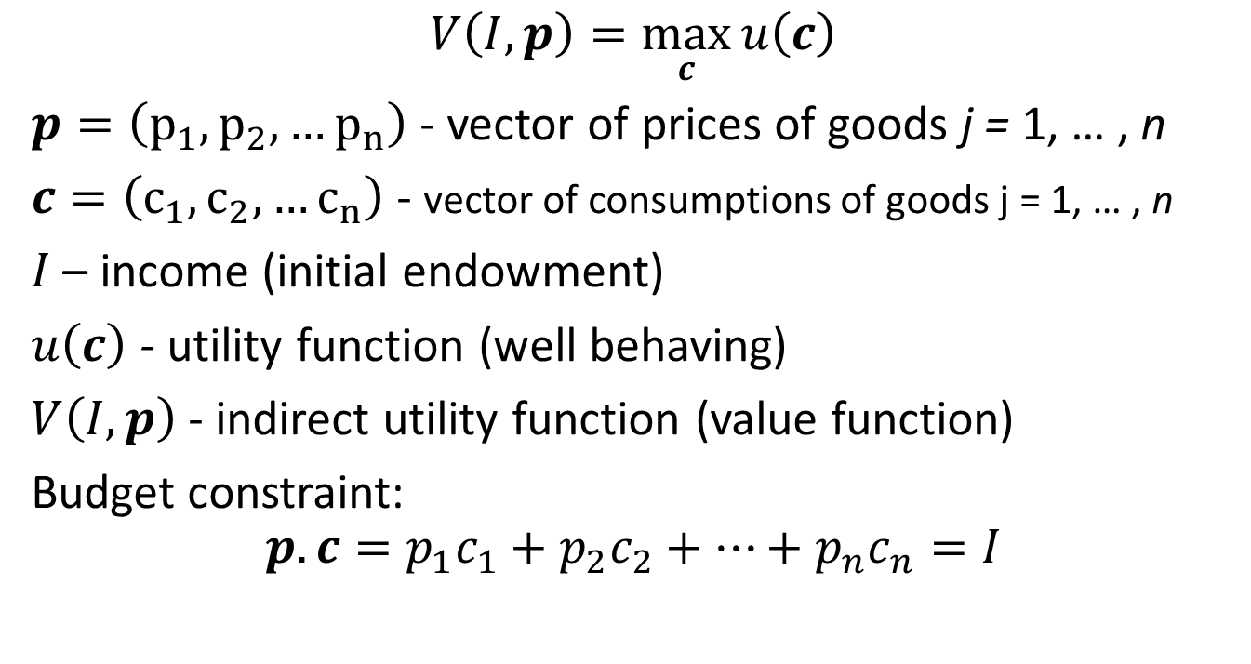
Consumers problem (discrete time)
$$V\left(I,p\right)=\max_{c}{u\left(c\right)}$$
$p=\left(p_{1},p_{2},…p_{n}\right)$ - vector of prices of goods j = 1, … , n
$c=\left(c_{1},c_{2},…c_{n}\right)$ - vector of consumptions of goods j = 1, … , n
$I$ – income (initial endowment)
$u\left(c\right)$ - utility function (well behaving)
$V\left(I,p\right)$ - indirect utility function (value function)
Budget constraint:
$$p.c=p_{1}c_{1}+p_{2}c_{2}+…+p_{n}c_{n}=I$$

Slide 10

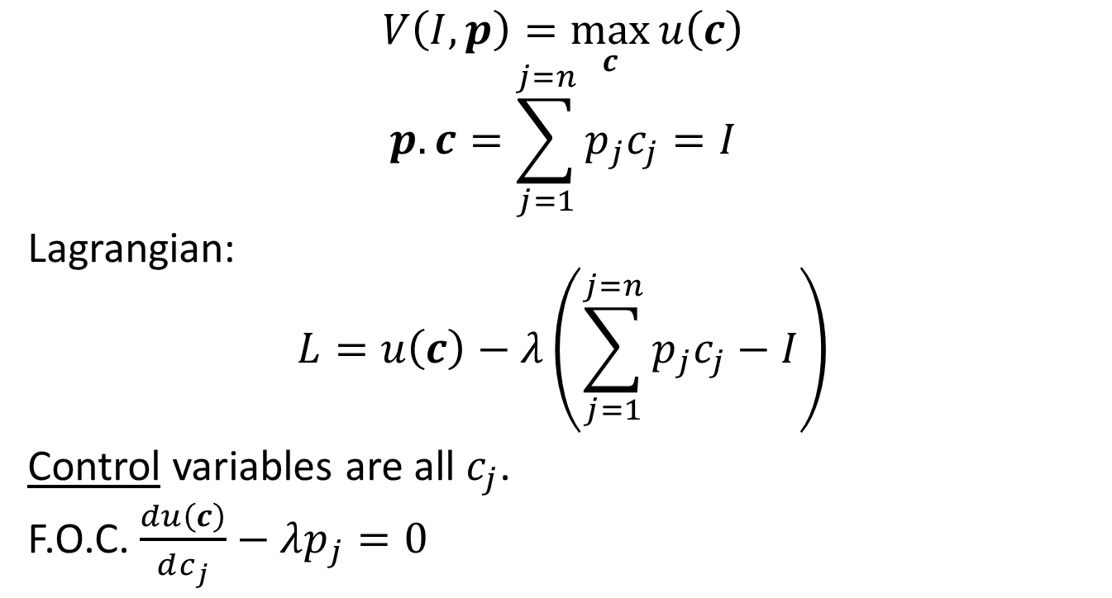
Consumers problem (discrete time)
$$V\left(I,p\right)=\max_{c}{u\left(c\right)}$$
$$p.c=\sum_{j=1}^{j=n}{p_{j}c_{j}}=I$$
Lagrangian:
$$L=u\left(c\right)−λ\left(\sum_{j=1}^{j=n}{p_{j}c_{j}}−I\right)$$
Control variables are all $c_{j}$.
F.O.C. $\frac{du\left(c\right)}{dc_{j}}−λp_{j}=0$
$$\frac{du\left(c\right)}{dc_{j}}\frac{1}{p_{j}}=λ$$

Slide 11
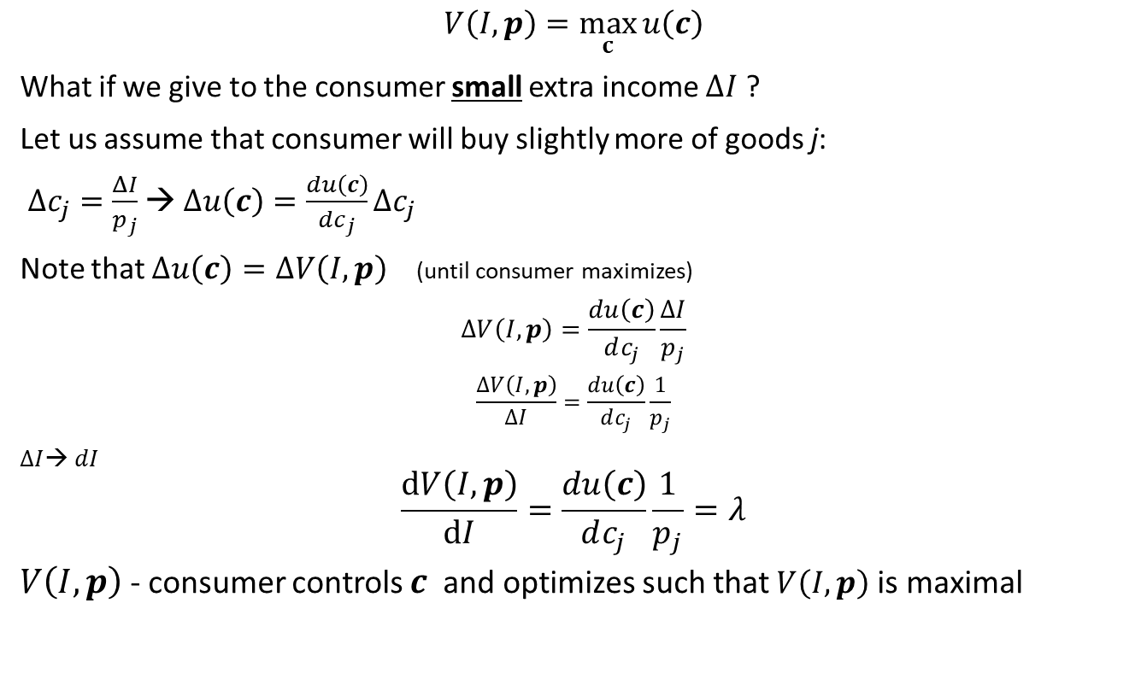

Consumers problem
$$V\left(I,p\right)=\max_{c}{u\left(c\right)}$$
What if we give to the consumer small extra income $ΔI$ ?
Let us assume that consumer will buy slightly more of goods j:
${Δc}_{j}=\frac{ΔI}{p_{j}}$ → $Δu\left(c\right)=\frac{du\left(c\right)}{dc_{j}}{Δc}_{j}$
Note that $Δu\left(c\right)=ΔV\left(I,p\right)$ (until consumer maximizes)
$$ΔV\left(I,p\right)=\frac{du\left(c\right)}{dc_{j}}\frac{ΔI}{p_{j}}$$
$$\frac{ΔV\left(I,p\right)}{ΔI}=\frac{du\left(c\right)}{dc_{j}}\frac{1}{p_{j}}$$
$ΔI$→ $dI$
$$\frac{dV\left(I,p\right)}{dI}=\frac{du\left(c\right)}{dc_{j}}\frac{1}{p_{j}}=λ$$
$V\left(I,p\right)$ - consumer controls $c$ and optimizes such that $V\left(I,p\right)$ is maximal
It does not matter, which good the consumer will buy extra. Buying any of them has the same marginal utility. (Until $ΔI$ is small.)

Slide 12

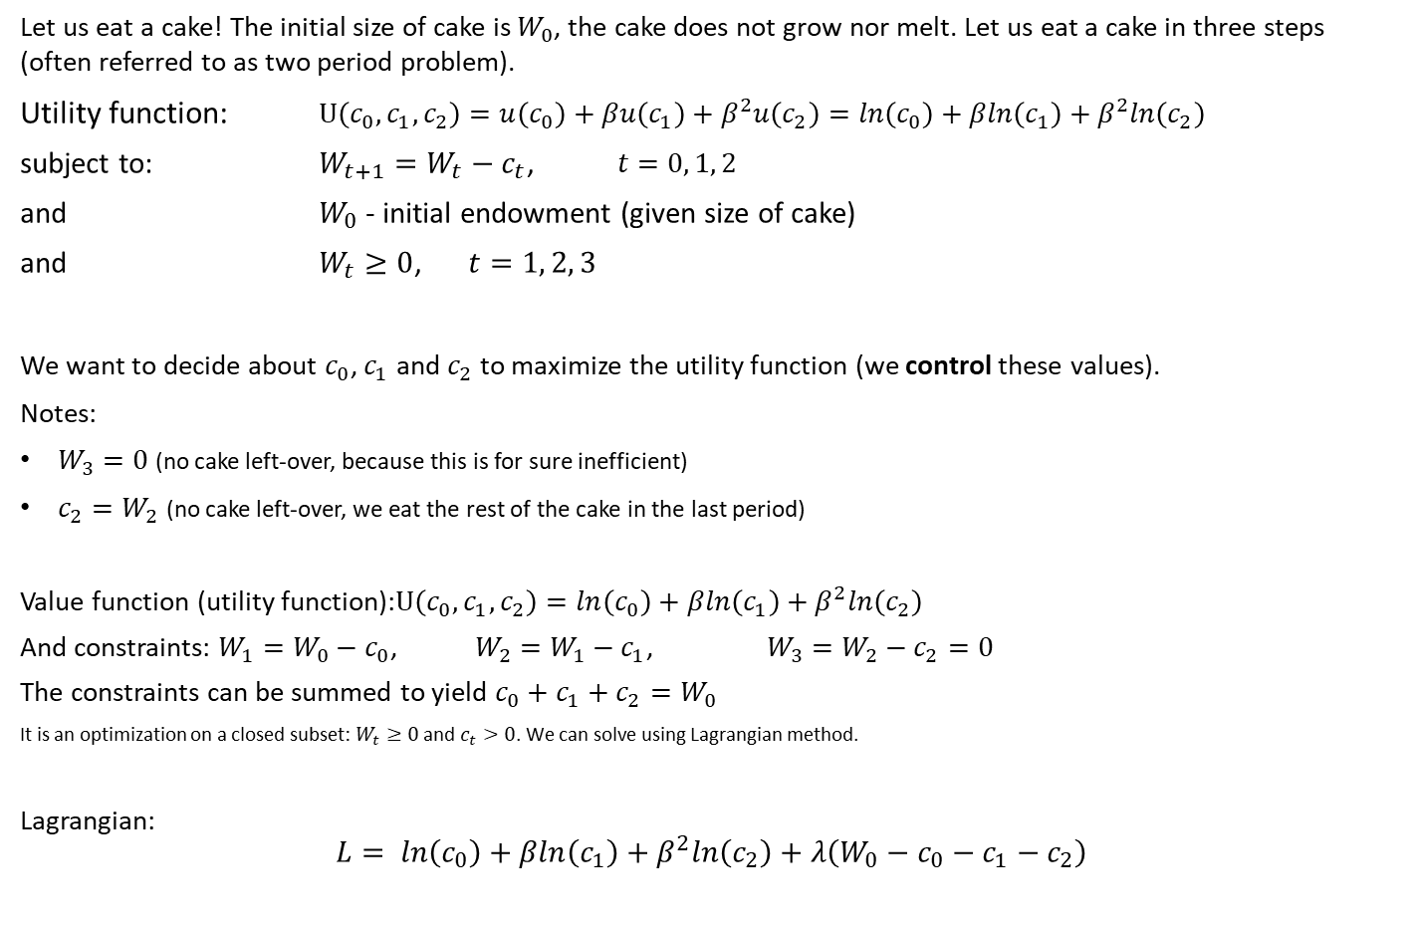
Cake eating – classical (Lagrangian) solution 1
Let us eat a cake! The initial size of cake is $W_{0}$, the cake does not grow nor melt. Let us eat a cake in three steps (often referred to as two period problem).
Utility function: $U\left(c_{0},c_{1}, c_{2}\right)=u\left(c_{0}\right)+βu\left(c_{1}\right)+β^{2}u\left(c_{2}\right)=ln\left(c_{0}\right)+βln\left(c_{1}\right)+β^{2}ln\left(c_{2}\right)$
subject to: $W_{t+1}=W_{t}−c_{t}$, $t=0, 1, 2$
and $W_{0}$ - initial endowment (given size of cake)
and $W_{t}≥0$, $t=1, 2, 3$
We want to decide about $c_{0}$, $c_{1}$ and $c_{2}$ to maximize the utility function (we control these values).
Notes:
$W_{3}=0$ (no cake left-over, because this is for sure inefficient)
$c_{2}=W_{2}$ (no cake left-over, we eat the rest of the cake in the last period)
Value function (utility function):$U\left(c_{0},c_{1}, c_{2}\right)=ln\left(c_{0}\right)+βln\left(c_{1}\right)+β^{2}ln\left(c_{2}\right)$
And constraints: $W_{1}=W_{0}−c_{0}$, $W_{2}=W_{1}−c_{1}$, $W_{3}=W_{2}−c_{2}=0$
The constraints can be summed to yield $c_{0}+c_{1}+c_{2}=W_{0}$
It is an optimization on a closed subset: $W_{t}≥0$ and $c_{t}>0$. We can solve using Lagrangian method.
Lagrangian:
$$L= ln\left(c_{0}\right)+βln\left(c_{1}\right)+β^{2}ln\left(c_{2}\right)+λ\left(W_{0}−c_{0}−c_{1}−c_{2}\right)$$
$$u\left(c_{t}\right)=ln\left(c_{t}\right)$$
$$t=0, 1, 2$$

Slide 13
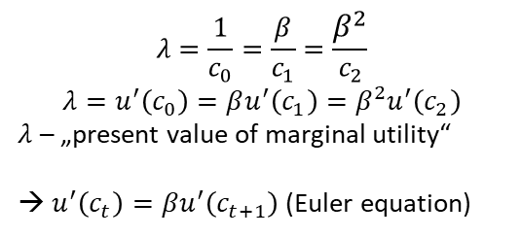

Cake eating – classical (Lagrangian) solution 2
Lagrangian:
$$L= ln\left(c_{0}\right)+βln\left(c_{1}\right)+β^{2}ln\left(c_{2}\right)+λ\left(W_{0}−c_{0}−c_{1}−c_{2}\right)$$
$$\frac{∂L}{∂c_{0}}=\frac{1}{c_{0}}−λ=0$$
$$\frac{∂L}{∂c_{1}}=\frac{β}{c_{1}}−λ=0$$
$$\frac{∂L}{∂c_{2}}=\frac{β^{2}}{c_{2}}−λ=0$$
$$\frac{∂L}{∂λ}=W_{0}−c_{0}−c_{1}−c_{2}=0$$
These are four equations for four uknown variables $c_{0}$, $c_{1}$, $c_{2}$ and $λ$.
Let us solve them:
$$c_{1}=βc_{0}$$
$$c_{2}=β^{2}c_{0}$$
$$W_{0}=c_{0}+βc_{0}+β^{2}c_{0}$$
$$c_{0}=\frac{1}{1+β+β^{2}}W_{0}$$
$$c_{1}=\frac{β}{1+β+β^{2}}W_{0}$$
$$c_{2}=\frac{β^{2}}{1+β+β^{2}}W_{0}$$
$$λ=\frac{1}{c_{0}}=\frac{β}{c_{1}}=\frac{β^{2}}{c_{2}}$$
$$λ=u^{′}\left(c_{0}\right)=βu^{′}\left(c_{1}\right)=β^{2}u^{′}\left(c_{2}\right)$$
$λ$ – „present value of marginal utility“
→ $u^{′}\left(c_{t}\right)=βu^{′}\left(c_{t+1}\right)$(Euler equation)

Slide 14
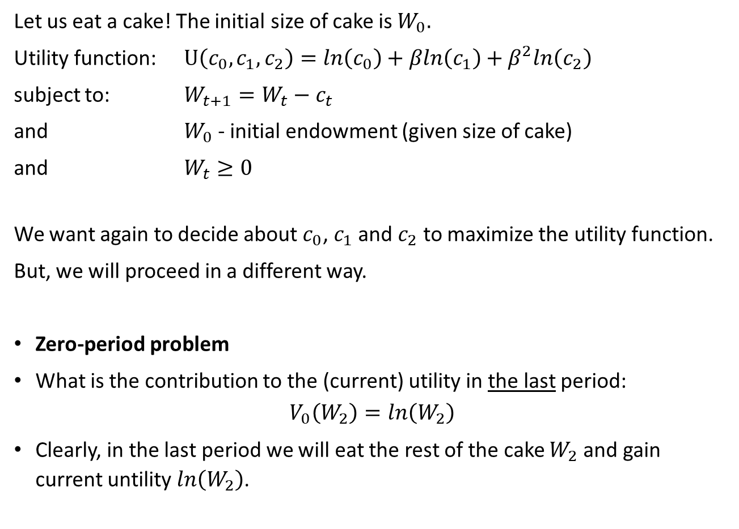
Example: Cake eating, two-period – Belman equation 1
Let us eat a cake! The initial size of cake is $W_{0}.$
Utility function: $U\left(c_{0},c_{1}, c_{2}\right)=ln\left(c_{0}\right)+βln\left(c_{1}\right)+β^{2}ln\left(c_{2}\right)$
subject to: $W_{t+1}=W_{t}−c_{t}$
and $W_{0}$ - initial endowment (given size of cake)
and $W_{t}≥0$
We want again to decide about $c_{0}$, $c_{1}$ and $c_{2}$ to maximize the utility function.
But, we will proceed in a different way.
Zero-period problem
What is the contribution to the (current) utility in the last period:
$$V_{0}\left(W_{2}\right)=ln\left(W_{2}\right)$$
Clearly, in the last period we will eat the rest of the cake $W_{2}$ and gain current untility $ln\left(W_{2}\right)$.

Slide 15
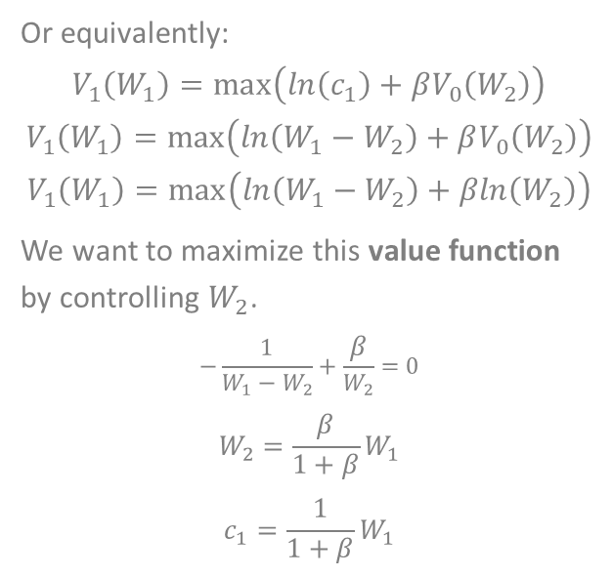
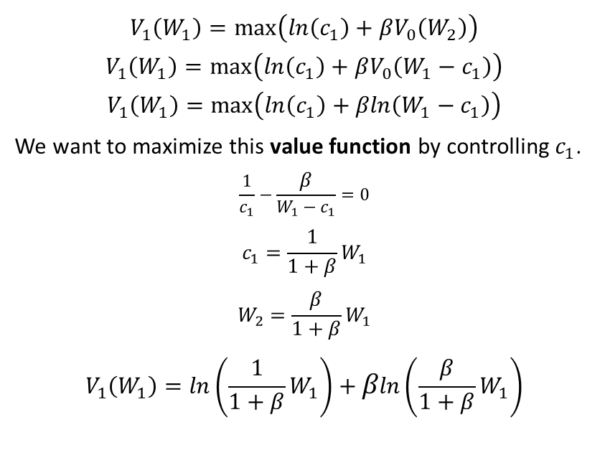

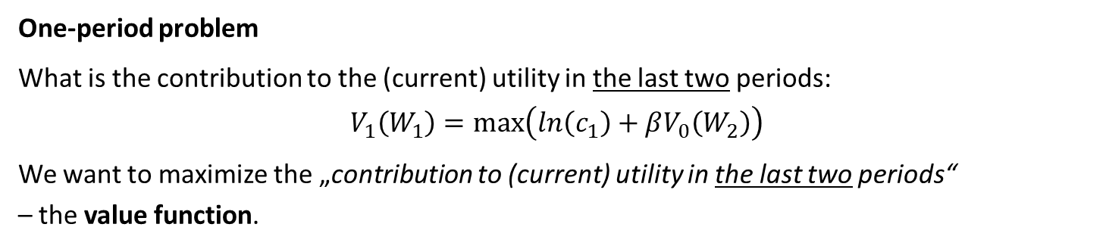
Example: Cake eating, two-period – Belman equation 2
One-period problem
What is the contribution to the (current) utility in the last two periods:
$$V_{1}\left(W_{1}\right)=\max\left(ln\left(c_{1}\right)+βV_{0}\left(W_{2}\right)\right)$$
We want to maximize the „contribution to (current) utility in the last two periods“ – the value function.
$$V_{0}\left(W_{2}\right)=ln\left(W_{2}\right)$$
Or equivalently:
$$V_{1}\left(W_{1}\right)=\max\left(ln\left(c_{1}\right)+βV_{0}\left(W_{2}\right)\right)$$
$$V_{1}\left(W_{1}\right)=\max\left(ln\left(W_{1}−W_{2}\right)+βV_{0}\left(W_{2}\right)\right)$$
$$V_{1}\left(W_{1}\right)=\max\left(ln\left(W_{1}−W_{2}\right)+βln\left(W_{2}\right)\right)$$
We want to maximize this value function by controlling $W_{2}$.
$$−\frac{1}{W_{1}−W_{2}}+\frac{β}{W_{2}}=0$$
$$W_{2}=\frac{β}{1+β}W_{1}$$
$$c_{1}=\frac{1}{1+β}W_{1}$$
$$V_{1}\left(W_{1}\right)=\max\left(ln\left(c_{1}\right)+βV_{0}\left(W_{2}\right)\right)$$
$$V_{1}\left(W_{1}\right)=\max\left(ln\left(c_{1}\right)+βV_{0}\left(W_{1}−c_{1}\right)\right)$$
$$V_{1}\left(W_{1}\right)=\max\left(ln\left(c_{1}\right)+βln\left(W_{1}−c_{1}\right)\right)$$
We want to maximize this value function by controlling $c_{1}$.
$$\frac{1}{c_{1}}−\frac{β}{W_{1}−c_{1}}=0$$
$$c_{1}=\frac{1}{1+β}W_{1}$$
$$W_{2}=\frac{β}{1+β}W_{1}$$
$$V_{1}\left(W_{1}\right)=ln\left(\frac{1}{1+β}W_{1}\right)+βln\left(\frac{β}{1+β}W_{1}\right)$$

Slide 16

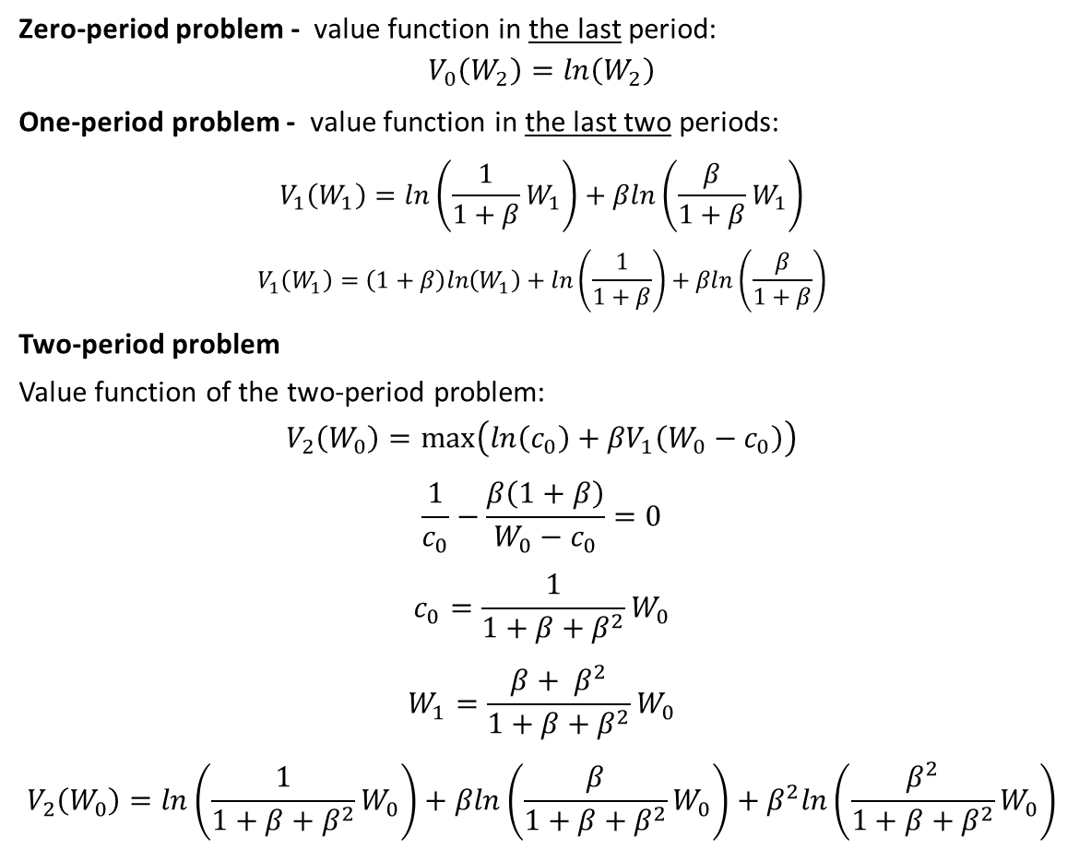
Example: Cake eating, two-period – Belman equation 4
Zero-period problem - value function in the last period:
$$V_{0}\left(W_{2}\right)=ln\left(W_{2}\right)$$
One-period problem - value function in the last two periods:
$$V_{1}\left(W_{1}\right)=ln\left(\frac{1}{1+β}W_{1}\right)+βln\left(\frac{β}{1+β}W_{1}\right)$$
$$V_{1}\left(W_{1}\right)=\left(1+β\right)ln\left(W_{1}\right)+ln\left(\frac{1}{1+β}\right)+βln\left(\frac{β}{1+β}\right)$$
Two-period problem
Value function of the two-period problem:
$$V_{2}\left(W_{0}\right)=\max\left(ln\left(c_{0}\right)+{βV}_{1}\left(W_{0}−c_{0}\right)\right)$$
$$\frac{1}{c_{0}}−\frac{β\left(1+β\right)}{W_{0}−c_{0}}=0$$
$$c_{0}=\frac{1}{1+β+β^{2}}W_{0}$$
$$W_{1}=\frac{{β+ β}^{2}}{1+β+β^{2}}W_{0}$$
$$V_{2}\left(W_{0}\right)=ln\left(\frac{1}{1+β+β^{2}}W_{0}\right)+βln\left(\frac{β}{1+β+β^{2}}W_{0}\right)+β^{2}ln\left(\frac{β^{2}}{1+β+β^{2}}W_{0}\right)$$
$$V_{2}\left(W_{0}\right)=\max\left(ln\left(W_{0}−W_{1}\right)+{βV}_{1}\left(W_{1}\right)\right)$$
$$−\frac{1}{W_{0}−W_{1}}−\frac{β\left(1+β\right)}{W_{1}}=0$$
$$−\frac{1}{W_{0}−W_{1}}−\frac{β\left(1+β\right)}{W_{1}}=0$$
$$W_{1}=\frac{{β+ β}^{2}}{1+β+β^{2}}W_{0}$$

Slide 17

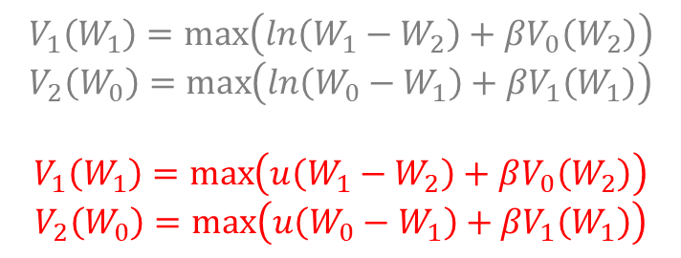
Example: Cake eating, two-period – Belman equation 5
We solved the problem by calculation of value function from zero-period problem.
We found:
$$c_{0}=\frac{1}{1+β+β^{2}}W_{0}$$
$$W_{1}=\frac{{β+ β}^{2}}{1+β+β^{2}}W_{0}$$
$$c_{1}=\frac{1}{1+β}W_{1}$$
$$W_{2}=\frac{β}{1+β}W_{1}$$
$$c_{2}=W_{2}$$
$$W_{3}=0$$
$$V_{1}\left(W_{1}\right)=\max\left(ln\left(W_{1}−W_{2}\right)+βV_{0}\left(W_{2}\right)\right)$$
$$V_{2}\left(W_{0}\right)=\max\left(ln\left(W_{0}−W_{1}\right)+{βV}_{1}\left(W_{1}\right)\right)$$
$$V_{1}\left(W_{1}\right)=\max\left(u\left(W_{1}−W_{2}\right)+βV_{0}\left(W_{2}\right)\right)$$
$$V_{2}\left(W_{0}\right)=\max\left(u\left(W_{0}−W_{1}\right)+{βV}_{1}\left(W_{1}\right)\right)$$

Slide 18
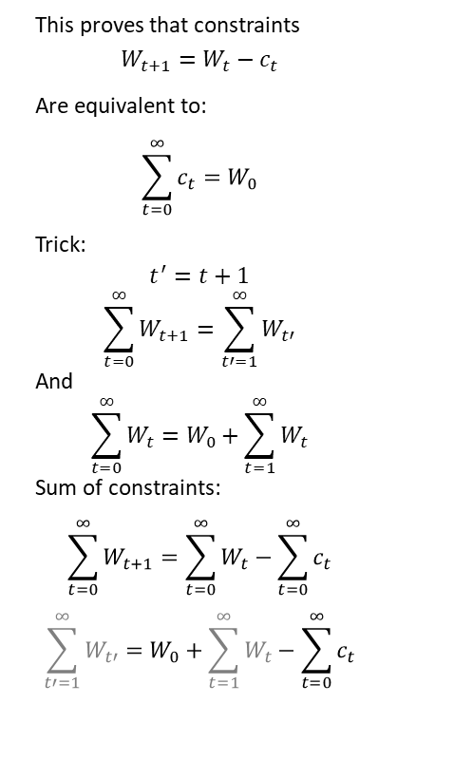
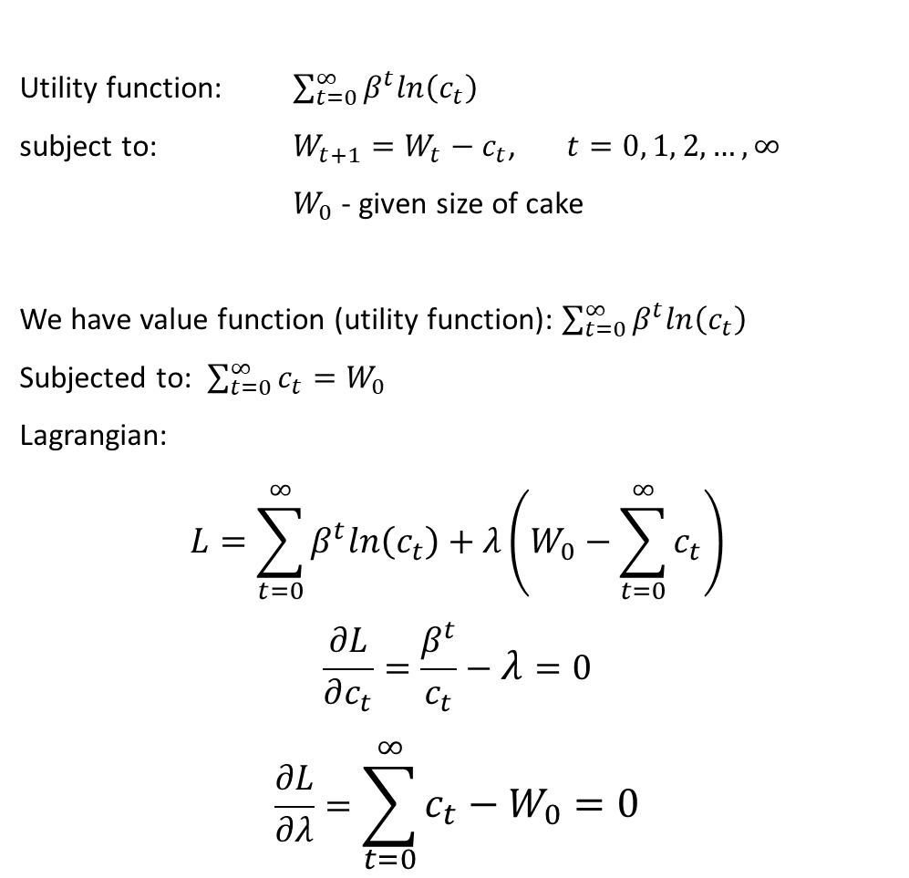
Cake eating, infinite horizon –Lagrangian solution 1
Utility function: $\sum_{t=0}^{∞}{β^{t}ln\left(c_{t}\right)}$
subject to: $W_{t+1}=W_{t}−c_{t}$, $t=0, 1, 2,…, ∞$
$W_{0}$ - given size of cake
We have value function (utility function): $\sum_{t=0}^{∞}{β^{t}ln\left(c_{t}\right)}$
Subjected to: $\sum_{t=0}^{∞}{c_{t}}=W_{0}$
Lagrangian:
$$L=\sum_{t=0}^{∞}{β^{t}ln\left(c_{t}\right)}+λ\left(W_{0}−\sum_{t=0}^{∞}{c_{t}}\right)$$
$$\frac{∂L}{∂c_{t}}=\frac{β^{t}}{c_{t}}−λ=0$$
$$\frac{∂L}{∂λ}=\sum_{t=0}^{∞}{c_{t}}−W_{0}=0$$
This proves that constraints
$$W_{t+1}=W_{t}−c_{t}$$
Are equivalent to:
$$\sum_{t=0}^{∞}{c_{t}}=W_{0}$$
Trick:
$$t^{′}=t+1$$
$$\sum_{t=0}^{∞}{W_{t+1}}=\sum_{t′=1}^{∞}{W_{t′}}$$
And
$$\sum_{t=0}^{∞}{W_{t}}=W_{0}+\sum_{t=1}^{∞}{W_{t}}$$
Sum of constraints:
$$\sum_{t=0}^{∞}{W_{t+1}}=\sum_{t=0}^{∞}{W_{t}}−\sum_{t=0}^{∞}{c_{t}}$$
$$\sum_{t′=1}^{∞}{W_{t′}}=W_{0}+\sum_{t=1}^{∞}{W_{t}}−\sum_{t=0}^{∞}{c_{t}}$$

Slide 19
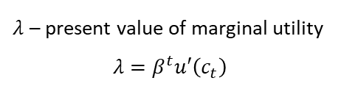

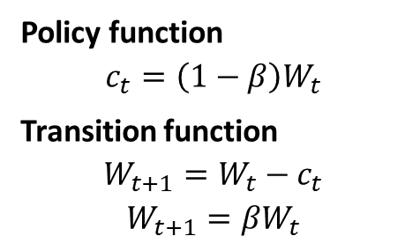
Example: Cake eating, infinite horizon –Lagrangian solution 2
$$\frac{β^{t}}{c_{t}}=λ$$
$$W_{0}=\sum_{t=0}^{∞}{c_{t}}$$
These are $∞$equations for $∞$ unknown variables $c_{0},…,c_{∞}$ and $λ$
For any $t>0$ holds the Euler equation
$\frac{β^{t}}{c_{t}}=\frac{β^{t+1}}{c_{t+1}}=λ$
$$u′\left(c_{t}\right)=βu′\left(c_{t+1}\right)$$
Let us compute:
$\frac{1}{c_{0}}=\frac{β}{c_{1}}$ → $c_{1}=βc_{0}$ → $c_{2}=βc_{1}{=β}^{2}c_{0}$ → $c_{t}=β^{t}c_{0}$
$$\sum_{t=0}^{∞}{c_{t}}=\sum_{t=0}^{∞}{β^{t}c_{0}}=\frac{1}{1−β}c_{0}$$
$$\frac{1}{1−β}c_{0}=W_{0}$$
$$c_{0}=\left(1−β\right)W_{0}$$
It follows then:
$$W_{1}=βW_{0}$$
$$c_{1}=β\left(1−β\right)W_{0}=\left(1−β\right)W_{1}$$
$$W_{2}=βW_{1}$$
…
$λ$ – present value of marginal utility
$$λ=β^{t}u′\left(c_{t}\right)$$
Policy function
$$c_{t}=\left(1−β\right)W_{t}$$
Transition function
$$W_{t+1}=W_{t}−c_{t}$$
$$W_{t+1}={βW}_{t}$$

Slide 20
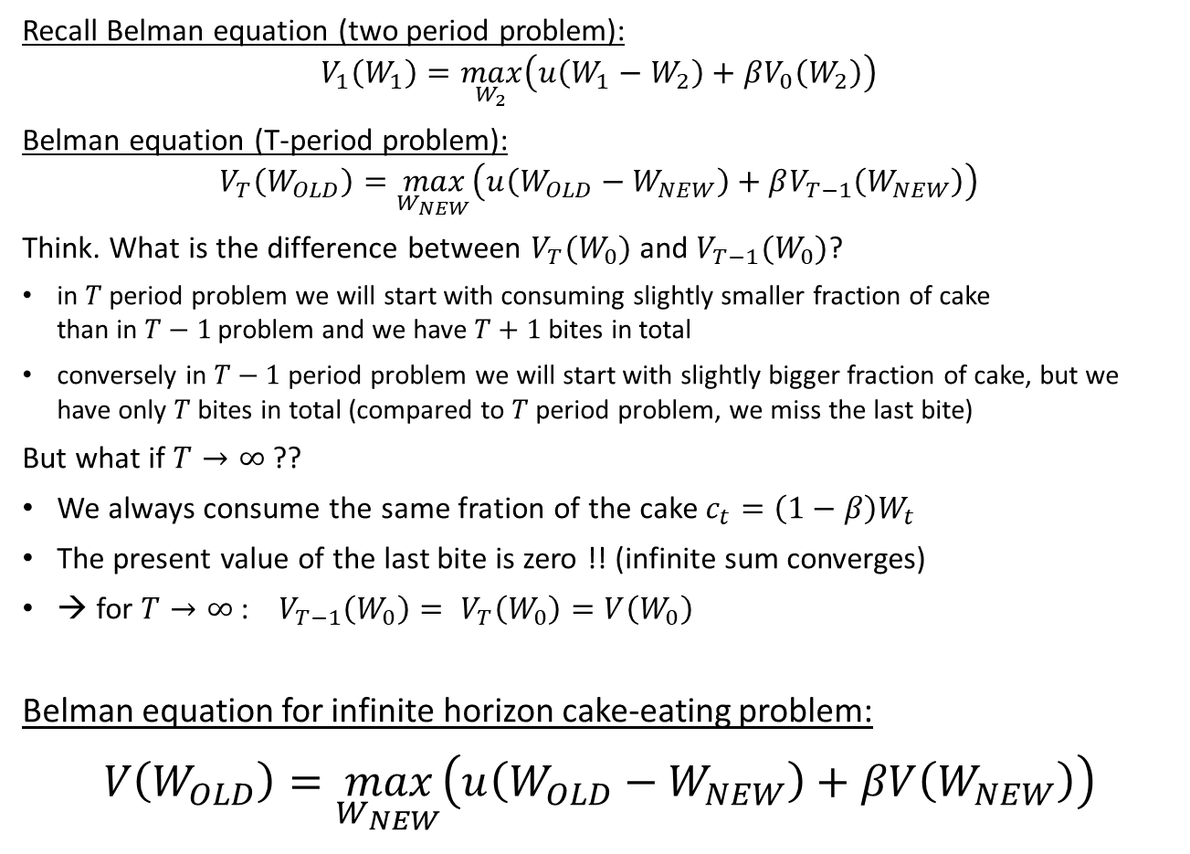
Example: Cake eating, infinite horizon – Belman equation 1
Recall Belman equation (two period problem):
$$V_{1}\left(W_{1}\right)=\max_{W_{2}}\left(u\left(W_{1}−W_{2}\right)+βV_{0}\left(W_{2}\right)\right)$$
Belman equation (T-period problem):
$$V_{T}\left(W_{OLD}\right)=\max_{W_{NEW}}\left(u\left(W_{OLD}−W_{NEW}\right)+βV_{T−1}\left(W_{NEW}\right)\right)$$
Think. What is the difference between $V_{T}(W_{0})$ and $V_{T−1}(W_{0})$?
in $T$ period problem we will start with consuming slightly smaller fraction of cake than in $T−1$problem and we have $T+1$ bites in total
conversely in $T−1$ period problem we will start with slightly bigger fraction of cake, but we have only $T$ bites in total (compared to $T$ period problem, we miss the last bite)
But what if $T→∞$ ??
We always consume the same fration of the cake $c_{t}=\left(1−β\right)W_{t}$
The present value of the last bite is zero !! (infinite sum converges)
→ for $T→∞$ : $V_{T−1}\left(W_{0}\right)= V_{T}\left(W_{0}\right)=V\left(W_{0}\right)$
Belman equation for infinite horizon cake-eating problem:
$$V\left(W_{OLD}\right)=\max_{W_{NEW}}\left(u\left(W_{OLD}−W_{NEW}\right)+βV\left(W_{NEW}\right)\right)$$

Slide 21
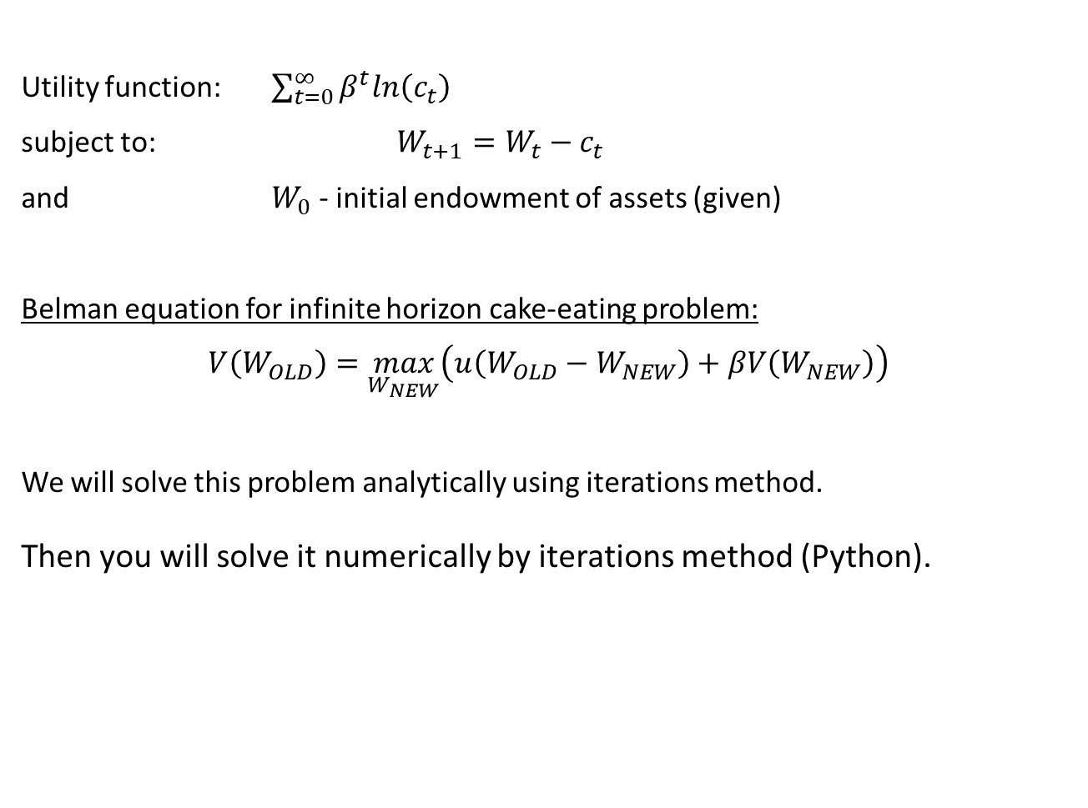
Example: Cake eating, infinite horizon – Belman equation 2
Utility function: $\sum_{t=0}^{∞}{β^{t}ln\left(c_{t}\right)}$
subject to: $W_{t+1}=W_{t}−c_{t}$
and $W_{0}$ - initial endowment of assets (given)
Belman equation for infinite horizon cake-eating problem:
$$V\left(W_{OLD}\right)=\max_{W_{NEW}}\left(u\left(W_{OLD}−W_{NEW}\right)+βV\left(W_{NEW}\right)\right)$$
We will solve this problem analytically using iterations method.
Then you will solve it numerically by iterations method (Python).

Slide 22
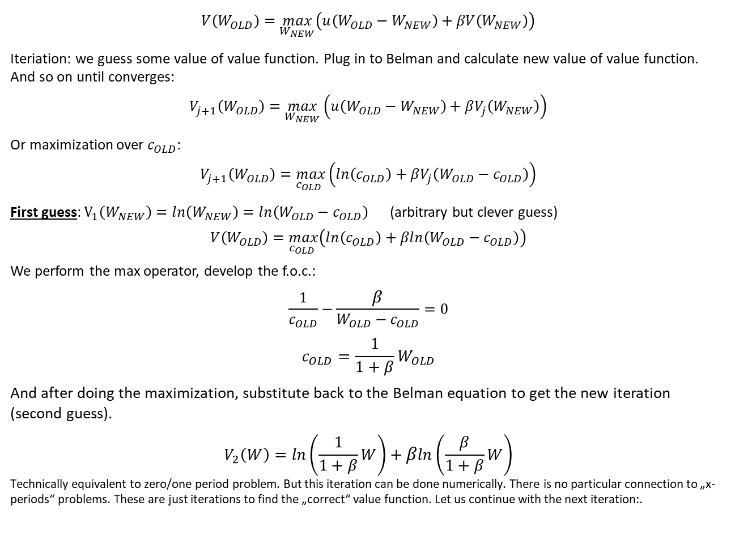
Example: Cake eating, infinite horizon – Iterations 1
$$V\left(W_{OLD}\right)=\max_{W_{NEW}}\left(u\left(W_{OLD}−W_{NEW}\right)+βV\left(W_{NEW}\right)\right)$$
Iteriation: we guess some value of value function. Plug in to Belman and calculate new value of value function. And so on until converges:
$$V_{j+1}\left(W_{OLD}\right)=\max_{W_{NEW}}\left(u\left(W_{OLD}−W_{NEW}\right)+βV_{j}\left(W_{NEW}\right)\right)$$
Or maximization over $c_{OLD}$:
$$V_{j+1}\left(W_{OLD}\right)=\max_{c_{OLD} }\left(ln\left(c_{OLD}\right)+βV_{j}\left(W_{OLD}−c_{OLD}\right)\right)$$
First guess: $V_{1}\left(W_{NEW}\right)=ln\left(W_{NEW}\right)=ln\left(W_{OLD}−c_{OLD}\right)$ (arbitrary but clever guess)
$$V\left(W_{OLD}\right)=\max_{c_{OLD} }\left(ln\left(c_{OLD}\right)+βln\left(W_{OLD}−c_{OLD}\right)\right)$$
We perform the max operator, develop the f.o.c.:
$$\frac{1}{c_{OLD}}−\frac{β}{W_{OLD}−c_{OLD}}=0$$
$$c_{OLD}=\frac{1}{1+β}W_{OLD}$$
And after doing the maximization, substitute back to the Belman equation to get the new iteration (second guess).
$$V_{2}\left(W\right)=ln\left(\frac{1}{1+β}W\right)+βln\left(\frac{β}{1+β}W\right)$$
Technically equivalent to zero/one period problem. But this iteration can be done numerically. There is no particular connection to „x-periods“ problems. These are just iterations to find the „correct“ value function. Let us continue with the next iteration:.

Slide 23
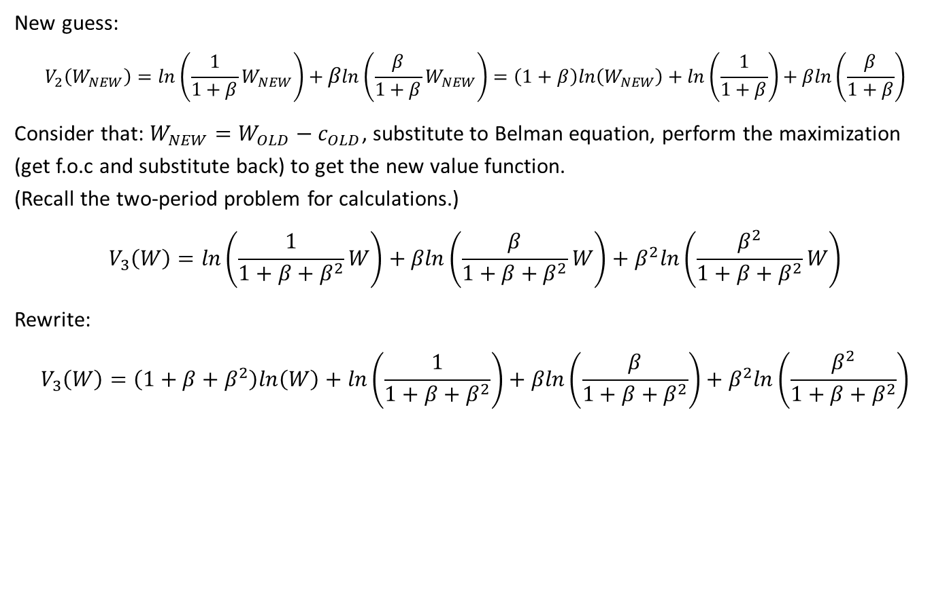
Example: Cake eating, infinite horizon – Iterations 2
New guess:
$$V_{2}\left(W_{NEW}\right)=ln\left(\frac{1}{1+β}W_{NEW}\right)+βln\left(\frac{β}{1+β}W_{NEW}\right)=\left(1+β\right)ln\left(W_{NEW}\right)+ln\left(\frac{1}{1+β}\right)+βln\left(\frac{β}{1+β}\right)$$
Consider that: $W_{NEW}=W_{OLD}−c_{OLD}$, substitute to Belman equation, perform the maximization (get f.o.c and substitute back) to get the new value function. (Recall the two-period problem for calculations.)
$$V_{3}\left(W\right)=ln\left(\frac{1}{1+β+β^{2}}W\right)+βln\left(\frac{β}{1+β+β^{2}}W\right)+β^{2}ln\left(\frac{β^{2}}{1+β+β^{2}}W\right)$$
Rewrite:
$$V_{3}\left(W\right)=\left(1+β+β^{2}\right)ln\left(W\right)+ln\left(\frac{1}{1+β+β^{2}}\right)+βln\left(\frac{β}{1+β+β^{2}}\right)+β^{2}ln\left(\frac{β^{2}}{1+β+β^{2}}\right)$$

Slide 24
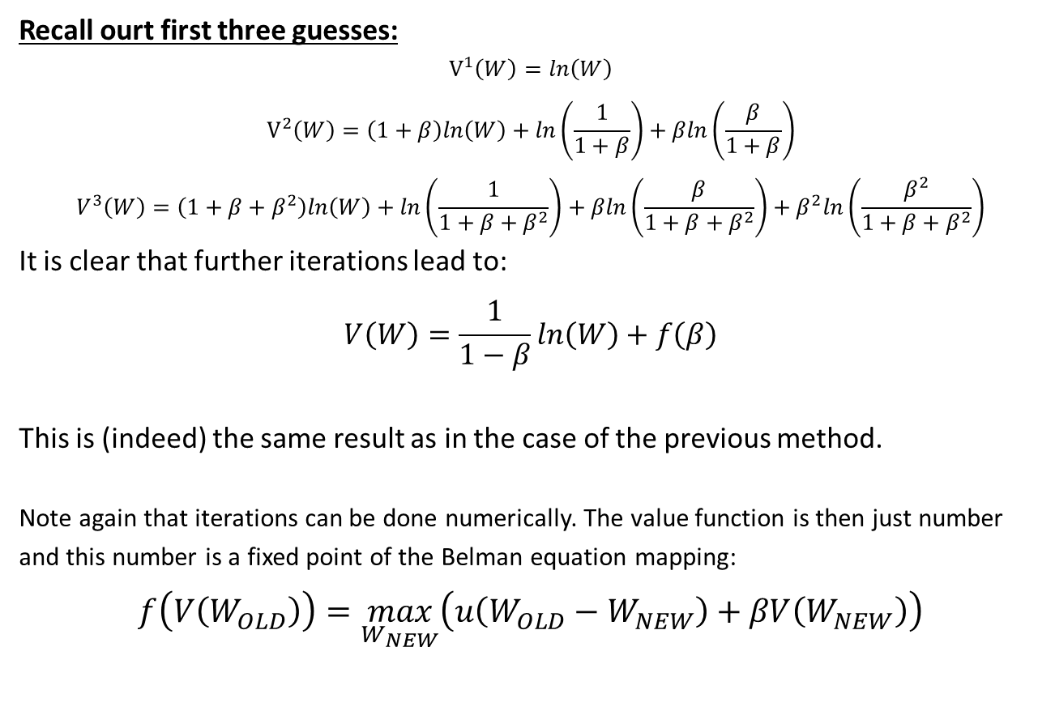
Example: Cake eating, infinite horizon – Iterations 3
Recall ourt first three guesses:
$$V^{1}\left(W\right)=ln\left(W\right)$$
$$V^{2}\left(W\right)=\left(1+β\right)ln\left(W\right)+ln\left(\frac{1}{1+β}\right)+βln\left(\frac{β}{1+β}\right)$$
$$V^{3}\left(W\right)=\left(1+β+β^{2}\right)ln\left(W\right)+ln\left(\frac{1}{1+β+β^{2}}\right)+βln\left(\frac{β}{1+β+β^{2}}\right)+β^{2}ln\left(\frac{β^{2}}{1+β+β^{2}}\right)$$
It is clear that further iterations lead to:
$$V\left(W\right)=\frac{1}{1−β}ln\left(W\right)+f\left(β\right)$$
This is (indeed) the same result as in the case of the previous method.
Note again that iterations can be done numerically. The value function is then just number and this number is a fixed point of the Belman equation mapping:
$$f\left(V\left(W_{OLD}\right)\right)=\max_{W_{NEW}}\left(u\left(W_{OLD}−W_{NEW}\right)+βV\left(W_{NEW}\right)\right)$$

Slide 25
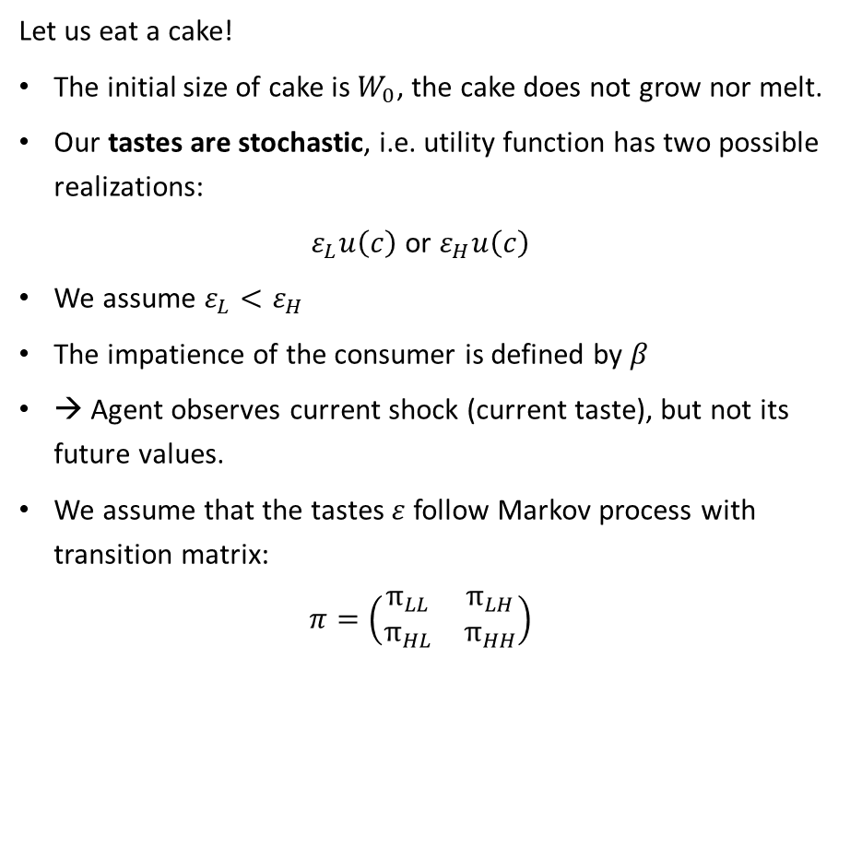
Discrete stochastic cake-eating problem – assumptions
Let us eat a cake!
The initial size of cake is $W_{0}$, the cake does not grow nor melt.
Our tastes are stochastic, i.e. utility function has two possible realizations:
$ε_{L}u\left(c\right)$ or $ε_{H}u\left(c\right)$
We assume $ε_{L}<ε_{H}$
The impatience of the consumer is defined by $β$
→ Agent observes current shock (current taste), but not its future values.
We assume that the tastes $ε$ follow Markov process with transition matrix:
$$π=\left(\begin{matrix}π_{LL} & π_{LH} \\ π_{HL} & π_{HH}\end{matrix}\right)$$
http://www.eco.uc3m.es/~jrincon/Teaching/Master/SDDP.pdf

Slide 26
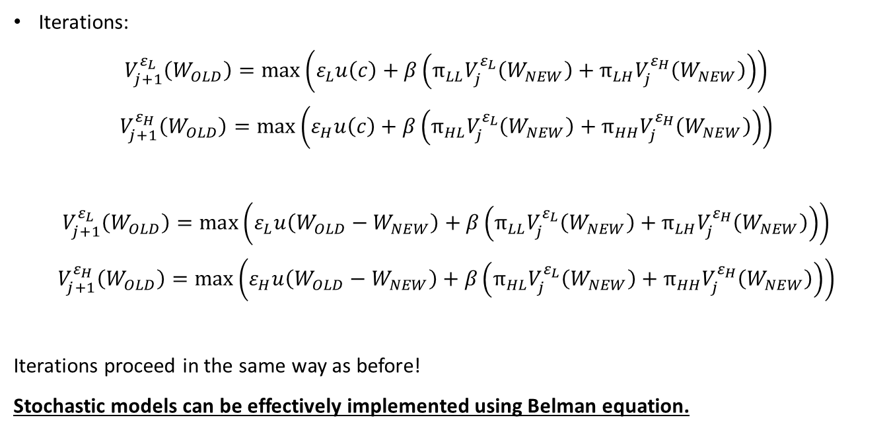
Discrete stochastic cake-eating problem – iterations
Iterations:
$$V_{j+1}^{ε_{L}}\left(W_{OLD}\right)=\max\left(ε_{L}u\left(c\right)+β\left(π_{LL}V_{j}^{ε_{L}}\left(W_{NEW}\right)+π_{LH}V_{j}^{ε_{H}}\left(W_{NEW}\right)\right)\right)$$
$$V_{j+1}^{ε_{H}}\left(W_{OLD}\right)=\max\left(ε_{H}u\left(c\right)+β\left(π_{HL}V_{j}^{ε_{L}}\left(W_{NEW}\right)+π_{HH}V_{j}^{ε_{H}}\left(W_{NEW}\right)\right)\right)$$
$$V_{j+1}^{ε_{L}}\left(W_{OLD}\right)=\max\left(ε_{L}u\left({W_{OLD}−W}_{NEW}\right)+β\left(π_{LL}V_{j}^{ε_{L}}\left(W_{NEW}\right)+π_{LH}V_{j}^{ε_{H}}\left(W_{NEW}\right)\right)\right)$$
$$V_{j+1}^{ε_{H}}\left(W_{OLD}\right)=\max\left(ε_{H}u\left({W_{OLD}−W}_{NEW}\right)+β\left(π_{HL}V_{j}^{ε_{L}}\left(W_{NEW}\right)+π_{HH}V_{j}^{ε_{H}}\left(W_{NEW}\right)\right)\right)$$
Iterations proceed in the same way as before!
Stochastic models can be effectively implemented using Belman equation.

Slide 27
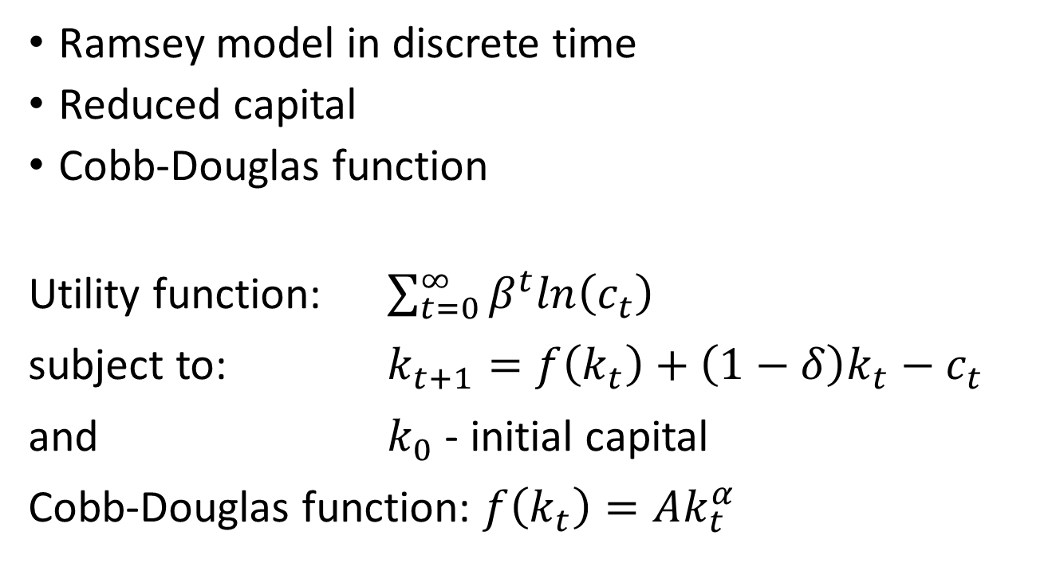
Ramsey model by Belman
Ramsey model in discrete time
Reduced capital
Cobb-Douglas function
Utility function: $\sum_{t=0}^{∞}{β^{t}ln\left(c_{t}\right)}$
subject to: $k_{t+1}=f\left(k_{t}\right)+\left(1−δ\right)k_{t}−c_{t}$
and $k_{0}$ - initial capital
Cobb-Douglas function: $f\left(k_{t}\right)=Ak_{t}^{α}$

Slide 28
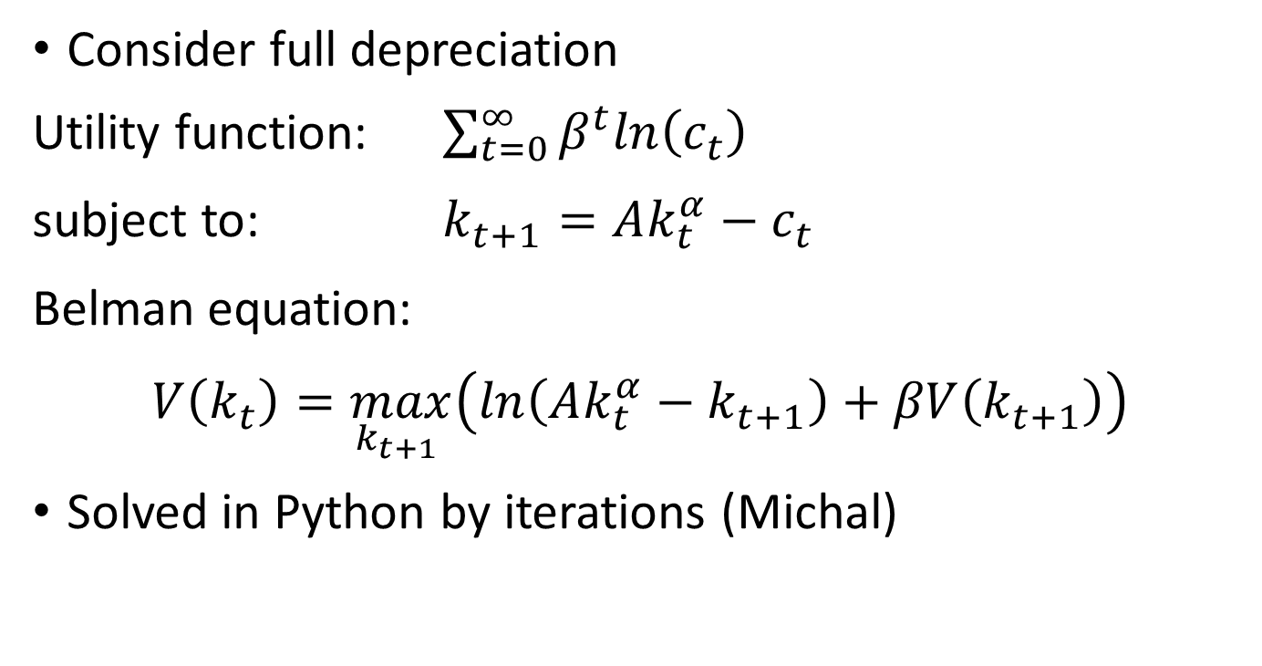
Ramsey model by Belman
Consider full depreciation
Utility function: $\sum_{t=0}^{∞}{β^{t}ln\left(c_{t}\right)}$
subject to: $k_{t+1}=Ak_{t}^{α}−c_{t}$
Belman equation:
$$V\left(k_{t}\right)=\max_{k_{t+1} }\left(ln\left({Ak_{t}^{α}−k}_{t+1}\right)+βV\left(k_{t+1}\right)\right)$$
Solved in Python by iterations (Michal)

Slide 29
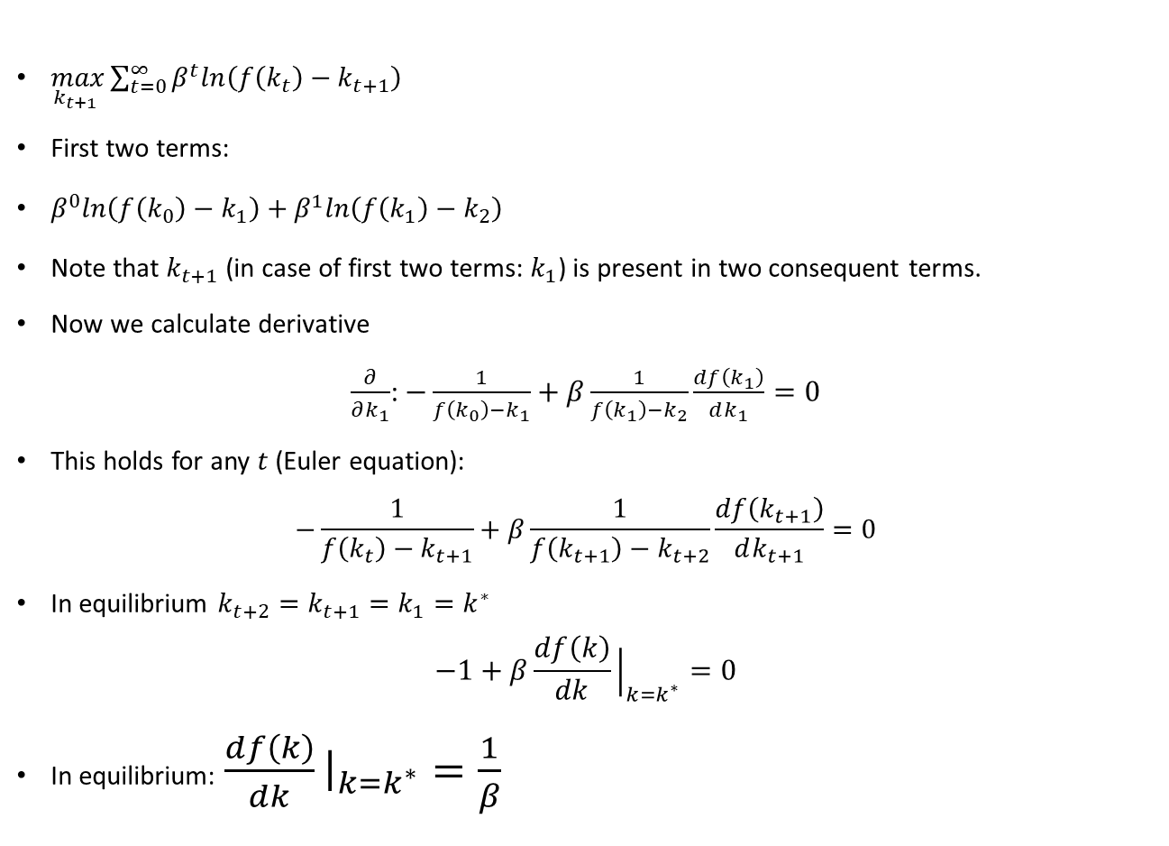
Equilibrium
$\max_{k_{t+1} }\sum_{t=0}^{∞}{β^{t}ln\left(f\left(k_{t}\right)−k_{t+1}\right)}$
First two terms:
$β^{0}ln\left(f\left(k_{0}\right)−k_{1}\right)+β^{1}ln\left(f\left(k_{1}\right)−k_{2}\right)$
Note that $k_{t+1}$ (in case of first two terms: $k_{1}$) is present in two consequent terms.
Now we calculate derivative
$\frac{∂}{∂k_{1}}$: $−\frac{1}{f\left(k_{0}\right)−k_{1}}+β\frac{1}{f\left(k_{1}\right)−k_{2}}\frac{df\left(k_{1}\right)}{dk_{1}}=0$
This holds for any $t$ (Euler equation):
$$−\frac{1}{f\left(k_{t}\right)−k_{t+1}}+β\frac{1}{f\left(k_{t+1}\right)−k_{t+2}}\frac{df\left(k_{t+1}\right)}{dk_{t+1}}=0$$
In equilibrium $k_{t+2}=k_{t+1}=k_{1}=k^{∗}$
$$−1+β\frac{df\left(k\right)}{dk}{\left.​\right|}_{k=k^{∗}}=0$$
In equilibrium: $\frac{df\left(k\right)}{dk}{\left.​\right|}_{k=k^{∗}}=\frac{1}{β}$

