Slide 1
Nonlinear Dynamics, Chaos and Bifurcations
Jaromír Baxa & Josef Stráský
2015

Slide 2
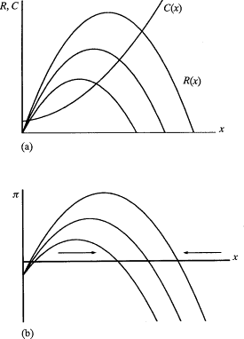
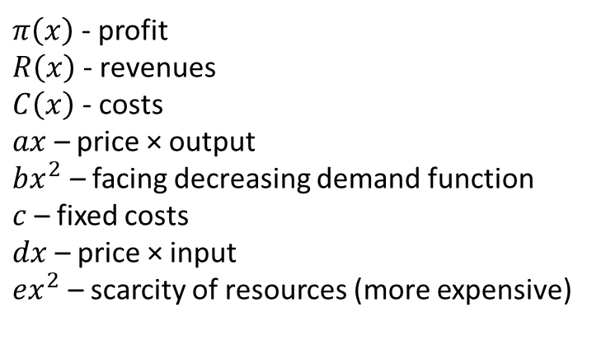
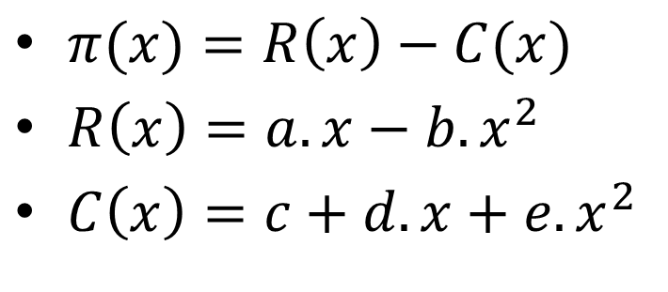
Simple economic non-linear problem
$π(x)=R\left(x\right)−C(x)$
$R\left(x\right)=a.x−b.x^{2}$
$C\left(x\right)=c+d.x+e.x^{2}$
$π\left(x\right)$ - profit
$R\left(x\right)$ - revenues
$C\left(x\right)$ - costs
$ax$ – price × output
$bx^{2}$ – facing decreasing demand function
$c$ – fixed costs
$dx$ – price × input
$ex^{2}$ – scarcity of resources (more expensive)

Slide 3
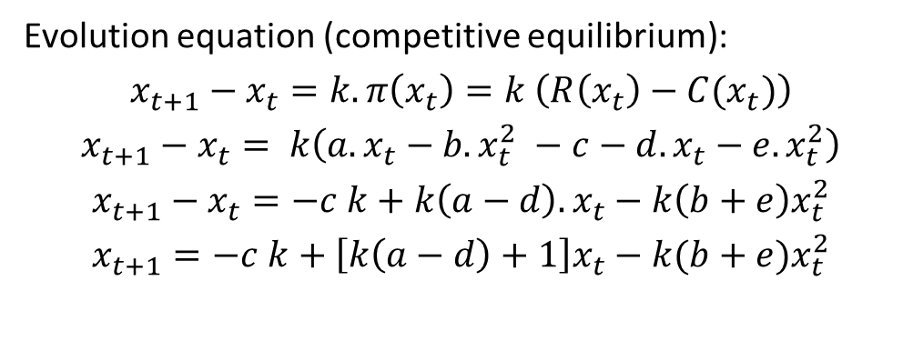
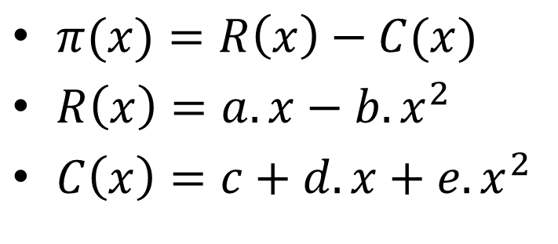
Simple economic non-linear problem
$π(x)=R\left(x\right)−C(x)$
$R\left(x\right)=a.x−b.x^{2}$
$C\left(x\right)=c+d.x+e.x^{2}$
Evolution equation (competitive equilibrium):
$x_{t+1}−x_{t}=k. π\left(x_{t}\right)=k$ $\left(R\left(x_{t}\right)−C(x_{t})\right)$
$$x_{t+1}−x_{t}= k\left(a.x_{t}−b.x_{t}^{2} −c−d.x_{t}−e.x_{t}^{2}\right)$$
$$x_{t+1}−x_{t}=−c k+k\left(a−d\right).x_{t}−k\left(b+e\right)x_{t}^{2}$$
$$x_{t+1}=−c k+\left[k\left(a−d\right)+1\right]x_{t}−k(b+e)x_{t}^{2}$$

Slide 4
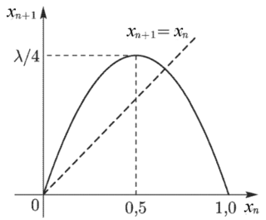


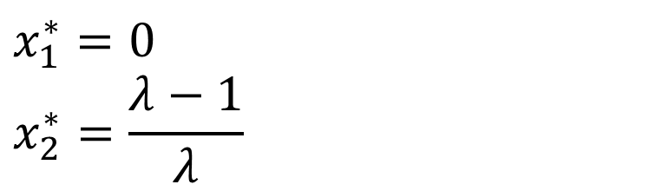
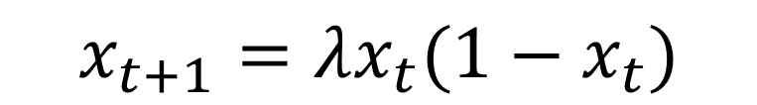
Simple economic non-linear problem
$$x_{t+1}=−c.k+(k.a−k.d+1).x_{t}−k(b+e)x_{t}^{2}$$
$$x_{t+1}=A+Bx_{t}−Cx_{t}^{2}$$
This is the reccurence logistic equation (logistic map)
$$x_{t+1}=λx_{t}(1−x_{t})$$
$$x_{t+1}=λx_{t}−λx_{t}^{2}$$
$$x_{1}^{∗}=0$$
$$x_{2}^{∗}=\frac{λ−1}{λ}$$

Slide 5
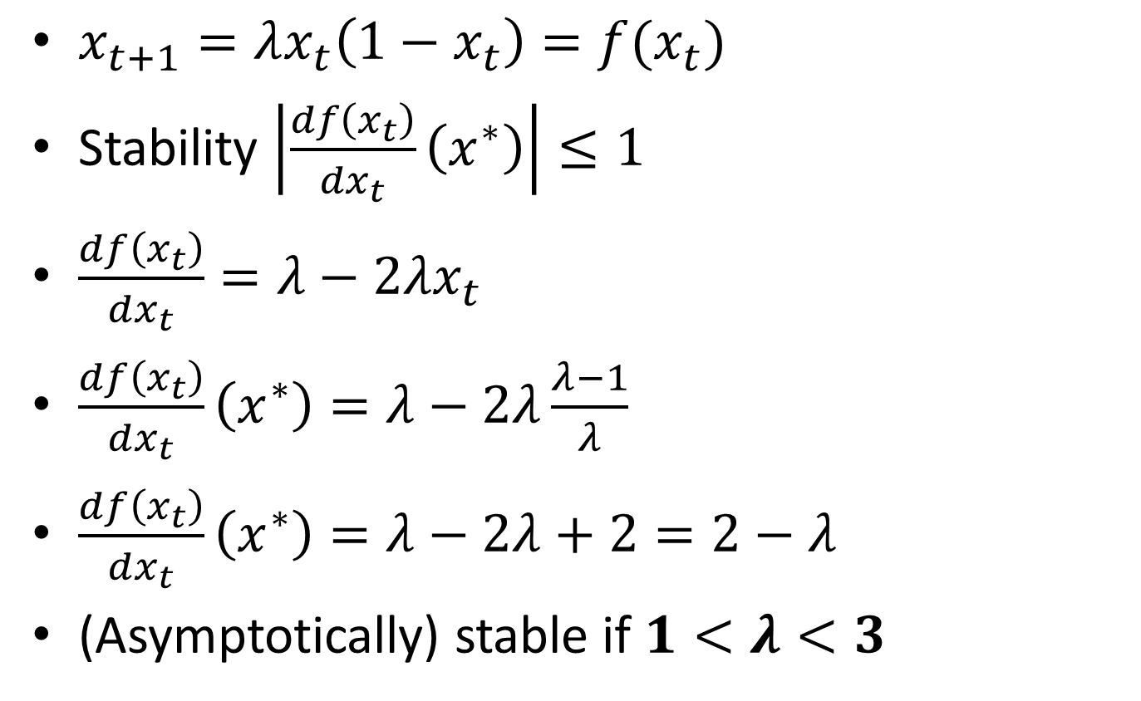


Logistic reccurence
$$x_{t+1}=λx_{t}−λx_{t}^{2}$$
$$x_{2}^{∗}=\frac{λ−1}{λ}$$
$x_{t+1}=λx_{t}\left(1−x_{t}\right)=f(x_{t})$
Stability $\left|\frac{df\left(x_{t}\right)}{dx_{t}}\left(x^{∗}\right)\right|≤1$
$\frac{df\left(x_{t}\right)}{dx_{t}}=λ−2λx_{t}$
$\frac{df\left(x_{t}\right)}{dx_{t}}\left(x^{∗}\right)=λ−2λ\frac{λ−1}{λ}$
$\frac{df\left(x_{t}\right)}{dx_{t}}\left(x^{∗}\right)=λ−2λ+2=2−λ$
(Asymptotically) stable if $1<λ<3$

Slide 6
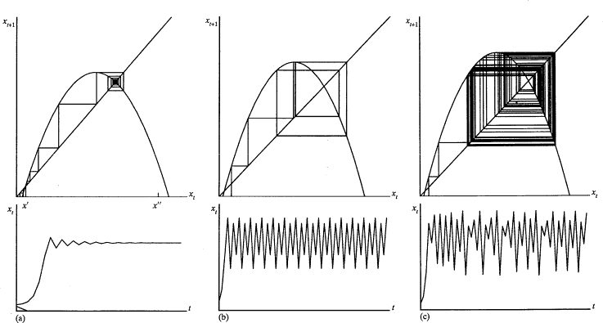
Logistic reccurence
Figure 2.2 from Richard H. Day (1994): Complex Economic Dynamics

Slide 7
Logistic reccurence
"LogisticCobwebChaos" by Sam Derbyshire at the English language Wikipedia. Licensed under CC BY-SA 3.0 via Commons - https://commons.wikimedia.org/wiki/File:LogisticCobwebChaos.gif#/media/File:LogisticCobwebChaos.gif

Slide 8
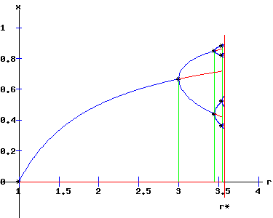
Road to bifurcation diagram
http://www.egwald.ca/nonlineardynamics/logisticsmapchaos.php

Slide 9
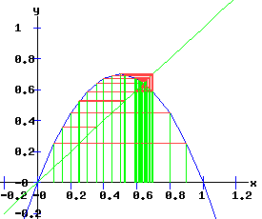
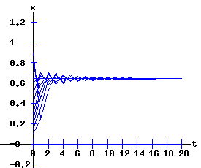
Road to bifurcation diagram
λ = 2.8
Different initial conditions
All converge to stable equilibrium (attractor)
http://www.egwald.ca/nonlineardynamics/logisticsmapchaos.php

Slide 10
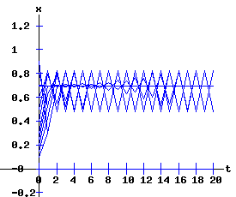
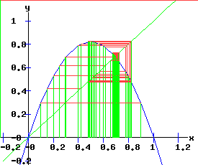
Road to bifurcation diagram
λ = 3.3
Different initial conditions
Equilibrium is repellor (!)
All ‘converge‘ to two-limit cycle
http://www.egwald.ca/nonlineardynamics/logisticsmapchaos.php

Slide 11
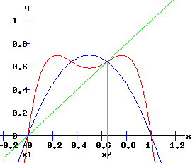
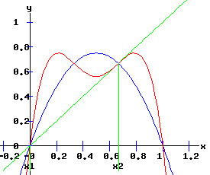
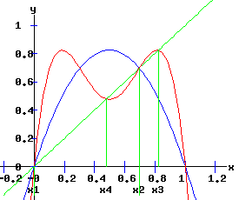
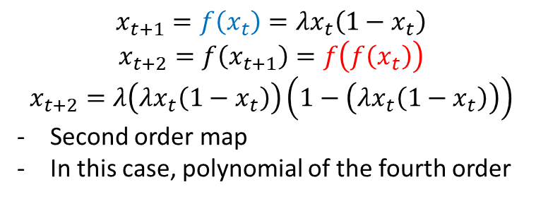
Road to bifurcation diagram
λ = 2.8
λ= 3
λ = 3.3
λ=2
Bifurcation (for λ=3)
$$x_{t+1}=f\left(x_{t}\right)=λx_{t}\left(1−x_{t}\right)$$
$$x_{t+2}=f\left(x_{t+1}\right)=f\left(f\left(x_{t}\right)\right)$$
$$x_{t+2}=λ\left(λx_{t}\left(1−x_{t}\right)\right)\left(1−\left(λx_{t}\left(1−x_{t}\right)\right)\right)$$
Second order map
In this case, polynomial of the fourth order
λ = 3.3
Different initial conditions
Equilibrium is repellor (!)
But ‘ equiilibria‘ of the second order map are stable
→ two-limit cycle
http://www.egwald.ca/nonlineardynamics/logisticsmapchaos.php

Slide 12
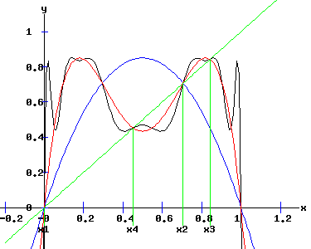
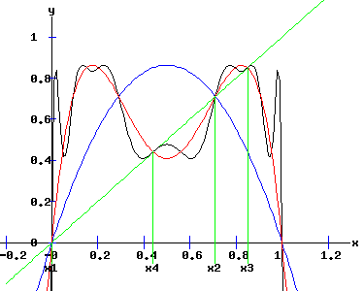
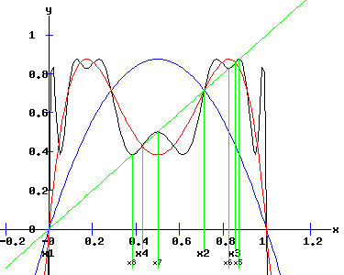
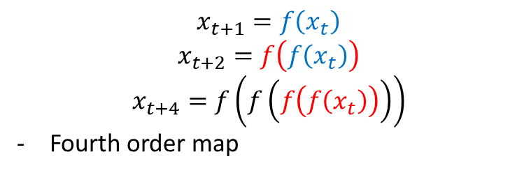
Road to bifurcation diagram
λ = 3.4
λ= 3.449
λ = 3.5
Bifurcation (for λ=3.449)
$$x_{t+1}=f\left(x_{t}\right)$$
$$x_{t+2}=f\left(f\left(x_{t}\right)\right)$$
$$x_{t+4}=f\left(f\left(f\left(f\left(x_{t}\right)\right)\right)\right)$$
Fourth order map
λ = 3.5
Equilibrium is repellor
‘Equiilibria‘ of the second order map are also repellors
But ‘equiilibria‘ of the fourth order map are stable
→ four-limit cycle
http://www.egwald.ca/nonlineardynamics/logisticsmapchaos.php

Slide 13
Road to bifurcation diagram
http://www.egwald.ca/nonlineardynamics/logisticsmapchaos.php

Slide 14
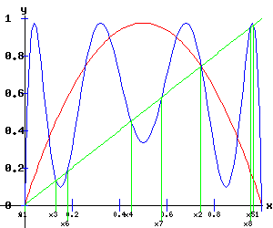
Road to bifurcation diagram
λ= 3.9
λ = 3.9
Equilibria of all orders are unstable (repellors)
→ chaotic behavior
http://www.egwald.ca/nonlineardynamics/logisticsmapchaos.php

Slide 15
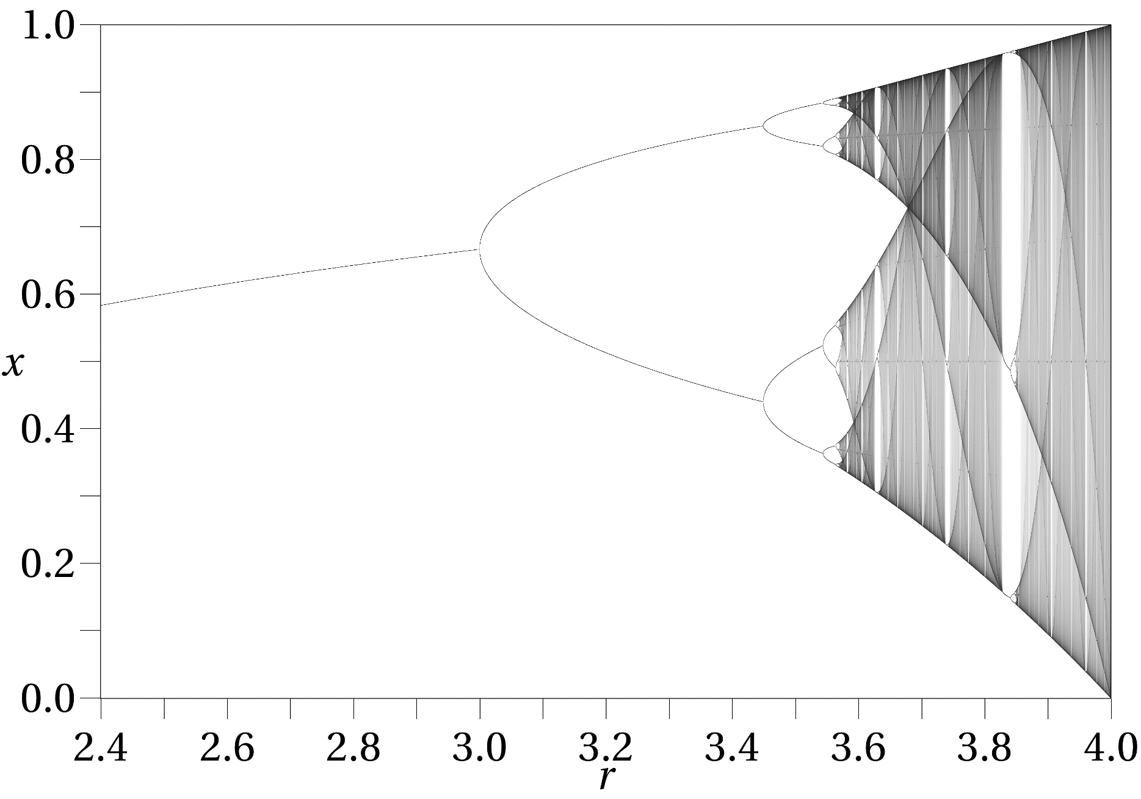
Bifurcation diagram
λ

