Slide 1
Recent differences in our difference-in-differences
Mitch Downey, IIES
mitch.downey@iies.su.se

Slide 2
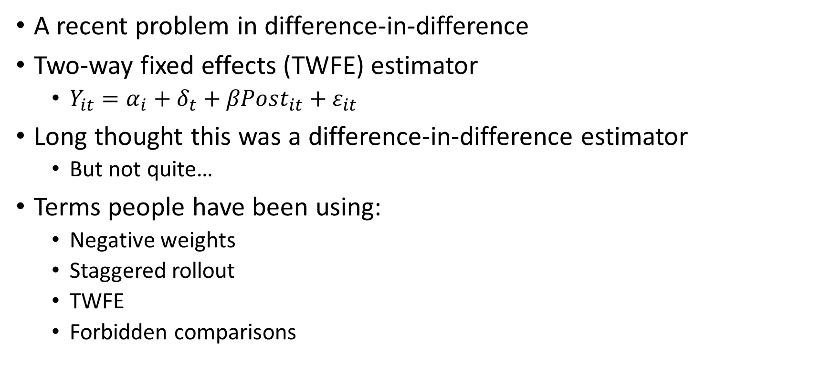
The problem
A recent problem in difference-in-difference
Two-way fixed effects (TWFE) estimator
  $Y_{it}=α_{i}+δ_{t}+βPost_{it}+ε_{it}$
Long thought this was a difference-in-difference estimator
  But not quite…
Terms people have been using:
  Negative weights
  Staggered rollout
  TWFE
  Forbidden comparisons

Slide 3
How important is this problem?
Somewhat important
  “It is possible for the TWFE estimator to be a different sign than all of the average treatment effects”
    Program increases income for all municipalities
    TWFE estimator shows it decreases income
To “my” knowledge: No results have been over-turned
Most results are somewhat wrong
  Same sign, sometimes larger sometimes smaller
  Significance is affected

Slide 4
Today
Where the problem is and isn’t
What causes it
How it’s solved
Actually implementing the solutions
Materials I’m sharing
  Stata code to do some useful simulations
  Some papers: Goodman-Bacon (2021) is my favorite
  Lecture slides from David Schonholzer (more technical than this presentation)

Slide 5
Where the problem is
Staggered rollout difference-in-difference designs
  In 2009: 8 municipalities treated
  In 2012: 14 municipalities treated
  In 2016: 9 municipalities treated
Does not apply when treatment happens at once
  In 2012: 31 municipalities treated
  In 2012: All municipalities treated, but 31 already had the law in place from the 1980’s
Does not apply* when treatment effects are constant over time
  Important when effects “grow” over time
    Immediate effects are small, but they grow as teachers/workers/etc. adjust
  Note that this is impossible to test
* Technically it still kind of applies…

Slide 6
What is NOT related
Parallel trends*
  Problem exists with static or dynamic diff-in-diff
Standard errors
  Clustering, over-rejection, etc.: Bertrand, Duflo, Mullainaithan (AER, 2004) How much should we trust difference-in-difference
Anticipation effects
  People knew the policy was coming, so it wasn’t a “shock”
Endogenous policy and time-varying omitted variables
  The municipalities adopting the policy were changing in other ways
  The municipalities adopting the policy adopted other stuff at same time
Binning endpoints*
* Technically it’s slightly related…

Slide 7
Actually two slightly different problems
(very very very similar)
Version 1:
  If:
    Treatment effects increase over time (effects “phase in”), and
    Staggered rollout
  Then:
    Likely that you underestimate effects because a “newly treated” municipality is also being compared to an “earlier treated” municipality
Version 2:
  If: This problem is severe enough (formalize later):
  Then: You can get the wrong sign.
    People make a big deal out of this…

Slide 8
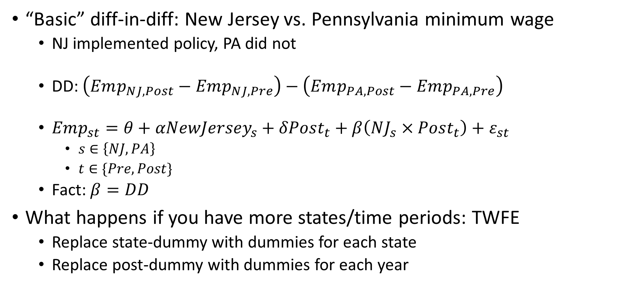
What is the problem: Version 1
“Basic” diff-in-diff: New Jersey vs. Pennsylvania minimum wage
  NJ implemented policy, PA did not
  DD: $\left(Emp_{NJ,Post}−Emp_{NJ,Pre}\right)−\left(Emp_{PA,Post}−Emp_{PA,Pre}\right)$
  $Emp_{st}=θ+αNewJersey_{s}+δPost_{t}+β\left(NJ_{s}×Post_{t}\right)+ε_{st}$
    $s∈\left\{NJ,PA\right\}$
    $t∈\{Pre,Post\}$
  Fact: $β=DD$
What happens if you have more states/time periods: TWFE
  Replace state-dummy with dummies for each state
  Replace post-dummy with dummies for each year

Slide 9
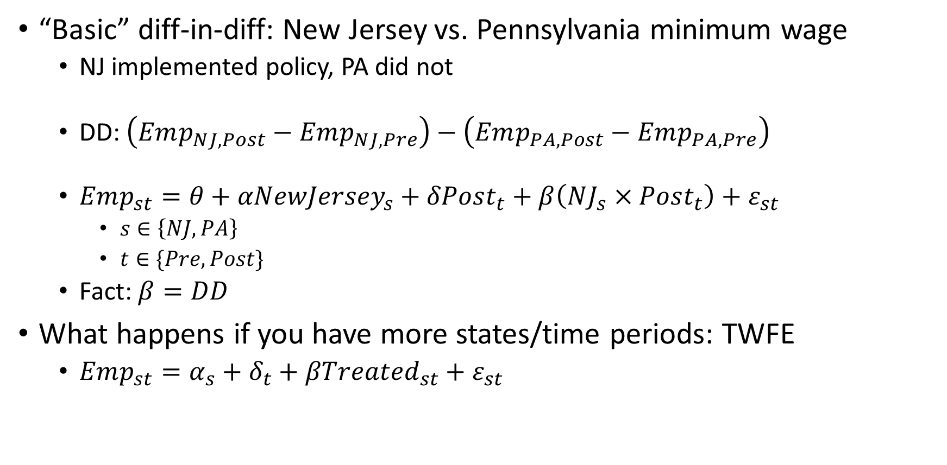
What is the problem: Version 1
“Basic” diff-in-diff: New Jersey vs. Pennsylvania minimum wage
  NJ implemented policy, PA did not
  DD: $\left(Emp_{NJ,Post}−Emp_{NJ,Pre}\right)−\left(Emp_{PA,Post}−Emp_{PA,Pre}\right)$
  $Emp_{st}=θ+αNewJersey_{s}+δPost_{t}+β\left(NJ_{s}×Post_{t}\right)+ε_{st}$
    $s∈\left\{NJ,PA\right\}$
    $t∈\{Pre,Post\}$
  Fact: $β=DD$
What happens if you have more states/time periods: TWFE
  $Emp_{st}=α_{s}+δ_{t}+βTreated_{st}+ε_{st}$

Slide 10
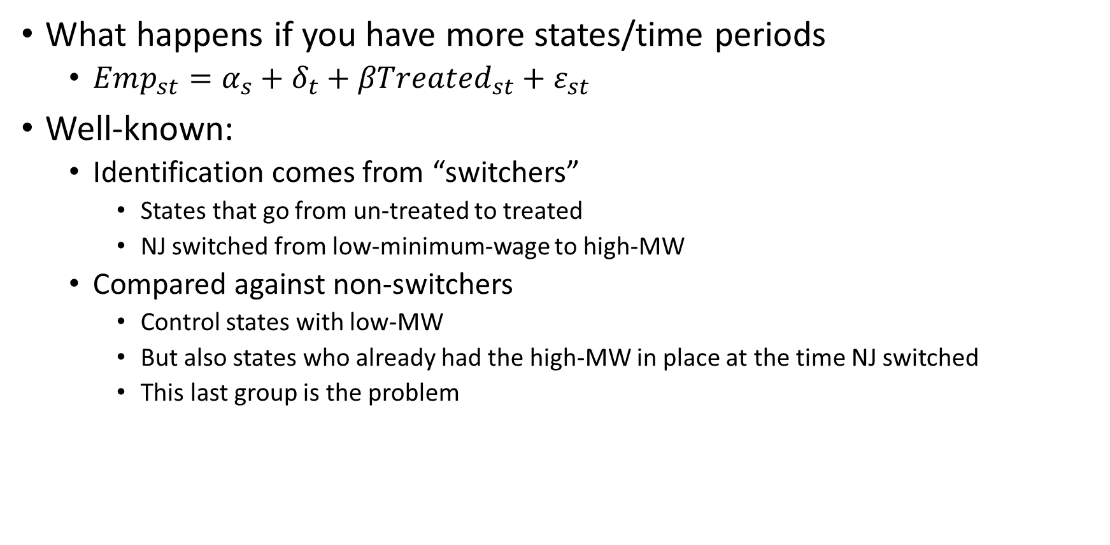
What is the problem: Version 1
What happens if you have more states/time periods
  $Emp_{st}=α_{s}+δ_{t}+βTreated_{st}+ε_{st}$
Well-known:
  Identification comes from “switchers”
    States that go from un-treated to treated
    NJ switched from low-minimum-wage to high-MW
  Compared against non-switchers
    Control states with low-MW
    But also states who already had the high-MW in place at the time NJ switched
    This last group is the problem

Slide 11
Fake data: Illustration
Comparing NJ to PA would be fine
Within our data, NY is also a non-switcher:
  TWFE treats it as a control group too

Slide 12
Fake data: Illustration

Slide 13
Fake data: Illustration
The problem: One of the non-switchers was affected, and effects are “phasing in”
Note that if effects were constant (no “phase in”) there would be no problem

Slide 14
Fake data: Illustration
The problem: One of the non-switchers was affected, and effects are “phasing in”
Note that if effects were constant (no “phase in”) there would be no problem

Slide 15
Fake data: Illustration
The problem: One of the non-switchers was affected, and effects are “phasing in”
Note that if effects were constant (no “phase in”) there would be no problem
Note that if there was no NY, there would be no problem
  31 municipalities treated in 2012
  Or: Only use never-treated municipalities as controls
  But TWFE never does this itself!

Slide 16
Summary so far
Diff-in-diff: Compare change in outcome for switcher to change in outcome for a control group
TWFE: Compare change in outcome for switchers to changes among those not currently switching
  This includes those treated earlier
Problem: Sometimes changes “control group” reflect treatment effects
  Only when treatment effects “phase in” over time
Solution: Only compare treated municipalities to “true control”/never treated municipalities
  Note: This is why not a problem when all treated municipalities are treated at the same time

Slide 17
Next
Slightly more formal
How bad can this get?
Intuition for solution
Actual implementation of solution
Feel free to ignore the blue parts
  I’ll tell you when to pay attention again

Slide 18
More formal
Two key facts about regression:
  Frisch-Waugh-Lovell: Identification comes from residual variation
  Least squares: More variation means more influence
These provide intuition for the De Chaisemartin-D’Haultfoeuille (2020) theorem

Slide 19
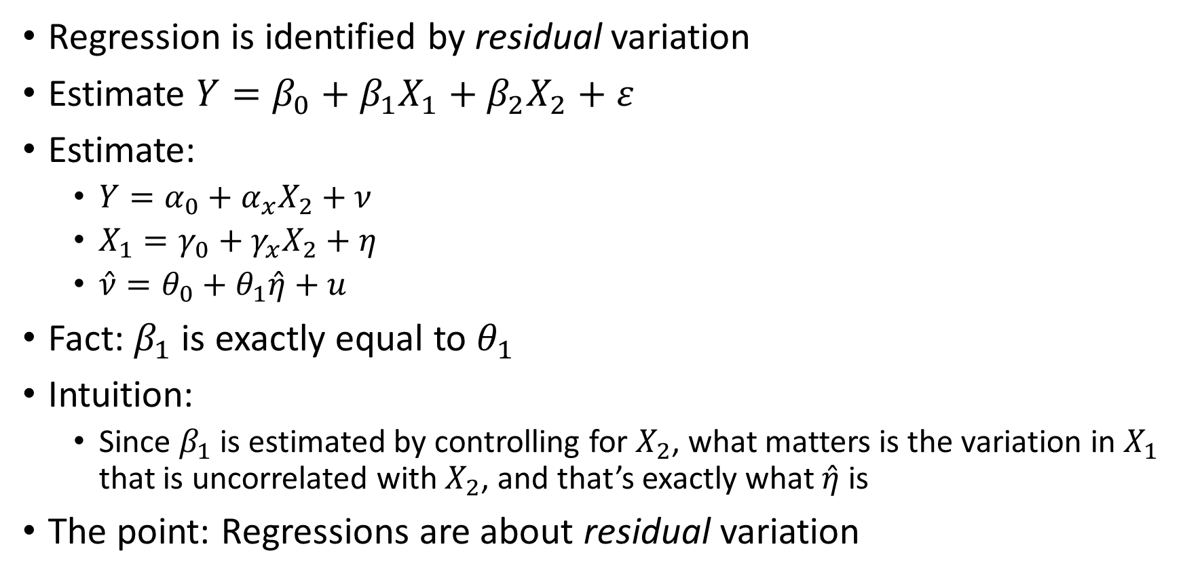
Frisch-Waugh-Lovell
Regression is identified by residual variation
Estimate $Y=β_{0}+β_{1}X_{1}+β_{2}X_{2}+ε$
Estimate:
  $Y=α_{0}+α_{x}X_{2}+ν$
  $X_{1}=γ_{0}+γ_{x}X_{2}+η$
  $\hat{ν}=θ_{0}+θ_{1}\hat{η}+u$
Fact:$β_{1}$ is exactly equal to $θ_{1}$
Intuition:
  Since $β_{1}$ is estimated by controlling for $X_{2}$, what matters is the variation in $X_{1}$ that is uncorrelated with $X_{2}$, and that’s exactly what $\hat{η}$ is
The point: Regressions are about residual variation

Slide 20
Frisch-Waugh-Lovell: Example
Once you control for age, OLS no longer cares about the difference between groups in the level of savings
OLS slope will match the slopes of the dots

Slide 21
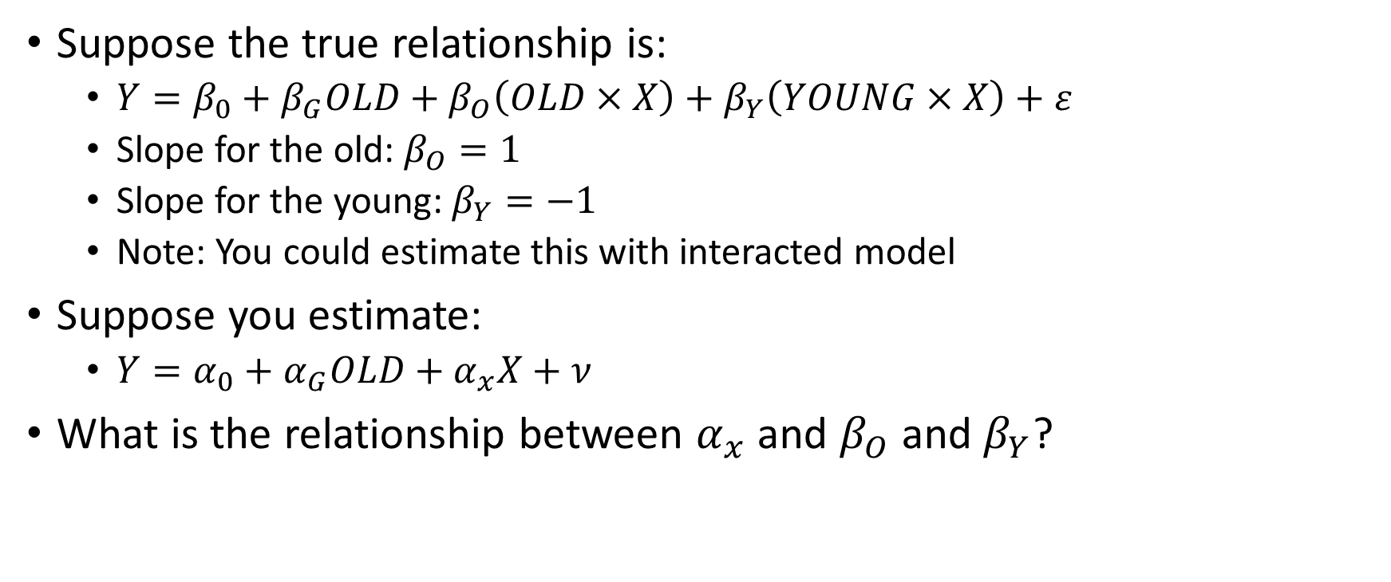
Least squares
Suppose the true relationship is:
  $Y=β_{0}+β_{G}OLD+β_{O}\left(OLD×X\right)+β_{Y}\left(YOUNG×X\right)+ε$
  Slope for the old: $β_{O}=1$
  Slope for the young: $β_{Y}=−1$
  Note: You could estimate this with interacted model
Suppose you estimate:
  $Y=α_{0}+α_{G}OLD+α_{x}X+ν$
What is the relationship between $α_{x}$ and $β_{O}$ and $β_{Y}$?

Slide 22
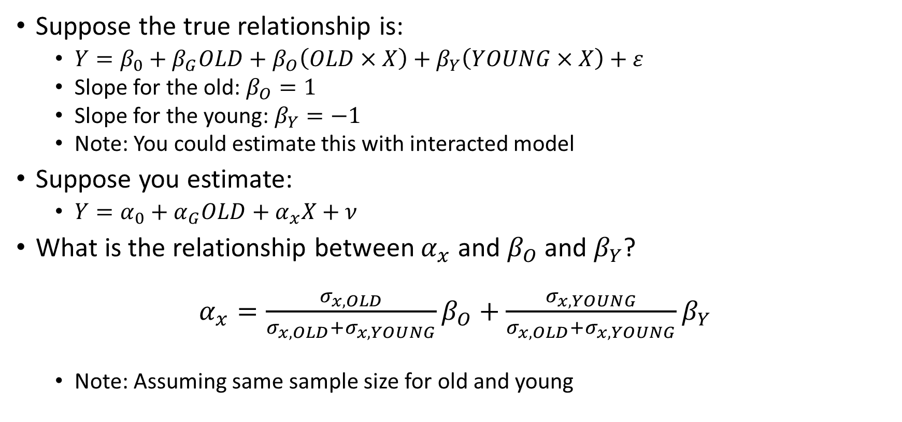
Least squares
Suppose the true relationship is:
  $Y=β_{0}+β_{G}OLD+β_{O}\left(OLD×X\right)+β_{Y}\left(YOUNG×X\right)+ε$
  Slope for the old: $β_{O}=1$
  Slope for the young: $β_{Y}=−1$
  Note: You could estimate this with interacted model
Suppose you estimate:
  $Y=α_{0}+α_{G}OLD+α_{x}X+ν$
What is the relationship between $α_{x}$ and $β_{O}$ and $β_{Y}$?
$α_{x}=\frac{σ_{x,OLD}}{σ_{x,OLD}+σ_{x,YOUNG}}β_{O}+$ $\frac{σ_{x,YOUNG}}{σ_{x,OLD}+σ_{x,YOUNG}}β_{Y}$
  Note: Assuming same sample size for old and young

Slide 23
Example
“Raw data” (that I made up)
But recall that we’re going to control for OLD
  Levels won’t matter
  Frisch-Waugh-Lovell

Slide 24
Example
Residual wage and savings (the identifying variation)
OLD: Slope +1
YOUNG: Slope -1
What slope will OLS yield?

Slide 25
Example
Residual wage and savings (the identifying variation)
OLD: Slope +1
YOUNG: Slope -1
What slope will OLS yield?
The “variation-weighted” slope is closer to -1 than +1

Slide 26
Summarizing from those examples
All regressions are weighted by the amount of variation
What matters is the identifying variation (i.e., residual variation)

Slide 27
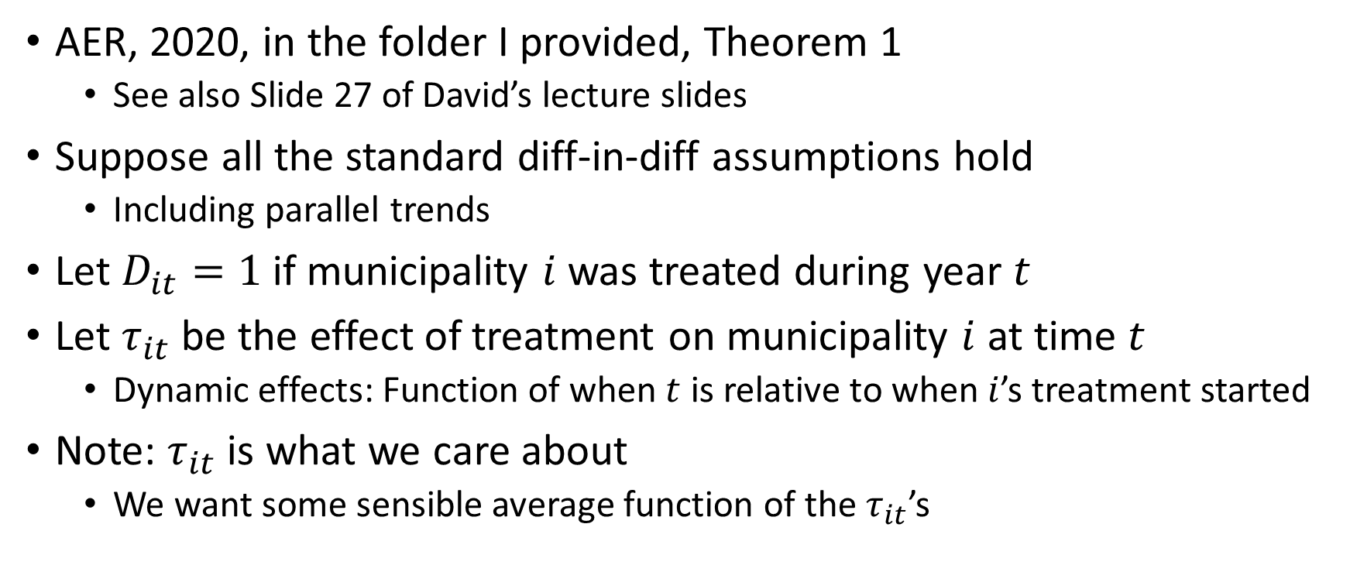
De Chaisemartin-D’Haultfoeuille Theorem
AER, 2020, in the folder I provided, Theorem 1
  See also Slide 27 of David’s lecture slides
Suppose all the standard diff-in-diff assumptions hold
  Including parallel trends
Let $D_{it}=1$ if municipality $i$was treated during year $t$
Let $τ_{it}$ be the effect of treatment on municipality $i$ at time $t$
  Dynamic effects: Function of when $t$ is relative to when $i$’s treatment started
Note: $τ_{it}$ is what we care about
  We want some sensible average function of the $τ_{it}$’s

Slide 28
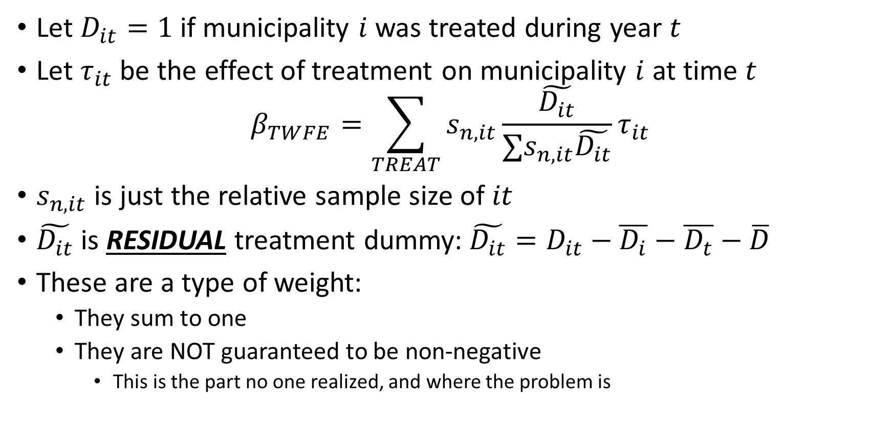
De Chaisemartin-D’Haultfoeuille Theorem
Let $D_{it}=1$ if municipality $i$was treated during year $t$
Let $τ_{it}$ be the effect of treatment on municipality $i$ at time $t$
$$β_{TWFE}=\sum_{TREAT}{s_{n,it}\frac{\tilde{D_{it}}}{∑s_{n,it}\tilde{D_{it}}}τ_{it}}$$
$s_{n,it}$ is just the relative sample size of $it$
$\tilde{D_{it}}$ is RESIDUAL treatment dummy:$\tilde{D_{it}}=D_{it}−\overline{D_{i}}−\overline{D_{t}}−\overline{D}$
These are a type of weight:
  They sum to one
  They are NOT guaranteed to be non-negative
    This is the part no one realized, and where the problem is

Slide 29
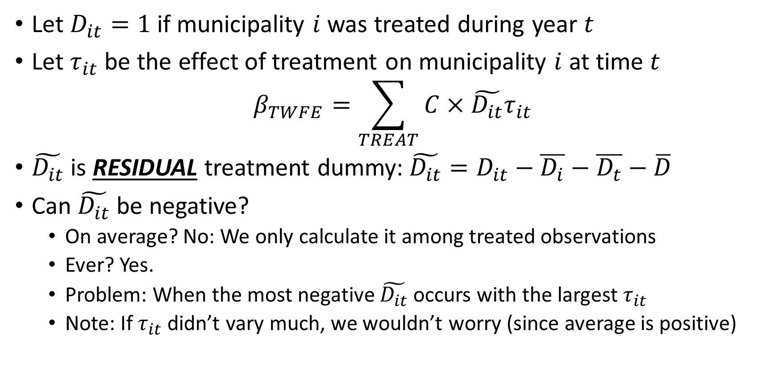
De Chaisemartin-D’Haultfoeuille Theorem
Let $D_{it}=1$ if municipality $i$was treated during year $t$
Let $τ_{it}$ be the effect of treatment on municipality $i$ at time $t$
$$β_{TWFE}=\sum_{TREAT}{C×\tilde{D_{it}}τ_{it}}$$
$\tilde{D_{it}}$ is RESIDUAL treatment dummy:$\tilde{D_{it}}=D_{it}−\overline{D_{i}}−\overline{D_{t}}−\overline{D}$
Can $\tilde{D_{it}}$ be negative?
  On average? No: We only calculate it among treated observations
  Ever? Yes.
  Problem: When the most negative $\tilde{D_{it}}$ occurs with the largest $τ_{it}$
  Note: If $τ_{it}$ didn’t vary much, we wouldn’t worry (since average is positive)

Slide 30
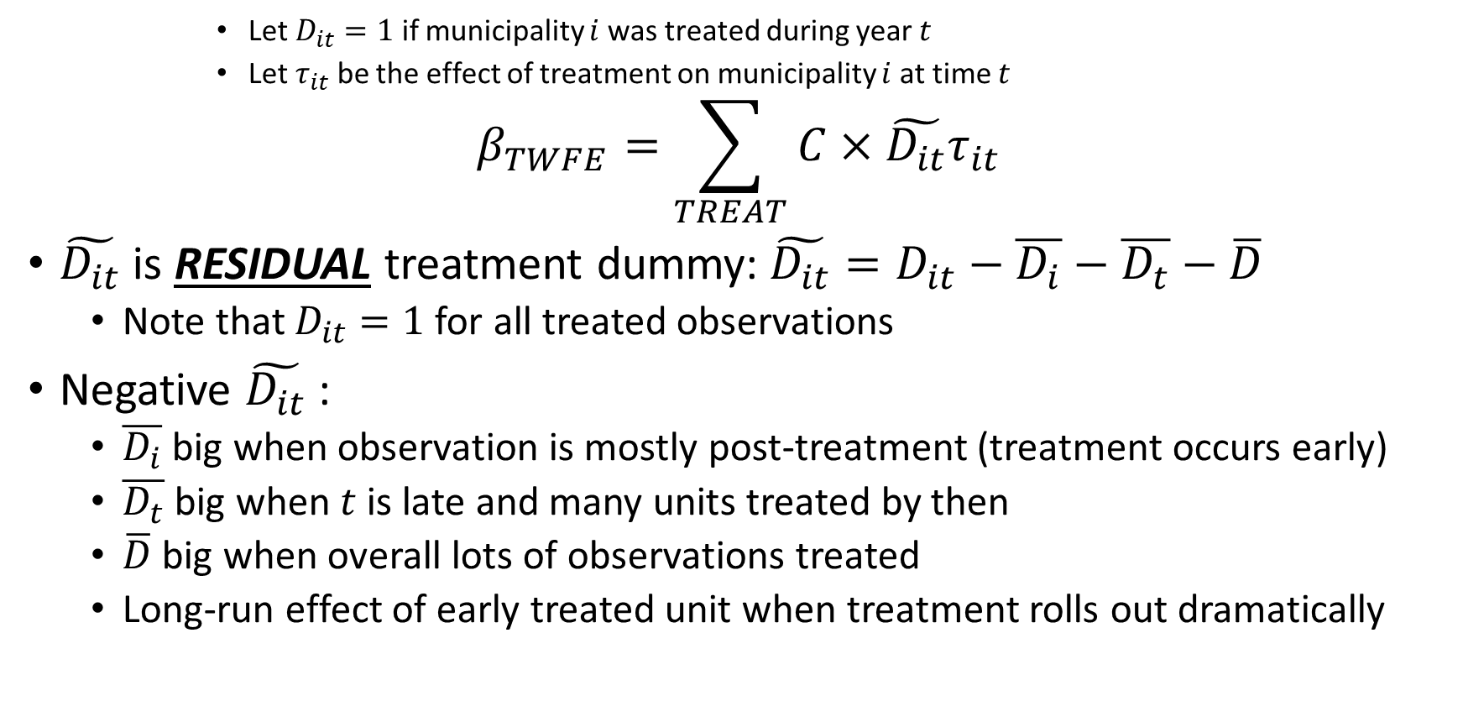
De Chaisemartin-D’Haultfoeuille Theorem
      Let $D_{it}=1$ if municipality $i$was treated during year $t$
      Let $τ_{it}$ be the effect of treatment on municipality $i$ at time $t$
$$β_{TWFE}=\sum_{TREAT}{C×\tilde{D_{it}}τ_{it}}$$
$\tilde{D_{it}}$ is RESIDUAL treatment dummy:$\tilde{D_{it}}=D_{it}−\overline{D_{i}}−\overline{D_{t}}−\overline{D}$
  Note that $D_{it}=1$ for all treated observations
Negative $\tilde{D_{it}}$ :
  $\overline{D_{i}}$ big when observation is mostly post-treatment (treatment occurs early)
  $\overline{D_{t}}$ big when $t$ is late and many units treated by then
  $\overline{D}$ big when overall lots of observations treated
  Long-run effect of early treated unit when treatment rolls out dramatically

Slide 31
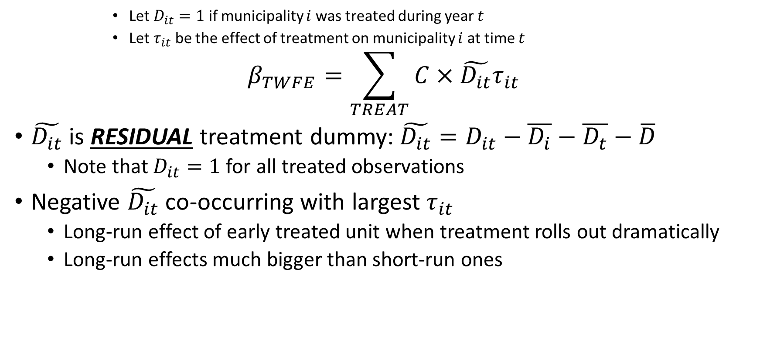
De Chaisemartin-D’Haultfoeuille Theorem
      Let $D_{it}=1$ if municipality $i$was treated during year $t$
      Let $τ_{it}$ be the effect of treatment on municipality $i$ at time $t$
$$β_{TWFE}=\sum_{TREAT}{C×\tilde{D_{it}}τ_{it}}$$
$\tilde{D_{it}}$ is RESIDUAL treatment dummy:$\tilde{D_{it}}=D_{it}−\overline{D_{i}}−\overline{D_{t}}−\overline{D}$
  Note that $D_{it}=1$ for all treated observations
Negative $\tilde{D_{it}}$ co-occurring with largest $τ_{it}$
  Long-run effect of early treated unit when treatment rolls out dramatically
  Long-run effects much bigger than short-run ones

Slide 32
Simulation
Included in the provided folder
290 municipalities, 16 years
You choose:
  Treatment pattern: What fraction of municipalities
    Treated ever
    Treated before data starts
    Treated in first 8 years
    Treated in second 8 years
  Treatment effect shape:
    Immediate/short-run treatment
    Total long-run treatment size
    Convex/Concave treatment effect growth

Slide 33
Example
Recall: Negative weights requires two things
  Biggest treatment effects are long-run
  By the time “long-run” happens, most units are treated
Example:
  99% of municipalities treated
  80% during last 8 years
  Treatment effects over time convex

Slide 34
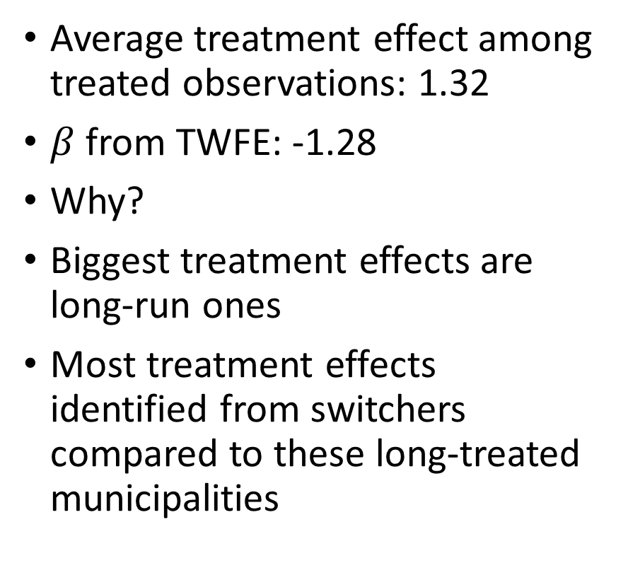
Example
Average treatment effect among treated observations: 1.32
$β$ from TWFE: -1.28
Why?
Biggest treatment effects are long-run ones
Most treatment effects identified from switchers compared to these long-treated municipalities
Recall: Negative weights requires two things
  Biggest treatment effects are long-run
  By the time “long-run” happens, most units are treated
Example:
  99% of municipalities treated
  80% during last 8 years
  Treatment effects over time convex

Slide 35
Example
Most weights are positive
  “Always”
But those treatment effects are small (they’re short-run)
The few big treatment effects (long-run) have very negative weight
Note: You cannot calculate this plot in real data! It requires knowing the true effects

Slide 36
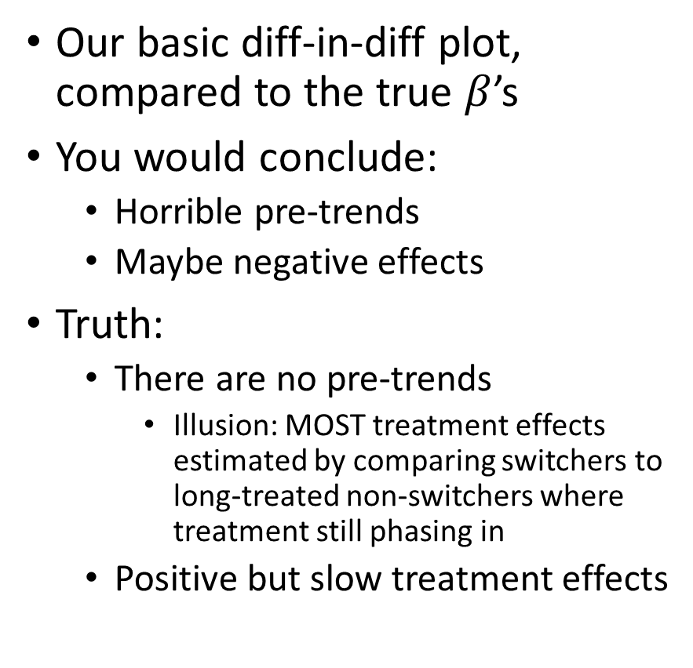
Example
Our basic diff-in-diff plot, compared to the true $β$’s
You would conclude:
  Horrible pre-trends
  Maybe negative effects
Truth:
  There are no pre-trends
    Illusion: MOST treatment effects estimated by comparing switchers to long-treated non-switchers where treatment still phasing in
  Positive but slow treatment effects

Slide 37
Summary so far
Baseline demo of problem
  99% treated
  Mostly late treated
  Biggest effects very long-run
  Effects come slowly
  Top plot: Big problems

Slide 38
Summary so far
Baseline demo of problem
  99% treated
  Mostly late treated
  Biggest effects very long-run
  Effects come slowly
  Top plot: Big problems
Only 30% of municipalities treated: Bottom plot

Slide 39
Summary so far
Baseline demo of problem
  99% treated
  Mostly late treated
  Biggest effects very long-run
  Effects come slowly
  Top plot: Big problems
Only 30% of municipalities treated and 80% treated in first half of sample period: Bottom plot

Slide 40
Summary so far
Baseline demo of problem
  99% treated
  Mostly late treated
  Biggest effects very long-run
  Effects come slowly
  Top plot: Big problems
Only 30% of municipalities treated and 80% treated in first half of sample period and effects stable beyond 5 years: Bottom plot

Slide 41
Intuition for solution
Return to the “bad” case
Source of problem:
  Identification comes from comparing newly treated observations to non-switchers
  Most non-switchers are earlier treated
  Those early treated observations have biggest treatment effects
  Those effects are slowly growing over time
Problem: Comparing newly treated to earlier treated

Slide 42
Intuition for solution
Return to the “bad” case
Problem: Comparing newly treated to earlier treated
Recall:
  If all treated units are treated at same time, no problem
  If treated are compared only to not-treated, no problem
    Example from earlier: In 2012: 31 municipalities treated
Imagine we only compare 2006 treatment cohort to never treated

Slide 43
Intuition for solution
Return to the “bad” case
Problem: Comparing newly treated to earlier treated
Recall:
  If all treated units are treated at same time, no problem
  If treated are compared only to not-treated, no problem
    Example from earlier: In 2012: 31 municipalities treated
Imagine we only compare 2006 treatment cohort to never treated (bottom plot)

Slide 44
Intuition for solution
Return to the “bad” case
Problem: Comparing newly treated to earlier treatedImagine we only compare 2006 treatment cohort to never treated (bottom plot)
We can do this for all the treatment cohorts:
  Compare each cohort to the never-treated observations

Slide 45
Intuition for solution
Return to the “bad” case
Problem: Comparing newly treated to earlier treated
Imagine we only compare 2006 treatment cohort to never treated
We can do this for all the treatment cohorts:
  Compare each cohort to the never-treated observations

Slide 46
Intuition for solution
Return to the “bad” case
Problem: Comparing newly treated to earlier treated
Compare each cohort to the never-treated observations
Each one works fine
But they’re noisy
Can we combine them? Yes.
Callaway-Sant’Anna (2021)

Slide 47
Summary so far (keeping on track)
Slightly more formal. Identifying variation is residual treatment status.
How bad can this get? Very bad, but often it won’t.
Intuition for solution: Each treatment cohort is well-identified
Actual implementation of solution: Callaway-Sant’Anna
Feel free to ignore the blue parts
  PLEASE PAY ATTENTION AGAIN

Slide 48
Callaway-Sant’Anna (2021)
In the folder I provided, but don’t read it…
Feel free to read Sant’Anna’s slides on the Stata command csdid
  (also in the folder)
Feel free to look at the end of the simulation do file that I provide
Intuition: Under standard assumptions of linear regression, you can calculate average effects for each treatment cohort and then average them
You can do that yourself, or use their package: csdid
  Their package can be annoying, programming ones self is also work

Slide 49
Solving the problem
Callaway-Sant’Anna (2021): csdid
Compares treated observations to never treated observations
  Option: Compare to not-yet-treated
  Important: Don’t compare to already-treated
Averages over all treated cohorts
  Options: Other types of averages
Left: Worst case scenario from earlier

Slide 50
Solving the problem

Slide 51
Summary
The thing we’ve all been doing sometimes compared newly treated units to earlier treated units
  Only when treatment roll-out was staggered (not simply “at once”)
  Only when treatment effects are non-constant over time
No one really noticed or understood this until recently
Solution is always to do something intuitive
  Compare treated to never-treated
  There are now resources to help you do that
Worth doing:
  Play with the simulation to understand when the problem is serious/not
  Read the Sant’Anna slides included (with Stata details)

