Slide 1
Git
Anton Baláž

Slide 2
About Version Control Tools

Slide 3
Version Control Tools
Revision control [...] is the management of changes to documents, computer programs, large web sites, and other collections of information.
Changes are usually identified by a number or letter code, termed the revision number” [...]. For example, an initial set of files is ”revision 1”. When the first change is made, the resulting set is ”revision 2”, and so on.
Each revision is associated with a timestamp and the person making the change.
Revisions can be compared, restored, and with some types of files, merged.

Slide 4
Use case 1: keeping an history
The life of your software/article is recorded from the beginning
at any moment you can revert to a previous revision
the history is browseable, you can inspect any revision
when was it done ?
who wrote it ?
what was changed ?
why ?
in which context ?
all the deleted content remains accessible in the history

Slide 5
Use case 2: working with others
VC tools help you to:
share a collection of files with your team
merge changes done by other users
ensure that nothing is accidentally overwritten

Slide 6
Use case 3: branching
You may have multiple variants of the same software, materialised as branches, for example:
a main branch
a maintenance branch (to provide bugfixes in older releases)
a development branch (to make disruptive changes)
a release branch (to freeze code before a new release)
VC tools will help you to
handle multiple branches concurrently
merge changes from a branch into another one

Slide 7
UC 4: working with external contributors
VC tools help working with third-party contributors:
it gives them visibility of what is happening in the project
it helps them to submit changes (patches) and it helps you to integrate these patches
forking the development of a software and merging it back into mainline

Slide 8
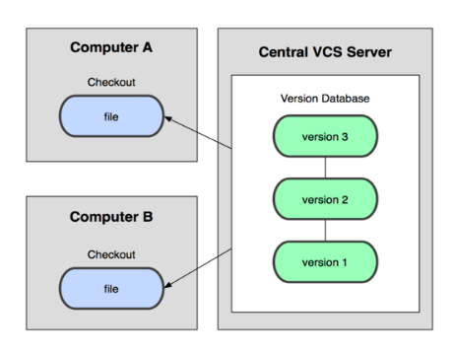
Centralized VCS
In Subversion, CVS, etc. A central server repository (repo) holds the "official copy" of the code
You make "checkouts" of it to your local copy
you make local modifications
your changes are not versioned
When you're done, you "check in" back to the server

Slide 9
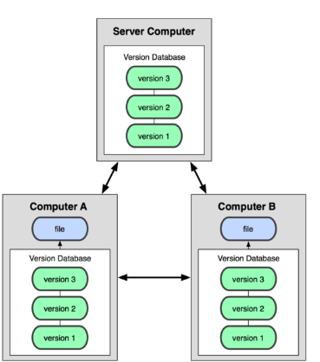
Distributed VCS (Git)
In git, mercurial, etc., you don't "checkout" from a central repo
you "clone" it and "pull" changes from it
Your local repo is a complete copy of everything on the remote server
Many operations are local:
check in/out from local repo
commit changes to local repo
local repo keeps version history
When you're ready, you can "push" changes back to server

Slide 10
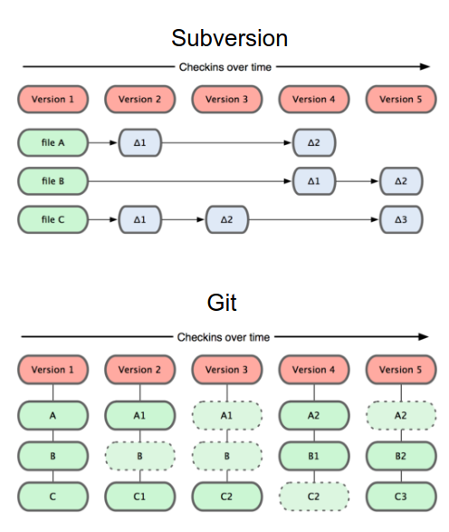
Git snapshots
Centralized VCS like Subversion track version data on each individual file.
Git keeps "snapshots" of the entire state of the project.
Each checkin version of the overall code has a copy of each file in it.
Some files change on a given checkin, some do not.
More redundancy, but faster.

Slide 11
What shall be stored into the repository
You should store all files that are not generated by a tool:
source files (.c .cpp .java .y .l .tex . . . )
build scripts / project files (Makefile configure.in Makefile.am CMakefile.txt wscript .sln)
documentation files (.txt README . . . )
resource files (images, audio, . . . )
You should not store generated files (or you will experience many unneccessary conflicts)
.o .a .so .dll .class .jar .exe .dvi .ps .pdf
source files / build scripts when generated by a tool (like autoconf, cmake, lex, yacc

Slide 12
Documentation
man git cmd
The Git book
http://git-scm.com/book
https://git-scm.com/book/cs/v2
Atlassian learning materials
https://www.atlassian.com/git
https://www.itnetwork.cz/programovani/git/git-tutorial-zaklady

Slide 13
Lab
Git cheat sheet
https://wac-cdn.atlassian.com/dam/jcr:e7e22f25-bba2-4ef1-a197-53f46b6df4a5/SWTM-2088_Atlassian-Git-Cheatsheet.pdf?cdnVersion=2491

Slide 14
Installation

Slide 15
Install Git
Install Git on Windows
https://gitforwindows.org/
https://github.com/git-for-windows/git/releases/download/v2.54.0.windows.1/PortableGit-2.54.0-64-bit.7z.exe
Install Git on Linux
sudo apt-get update && apt-get install git
git --version
3rd party GUIs
https://git-scm.com/downloads/guis

Slide 16
Lab
Install git

Slide 17
Working locally

Slide 18
Initial Git configuration
Set the name and email for Git to use when you commit:
git config --global user.name "Bugs Bunny"
git config --global user.email bugs@gmail.com
You can call git config --list to verify these are set.
Set the editor that is used for writing commit messages:
git config --global core.editor nano
(it is vim by default)
~/.gitconfig
Notes:
git config --global user.name “anton”
git config --global user.email “anton.balaz@tuke.sk”
git config --list

Slide 19
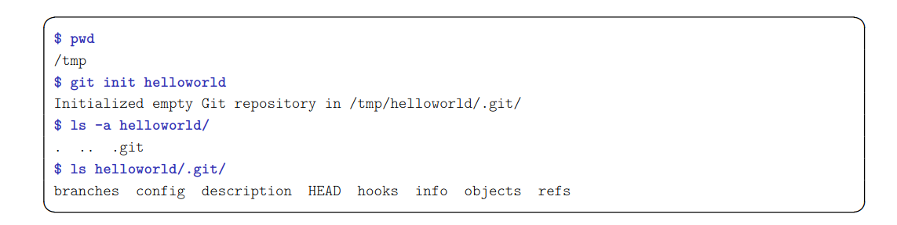
Create a new repository
git init myreposit
This command creates the directory myrepository.
the repository is located in myrepository/.git
the (initially empty) working copy is located in myrepository/
The /.git/ directory contains your whole history, do not delete it
Notes:
demo

Slide 20
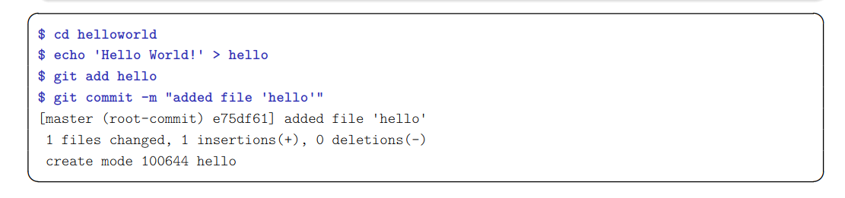
Commit your first file
git add file
git commit [ -m message ]
Notes:
2011 git init lab1
2012 ls -la
2013 cd lab1/
2014 ls
2015 ls -la
2016 echo "ahoj" > f1
2017 echo "ahoj2" > f2
2018 git status
2019 git add f1
2020 git status
2021 touch f3
2022 git status
2023 git add .
2024 git status
2025 git commit -m "pridane subory"
2026 git status

Slide 21
The staging area (aka the “index”)
Usual version control systems provide two spaces:
the repository (the whole history of your project)
the working tree (or local copy), (the files you are editing and that will be in the next commit)
Git introduces an intermediate space : the staging area (also called index)
The index stores the files scheduled for the next commit
git add files → copy files into the index
git commit → commits the content of the index

Slide 22
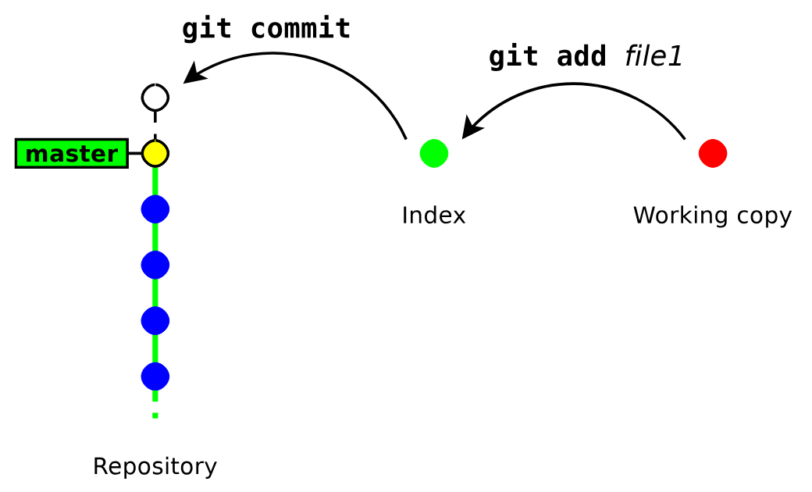
The staging area (aka the “index”)

Slide 23
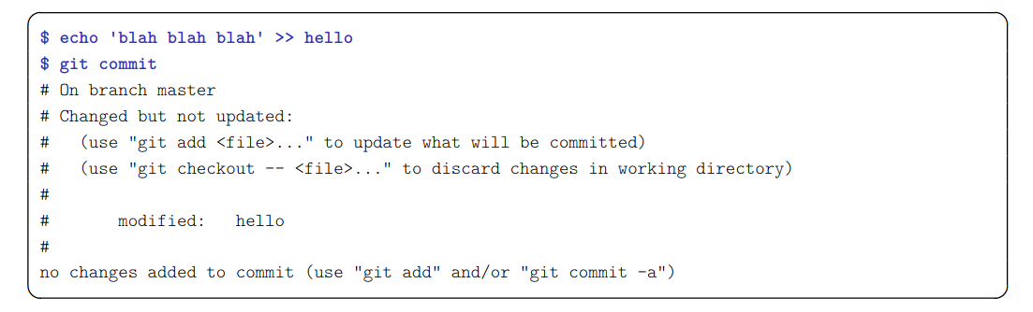
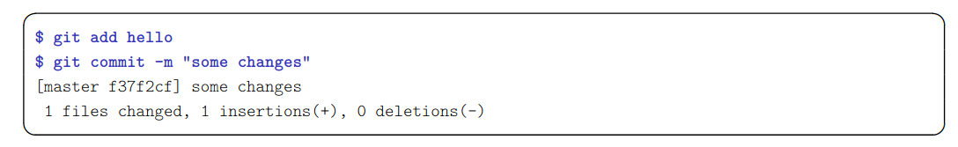
Update a file
Git complains because the index is unchanged (nothing to commit)
→ We need to run git add to copy the file into the index
Notes:
2028 echo "zmena f1" > f1
2029 git status
2030 git commit
2031 git add f1
2032 git commit

Slide 24
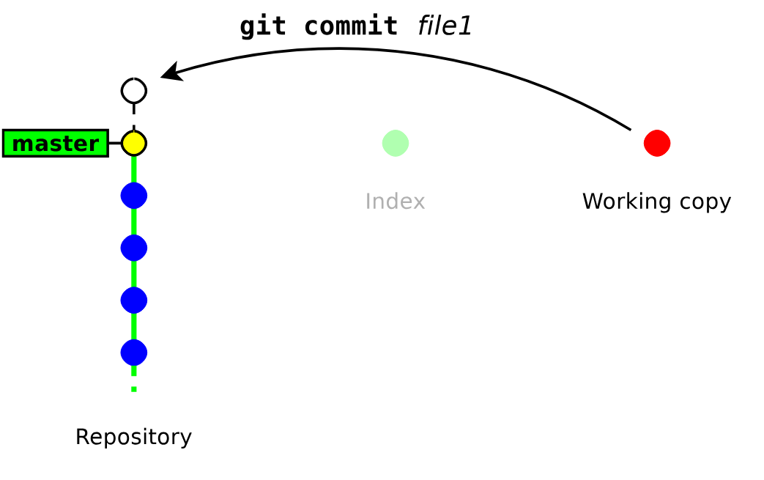
Bypassing the index
Running git add & git commit for every iteration is tedious. GIT provides a way to bypass the index
git commit file1 [ file2 . . .]
This command commits files (or dirs) directly from the working tree
Notes:
2040 touch f5
2041 git commit f5
2043 echo "dalsia zmena f1" > f1
2044 git commit f1

Slide 25
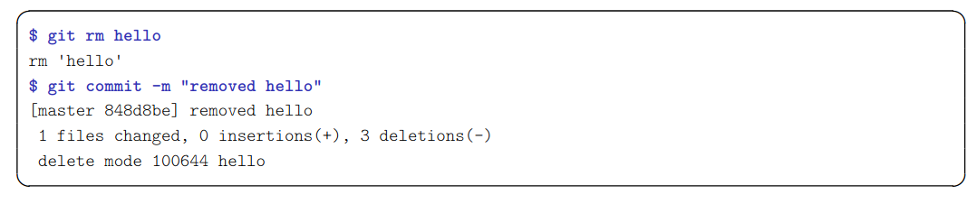
Deleting files
git rm file
remove the file from the index and from the working copy
git commit
commit the index
Notes:
2047 git log
2048 ls
2049 git rm f1
2050 git status
2051 git commit -m "zmazany f1"
2052 ls
—--------------------------------------------------
2055 git rm -h
2056 git rm --cached f2
2057 git status
ls

Slide 26
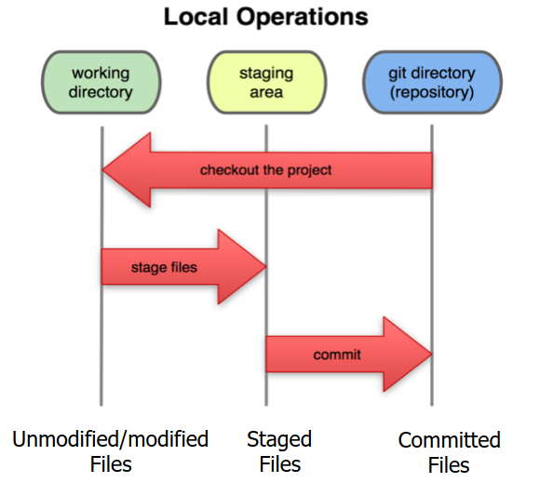
Local git areas
In your local copy on git, files can be:
In your local repo
(committed)
Checked out and modified, but not yet committed
(working copy)
Or, in-between, in a "staging/index" area
Staged files are ready to be committed.
A commit saves a snapshot of all staged state.

Slide 27
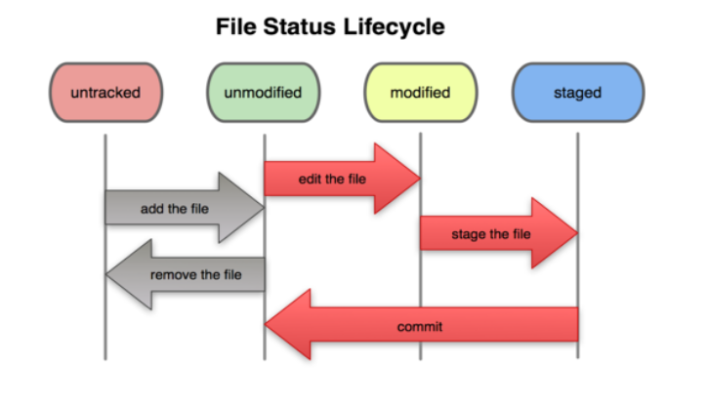
Basic Git workflow
Modify files in your working directory
Stage files, adding snapshots of them to your staging area
Commit, which takes the files in the staging area and stores that snapshot permanently to your Git directory.

Slide 28
Showing differences
git diff [ rev a [ rev b ] ] [ -- path . . . ]
shows the differences between two revisions rev a and rev b (in a format suitable for the patch utility)
by default rev a is the index
by default rev b is the working copy
git diff --staged [ rev a ] [ -- path . . . ]
shows the differences between rev a and the index
by default rev a is HEAD (a symbolic references pointing to the last commit)
Notes:
cat f3
2060 git diff
2061 echo "zmena f3" > f3
2062 git diff
—---------------------------
2066 git status
2067 git add .
2068 git commit -m "update"
2069 cat f2
2070 echo "zmena f2"
2071 echo "zmena f2" > f2
2072 git add f2
2073 git diff --staged

Slide 29
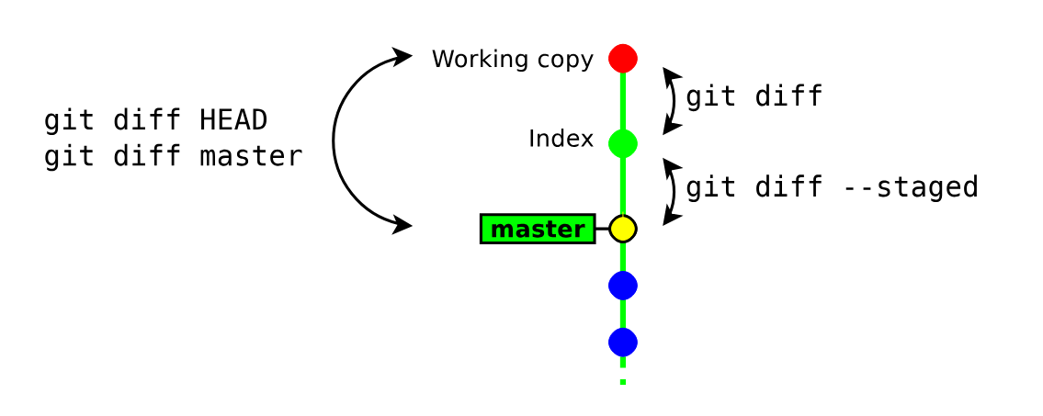
About git diff and the index

Slide 30
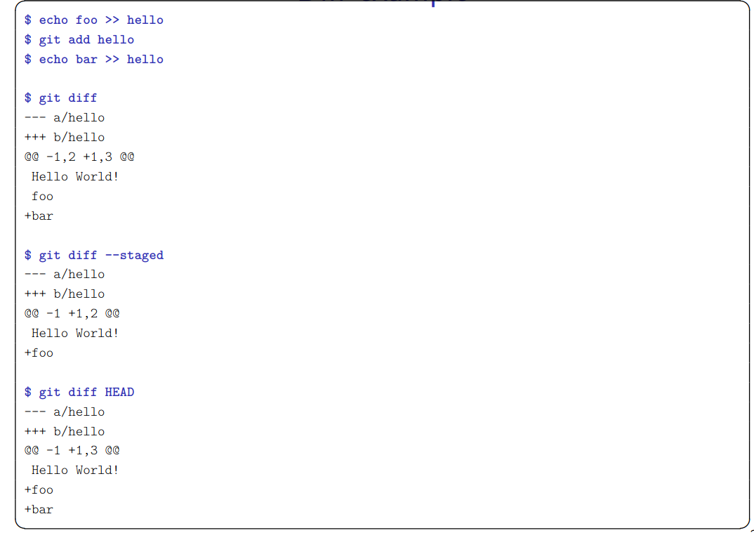
Diff example

Slide 31
Other local commands
git status
show the status of the index and working copy
git show [file]
show the details of a commit (metadata + diff)
git log [--oneline]
show the history
git mv
move/rename a file
Notes:
2193 git log --oneline
2194 echo "doplnene data" >> f1
2195 git add f1
2196 git commit -m "doplnene data"
2197 git status
2198 git log --oneline
2199 git show 800464b

Slide 32
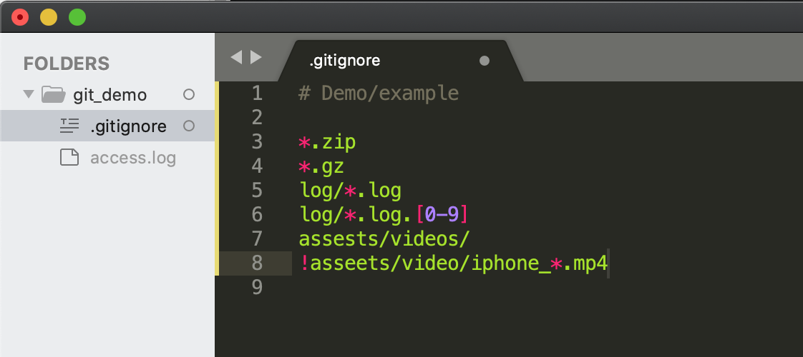
Git ignore
Git sees every file in your working copy as one of three things:
1. tracked - a file which has been previously staged or committed;
2. untracked - a file which has not been staged or committed; or
3. ignored - a file which Git has been explicitly told to ignore.
.gitignore
Notes:
https://www.atlassian.com/git/tutorials/saving-changes/gitignore
git config --global core.excludesFile ~/.gitignore
2201 touch f1.zip
2202 git status
2203 vi .gitignore
2204 git status

Slide 33
Lab
http://zeus.fei.tuke.sk/git/git1.html
https://docs.google.com/document/d/1tY3hwP-lazsVip6ULPcqxYbxe4f_u7BSmCt0pr6Gpe0/edit?usp=sharing

Slide 34
Undo Changes

Slide 35
Git HEAD
HEAD is a reference to the current commit on the currently checked-out branch.
Pointer to current commit
HEAD usually points to the latest commit in your current branch, allowing Git to know what the current state of your project is and what changes are staged for the next commit.
Moving HEAD
Typical operations that move HEAD include git checkout, git switch, and git reset. These commands change your current branch or roll back changes in your repository, respectively, thereby updating where HEAD points.
Detached HEAD state
When you check out an older commit, a tag, or a remote branch, HEAD detaches and directly points to a specific commit instead of a branch. In this state, any new commits you make will be orphaned when you switch back to a branch, unless you create a new branch starting from the detached HEAD.

Slide 36
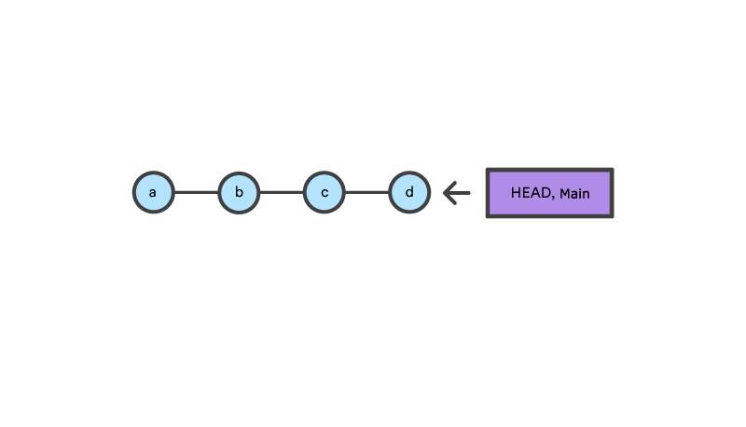
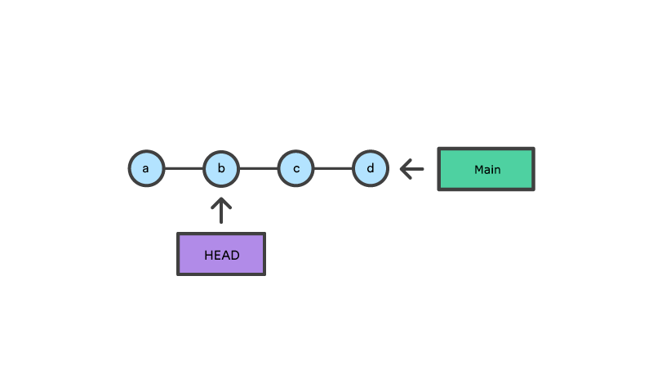
Undoing Commits
git checkout
checkout the previous commit
putting the repository in a state before the commit
Notes:
2078 git diff HEAD
2079 ls
2080 git status
2081 git log f2
2083 git checkout -h
2084 git log f2
2085 git checkout d61b5f1aae35fbc7295fe5c86efe40d3b14f762b
2086 cat f2
2087 ls
2088 cat f1
2089 ls
2091 git checkout master
2092 ls
2093 cat f2

Slide 37
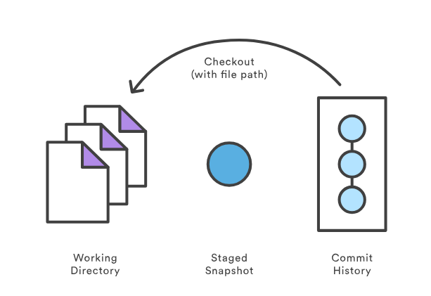
Resetting changes in the working copy
git checkout -- path
This command restores a file (or directory) as it appears in the index (thus it drops all unstaged changes)
Notes:
2095 ls
2096 cat f2
2097 echo "dalsia zmena f2" > f2
2098 git diff HEAD
2099 git checkout -- f2
2100 git diff HEAD
—--
git checkout HEAD~1

Slide 38
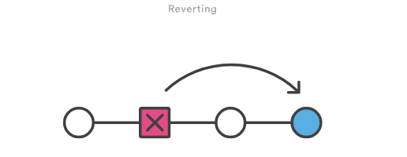
Undoing Commits
git revert
undoes a single commit—it does not "revert" back to the previous state of a project by removing all subsequent commits
Notes:
2144 git init lab2
2145 cd lab2
2146 ls
2147 touch f1
2148 git add .
2149 git commit -m "initial"
2150 echo "data" > f1
2151 git add f1
2152 git commit -m "pridane data"
2153 echo "doplnene data" >> f1
2154 git add f1
2155 git commit -m "doplnene data"
2156 git log --oneline
2168 git revert HEAD
2169 cat f1
2172 gitk

Slide 39
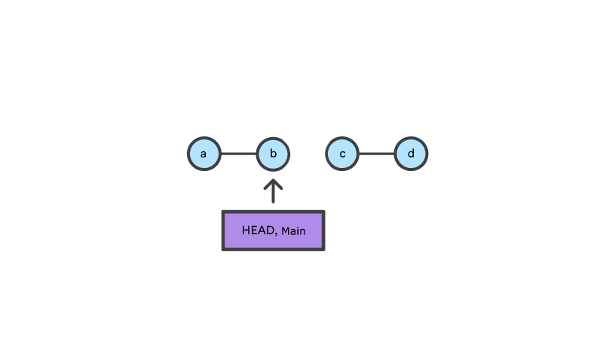
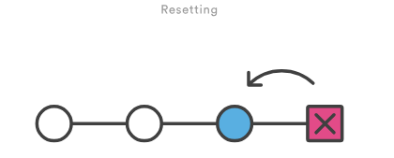
Resetting changes
git reset [ --hard ] [ -- path . . . ]
git reset cancels the changes in the index (and possibly in the working copy)
git reset --mixed drops the changes staged into the index, but the working copy is left intact
git reset --hard drops all the changes in the index and in the working copy
git reset, moves both the HEAD and branch refs to the specified commit
Notes:
git reflog vsetky commity

Slide 40
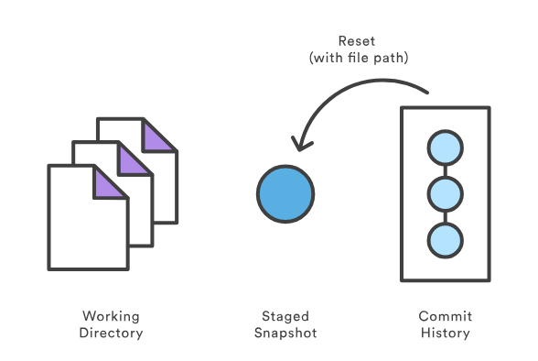
Git checkout file
git reset -- file

Slide 41
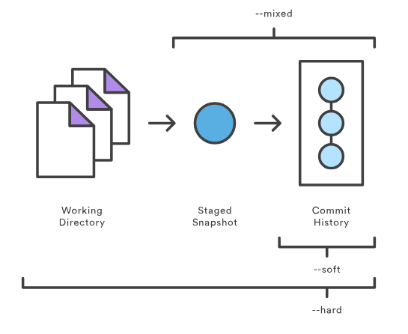
Resetting changes
Notes:
2181 git status
2182 git log --oneline
2183 git reset ee65a30
2184 git status
2185 cat f1
2187 git commit -m "asd" f1
2188 cat f1
2189 git log --oneline

Slide 42
Undo
https://git-scm.com/book/cs/v2/Git-Tools-Reset-Demystified

Slide 43
Lab
https://docs.google.com/document/d/1wYdyXlDaZp5dxQsjYPekAp0oWlS-0M5kZOmnHdtCmhg/edit?usp=sharing

Slide 44
Branching & merging

Slide 45
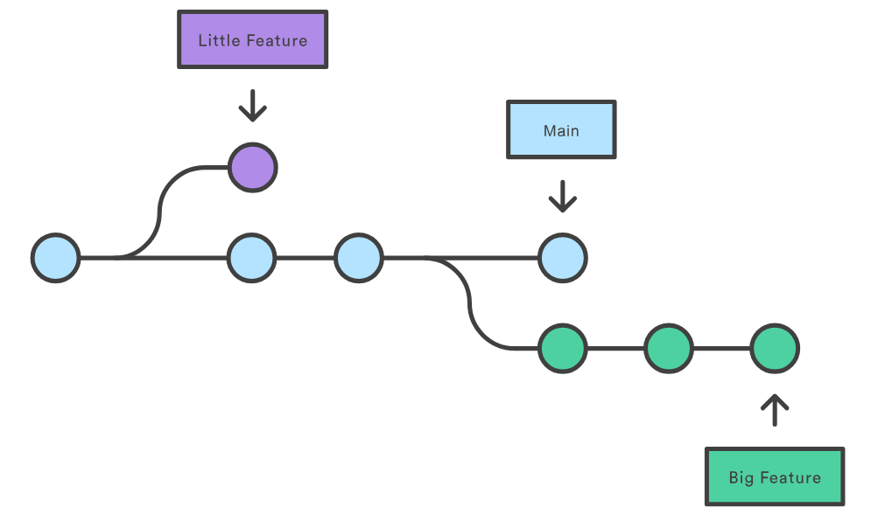
Branches

Slide 46
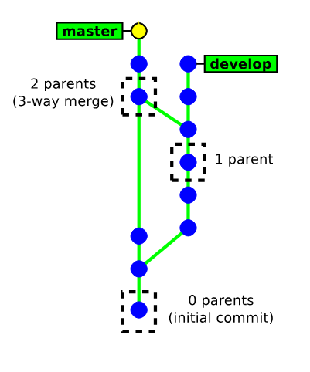
How GIT handles its history
Each commit object has a list of parent commits:
0 parents → initial commit
1 parent → ordinary commit
2+ parents → result of a merge
This is a Direct Acyclic Graph

Slide 47
How GIT handles its history
here is no formal “branch history”
a branch is just a pointer on the latest commit.
(git handles branches and tags in the same way internally)
Commits are identified with SHA-1 hash (160 bits) computed from:
the commited files
the meta data (commit message, author name, . . . )
the hashes of the parent commits
A commit id (hash) identifies securely and reliably its content and all the previous revisions

Slide 48
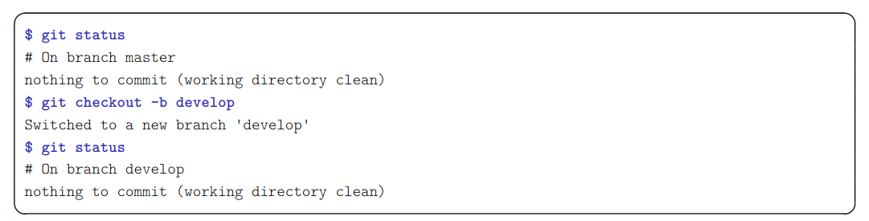
Creating a new branch
git checkout -b new_branch [ starting point ]
new branch is the name of the new branch
starting point is the starting location of the branch (possibly a commit id, a tag, a branch, . . . ). If not present, git will use the current location.
Notes:
gitkraken

Slide 49
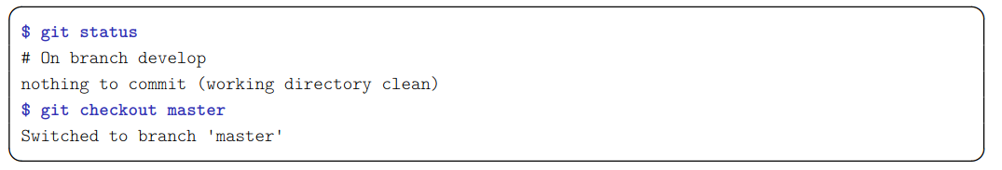
Switching between branches
git checkout [-m] branch_name

Slide 50
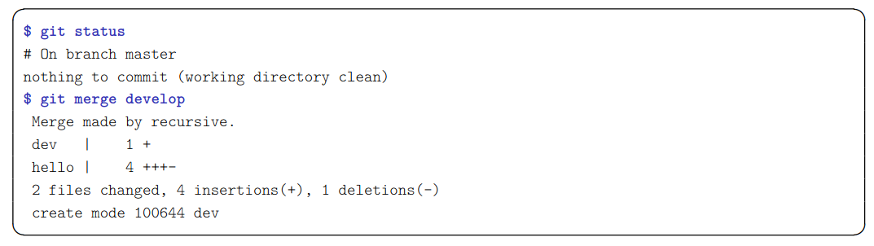
Merging a branch
git merge other_branch
This will merge the changes in other branch into the current branch
Notes:
2212 git checkout -b develop
2213 git status
2214 gitk
2215 git checkout master
2216 git checkout develop
2218 echo "vyvoj novej vlastnosti" >> f1
2219 git status
2221 git commit -m "nova funkcia" f1
2222 git status
2223 git switch master
2225 git merge develop

Slide 51
About merging
The result of git merge is immediately committed (unless there is a conflict)
The new commit object has two parents.
git merge applies only the changes since the last common ancestor in the other branch.
Notes:
git log --graph --oneline --all

Slide 52
Branging example
https://docs.google.com/document/d/1CjpQSLBXQNRSQquDXfxxzqrvNA87tQZ9UX9R-9ZfdBw/edit?usp=sharing

Slide 53
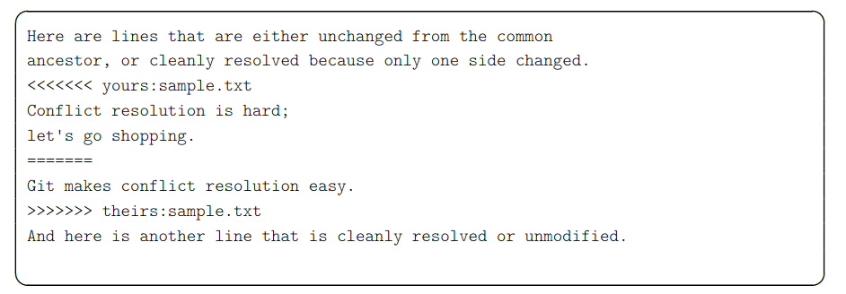
How Git merges files ?
If the same file was independently modified in the two branches, then Git needs to merge these two variants
textual files are merged on a per-line basis
lines changed in only one branch are automatically merged
if a line was modified in the two branches, then Git reports a conflict. Conflict zones are enclosed within <<<<<<< >>>>>>>
binary files always raise a conflict and require manual merging

Slide 54
Merge conflicts
In case of a conflict:
unmerged files (those having conflicts) are left in the working tree and marked as “unmerged”
the other files (free of conflicts) and the metadata (commit message, parents commits, ...) are automatically added into the index (the staging area)

Slide 55
Conflict example
https://docs.google.com/document/d/1uJxeoGkUgq-_i5pm3nKEr0H5qWRzZSKIk8ggNjrrh90/edit?usp=sharing

Slide 56
Resolving conflicts
There are two ways to resolve conflicts:
either edit the files manually, then run
git add file → to check the file into the index
or
git rm file → to delete the file
or with a conflict resolution tool(xxdiff, kdiff3, emerge,....)
git mergetool [ file ]
Then, once all conflicting files are checked in the index, you just need to run git commit to commit the merge.
Notes:
mergetool
https://examples.javacodegeeks.com/software-development/git/git-mergetool-example/
2247 git status
2248 echo master >> f1
2249 git checkout develop
2250 git status
2251 git commit -m master f1
2252 git checkout develop
2253 echo develop >> f1
2254 git commit -m develop f1
2255 git switch master
2256 git mergetool
2261 git config --global merge.tool vimdiff
2262 git status
2263 git merge develop
2264 git mergetool
2265 git status
2266 rm f1.orig
2267 git status
2268 cat f1
2270 git commit
2271 cat f1

Slide 57
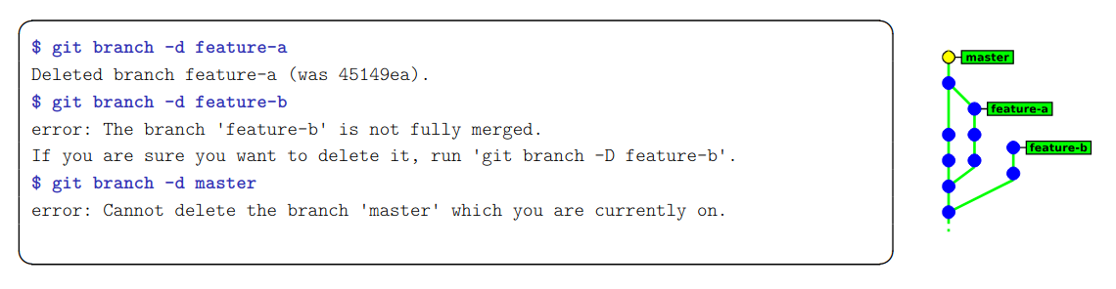
Deleting branches
git branch -d branch name
This command has some restrictions, it cannot delete:
the current branch (HEAD)
a branch that has not yet been merged into the current branch

Slide 58
Lab
http://zeus.fei.tuke.sk/git/git2.html
http://zeus.fei.tuke.sk/git/git3.html
https://docs.google.com/document/d/1L2aJyPvGiZxK5_X_v1EaLUOQhKrl2QO2P_Vc5mRfAdU/edit?usp=sharing

Slide 59
GitLab
Sign In
Notes:
gitlab login

Slide 60
Interacting with a remote
repository

Slide 61
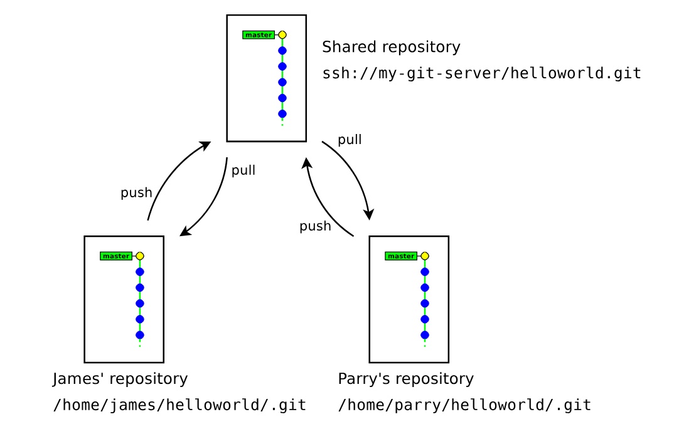
Simple workflow (Centralised)

Slide 62
Team Workflow
https://docs.google.com/document/d/1f4-pzqwKgQNVIVGBc__hfiKylNBI5Xig7bBSe5p-ll0/edit?usp=sharing

Slide 63
How git handles remote repositories
It is possible to work with multiple remote repositories
Each remote repository is identified with a local alias. When working with a unique remote repository, it is usually named origin
Remote repositories are mirrored within the local repository
Remote branches are mapped in a separate namespace:
remote/name/branch
master refers to the local master branch
remote/origin/master refers to the master branch of the remote repository named origin

Slide 64
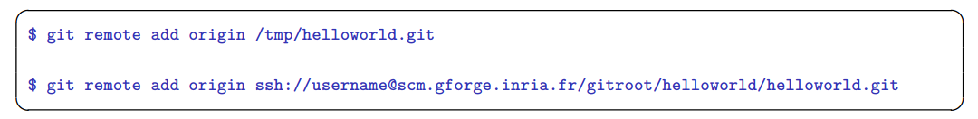
Adding a remote repository
git remote add name url
name is a local alias identifying the remote repository
url is the location of the remote repository
Notes:
gitlab projekt cisty
git init -b main
git remote add origin ……..
git remote -v

Slide 65
Pushing (uploading) local changes to the remote repository
git push
git push examines the current branch, then:
if the branch is tracking an upstream branch, then the local changes (commits) are propagated to the remote branch
if not, then nothing is sent (new branches created locally are considered private by default)
In case of conflict git push will fail and require to run git pull first

Slide 66
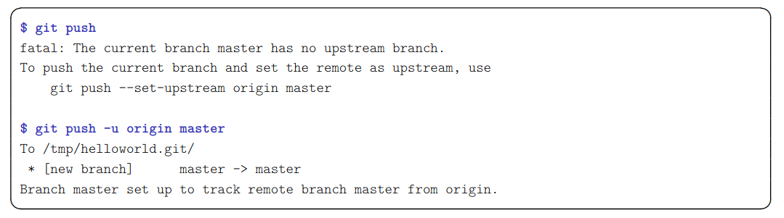
Pushing a new branch to the remote repository
git push -u destination repository ref [ref . . . ]
explicit variant of git push: the local reference ref (a branch or a tag) is pushed to the remote destination repository
-u/--set-upstream configures the local branch to track the remote branch
Notes:
echo abcd > f1
git add f1
git commit -m f1
git push -u origin main
check na gitlab

Slide 67
Fetching (downloading) changes from the remote repository
git fetch updates the local mirror of the remote repository
it downloads the new commits from the remote repository
it updates the references remote/remote name/* to match their counterpart in the remote repository.
Example: the branch remote/origin/master in the local repository is updated to match the new position of the branch master in the remote repository
Notes:
zmeny v subore cez gitlab
git status
git fetch
git diff main origin/main

Slide 68
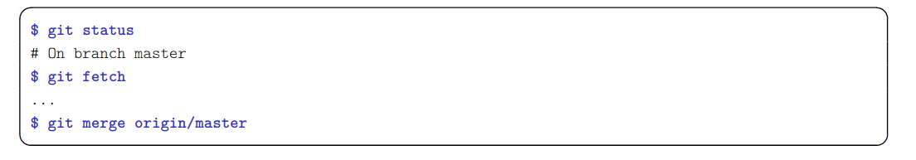
Merging remote changes into the current local branch
Changes in the remote repository can be merged explicitly into the local branch by running git merge
In practice, it is more convenient to use git pull, which is a shortcut for git fetch + git merge
Notes:
git merge origin/main
- - - - - - -
gitlab zmena suboru
git pull

Slide 69
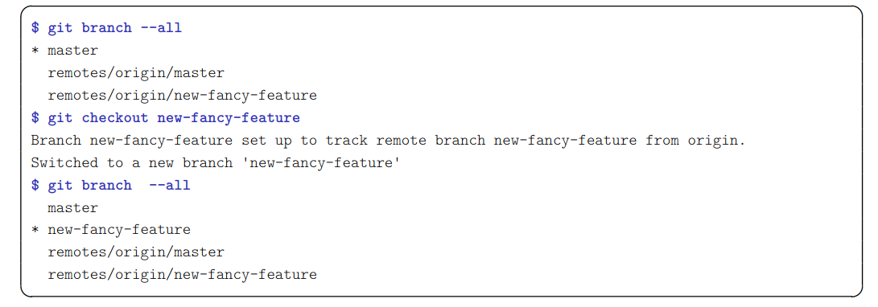
Importing a new remote branch
git checkout branch_name
If the branch name does not exist locally, then GIT looks for it in the remote repositories. If it finds it, then it creates the local branch and configures it to track the remote branch.
Notes:
vytvorit vetvu na gitlab
git fetch
git branch -a
git status
git checkout branch

Slide 70
Cloning a repository
git clone url [ directory ]
git clone makes a local copy of a remote repository and configures it as its origin remote repository
git clone is a shortcut for the following sequence:
git init directory
cd directory
git remote add origin url
git fetch
git checkout master
In practice you will rarely use git init, git remote and git fetch directly, but rather use higher-level commands:
git clone and git pull.
Notes:
new dir
git clone https://……

Slide 71
Remote example
https://docs.google.com/document/d/1TNn7XZ8jqPFiXWuFIm8v0RYK-vkUWC4OIofi3NamlcI/edit?usp=sharing

Slide 72
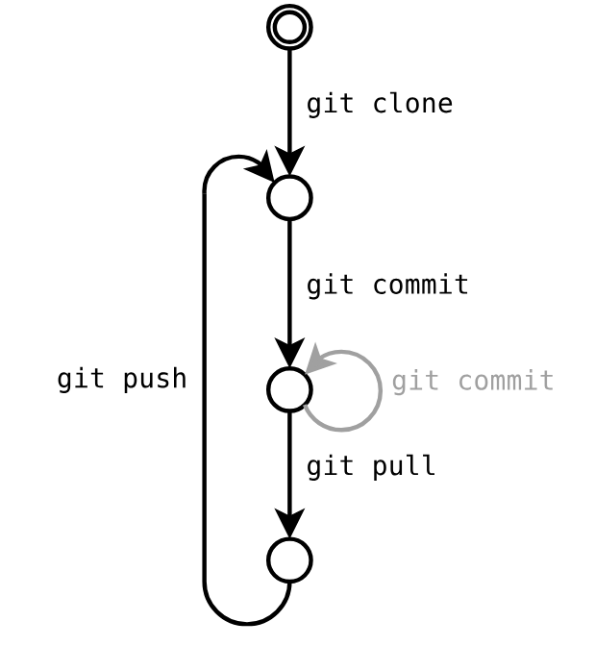
Typical Workflow

Slide 73
Lab
Gitlab Login
https://docs.google.com/document/d/1mNCKAjU-4GRi9o_TcUMRRzgRQrTdJkvVf6_L6iFZyG0/edit?usp=sharing
https://docs.google.com/document/d/1xstPGwzzC0rDIFechTEYKc66XssYd7G07lVPscSKhkY/edit?usp=sharing

Slide 74
Extras

Slide 75
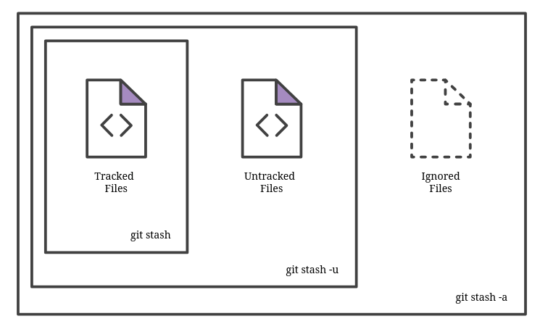
Git stash
git stash
temporarily shelves (or stashes) changes you've made to your working copy so you can work on something else, and then come back and re-apply them later on
git stash pop(apply)
reapply previously stashed changes
Multiple stashes
git stash
git stash
git stash list
git stash pop stash@{X}
Notes:
demo
git status
git stash
git status
git changes…
git stash pop(apply)

Slide 76
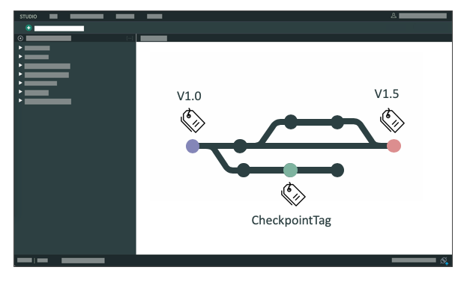
Git tag
Tags are ref's that point to specific points in Git history. Tagging is generally used to capture a point in history that is used for a marked version release (i.e. v1.0.1).
git tag <tagname>
git tag -a <tagname>
Annotated tags store extra meta data such as: the tagger name, email, and date.
Notes:
demo
git log –oneline

Slide 77
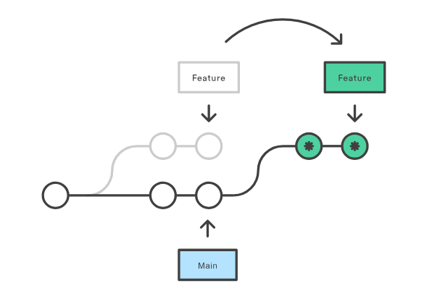
Rebase
Rebasing is the process of moving or combining a sequence of commits to a new base commit.
The primary reason for rebasing is to maintain a linear project history.
git checkout main
git rebase [-i] develop
Notes:
demo

Slide 78
Why rebase?
Creates a linear history; often cleaner and easier to read.
Reorder commits
Change commit stage/message
Drop commits
Squash multiple commits into one
But…DO. NOT. EVER. rebase anything that has already been pushed to a repo someone else has access to
Rebasing removes commits and writes new ones; but someone else might have already based their work off your old commits!
Notes:
git rebase -i HEAD~3

Slide 79
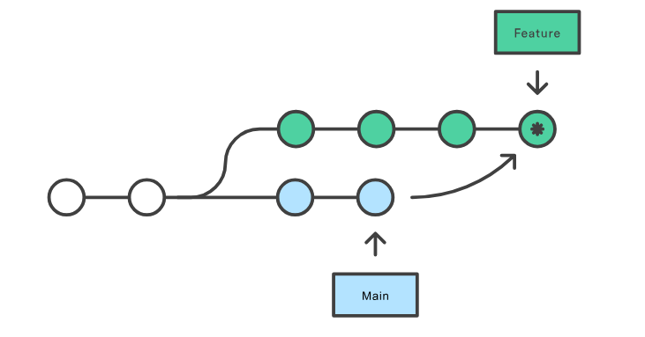
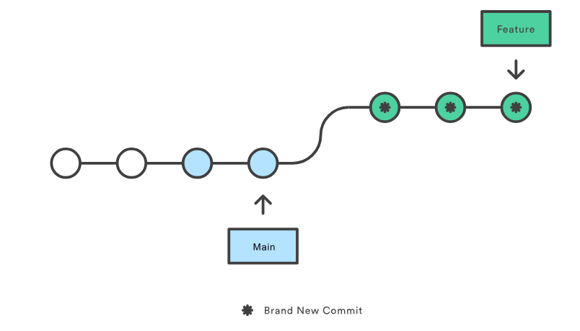
Merge vs Rebase
Instead of a merge, which creates a new commit originating from both branches, a rebase takes the contents of one branch after the “split” and moves them to the end of the other branch.

Slide 80
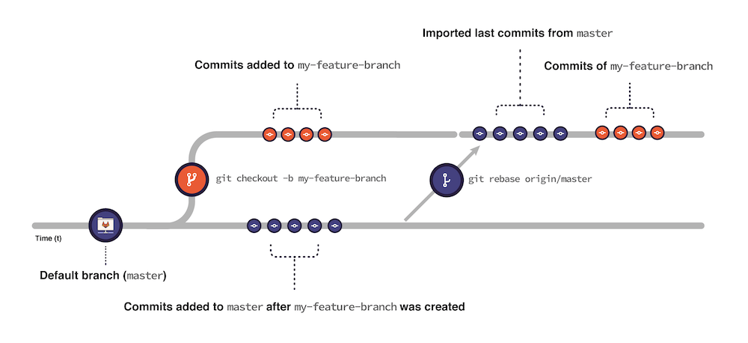

Slide 81
Some advices
commit as often as you can (keep independent changes in separate commits)
run git diff before preparing a commit
in commit messages, describe the rationale behind of your changes (it is often more important than the change itself)
do not forget to run git push
use a .gitignore file to ignore generated files (*.o, *.a, . . . )
don’t be fully desynchronised → run git pull enough often to avoid accumulating conflicts

Slide 82
Common trap
git diff without arguments shows the difference with the index → run git diff HEAD to show the differences with the last commit
git reset reverts the index, but keeps the working copy unchanged → do git reset --hard if you need to revert the working copy too
GIT is not forgiving, do not ignore its warnings and do not use --force unless you have a clear idea of what you are doing
GIT’s history is not immutable
git checkout on an arbitrary commit or a tag (anything that is not a branch) puts your in “detached HEAD” state. You can commit, but your history be lost if you don’t create any branch (or tag) to reference them.

Slide 83
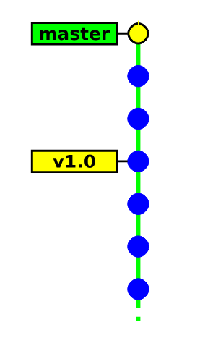
Detached head state

Slide 84
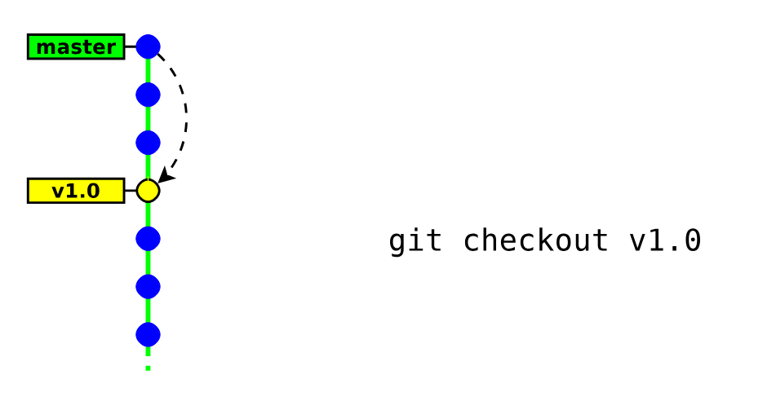
Detached head state

Slide 85
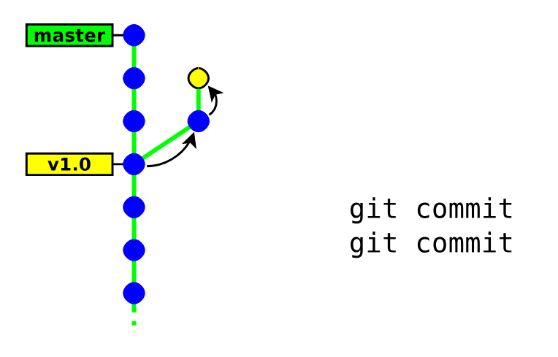
Detached head state

Slide 86
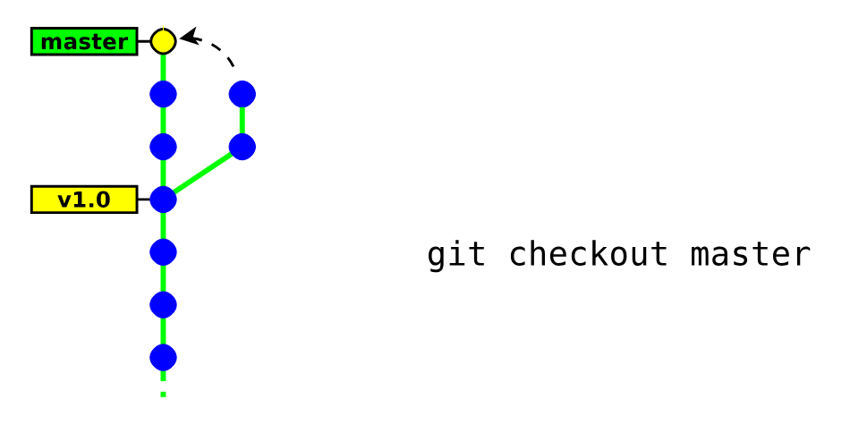
Detached head state

Slide 87
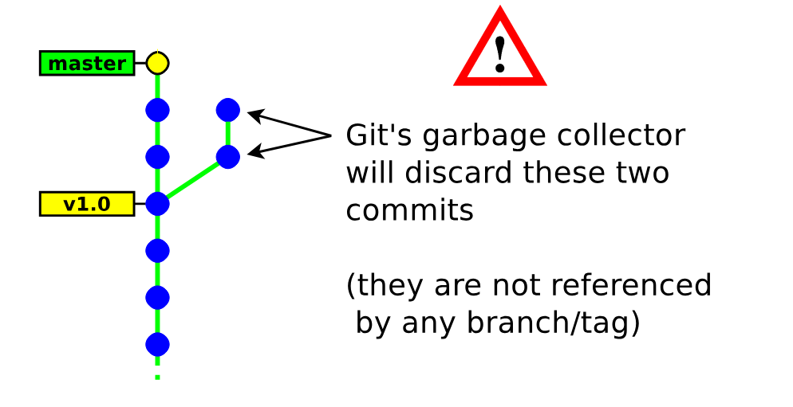
Detached head state
Notes:
git switch -c branch

Slide 88
Lab
https://console.cloud.google.com/cloudshell/editor?cloudshell_git_repo=https://github.com/praqma-training/git-katas.git
or Clone Repository - https://github.com/eficode-academy/git-katas
Try exercises (cd bold; cat README.md)
basic-commits - Very basic creation of commits.
basic-staging - Interacting with the stage (index).
basic-branching - The first stride into branching.
ff-merge - A tour around the most trivial of merges.
3-way-merge - A basic merge, involving multiple diverged branches.
basic-revert - Use revert to revert a change
reset - Reset is a powerful and slightly dangerous command if you do not know what you are doing. Go through the three modes of resetting here.
basic-cleaning - Cleaning the workspace.
amend - Amending previous commits.
basic-stashing - The first stride into stashing.
ignore - The basics of using the .gitignore file. And using git rm.
git-tag - Tags are convenient for keeping track of commits that bump a version number. In this exercise, you will list, add and delete tags.
https://www.w3schools.com/git/exercise.asp

