Slide 1
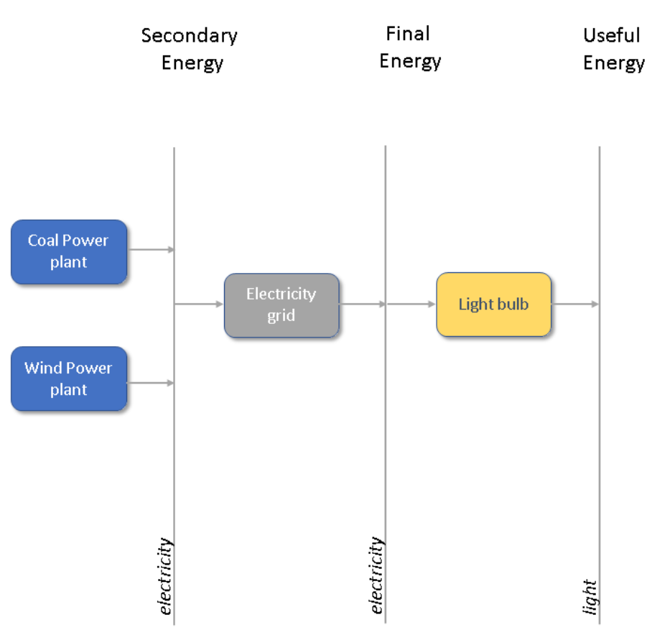
Secondary Energy
Storage
Energy
Tertiary
Energy
Final
Energy
Wind power plant
Water electrolyser
Fuel cell
Hydro turbine
Hydro turbine
Battery
grid
Hydrogen
Electricity
Water
Electricity
Electricity

Slide 2
