Slide 1







Programovanie moderných Web Aplikácií vo Vue.js

Slide 2
Installation
download and install Git
download and install Node.js
download and install VSCode
open command line
npm install -g @vue/cli
start VSCode

Slide 3
Basic VSCode setup
open terminal window
select default shell
open cmd shell
check vue --version (3.11.0 as of 9/2019)
check npm --version (6.11.2 as of 9/2019)
check node --version (v10.13.0 as of 9/2019)

Slide 4
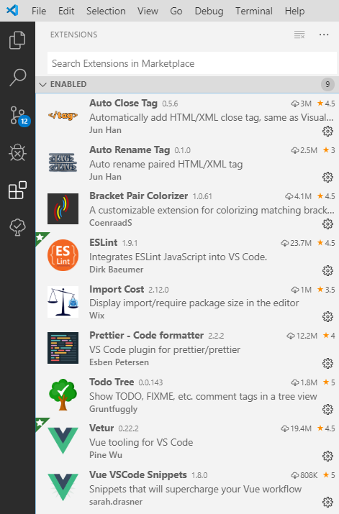
Install VSCode plugins

Slide 5
Create basic project scaffold
vue create <app_name>
manually select features
add vuex and router
use history mode
ESLint standard
Lint on save
Dedicated config files
Open the created project - File > Open Project

Slide 6
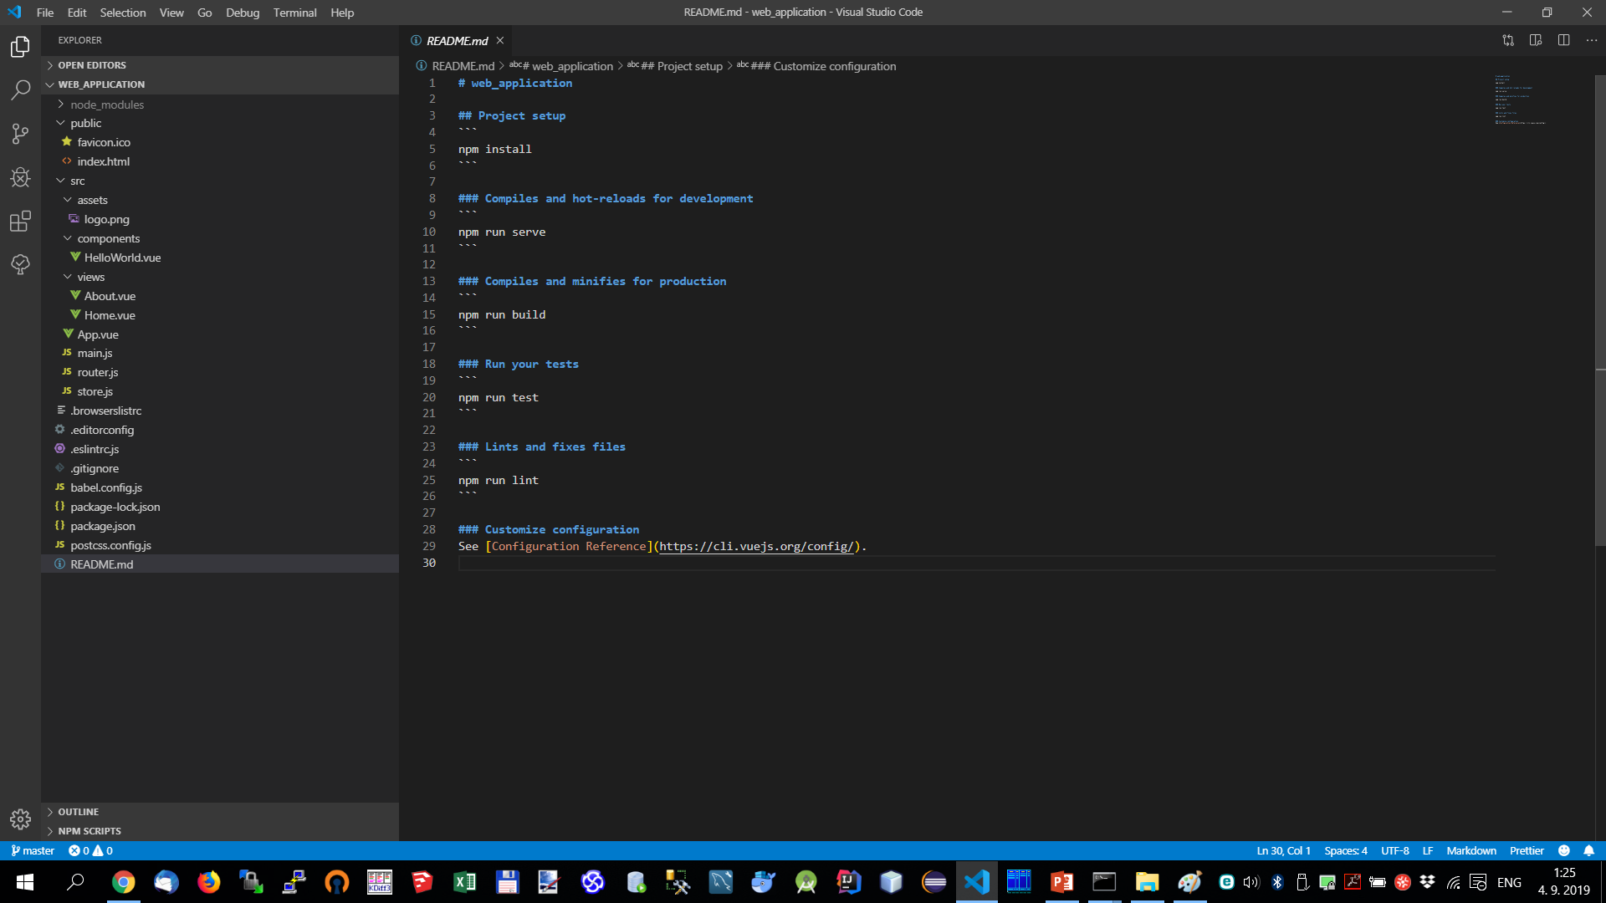
Review basic project scaffold with vuex and router

Slide 7
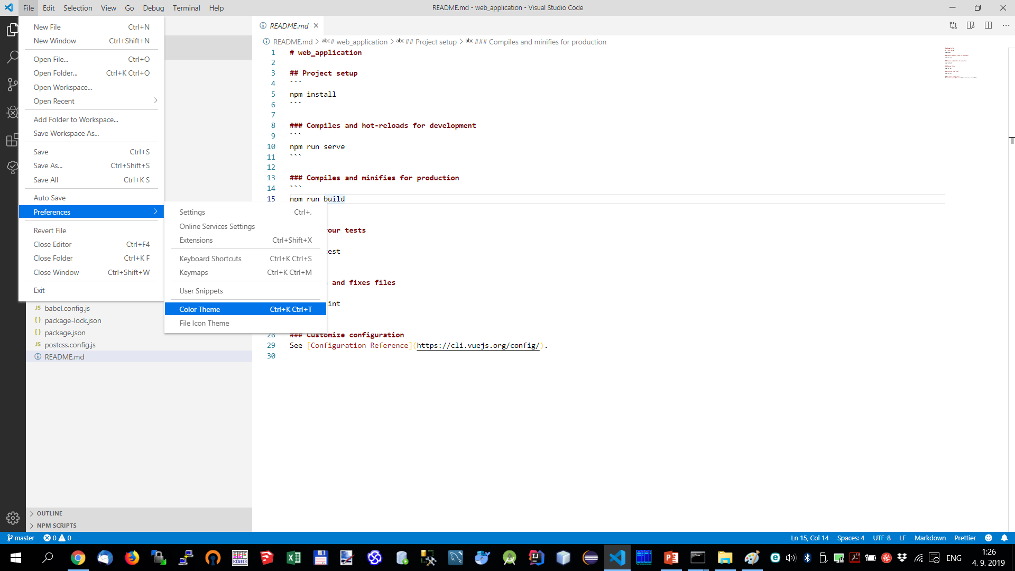
Adjust VSCode theme if wished to

Slide 8
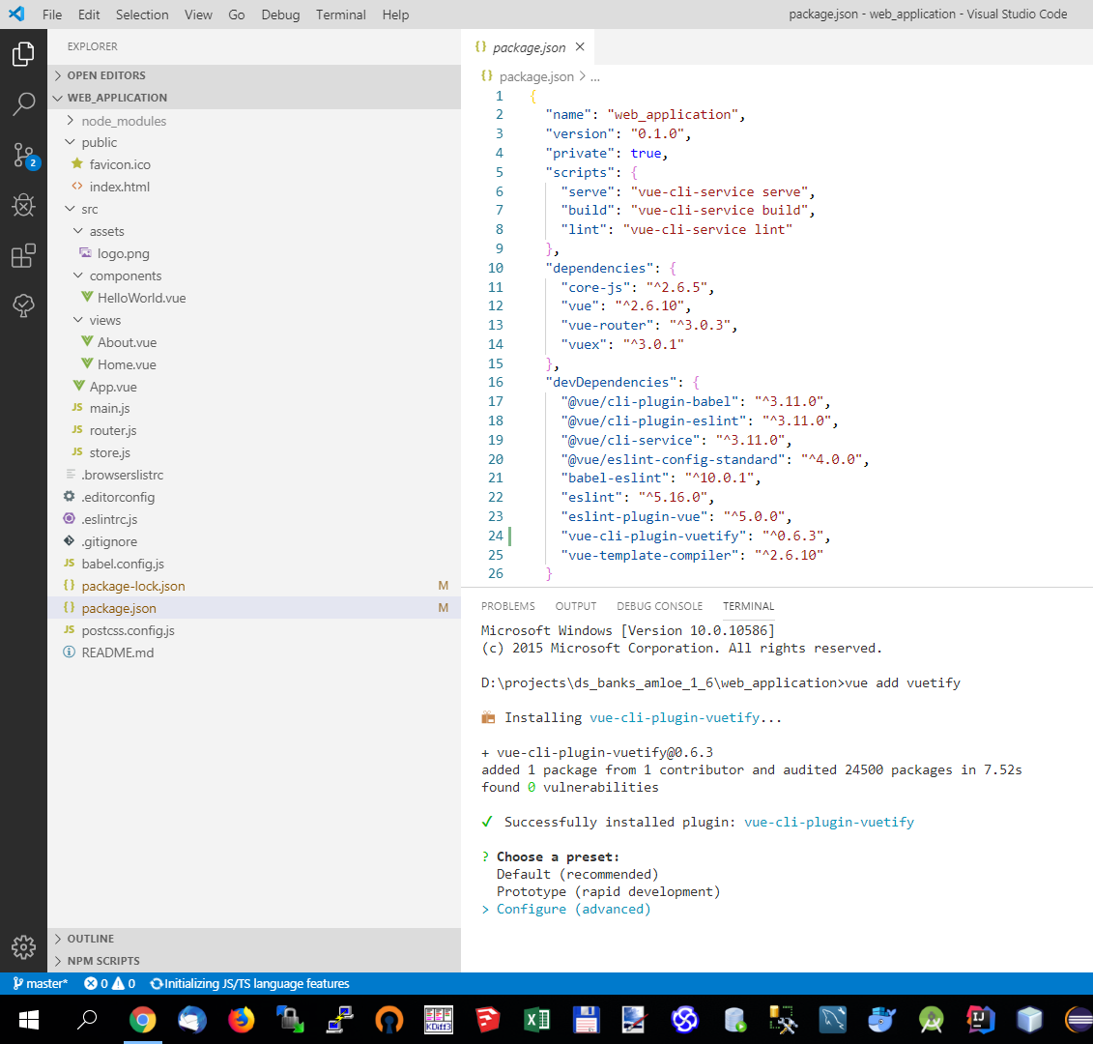
Add Vuetify component library
configure the installation
yes to pre-made template
no to custom theme
no to custom properties
font mdi
yes to use fonts as dependency
yes to a-la-carte components

Slide 9
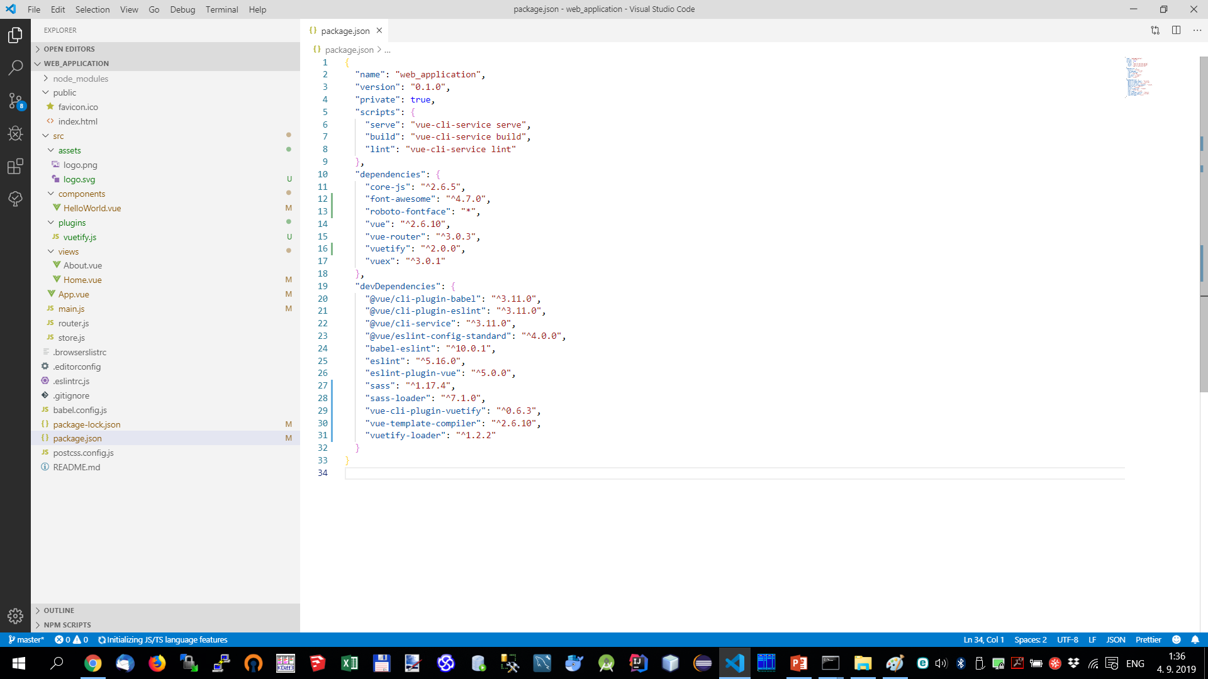
Review project and dependencies

Slide 10
Cleanup the project
move router.js and store.js to plugins directory
delete About.vue and Home.vue Views
delete HelloWorld.vue Component
delete or comment out paths from router.js

Slide 11
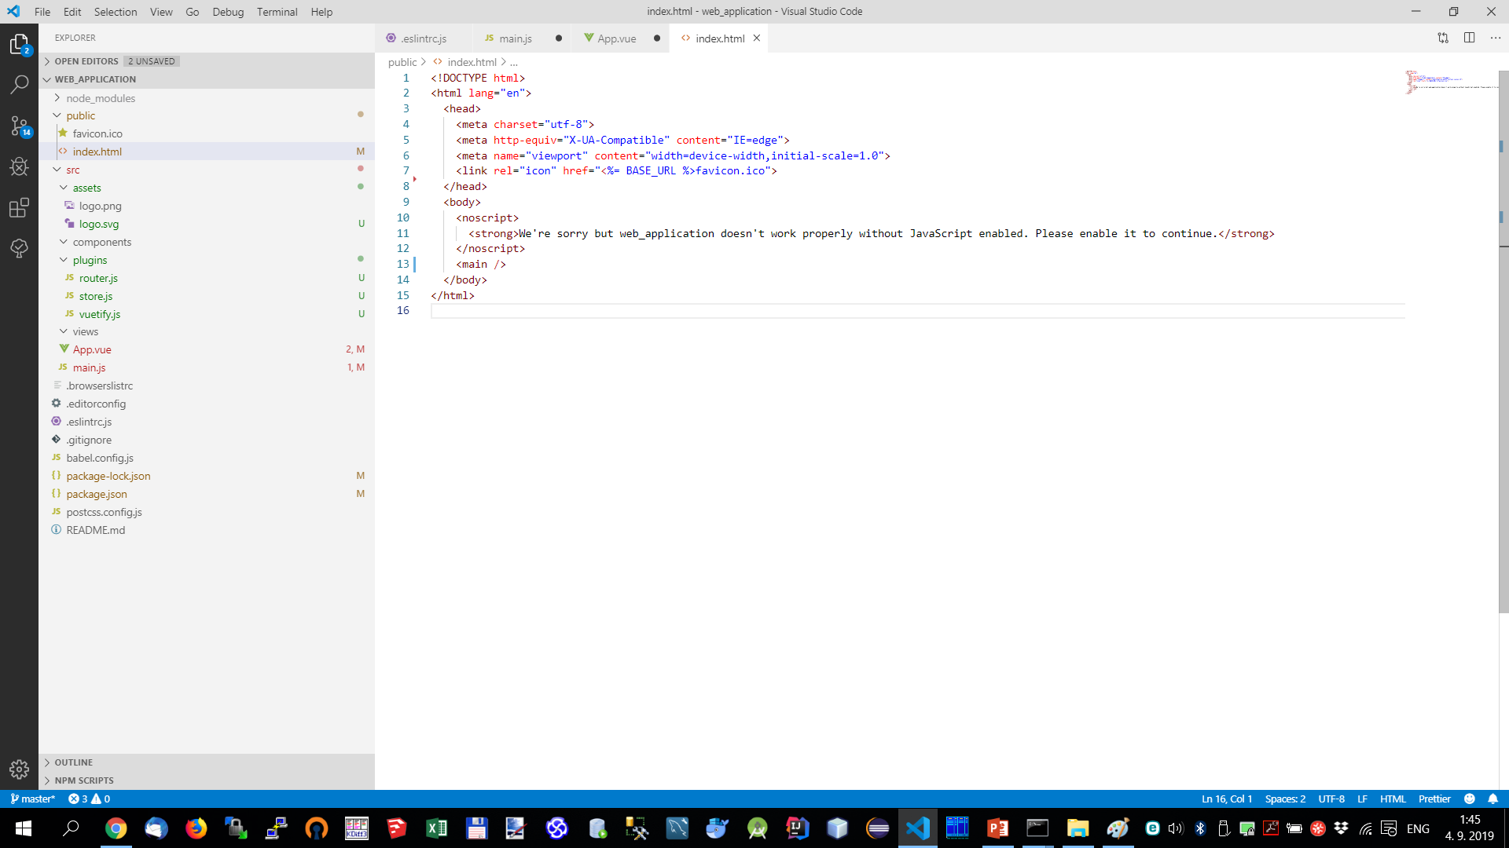
index.html - replace app div by main element and delete title (we make it dynamic)

Slide 12
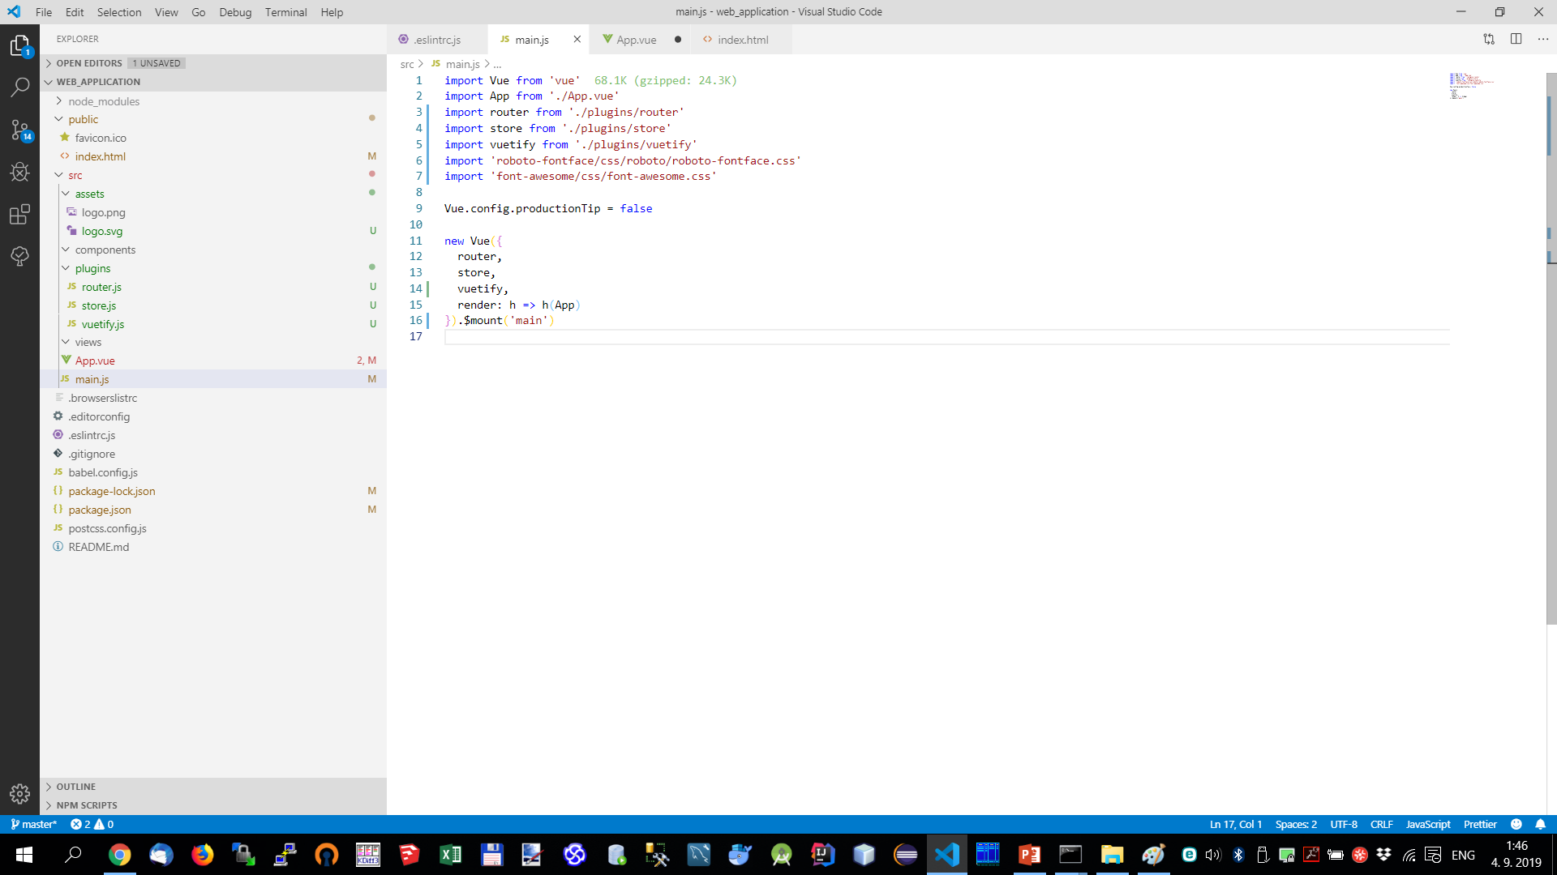
main.js - change vue mount to main element

Slide 13
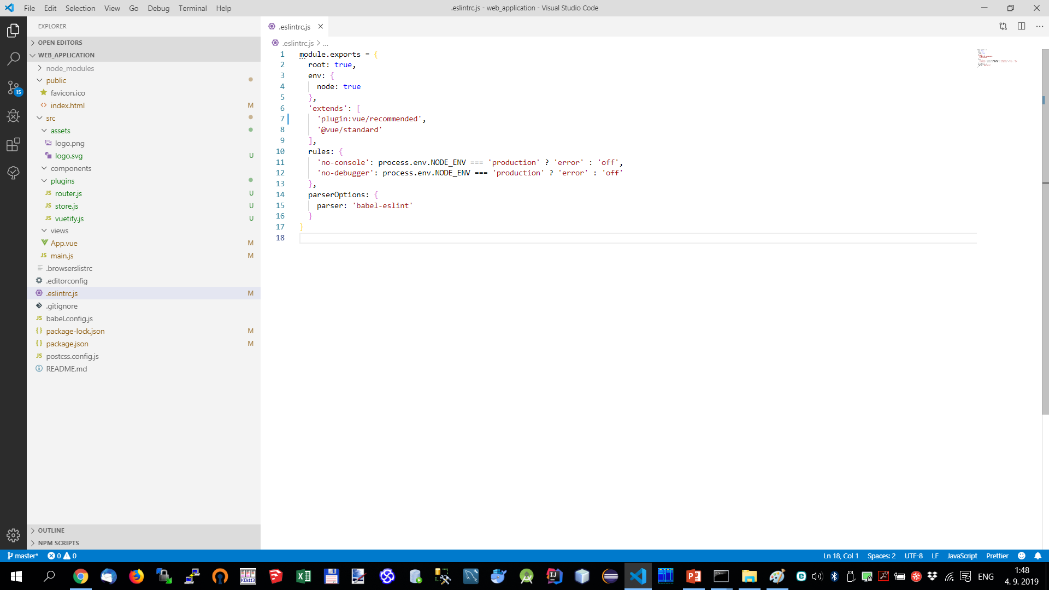
.eslint.js - update plugin vue/essential to vue/recommended

Slide 14
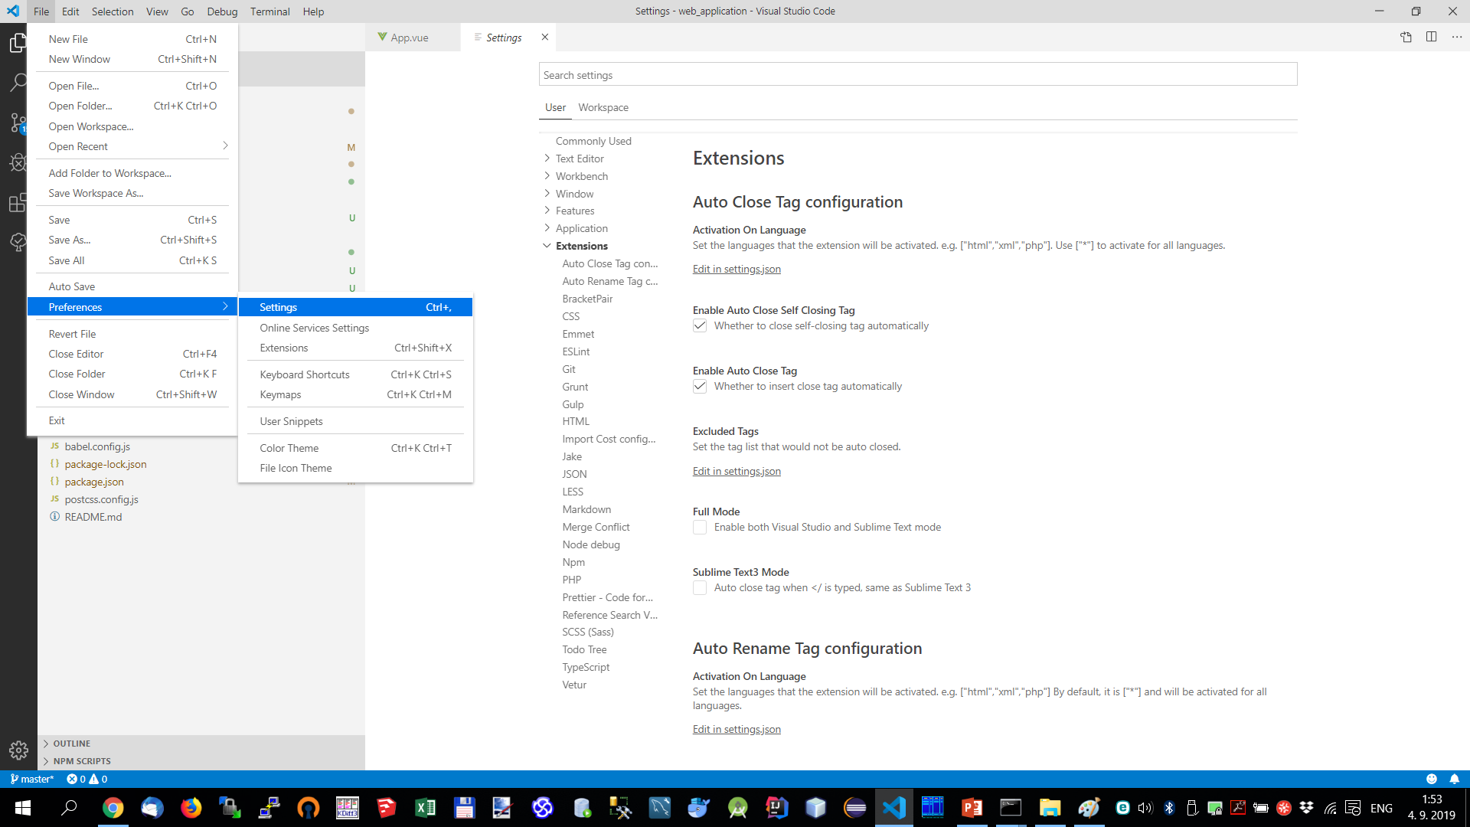
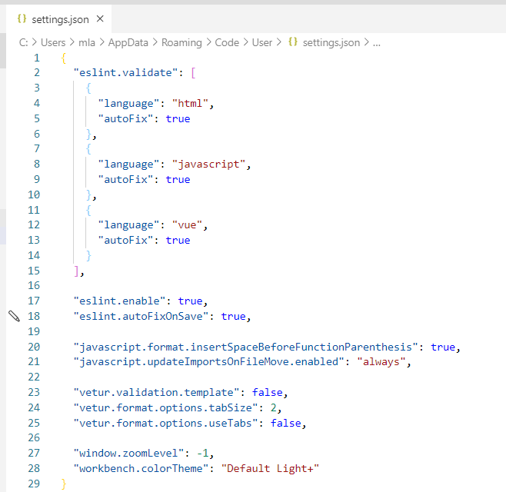
Customize VSCode settings to get autofix

Slide 15
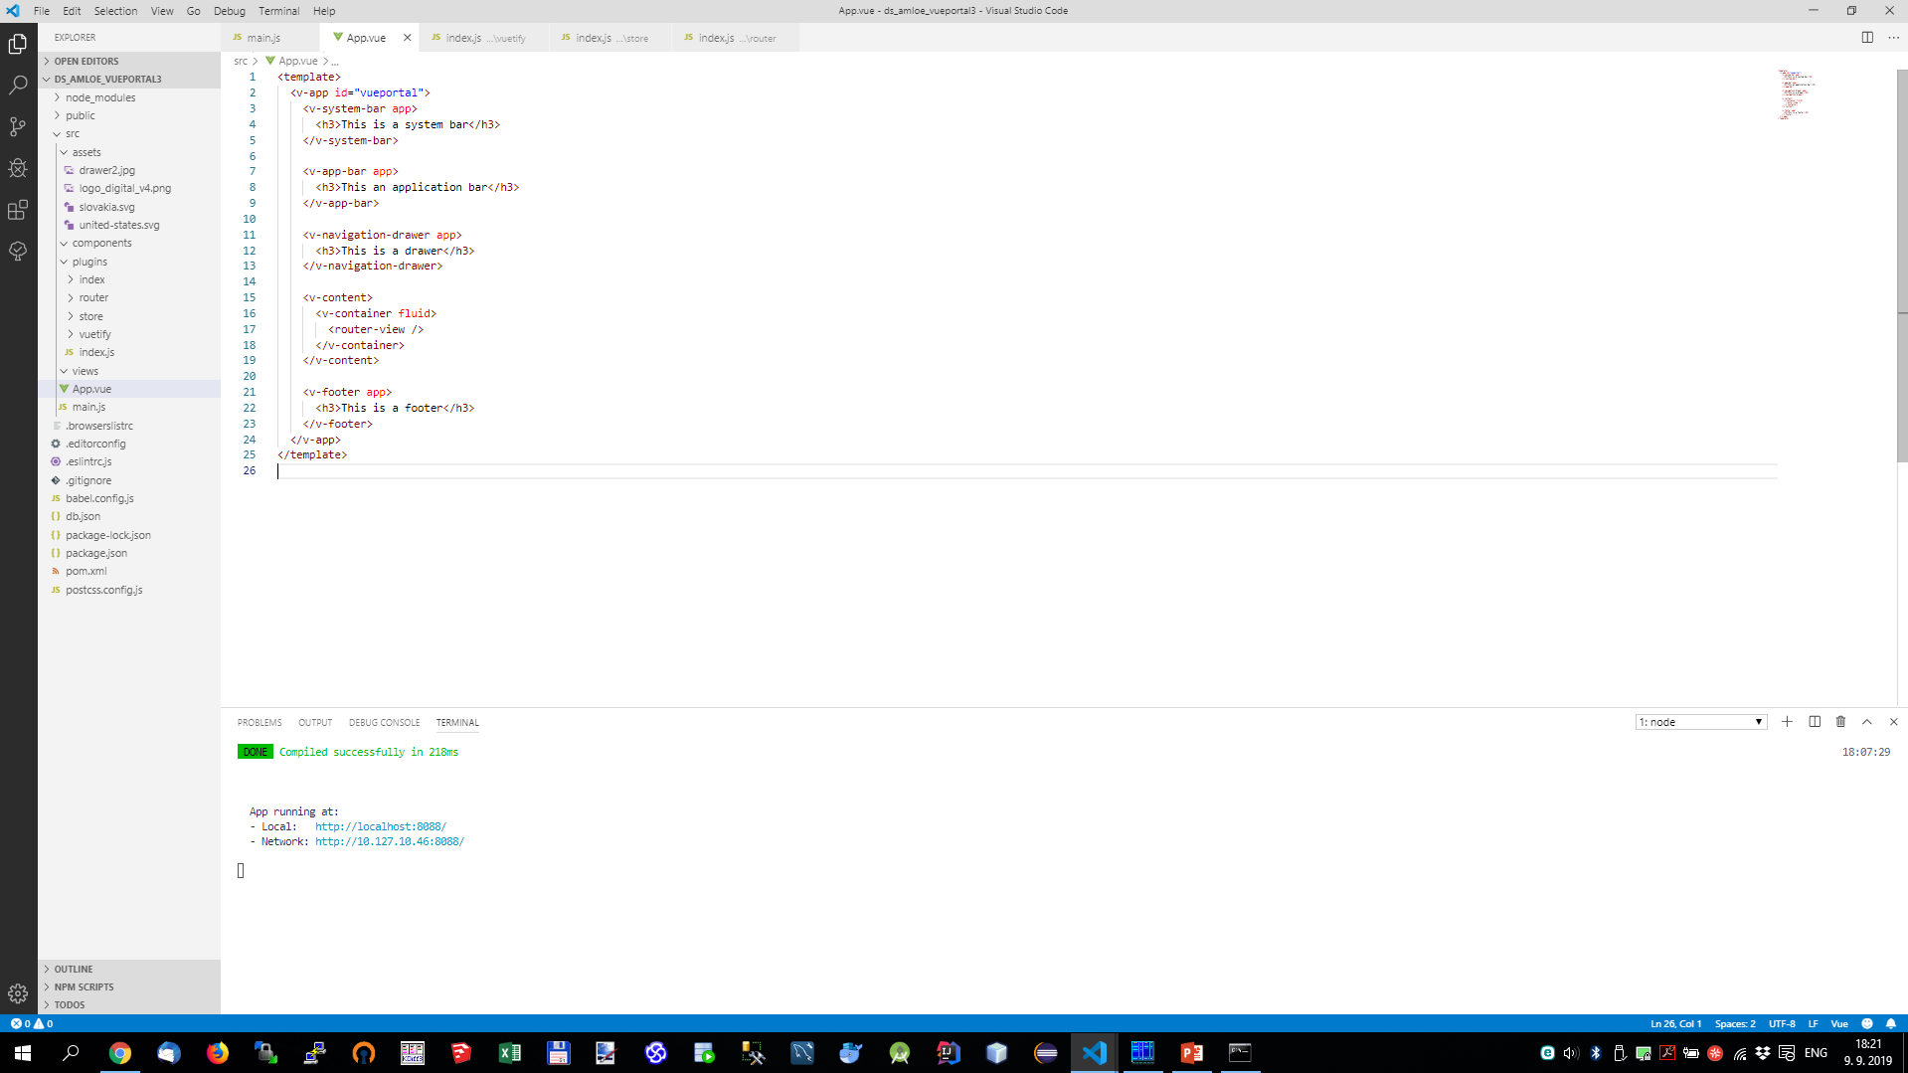
Establish application layout in App.vue

Slide 16
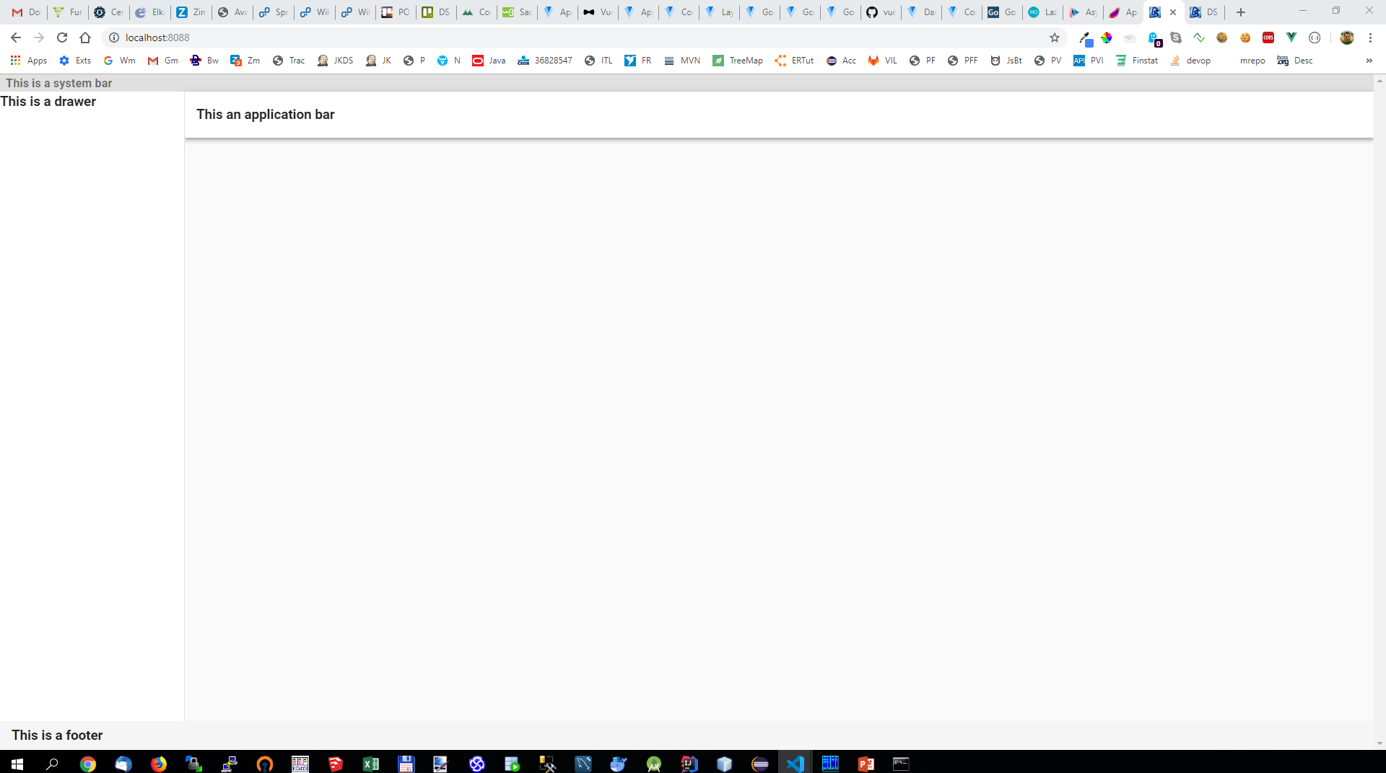
Establish application layout in App.vue

Slide 17
Establish application layout in App.vue
craeate single file vue components
AppBar.vue
Content.vue
Drawer.vue

