Slide 1
Pragmatic approach to writing and maintaining tests
Marek Dominiak
marek@dominussoft.pl
Notes:
Moje cele:
Zarzuc 5 zartow z ktorych sam sie bede smial
Zadane pytanie powtorz albo oddeleguj po prezentacji
Nie robic w przerwach EEEEEEE
Dac mozliwosc uczestnikom na zadawanie pytan - odpowiadac na nie po chwili - byc bardziej interaktywnym

Slide 2





Slide 3
Agenda
Observation
Maintaining tests with time is getting harder and harder
What can go wrong?
How to deal with “challenges”
#WDI18
Notes:
Inne prawa dla kodu testow i produkcyjnego

Slide 4

Observation: In a big project writing and maintaining tests...
Is getting harder and harder
It’s getting more costly
And in some projects it can became a
sophisticated sado-maso game for programmers
#WDI18

Slide 5

Why do we want to write tests?
Duh! Is it really necessary to explain this in 2018?
Regression
Refactoring
Fast feedback *
Check code correctness
Good tool for checking quality
of the production code
It’s cool not to switch job
every 1.5 years
Testing live on production **
#WDI18

Slide 6
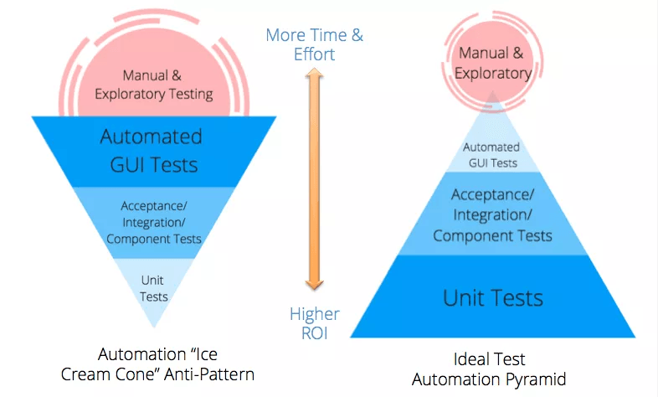
Revered test pyramid
GOOD!
BAD!
#WDI18
Source: http://www.abstracta.us/2015/10/26/best-testing-practices-for-agile-teams-the-automation-pyramid/
Notes:
Pozniej opowiemy sobie jak dochodzi do ani patternu odwroconej piramidy
To jest zalozenie dla ogolu/wiekszosci projektow - na pewno dla niektorych projektow “idealne” piramidy beda wygladac inaczej

Slide 7
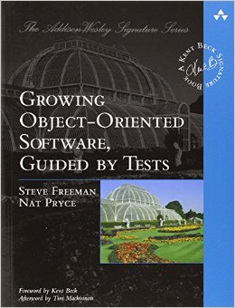
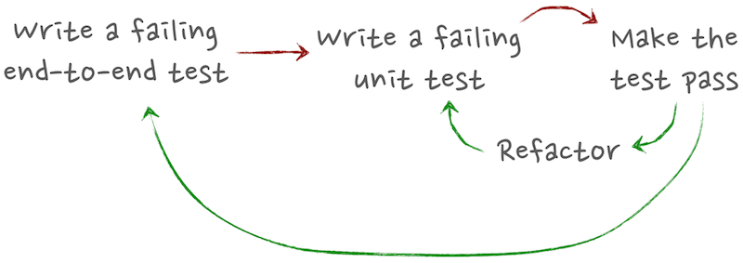
BDD in practice
Source: http://megakemp.com/2014/04/24/bdd-all-the-way-down/
#WDI18
Notes:
Leading test - Uzytkownik sie rejestruje,
Moze sie zalogowac na konto
I widzi homepage
I dostaje email potwierdzajacego rejstracje
1,3,15 testow

Slide 8
How many tests to write?*
Unit - 75% of all tests (testing core domain)
Integration - 20%
Acceptance - 5%
Manual - 0%
* Of course, it depends on the project. This is just an example. Pick your own ratios consciously and you will be fine
#WDI18
Notes:
Nie wszystkie moduly sa rowne, niektore sa wazniejsze :)
Idealna piradmida bedzie wygladac inaczej dla konkretnego projektu

Slide 9
What problems do you have with your unit tests?
They don’t test important functions (they should test Core domain)
They are hard to write
It's hard to read them - too much magic
They are unstable
There are slow
Too many mocks are needed!
#WDI18

Slide 10
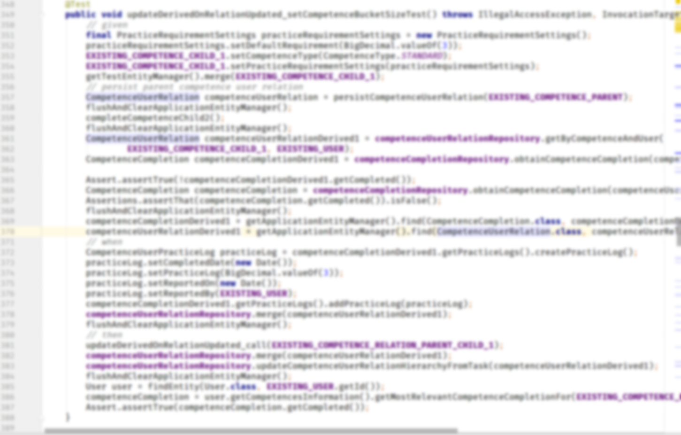
Example of a bad test
#WDI18

Slide 11
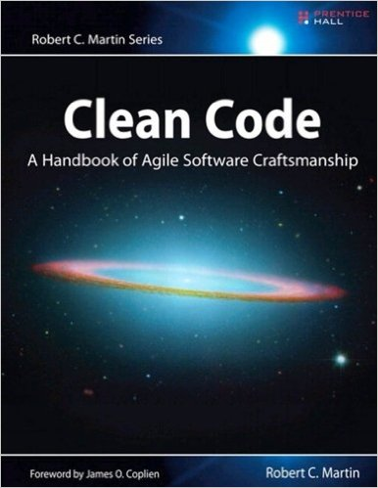



Problem - Unit test is hard to write
How to fix it?
Use Test builders
Refactor test and production code (Clean code)
Redesign the production code (Solid, GRASP, DDD, CQRS,
Hexagonal architecture)
Use mock-s / s-stub if necessary (Mockito)
#WDI18

Slide 12
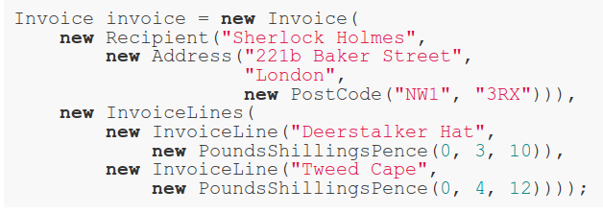


Test builders
BAD!
Object with predefined values.
Customized object
GOOD!
#WDI18
Source: http://www.natpryce.com/articles/000714.html http://www.natpryce.com/articles/000726.html

Slide 13
Problem: they are too hard to read
How to fix it?
Inline setup
Use Test builders
Expect literals
Remove loop from test code → use parameterized tests (testng, spock, Junit params)
One assert per test
Assert for exceptions - Assertions.assertThatThrownBy(..)
Don’t use @Test(excepted=). Junit 5 comes with assertThrows
#WDI18
Notes:
Test and production code have different laws

Slide 14
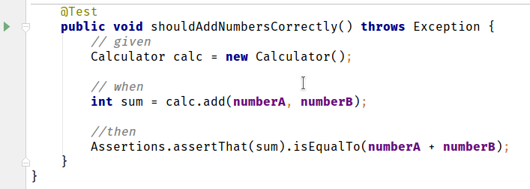
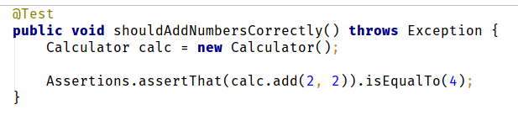
Expect literals
BAD!
GOOD!
#WDI18
Notes:
Maybe magic numbers are ok in tests.
DRY

Slide 15
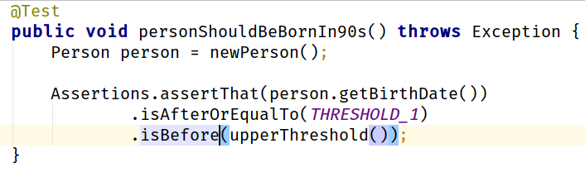
Inline setup, expected literals
#WDI18

Slide 16
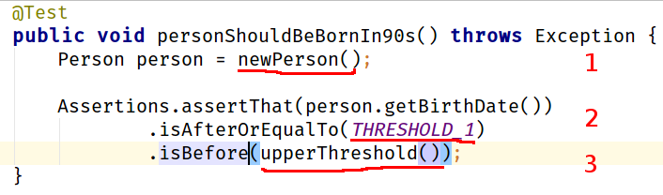
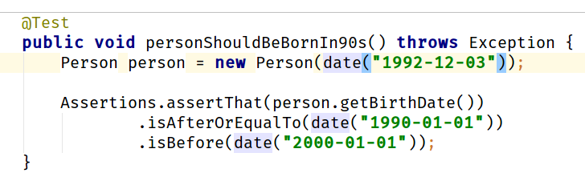
Inline setup, expected literals
VERY BAD!
GOOD!
#WDI18

Slide 17
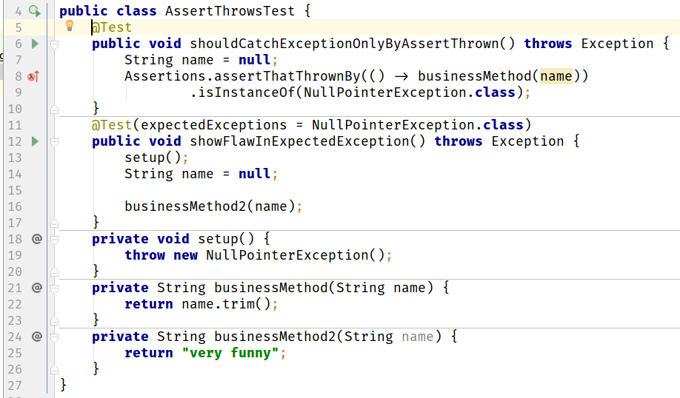
What is wrong with Expected exception?
#WDI18

Slide 18
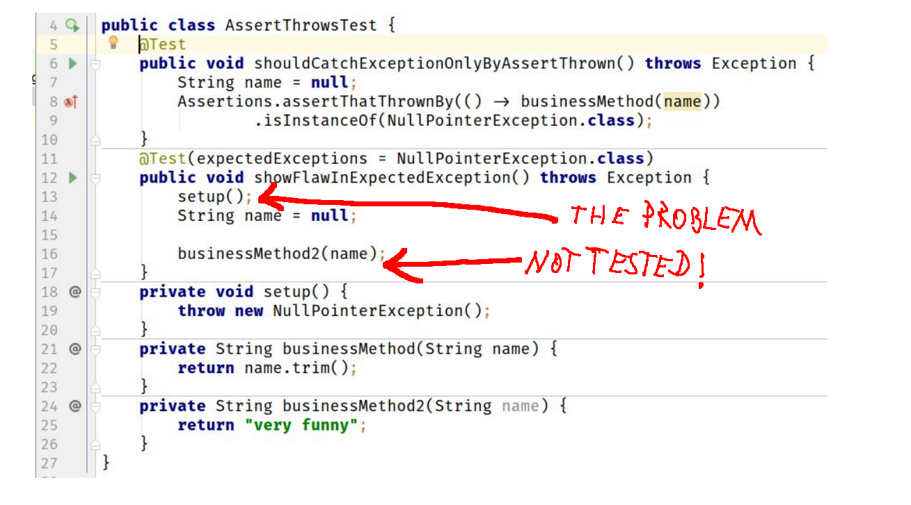
What is wrong with Expected exception?
GOOD!
BAD!
#WDI18

Slide 19

Problem: they are unstable
How to fix it?
The tests should test a single behavior - one
reason to fail
Do not rely too much on DRY, use DAMP instead →
(Descriptive And Maintainable Procedures)
Avoid inheritance hierarchy of classes of tests
Operations on dates/time -> in production code
use Clock instead of LocalDateTime.now() or new Date()
ThreadLocal variables not cleaned between tests
#WDI18

Slide 20


Problem: they are slow
BAD!
GOOD!
#WDI18

Slide 21
Problem: they are slow
How to fix it?
Delete sleep-s from code - Use Clock instead (see example SessionRegistryImplTests.java)
Make sure tests do not use external resources (e.g. they do not touch the file system etc.). All external resources should be mocked
#WDI18
Notes:
Co moze byc zepsute bedzie zepsute

Slide 22
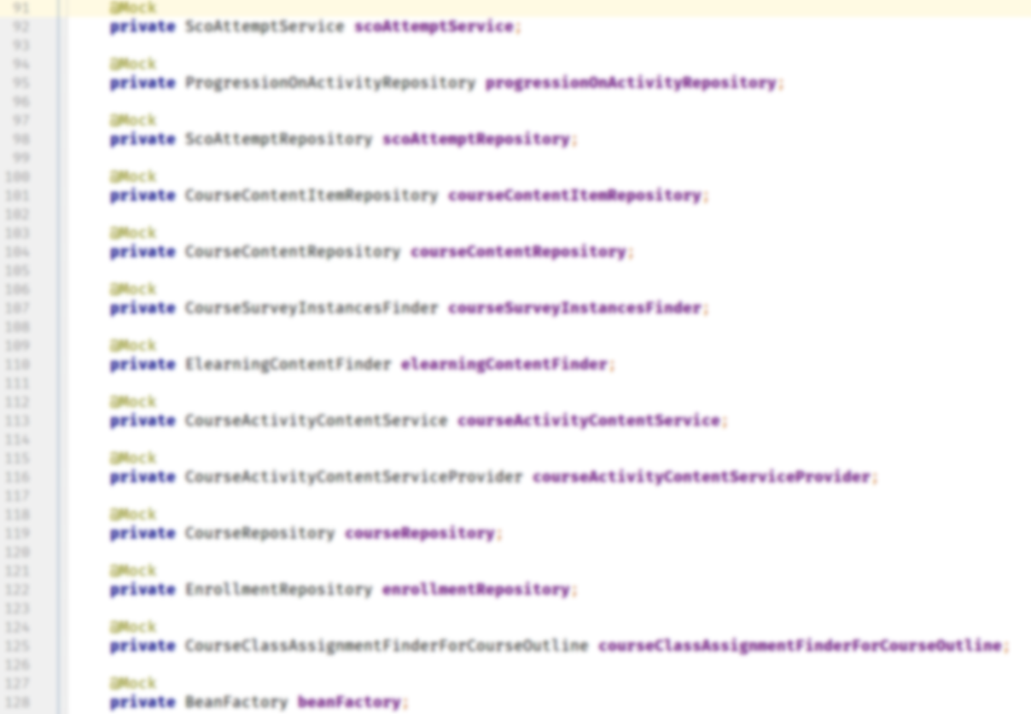
Too many mocks!
#WDI18

Slide 23
Problem: too many mocks!
How to fix it?
Redesign production code if not too late…
  Use SRP - Single Responsibility Principle
  SOLID Principles
  GRASP - General Responsibility Assignment Software Patterns
  DDD - Domain Driven Design
  CRQS - Command Query Responsibility Segregation
  ES - Event Sourcing
  Microservices
Probable cause: too many Bounded Contexts mixed together
#WDI18

Slide 24
Characteristics of good unit tests
Fast
Independent (they do not rely too much on DRY)
Stable
Easy to read
Easy to write -> to get high ROI (Return Of Investment)
Testing only one behavior - only one reason to fail
#WDI18
Notes:
Cechy

Slide 25
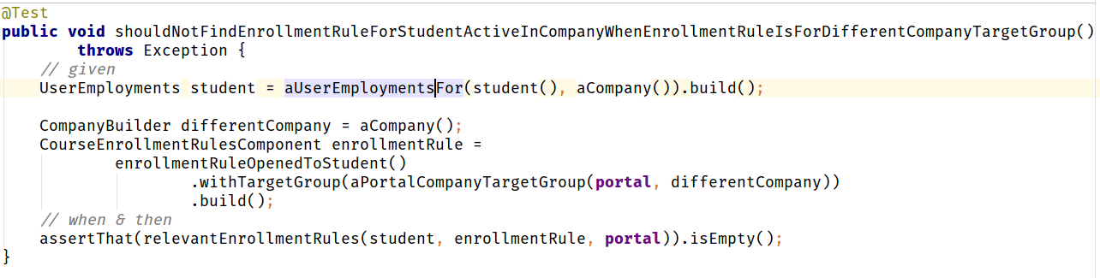
Example of a good unit test
#WDI18

Slide 26
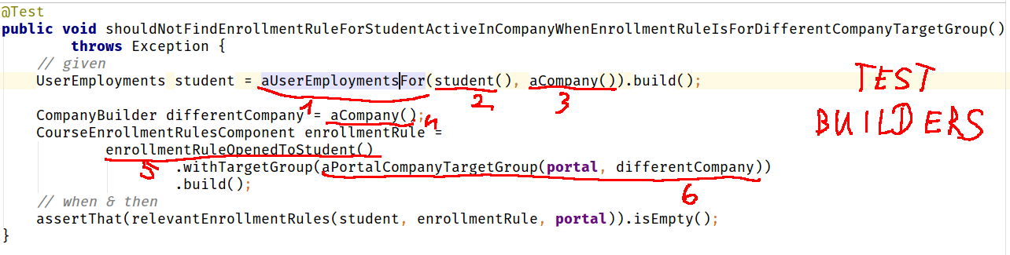
Example of a good unit test - using test Builders
#WDI18
Notes:
Dodaj zaznaczenie uzycia test builderow

Slide 27
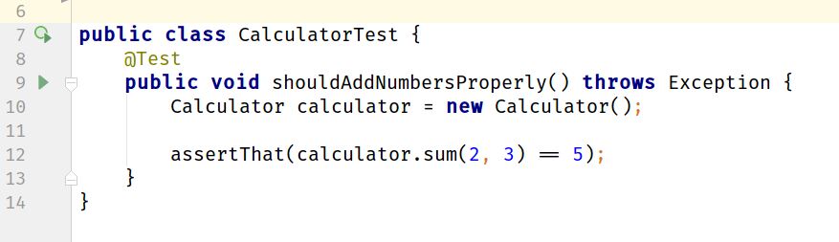
Can you spot what is wrong with this test?
This test is always green
There are no assertions here
#WDI18

Slide 28
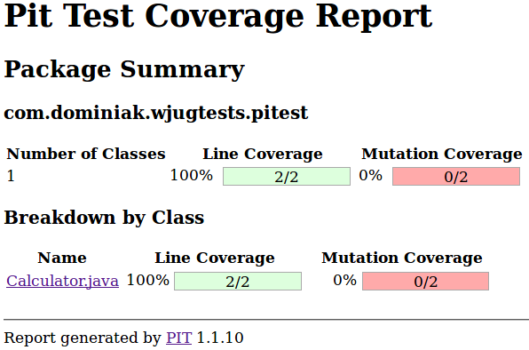
Mutation testing (Pitest) to the rescue!
#WDI18

Slide 29
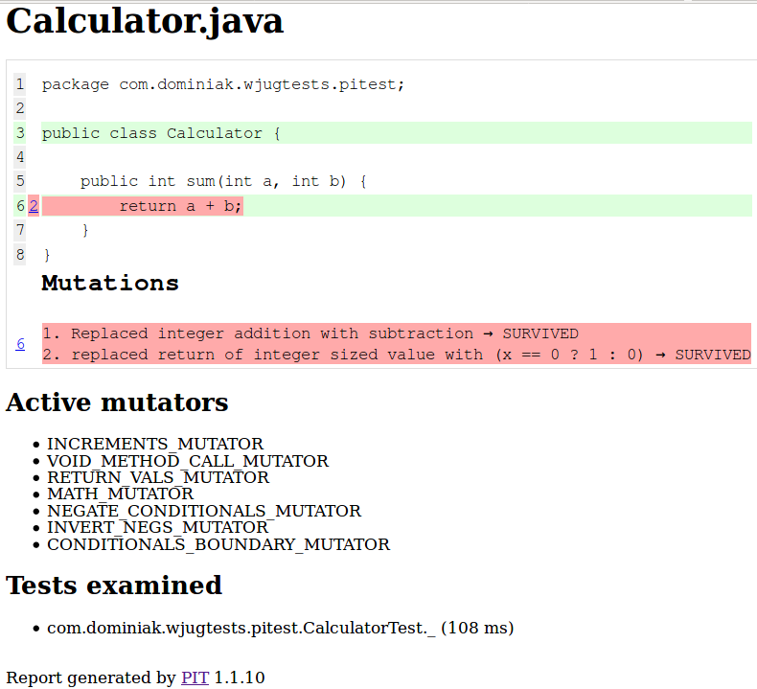
Mutation testing (Pitest) to the rescue!
#WDI18

Slide 30
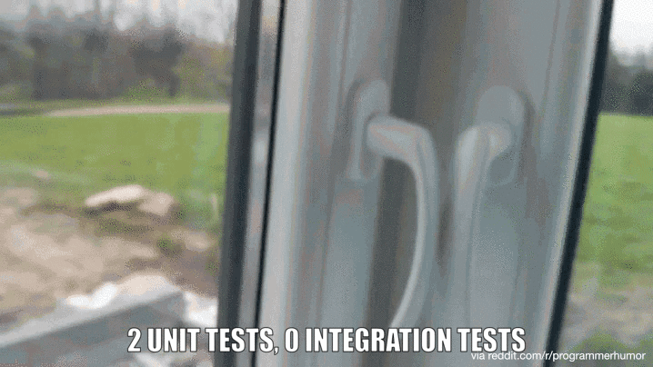
Why do we need integration tests?
#WDI18
Notes:
Np w jaki sposob przekonac sie ze Twoje zapytanie do bazy danych rzeczywiscie dziala?

Slide 31
What can go wrong with integration tests?
They are very slow ...
They are very unstable
They are hard to read
Too many false - positives
#WDI18

Slide 32
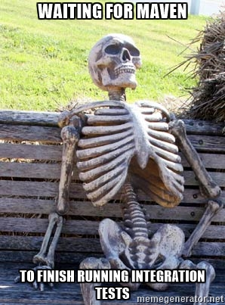
Problem with integration tests: they are slooow!
How to fix it? A couple of quick hacks:
Remove the “sleeps” from tests
Use SSD / RAM disk for /tmp, database
Use in-memory DB (or libs like otj-pg-embedded)
Remove unnecessary logging
Smoke tests for configuration (database etc.)
Be aware of how many application contexts are
created (be aware of @MockBean!)
Make them run in parallel
#WDI18
Source: https://vladmihalcea.com/2016/04/11/how-to-run-database-integration-tests-20-times-faster/
Notes:
Sprawdz czy Smoke test. Fail fast
Smoke test of configuration

Slide 33
Problem with integration tests: they are slooow!
How to fix it? Solutions requiring more work
Are integration tests testing what unit tests should?
Does your tests structure looks like on Reversed
Test Pyramid?
Redesign production code so unit tests
are easier to write
Perhaps the project has expanded too much?
Introduce modularization, Bounded
Contexts -> Domain Driven Design
#WDI18

Slide 34
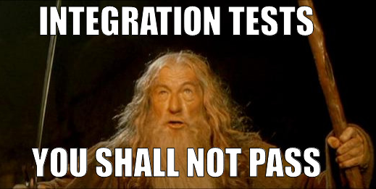
Problem: Integration tests are unreliable
How to fix it?
Make sure operations on time
don’t compare to the milliseconds
Remove the "flickering" tests
Provide the same environment for
tests - "Works for me", e.g.
a database on docker.
#WDI18

Slide 35
Problem: Integration tests are unreliable 2
How to fix it? Mock/Fake external resources
FileSystem (for nio - Jimfs, Apache
Commons VFS)
Date / Time (use Clock, JodaTime -
org.joda.time.DateTimeUtils#setCurrentMillisFixed),
Database (in memory databases like H2, hsql,
otj-pg-embedded, Fongo for MongoDB)
MailServer (Greenmail),
FTP server (MockFTPServer),
HTTP (okhttp, Wiremock)
Consumer Contract Testing - Spring Cloud Contract, Pact
#WDI18

Slide 36
Problem: Integration tests are hard to read
How to fix it?
The same tips as for unit tests applies for integration tests
Avoid inheritance hierarchy - use @Rule Junit 4 and from Junit 5 Extensions when you need some customisation
#WDI18

Slide 37
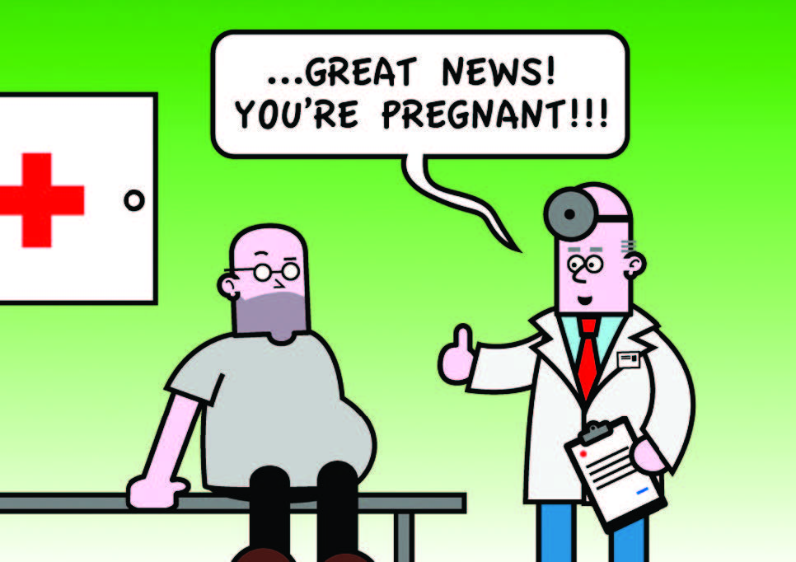
Problem: too many false-positives
Transactional tests pitfalls
There is always a transaction
You won’t get any LazyInitializationExceptions
If you forgot to open a transaction in prod
code your test won’t throw any errors
You can’t use your DB client to see what is
in the database
Source: http://www.nurkiewicz.com/2011/11/spring-pitfalls-transactional-tests.html http://blog.myesr.org/wp_live_esr11_23zcq/wp-content/uploads/2014/03/p9_Sunday_SF15b_Figure-1-cartoon-FP.jpg
#WDI18

Slide 38
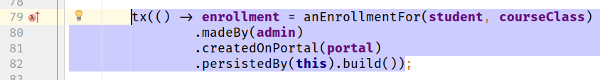
Problem: too many false-positives
How to fix?
Use non-transactional tests*
* This is not a silver bullet - they are slower, we must remove data after each test, harder to run them in parallel, but imo worth the price
Source: http://www.nurkiewicz.com/2011/11/spring-pitfalls-transactional-tests.html
#WDI18

Slide 39


Two words about Spock
Spock == Mockito + Junit 5 + much more
Perfect for BDD, (given, when, then)
Nice assertions
Perfect for parameterized tests
Easier operations on text
Pivotal Support, good Spring support, uses JUnit runner
It’s not a silver bullet but in some cases
can be more effective than Junit 5
#WDI18

Slide 40
Before you go
Check if you can remove the initial end-to-end "leading" tests
Remove ignored tests
Remove flickering tests
Ask yourself if you really need this test?
Remember about Reversed Test Pyramid, define your own ideal
test ratios for your project
Test behavior, not implementation
Listen to “tests”, hard to read/write => production code sucks
Use the right tool for the job
Divide and conquer if still possible (modularize). If not change job :P
#WDI18

Slide 41
Tools
Unit testing: Junit, testng, Spock, Mockito, AssertJ, Truth
Mutation testing: Pitest
Integration testing: SpringTest
End-to-end Testing: WebDriver - Selenium, Geb
Performance testing: JMeter, gatling, apache-bench
BDD testing frameworks: Cucumber, JBehave
Other tools: Awaitility *, Powermock *
#WDI18

Slide 42
Books, links, sources
Practical Unit Testing with TestNG and Mockito - Tomek Kaczanowski
Working Effectively with Unit Tests - Jay Fields
Growing Object-Oriented Software, Guided by Tests - Nat Pryce, Steve Freeman
http://www.abstracta.us/2015/10/26/best-testing-practices-for-agile-teams-the-automation-pyramid/
http://www.slideshare.net/wakaleo/bdd-the-unit-test-of-the-product-owner
http://www.natpryce.com/articles/000714.html
https://vladmihalcea.com/2016/04/11/how-to-run-database-integration-tests-20-times-faster/
http://www.nurkiewicz.com/2011/11/spring-pitfalls-transactional-tests.html
#WDI18

Slide 43



Q/A
@marekdominiak
marek@dominussoft.pl
github.com/marekdominiak
#WDI18

