Slide 1

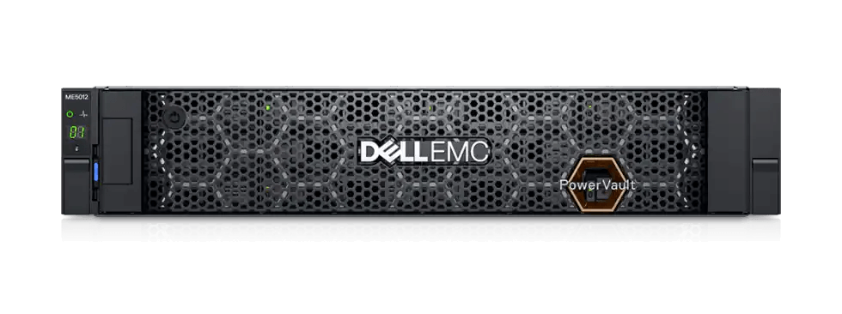
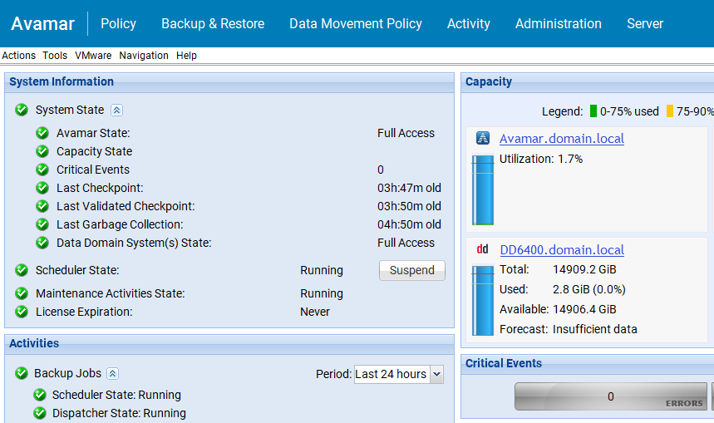
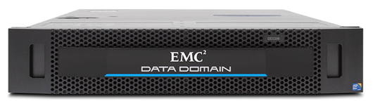
Current State
No Risk Management of PII and Sensitive Data
Primary DC
Clients & Protected Storage
Files
Devices
Database
VMs
Applications
PowerStore
110 VMs | 30TB
MCS
Avamar
East
Protected Data Layer
No Inline Backup Detection
1
2
No tools to run forensics on existing backups
No Pre-Backup Detection
Not Immutable

Slide 2



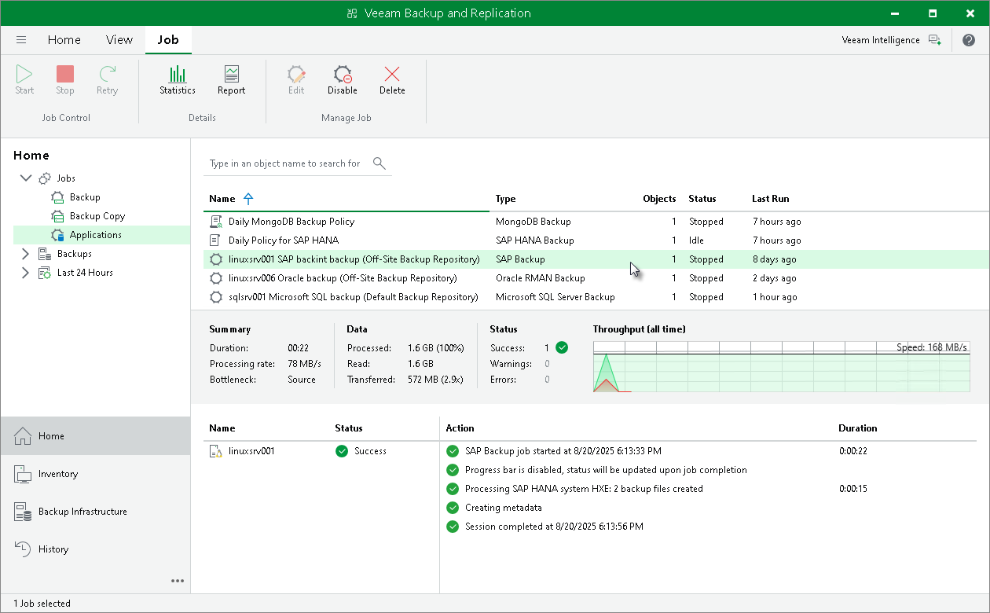


Current State – 1 Site and Cloud
Site Design:​
Primary DC – 1st Copy to Synology
Primary DC - 2nd Copy to Wasabi (Not all data replicated)
M365 - 1st Copy to Rubrik
AD / EntraID – not protected
​
Assumptions:​
30 Day Retention​ - All Copies
100% Data Replication​
​
Challenges:​
No Immutability on Prem
No Single Platform to Manage
Not easily scaled
Expensive Maintenance Costs
Disparate Contract Expiration Dates
Veeam, Rubrik, Wasabi, Synology?
Multiple calls for Support
​
Primary DC
Clients & Protected Storage
Files
Devices
Database
VMs
Applications
1
100 VMs | 10TB Physical Servers
Veeam
M365
AD / ENTRA ID
VS
1000 users
68,000 users
Not Protected
VP
VP
VP
Protected Data Layer
1
2
75TB Usable
Not Immutable
Not able to write all backups to Wasabi

Slide 3
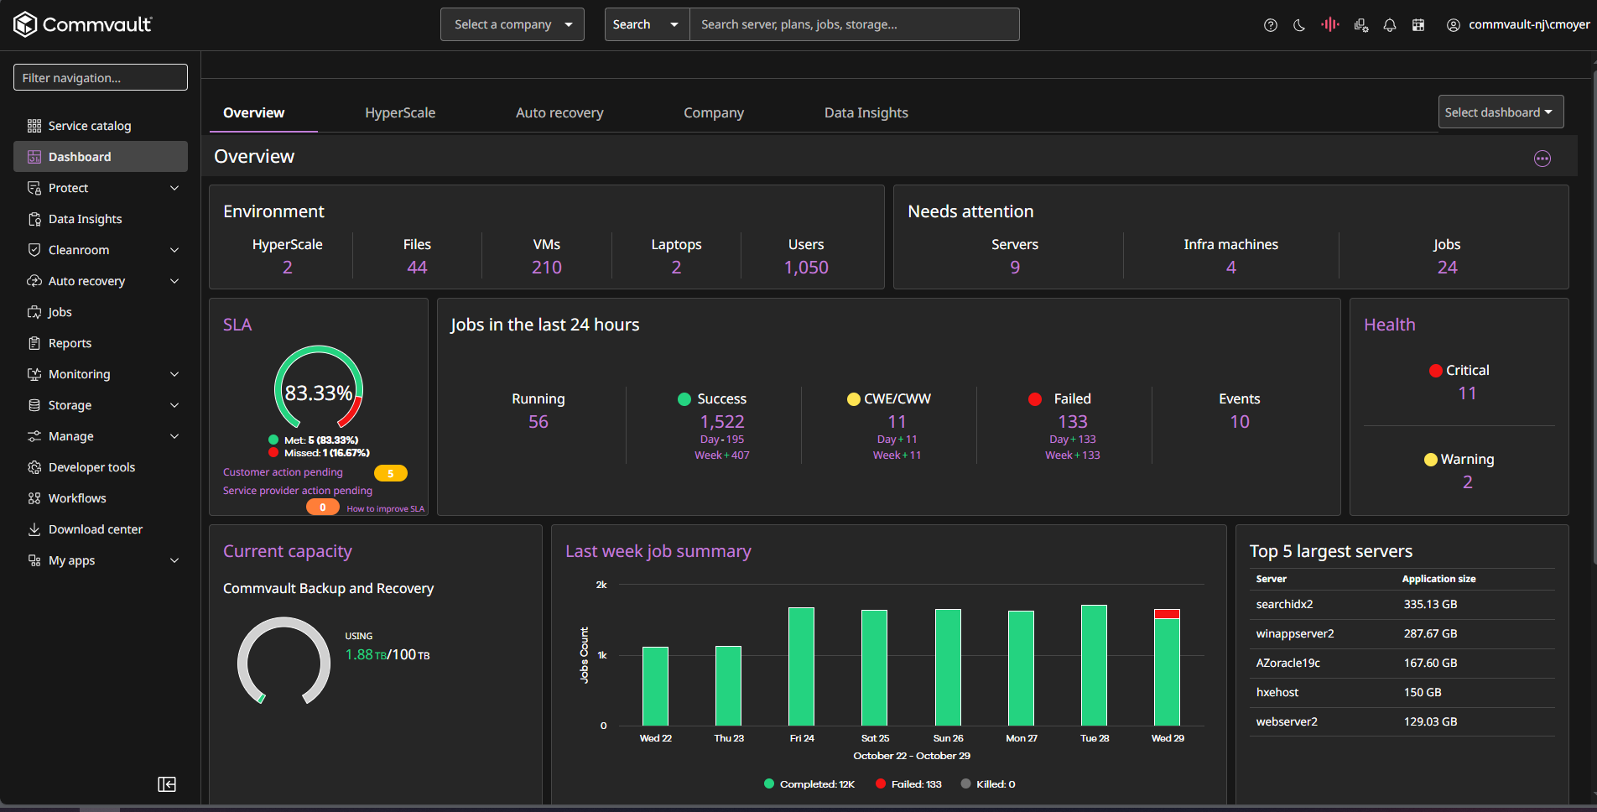
Future State
Primary DC
Clients & Protected Storage
Files
Devices
Database
VMs
Applications
Anomaly Detection (IoC’s)
Pre- Detection | In-line Backup
Live File Activity Canary Files | Agentless VM CMDR File Extension change MIME Type Mismatch Backup size change
Threat Analysis
File & VM AI Threat Scan
File Entropy View Corrupt versions Quarantine Versions Signature Based Scan AI Zero Day Scan
Data Security Posture Mgmt.
Forensic Scan for Impact
PowerStore
SaaS DB’s. Monitoring, Masking
IAM| Access | Permissions
Sensitive Data Remediation
110 VMs | 30TB
Detect & Protect
Quarantine & Clean
Forensic Analysis (PII)
CS
East
MA
MA
Command Center
Protected Data Layer
Zero Trust Access
1 | HSX - 01
2
3 | HSX - 02
4
5 | HSX - 03
6
7 | HSX - 04
1
2
Immutable
Deduped
Encrypted
4-Node HSX Appliance
67TB Usable
All Backups Immutable

Slide 4

Future State – 2
Primary DC
Clients & Protected Storage
Files
Devices
Database
VMs
Applications
Anomaly Detection (IoC’s)
Pre- Detection | In-line Backup
Live File Activity Canary Files | Agentless VM CMDR File Extension change MIME Type Mismatch Backup size change
Threat Analysis
File & VM AI Threat Scan
File Entropy View Corrupt versions Quarantine Versions Signature Based Scan AI Zero Day Scan
Data Security Posture Mgmt.
Forensic Scan for Impact
PowerStore
SaaS DB’s. Monitoring, Masking
IAM| Access | Permissions
Sensitive Data Remediation
110 VMs | 30TB
Detect & Protect
Quarantine & Clean
Forensic Analysis (PII)
CS
East
MA
MA
Command Center
All Backups Replicated to AGP
Protected Data Layer
AirGap Protect
Immutable Deduped Encrypted
Zero Trust Access
1 | HSX - 01
2
3 | HSX - 02
4
5 | HSX - 03
6
7 | HSX - 04
3
Immutable
Deduped
Encrypted
1
2
“Airgap”
4-Node HSX Appliance
67TB Usable
All Backups Immutable

Slide 5


Future State - Software
Commvault Unity
AirGap Protect
SaaS Tenant
Immutable Deduped Encrypted
Unified Control Plane for OnPrem + Cloud
AD / ENTRA ID
M365
Protected
Protected
Primary DC
Clients & Protected Storage
Secondary DC
Devices
Database
VMs
Applications
Auto Recovery
Data Security Posture Mgmt.
Forensic Scan for Impact
130 VMs | Vmware + Nutanix
SaaS DB’s. Monitoring, Masking
IAM| Access | Permissions
Sensitive Data Remediation
CS
MA
MA
Command Center
Forensic Analysis (PII)
Protected Data Layer
AirGap Protect
(Infrequent Tier) 120TB Usable
Immutable Deduped Encrypted
Anomaly Detection (IoC’s)
Pre- Detection | In-line Backup
Live File Activity Canary Files | Agentless VM CMDR File Extension change MIME Type Mismatch Backup size change
Threat Analysis
File & VM AI Threat Scan
File Entropy View Corrupt versions Quarantine Versions Signature Based Scan AI Zero Day Scan
1
2
“Airgap”
Compliance Lock - Software Immutability
Zero Trust Access
Detect & Protect
Quarantine & Clean
All Backups Replicated to AGP

Slide 6

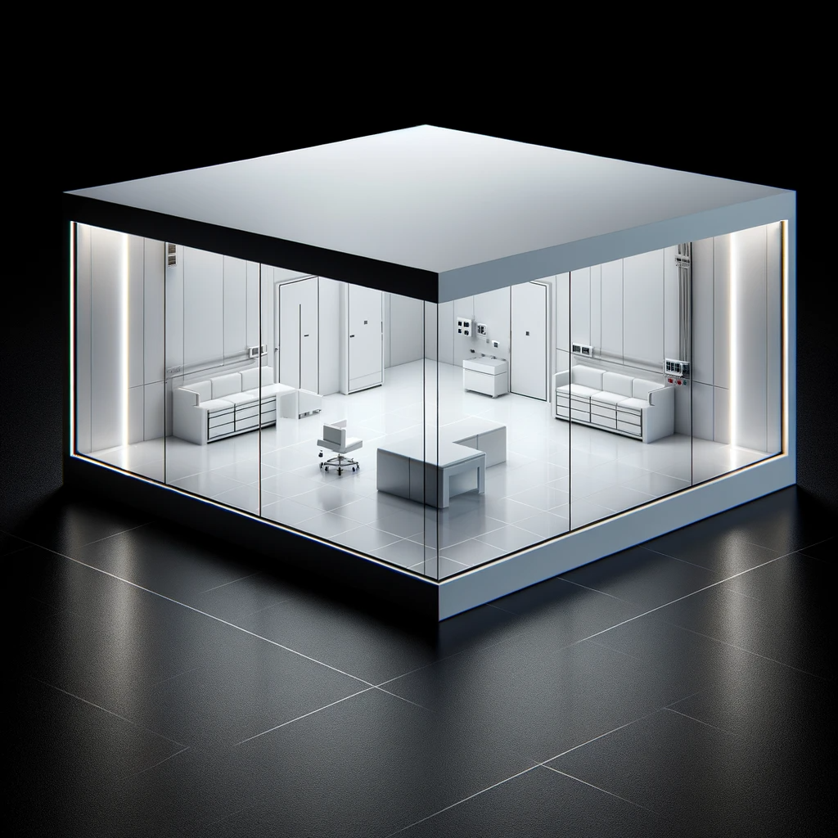
Future State – 2 Site with AGP & Cleanroom
Site Design:​
Primary DC – 1st Copy to HSX
Primary DC - 2nd Copy to DR HSX
Primary DC – 3rd Copy to AGP
M365 & AD/EntraID – 1st Copy to AGP (Infrequent Tier)​
​
Assumptions:​
30 Day Retention​ - All Copies
100% Data Replication​
​
Advantages:​
Immutable Backups on-prem with Airgap copy in the cloud
Single Platform for all Data Protection
Simplified Administration
Simple scale-out expansion
One call for Support
​
DR DC
Primary DC
Clients & Protected Storage
Clients & Protected Storage
Files
Devices
Database
VMs
Applications
Files
Devices
Database
VMs
Applications
M365
AD / ENTRA ID
1000 users
68,000 users
Protected
Protected
100 VMs | 10TB Physical Servers
100 VMs | 10TB Physical Servers
1
CS
CS
Command Center (Standby)
Command Center
Protected Data Layer
Protected Data Layer
AirGap Protect | Cloud Cleanroom
(Infrequent Tier) 120TB Usable | (Customer Tenant) 40TB Usable
Immutable Deduped Encrypted | Cyber Recovery CR Testing Forensic Analysis
1 | HSX - 01
2
3 | HSX - 02
4
5 | HSX - 03
6
7 | Future expansion
8
9 | Future expansion
10
11 | Future expansion
12
1 | HSX - 01
2
3 | HSX - 02
4
5 | HSX - 03
6
7 | Future expansion
8
9 | Future expansion
10
11 | Future expansion
12
3
2
1
Immutable
Deduped
Encrypted
Immutable
Deduped
Encrypted
“Airgap”
3-Node HSX Appliance
150TB Usable
3-Node HSX Appliance
150TB Usable
All Backups Immutable
All Backups Immutable
All Backups Replicated to AGP

