Slide 1
Traffic Light Control
~ Marek Hummel

Slide 2
Context
Find optimal traffic light control with RL
→ When to switch which traffic light for most efficient traffic flow
Simplified setting
Two lights, only either of them can be green at any time
New cars continuously arriving
During green light, cars are passing
Reward for passing cars, penalty for long waiting cars

Slide 3
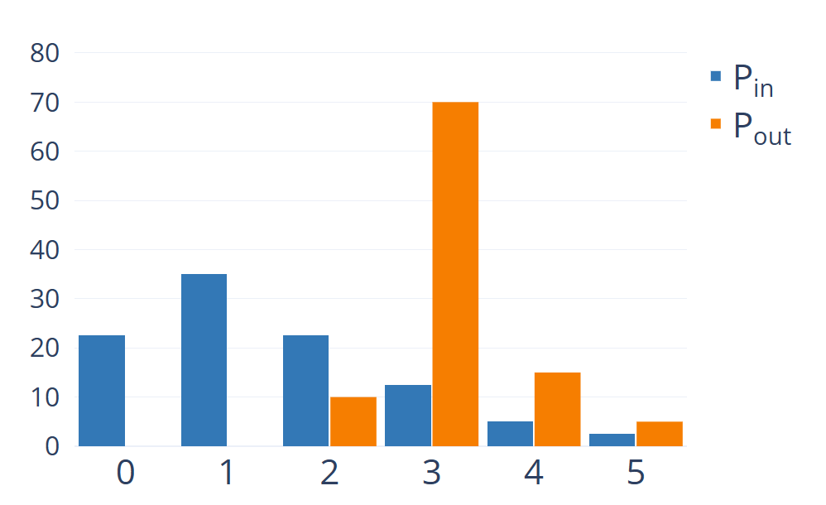


Context
For RL simulation, discretize time
Use distributions to generalize a bit
$$μ_{P_{in}}=1.5$$
$$μ_{P_{out}}=3.15$$
cars passing: $$c_{pass} \sim P_{out}$$
new cars left: $$c_{left} \sim P_{in}$$
new cars right: $$c_{right} \sim P_{in}$$

Slide 4
Environment
Action Space:
Both Red | Left Green | Right Green
Observation Space:
Amount of waiting cars per side
More?
Reward:
Positive for passing cars
Negative for long waiting
Bounding?

Slide 5
Environment – Observation Space
Current active light irrelevant, switch doesn‘t cost anything
Instead of just tracking the amount of waiting cars, track their waiting time
Extend observation space by statistical measure like maximum, average, (weighted) sum

Slide 6
Environment – Reward
Relevant metrics: passing cars + waiting cars / wait time
Idea 1
Sum up all wait times, use as negative reward
Use passing cars as compensation (reward some movement more than none)
Idea 2
Use passing cars are positive reward
Only penalize, if queues on either side get too long

Slide 7
Iterations
Penalize for all waiting cars -> minimize penalty
Done when no cars left
Difficult to weigh different metrics into the reward
Incentive: Get done asap
Reward for passing, slight penality for waiting
Abort only if too many cars and high penalty
Incentive: Run as long as possible to maximize reward

Slide 8
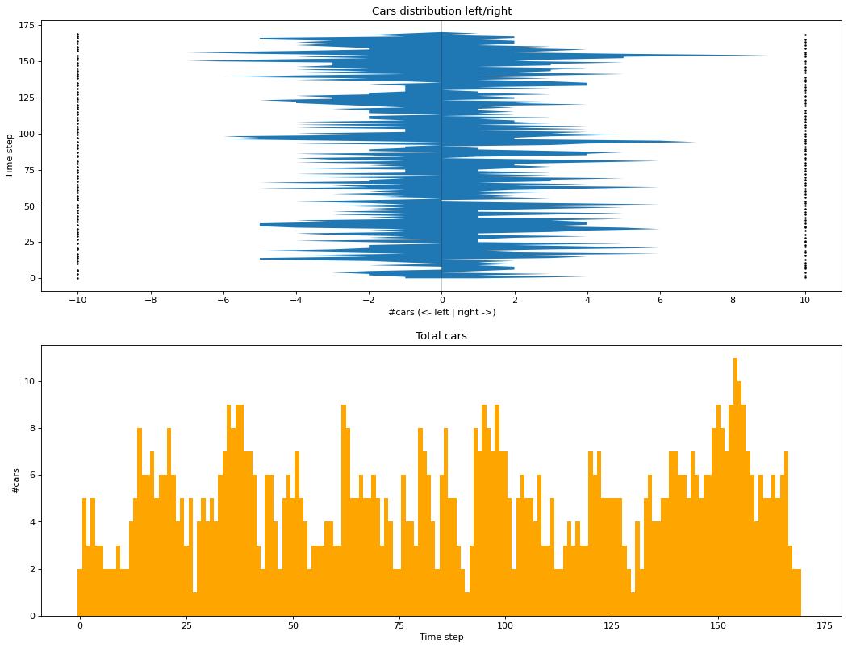
Results
I
reward too complicated
only works with generous distributions

Slide 9
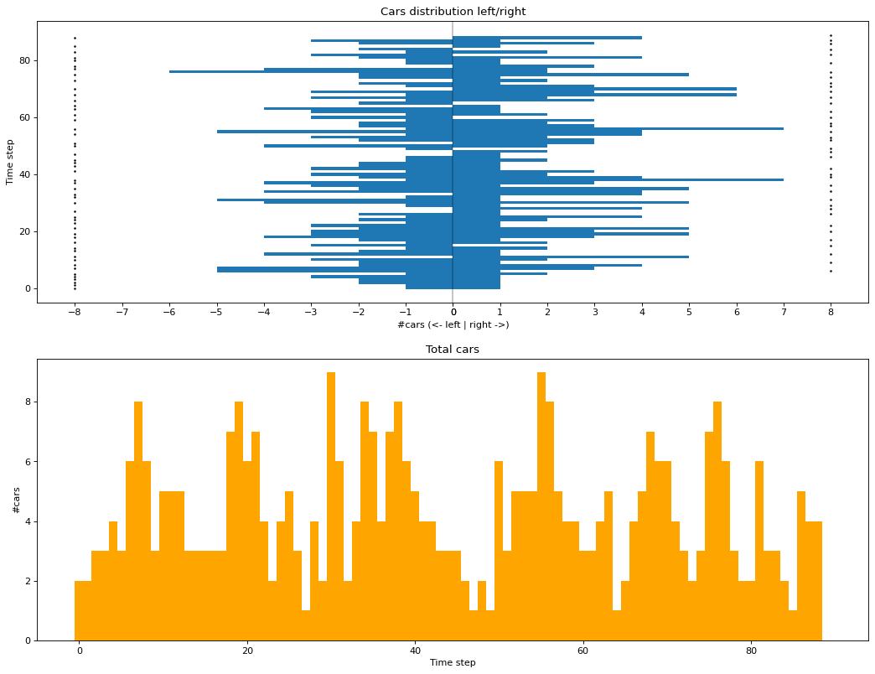
Results
I
reward simplified
still unstable

Slide 10
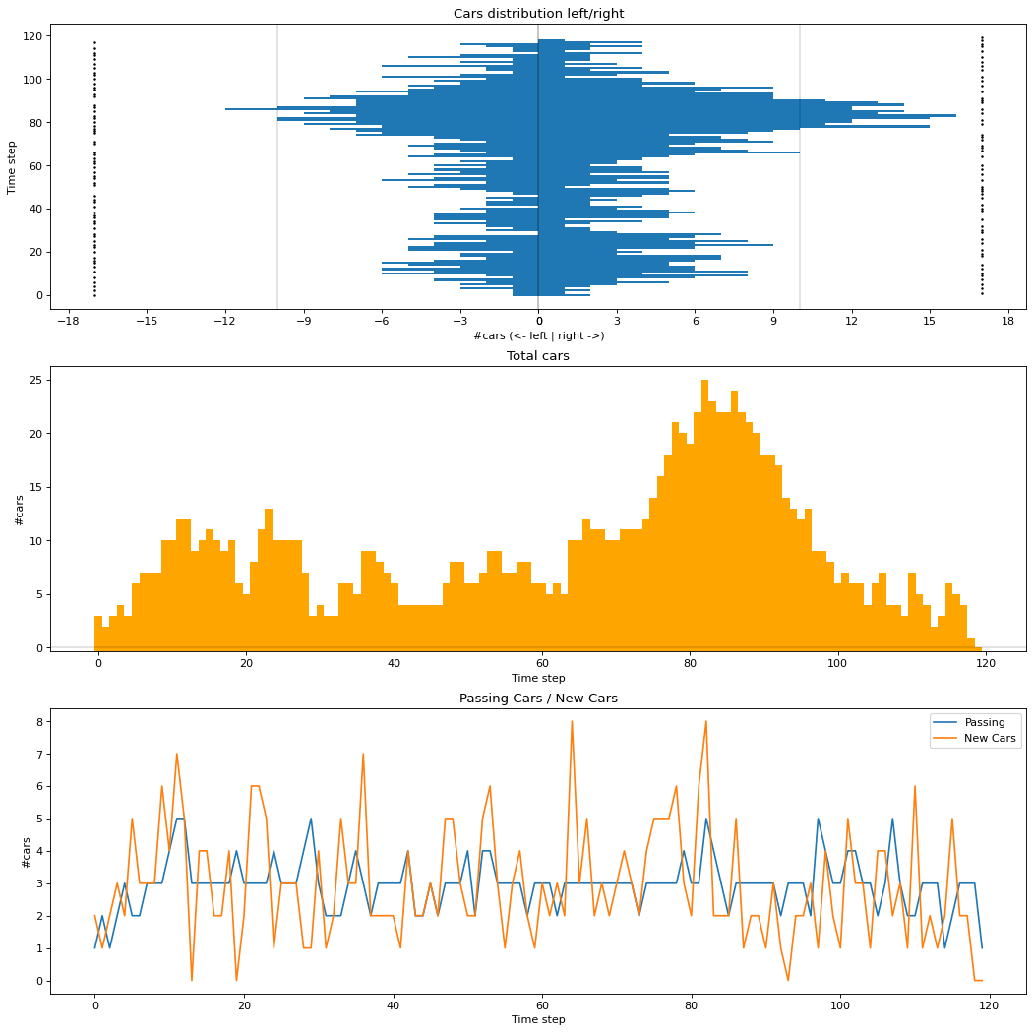
Results
II
simple reward, threshold penalty
bounded by either success (0 cars) or failure (too many cars)

Slide 11
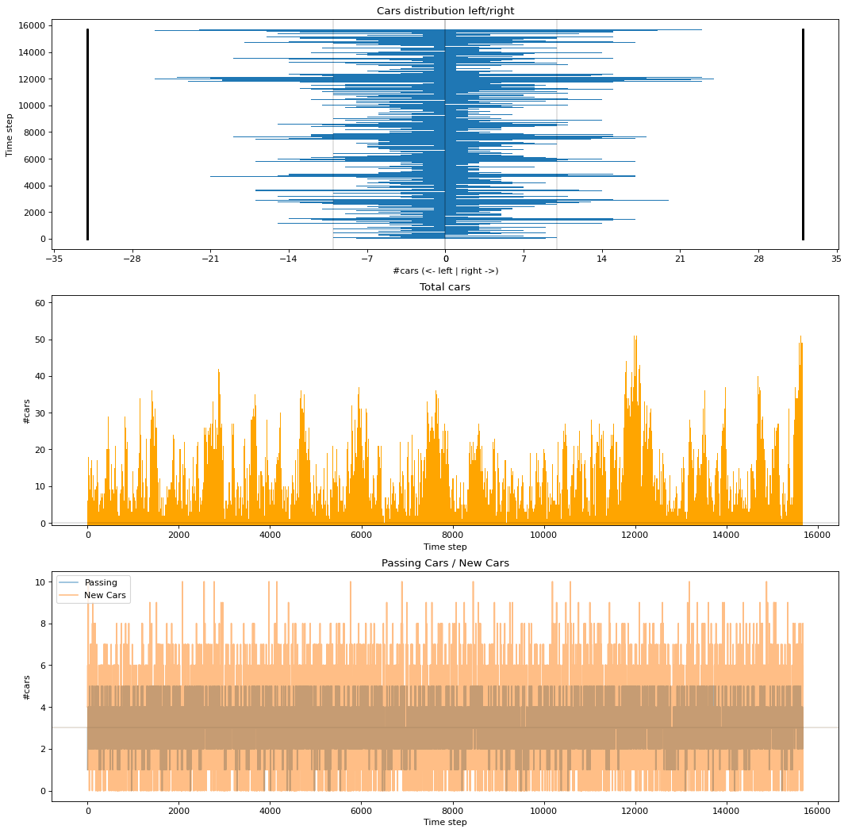
Results
II
simple reward, threshold penalty
only terminates if failure
much more stable, even with equal mean for distributions

