Slide 1
Traffic Light Control
~ Marek Hummel

Slide 2
Context
Find optimal traffic light control with RL
→ When to switch which traffic light for most efficient traffic flow
Simplified setting
Two lights, only either of them can be green at any time
New cars continuously arriving
During green light, cars are passing
Reward for passing cars, penalty for long waiting cars

Slide 3
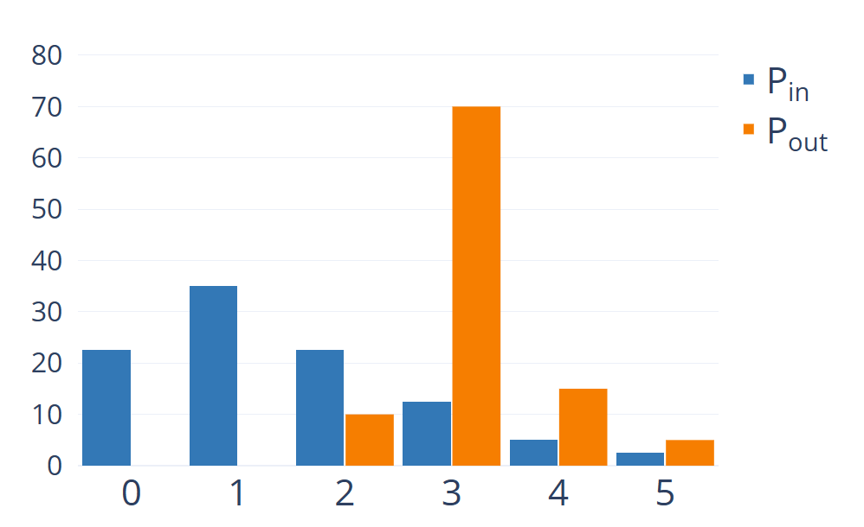


Context
For RL simulation, discretize time
Use distributions to generalize a bit
$$μ_{P_{in}}=1.5$$
$$μ_{P_{out}}=3.15$$
cars passing: $$c_{pass} \sim P_{out}$$
new cars left: $$c_{left} \sim P_{in}$$
new cars right: $$c_{right} \sim P_{in}$$

Slide 4
Environment
Action Space:
Both Red | Left Green | Right Green
Observation Space:
Amount of waiting cars per side
More?
Reward:
Positive for passing cars
Negative for long waiting
Bounding?

Slide 5
Environment – Observation Space
Current active light irrelevant, switch doesn‘t cost anything
Instead of just tracking the amount of waiting cars, track their waiting time
Extend observation space by statistical measure like maximum, average, (weighted) sum

Slide 6
Environment – Reward
Relevant metrics: passing cars + waiting cars / wait time
Idea 1
Sum up all wait times, use as negative reward
Use passing cars as compensation (reward some movement more than none)
Idea 2
Use passing cars are positive reward
Only penalize, if queues on either side get too long

Slide 7
Iterations
Penalize for all waiting cars -> minimize penalty
Done when no cars left
Difficult to weigh different metrics into the reward
Incentive: Get done asap
Reward for passing, slight penality for waiting
Abort only if too many cars and high penalty
Incentive: Run as long as possible to maximize reward

Slide 8
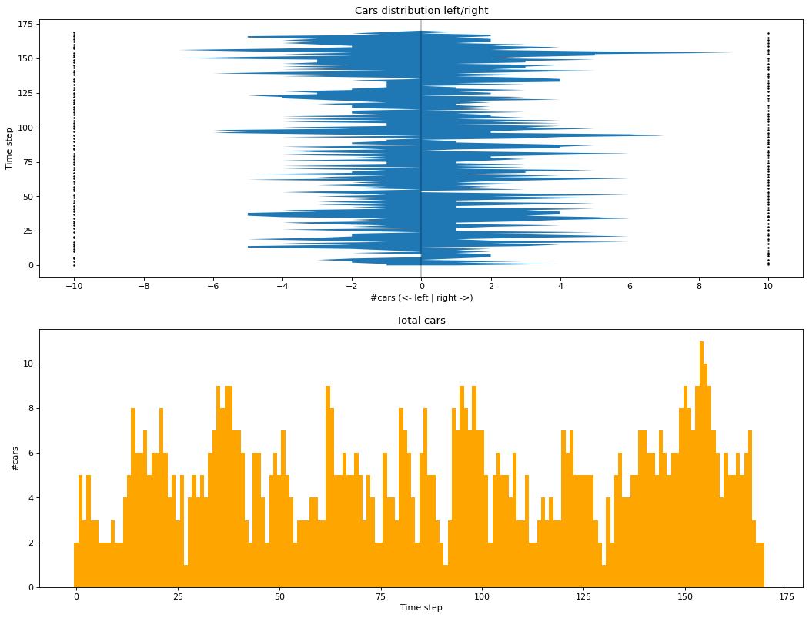
Results
I
reward too complicated
only works with generous distributions

Slide 9
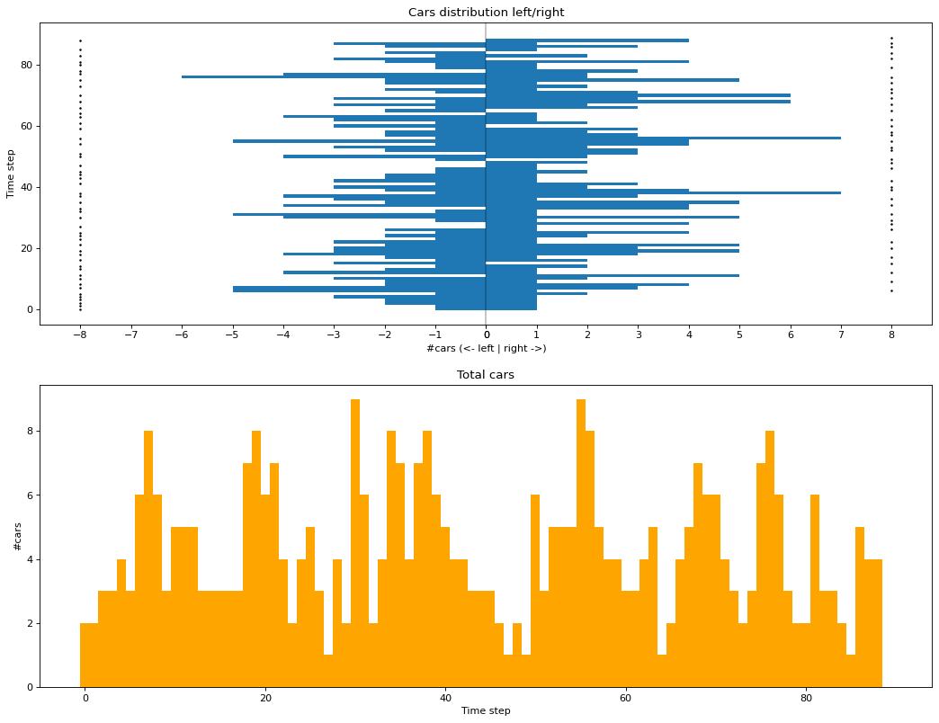
Results
I
reward simplified
still unstable

Slide 10
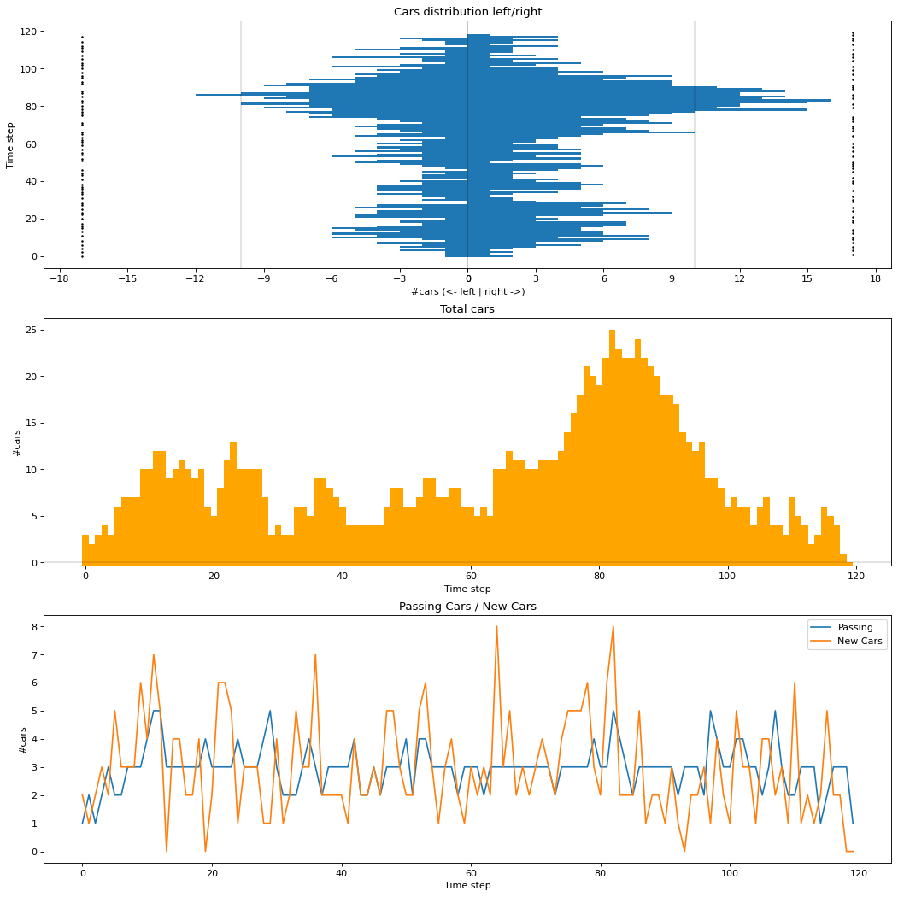
Results
II
simple reward, threshold penalty
bounded by either success (0 cars) or failure (too many cars)

Slide 11
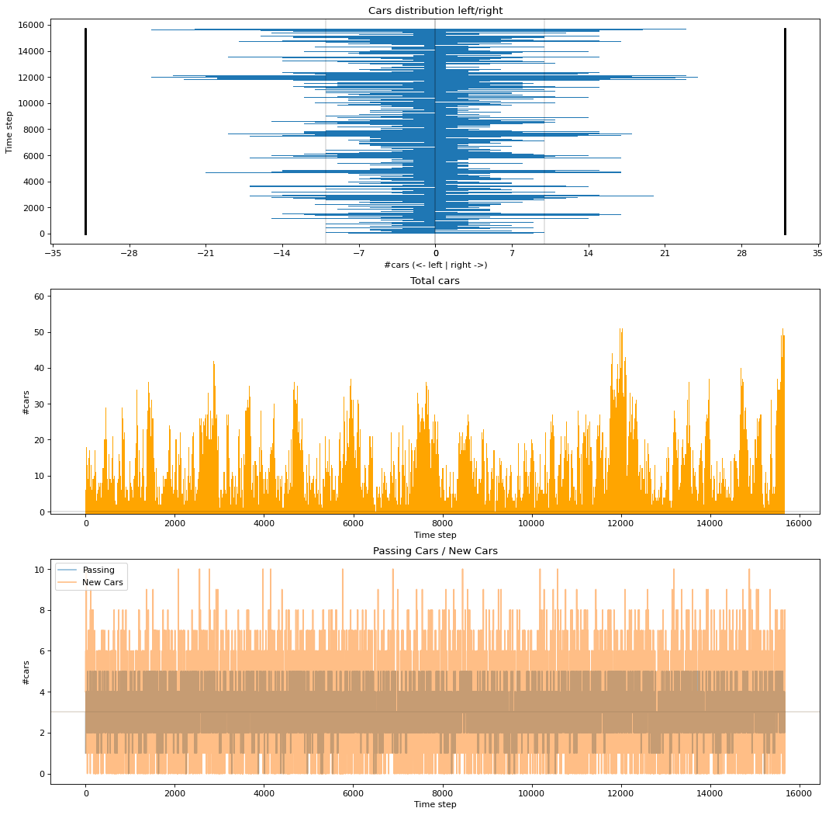
Results
II
simple reward, threshold penalty
only terminates if failure
much more stable, even with equal mean for distributions

Slide 12
Agents
A2C
Longest runs with 20,000 training steps: ~16,000
Still okay with 2,000 steps: ~4,000
Fails with only 200 steps
PPO
Weaker than A2C at 20,000: ~8,000
Fails with 2,000 steps
DQN
Useless, even with 20,000 steps no results (chooses no action too often)

Slide 13
Agents
Random
As a baseline, but also chooses no action to often and fails
Toggle
Chooses left and right light in alternation
Can‘t consider long queues, fails quickly: ~200
Manual
Chooses light at which more cars are waiting
Same performance as A2C: ~16,000

Slide 14
Conclusion
Environment difficult to implement due to the reward function
Now that the observation is kept simple, the best RL agent can be easily reproduced with a manual AI
However, extending the observation again did not help with the agents performance
Current reward is working for training, but actual value not really representative for efficiency (hence only comparison based on run length)

