Slide 1
IBM Data Science capstone project
Analyzing Food Market In Milan, Italy

Slide 2
During the IBM Artificial Intelligence Capstone Project, I am using real datasets described below in order to analyze restaurant market in Milan, Italy. Purpose of this project is having a clear view of how the competitors market looks like for opening the italian cafeteria.
All the steps in this data science project will be described in details. I have started with defining a business case. Other steps are data preparation (collecting, cleansing, feature engineering, etc.), data analyzing and final outputs.
These outputs and concolustions can be used by a stakeholder to make a decision.

Slide 3
Data Preparation
Data Source
https://developer.foursquare.com/docs - portal with various, categorized venues in Milan which can be rated by the customers.
2.2 Data Mining
Foursquare will be used to get a data of venues in Milan. Venue ID, Name and Address will be used in the first part of the project. In the second part, we will merge this dataframe with "Likes" received by each venue.

Slide 4
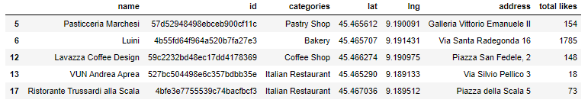
Piece of Foursquare data frame which is base for clustering and the result will be presented in a map form.

Slide 5
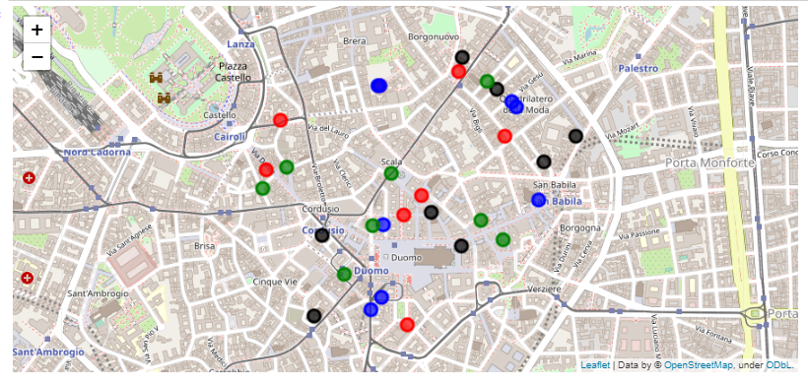
We completed the exercise with transforming food-related venues into various clusters. Below is the result.

Slide 6
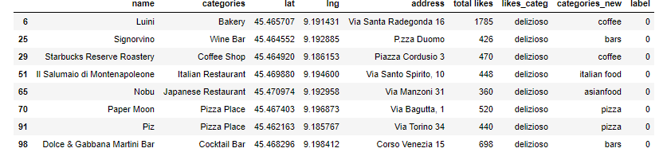
We can see that food venues in Milan have been divided into four different clusters based on the category and total likes of users using Foursquare. In next cells I will analyze and briefly describe each of the cluster.If we take a look at the map above, we can see that there is no correlation between the quality (# of likes) of the venue and distance to Centro Storico (Duomo di Milano). It is a good tip for visitors, that even close to the city center, they can still find a good meal or lunch nearby.
The first cluster (label 0) is showing us the best places in a radius of 1000 ft from Milan City Center. This is represented mainly by coffee and wine bars which seems to be the most popular venues for italian and tourists.
The second cluster (label 1) contains venues that are still quite popular and well-rated along Foursquare users. Once again we can observe that these are mainly coffee shops and pastries/bakeries.
The third cluster (label 2) is based of mainly restaurants, which doesn't seem to be as popular venues to spend time in compared to first two clusters. It can also indicate, that italians prefer their home food rather than the one in the restaurants.
The fourth cluster (label 3) is the least attractive for the customers. It is rated within the average, but certainly we can find better places to eat or have lunch in.

Slide 7
Conclusion
The analysis goal has been met. Materials from the above steps can be used in various ways.
Future entrepreneurs may see the clusters on the map which can tell in which area of Milan there is lack of food-venues with a good quality service.
Other benefit is for tourists visiting Milan and Milan citizens, who will get rid of a stereotype that close to the Duomo Di Milano there are no nice restaurants or coffee shops.

