Slide 1
Visualization of forecast models verification
Autor: Bc. Marek Kružliak
Školiteľ: RNDr. Andrej Lúčny, PhD.
Odborný poradca: Mgr. Juraj Bartok, PhD.
Spoločnosť: MicroStep-MIS, spol. s r. o

Slide 2
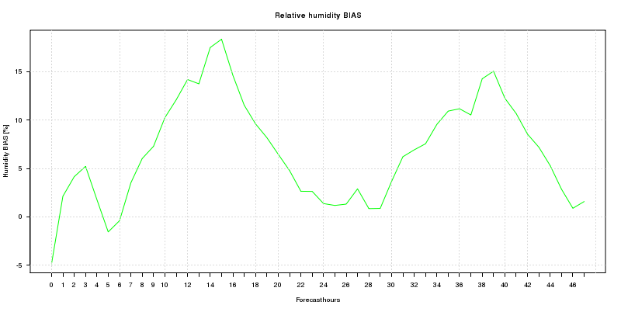
Ciele
Implementácia verifikácie predpovedného modelu počasia
Vizualizácia výsledkov verifikácie:
  - Mnohorozmerné dáta v jednom obrázku
  - Interaktívna aplikácia

Slide 3
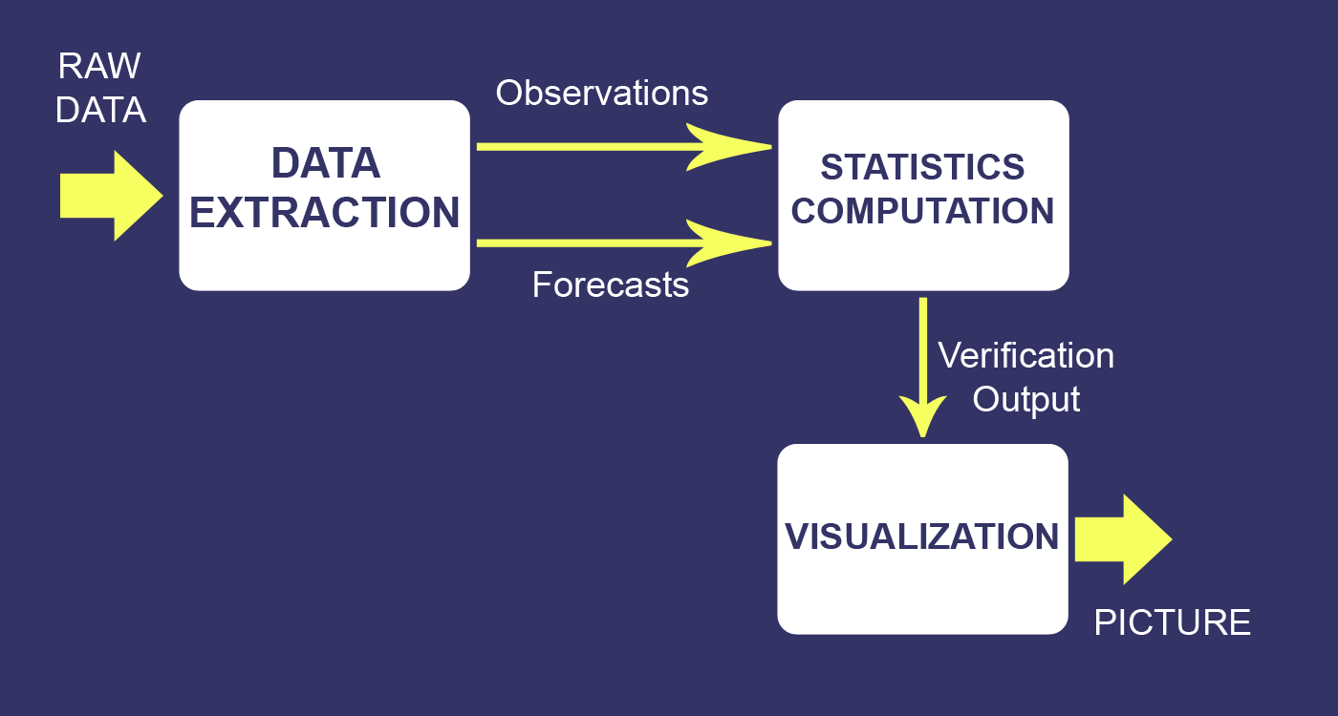
Návrh systému
Simplified System Design inspired by NCAR's METviewer [2]

Slide 4
Doterajšie riešenie
Získavanie dát:
  GRADS
  Ručne
Výpočet štatistík a vizualizácie:
  R-Script
Všetko riadene pomocou niekoľkých BASH skriptob

Slide 5
Slabiny doterajšieho riešenie
Usability:
  User side:
    No GUI
    No Settings control
    Only programmer can run it
  Programmer side:
    Not versatile (Hard to make changes)
    Big mess
    3rd party software (GRADS)

Slide 6
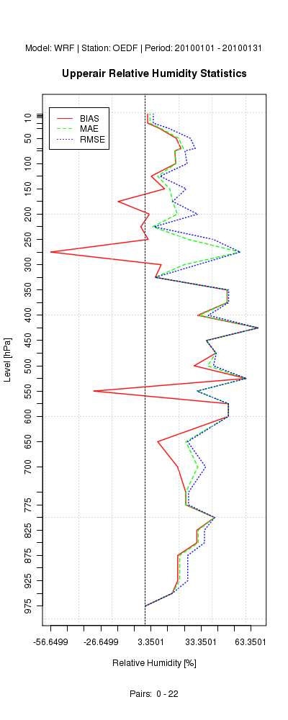
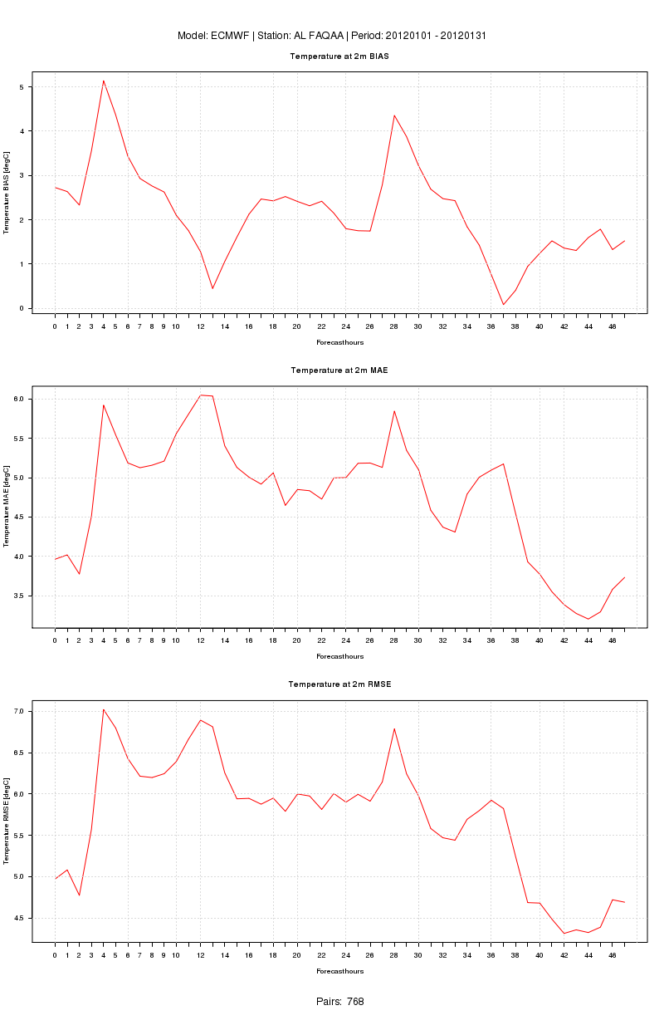
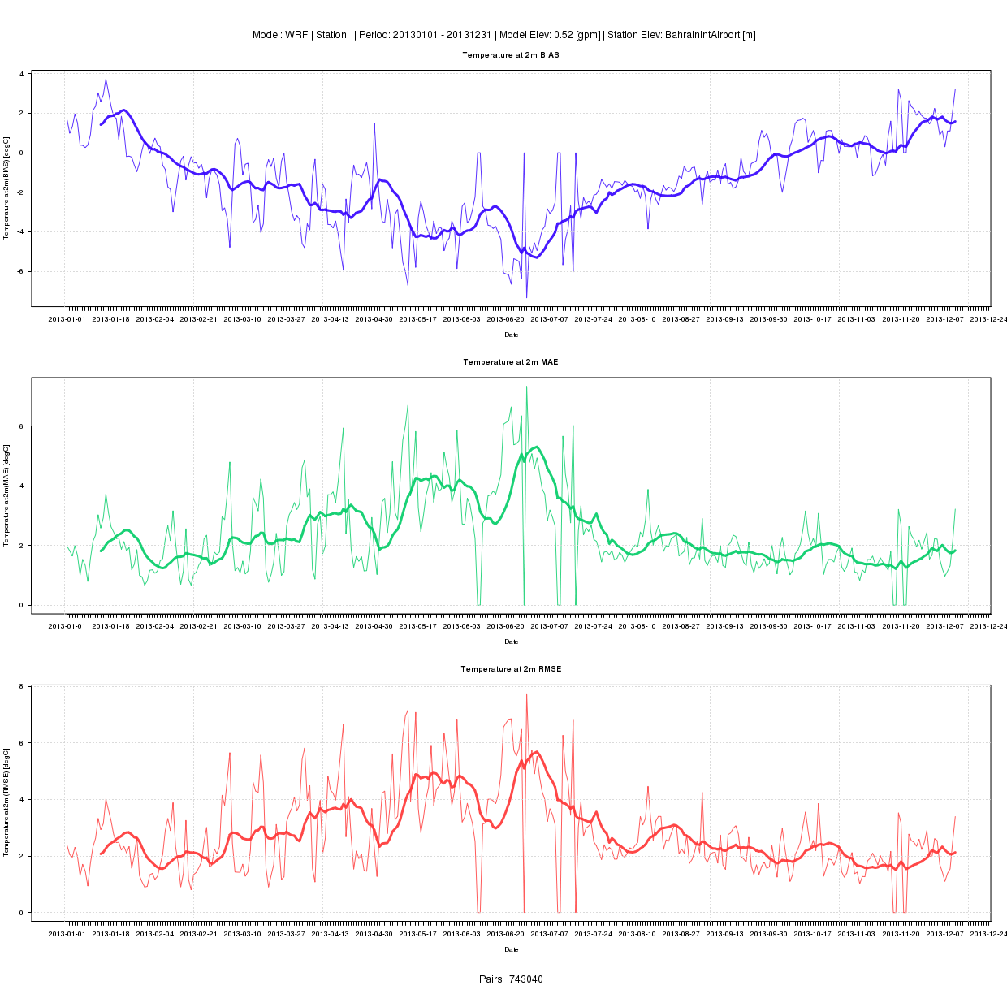
Verification Visualization today

Slide 7
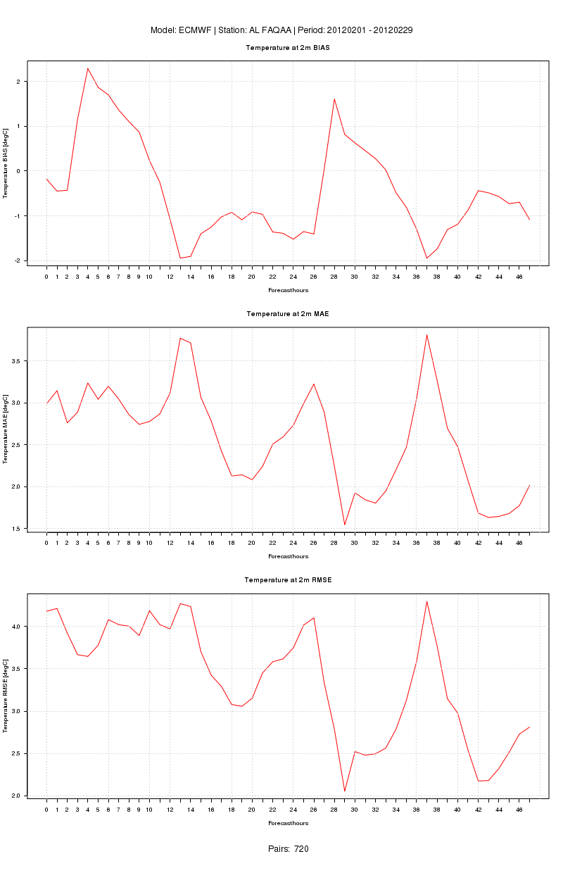
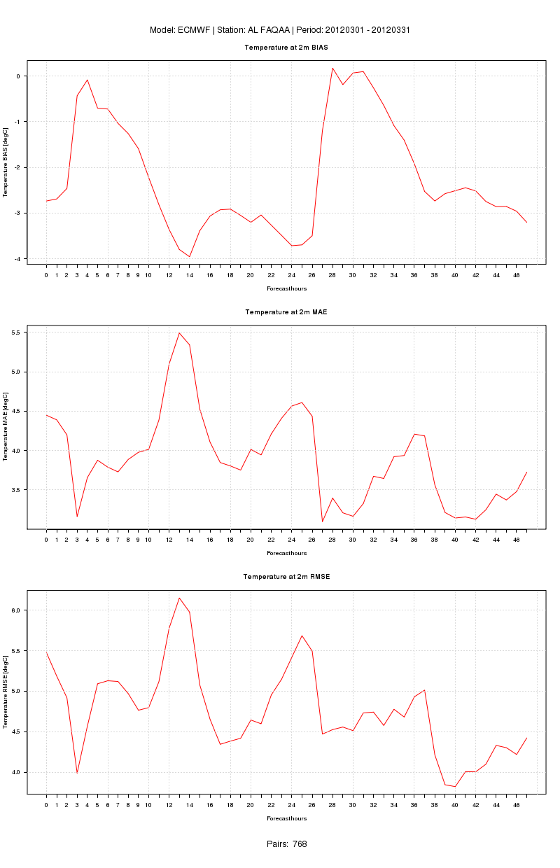
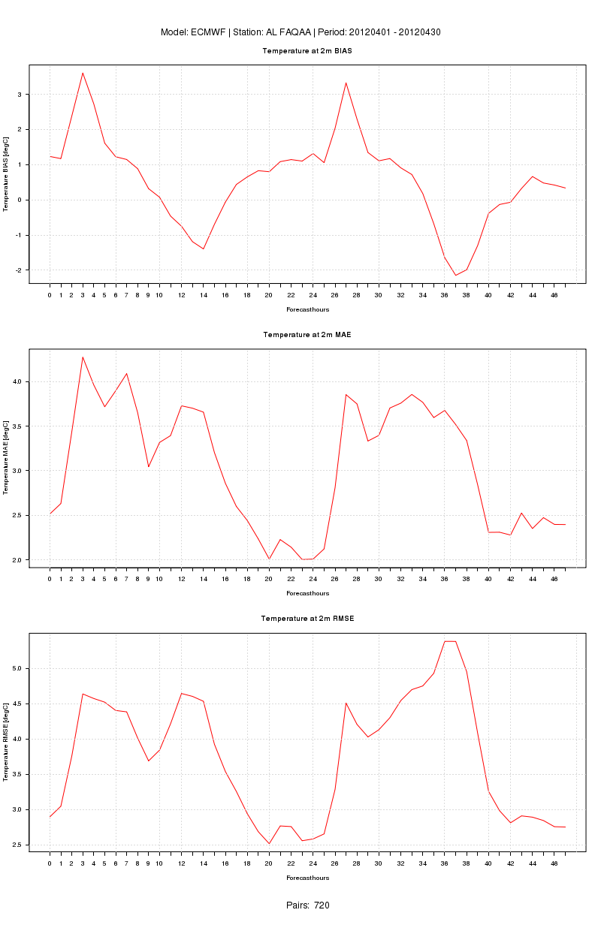
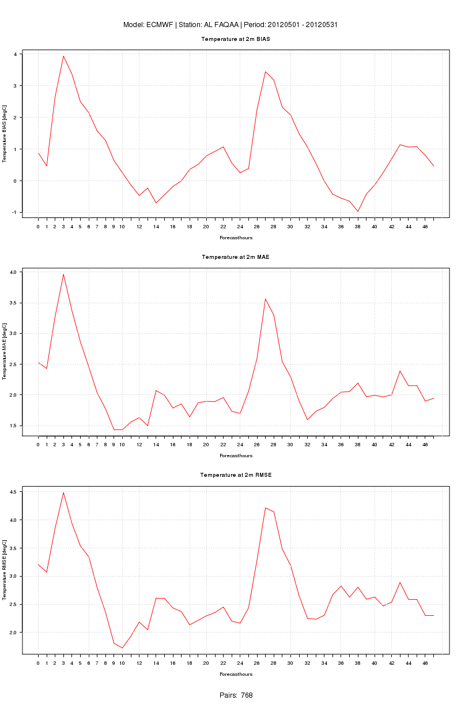
How to compare values in year?
This strongly resembles Nested Timelines [3]

Slide 8
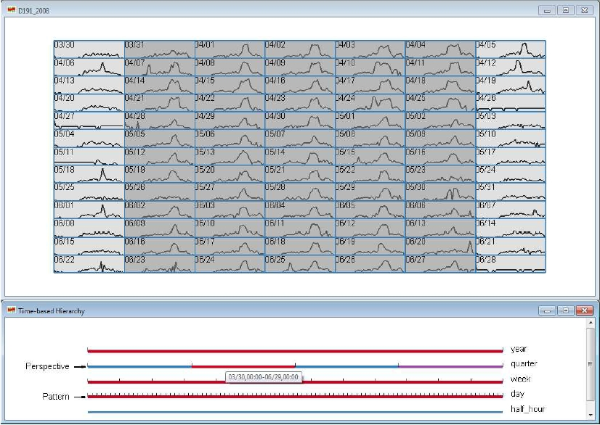
Nested Timelines [3]

Slide 9
Why it isn't enough?
Not eye appealing
Screen Space consumption
No interactivity
Loss of information about relationships
Hard to compare two/more time intervals

Slide 10
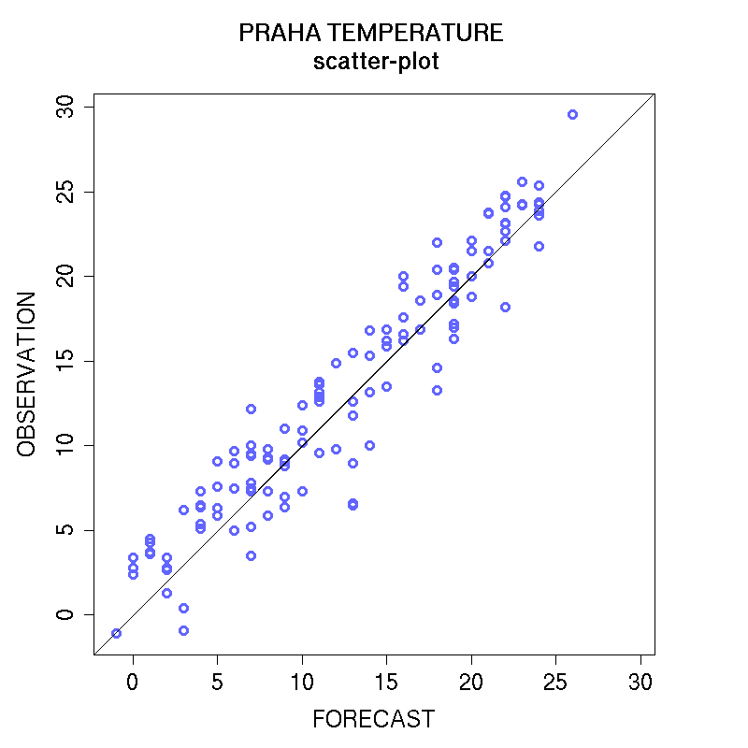
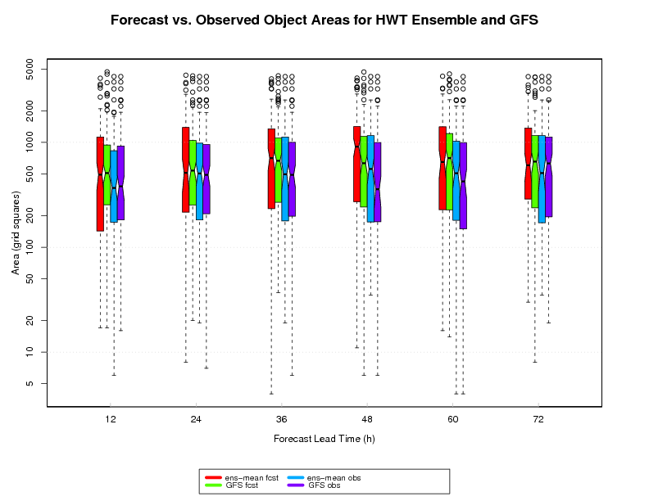
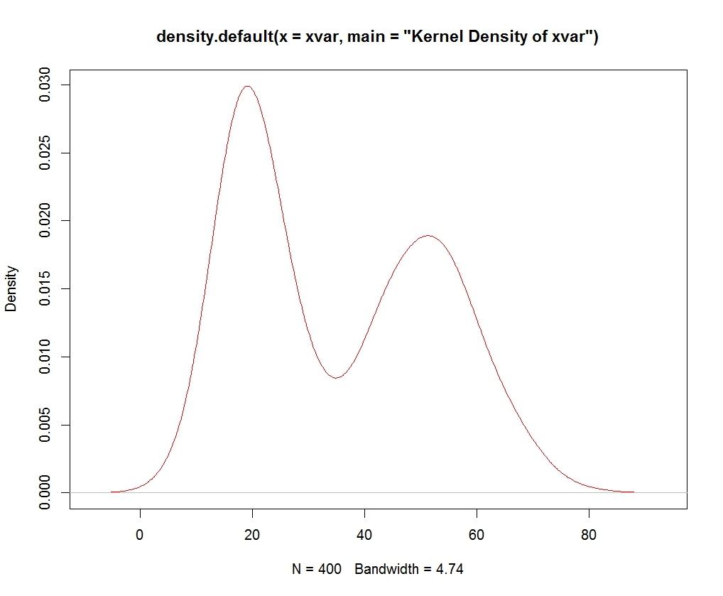
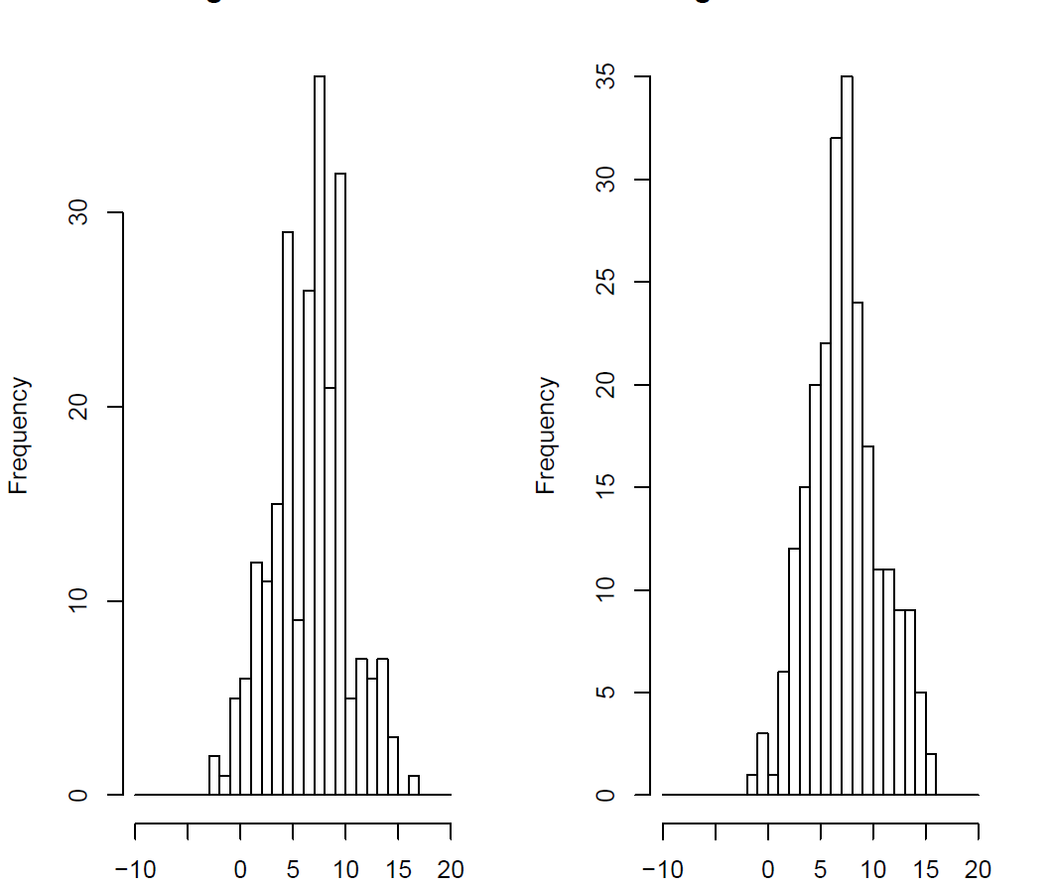
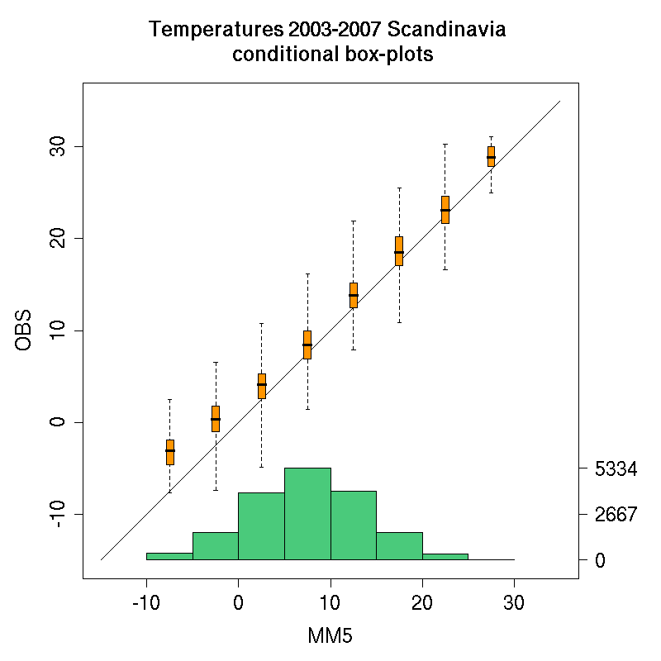
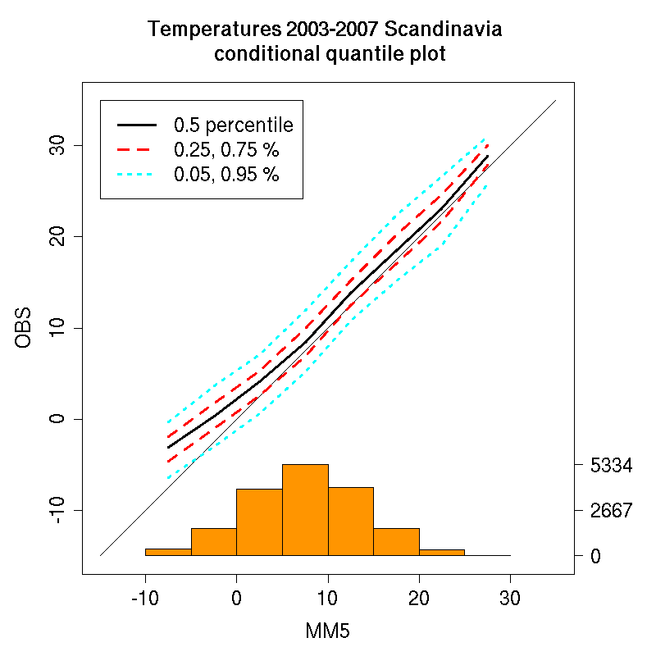
Other Solutions
Scatter plots
Density plots
Box plots
Histograms
Cumulative distributions
Quantile-Quantile plots
Conditional quantile plots
Conditional box plots
Visualisation techniques of verifications used in other applications [1] [2] [4]

Slide 11
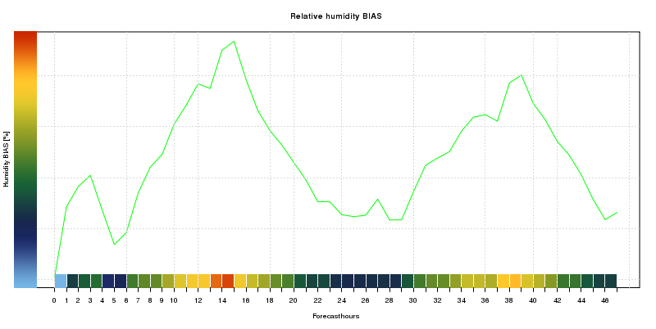
1st Visualization Design
Mapping Error to Colors

Slide 12
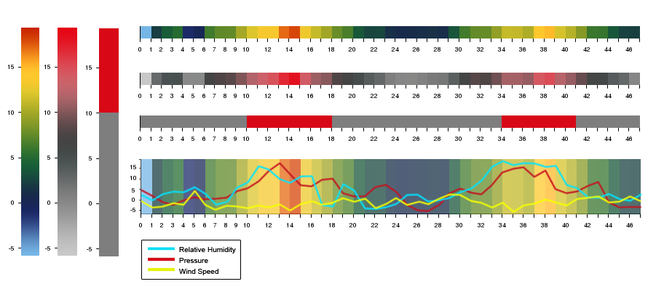
1st Visualization Design
Color Palette and Semantic Zoom

Slide 13
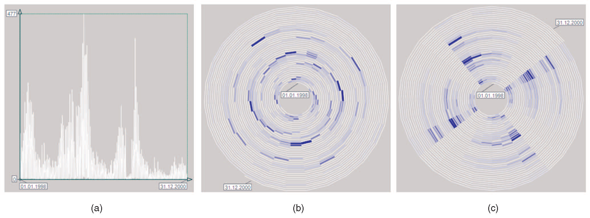
1st Visualization Design
Cyclic Time
Suitable method to find patterns in forecast errors
during a year is Spiral Grahp [5]

Slide 14
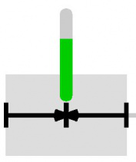
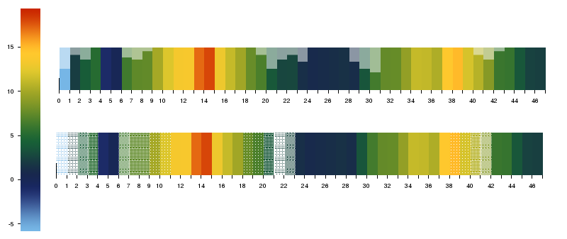
Data Credibility Visualization Design
Data credibility vis by Bade
and Shlechtweg [6]

Slide 15
Current State of Implementation
Continuous,Categorical Statistics based on Barbara Brown's Verification tutorial [4]
Data extraction from local GRIB database
Visualization libraries and tools:
  Protovis [7]
  Cubism.js + D3.js [8]
  R [9]

Slide 16
References 1
[1] Lundblad, P. ; Swedish Meteorol. & Hydrol. Inst., Sweden ; Lofving, H. ; Elovsson, A. ; Johansson, J., Exploratory Visualization for Weather Data Verification, 15th International Conference on Information Visualisation, 2011
[2] Oldenburg P. ; Halley Gotway J. ; Jensen T. ; The Model Evaluation Tools (MET) verification statistics visualization, poster NCAR / RAL / DTC, 2011
[3] Xie, Zaixian; Ward, Matthew O.; Rundensteiner, Elke A., Exploring Large Scale Time-series Data Using Nested Timelines, Oracle America Inc., 1 Oracle Drive, Nashua, NH, USA Worcester Polytechnic Institute, 100 Institute Road, Worcester, MA, USA , Proceedings of the SPIE, Volume 8654, 2013
[4] Barbara Brown, Verification Tutorial, National Center for Atmospheric Research, Boulder Colorado USA

Slide 17
References 2
[5] Wolfgang Aigner, Silvia Miksch, Wolfgang Muller, Heidrun Schumann, and Christian Tominski, Visual Methods for Analyzing Time-Oriented Data, IEEE TRANSACTIONS ON VISUALIZATION AND COMPUTER GRAPHICS, VOL. 14, NO. 1, JANUARY/FEBRUARY 2008
[6] R. Bade, S. Schlechtweg, and S. Miksch, Connecting Time-Oriented Data and Information to a Coherent Interactive Visualization, Proc. 2004 Conf. Human Factors in Computing Systems (CHI '04), pp. 105-112, 2004.
[7] Jeff Heer and Mike Bostock of the Stanford Visualization Group, Protovis, http://mbostock.github.io/protovis/protovis-java/
[8] Mike Bostock, Data Drivern Documents (D3), http://d3js.org/
[9] Robert Gentleman and Ross Ihaka, R-script project,
http://www.r-project.org/, Statistics Department of the University of Auckland

Slide 18
Thank You

