Slide 1
Gaussian Mixture Models and Expectation Maximization

Slide 2
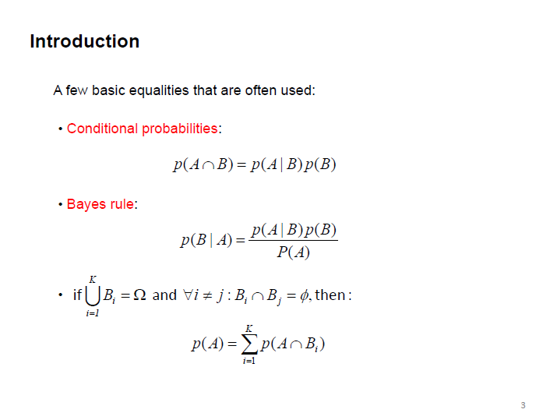

Slide 3
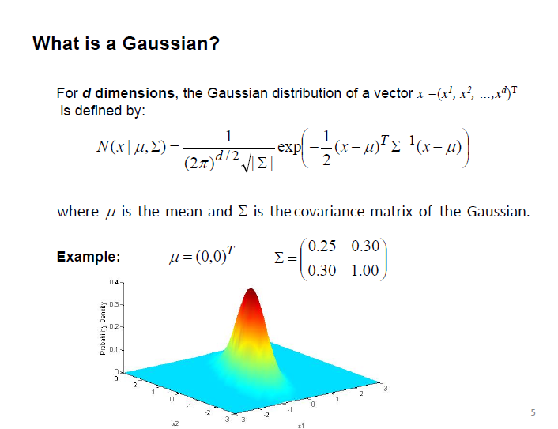

Slide 4
The Problem
You have data that you believe is drawn from n populations
You want to identify parameters for each population
You don’t know anything about the populations a priori
Except you believe that they’re gaussian…

Slide 5
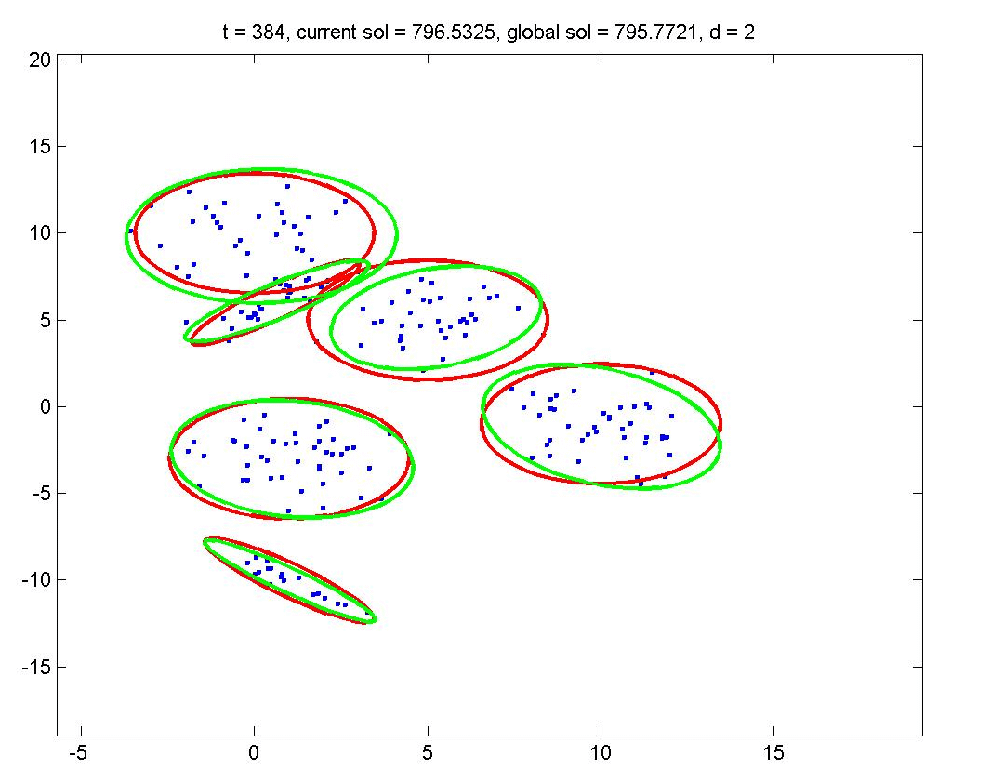
Gaussian Mixture Models
Rather than identifying clusters by “nearest” centroids
Fit a Set of k Gaussians to the data
Maximum Likelihood over a mixture model
Notes:
p(x) = \pi_0f_0(x) + \pi_1f_1(x) + \pi_2f_2(x) + \ldots + \pi_kf_k(x)

Slide 6
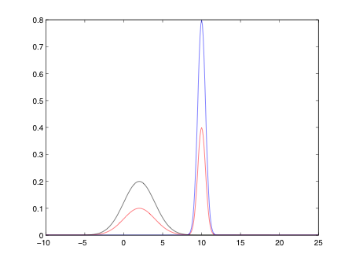

GMM example

Slide 7


Mixture Models
Formally a Mixture Model is the weighted sum of a number of pdfs where the weights are determined by a distribution,

Slide 8

Gaussian Mixture Models
GMM: the weighted sum of a number of Gaussians where the weights are determined by a distribution,

Slide 9
Graphical Models with unobserved variables
What if you have variables in a Graphical model that are never observed?
Latent Variables
Training latent variable models is an unsupervised learning application
uncomfortable
amused
sweating
laughing

Slide 10
Latent Variable HMMs
We can cluster sequences using an HMM with unobserved state variables
We will train latent variable models using Expectation Maximization

Slide 11
Expectation Maximization
The training of GMMs with latent variables can be accomplished using Expectation Maximization
Step 1: Expectation (E-step)
Evaluate the “responsibilities” of each cluster with the current parameters
Step 2: Maximization (M-step)
Re-estimate parameters using the existing “responsibilities”
Similar to k-means training.

Slide 12
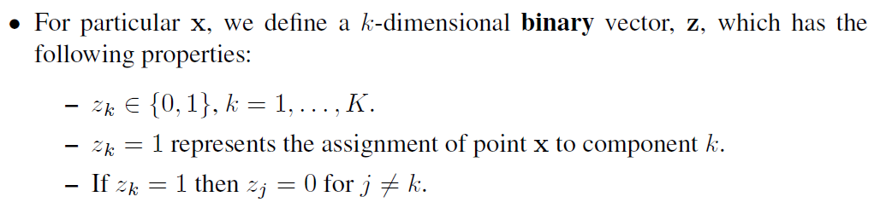
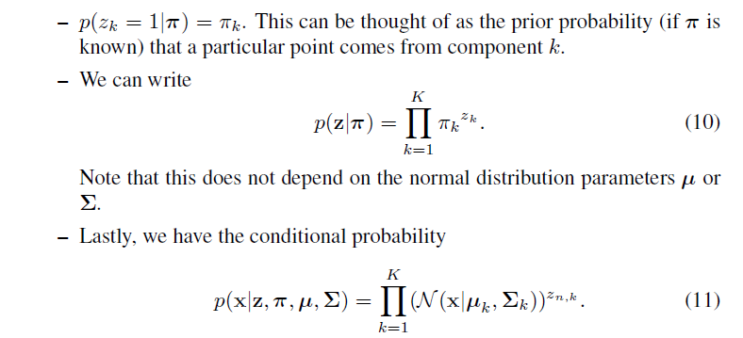

Slide 13



Latent Variable Representation
We can represent a GMM involving a latent variable
What does this give us?

Slide 14
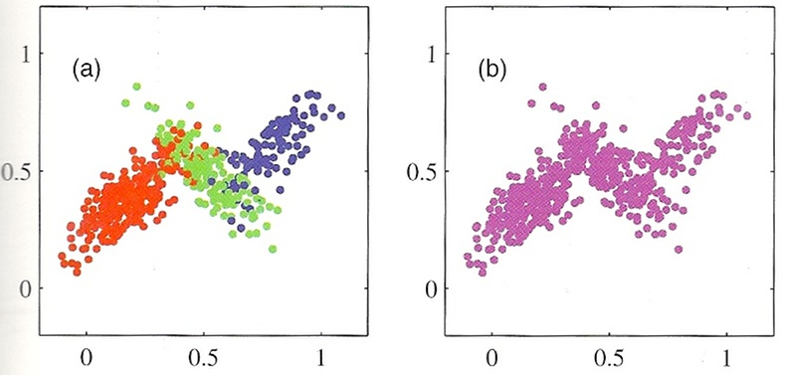
GMM data and Latent variables

Slide 15
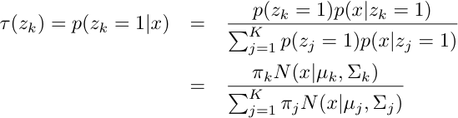
One last bit
We have representations of the joint p(x,z) and the marginal, p(x)…
The conditional of p(z|x) can be derived using Bayes rule.
The responsibility that a mixture component takes for explaining an observation x.

Slide 16

Maximum Likelihood over a GMM
As usual: Identify a likelihood function
And set partials to zero…

Slide 17

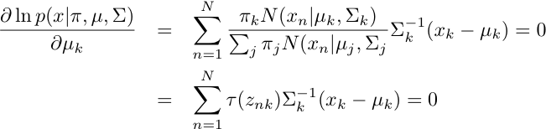
Maximum Likelihood of a GMM
Optimization of means.

Slide 18


Maximum Likelihood of a GMM
Optimization of covariance

Slide 19



Maximum Likelihood of a GMM
Optimization of mixing term
Notes:
\frac{\partial \ln p(x|\pi, \mu,\Sigma) + \lambda\left(\sum_{k=1}^K \pi_k -1\right)}{\partial \pi_k}&=&

Slide 20



MLE of a GMM

Slide 21
EM for GMMs
Initialize the parameters
Evaluate the log likelihood
Expectation-step: Evaluate the responsibilities
Maximization-step: Re-estimate Parameters
Evaluate the log likelihood
Check for convergence

Slide 22

EM for GMMs
E-step: Evaluate the Responsibilities

Slide 23



EM for GMMs
M-Step: Re-estimate Parameters

Slide 24
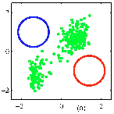
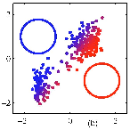
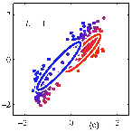

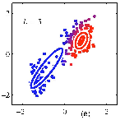
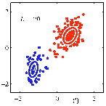
Visual example of EM

Slide 25
Potential Problems
Incorrect number of Mixture Components
Singularities

Slide 26
Incorrect Number of Gaussians

Slide 27
Incorrect Number of Gaussians

Slide 28
Relationship to K-means
K-means makes hard decisions.
Each data point gets assigned to a single cluster.
GMM/EM makes soft decisions.
Each data point can yield a posterior p(z|x)
Soft K-means is a special case of EM.

Slide 29

General form of EM
Given a joint distribution over observed and latent variables:
Want to maximize:
Initialize parameters
E Step: Evaluate:
M-Step: Re-estimate parameters (based on expectation of complete-data log likelihood)
Check for convergence of params or likelihood

