Slide 1
Maternal Mortality

Slide 2
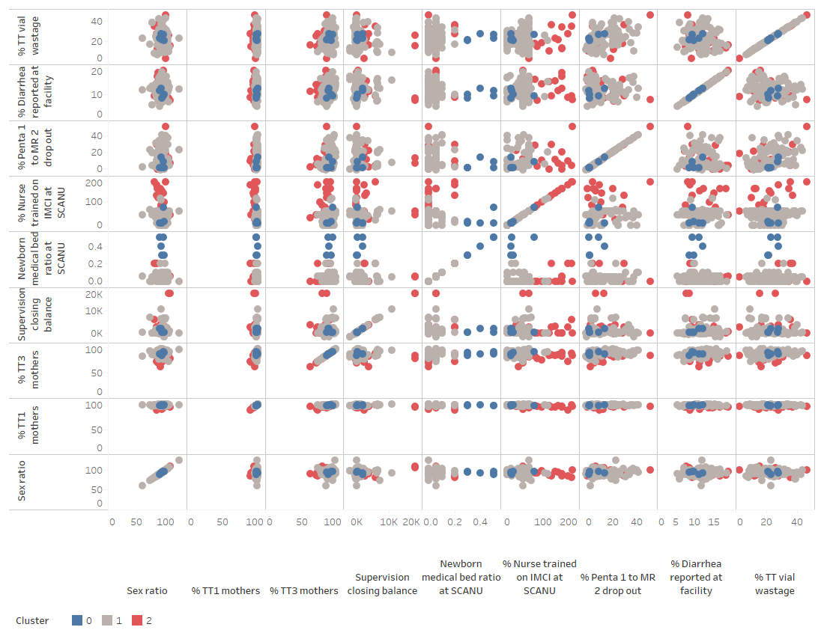
Correlation Matrix

Slide 3
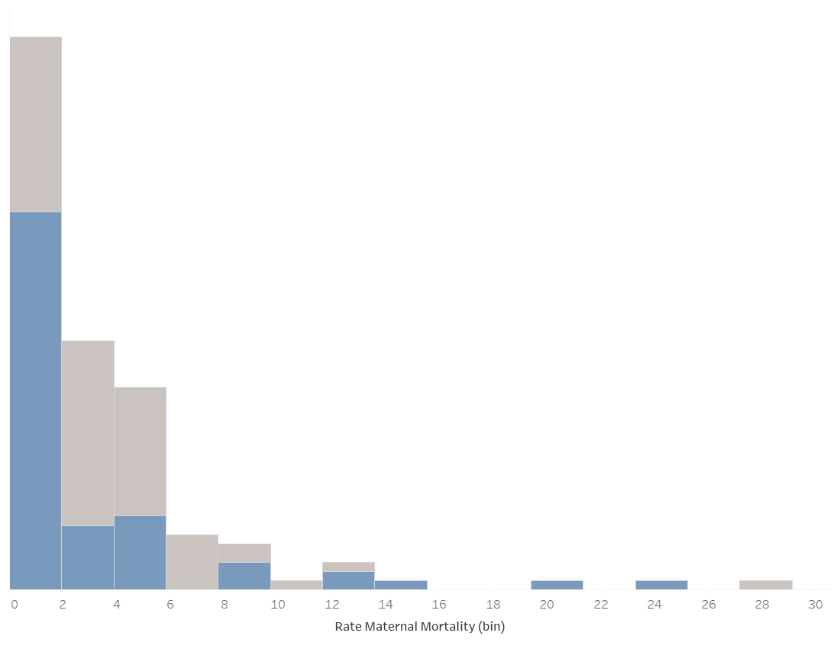
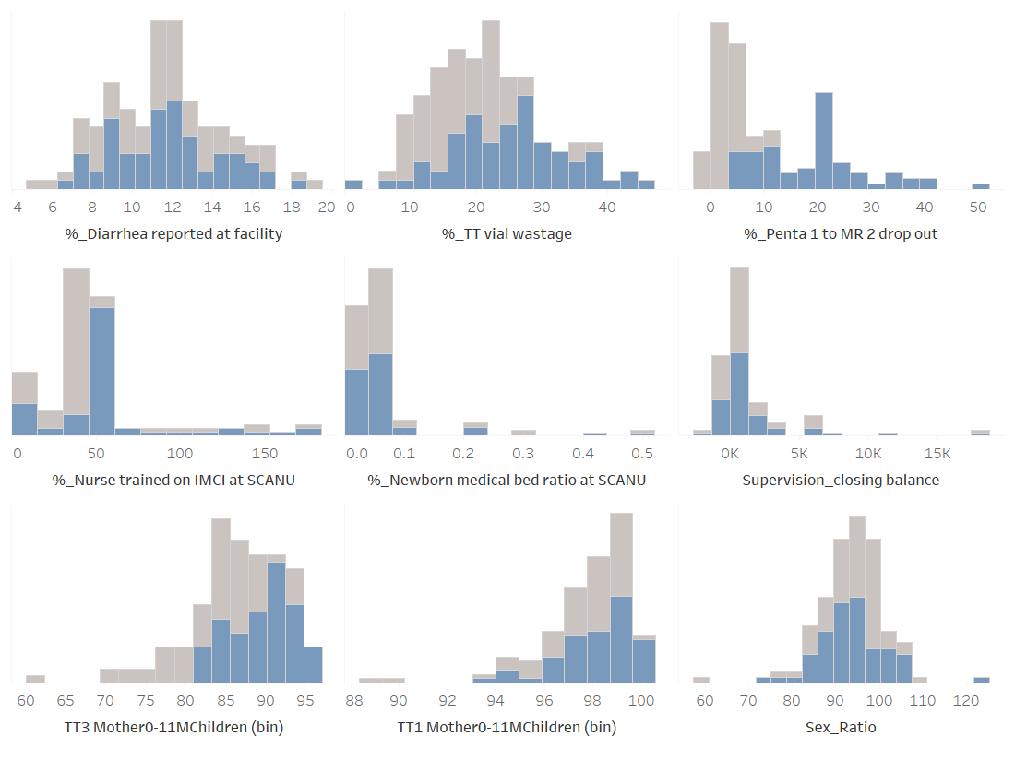
Distribution

Slide 4
Median
Variable | Cluster 0 | Cluster 1 | Cluster 2
% Diarrhea reported at facility | 9.8 | 11.7 | 11.3
% TT vial wastage | 23 | 20.8 | 19.3
% Penta 1 to MR 2 drop out | 0.9 | 5.5 | 9.2
% Nurse trained on IMCI at SCANU | 11.2 | 43.4 | 80.3
Newborn medical bed ratio at SCANU | 0.4 | 0.05 | 0
Supervision closing balance | 335 | 143 | 362
% TT1 mothers | 98.1 | 98.6 | 95.7
% TT3 mothers | 86.9 | 88.1 | 83.6
Sex ratio | 93.5 | 94.2 | 93.2
Maternal mortality rate | 1.8 | 2.1 | 3.9
Number of Records | 5 | 99 | 24

Slide 5
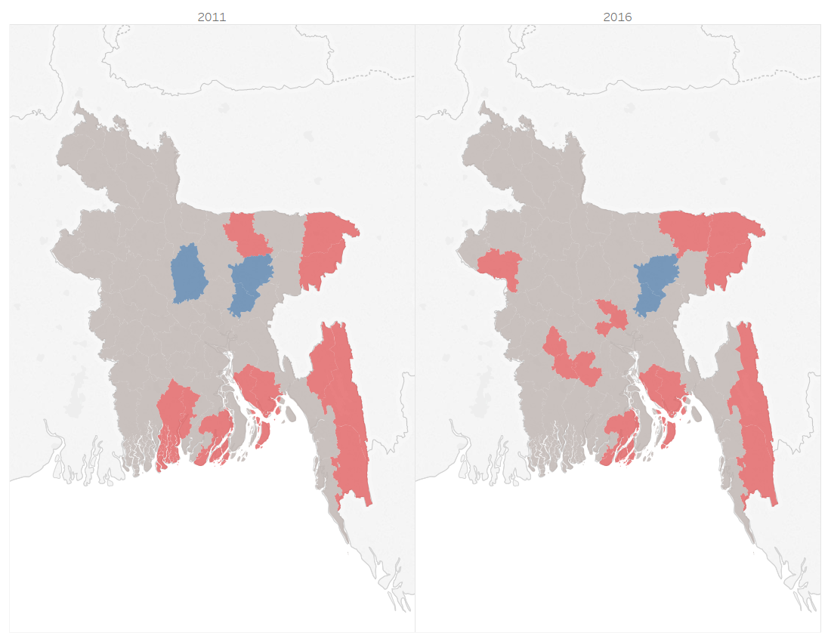
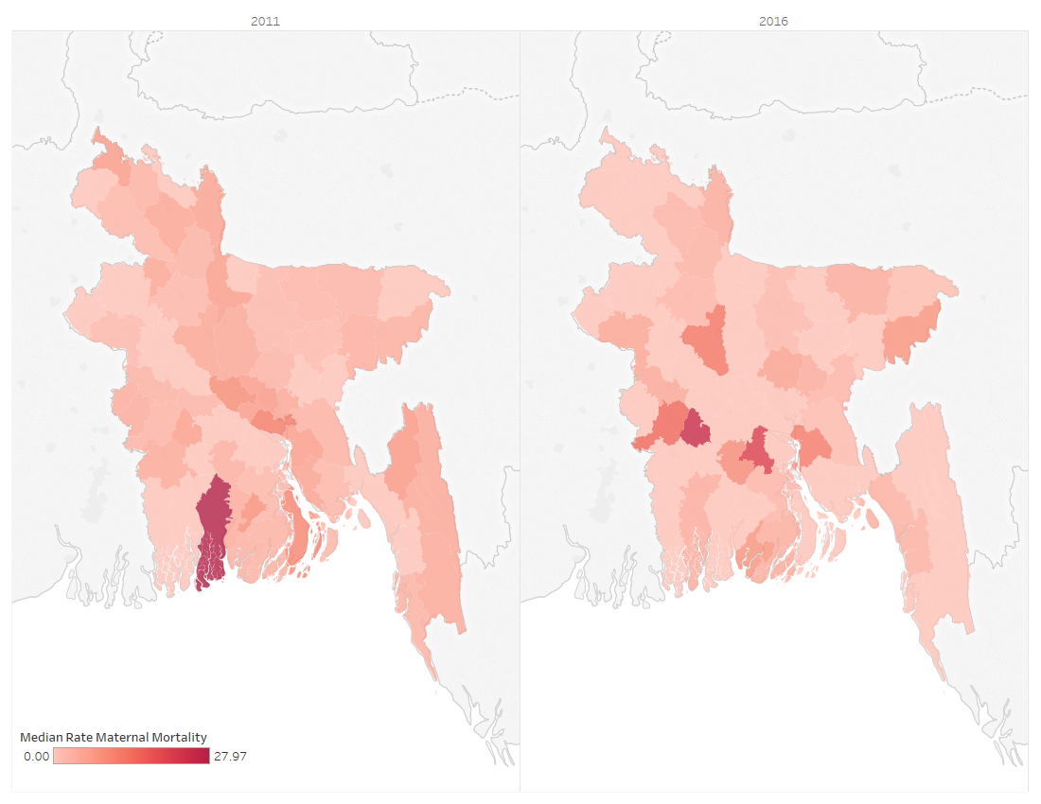
Clusters vs Maternal Mortality

Slide 6
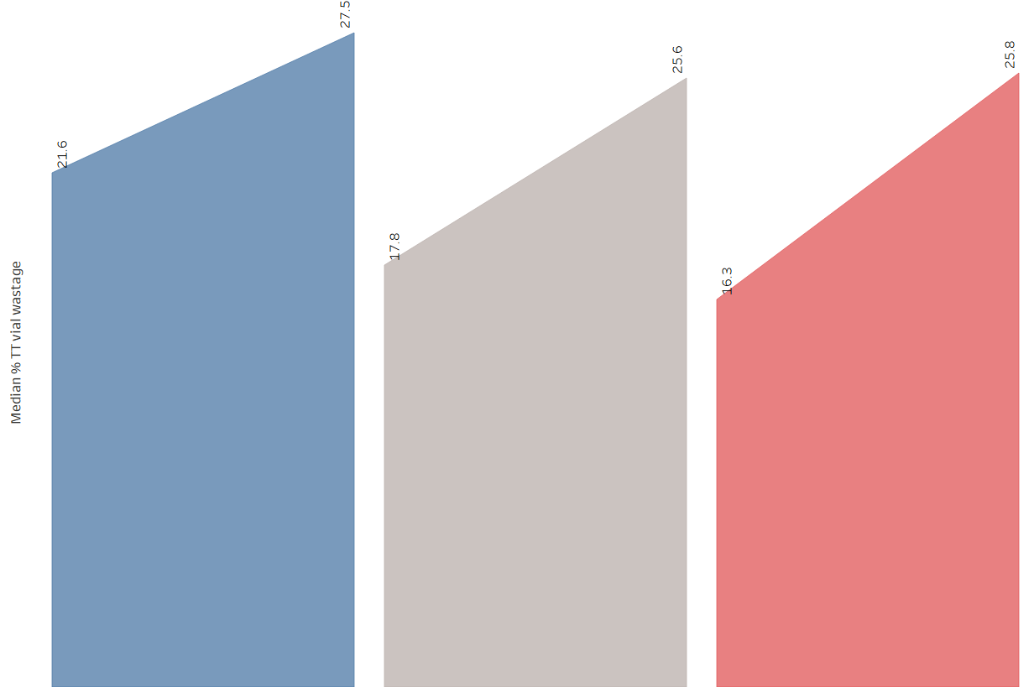
TT wastage

Slide 7
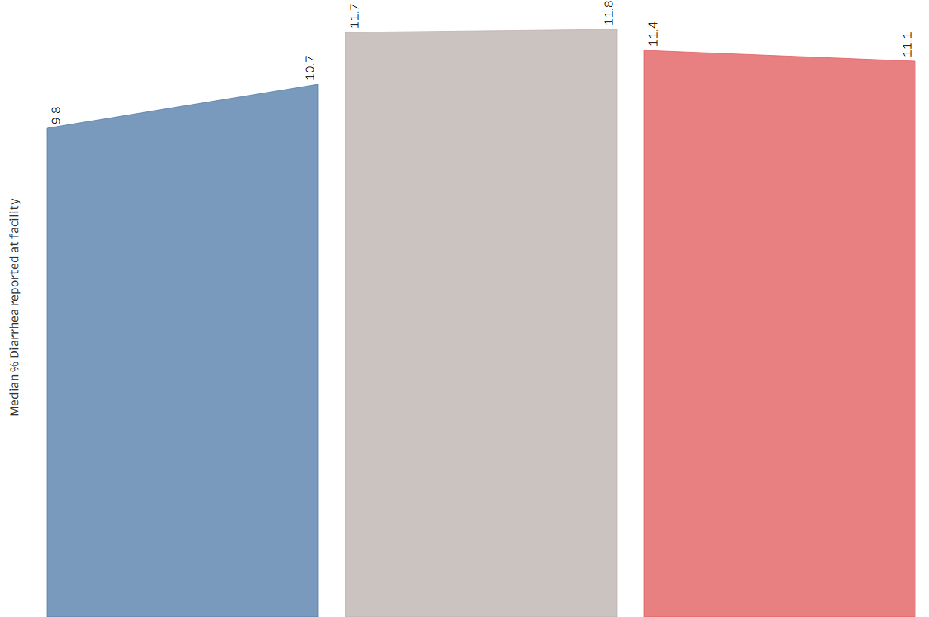
Diarrhea

Slide 8
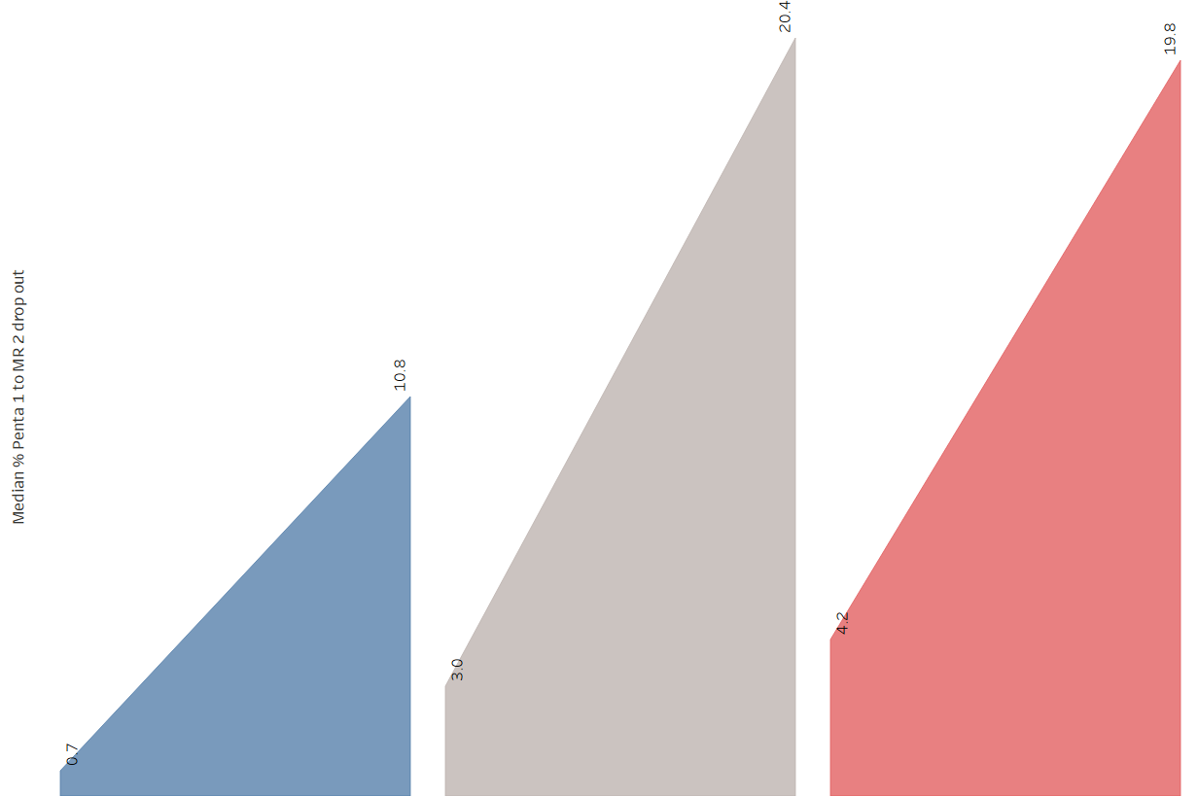
Penta 1 to MR 2 dropout

Slide 9
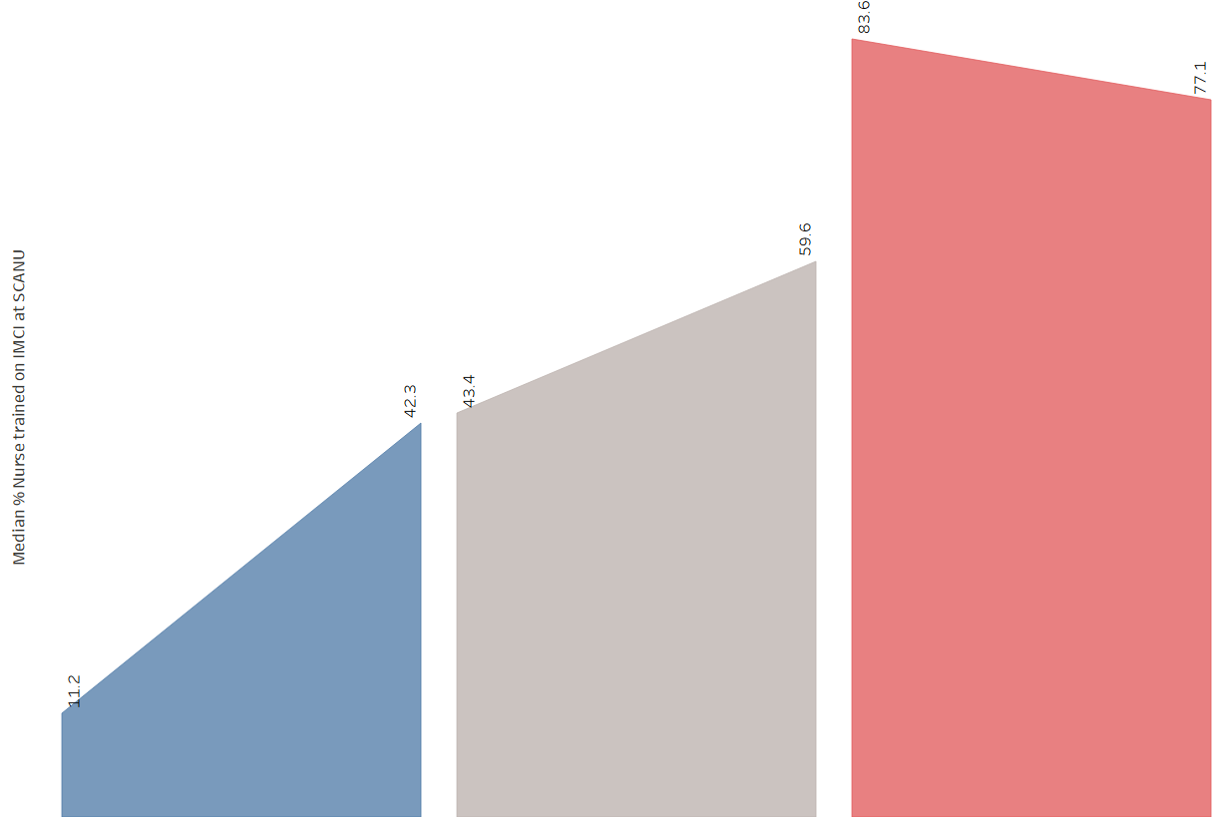
Nurses trained

Slide 10
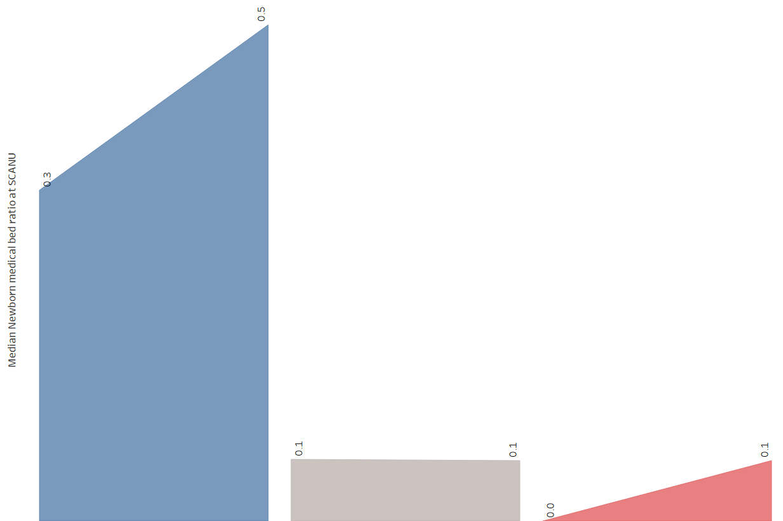
Newborn bed

Slide 11
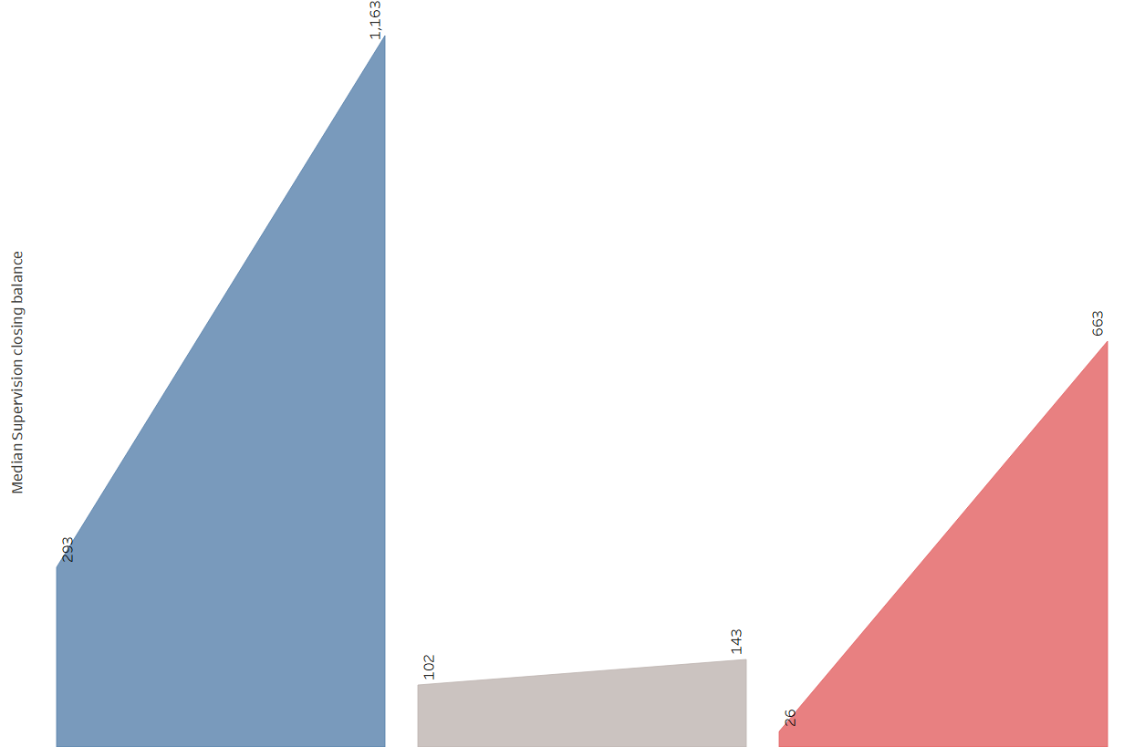
Supervision

Slide 12
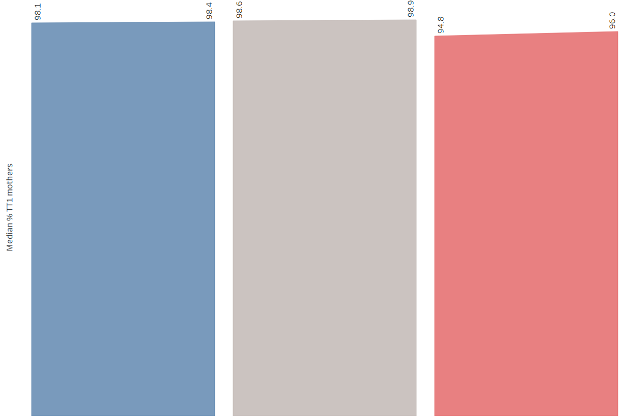
TT1

Slide 13
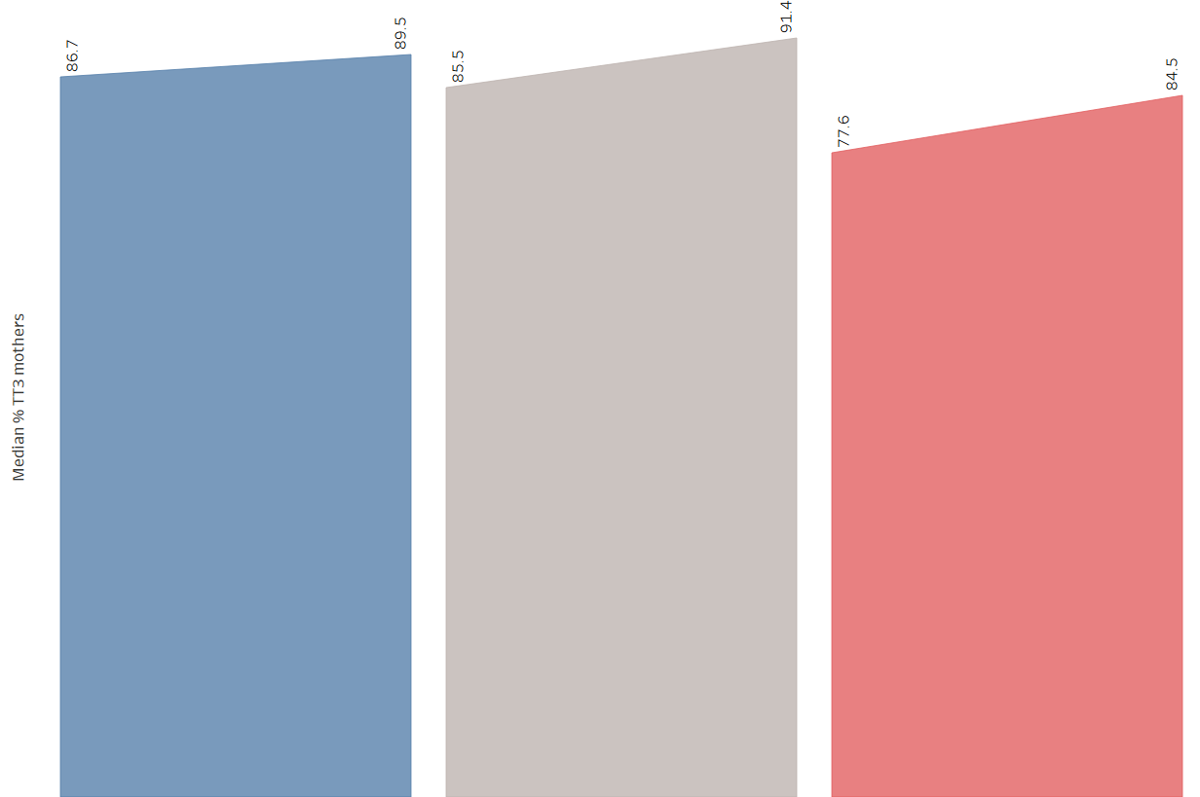
TT3

Slide 14
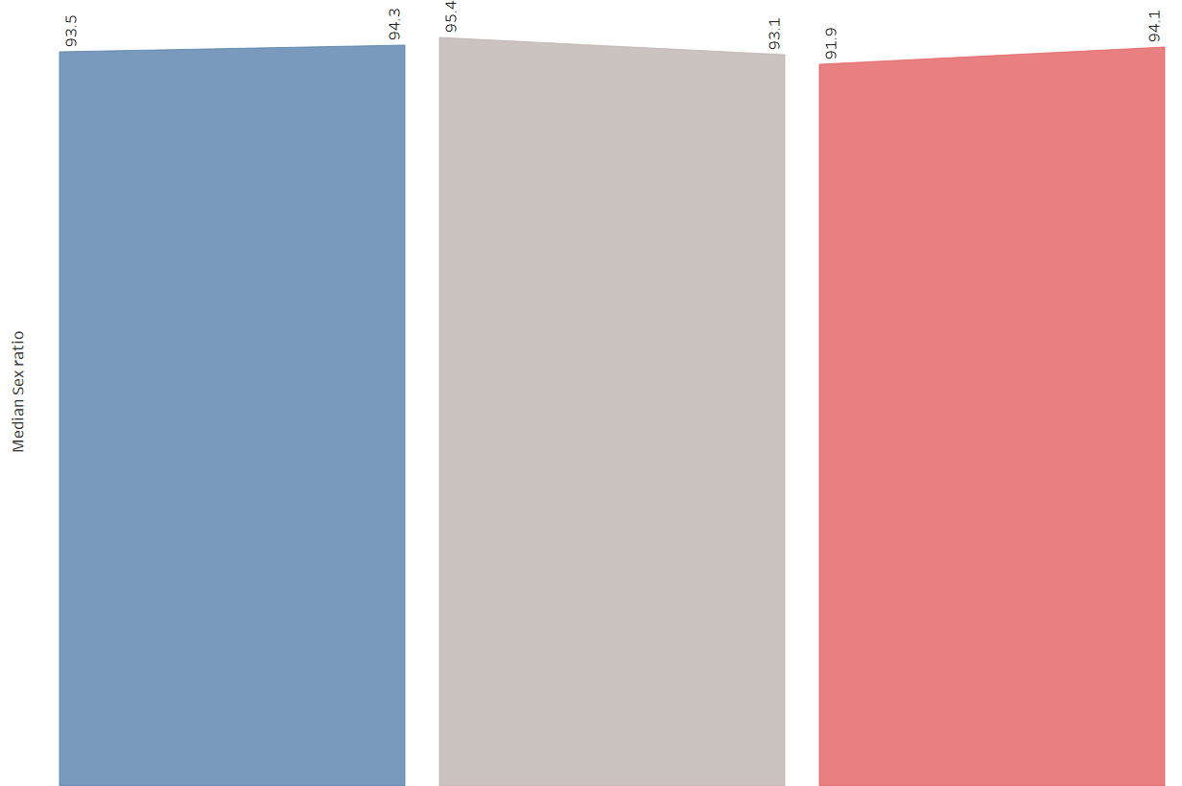
Sex ratio

Slide 15
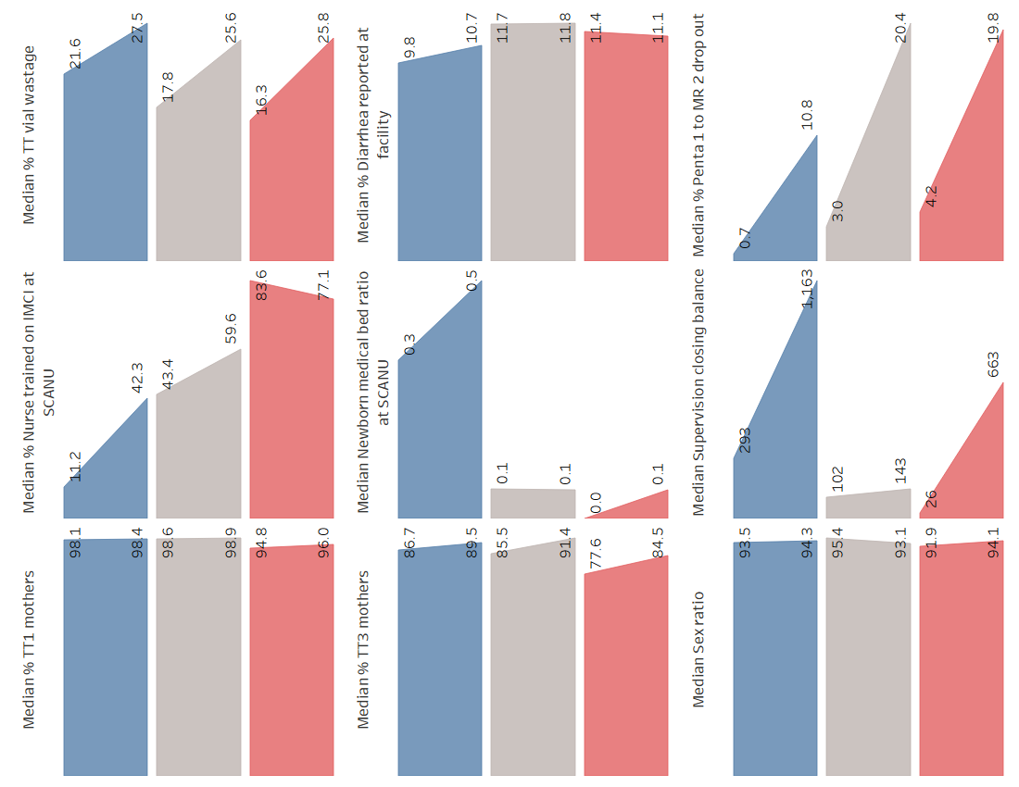
Summary

