Slide 1

Exploratory Data Analysis
G2M Case Study
15-March-2021

Slide 2
Background –G2M(cab industry) case study
XYZ is a private equity firm in US. Due to remarkable growth in the Cab Industry in last few years and multiple key players in the market, it is planning for an investment in Cab industry.
Objective : Provide actionable insights to help XYZ firm in identifying the right company for making investment.
The analysis has been divided into four parts:
Data Understanding
Forecasting profit and number of trip for each cab type
Finding the most profitable Cab company
Recommendations for investment

Slide 3
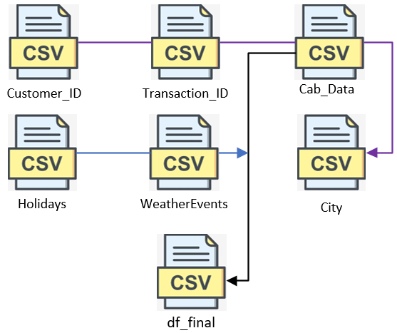
Data Exploration
Timeframe of the data: 2016-01-02 to 2018-12-31
Total data points :359,392
Assumptions:
Outliers are present in Price_Charged feature but due to
unavailability of trip duration details ,we are not treating this as outlier.
Profit of rides are calculated keeping other factors constant and only
Price_Charged and Cost_of_Trip features used to calculate profit.
Users feature of city dataset is treated as number of cab users in the city.
we have assumed that this can be other cab users as well(including Yellow and
Pink cab)

Slide 4
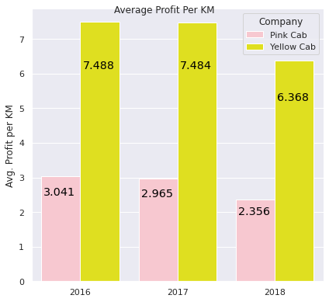
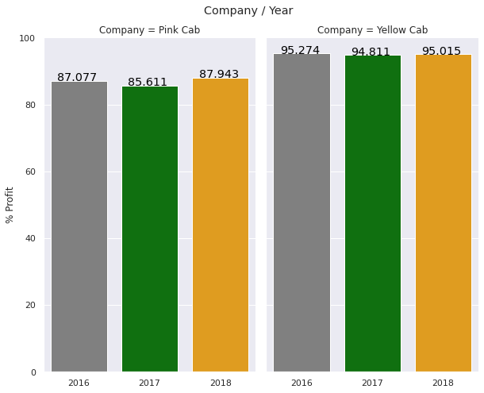

Profit Analysis
Profit Analysis
Profit % Yearwise

Slide 5
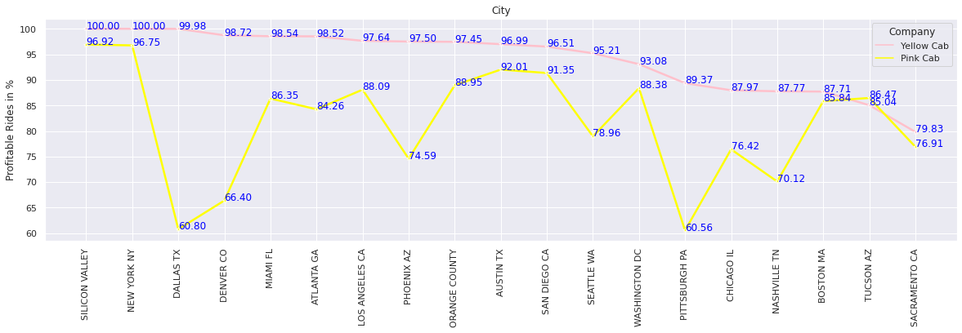
Profit Analysis
Profit Analysis
Citywise Profitable rides Percentage

Slide 6
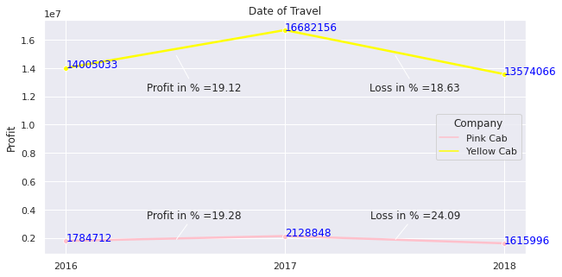
Yearly Profit Analysis

Slide 7
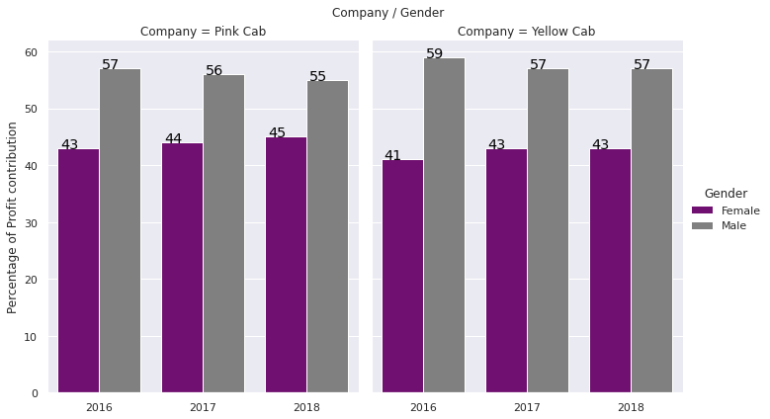
Profit base Analysis Gender wise
There is almost equal distribution of gender in the
Profit.

Slide 8
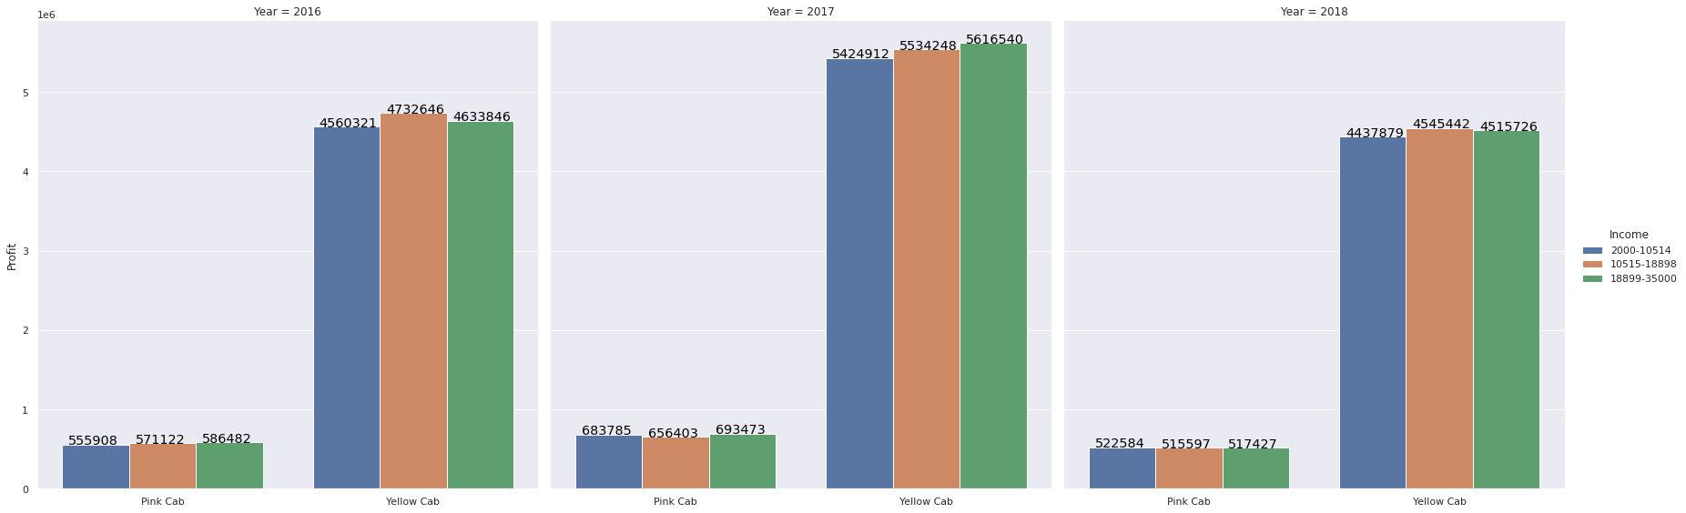
Income Class wise Profit Analysis
Middle class (10515-18898) and high class(18899-35) contributes more in the profit as well as in the customer base of both the cabs

Slide 9
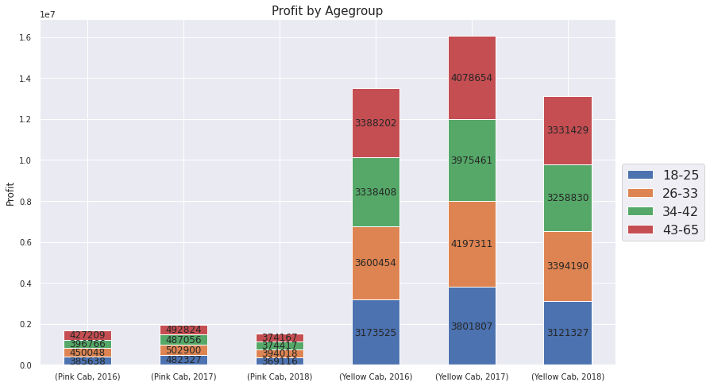
Age GroupWise Profit Analysis
the age range 26-33 have more Profit for both cab in all years.

Slide 10
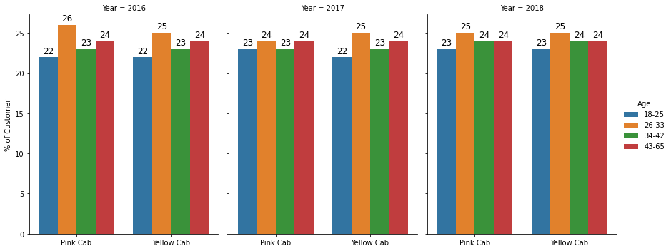
Age GroupWise Profit Analysis
the age range 26-33 has more Customer percentage in both cab in all years.

Slide 11
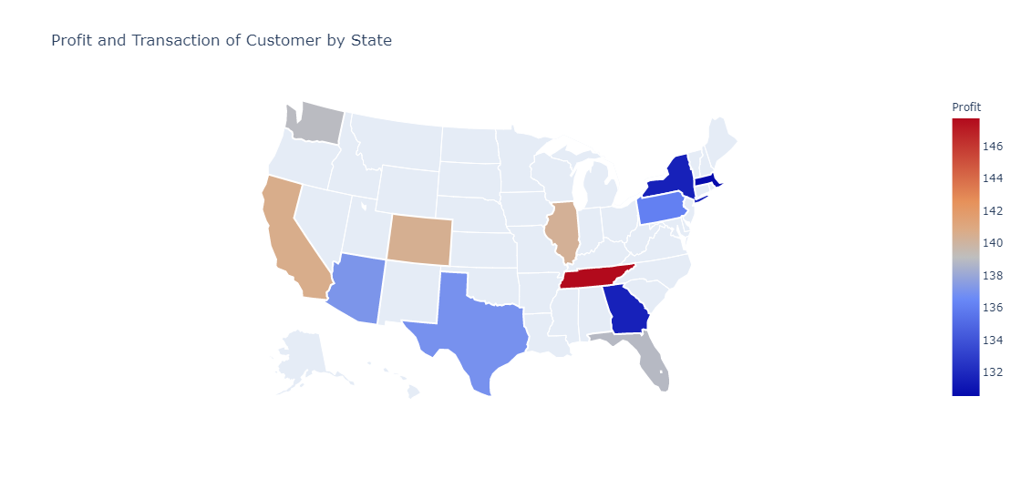
Profit of Customer by State
These are the states where both cab have presence.
The New York State is where they have more profit

Slide 12
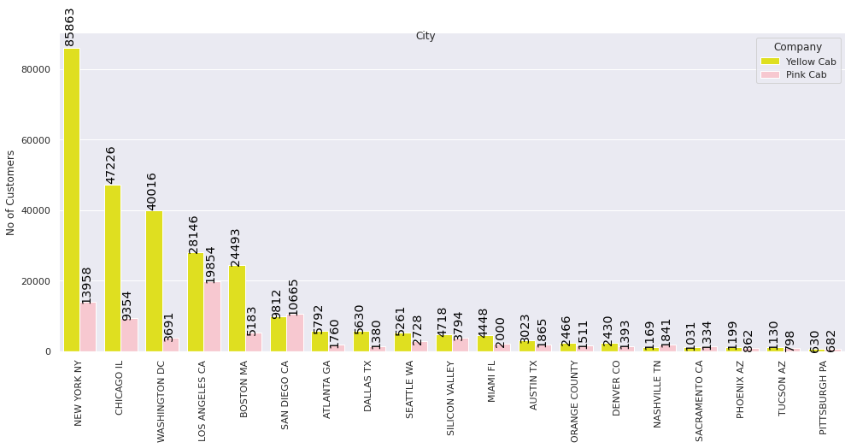
Customer Presence of Yellow and Pink cab City Wise
New York city is when Yellow Cab has more presence and Los Angeles city is where Pink Cab has more precence

Slide 13
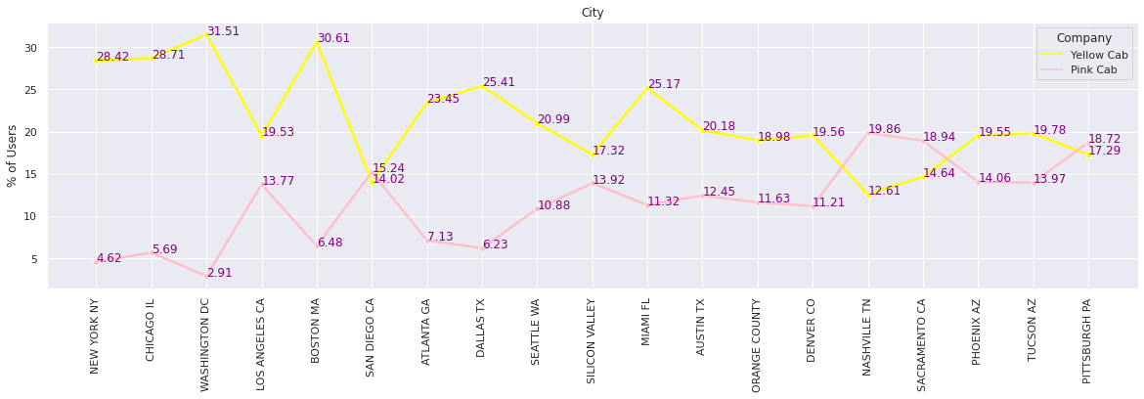
City wise cab Users Covered By Company

Slide 14
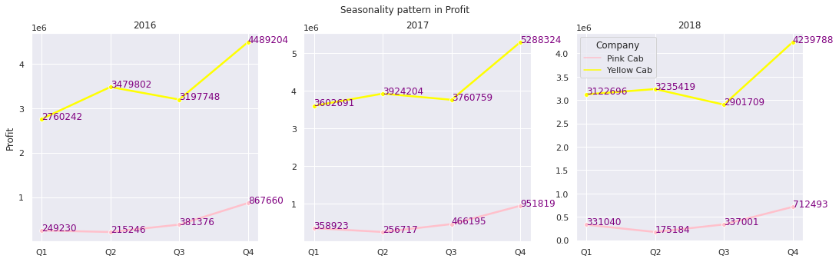
Seasonality in the Profit
Seasonal pattern 4 quarter cycle.

Slide 15
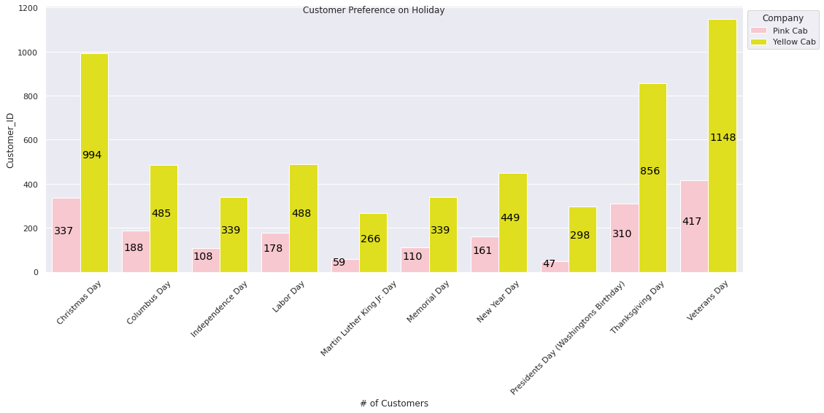
Customer Preference on Holiday
Yellow cab is performing
well as
compared
to Pink cab on
Holidays.
Yellow cab is even Performing well
In the cities
where Pink
cab’s customer
is more.

Slide 16
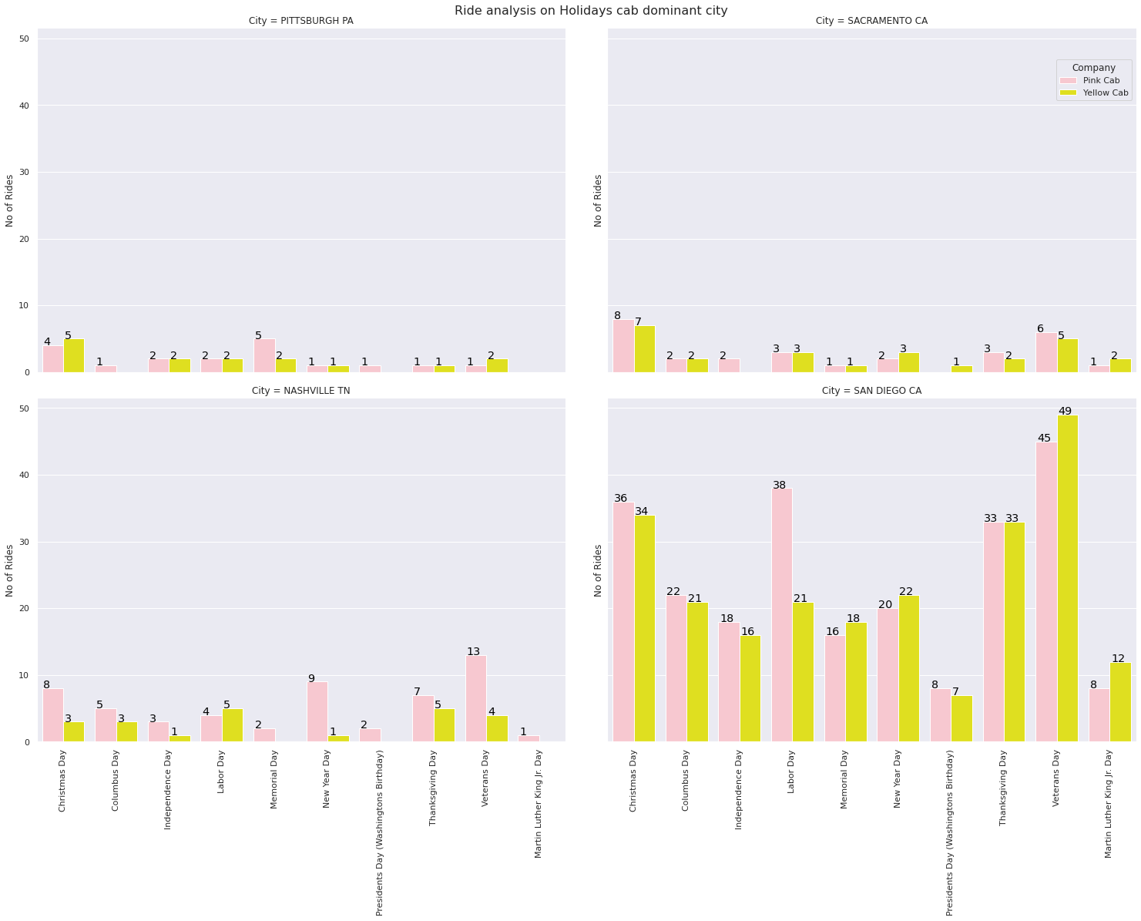
Customer Preference on Holiday
Ride analysis on Holiday in Pink cab dominant cities
San Diego has more rides on Holidays as compare to cities where Pink cab dominates and here also Yellow cab is giving tough competition to Pink cab

Slide 17
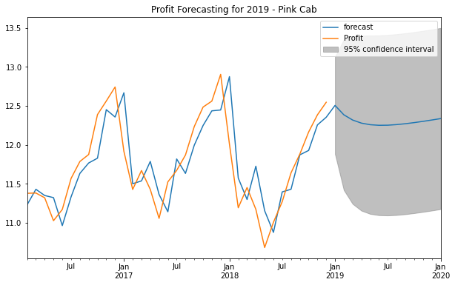
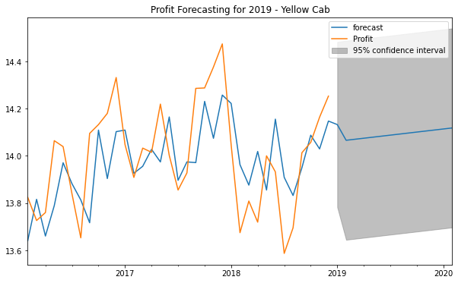
Profit Forecasting for 2019
Profit Forecasting for 2019 for Pink Cab and Yellow Cab

Slide 18
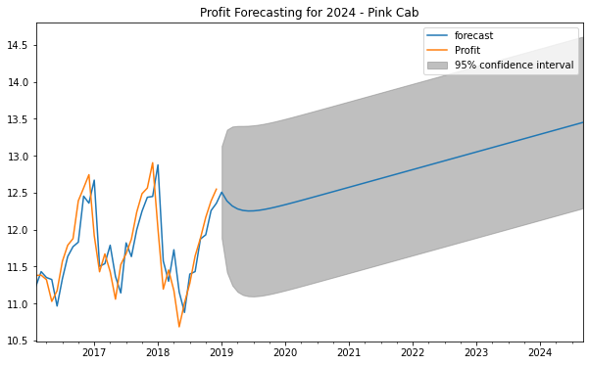
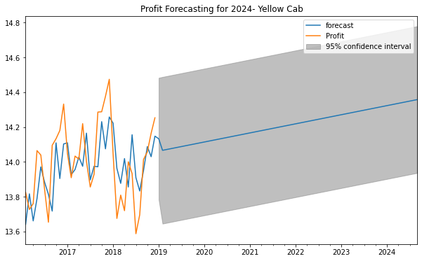
Profit Forecasting for 2024
Profit Forecasting for 2024 for Pink Cab and Yellow Cab

Slide 19
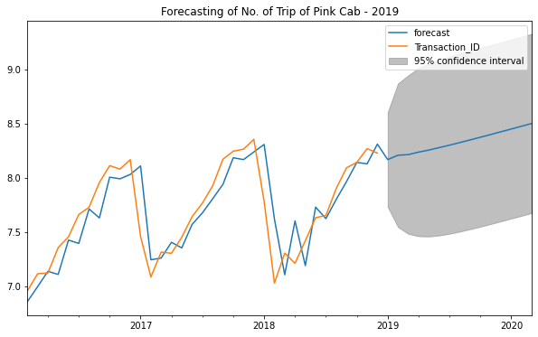
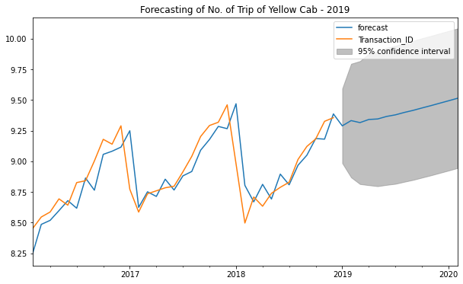
Trip Forecasting for 2019
Trip Forecasting for 2019 for Pink Cab and Yellow Cab

Slide 20
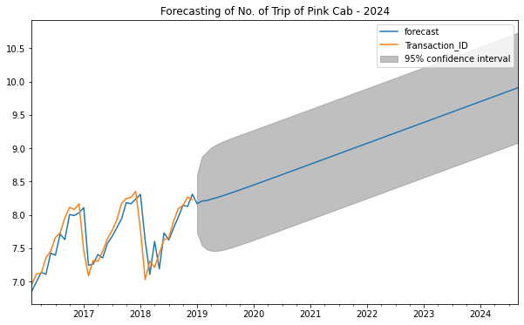
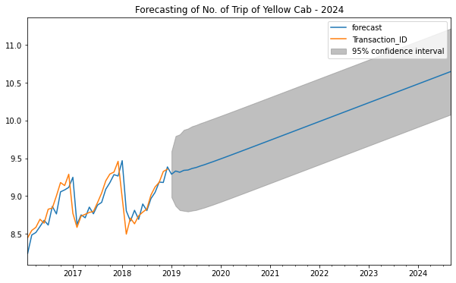
Trip Forecasting for 2024
Trip Forecasting for 2024 for Pink Cab and Yellow Cab

Slide 21
Recommendations
We have evaluated both the cab companies on following points and found Yellow cab better than Pink cab:
Customer Reach : Yellow cab has higher customer reach in 25 cities while Pink cab has higher customer reach in 4 cities. We have also observed that Yellow cab is doing good in covering other cab users as compared to Pink cab.
Age wise Reach : Yellow cab has customer in all age group and it’s been observed that it’s even popular in 26-33 age group.
Average Profit per KM: Yellow cab’s average profit per KM is almost three times the average profit per KM of the Pink cab.
Income wise Reach :Both the cabs are very popular in high and medium income class but here also Yellow cab is performing better than Pink cab in offering their services to all the three income class group (low, medium and high).
Ride count and Profit Forecasting : Pink Cav has loss in the profit and low no. of ride. Yellow cab has loss forecasted no of ride loss is lesser than Pink cab.
Besides that ,
Yellow Cab are dominating the market and haven't lost much business to Pink Cabs and above all it has more profits.
New York is the city with the most visitors per year and it is the city in which Yellow Cab has the most presence.
Pink Cab has potential and can grow much more if implemented some policies better
Yellow Cab has the politice to give more discount in higth season and decrease in slow seasons.
Yellow Cab increases its margins when there are less customers and decrease when there is season, and I beleive thats a good business model
I believe that yellow cab will continue to dominate the market for a longer period of time
On the basis of above point , we will recommend Yellow cab for investment.

Slide 22
Thank You

